Slide 1
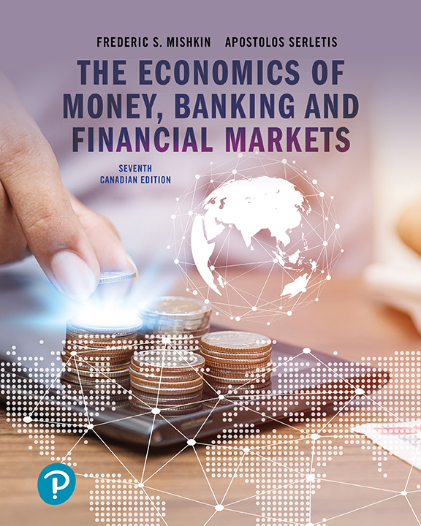
The Economics of Money, Banking, and Financial Markets
Seventh Canadian Edition
Chapter 4
The Meaning of Interest Rates
Copyright © 2020 Pearson Canada Inc.

Slide 2
Learning Objectives
Calculate the present value of future cash flows and the yield to maturity on the four types of credit market instruments
Recognize the distinctions among yield to maturity, current yield, rate of return, and rate of capital gain
Interpret the distinction between real and nominal interest rates

Slide 3
Time Value of Money (TVM)
Basic Definitions:
  Present Value (PV)
    earlier money on a timeline
    a dollar paid to you later is less valuable than a dollar paid to you today
  Future Value (FV)
    later money of a timeline
    a dollar paid to you today is worth more than a dollar paid to you later
PV
FV

Slide 4
Simple vs Compound Interest
Application Question:
How much additional interest income is generated over three years from an initial $500 investment earning 4% simple interest as opposed to 4% annually compounded interest?

Slide 5
Yield to Maturity
Yield to Maturity (YTM):
  Closest financial concept to the idea of an ‘interest rate’
  The yield to maturity is the interest rate that equates the present value of future cash flow payments received from a debt instrument with its value today
  Considered the most ‘appropriate’ measurement (that which is most accurate) of the interest rate

Slide 6
Simple Present Value
Application Question:
How much would you pay for an investment that was designed to pay you $500 in 3 years if the interest rate was 6%/compounded annually?
Would you pay more or less if the interest rate was 6%/compounded quarterly? Why?

Slide 7
Calculating Term
Application Question:
How long would it take a $2000 investment to accumulate to $2612.10 if its YTM is 9% compounded quarterly?

Slide 8
Four Types of Credit Market Instruments
Simple Loan
  One payment at the maturity date
Fixed Payment Loan
  Multiple fixed payments at pre-specified dates
Coupon Bond
  A bond that pays fixed amounts (the coupons) at fixed dates, plus a final payment (the face value) at maturity
Discount Bond
  A bond that pays zero coupons, only a final payment at maturity. “Discount” since price typically less than face value.

Slide 9
Simple Loan
Simple Loan
  - borrower repays the original principle plus all additional interest at date of maturity
  - loan repayment is a ‘lump-sum’ payment
  - common for commercial loans
    LV = loan value
    FV = final repayment value
    i = interest rate
    n = number of period to maturity

Slide 10
Simple Loan—Yield to Maturity
Application Question:
Suppose you borrow $1000 today and agree to repay $1,218.40 in eight years time. What is the implied yield to maturity on this loan?
(assume money is compounded annually)

Slide 11
Fixed Payment Loan
Fixed Payment Loan - fully amortized loan
  loan where the principle of the loan is paid down over the life of the loan, according to some amortization schedule;
  payments are typically equal;
  payments consist of a portion of interest and a portion of principal;
  mortgage loans are typical amortizing loans.

Slide 12
Fixed Payment Loan
Application Question:
You take-out a $100,000 loan for 25 years at 4 % compounded semi-annually. What will your payments be if you repay the loan semi-annually?

Slide 13
Fixed Payment Loan
Application Question:
You decide to purchase a new home and need a $250,000 mortgage. Your friendly neighborhood bank will lend you the money if you agree to pay $1,511.46 monthly for the next 25 years. What is the implied yield to maturity on this loan?
(the loan is compounded semi-annually)

Slide 14
Coupon Bond
Coupon Bond
  - a debt security that requires the issuer to pay interest (coupon) payments and a principle amount at maturity.
    P = price of coupon bond
    C = yearly coupon payment (calculated as a percentage of the face value)
    F = face value
    n = periods to maturity

Slide 15
Coupon Bond
Application Question:
A semi-annual bond with a price of 108.18 will mature in 10 years. If the coupon rate of this bond is 5 %, what is the implied yield to maturity?
What ‘type’ of bond is this, based on the relationship between price and face value?

Slide 16
Three Facts About Coupon Bonds
When the coupon bond is priced at its face value, the yield to maturity equals the coupon rate
The price of a coupon bond and the yield to maturity are negatively related
  As the yield to maturity rises, the price of the bond falls
The yield to maturity is greater than the coupon rate when the bond price is below its face value

Slide 17
Coupon Bond
Bond Yield Curve – additional properties
For a given change in interest rates, bond price will change more when rates decrease that they will decrease when rates increase.
The longer the time to maturity, the more sensitive the bond price to changes in the yield to maturity.

Slide 18
Discount Bond
  Discount Bond – Deep Discount Bond
    zero coupon bond (strip-bond)
    bond that is sold well below its face value
    debt security where the face value is repaid at maturity.
      F = face value of the discount bond
      P = current price of the discount bond

Slide 19
Discount Bond
Application Question:
A discounted bond with a face value of $1000 is selling for $900. With a maturity of 1 year, what is the implied yield to maturity?

Slide 20
Consol or Perpetuity
P_{c} = price of the consol
C = yearly interest payment
i_{c} = yield to maturity of the consol
A bond with no maturity date that does not repay principal but pays fixed coupon payments forever

Slide 21
The Distinction Between Interest Rates and Returns
How well a person does financially by holding a bond for some period of time is the rate of return
  The return (R) depends on coupons received (C) and the price for which the bond is eventually sold:

Slide 22
One-Year Returns on Different-Maturity 10%-Coupon-Rate Bonds When Interest Rates Rise from 10% to 20%
Table 4-2 One-Year Returns on Different-Maturity 10%-Coupon-Rate Bonds When Interest Rates Rise from 10% to 20%
(1) Years to Maturity when Bond is Purchased | (2) Initial Current Yield (%) | (3) Initial Price ($) | (4) Price Next Year* ($) | (5) Rate of Capital Gain (%) | (6) Rate of Return [col (2) + col (5)] (%)
30 | 10 | 1000 | 503 | −49.7 | −39.7
20 | 10 | 1000 | 516 | −48.4 | −38.4
10 | 10 | 1000 | 597 | −40.3 | −30.3
5 | 10 | 1000 | 741 | −25.9 | −15.9
2 | 10 | 1000 | 917 | −8.3 | +1.7
1 | 10 | 1000 | 1000 | 0.0 | +10.0
*Calculated with a financial calculator, using Equation 3.

Slide 23
Rate of Return and Interest Rates
Findings that are generally true for all bonds
The return equals the yield to maturity only if the holding period equals the time to maturity.
A rise in interest rates is associated with a fall in bond prices, resulting in a capital loss if time to maturity is longer than the holding period.
The more distant a bond’s maturity, the greater the size of the percentage price change associated with an interest-rate change.

Slide 24
Rate of Return and Interest Rates (cont’d)
The more distant a bond’s maturity, the lower the rate of return that occurs as a result of an increase in the interest rate.
Even if a bond has a substantial initial
interest rate, its return can be negative if interest rates rise.

Slide 25
Interest-Rate Risk
Two Key Conclusions:
Prices and returns for long-term
bonds are more volatile than those for
shorter-term bonds.
There is no interest-rate risk for any bond whose time to maturity matches the holding period.

Slide 26
Real and Nominal Interest Rates
Nominal interest rates make no allowance for inflation
Real interest rates adjust for changes in price level
  more accurately reflects the cost of borrowing
Ex ante real interest rate is adjusted for expected changes in the price level
Ex post real interest rate is adjusted for actual changes in the price level

Slide 27
Fisher Equation
When the real interest rate is low, there are greater incentives to borrow and fewer incentives to lend.
The real interest rate is a better indicator of the incentives to borrow and lend.
i = nominal interest rate
r = real interest rate
π^{e} = expected inflation rate

Slide 28
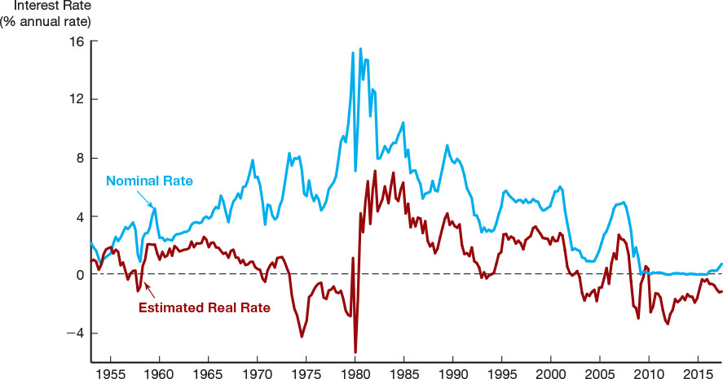
Figure 4-1
Real and Nominal Interest Rates (Three-Month Treasury Bill), 1953–2017 Nominal and real interest rates often do not move together. When nominal rates were high in the 1970s, real rates were actually extremely low—often negative. Sources: Nominal rates from Federal Reserve Bank of St. Louis FRED database: fred.stlouisfed.org/series/TB3MS and fred.stlouisfed.org/series/CPIAUCSL. The real rate is constructed using the procedure outlined in Frederic S. Mishkin, “The Real Interest Rate: An Empirical Investigation,” Carnegie-Rochester Conference Series on Public Policy 15 (1981): 151–200. This procedure involves estimating expected inflation as a function of past interest rates, inflation, and time trends, and then subtracting the expected inflation measure from the nominal interest rate.

