Slide 1
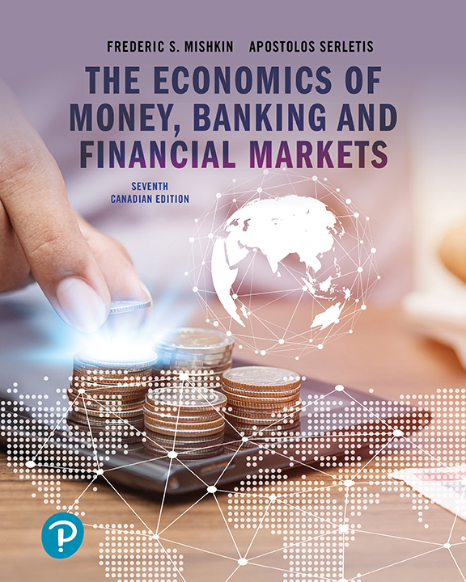
The Economics of Money, Banking, and Financial Markets
Seventh Canadian Edition
Chapter 3
What Is Money?

Slide 2
Learning Objectives
Describe what money is.
List and summarize the functions of money.
Identify different types of payment systems.
Compare and contrast the various monetary aggregates calculated by the Bank of Canada.

Slide 3
Meaning of Money
Money: Anything that is generally accepted in payment for goods or services or in the repayment of debts.
  Currency: paper money and coins
It is a broad notion
Distinct from:
  Wealth: total property that stores value
  Income: flow of earnings per unit of time

Slide 4
Functions of Money: Medium of Exchange
Medium of Exchange:
  Facilitates exchange (lower transaction costs)
  Eliminates need for double coincidence of wants
  Allows for specialization and division of labour
An effective medium of exchange must:
  be easily standardized
  be widely accepted
  be divisible
  be easy to carry
  not deteriorate quickly

Slide 5
Functions of Money: Unit of Account
Unit of Account:
  Units in which value is denominated throughout the economy
  Reduces transaction costs
Consider a store with 10 goods
  Without a unit of account, we would need to know 45 prices to exchange one good for another
  With a unit of account, we only need 10 prices as everything would be reported in dollars

Slide 6
Functions of Money: Store of Value
Store of Value:
  Repository of purchasing power over time
  Other assets also serve this function (stocks, bonds, land, houses, art, jewelry, etc…)
  Money is the most liquid of all assets but does not pay a return, so loses value during inflation
  Money is particularly poor store of value during periods of hyperinflation – when inflation exceeds 50% per month

Slide 7
Functions of Money (Cont’d)
If money is not unique as a store of value, why do people hold money?
  Answer: liquidity
    the relative ease and speed which an asset can be converted into a medium of exchange.

Slide 8
Evolution of the Payments System
Commodity Money:
  Money that is made up of precious metal (gold and silver) and other valuable commodities
  The ‘worth’ of commodity money is intrinsic.
  The success of this form of money represents the importance of universal acceptance.
  Bulky and limited in supply.

Slide 9
Evolution of the Payments System
Fiat Money – paper money
  Original fiat money had a commodity equivalent (gold standard era)
  Modern fiat money backed by government promise
  ‘this note is legal tender’
Cheques
  A financial instrument that enables your bank to transfer money from your account to someone else's account (upon deposit)
  Cheque clearing function
  Transaction record, security, efficiency of transfer

Slide 10
Evolution of the Payments System
Electronic Payment
  Electronic transfers of funds by their ‘owner’.
  Substitute for paper cheques.
E-Money
  Money that only exists in electronic form.
  Substitute for paper cash.
  Debit cards, smart cards, e-cash.

Slide 11
FYI: Are We Headed for a Cashless Society?
Predictions of a cashless society have been around for decades
E-money might be more convenient and efficient than a payments system based on paper
Several factors work against the disappearance of the paper system
The use of e-money will increase in the future
Bitcoins?

Slide 12
Measuring Money
Bank of Canada’s Monetary Aggregates
  M1+ = currency + chequable deposits
  M2 = currency + bank deposits + fixed-term deposits
  M2+ = M2 + deposits at TMLs and CUCPs
  M2++ = M2+ + certain retail debt instruments
  M3 = M2 + non-personal term deposits + foreign currency bank deposits

Slide 13
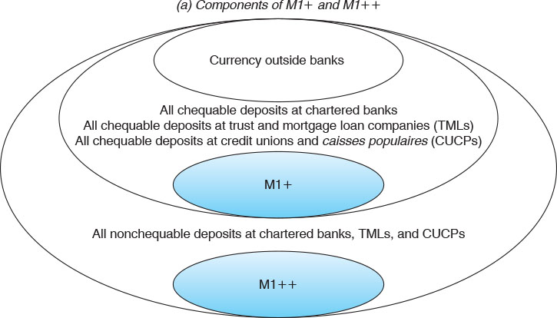
Figure 3-1 (1 of 3)
Definitions of the Money Supply

Slide 14
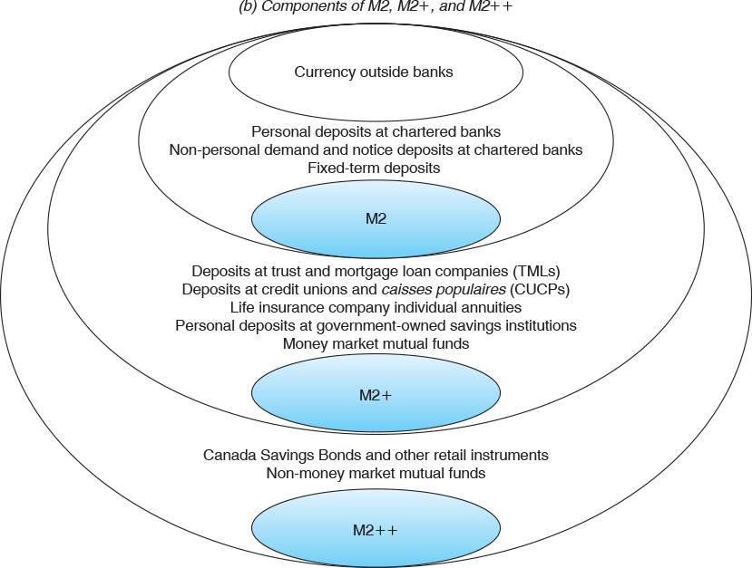
Figure 3-1 (2 of 3)
Definitions of the Money Supply

Slide 15
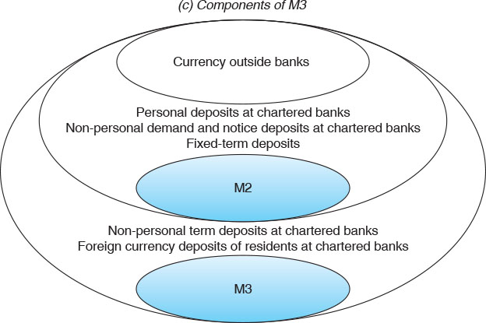
Figure 3-1 (3 of 3)
Definitions of the Money Supply

Slide 16
Measures of Monetary Aggregates (4 of 4)
Table 3-1 Measures of Monetary Aggregates and Their Components
Asset | M1+ | M1++ | M2 | M2+ | M2++ | M3
Currency outside banks | ✓ | ✓ | ✓ | ✓ | ✓ | ✓
Personal deposits at chartered banks | Blank | Blank | ✓ | ✓ | ✓ | ✓
Non-personal demand and notice deposits at chartered banks | Blank | Blank | ✓ | ✓ | ✓ | ✓
Fixed-term deposits | Blank | Blank | ✓ | ✓ | ✓ | ✓
Deposits at trust and mortgage loan companies (TMLs) | Blank | Blank | Blank | ✓ | ✓ | Blank
Deposits at credit unions and caisses populaires (CUCPs) | Blank | Blank | Blank | ✓ | ✓ | Blank
Life insurance company individual annuities | Blank | Blank | Blank | ✓ | ✓ | Blank
Personal deposits at government-owned savings institutions | Blank | Blank | Blank | ✓ | ✓ | Blank
Money market mutual funds | Blank | Blank | Blank | ✓ | ✓ | Blank
Canada Savings Bonds and other retail instruments | Blank | Blank | Blank | Blank | ✓ | Blank
Non-money market mutual funds | Blank | Blank | Blank | Blank | ✓ | Blank
All chequable deposits at chartered banks, TMLs, and CUCPs | ✓ | ✓ | Blank | Blank | Blank | Blank
All nonchequable deposits at chartered banks, TMLs, and CUCPs | Blank | ✓ | Blank | Blank | Blank | Blank
Non-personal term deposits at chartered banks | Blank | Blank | Blank | Blank | Blank | ✓
Foreign currency deposits of residents at chartered banks | Blank | Blank | Blank | Blank | Blank | ✓
Note Monetary aggregates exclude interbank deposits and include continuity adjustments. In January 2007, the monetary aggregates were redefined to reflect (i) the elimination of demand deposits and (ii) the inclusion of private-sector float.

Slide 17
Major Canadian Money Supply Aggregates

Slide 18
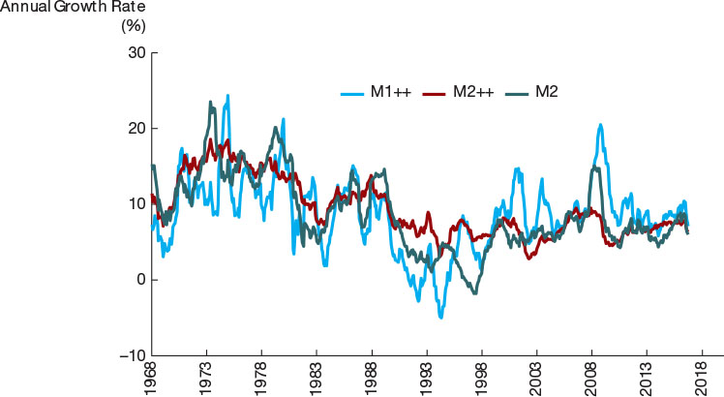
Figure 3-2
Growth Rates of the M2, M1++, and M2++ Aggregates, 1969–2017
The timing of the rise and fall of growth rates is roughly similar for both M1 and M2. There are periods, however, during which they move in opposite directions, leading to conflicting recommendations about the best course of monetary policy.
Source: Data from Statistics Canada CAN SIM series V4152796, V37152, and V41552801.

Slide 19
FYI: Where Are All the Dollars?
There is almost $2000 of currency held per person in the Canada and over $4500 of U.S. currency per person in the United States
  Do you know anyone who carries $2000 in their pocket?
Where are all these dollars and who is holding them?
  Criminals
  Foreigners (especially for U.S. dollars)

