Slide 1

The Economics of Money, Banking, and Financial Markets
Seventh Canadian Edition
Chapter 2
An Overview of the Financial System
Copyright © 2020 Pearson Canada Inc.

Slide 2
Learning Objectives
By the end of this chapter, you will understand
The structure of financial markets
  Direct and indirect finance
  International dimensions of financial markets
Various types of financial market instruments
Various types of financial intermediaries
  How transaction costs, risk sharing, information matter
Reasons for and types of financial market regulations

Slide 3
Function of Financial Markets
Channel funds from economic players that have surplus funds to those that have a shortage of funds
Indirect Finance
  Plays important role in the economy
  Efficient allocation of capital
Direct finance
  Borrow funds directly from lenders
  Involves selling a liability (IOU or debt)

Slide 4
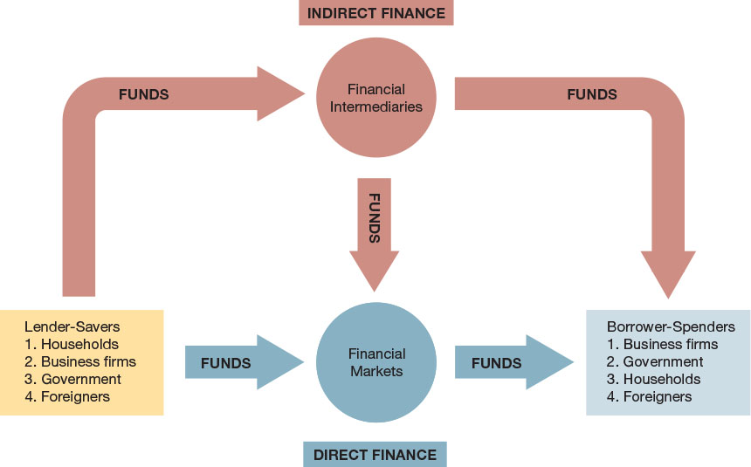
Figure 2-1
Flows of Funds Through the Financial System: The arrows show that funds flow from lender-savers to borrower-spenders via two routes: direct finance, in which borrowers borrow funds directly from financial markets by selling securities, and indirect finance, in which a financial intermediary borrows funds from lender-savers and then uses these funds to make loans to borrower-spenders.

Slide 5
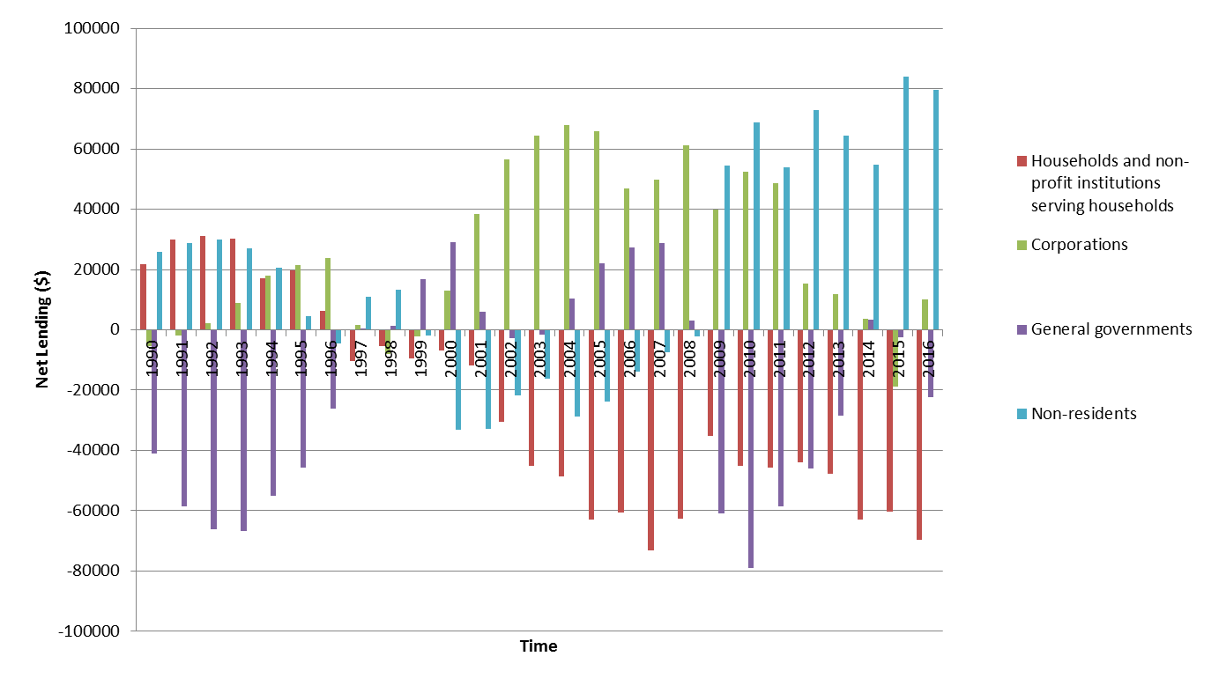
Net Lending Canada: 1990 – 2016

Slide 6
Debt and Equity Markets
Bonds - Debt instruments
  A contract between a borrower (who issues the bond) and lender (who owns it)
  Regularly payments until Maturity (short-term, < 1 year, intermediate-term, 1-10 years, and long-term, >10 years
Equity – Shares in a corporation
  Don’t have maturity dates
  Some make dividend payments
  Equity holders are residual claimants

Slide 7
Primary and Secondary Financial Markets
Primary Market
  New security issues sold to initial buyers
  Not well known to public; typically private
  Investment banks guarantee prices (called underwriting)
Secondary Market
  Previously issued securities can be bought and sold
  Brokers match buyers and sellers with each other
  Dealers offer to buy and sell securities at stated prices

Slide 8
Exchanges and Over-the-Counter Markets
Two main ways to organize a secondary market:
Exchanges
  Buyers and sellers meet in one central location
  Toronto Stock Exchange for stocks
  ICE Futures Canada for commodities (wheat, oats)
Over-the-Counter Markets (OTC)
  Dealers have inventory, ready to buy/sell at stated prices
  Many stocks are not traded OTC, but are on exchanges
  Canadian government bond market is an OTC market

Slide 9
Money and Capital Markets
Distinguish markets by maturity of the securities
Money Markets
  Only short-term debt instruments are traded (<1 year)
  Corporations and banks actively use money markets to each interest on temporary surplus funds
Capital Markets
  Market for longer-term debt (>1 year)
Money markets are more liquid than capital markets

Slide 10
Money Market Instruments
Government of Canada Treasury Bills
  ST government debt, usually issued in units of $250,000 (essentially riskless debt)
Certificates of Deposit
  Fixed-income debt security issued by chartered banks (maturity of one to six years)
Commercial Paper
  ST debt issued by corporations

Slide 11
Money Market Instruments
Repurchase Agreements
  Usually in government securities (T-bills)
  Seller agrees to buy back the security at a later date
Overnight Funds
  Bank to bank loans (settlement deposits)
  Overnight interest rate

Slide 12
Table 2-1 Principal Money Market Instruments
Amount Outstanding ($ millions)
Type of Instrument | 1990 | 2000 | 2010 | 2016
Treasury bills
Government of Canada | 113 654 | 76 634 | 150 831 | 128 538
Provincial governments | 12 602 | 17 523 | 33 858 | 51 174
Municipal governments | 514 | 188 | 875 | 435
Short-term paper
Commercial paper | 12 971 | 24 330 | 11 221 | 8 188
Source: Statistics Canada Cansim series V37377, V122256, V122257, and V122652.

Slide 13
Capital Market Instruments
Stocks (corporate)
  Equity shares in private corporations
  Total market is large, but annual new stock issues are small
Corporate bonds
  LT corporate bonds
  Highly illiquid market
Government of Canada bonds
  LT debt issued by the federal government
  Liquid investments which may be sold back by investor into the secondary market prior to maturity

Slide 14
Capital Market Instruments (con’t)
Mortgages and mortgage-backed securities
Canada Savings bonds
Provincial and municipal government bonds
Government agency securities
Consumer and bank commercial loans
      Loans from financial intermediaries to businesses and consumers

Slide 15
Table 2-2 Principal Capital Market Instruments
Amount Outstanding ($ billions)
Type of Instrument | 1990 | 2000 | 2010 | 2016
Corporate stocks (market value) | 110.7 | 238.7 | 366.9 | 533.6
Residential mortgages | 245.3 | 432.0 | 990.2 | 1395.0
Corporate bonds | 72.3 | 186.2 | 333.4 | 540.4
Government of Canada securities(marketable) | 124.6 | 301.9 | 344.3 | 445.7
Bank commercial loans | 133.9 | 157.7 | 187.1 | 333.6
Consumer loans | 99.6 | 193.8 | 474.3 | 561.0
Nonresidential and farm mortgages | 56.1 | 52.7 | 92.7 | 133.9
Source: Statistics Canada CANSIM series V122642, V122746, V122640, V37378 V122631, V122707, V122656, V122657, V122658, V122659, and V800015, and the authors’ calculations

Slide 16
Internationalization of Financial Markets
Foreign Bonds
  Sold in foreign country, denominated in that country’s currency
  For example, Canadian company selling bond in the United Kingdom denominated in British Pounds
Eurobond
  Sold in foreign country, denominated in another currency
  For example, Canadian company selling bond in the United Kingdom denominated in US dollars
  Recent development
  Widely used: over 80% of new issues are Eurobonds

Slide 17
Internationalization of Financial Markets (cont’d)
Eurocurrencies
  Variant of Eurobond (that is, domestic securities being bought and sold in foreign markets)
  Foreign currencies deposited in banks outside home country
  Eurodollars: U.S. dollars deposited in foreign banks outside the U.S. or in foreign branches of U.S. banks
World Stock Markets
  NYSE, Nikkei, FTSE, 100-Share Index, and many more

Slide 18
Financial Intermediaries: Indirect Finance
Financial Intermediation
  Indirect financing using financial intermediates (banks)
  Financial intermediaries ‘buy’ funds from savers and use these funds to ‘sell’ loans to borrowers
  Primary route to move funds from lenders to borrowers
  Transaction costs
  Risk sharing, and
  Asymmetric information

Slide 19
Financial Intermediaries: Indirect Finance (con’t)
Lowers Transaction Costs
  Refers to the time and money involved in designing/ executing / monitoring financial transactions
  Financial intermediaries make profits by significantly reducing transaction costs
  Economies of scale
  Economies of scope
  Liquidity services

Slide 20
Financial Intermediaries: Indirect Finance (cont’d)
Improves Risk Sharing
  The act of reducing the exposure of investors to investment risk
  Asset transformation – the act of creating and selling assets with low risk characteristics, then using these funds to create and sell assets with greater risk
  Diversification - creation of assets that have broad to exposure to risk

Slide 21
Financial Intermediaries: Indirect Finance
Help manage Asymmetric Information problems
  When one party in a transaction knows more than another party
  Adverse Selection: asymmetric information that occurs before the transaction
  Potential borrows who are more likely to default are the ones who most actively seek out loans
  Moral Hazard: asymmetric information that occurs after the transaction
  Borrowers might engage in activities that are undesirable from a lender’s point of view

Slide 22
Types of Financial Intermediaries
Depository Institutions
  Chartered Banks, Trusts and Mortgage Loan Companies, Credit Unions and Caisses Populaires
Contractual Savings Institutions
  Life Insurance Companies, Property and Casual Insurance Companies, Pension Funds and Retirement Funds
Investment Intermediaries
  Finance Companies, Mutual Funds, Money Market Mutual Funds, Hedge Funds, Investment Banks

Slide 23
Table 2-3 Primary Assets and Liabilities of Financial Intermediaries
Type of Intermediary | Primary Liabilities (Sources of Funds) | Primary Assets (Uses of Funds)
Depository institutions (banks)
Chartered banks | Deposits | Loans, mortgages, government bonds
Trust and loan companies | Deposits | Mortgages
Credit unions and caisses populaires | Deposits | Mortgages
Contractual savings institutions
Life insurance companies | Premiums from policies | Corporate bonds and mortgages
Property and casualty insurance companies | Premiums from policies | Corporate bonds and stocks
Pension funds | Retirement contributions | Corporate bonds and stocks
Investment intermediaries
Finance companies | Finance paper, stocks, bonds | Consumer and business loans
Mutual funds | Shares | Stocks and bonds
Money market mutual funds | Shares | Money market instruments

Slide 24
Table 2-4 Relative Shares of Financial Institutions and Pension Plans Regulated by OSFI (as of October 31, 2017)
Type of Intermediary | Total assets (in $ millions) | Percent (%)
Chartered Banks
Domestic | 5 037 396 | 68.54
Foreign bank subsidiaries | 130 286 | 1.77
Foreign bank branches | 1 996 | 0.03
Trust Companies | 164 318 | 2.24
Loan Companies | 188 088 | 2.56
Cooperative Credit Associations | 25 030 | 0.34
Life Insurance Companies
Canadian-incorporated | 1 412 325 | 19.22
Foreign branches | 19 869 | 0.27
Fraternal Benefit Societies
Canadian-incorporated | 18 670 | 0.25
Foreign branches | 3 322 | 0.05
Property and Casualty Insurance Companies
Canadian-incorporated | 123 829 | 1.68
Foreign branches | 26 859 | 0.37
Pension Plans | 198 000 | 2.69
Total | 7 349 988 | 100.00
Source: OSFI website www.osfi-bsif.gc.ca/Eng/Pages/default.aspx

Slide 25
Regulation of Financial Markets
Primary Reasons for Regulation:
Increase information available to investors
  Reduce adverse selection and moral hazard problems
  Increase efficiency of financial markets
Ensure soundness of financial intermediaries
  Restrictions on entry and competition, reporting requirements, and restrictions on assets and activities
  Deposit insurance

Slide 26
Table 2-5 Principal Regulatory Agencies of the Canadian Financial System (1 of 2)
Regulatory Agency | Subject of Regulation | Nature of Regulations
Provincial securities and exchange commissions | Organized exchanges and financial markets | Requires disclosure of information and restricts insider trading
Bank of Canada | Chartered banks, TMLs, and CUCPs | Examines the books of the deposit taking institutions and coordinates with the federal agencies that are responsible for financial institution regulation: OSFI and CDIC
Office of the Superintendent of Financial Institutions Canada (OSFI) | All federally regulated chartered banks, TMLs, CUCPs, life insurance companies, P&C insurance companies, and pension plans | Sets capital adequacy, accounting, and board-of-directors responsibility standards; conducts bank audits and coordinates with provincial securities commissions
Canada Deposit Insurance Corporation (CDIC) | Chartered banks, TMLs, CUCPs | Provides insurance of up to $100 000 for each depositor at a bank, examines the books of insured banks, and imposes restrictions on assets they can hold

