Slide 1
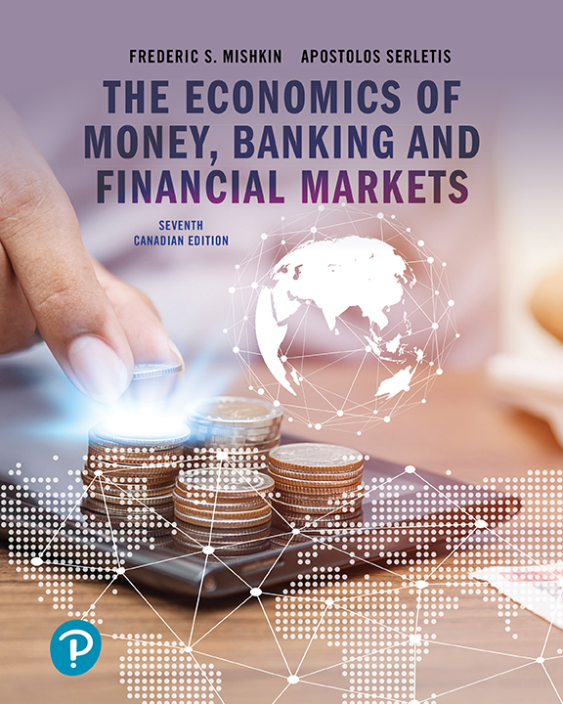
The Economics of Money, Banking, and Financial Markets
Seventh Canadian Edition
Chapter 1
Why Study Money, Banking, and Financial Markets?
Copyright © 2020 Pearson Canada Inc.

Slide 2
FIN2330 – Course Overview
Theme Breakdown FIN2330 [textbook chapters]:
Part I: Introduction [1, 2, 3]
Part II: Financial Markets [4, 5, 6]
Part III: Financial Institutions [8, 9, 10]
Part IV: Management of Financial Institutions [12]
Part V: Central Banking and the Conduct of Monetary Policy [15]
  Term Test #1 Term Test #2 Term Test #3

Slide 3
FIN2330 – Course Overview
Part I and II Coverage: Introduction and Financial Markets
  Chapter 2 –Overview of the Financial System (Canada)
  Chapter 3 – What is Money?
  Develop an Understanding Interest Rates
    Chapter 4: Understanding Interest Rates
    Chapter 5: The Behaviour of Interest Rates
    Chapter 6: The Risk and Term Structure of Interest Rates

Slide 4
Types of Financial Markets
Two Types of Financial Markets:
  Bond markets:
    debt security that promises periodic payments for a specified time
    interest rates play a central role in these markets
  Stock markets:
    a security (financial instrument) is a claim on the issuer’s future income or assets
    an asset is any financial claim that is subject to ownership

Slide 5
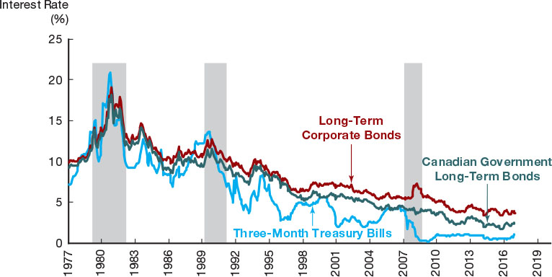
Figure 1.1
Interest Rates on Selected Bonds, 1977–2017
Although different interest rates have a tendency to move in unison, they often differ substantially,and the spreads between them fluctuate.
Source: Data from Statistics Canada CANSIM series V122531, V122544, and V122518, the latter extended with the 30 year A-rated corporate bond interest rate (C28730Y) from Bloomberg

Slide 6
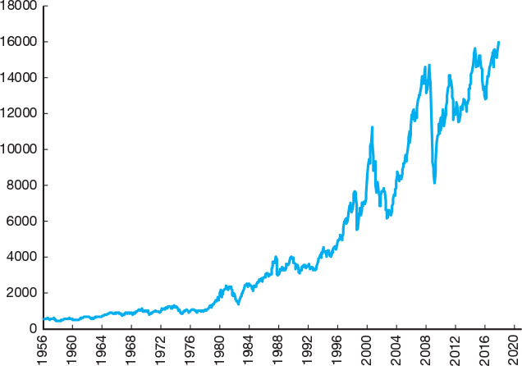
Figure 1.2
Stock Prices as Measured by the S&P/TSX Composite Index,1956–2017
Stock prices are extremely volatile.
Source: Data from Statistics Canada CANSIM series V122620

Slide 7
FIN2330 – Course Overview
Part III and IV Coverage: Financial Institutions
  Chapter 8 - An Economic Analysis of Financial Structure
  Chapter 9 - Economic Analysis of Financial Regulation
  Chapter 10 – Banking Industry: Structure and Competition
  Chapter 12 – Banking and the Management of Financial Institutions

Slide 8
Why Study Financial Institutions and Banking?
Financial Intermediaries: organizations enable financial markets to work
  – effectively ‘transferring’ funds from savers to those in need of investment finds
Banks: Borrow funds by accepting deposits
  chartered banks, trust and mortgage loan companies, and credit unions and caisses populaires
Other Financial Institutions: insurance companies, finance companies, pension funds, mutual funds and investment banks

Slide 9
Financial Innovation
Innovation in financial markets is the development of new financial products and services
  As with innovation in any sector, it is an important force for good by making the financial system more efficient
E-Finance: Delivering financial services electronically
Creative thinking by financial institutions can improve efficiency, increase profits, but can also sometimes result in financial disasters

Slide 10
Financial Crises
Financial crises: major disruptions in financial markets
  sharp declines in asset prices and the failures of many financial and nonfinancial firms
Are a feature of economies throughout history
Typically followed by severe business cycle downturns
August 2007, the U.S. experienced a serious crisis
  Defaults in subprime residential mortgages
  Major losses in financial institutions, with many failing

Slide 11
FIN2330 – Course Overview
Part V Coverage: Central Banking and Monetary Policy
  Chapter 15 – Money Supply Process

Slide 12
Why Study Money and Monetary Policy?
Money is anything that is generally accepted as payment for goods or services, or to repay debts
It affects a wide variety of other economic variables:
  Business Cycles
  Inflation
  Interest Rates
Monetary policy used to influence the economy
  Central role of Bank of Canada

Slide 13
Money and Business Cycles
Business cycles are the upward and downward movement of aggregate output in the economy
Affects the unemployment rate (share of labour force that is not employed)
Evidence suggests money plays an important role in generating business cycles

Slide 14
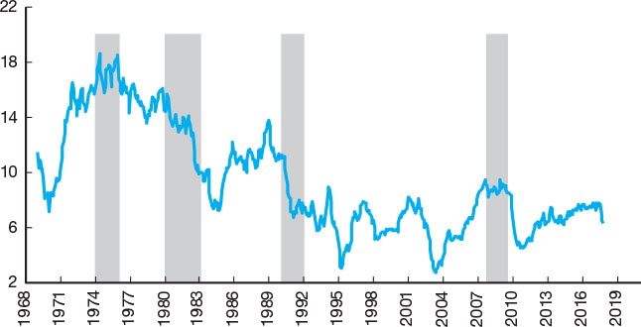
Figure 1.3
Money Growth (M2++ [gross] Annual Rate) and the Business Cycle in Canada, 1968–2017
Although money growth has declined before almost every recession, not every decline in the rate of money growth is followed by a recession.
Shaded areas represent recessions.
Source: Data from Statistics Canada CANSIM series V41552801

Slide 15
Money and Inflation
Aggregate price level is the average price of goods and services in an economy
Inflation is a broad-based increase in the price level
  Affects individuals, businesses, and the government
What explains inflation?
  Inflation rate (percentage change of the price level) strongly related to growth rate of the money supply
  This is true both within and across countries

Slide 16
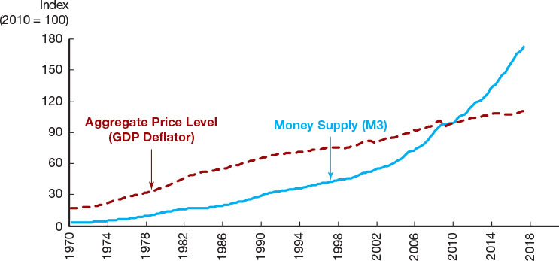
Figure 1.4
Aggregate Price Level and the Money Supply in Canada, 1970–2017
From 1970 to 2017, the price level increased more than sixfold.
Source: Data from Federal Reserve Bank of St. Louis, FRED database: http://research.stlouisfed.org/fred2/

Slide 17
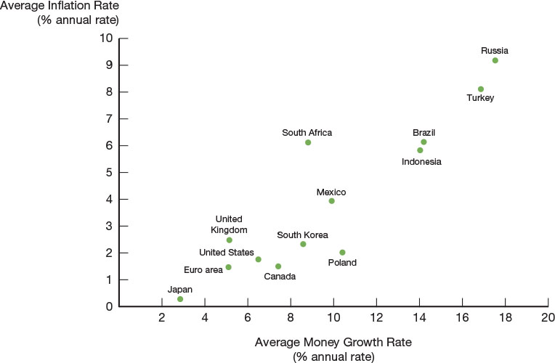
Figure 1.5
Average Inflation Rate Versus Average Rate of Money Growth for Selected Countries, 2006–2016
A positive association can be seen between the 10-year averages of inflation and the growth rate of the money supply: the countries with the highest inflation rates are also the ones with the highest money growth rates.
Source: Federal Reserve Bank of St. Louis, FRED database: https://fred.stlouisfed.org/

Slide 18
Money and Interest Rates
An interest rate is the cost of borrowing or the price paid for the rental of funds
  Must compensate borrowers for expected inflation
Prior to 1980, the rate of money growth and the interest rate on long-term bonds were closely tied
Since then, the relationship is less clear but still an important determinant of interest rates

Slide 19
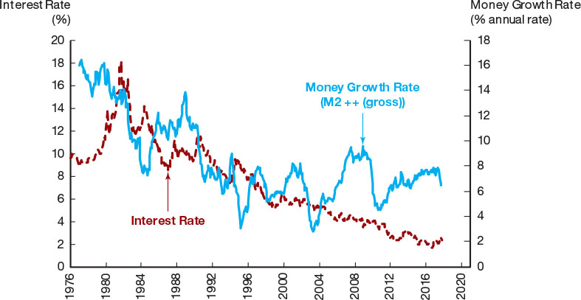
Figure 1.6
Money Growth (M2++ [gross] Annual Rate) and Interest Rates (Long-Term Government of Canada Bonds), 1976–2017
As the money growth rate rose in the 1980s and 1990s, the long-term bond rate rose with it. However, the relationship between money growth and interest rates has been less clear-cut since 2000.
Source: Data from Statistics Canada CANSIM series V41552801 and V122544

Slide 20
Fiscal and Monetary Policy
Monetary policy involves managing the money supply and interest rates
  Conducted by the Bank of Canada using a variety of tools
Fiscal policy involves setting government expenditures and tax revenue
  Conducted by the government (Federal, Provincial)
  Budget deficit is spending in excess of revenue
  Budget surplus is spending less than revenue

Slide 21
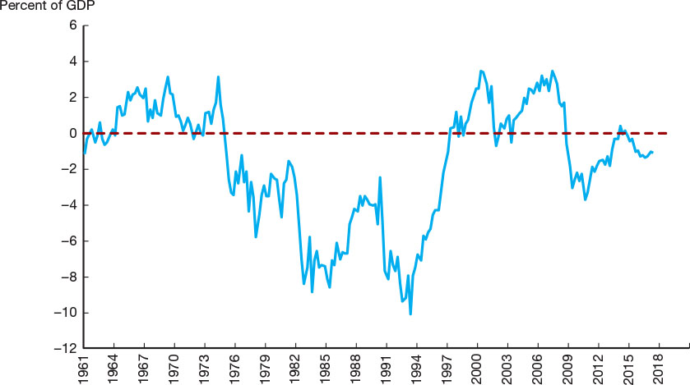
Figure 1.7
Government Budget Surplus or Deficit as a Percentage of Gross Domestic Product, 1961–2017
The budget deficit, relative to the size of the Canadian economy, has fluctuated substantially over the years. It rose to close to 9% of GDP in 1993 and then fell, eventually leading to budget surpluses from 1997 to 2008. Subsequently, budget deficits climbed, peaking at over 4% of GDP in 2009 and falling substantially thereafter. Source: Data from Statistics Canada CANSIM series V62425528, V62425550, and V62305783

Slide 22
FIN2330 – Course Overview
Part VI Coverage: International Finance
  Chapter 18 – The Foreign Exchange Market
  Role of foreign exchange market in the operation of the economy
    The foreign exchange market is where one country’s currency is exchanged for another
  The exchange rate is the price of one country’s currency in terms of another
    Appreciation/depreciation is a rise/fall in the value of a country’s currency

Slide 23
Why Study International Finance?
Globalization of financial markets has accelerated at a rapid pace in recent years
  Financial markets are increasingly integrated
Borrowing and lending can cross borders
  Canadian companies borrow in foreign markets
  Foreign companies borrow in Canadian markets
Financial institutions increasingly international
  Operations in many countries

Slide 24
Foreign Exchange, The Market and Rates
The foreign exchange market is where funds are converted from one currency into another
The foreign exchange rate is the price of one currency in terms of another currency
  If it takes $0.80 U.S. dollars to buy $1 Canadian dollar, then the USD/CAD exchange rate is 0.80
  Appreciation is a rise in the value of the Canadian dollar
  Depreciation is a fall in the value
Exchange rates determined in the market

Slide 25
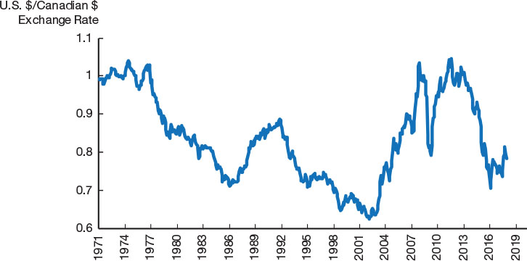
Figure 1.8
Exchange Rate of the Canadian Dollar, 1971–2018
The value of the Canadian dollar relative to the U.S. dollar has fluctuated substantially over the years.
Source: Data from Federal Reserve Bank of St. Louis, FRED database: https://fred.stlouisfed.org/series/EXCAUS

