Slide 1
Chapter 10
Motivation
1

Slide 2
Motivational Theories and Concepts
•
Motives – needs, wants, desires leading to goal-directed behaviour
Drive theories – seeking homeostasis Incentive theories – regulation by external stimuli
Evolutionary theories – maximizing reproductive success
•
•
•
Question: Using the 3 theories above, explain why someone might be motivated to go to
University?
2

Slide 3
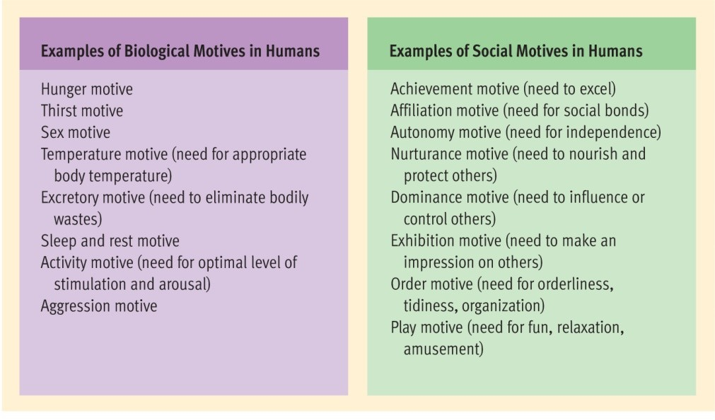
Figure 10.2 The diversity of human motives.
People are motivated by a wide range of needs, which can be divided into two broad classes: biological motives and social motives. The list on the left (adapted from Madsen, 1973) shows some important biological motives in humans. The list on the right (adapted from Murray, 1938) provides examples of prominent social motives in humans. The distinct3ion between
•

Slide 4
The Motivation of Hunger and Eating: Biological Factors
•
Brain regulation
–
–
–
Lateral and ventromedial hypothalamus Paraventricular nucleus
Neuropetide Y, serotonin
Glucose and digestive regulation
Glucostatic theory Hormonal regulation
Insulin, ghrelin, and leptin
•
•
Video: Role of hormones in hunger https://www.khanacademy.org/test- prep/mcat/biomolecules/hormonal-regulation/v/hormone-
control-of-hunger
4

Slide 5
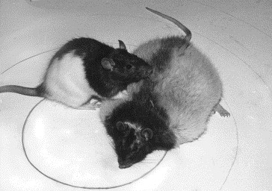

Slide 6
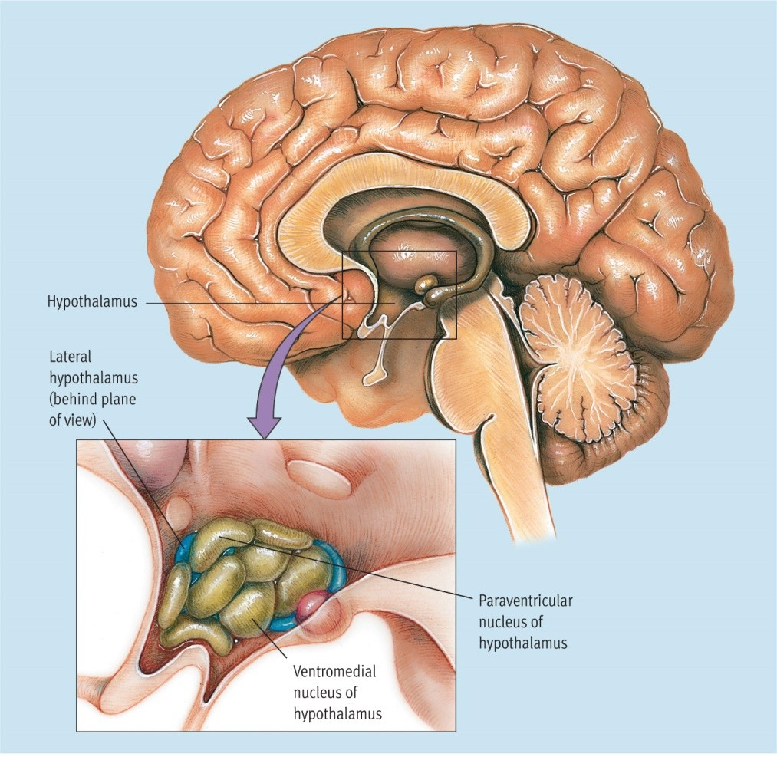
Figure 10.3 The hypothalamus.
•
This small structure at the base of the forebrain plays a role in regulating a variety of human biological needs, including hunger. The detailed blowup shows that the hypothalamus is made up of a variety of discrete areas. Scientists used to believe that the lateral and ventromedial areas were the brain’s on–off centres for eating. However, more recent research suggests that the paraventricular nucleus may be more crucial to the regulation of hunger and that thinking in terms of neural circuits rather than anatomical
centres makes more sense.
6

Slide 7
The Motivation of Hunger and Eating: Environmental Factors
Learned preferences and habits
Exposure
When, as well as what
Food-related cues
Appearance, odour, effort required
Stress
Link between heightened arousal/negative emotion and overeating
•
•
•
7

Slide 8


Slide 9


Slide 10
Eating and Weight: The Roots of Obesity
Evolutionary explanations Genetic predisposition
– Body Mass Index and adoption study
The concept of set point/settling point Dietary restraint
Eating disorders
•
•
•
•
•
10

Slide 11
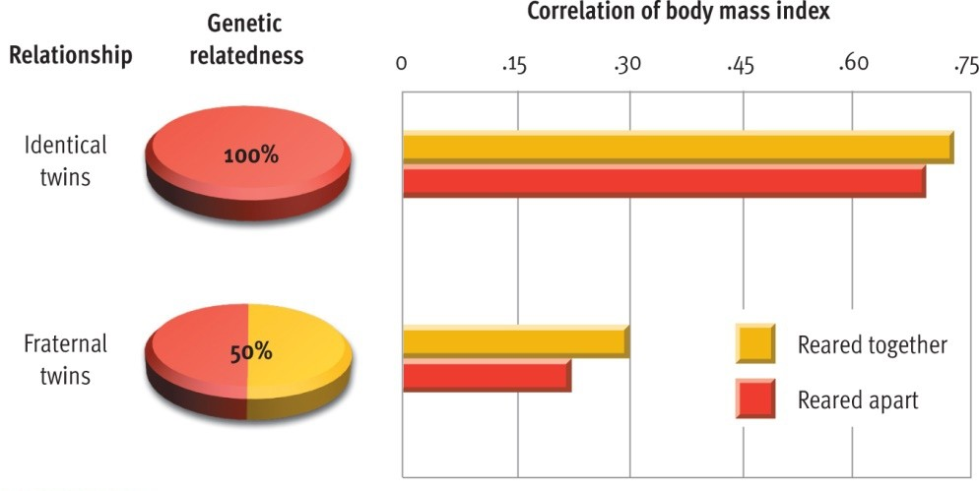
Figure 10.5 The heritability of weight.
•
These data from a twin study by Stunkard et al. (1990) reveal that identical twins are much more similar in body mass index than fraternal twins, suggesting that genetic factors account for much of the variation among people in the propensity to become overweight¹.¹

Slide 12
Sexual Motivation and Behaviour
Hormonal regulation
Estrogens
Androgens
Testosterone
Evolutionary factors Parental investment theory
Gender differences in mate preferences Pornography
•
•
•
•
•
12

Slide 13
The Human Sexual Response
•
Masters and Johnson – 1966
Stages:
Excitement
Plateau
Orgasm
Resolution
•
13

Slide 14
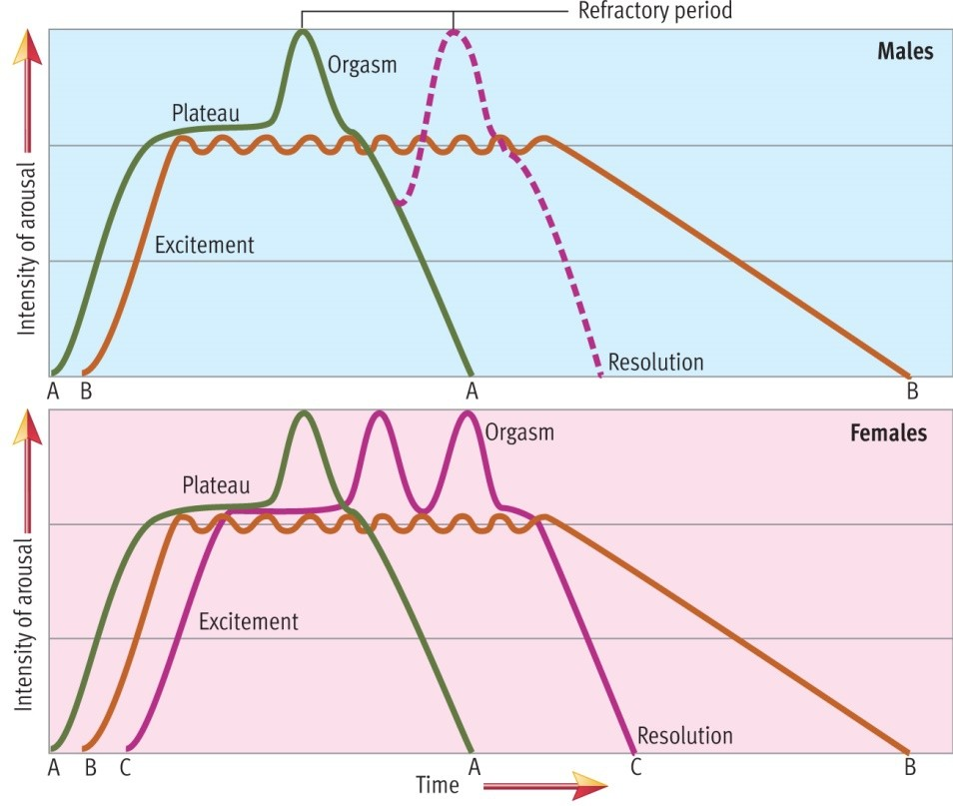
Figure 10.6 The human sexual response cycle.
•
There are similarities and differences between men and women in patterns of sexual arousal. Pattern A, which culminates in orgasm and resolution, is the ideal sequence for both sexes but not something one can count on. Pattern B, which involves sexual arousal without orgasm followed by a slow resolution, is seen in both sexes but is more common among women (see Figure 10.7). Pattern C, which involves multiple orgasms, is seen almost exclusively in women, as men go through a refractory period
before they are capable of another orgasm.
14
•
Source: Based on Masters, W. H., and Johnson, V. E. (1966). Human sexual response. Boston: Little, Brown. Copyright © 1966 Little, Brown

Slide 15
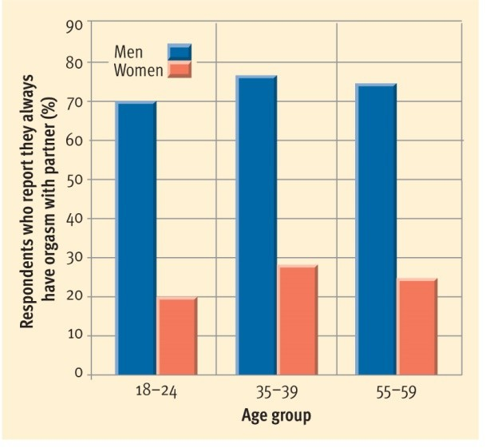
Figure 10.7 The gender gap in orgasm consistency.
•
In their sexual interactions, men seem to reach orgasm more reliably than women. The data shown here suggest that the gender gap in orgasmic consistency is pretty sizable. Both biological and
sociocultural factors may contribute to this gender ga1p5.

Slide 16
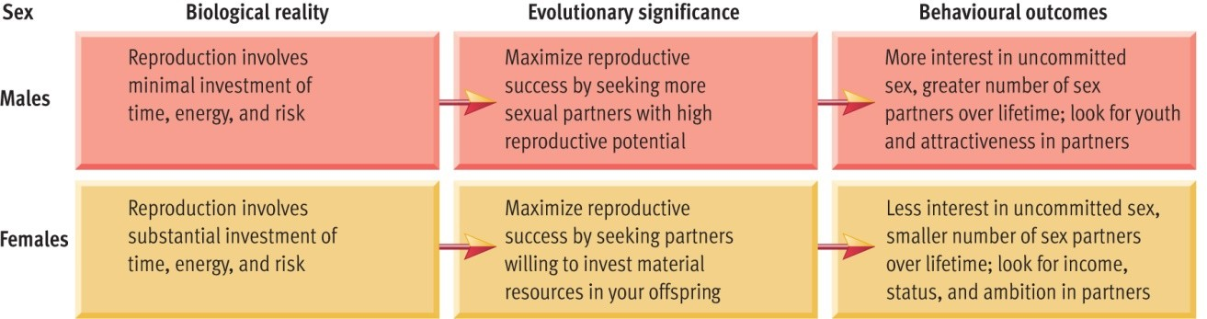
Figure 10.8 Parental investment theory and mating preferences.
•
Parental investment theory suggests that basic differences between males and females in parental investment have great adaptive significance and lead to gender differences in mating propensities and preferences, as outlined here.
16

Slide 17
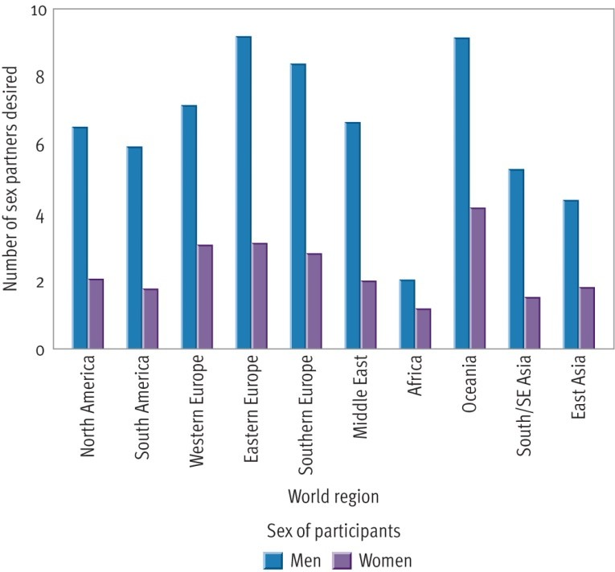
Figure 10.10 The gender gap in desire for a variety of sexual partners.
Schmitt et al. (2003) gathered cross-
•
cultural data on gender disparities in the number of sex partners desired by people. Respondents were asked about how many sexual partners they ideally would like to have in the next 30 years. As evolutionary theorists would predict, males reported that they would like to have more sexual
partners in all ten world regions
examined.
Source: Schmitt, D.P., and 118 Members of the International Sexuality Description Project. (2003). Universal sex differences in the desire for sexual variety: Tests from 52 nations, 6 continents, and 13 islands. Journal of
•
Personality and Social Psychology, 85, 85–104. Copyright ©2003 by the
17
American Psychological Association. Reprinted by permission.

Slide 18
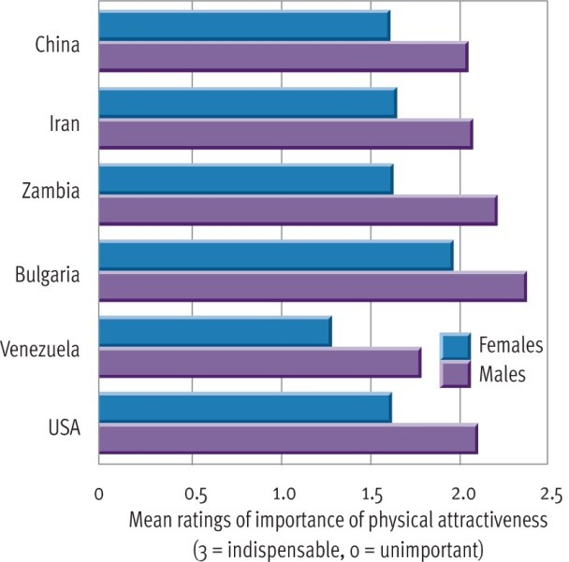
Figure 10.12 Gender and potential mates’ physical attractiveness.
•
Consistent with evolutionary theory, Buss (1989) found that all over the world, males place more emphasis on potential partners’ good looks than females do. The specific results for 6 of the 37 cultures studies by Buss are
shown here.
18

Slide 19
The Mystery of Sexual Orientation
Heterosexual – Bisexual – Homosexual
A continuum
Theories explaining homosexuality
Biological
•
•
19

Slide 20
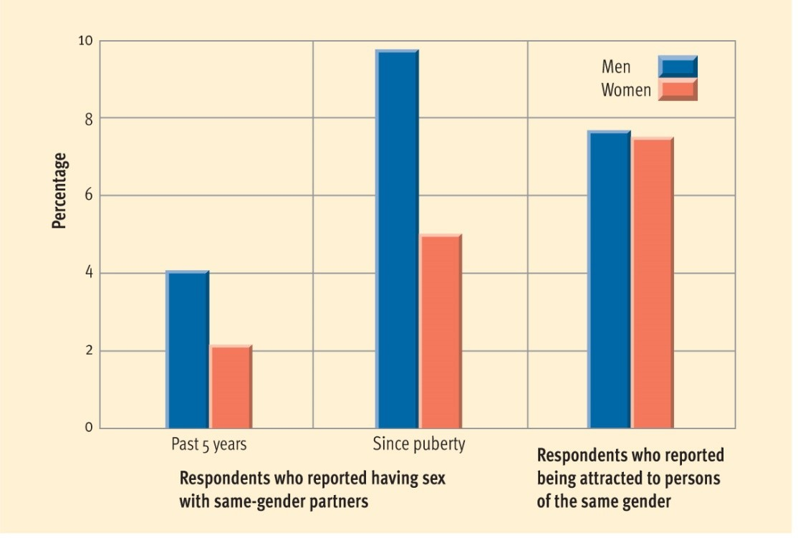
Figure 10.14 How common is homosexuality?
•
The answer to this question is both complex and controversial. Michaels (1996) brought together data from two large-scale surveys to arrive at the estimates shown here. If you look at how many people have actually had a same-sex partner in the last five years, the figures are relatively low, but if you count those who have had a same-sex partner since puberty, the figures more than double. Still another way to look at it is to ask people whether they are attracted to people of the same sex (regardless of their actual behaviour). This approach suggests that about 8 percent of the population could be characterized as homosexual.
20

Slide 21
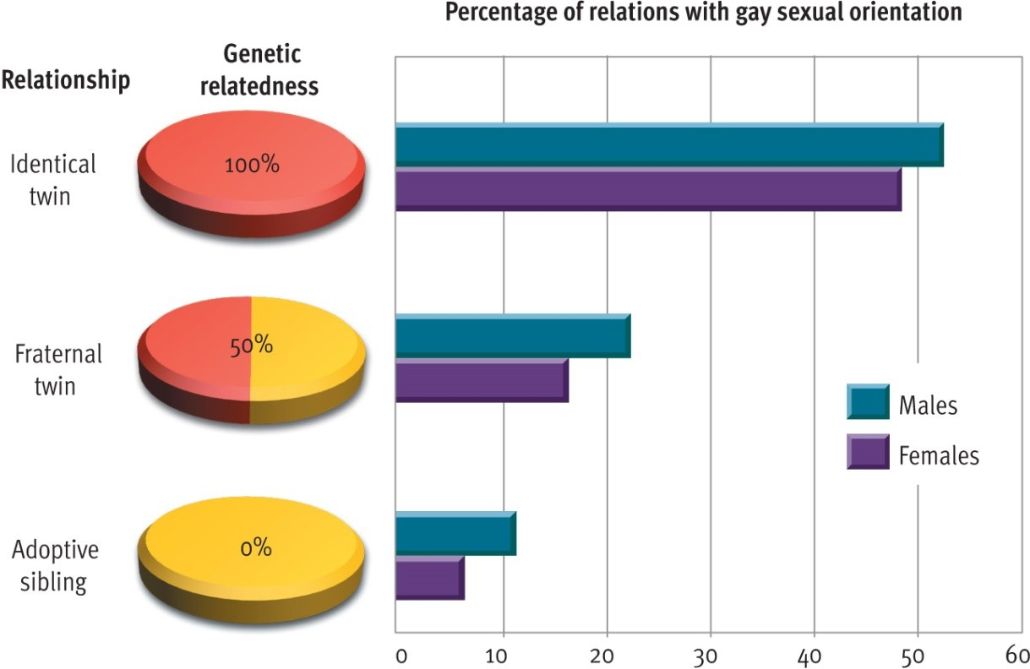
Figure 10.15 Genetics and sexual orientation.
•
If relatives who share more genetic relatedness show greater similarity on a trait than relatives who share less genetic overlap, this evidence suggests a genetic predisposition to the characteristic. Studies of both gay men and lesbian women have found a higher prevalence of homosexuality among their identical twins than among their fraternal twins, who, in turn, are more likely to be homosexual than their adoptive siblings. These findings suggest that genet₂i₁c factors influence sexual orientation.

Slide 22
The Need to Belong: The Affiliation Motive
Affiliation
•
•
Ostracism
•
Fear of rejection
Video: Brain and Social Rejection - https://www.youtube.com/watch? v=VOvHb4zmXe8
22

Slide 23
Achievement Motivation
●
Achievement motive = need to excel
Work harder and more persistently Delay gratification
Pursue competitive careers
Situational influences on achievement motives Thematic Apperception Test (TAT)
−
−
−
−
−
23

Slide 24
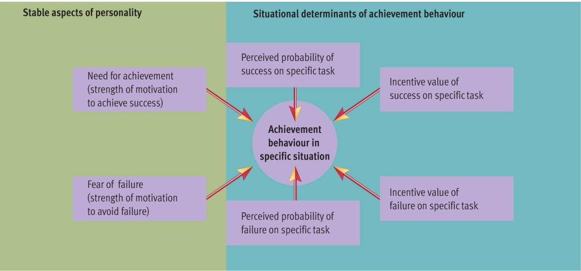
Figure 10.17 Determinants of achievement behaviour.
•
According to John Atkinson, a person’s pursuit of achievement in a particular situation depends on several factors. Some of these factors, such as need for achievement or fear of failure, are relatively stable motives that are part of the person’s personality. Many other factors, such as the likelihood and value of success or f₂a₄ilure, vary from one situation to another, depending on the circumstances.

