Slide 1
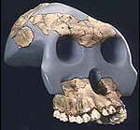
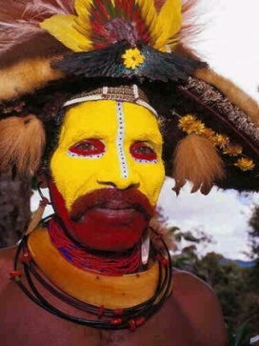

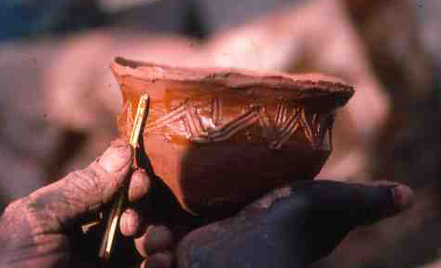
Anthropology 1001C

Slide 2
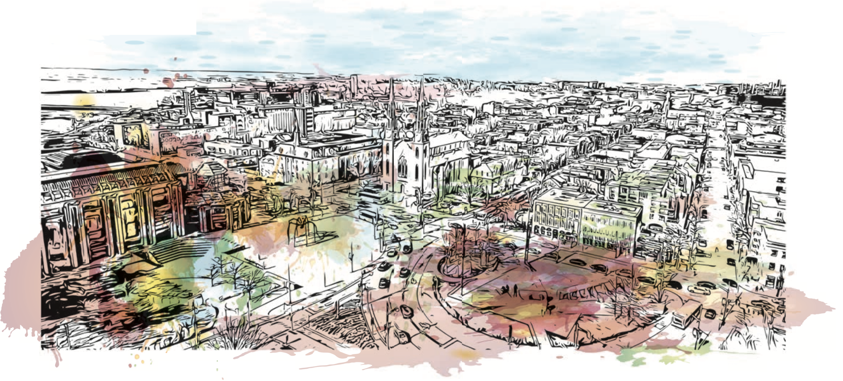

Winter 2020
Join us for a series of unique panel events which will ask the important question:
“What defines a healthy city in 2020?”
Panel will take place at 7:00 PM, at the Carleton Dominion-Chalmers Centre
JANUARY 14 Climate Change and Sustainability in the City
Dr. Elizabeth Gilmore (Scholar in residence, Environment Canada)
Dr. Zoe Todd (Sociology and Anthropology)
Dr. Sheryl-Ann Simpson (Geography and Environmental Studies)
Moderator: Dr. David Hugill (Geography and Environmental Studies)

Slide 3


Sexual Assault Resistance Education Program
Sign up here: https://carleton.ca/sexual-violence-support/programs-and-training/eaaa/eaaa-program-registration/
eaaa@cunet.carleton.ca
Jan 25-26th (both days, 11 AM to 5 PM)
March 7th and 14th (both days, 11 AM to 5 PM)

Slide 4
What this lecture covers
Anthropology 1001C
Class Format
Course Outline
Anthropology and its sub fields

Slide 5
Liam Kilmurray
HBA – University of Western Ontario
M.A. Carleton
M.Philosophy in Anthropological Theory – Cambridge U.K.
PhD Prehistory and Archaeology – Sheffield U.K.
8 years in fieldwork (Archaeology)
17 years University teaching at Carleton
13 Full Time at University of Ottawa

Slide 6
Courses Taught
Soc 1101 Introduction to Sociology
Soc 1105 Conflict, Activism and Change
Scs 1150 Introduction to the Social Sciences
Ant 1101 Social and Cultural Anthropology
Ant 2126 Indigenous Peoples of the Americas
Soc 2105 Cultural Ecology
Ant 2113 Techniques, Culture, & Society
Soc 3137 Minority Groups
Soc 3126 Marx & Marxist Theory
ANTH 1001 Introduction to Anthropology
ANTH 1002 Select Issues in social Anthropology
ANTH 2020 Race & Ethnicity
ANTH 3040 Culture & Society
ANTH 3007 History of Anthropological Theory

Slide 7
Office
Loeb A739
Hours: Monday. 1 – 2 PM
Phone: 613-520-2600 x. 3785
Email: liam.kilmurray@carleton.ca

Slide 8
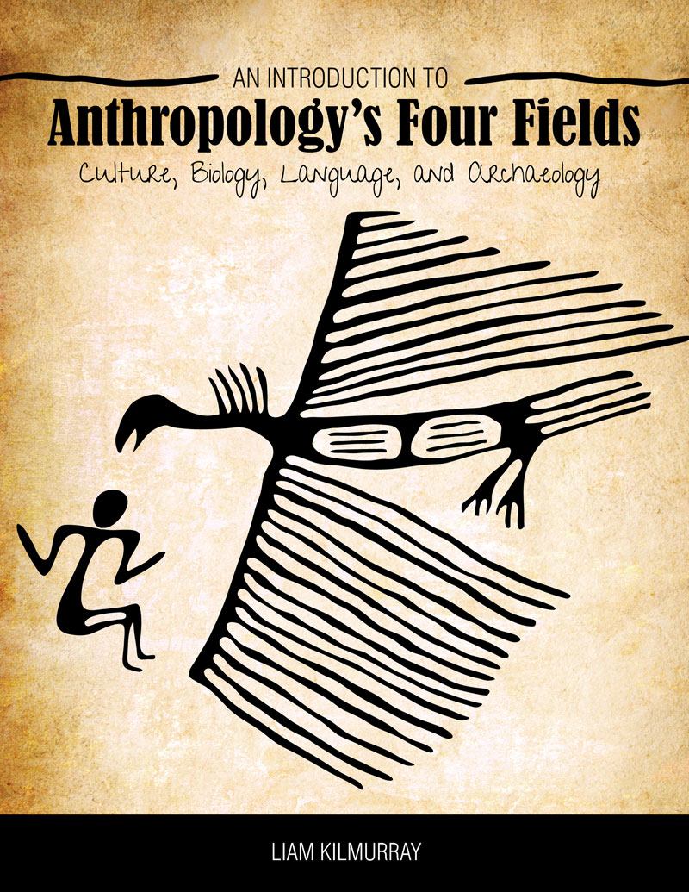
Course Textbook
COURSE TEXT: Kilmurray, Liam 2019. An Introduction to Anthropology’s Four Fields: Culture, Biology, Language, and Archaeology. First edition’. Available at Carleton U bookstore, or at https://he.kendallhunt.com/kilmurray

Slide 9
Class Structure
Class starts at 2:35 Sharp
Break at 3:30
Class restarts at 3:40
Class Finishes 4:25

Slide 10
Date | # | Lecture Topic | Readings
Jan. 6 | 1 | Introduction: Anthropology & Anthropologists. | Ch. 1
Jan. 13 | 2 | Darwin, Evolution & Physical anthropology. | Ch. 2
Jan. 20 | 3 | The Emergence of Humanity. | Ch. 3
Jan. 27 | 4 | The Concept of Culture. Anthropological Theory. | Ch. 4
Feb. 3 | 5 | Kinship & Descent. | Ch. 5
Feb. 10 |  | Mid-term examination | Reading Review
Feb. 17 |  | Winter Break: No Classes. | Reading Review
Feb. 24 | 6 | Expressive Culture: Symbols and Language. | Ch. 6
Mar. 2 | 7 | Ethnographic research in Anthropology. | Ch. 7
Mar. 9 | 8 | Subsistence systems. | Ch. 8
Mar. 16 | 9 | Archaeology. ESSAY DUE. | Ch. 10
Mar. 23 | 10 | Religion & Spirituality. FINAL ASSIGNMENT ISSUED. | Ch. 9
Mar. 30 | 11 | Applied Anthropology. | Ch11
Apr. 6 | 12 | Conclusion – Review. FINAL ASSIGNMENT DUE. | Ch. 12 (conclusion)

Slide 11
Internet
Course web-Site: C U Learn Anth 1001C

Slide 12
Evaluation
Assignment | Date | Weight (%)
Mid-term | Feb. 10th | 20%
Essay | Mar. 16th | 35%
Tutorial | Jan. 13th – Mar. 30th | 15%
Final Assignment | Mar. 23rd – Apr. 6th | 30%

Slide 13
Essays
Clear and coherent structure
Do an outline before you start to write
Make sure spelling and grammar are correct
Correct citations required
Original contribution
Bibliographic Requirements
Essay = 6-7 pages, not including cover page & bibliog.

Slide 14
Tutorials
The tutorial is designed to help you reflect upon, and learn more about the given lecture topic each week.
Teaching Assistants will go over the lecture material, and answer any questions you may have
Tas will advise you on further research, both for the examinations and also to help you to construct your essay

Slide 15
Tutorials
Attendance-participation = 5%
Annotated bibliog. = 5%
Written work = 5%
NB: students must write their Tutorial Group number on Each Assignment.
You should see which group you are in on your Carleton account
There can be NO switching groups
Your Teaching Assistant for tutorials will be announced in a few days

Slide 16
Tutorial Groups
No tutorials this afternoon
They start next Monday, Jan 13
Details to be announced
I am not responsible for group selection, nor can I alter any student or group.
C1 – ME 3190. 4:35-5:25
C2 – PA 129. 4:35-5:25
C3 – 3356 ME. 4:35-5:25
C4 – 3174 ME. 4:35-5:25
C5 – 505 SA. 4:35-5:25
C6 – 3400 CB. 4:35-5:25
C7 – 3356 ME. 5:35-6:25
C8 – 501 SA. 5:35-6:25
C9 – 505 SA. 5:35-6:25
C 10 – 417 SP. 5:35-6:25
C 11 – 378 UC. 5:35-6:25
C 12 – 279 UC. 5:35-6:25

Slide 17
What is Anthropology?
The word anthropology is derived from two Greek words: anthropos meaning man or human and logos, meaning thought or reason.
  The study of Humanity
  The relationships between humans and the rest of the natural world
  The interactions between humans and the environment, including interactions with other species
  The study of human abilities to manipulate symbols, to employ abstract thought and language

Slide 18
The 4 Fields of Anthropology
Physical Anthropology | Archaeology
Linguistic Anthropology | Cultural Anthropology

Slide 19
Linguistic Anthropology
Fochail
Mots
Words
DAN
EPN:Q
Language
Origins of language
Dialects: Social factors & language
Historical Linguists

Slide 20
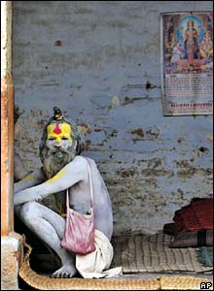
Cultural Anthropology
Ethnographic, Social
Cross-Cultural Studies
Ethnologists
Urban anthropology,
Medical anthropology,
Economic anthropology

Slide 21
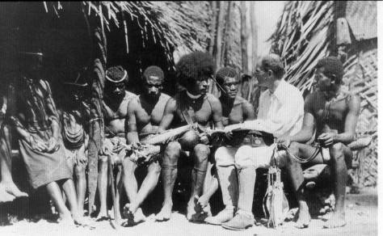
Ethnography
Ethnography is the controlled participant-observant analysis of a cultural field
Ethnographers = Anthropologists who specialize in recording the customs of human societies

Slide 22
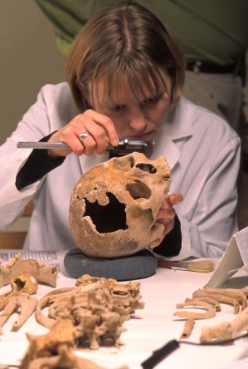
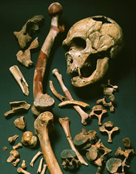
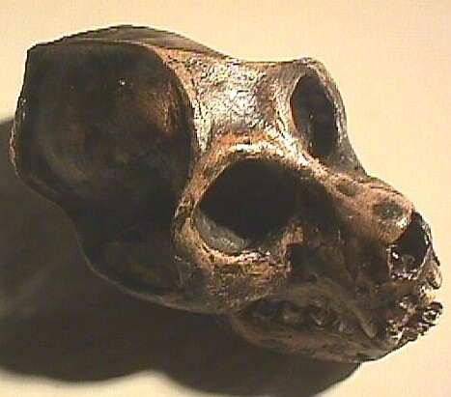
Physical Anthropology
An anthropological analysis of the human species as a biological phenomenon

Slide 23
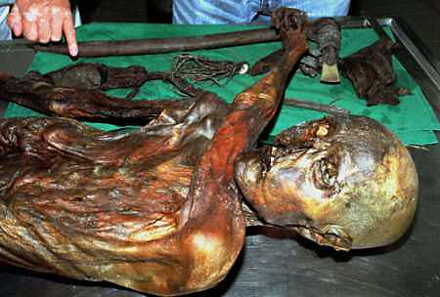
Types of Physical Anthropology
Growth and Developmental Specialists
Geneticists
Paleopathologists
Paleobiologists
Paleoanthropologists
Paleoecologists
Skeletal and Forensic Anthropologists

Slide 24
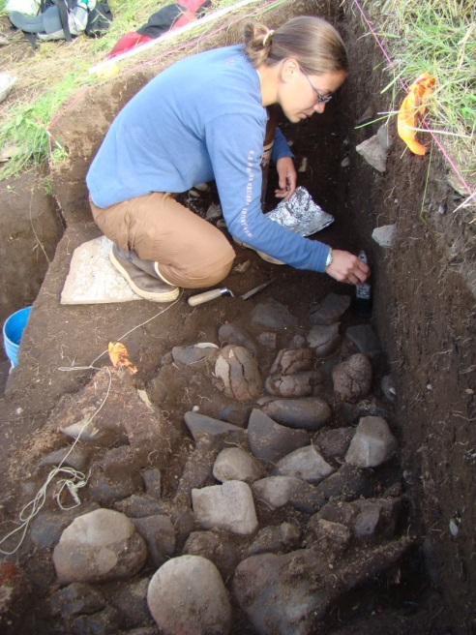
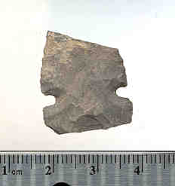
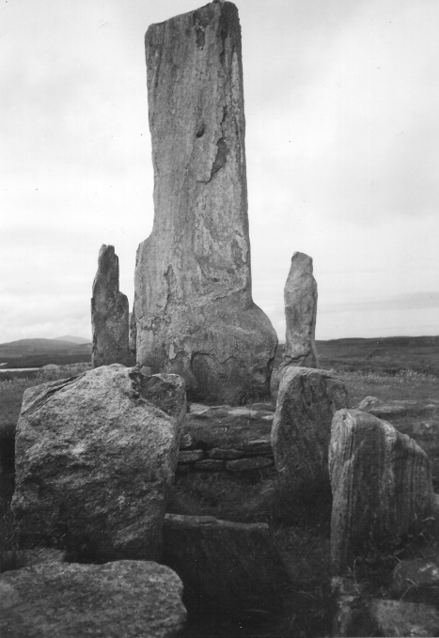
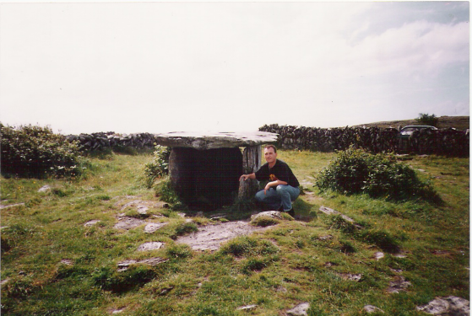
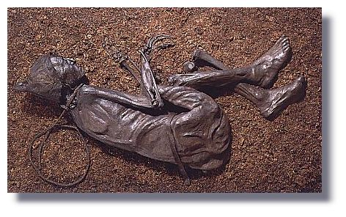
Archaeology
Material Remains
Excavation Techniques
The Past
Preservation & Conservation
Time Depth

Slide 25
Key Points
Anthropologists focus on Key areas of culture and society: death, marriage, economics, kinship, ritual, spirituality etc.
Anthropologists attempt to document and understand cultural differences
Anthropologists attempt to discover laws and generalisms, perhaps universalisms
Dr. L. Kilmurray

Slide 26
Key Points
Anthropologists often encounter practices and beliefs very alien to their own:
Cutting off tips of fingers among the Dani as a funerary ritual
Head hunting as a way to prove masculinity or to avenge a wrong
An opposition to burial amongst some cultures
Witchcraft and Sorcery
Dr. L. Kilmurray

Slide 27
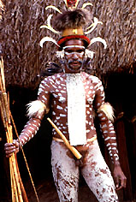

Key Points
Through examining other cultures, (cultural) anthropologists often gain insights into their own culture
Dr. L. Kilmurray

Slide 28

Anthropology 1001C
Evolution
Complex Social Systems
Anthropological Theory
Bipedalism
Archaic humans
Kinship
Culture
Linguistics
Cultural Anthropology
Civilizations
Archaeology
Social Organization

