Slide 1
ITM 100 Fall 2019
Class 1
Information Systems in Business Today
adapted from
Kenneth C. Laudon, Jane P. Laudon, (2019), Management Information Systems: Managing the Digital Firm, Fifteenth Edition
Notes:
Insert Your Header Here.

Slide 2
Learning Objectives
1-1 How are information systems transforming business, and why are they so essential for running and managing a business today?
1-2 What is an information system? How does it work? What are its management, organization, and technology components?
1-3 What academic disciplines are used to study information systems, and how does each contribute to an understanding of information systems?
Notes:
Students may not know exactly what is meant by globalization, or may have an incomplete understanding of the term. You might ask students what they think it means. Potential answers could include: reduction of economic and cultural advantages of developed countries, increased number of companies with operations in multiple countries worldwide, and increased reliance on imports and exports of goods (and jobs). Globalization will be discussed in later slides as well.

Slide 3
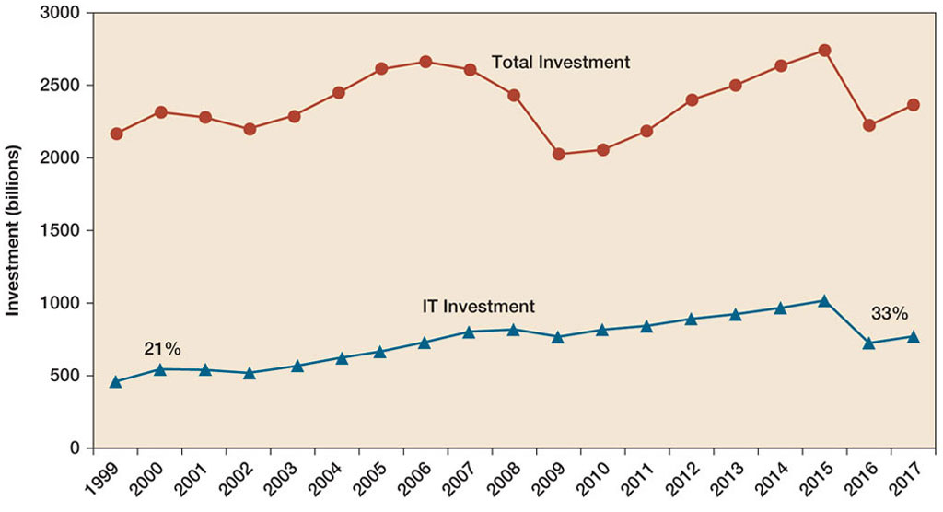
Figure 1.1: Information Technology Capital Investment
Notes:
Figure 1.1, Page 6.
Information technology capital investment, defined as hardware, software, and communications equipment, grew from 21 to 37 percent of all invested capital between 1999 and 2015.
Source: Based on data in U.S. Department of Commerce, Bureau of Economic Analysis, National Income and Product Accounts,
Table 5.3.6. Real Private Fixed Investment by Type, Chained Dollars (2016).
Emphasize to students that total investment is more than one trillion dollars in 2012, and that more than 540 billion dollars of that was invested in information technology. You could ask them why it is that the percentage of total investment devoted to IT has increased so much since 1980. Other kinds of capital investment are machinery and buildings. Why would firms increase IT investment faster than machinery and buildings? The answer is capital substitution: the price of IT capital has been falling exponentially, whereas the price of machine and buildings has been growing at slightly more than the rate of inflation. Wherever possible, firms would much rather invest in more IT than machinery or buildings because the returns on the investment are greater.

Slide 4
What is New in Management Information Systems
Continuous changes in technology, management, and business processes
IT Innovations
  Cloud computing, mobile digital platforms, big data, AI, the Internet of Things (IoT)
New Business Models
  Viewers are unplugging from cable and using only the Internet for entertainment (Netflix)
E-Commerce Expanding
  Selling services, not only goods
Management Changes
  Online collaboration, Business Intelligence, Virtual meetings
Changes in Firms and Organizations
  Multiple roles, social media to listen to consumers, more aware of technologies

Slide 5

Globalization
Globalization challenges and opportunities
  A “flattened” world
  Internet has drastically reduced costs of operating on global scale
  Increases in foreign trade, outsourcing
  Presents both challenges and opportunities

Slide 6
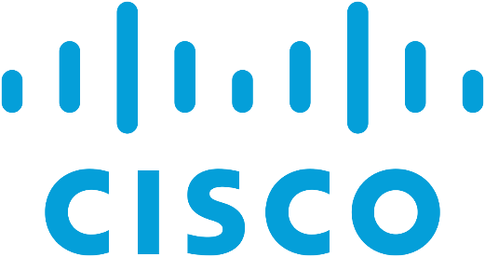


The Emerging Digital Firm
In a fully digital firm
  Significant business relationships are digitally enabled and mediated
  Core business processes are accomplished through digital networks
  Key corporate assets are managed digitally
Digital firms offer greater flexibility in organization and management
  Time shifting, space shifting
Many firms are close to becoming digital firms

Slide 7
Strategic Business Objectives of Information Systems
Growing interdependence between:
  Ability to use information technology and
  Ability to implement corporate strategies and achieve corporate goals
Notes:
In the opening case, the UPS Interactive Session later in the chapter, and with many of the Interactive Sessions and opening cases in the book, it will be useful to ask students to explain how various information systems succeeded or failed in achieving the six strategic business objectives. You might ask the students to think about some other business objectives and think about how IT might help firms achieve them. For instance, speed to market is very important to firms introducing new products. How can IT help achieve that objective?

Slide 8
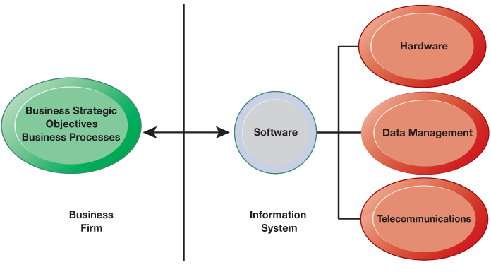
The Interdependence Between Organizations and Information Systems
Notes:
Objectives and strategies are now dependent to what current IS, hardware, databases and telecommunications allow

Slide 9
Strategic Business Objectives of Information Systems
Firms invest heavily in information systems to achieve six strategic business objectives:
  Operational excellence
  New products, services, and business models
  Customer and supplier intimacy
  Improved decision making
  Competitive advantage
  Survival

Slide 10


The Role of Information Systems in Business Today
Operational excellence
  Improvement of efficiency to attain higher profitability
  Information systems and technologies
    The most important tools in achieving greater productivity
  Example
    Walmart
      Almost $500 billion in sales
      Retail Link System
        Links suppliers to stores for superior replenishment system
Notes:
Customer purchases, supplier can monitor the item knows to ships a replacement to the shelf

Slide 11
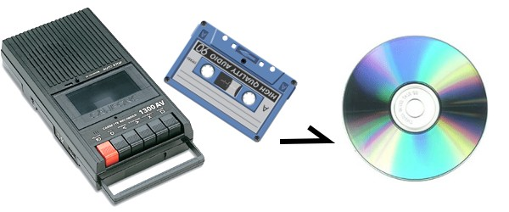
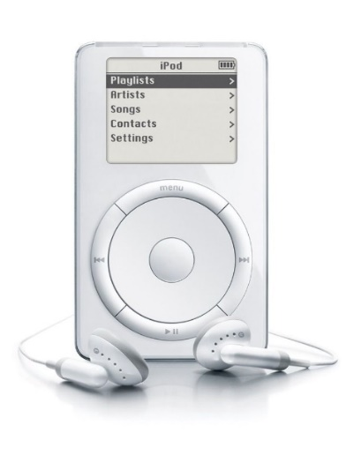
The Role of Information Systems in Business Today (Cont.)
New products, services, and business models
  Business model?
    How company produces, delivers, and sells product or service to create wealth
  Information systems are a major enabling tool to create
    New products
    New services
    Entirely new business models
  Example
    Apple
      Old business model: records, tapes, CDs
      New business model: online, iPad, iTunes

Slide 12


The Role of Information Systems in Business Today (Cont.)
Customer and supplier intimacy
  Serving customers well leads to customers returning
    It raises revenues and profits
    Example
      Personalized services in high-end hotels
        Mandarin Oriental hotel
          Room temperature, lights, music
  Intimacy with suppliers result in lower costs
    It allows them to provide vital inputs
      Example
        JCPenney’s Information System
          Enhances relationship with supplier in Hong Kong
Notes:
acquisition , retention
JCPenney’s -> TAL supplier -> how many, what color shirt

Slide 13

The Role of Information Systems in Business Today (Cont.)
Improved decision making
  Managers do not have the right information at the right time
    Needle in haystack
  Without accurate information:
    They rely on forecasts, best guesses and luck
      Results in:
        Misallocation of resources;
        Poor response times
    Poor outcomes raise costs, lose customers
Real-time data improves ability of managers to make decisions.
  Example: Verizon’s web-based digital dashboard
    Real-time data on customer complaints, network performance, and so on
Notes:
Big data area.

Slide 14
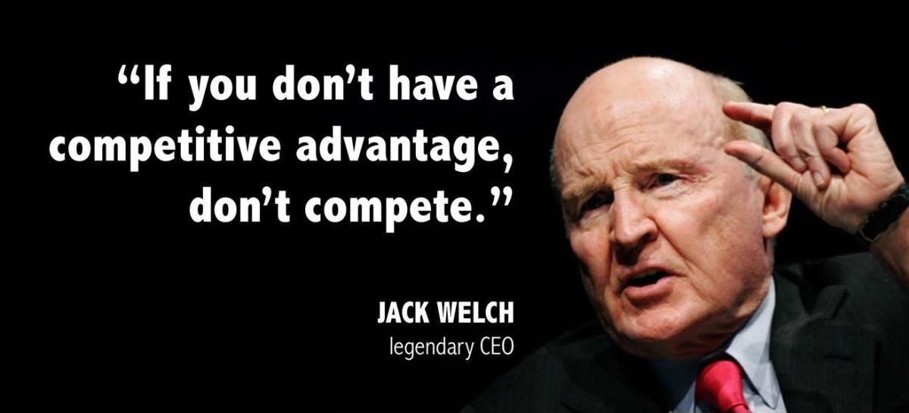
The Role of Information Systems in Business Today (Cont.)
Competitive advantage
  Delivering better performance
  Charging less for superior products
  Responding to customers and suppliers in real time
  Examples
    Industry leaders (i.e., Apple, Walmart, UPS)
      They know how to use information systems for this purpose
  Competitive advantage often results from achieving previous business objectives
Notes:
Electric between 1981 and 2001. During his tenure at GE, the company's value rose 4,00

Slide 15
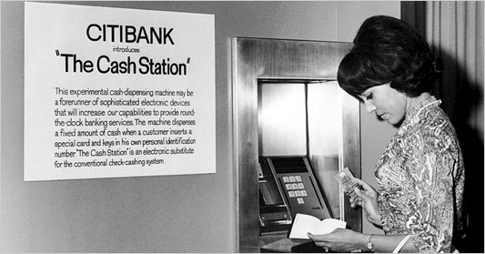
The Role of Information Systems in Business Today (Cont.)
Survival
  Information technologies as necessity of business
  Keeping up with competitors (e.g., industry-level changes)
    Citibank’s introduction of ATMs
  Governmental regulations requiring record-keeping
    Toxic Substances Control Act
    Sarbanes-Oxley Act
    Dodd-Frank Act
Notes:
Exposure of US workers to more than 75000 toxic chemicals, requires firm to retain records for 30 years
Accounting firms to retain papers including emails for 5 years
To strengthen banking regulations to retain records for 10 years

Slide 16
What is an Information System?
Information system
  Set of interrelated components
  Collect, process, store, and distribute information
  Support decision making, coordination, and control
Information technology
    The hardware and software that a firm needs to achieve business objectives
    Hardware and software are technical foundation and tools, similar to the material and tools used to build a house.

Slide 17
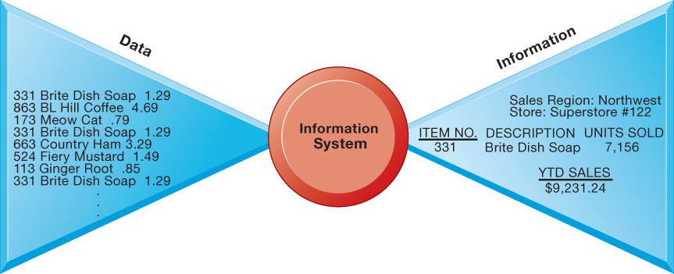
Data and Information
Information vs. data
  Data are streams of raw facts
  Information is data shaped into meaningful form
Notes:
Year to date

Slide 18

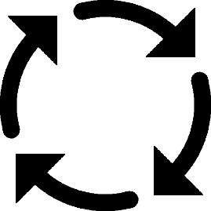


Functions of an Information System
Input
  Raw data or information from organization, external environment or other IS
Processing
  Converts raw data (or one form of information) into more meaningful information
Output
  Information to be supplied to people, activities (or other IS) that use it
Feedback
  Output returned to members of the organization to help them evaluate or correct the input and/or processing

Slide 19
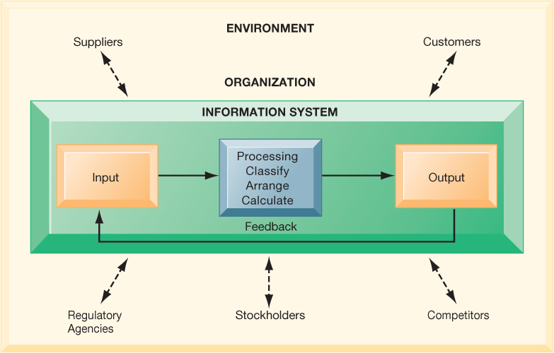
Functions of an Information System (Cont.)

Slide 20
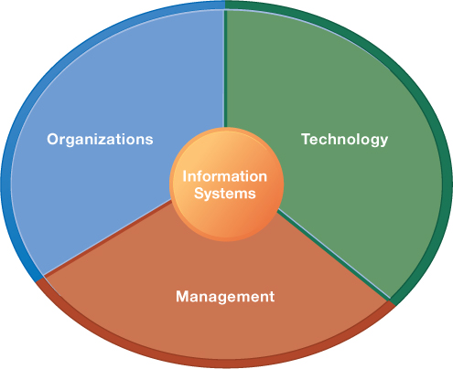
Dimensions of Information Systems
Organization:
  Hierarchy of authority, responsibility; Separation of business functions; Unique business processes; Unique business culture; Organizational politics
Organization:
  Managers set organizational strategy
  Managers must act creatively:
    Creation of new products and services
    Occasionally re-creating the organization
Technology:
  Hardware/software
  Infrastructure
  Data management

Slide 21
It Isn’t Just Technology: A Business Perspective on Information Systems
Information system is instrument for creating value
Investments in information technology will result in superior returns
Business information value chain
  Raw data acquired and transformed through stages that add value to that information
  Value of information system determined in part by extent to which it leads to better decisions, greater efficiency, and higher profits
Business perspective
  Calls attention to organizational and managerial nature of information systems
Notes:
You could ask students to consider how this view of information systems might contrast with the sociotechnical view or other views. You could also ask them to consider the circumstances under which information systems might not result in increased productivity and revenue.

Slide 22
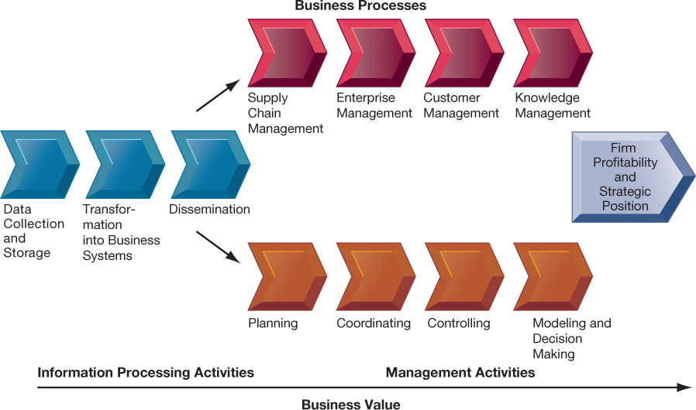
The Business Information Value Chain
Notes:
Figure 1.7, Page 26.
From a business perspective, information systems are part of a series of value-adding activities for acquiring, transforming,
and distributing information that managers can use to improve decision making, enhance organizational
performance, and, ultimately, increase firm profitability.
The information value chain is one way to visualize the relationship among information activities, business processes, and management activities. You could also ask students if they could imagine any reason to create an information system besides profitability or strategic positioning (it’s not likely that they will think of one, which will prove the point). One reason to create a system that is not primarily profit-oriented is to meet the information reporting requirements of government and other authorities.

Slide 23
A Business Perspective on Information Systems (Cont.)
Investing in information technology does not guarantee good returns
  There is considerable variation in the returns firms receive from systems investments
Factors
  Adopting the right business model
  Investing in complementary assets
    Assets required to derive value from a primary investment
      Organizational assets (e.g., efficient business processes)
      Managerial assets (e.g., incentives for management innovation)
      Social assets (e.g., Internet and telecommunications infrastructure)
Notes:
You could ask students to consider how this view of information systems might contrast with the sociotechnical view or other views. You could also ask them to consider the circumstances under which information systems might not result in increased productivity and revenue.

Slide 24
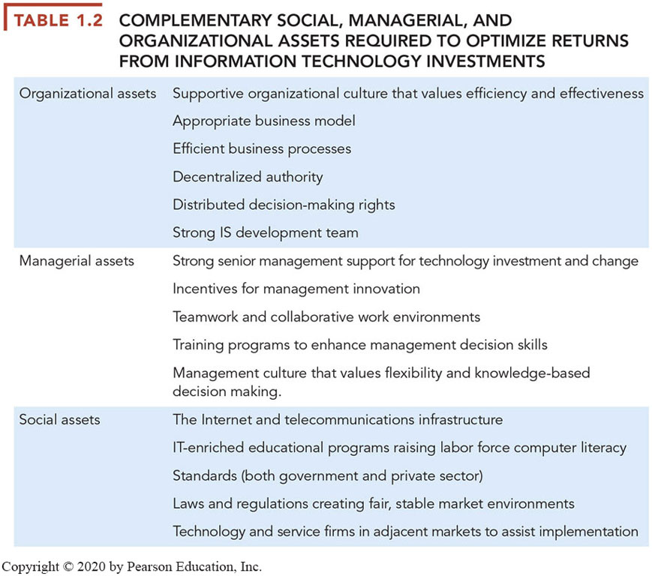
Examples of Complementary Assets

Slide 25
Contemporary Approaches to Information Systems
Technical Approach
  Emphasizes mathematically based models
  The disciplines are
    Computer science, management science, operations research
Behavioral approach
  Behavioral issues (strategic business integration, implementation, etc.)
  The disciplines are
    Psychology, economics, sociology
Approach of our Book/Class: Sociotechnical
  Optimal organizational performance achieved by jointly optimizing both social and technical systems used in production
  Helps avoid purely technological approach
Notes:
Ask students to describe some of the relationships between the four main actors. For example, business firms look to acquire the components of their information systems from suppliers of hardware and software. The firm’s environment may dictate the type of software a company uses as well as the kind of employees that work there.

Slide 26
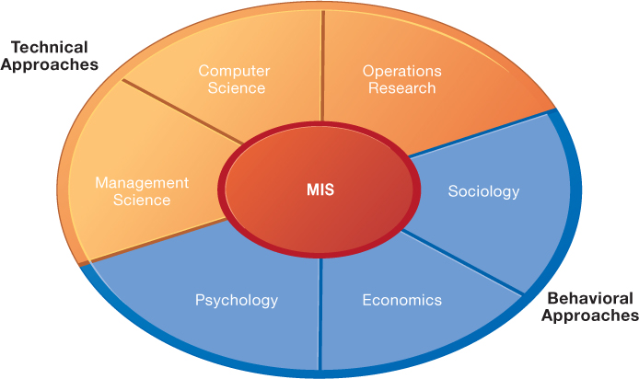
Contemporary Approaches to Information Systems

