Slide 1
Introductory Macroeconomics
Week 8
Basic Macroeconomic Relationships
The Aggregate Expenditures Model

Slide 2
Online Graded Assignments on CONNECT
Due Dates:
Graded Assignment 3: Nov 24 (Sun) at 11:30 p.m.
Graded Assignment 4: Dec 1 (Sun) at 11:30 p.m.
Late submission for Assignments 3 and 4:
20% deduction per day
Graded Assignments 5 and 6: Dec 6 (Fri) at 11:30 p.m.
NO LATE submission for the last two assignments

Slide 3
Basic Macroeconomic Relationships

Slide 4
The Aggregate Expenditures Model
Keynesian model
  the amount of goods & services produced depends directly on the level of total spending
  Assume:
  excess production capacity & unemployed labour
  price level is constant
  downward rigidity of prices/ money wages
  There is a difference between planned and actual levels of expenditures (uncertainty, changes in expectations)
Notes:
4

Slide 5
Keynesian Model
Main Factor which affects total spending: total income
Autonomous Expenditure
Components of expenditure which do NOT change in response to changes in national income
Example: expenditure on basic food consumption
Induced Expenditure
Components of expenditure which change in response to changes in national income
Example: expenditure on luxury goods
Total expenditure = Autonomous E + Induced E

Slide 6
The Aggregate Expenditures Model
Simplifications:
  A private closed economy
    No government
    No taxes
    No exports or imports
  All saving is personal
  Depreciation is zero
  GDP=Disposable income
Notes:
6

Slide 7
Aggregate Expenditure: Private Closed Economy
Aggregate expenditure = Consumption + Investment
  AE = C + I
  Consumption schedule
  Relationship between Consumption & GDP (Income)
  Investment schedule
  Relationship between investment & GDP (Income)

Slide 8
The Income-Consumption &
Income-Saving Relationships
The Consumption Schedule
  Reflects the direct consumption-disposable income relationship
  higher income → higher consumption
The Saving Schedule
  Saving = Income − Consumption
  higher income → higher saving
  Illustrated…
Notes:
8

Slide 9
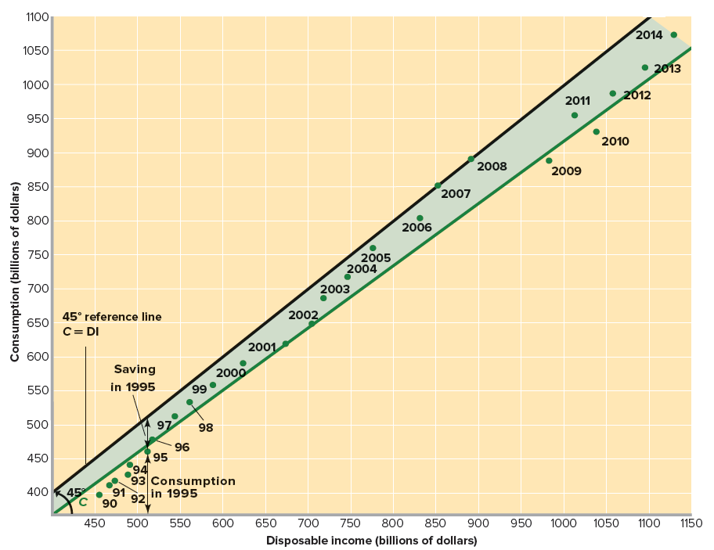
Consumption and Disposable Income, 1992-2014
Higher Income,
Higher Consumption,
More Saving
Notes:
9

Slide 10
Average and Marginal Propensities to Consume and Save
APC + APS = 1
consumption
APC
=
income
saving
APS
=
MPC + MPS = 1
income
change in consumption
MPC
=
change in income
change in saving
MPS
=
change in income
Notes:
10

Slide 11
The Consumption Function
The relationship between total desired consumption expenditure and the factors which affect it
Main factor: disposable income (Y_{d})
C = f (Y_{d})
If assume no taxes, total income = disposable income
Y = Y_{d} ⇒ C = f (Y)
Linear case: C = a + bY
where a and b are positive constants
  a (intercept) is autonomous consumption and bY is induced consumption
  b is the slope which is equal to the change in C when there is a change in Y (MPC)

Slide 12
(1) GDP (=DI) | (2) C | (3) S (1)-(2) | (4) APC (2)/(1) | (5) APS (3)/(1) | (6) MPC Δ(2)/Δ(1) | (7) MPS Δ(3)/Δ(1)
370 | 375
390 | 390
410 | 405
430 | 420
450 | 435
470 | 450
490 | 465
510 | 480
530 | 495
370 - 375 = -5
- 5
375/370 = 1.01
1.01
-5/370 = -.01
-.01
15/20= .75
.25
5/20 = .25
0
1.00
.00
.75
break-even
5
.99
.75
.25
.01
10
.98
.02
.75
.25
15
.97
.03
.75
.25
20
.96
.04
.75
.25
25
.95
.05
.75
.25
30
.94
.06
.75
.25
35
.93
.07
.75
.25
.75
.25
Notes:
12

Slide 13
Graphically presented....
C = Y
S = 0
Consumption
o
0
45
Disposable Income (Y)
Saving
0
Disposable Income (Y)
Notes:
13

Slide 14
Graphically presented....
C = Y
S = 0
C
Consumption
schedule
Consumption
Break-even level
o
45
Disposable Income
Saving
0
390
Disposable Income
Notes:
14

Slide 15
Graphically presented....
SAVING
C
Consumption
schedule
Consumption
MPC = Slope of C
DISSAVING
o
45
Disposable Income
MPS = Slope of S
Saving
schedule
S
Saving
SAVING
0
DISSAVING
390
Disposable Income
Notes:
15

Slide 16
Graphically presented....
MPC = 15/20 = 0.75
C
Consumption
ΔC ($15)
ΔDI ($20)
Disposable Income
MPS = 5/20 = 0.25
S
Saving
ΔS ($5)
ΔDI ($20)
Disposable Income
Notes:
16

Slide 17
Non-Income Determinants of Consumption & Saving
Wealth
  Both real assets and financial assets that household own
  When events increase the value of existing wealth, households increase their spending and decrease their saving
    For example, the stock market boom in the late 1990s → wealth ↑ → C ↑ S ↓
Expectations
  Expectations of rising prices tomorrow trigger more consumer spending and less saving today (C ↑ S ↓)
  Expectations of lower income in the future result in less consumption and more saving today (S ↑ C ↓)

Slide 18
Non-Income Determinants of Consumption & Saving
Real Interest Rates
  When real interest rates fall, households tend to borrow more, consume more and save less ( r ↓ → C↑ S↓ )
Household Debt
  Increased borrowing enables consumers to increase consumption (Debt ↑ → C ↑ S ↓)
  When household debt is getting too high, households may decide to reduce consumption to pay off some of their loans (Repayment of debt → S ↑ C ↓ )
Taxation
  A tax increase (decrease) will reduce (increase) disposable income and reduce (increase) both consumption and saving (Tax ↑ Disposable income ↓ → C ↓ S ↓)

Slide 19
Schedule Shifts
C
Consumption
o
45
Disposable Income
Saving
S
390
Disposable Income

Slide 20
Schedule Shifts
C₁
C
An
increase in
consumption...
Consumption
o
45
Disposable Income
S
Saving
390
Disposable Income

Slide 21
Schedule Shifts
C₁
C
An
increase in
consumption...
Consumption
o
45
Causes a
decrease
in saving
Disposable Income
S
Saving
S₁
Disposable Income

Slide 22
Schedule Shifts
C
C₂
A
decrease in
consumption...
Consumption
o
45
Disposable Income
Saving
S
Disposable Income

Slide 23
Schedule Shifts
C
C₂
A
decrease in
consumption...
Consumption
o
45
Disposable Income
Causes an
increase
in saving
S₂
Saving
S
Disposable Income

Slide 24
The Interest-Rate-Investment Relationship
Investment consists of expenditures on new plants, capital equipment, machinery, inventory
The marginal benefit is the expected rate of return, r
The marginal cost is the real interest rate, i
  i = nominal rate - rate of inflation
  crucial in making investment decisions
Businesses will invest in all projects for which the expected rate of return exceeds the interest rate
r ≥ i
Notes:
24

Slide 25
Expected rate of returns, real interest rates and investment: an example
Investment: infrastructure project:
Cost = $10 million
Revenue expected = $11 million
Profits expected = $1 million
Expected rate of returns = $1 / $10 = 0.1 or 10%
An economy has three investment projects to consider, each worth $10 million
Expected rate of returns of project A, B and C are 10%, 8% and 6% respectively:
 | Real interest rate | Number of projects undertaken | Total Investment
Case 1 | 5 %
Case 2 | 7 %
Case 3 | 9 %

Slide 26
Expected rate of returns, real interest rates and investment: an example
Investment: infrastructure project:
Cost = $10 million
Revenue expected = $11 million
Profits expected = $1 million
Expected rate of returns = $1 / $10 = 0.1 or 10%
An economy has three investment projects to consider, each worth $10 million
Expected rate of returns of project A, B and C are 10%, 8% and 6% respectively:
 | Real interest rate | Number of projects undertaken | Total Investment
Case 1 | 5 % | 3 (A+B+C) | $ 30 million
Case 2 | 7 %
Case 3 | 9 %

Slide 27
Expected rate of returns, real interest rates and investment: an example
Investment: infrastructure project:
Cost = $10 million
Revenue expected = $11 million
Profits expected = $1 million
Expected rate of returns = $1 / $10 = 0.1 or 10%
An economy has three investment projects to consider, each worth $10 million
Expected rate of returns of project A, B and C are 10%, 8% and 6% respectively:
 | Real interest rate | Number of projects undertaken | Total Investment
Case 1 | 5 % | 3 (A+B+C) | $ 30 million
Case 2 | 7 % | 2 (A+B) | $ 20 million
Case 3 | 9 % | 1 (A) | $10 million
Real interest rate and desired investment are inversely related.

Slide 28
Investment
Investment Demand curve
Shows the quantity of investment demanded at each interest rate (“price” of investment)
Investment Schedule
the relationship between investment & GDP
assume planned investment is independent of the level of current disposable income or real output

Slide 29
16
14
12
10
8
6
4
2
0
Expected rate of net profit, r,
and interest rate, i (percent)
Investment
demand curve
ID
5 10 15 20 25 30 35 40
Investment (billions of dollars)

Slide 30
The Investment Schedule
Investment
schedule
Investment (billions of dollars)
20
I_{g}
GDP (billions of dollars)
The level of investment spending ($20 billion) is determined by the real interest rate (8%) together with the investment demand curve ID.
The investment schedule relates the amount of investment at various levels of GDP.

Slide 31
Shifts in the ID Curve
Acquisition, Maintenance & Operating Costs
  When costs fall, the expected rate of return from prospective investment projects rises, shifting the ID to the right
Business Taxes
  An increase in business taxes lowers the expected profitability of investments and shifts the ID to the left
Technological Change
  Development of new products stimulates investment

Slide 32
Shifts in the ID Curve
Stock of Capital Goods on Hand
  When firms have excessive inventories of finished goods, the expected return on new investment declines, shifting the ID to the left
Expectations / Planned Inventory
  Based on forecasts of future business conditions which can be affected by many factors, e.g. political climate, population growth, change in consumer tastes
  A pessimistic outlook will shift ID to the left while an optimistic outlook will shift it to the right
  A firms that expects its sales to double next year will want to keep more inventory in stock, thereby increasing its investment demand

Slide 33
Shifts in ID Curve
Increase in investment demand
Expected rate of net profit, r,
and interest rate, i (percent)
Decrease in investment demand
ID₂
ID₀
ID₁
Investment (billions of dollars)

Slide 34
The Investment Schedule
Investment Schedule will shift up and down, depending on the shifts in Investment demand (ID)
Investment (billions of dollars)
20
I_{g}
GDP (billions of dollars)
The level of investment spending ($20 billion) is determined by the real interest rate (8%) together with the investment demand curve ID.
The investment schedule relates the amount of investment at various levels of GDP.

Slide 35
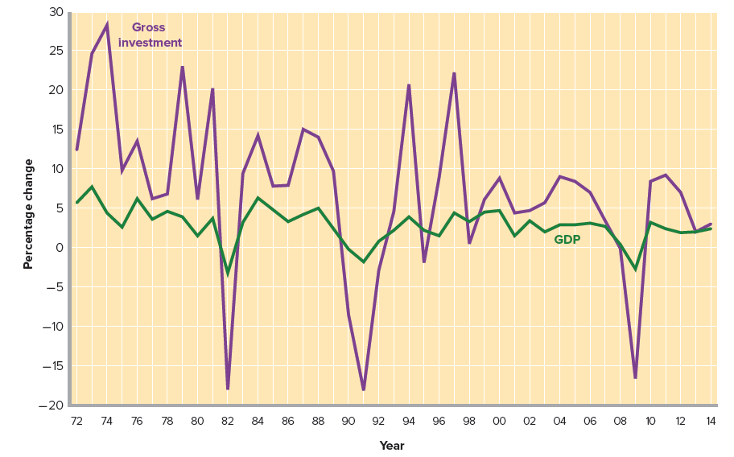
The Volatility of Investment
Investment spending is more volatile than GDP (total production)
Fluctuation of output is most likely related to changes in investment spending.

Slide 36
Fluctuations of Investment
Durability
  Purchase of capital goods are discretionary and can be postponed
Irregularity of Innovation
  Give rise to “waves” of investment spending which in time recedes
  The emergence of personal computers and the Internet led to a surge of investment in those industries and related industries

Slide 37
Fluctuations of Investment
Variability of Profits
  Expanding profits give firms both greater incentives and greater means to invest
  Declining profits have the opposite effects
  Actual profits are themselves highly variable
Variability of Expectations
  Expectations may change quickly when some event suggest possible change in future business conditions, e.g. change in government policies, change in international trade agreements
  Stock market can influence business expectations because it shows the society’s overall confidence

Slide 38
Equilibrium GDP (Private Closed economy)
When the real output (GDP) equals desired aggregate expenditure (C + I)
GDP* = AE
GDP* = C + I
Question: What will happen if GDP ≠ AE?
There will be unplanned change in inventory
→ signal for change in production level (GDP)
Inventory too high → Produce less
Inventory too low → Produce more

Slide 39
Determination of the Equilibrium
levels of Employment, Output and Income
employment (millions) | GDP | C | S | I_{g}
2.5 | 370 | 375 | -5 | 20
5.0 | 390 | 390 | 0 | 20
7.5 | 410 | 405 | 5 | 20
10.0 | 430 | 420 | 10 | 20
12.5 | 450 | 435 | 15 | 20
15.0 | 470 | 450 | 20 | 20
17.5 | 490 | 465 | 25 | 20
20.0 | 510 | 480 | 30 | 20
22.5 | 530 | 495 | 35 | 20
25.0 | 550 | 510 | 40 | 20
I_{g} is $20 billion, no matter what GDP is

Slide 40
Determination of the Equilibrium
levels of Employment, Output and Income
employment (millions) | GDP | C | S | I_{g} | AE
2.5 | 370 | 375 | -5 | 20 | 395
5.0 | 390 | 390 | 0 | 20 | 410
7.5 | 410 | 405 | 5 | 20 | 425
10.0 | 430 | 420 | 10 | 20 | 440
12.5 | 450 | 435 | 15 | 20 | 455
15.0 | 470 | 450 | 20 | 20 | 470
17.5 | 490 | 465 | 25 | 20 | 485
20.0 | 510 | 480 | 30 | 20 | 500
22.5 | 530 | 495 | 35 | 20 | 515
25.0 | 550 | 510 | 40 | 20 | 530
AE = C + I_{g}

Slide 41
Determination of the Equilibrium
levels of Employment, Output and Income
employment (millions) | GDP | C | S | I_{g} | AE | unplanned Δinventories
2.5 | 370 | 375 | -5 | 20 | 395
5.0 | 390 | 390 | 0 | 20 | 410
7.5 | 410 | 405 | 5 | 20 | 425
10.0 | 430 | 420 | 10 | 20 | 440
12.5 | 450 | 435 | 15 | 20 | 455
15.0 | 470 | 450 | 20 | 20 | 470
17.5 | 490 | 465 | 25 | 20 | 485
20.0 | 510 | 480 | 30 | 20 | 500
22.5 | 530 | 495 | 35 | 20 | 515
25.0 | 550 | 510 | 40 | 20 | 530
unplanned
inventory change is the difference between production & AE

Slide 42
Determination of the Equilibrium
levels of Employment, Output and Income
employment (millions) | GDP | C | S | I_{g} | AE | unplanned Δinventories
2.5 | 370 | 375 | -5 | 20 | 395
5.0 | 390 | 390 | 0 | 20 | 410
7.5 | 410 | 405 | 5 | 20 | 425
10.0 | 430 | 420 | 10 | 20 | 440
12.5 | 450 | 435 | 15 | 20 | 455
15.0 | 470 | 450 | 20 | 20 | 470
17.5 | 490 | 465 | 25 | 20 | 485
20.0 | 510 | 480 | 30 | 20 | 500
22.5 | 530 | 495 | 35 | 20 | 515
25.0 | 550 | 510 | 40 | 20 | 530
-25

Slide 43
Determination of the Equilibrium
levels of Employment, Output and Income
employment (millions) | GDP | C | S | I_{g} | AE | unplanned Δinventories
2.5 | 370 | 375 | -5 | 20 | 395 | -25
5.0 | 390 | 390 | 0 | 20 | 410 | -20
7.5 | 410 | 405 | 5 | 20 | 425 | -15
10.0 | 430 | 420 | 10 | 20 | 440 | -10
12.5 | 450 | 435 | 15 | 20 | 455 | -5
15.0 | 470 | 450 | 20 | 20 | 470 | 0
17.5 | 490 | 465 | 25 | 20 | 485 | +5
20.0 | 510 | 480 | 30 | 20 | 500 | +10
22.5 | 530 | 495 | 35 | 20 | 515 | +15
25.0 | 550 | 510 | 40 | 20 | 530 | +20
when inventories run down, production will increase

Slide 44
Determination of the Equilibrium
levels of Employment, Output and Income
employment (millions) | GDP | C | S | I_{g} | AE | unplanned Δinventories | tendency of output
2.5 | 370 | 375 | -5 | 20 | 395 | -25 | increase
5.0 | 390 | 390 | 0 | 20 | 410 | -20
7.5 | 410 | 405 | 5 | 20 | 425 | -15
10.0 | 430 | 420 | 10 | 20 | 440 | -10
12.5 | 450 | 435 | 15 | 20 | 455 | -5
15.0 | 470 | 450 | 20 | 20 | 470 | 0
17.5 | 490 | 465 | 25 | 20 | 485 | +5
20.0 | 510 | 480 | 30 | 20 | 500 | +10
22.5 | 530 | 495 | 35 | 20 | 515 | +15
25.0 | 550 | 510 | 40 | 20 | 530 | +20

Slide 45
Determination of the Equilibrium
levels of Employment, Output and Income
employment (millions) | GDP | C | S | I_{g} | AE | unplanned Δinventories | tendency of output
2.5 | 370 | 375 | -5 | 20 | 395 | -25 | increase
5.0 | 390 | 390 | 0 | 20 | 410 | -20
7.5 | 410 | 405 | 5 | 20 | 425 | -15
10.0 | 430 | 420 | 10 | 20 | 440 | -10
12.5 | 450 | 435 | 15 | 20 | 455 | -5
15.0 | 470 | 450 | 20 | 20 | 470 | 0
17.5 | 490 | 465 | 25 | 20 | 485 | +5
20.0 | 510 | 480 | 30 | 20 | 500 | +10
22.5 | 530 | 495 | 35 | 20 | 515 | +15
25.0 | 550 | 510 | 40 | 20 | 530 | +20

Slide 46
Determination of the Equilibrium
levels of Employment, Output and Income
employment (millions) | GDP | C | S | I_{g} | AE | unplanned Δinventories | tendency of output
2.5 | 370 | 375 | -5 | 20 | 395 | -25 | increase
5.0 | 390 | 390 | 0 | 20 | 410 | -20
7.5 | 410 | 405 | 5 | 20 | 425 | -15
10.0 | 430 | 420 | 10 | 20 | 440 | -10
12.5 | 450 | 435 | 15 | 20 | 455 | -5
15.0 | 470 | 450 | 20 | 20 | 470 | 0
17.5 | 490 | 465 | 25 | 20 | 485 | +5
20.0 | 510 | 480 | 30 | 20 | 500 | +10
22.5 | 530 | 495 | 35 | 20 | 515 | +15
25.0 | 550 | 510 | 40 | 20 | 530 | +20

Slide 47
Determination of the Equilibrium
levels of Employment, Output and Income
employment (millions) | GDP | C | S | I_{g} | AE | unplanned Δinventories | tendency of output
2.5 | 370 | 375 | -5 | 20 | 395 | -25 | increase
5.0 | 390 | 390 | 0 | 20 | 410 | -20
7.5 | 410 | 405 | 5 | 20 | 425 | -15
10.0 | 430 | 420 | 10 | 20 | 440 | -10
12.5 | 450 | 435 | 15 | 20 | 455 | -5
15.0 | 470 | 450 | 20 | 20 | 470 | 0
17.5 | 490 | 465 | 25 | 20 | 485 | +5
20.0 | 510 | 480 | 30 | 20 | 500 | +10
22.5 | 530 | 495 | 35 | 20 | 515 | +15
25.0 | 550 | 510 | 40 | 20 | 530 | +20 | decrease

Slide 48
Determination of the Equilibrium
levels of Employment, Output and Income
employment (millions) | GDP | C | S | I_{g} | AE | unplanned Δinventories | tendency of output
2.5 | 370 | 375 | -5 | 20 | 395 | -25 | increase
5.0 | 390 | 390 | 0 | 20 | 410 | -20 | increase
7.5 | 410 | 405 | 5 | 20 | 425 | -15 | increase
10.0 | 430 | 420 | 10 | 20 | 440 | -10 | increase
12.5 | 450 | 435 | 15 | 20 | 455 | -5 | increase
15.0 | 470 | 450 | 20 | 20 | 470 | 0
17.5 | 490 | 465 | 25 | 20 | 485 | +5 | decrease
20.0 | 510 | 480 | 30 | 20 | 500 | +10 | decrease
22.5 | 530 | 495 | 35 | 20 | 515 | +15 | decrease
25.0 | 550 | 510 | 40 | 20 | 530 | +20 | decrease

Slide 49
Determination of the Equilibrium
levels of Employment, Output and Income
employment (millions) | GDP | C | S | I_{g} | AE | unplanned Δinventories | tendency of output
2.5 | 370 | 375 | -5 | 20 | 395 | -25 | increase
5.0 | 390 | 390 | 0 | 20 | 410 | -20 | increase
7.5 | 410 | 405 | 5 | 20 | 425 | -15 | increase
10.0 | 430 | 420 | 10 | 20 | 440 | -10 | increase
12.5 | 450 | 435 | 15 | 20 | 455 | -5 | increase
15.0 | 470 | 450 | 20 | 20 | 470 | 0 | equilibrium
17.5 | 490 | 465 | 25 | 20 | 485 | +5 | decrease
20.0 | 510 | 480 | 30 | 20 | 500 | +10 | decrease
22.5 | 530 | 495 | 35 | 20 | 515 | +15 | decrease
25.0 | 550 | 510 | 40 | 20 | 530 | +20 | decrease

Slide 50
Equilibrium GDP
530
AE=C + I_{g}
510
Equilibrium point
490
C
470
Aggregate
expenditures
450
I_{g} = $20 billion
Aggregate Expenditure s (billions of dollars)
430
410
390
C = $450 billion
370
45
o
370 390 410 430 450 470 490 510 530 550
Real domestic product, GDP (billions of dollars)

Slide 51
Macroeconomic Equilibrium in a Private Closed Economy
AE = C + I
C = a + bY
AE = (a + bY) + I = (a + I) + bY
Equilibrium (Y* = AE): Y* = (a + I) + bY*
⇒ (1 – b) Y* = (a + I)
⇒ Y* = 1 × (a + I)
(1 – b)
Example: Given: a = 97.5, I = 20, MPC = 0.75
Question: What is equilibrium Y?
Answer: Y* = (1/ (1 – 0.75)) [97.5 + 20]
= 4 x 117.5 = 470

Slide 52
Equilibrium in a private closed economy
Aggregate Expenditures
(AE)
Y = AE
equilibrium
C + I
C
I = 20
a + I
a
C = 450
45º
0
390
470
Real GDP (Y)

Slide 53
Equilibrium in a private closed economy
Aggregate Expenditures
(AE)
Y < AE
Y > AE
AE = C + I
C
a + I
a
45º
0
470
Real GDP (Y)
Y = AE

Slide 54
Equilibrium GDP: Summary
The equilibrium output is that output the production of which creates total spending just sufficient to purchase that output
  No overproduction or underproduction
  No draw down or piling up of inventories
No Unplanned Changes in Inventories
  changes in inventories are a part of investment
  when unplanned changes in inventories are considered, investment & savings are always equal, at any level of GDP
Savings Equals Planned Investment
  saving represents a leakage of spending
  investment can be thought of as an injection of spending
  Y* = AE
  C + S = C + I
  S = I
Notes:
54

Slide 55
Circular Flows: Leakages and Injections
INCOME
$
HOUSEHOLDS
FIRMS
Leakages
$
Consumption Expenditure
$
Injection
$
SAVING
INVESTMENT
FINANCIAL SYSTEM

Slide 56
Equilibrium GDP (Private Closed economy)
At equilibrium, Y* = AE
Y* = AE = C + I
Y* = C + S
Therefore, when Y* = AE, S = I
 |  | Unplanned Change in inventory | Change in Y
Y* = AE | S = I | No | No
Y > AE | S > I
Y < AE | S < I

Slide 57
Equilibrium GDP (Private Closed economy)
At equilibrium, Y* = AE
Y* = AE = C + I
Y* = C + S
Therefore, Y* − C = S = I
 |  | Unplanned Change in inventory | Change in Y
Y = AE | S = I | No | No
Y > AE Over-production | S > I | ↑ | ↓
Y < AE | S < I

Slide 58
Equilibrium GDP (Private Closed economy)
At equilibrium, Y* = AE
Y* = AE = C + I
Y* = C + S
Therefore, Y* − C = S = I
 |  | Unplanned Change in inventory | Change in Y
Y = AE | S = I | No | No
Y > AE | S > I | ↑ | ↓
Y < AE Under-production | S < I | ↓ | ↑

Slide 59
Determination of the Equilibrium
levels of Employment, Output and Income
employment (millions) | GDP | C | S | I_{g} | AE | unplanned Δinventories | tendency of output
2.5 | 370 | 375 | -5 | 20 | 395 | -25 | increase
5.0 | 390 | 390 | 0 | 20 | 410 | -20 | increase
7.5 | 410 | 405 | 5 | 20 | 425 | -15 | increase
10.0 | 430 | 420 | 10 | 20 | 440 | -10 | increase
12.5 | 450 | 435 | 15 | 20 | 455 | -5 | increase
15.0 | 470 | 450 | 20 | 20 | 470 | 0 | equilibrium
17.5 | 490 | 465 | 25 | 20 | 485 | +5 | decrease
20.0 | 510 | 480 | 30 | 20 | 500 | +10 | decrease
22.5 | 530 | 495 | 35 | 20 | 515 | +15 | decrease
25.0 | 550 | 510 | 40 | 20 | 530 | +20 | decrease
Actual investment = planned investment + unplanned changes in inventories = S

Slide 60
Equilibrium in a private closed economy
Saving or Investment
equilibrium
S
I
I = 20
0
390
470
Real GDP (Y)

Slide 61
Equilibrium National Income
(Closed economy with no government)
Changes in national income
Movements along the AE curve
Movements along the desired saving line
Changes in equilibrium national income
Due to shifts in the AE curve
Due to shifts in the desired saving and investment

Slide 62
Changes in Equilibrium GDP & the Multiplier
Question: What factors can cause the shift?
The “Initial Change in Spending”
- associated with investment spending because of investment’s volatility
- associated with investment spending results from either a change in the real interest rate or a shift of the ID curve (factors other than real interest rate)
There is a direct relationship between changes in spending and changes in real GDP
Initial changes in spending will set off a spending chain, producing magnified changes in output and income

Slide 63
Changes in Equilibrium GDP & the Multiplier
a $5 billion increase of investment will shift the AE schedule upward
  equilibrium GDP will rise from $470 billion to $490 billion (an increase of more than $5 billion)
  I ↑ < Y* ↑
a $5 billion decrease of investment will shift the AE schedule downward
  equilibrium GDP will fall from $470 billion to $450 billion (an decrease of more than $5 billion)
  I ↓ < Y* ↓

Slide 64
Changes in Equilibrium GDP and the Multiplier
(C + I_{g} ) ₁
490
+5
(C + I_{g} ) ₀
470
(C + I_{g} ) ₂
Aggregate expenditures
(billions of dollars)
450
-5
+20
-20
430
o
45
o
430 450 470 490 510
Real domestic product, GDP (billions of dollars)
Through a multiplier effect, an initial change in investment spending can cause a magnified change in domestic output

Slide 65
The Multiplier Effect
Multiplier
- the ratio of a change in the equilibrium GDP to the change in investment
Multiplier = Changes in equilibrium GDP
initial change in spending
In the example, multiplier = 20 / 5 = 4
Changes in equilibrium GDP
= multiplier x initial change in spending
Notes:
65

Slide 66
The Multiplier Effect: rationale
Spending generates income
One person’s spending is another person’s income
Change in income will cause both consumption & saving to change (change in induced expenditure)
More spending generates the next round of income changes
As long people spend some or all of the extra income, there will be many rounds of income generation
Notes:
66

Slide 67
 | (1) Δ income | (2) Δ C (MPC=.75) | (3) Δ S (MPS=.25)
I_{g} increases $5 | $5.00 | $3.75 | $1.25
2nd round
3rd round
4th round
5th round
All other rounds
Total

Slide 68
 | (1) Δ income | (2) Δ C (MPC=.75) | (3) Δ S (MPS=.25)
I_{g} increases $5 | $5.00 | $3.75 | $1.25
2nd round | 3.75
3rd round
4th round
5th round
All other rounds
Total

Slide 69
 | (1) Δ income | (2) Δ C (MPC=.75) | (3) Δ S (MPS=.25)
I_{g} increases $5 | $5.00 | $3.75 | $1.25
2nd round | 3.75 | 2.81 | 0.94
3rd round
4th round
5th round
All other rounds
Total

Slide 70
 | (1) Δ income | (2) Δ C (MPC=.75) | (3) Δ S (MPS=.25)
I_{g} increases $5 | $5.00 | $3.75 | $1.25
2nd round | 3.75 | 2.81 | 0.94
3rd round | 2.81 | 2.11 | 0.70
4th round | 2.11 | 1.58 | 0.53
5th round | 1.58 | 1.19 | 0.39
All other rounds | 4.75 | 3.56 | 1.19
Total | $20.00 | $15.00 | $5.00

Slide 71
The Multiplier Process (MPC=.75)
All
other
ΔI = $5 billion

Slide 72
 | (1) Δ income | (2) Δ C (MPC=b=0.75) | (3) Δ S (MPS=1–b= 0.25)
I_{g} increases by x | x | bx | (1-b) x
2nd round
3rd round
4th round
5th round
All other rounds
Total
bx
b (bx)
(1-b) (bx)
b²x

Slide 73
 | (1) Δ income | (2) Δ C (MPC=b=0.75) | (3) Δ S (MPS=1–b= 0.25)
I_{g} increases by x | x | bx | (1-b) x
2nd round | b x | b² x | (1-b) b x
3rd round | b²x | b³ x | (1-b) b²x
4th round | b³x | b⁴x | (1-b) b³x
5th round | b⁴x | b⁵x | (1-b) b⁴x
All other rounds | ….. | ….. | ……
Total | x / (1-b) | bx / (1-b) | (1-b)x / (1-b)
∆Y* = x [ 1 + b + b² + b³ + …..+ b^{n} ] = x [ 1 ]
1 – b
Multiplier = ∆Y / x = 1
1 - b

Slide 74
The Multiplier Effect
How large is the actual multiplier effect?
actual multiplier: 1 ÷ (fraction of change in income that is not spent on domestic output)
Multiplier = 1
1 – b
In reality, consumption of domestic output increases in each round by a lesser amount than implied by MPS alone
  imports & taxes

Slide 75
 | (1) Δ income | (2) Δ Induced expenditure (z = 0.75) | (3) Δ Leakages (1 – z = 0.25)
I_{g} increases by x | x | zx | (1-z) x
2nd round | z x | z² x | (1-z) z x
3rd round | z²x | z³ x | (1-z) z²x
4th round | z³x | z⁴x | (1-z) z³x
5th round | z⁴x | z⁵x | (1-z) z⁴x
All other rounds | ….. | ….. | ……
Total | x / (1-z) | zx / (1-z) | (1-z)x / (1-z)

Slide 76
The Size of the Multiplier
The Multiplier and the Slope of the AE Curve (z)
  The slope of the AE curve (marginal propensity to spend out of extra income) determines the magnitude of the multiplier:
  Multiplier = 1 ÷ (1 – Slope of AE curve) = 1
  1 – z
Why Is the Multiplier Greater than 1?
  The multiplier is greater than 1 because an increase in autonomous expenditure induces further increases in other induced expenditure
  Slope of AE < 1 ⇒ (1 – z ) < 1 ⇒ 1/(1 – z) > 1
Notes:
76

Slide 77
Equilibrium in an Closed Economy
Slope of AE
AE = A + z Y
At Equilibrium: Y* = AE
Y* = A + z Y*
Y* - z Y* = A
(1 – z) Y* = A
Y* = 1 × (A)
1 - z
Y* = [Multiplier] x [Autonomous Spending]
ΔY* = [Multiplier] x Δ [Autonomous Spending]
Autonomous spending
Autonomous spending
Multiplier

Slide 78
Numerical Example
Given the following data:
Question: What is the equation for AE?
Answer: AE = 40 + (80/100)Y = 40 + 0.8Y
Question: What is the equilibrium level of Y?
Answer: Y* = (1 / (1 − 0.8)) × (40) = 5 × 40 = 200
Y | AE
0 | 40
100 | 120
Slope of AE = 80/100
= 0.8
+100
+80
200
=
200
Equilibrium

Slide 79
The Multiplier
In the textbook example, the slope of the AE curve is 0.75, so the multiplier is
ΔY ÷ ΔA = 1 ÷ (1 − 0.75) = 1 ÷ (0.25) = 4
When there are no income taxes and no imports, the slope of the AE curve equals the marginal propensity to consume, so the multiplier is
Multiplier = 1 ÷ (1 − MPC)
But 1 – MPC = MPS, so the multiplier is also
Multiplier = 1 ÷ MPS

Slide 80
The Multiplier
MPC & the multiplier are directly related
MPS & the multiplier are inversely related
1
1
Multiplier
=
OR
MPS
1 - MPC

Slide 81
The MPC & the Multiplier
.9
10
.8
5
.75
4
.67
3
.5
2
The larger the MPC (& the smaller the MPS), the greater the size of the multiplier

Slide 82
AN ECONOMY
WITH TRADE

Slide 83
International Trade & Equilibrium Output
Net Exports & Aggregate Expenditures
  exports (X) create domestic production, income & employment
  imports (M) represent goods & services produced abroad
in an open economy, aggregate spending is C+I_{g}+X_{n}, where X_{n}=(X-M)

Slide 84
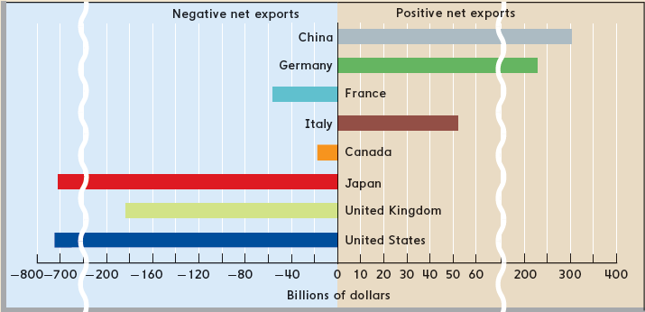
Net Exports of Goods, Selected Nations, 2014
Source: CIA World Factbook, www.cia.gov
In 2014, some countries had trade surpluses (positive net exports) and some had trade deficits (negative net exports).

Slide 85
The Net Export Function
Net Export (trade surplus / deficit)
= Exports – Imports = X – M
Exports: autonomous expenditure
Demand depends on foreign income
  if GDP in other countries is growing, demand for our exports will increase
Imports: induced expenditure
Demand depends on domestic income (GDP)
Net Export Function: X_{n} = f (Y)
Y ↑, imports ↑, X_{n} ↓
Y ↓, imports ↓, X_{n} ↑

Slide 86
Imports and the Multiplier
Imports: another form of leakages
Leakages in an open economy: Saving + Imports
Marginal Propensity to Import (MPM)
MPM = ΔM (import) / ΔGDP
Open Economy Multiplier: 1
MPS + MPM

Slide 87
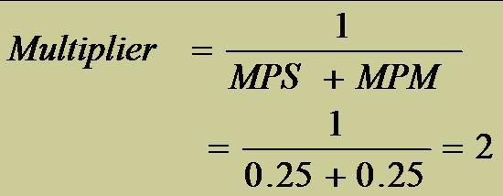
Net Export Schedule
GDP GDP = DI | Export (X) | Import (M) | Net Export X_{n} = X - M | MPM ΔM/ΔGDP
370 | 40 | 15
390 | 40 | 20
410 | 40 | 25
430 | 40 | 30
450 | 40 | 35
470 | 40 | 40
490 | 40 | 45
40–15=25
20-15
390-370
20
15
0.25
10
0.25
5
0.25
0
0.25
-5
0.25

