Slide 1
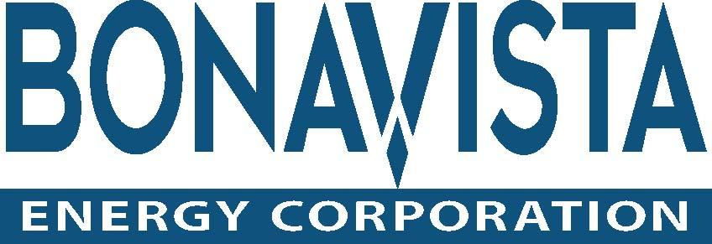
Mary Valair, Jordan Stewart, Alison Rumsey, Farzad Raeisifard

Slide 2
Bonavista: An Overview
Oil and gas company
Based in Calgary
Founded in 1977
Focused on strategies that focus on long term profitability.
Return on equity of over 35%.
In July 2003 converted into an energy trust
One of Canada's largest dividend paying energy companies

Slide 3
One of Canada's largest dividend paying energy companies
Market capitalization of approximately $3.0 billion CDN
Trades on the Toronto Stock Exchange under the symbol of BNP.
Currently producing 74,500 barrels of oil (boe) per day
Current monthly dividends of $0.12 per share are generated

Slide 4
Horizontal Analysis
Statement of Income | 2010 | 2011
Revenue | 100% | 111%
Expenses | 100% | 119%
Net income before taxes | 100% | 274%
Income Taxes | 100% | 508%
Net income | 100% | 167%
Statement of Financial Position | 2010 | 2010 (2) | 2011
Current Assets | 100% | 107% | 112%
Non-Current Assets | 100% | 112% | 128%
Current Liabilities | 100% | 31% | 29%
Non-Current Liabilities | 100% | 111% | 137%
Shareholders Equity | 100% | 164% | 179%

Slide 5
Vertical Analysis
Statement of Financial Position | 2010 | 2011
Assets
Current | 5 | 5
Non Current | 95 | 95
Liabilities
Current | 6 | 5
Non Current | 40 | 44
Unitholders' Equity | 54 | 51
Income Statement | 2008 | 2009 | 2010 | 2011
Revenue | 100 | 100 | 100 | 100
Expenses | 53 | 91 | 65 | 71
Income before taxes | 47 | 9 | 35 | 29
Deferred Income Taxes (Recovery) | 5 | -8 | -1 | 6
Net and Comprehensive Income | 42 | 17 | 36 | 23

Slide 6
Total Asset Turnover
Sales Revenue/Total Assets
The measurement of how well a company is using it's assets to generate revenue.
Bonavista year ending 2011 (used for all calculations)
882,672 (Sales)
3,924,160 (Total Assets) = 0.22493 =22.49%
Used to find certain assets that are not being used to their full potential
Example: A piece of equipment was recorded as an asset but was never used. It would not be contributing to sales and therefore would be driving this ratio even lower.

Slide 7
Current Ratio
Current assets/current liabilities
Shows the company's ability to pay back its short-term liabilities with its short-term assets
$156,842 (Current Assets)
$207,952 (Current Liabilities) = 0.77663
The higher the current ratio, the more capable the company is of paying its liabilities.
A ratio under 1 suggests that the company would be unable to pay off its obligations at the time
Under 1 would not predict bankrupcy
Gives a sense of the efficiency of a company's operating cycle or its ability to turn its product into cash
Similar to the acid-test ratio except includes inventory and prepaid assets that can be liquidated

Slide 8
Debt on Equity
Total Liabilities/Shareholder's Equity
Allows us to see what proportion of equity to debt the company is using to finance it's assets
$1,922,358 (Total Liabilities)
$2,001,802 (Shareholders’ Equity) = 0.96031 = 96.03%
The lower this ratio is the better
The average D/E ratio for the energy industry is about 16%
Bonavista's D/E ratio is 96% meaning they have similar amounts of debt and equity to finance their assets
This suggests agressiveness in spending

Slide 9
Return on Sales
Net Income (before interest and tax)/Sales
Indicates how much of the sales from the company is actually being turned into net income by the end of the fiscal period
$194,333 (Net Income before interest and tax)
$882,672 (Sales) = 0.22016 = 22.02%
This ratio can be used after expenses, taxes, ect.
Trending it with the ratio from previous years can find more efficient ways of using revenue.

Slide 10
Return on Equity
Net Income/Shareholders’ Equity
Shows how well the company is using it's capital to create income
$ 137,184 (Net Income)
$2,001,802 (Shareholders’ Equity) = 0.06853 = 6.85%
Allows investors to check and see how well a company is being managed
The higher this ratio is the more income is being generated using capital

Slide 11
Acid Test
Cash + A/R + Short-term Investments / Current Liabilities
(no cash in the company)
Similar to the current ratio except Inventory, Supplies, and Prepaid Expenses are not included
Compares the total cash, temporary marketable securities, and accounts receivable to the total current liabilities
$133,324 (Cash + A/R + Short-term Investments)
$ 207,952 (Current Liabilities) = 0.64113
The larger the acid test ratio the more easily the company will meet its current financial obligations
The acid test ratio is also known as the quick ratio

Slide 12
Invest?
Profit Margins
Net and comprehensive income has dropped dramatically due to the financial crisis in 2008
It is on the rise but other factors must be considered to determine if this is sustainable growth
One sign that it is not is the high ratio of liabilities to shareholders‘ equity
Year | 2008 | 2009 | 2010 | 2011
Revenue | 1,034,879. | 628,560. | 815,063. | 887,503.
Expenses | 547,062. | 574,581. | 531,139. | 632,751.
Income before taxes | 487,817. | 53,979. | 71,035. | 194,333.
Deferred Income Taxes (Recovery) | 49,451. | -52,627 | -11,253 | 57,149.
Net and Comprehensive Income | 438,366. | 106,606. | 82,288. | 137,184.

Slide 13
Invest?
Management and Future Prospects
Pros
Revenue is going up
Cons
Non-current liabilities are increasing
Current ratio below 1 and non-current liabilities increasing means a lot of debt to pay off
The company is not liquid
Current assets are very small compared to non-current assets
Not able to pay off current liabilities in full
Return on Equity is lower than the range for a healthy company (10-25%) as stated by Reuters
Could be a reflection of management problems

Slide 14
Invest?
Explaination
Stock is undervalued because it is being hammered down by poor market sentiment
The 4 year trend shows it really follows the markets movement
A successful company would be showing continuous profits and growth
It is paying a good dividend
Can convert oil reserves to cash
We recommend investment

