Slide 1
Session 8
Investment and financial markets

Slide 2
Outline
Investment decisions: micro-level
Financial intermediaries
Monetary policy
Foreign investment
Microfinance

Slide 3
Investment and financial markets

Slide 4
What is investment?
Investment is bearing costs today in the hope of reaping benefits in the future, typically with some risk attached.
The way investment bears returns is by creating, purchasing, maintaining or improving the mobilization of assets.

Slide 5
Why study investment decisions?
The study of investment decisions and financial markets is crucial in development economics.
  Growth requires investment.
  People make development possible when they choose to invest.
  The forces that determine who invests, how much they invest, and what kinds of investment they undertake determine the rate of economic growth and the character of development.
Some of those forces operate through financial markets.
The concept of liquidity constraints (or financial constraints more generally)
The possible existence of liquidity constraints and insurance constraints could partially explain why poor households may be less likely than non-poor households to:
  use some kinds of infrastructure services, to send their children to school,
  to adopt new agricultural technologies,
  to purchase long-lasting health inputs,
  etc.

Slide 6
Why study investment decisions?
Growth requires diverse investments:
  many kinds of investment undertaken by many kinds of investors.
  The assets in which people must invest for growth and development include machines, vehicles, roads, well, schooling, job training, new methods of growing corn, and insecticide-treated bed nets, among others.
    farmers and nonfarm entrepreneurs invest in equipment, structures, training, and new technologies
    workers invest in education and migration.
    collective investments in transport, communication, and power infrastructure
Investments (of specific sorts) can generate increases in demands for labor, and increases in supply and development of markets, which may spread the benefits of growth to many people.
Many policy challenges involve finding effective and low-cost ways to get households, firms or communities to undertake investment.

Slide 7
Basic investment decision framework

Slide 8
Basic investment decision framework: overview
Investment decisions are more complicated than the decisions regarding consumption, time allocation, and production in two ways:
  They require “intertemporal comparisons”, or comparisons of costs and benefits that are spread out over multiple time periods. More specifically, they involve comparison of present costs to future benefits.
  They involve risk or uncertainty. This means that the size of benefit that an investment will ultimately deliver depends on factors that are beyond the investor’s control and are unknown at the time of the investment decision.

Slide 9
Basic investment decision framework: overview
Under what conditions will a particular investor choose to undertake a particular investment project?
The investor must:
  be aware of the investment opportunity, and
  perceive that the expected benefits outweigh the costs, where
    the expected benefits include all immediate and average future improvements in income or well-being, and
    The costs include up-front and on-going direct costs, and costs associated with financing and risk.

Slide 10
Basic framework: financing concerns
Understanding how the need to finance causes investors to weigh each dollar of present cost more heavily than each dollar of future benefit is a key point.
Investors have three methods for immediate financing of investments.
  Financing by borrowing
  Financing by liquidating assets (drawing down past savings)
  Financing by saving out of current income
  Consider an investment on which the investor must spend C in cost today and which pays the investor a return of R next period.

Slide 11
Basic framework: financing concerns
  If an investor finances by borrowing at an interest rate of r^{b} per period:
    she does not have to alter consumption in the present
    she receives R in return next period and pays off C(1+r^{b}) next period
    so she compares R to C(1+r^{b})

Slide 12
Basic framework: financing concerns
  If she finances by drawing down savings that would otherwise pay interest at the rate r^{s},
    she does not have to alter consumption in the present
    she receives R in return next period
    she takes C out of savings in the first period, meaning she has C(1+r^{s}) less from savings to spend next period
    so she compares R to C(1+r^{s})
    r^{s} is the opportunity cost of the funds

Slide 13
Basic framework: financing concerns
  If she finances by saving out of current income
    she must cut current consumption by C
    she receives R in return next period
    she compares R in one period to C today, and current C weighs more because:
      she discounts the future
      her utility is characterized by diminishing marginal utility (and investment would make future consumption higher than current consumption)

Slide 14
Standard model of inter-temporal choice: Comparing financing options
To summarize:
If she finances by borrowing, she compares R to C(1+r^{b})
If she finances by liquidating past savings, she compares R to C(1+r^{s})
If she finances by saving out of current income, she compares R to C(1+rª),
    where rª is a term we could calculate that reflects the cost of delaying consumption (and incorporates the effects of discounting and diminishing single-period utility)
To pick the best financing option, an investor compares r^{b}, r^{s} and rª and picks the option associated with the lowest one of these.
She invests if, when using the best available financing option, her overall utility is higher if she invests than if she does not invest.

Slide 15
Standard model of inter-temporal choice: Implications thus far
The investor is more likely to invest if she:
  has better access to loans
  faces loans at lower interest rates
  has more assets to draw down
  is earning less on her other assets (reducing the opportunity cost of foregone interest)
  discounts the future less heavily

Slide 16
Standard model of inter-temporal choice: Implications thus far
We see that the poor tend to face worse financing options, because they:
  have fewer assets to draw down,
  are consuming at low levels (and therefore probably face a high cost of delaying consumption),
  and face inferior borrowing options
This means that:
  they weigh present costs more heavily relative to future returns than non-poor people, and
  they might (rationally) choose not to undertake investments that are every bit as profitable as investments undertaken by non-poor people.

Slide 17
Standard model of inter-temporal choice: assumptions
The decision maker seeks to maximize
  U(F₀, F₂, …, F_{T}) = u(F₀) + βu(F₁) + β²u(F₂) + … + β^{T}u(F_{T})
  where
  u(.) is a “single period utility function”, used to evaluate within-period utility in any period
  F_{j} is what the decision maker will consume in time period j
  β is a “discount factor” between 0 and 1

Slide 18
Standard model of inter-temporal choice: Investment financing options and choices
Suppose:
  In the status quo (i.e. not investing; SQ), the decision maker consumes Y in period 0 and Y again in all future periods.
  Undertaking an investment costs C in period 0 and returns R in period 1.

Slide 19
Standard model of inter-temporal choice: Financing by saving out of current income
If the potential investor plans to finance the investment by saving out of current income (IS), she must reduce period 0 consumption to free up cash for covering the investment cost.
She compares
  U^{IS} = u(Y-C) + βu(Y+R)
  to
  U^{SQ}= u(Y) + βu(Y)
  and invests if U^{IS} > U^{SQ}.
She weighs each dollar of cost more heavily than each dollar of return because
  she discounts the future, and because
  Y+R > Y-C and her u(.) exhibits diminishing marginal utility.

Slide 20
Standard model of inter-temporal choice: Financing by borrowing
If the potential investor plans to finance the investment by borrowing (IB), she does not have to reduce current consumption but must pay the loan back with interest.
She compares
  U^{IB} = u(Y) + βu(Y+R-C(1+r^{b}))
  to
  U^{SQ}= u(Y) + βu(Y)
  and invests while financing out of current income if U^{IB} > U^{SQ}.
She weighs each dollar of cost more heavily than each dollar of return because
  she must pay interest on the loan required to cover the cost up front.

Slide 21
Standard model of inter-temporal choice: Financing by drawing down savings
If the potential investor plans to finance the investment by drawing down savings (or liquidating other assets; IA), she does not have to reduce current consumption but loses the interest she would have earned on the savings.
She compares
  U^{IA} = u(Y) + βu(Y+R-C(1+r^{s}))
  to
  U^{SQ}= u(Y) + βu(Y)
  and invests while financing out of current income if U^{IA} > U^{SQ}.
She weighs each dollar of cost more heavily than each dollar of return because
  she must “pay” the opportunity cost of forgone interest receipts.

Slide 22
Standard model of inter-temporal choice: Financing by drawing down savings
To summarize, the comparison will be among:
  U^{SQ}= u(Y) + βu(Y)
  U^{IS} = u(Y-C) + βu(Y+R)
  U^{IB} = u(Y) + βu(Y+R-C(1+r^{b}))
  U^{IA} = u(Y) + βu(Y+R-C(1+r^{s}))

Slide 23
Investment and risk

Slide 24
Basic framework: “costs associated with risk”
What is risk and why might investors perceive investments as risky?
  Investments might be risky because they have physical returns that depend on uncertain factors like weather, because the value of the physical returns fluctuates with uncertain market prices, because the physical returns differ across circumstances and the potential investors are uncertain about how good or bad their circumstances are.
What do we mean when we say that people are risk averse?
  They are willing to take some reduction in average future income if it buys them enough reduction in the risk to which they are exposed.
  Risk is potential for fluctuation above or below the average; and the fluctuations matter because fluctuation downward “hurts” more than fluctuation above the average “helps,” so people want to avoid those downward fluctuations.

Slide 25
Basic framework: “costs associated with risk”
If an investment increases risk, we can think of the associated reduction in utility as a cost of the investment
  (much like the cost of having to delay consumption).
This utility cost associated with risk tends to increase as
  the probability of shocks that cause fluctuations increases.
  the severity of the effects of shocks increases.
  the potential investor’s degree of risk aversion increases.

Slide 26
Basic framework: “costs associated with risk”
If investors had access to appropriate insurance, then they might be able to convert the cost associated with risk into another form and perhaps reduce the cost associated with risk.
  The availability of insurance for purchase might reduce the cost of risk to a potential investor.
An insurance contract promises to pay the buyer specified payments in the event of specified hazards.
  When investors can purchase appropriate insurance, they become capable of investing in risky projects without exposing themselves to severe reductions in consumption when hit by bad shocks, and they might thus become more willing to undertake risky investments.
Unfortunately, insurance markets, too, do not always work very well, especially for poor clients. Often they do not exist at all.

Slide 27
Standard model of choices involving risk: risk aversion
If investors are risk averse, they may give up the chance to raise their expected return (i.e. the average of the returns across possible states of the world) in order to avoid increasing the variability of returns to which they are exposed.
This is of concern to development economists because it means that potential investors who cannot protect themselves against risk may choose not to undertake investments that could help raise them out of poverty.

Slide 28
Financial Markets

Slide 29
Financial markets
Because investments produce returns only after some delay and are risky, financial markets - markets for credit, savings-deposit services, and insurance - have important roles to play in facilitating investment.
The market for loanable funds is also a vehicle for mutually beneficial exchange between households experiencing unusually high income, who wish to save, and those experiencing unusually low income, who wish to borrow or draw down savings.
  Households can smooth consumption in the face of income fluctuations by saving when income is high and drawing down savings when income is low, or by borrowing when income is low and repaying the debt when income is high.

Slide 30
Financial markets
Basic functions:
  Channeling funds from savers to investors and people who wish to borrow for other reasons (markets for loanable funds)
  Increasing asset liquidity
  Reducing transfer costs in goods and labor markets (checking account and mobile money services)
  Pricing, transferring and pooling risks (insurance markets)
  Generating/distributing information
In developed countries, financial intermediaries are able to mobilize private savings and efficiently allocate them to their most productive uses.

Slide 31
Suggestive evidence of financial market malfunctions in developing countries
Unfortunately, high transaction costs and deeper market failures appear to prevent financial markets in developing countries from fulfilling their developmental potential.
Markets and financial institutions in many developing countries are highly unorganized, often externally dependent, and spatially fragmented.
Many commercial banks in developing countries are overseas branches of major private banking corporations in developed countries.
  Their orientation (like that of multinational corporations) may be more toward external and less toward internal monetary situations.
Because of limited information and incomplete credit markets, the commercial banking system of many developing countries lacks “transparency”.
Financial market weakness might impose financial constraints on some potential investors, which prevent them from undertaking valuable investments.

Slide 32
Suggestive evidence of financial market malfunctions in developing countries
Studies suggest that financial markets do not fulfill their developmental potential in developing countries:
  In developed countries:
    Almost everyone has a loan (mortgage, credit card loan, student loan, etc.), mostly from formal financial institutions.
    The interest rates in developing countries are relatively low (28% for credit cards; 2-5% per year for mortgage)
  In developing countries:
    Financial markets serve smaller fractions of the population, especially among the poor (10% to 90% of the population)
    Use of formal financial services is especially low among the poor in developing countries.
    They have unattractive terms on informal financial services.
    The interest rates are very high, sometimes 5% per day.

Slide 33
Financial market failures
Even after financial market participants have put resources into improving information and trust (incurring transfer costs), financial markets will still be characterized by asymmetric information.
  One party to a transaction knows more about the quality of the product being exchanged than the other.
  e.g. a borrower knows more about the quality of his investment and work effort than does the lender
  e.g. the insurance buyer knows more about her probability of being hit by a covered shock than does the insurer
Asymmetric information is a source of market failure that can cause valuable markets to disappear or to be characterized by rationing (i.e. offer fewer financial services than are demanded at going interest rates).

Slide 34
Financial market failures
Two types of asymmetric information might lead to failure in credit markets:
  In the case of adverse selection, the lender knows less about the quality of the investment project and investor than the borrower does.
    The lender cannot protect against the “adverse selection” of poor risks into the market.
  In the case of moral hazard, the lender knows less about the investor’s work effort than the investor does .
    The lender cannot prevent the “moral hazard” of the borrower applying inadequate effort (i.e. not working hard enough to avoid default).
Adverse selection and moral hazard may lead to failures in credit markets when they create a tendency for default rates to rise as the interest rate charged by the lender rises.

Slide 35
Liquidity constraints
Potential investors are liquidity constrained if they would undertake an investment if financial markets worked well, but they do not because they:
  do not have (good) access to credit,
  have no savings to draw down,
  and face high costs of financing the investment out of current consumption.

Slide 36
Liquidity constraints
The poor are more likely to be liquidity constrained than the non-poor, because
  they lack savings, and often lack effective ways to “save up,”
  they have poor access to credit (financial transaction costs and market failures are worse for them for logical reasons), and
  they are already consuming little in the present, making it more difficult to delay consumption.
    Even small up-front costs may be very daunting, and might weigh heavily against future returns.

Slide 37
Financial constraints: Policy implications
Asymmetric information and liquidity constraint are examples of market failure and may constitute a rationale for intervention.
Some solutions:
  regulate financial markets
  consider targeting investment-related grants and subsidized loans to the poor
  switch from supply-side to demand-side approaches to subsidizing education, health and other services
  create microfinance institutions and programs

Slide 38
Monetary policy, Financial Crises, and Stabilization Policies

Slide 39
Finance and Fiscal Policy for Development
Monetary and financial policy could play a major role in governmental efforts designed to expand economic activity in times of unemployment and surplus capacity and to contract that activity in times of excess demand and inflation.
  Monetary policy: using the money supply and interest rates
The ability of governments in many developing countries to regulate the national supply of money is constrained by the openness of their economies,
  in some cases the pegging of their currencies to the dollar or alternatively to the euro or a basket of major developed-country currencies,
  monetary policy and fiscal policy are not independent,
  the accumulation of foreign-currency earnings is a significant but highly variable source of their domestic financial resources.

Slide 40
Macroeconomic Instability, Classic IMF Stabilization Policies, and Their Critics
The IMF stabilization program
  Macroeconomic instability
  Stabilization policies
  Four basic components of IMF stabilization program:
    Opening up of the economy to international trade
    Liberalization of foreign exchange
    Devaluation of the official exchange rate
    Rigid domestic anti-inflation program

Slide 41
Macroeconomic Instability, Classic IMF Stabilization Policies, and Their Critics
The IMF stabilization program (continued)
  Such policies can be politically unpopular because they hurt the lower- and middle-income groups.
  Less radical observers view the IMF as neither a developmental nor an antidevelopmental institution.

Slide 42
Foreign Investment

Slide 43
The International Flow of Financial Resources
The international flow of financial resources takes three main forms:
(1) private foreign direct and portfolio investment, consisting of
(a) foreign “direct” investment by large multinational (or transnational) corporations, usually with headquarters in the developed nations,
(b) foreign portfolio investment (e.g., stocks, bonds, and notes) in developing countries’ credit and equity markets by private institutions (banks, mutual funds, corporations) and individuals;
(2) remittances of earnings by international migrants;
(3) public and private development assistance (foreign aid), from
(a) individual national governments and multinational donor agencies and,
(b) private nongovernmental organizations (NGOs), most working directly with developing nations at the local level.

Slide 44
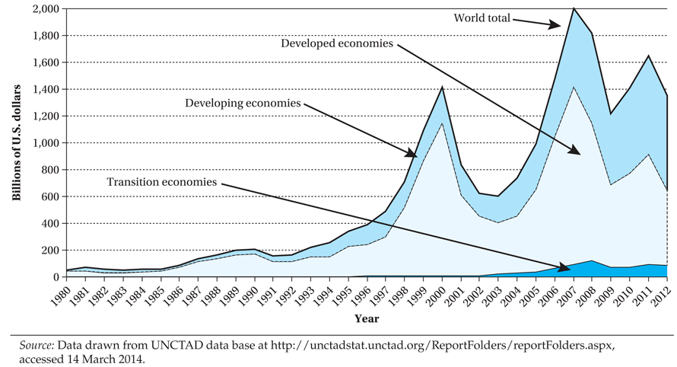
FDI inflows, Global and By Group of Economies, 1980–2012 (Billions of Dollars)

Slide 45
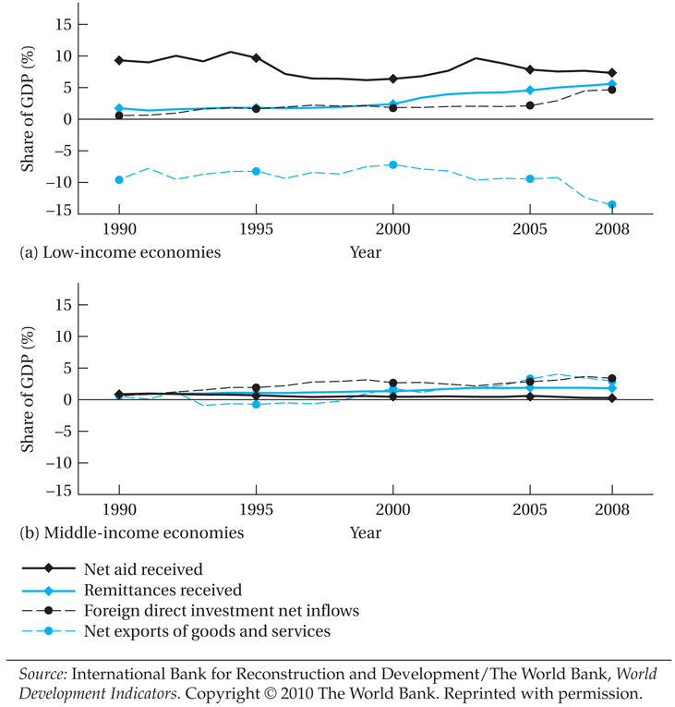
Sources of External Financing for Developing Countries, 1990–2008

Slide 46
Multinational corporations
Multinational corporations (MNCs) are the major force in the rapid globalization of world trade.
Two central characteristics of MNCs are their large size and the fact that their worldwide operations and activities tend to be centrally controlled by parent companies.
A majority of developing countries, especially the smaller and least developed ones, feel overwhelmed in attempting to bargain with such powerful entities.
Historically, MNCs, especially those operating in developing nations, focused on extractive and primary industries, mainly petroleum, nonfuel minerals, and plantation activities (export-oriented agriculture and local food processing).
Recently, manufacturing operations and services (banks, hotels, etc.) have occupied a dominant share of MNC production activities.

Slide 47
Private Foreign Investment for Development: Pros and Cons
Pro-foreign-investment argument:
  Private foreign investment (as well as foreign aid) fills in gaps between the domestically available supplies of savings, foreign exchange, government revenue, and human capital skills and the desired level of these resources necessary to achieve growth and development targets (The usual argument from the economists!).

Slide 48
Private Foreign Investment for Development: Pros and Cons
Counter argument:
  Although MNCs provide capital, they may also:
    lower domestic savings and investment rates by substituting for private savings,
    suppress competition through exclusive production agreements with host governments,
    Fail to reinvest much of their profits,
    inhibit the expansion of indigenous firms that might supply them with intermediate products by instead importing these goods from overseas affiliates.
    crowd out the investment of local firms by raising a large fraction of their capital locally in the developing country itself.
  The management, entrepreneurial skills, ideas, technology, and overseas contacts provided by MNCs may have little impact on developing local sources of these scarce skills and resources and may, in fact, inhibit their development by stifling the growth of indigenous entrepreneurship as a result of the MNCs’ dominance of local markets.

Slide 49
Private Foreign Investment for Development: Pros and Cons
  The impact of MNCs on development is very uneven, and in many situations, MNC activities reinforce dualistic economic structures and exacerbate income inequalities.
    They tend to promote the interests of a small number of local factory managers and relatively well-paid modern-sector workers against the interests of the rest by widening wage differentials.
    They divert resources away from needed food production to the manufacture of sophisticated products catering primarily to the demands of local elites and foreign consumers.
    They tend to worsen the imbalance between rural and urban economic opportunities by locating primarily in urban export enclaves and contributing to excessive rural-urban migration.

Slide 50
Private Foreign Investment for Development: Pros and Cons
  MNCs typically produce products only demanded by a small, rich minority of the local population, stimulate inappropriate consumption patterns through advertising and their monopolistic market power, and do this all with inappropriate (capital-intensive) technologies of production that as a result create comparatively little employment.
    Thus, local resources tend to be allocated for socially undesirable projects.
    Also, this process aggravates the already sizable inequality between rich and poor and the serious imbalance between urban and rural economic opportunities.
  Multinationals use their economic power to influence government policies in directions that are unfavorable to development.
    The fear is often expressed that powerful multinational corporations can gain control over local assets and jobs and can then exert considerable influence on political decisions at all levels.

Slide 51
Private Foreign Investment for Development: Pros and Cons
  MNCs may damage host economies by suppressing domestic entrepreneurship and using their superior knowledge, worldwide contacts, advertising skills, and range of essential support services to drive out local competitors and inhibit the emergence of small-scale local enterprises.
    Through the privatization of public corporations and the use of debt-for-equity swaps to reduce debt burdens, MNCs have been able to acquire some of the best and potentially most lucrative local businesses.

Slide 52
Summary and reconciling the Pros and Cons
The real debate ultimately centers on different ideological and value judgments about the nature and meaning of economic development and the sources from which it springs.
The advocates of a central role for private foreign investment tend to be free-market proponents who firmly believe in the efficacy and beneficence of the market mechanism, where this is usually defined as a hands-off policy on the part of host governments.
  Some positive experiences: Some of the east Asian countries
However, the actual operations of MNCs tend to be monopolistic and oligopolistic. Price setting is achieved more as a result of international bargaining and, in some cases, collusion than as a natural outgrowth of free-market supply and demand.
Those who argue against the activities of MNCs are often motivated by a sense of the importance of national control over domestic economic activities and the minimization of dominance-dependence relationships between powerful MNCs and developing-country governments.
  Some negative experiences: Mexico, Thailand, Malaysia, and Indonesia in the 1990s

Slide 53
Microfinance

Slide 54
Microfinance
Microfinance programs provide credit, savings, insurance and other financial services to clients that are poorer than those typically served by commercial banks.
Microcredit programs (a subset of microfinance activities) provide loans to these clients.
  They vary a great deal, but usually involve lending to people who are required to begin repaying their loans very soon after taking out the loans, and who must meet frequently with other borrowers and with program staff to make payments.
Promoters of microcredit see it in diverse ways:
  Some see it as a sort of safety net, creating a means of earning income for people who have few other opportunities.
  Others see it as a means of expanding business investment by relaxing the liquidity constraints of the poor.
  Many also see it as a way to empower women and improve intra-household distribution.

Slide 55
Microfinance
Microfinance was born in the mid-1970s, when Nobel Prize–winning economist Mohammad Yunus and his graduate students at Chittagong University in Bangladesh began making small loans to poor villagers.
They demonstrated that their clients - often women - not only were eager to borrow small amounts but also were able to pay off their loans with interest.
Yunus’s efforts soon attracted worldwide attention and inspired replication and experimentation around the world.
According to the 2012 report of the Microcredit Summit Campaign, more than 3,600 institutions now provide microfinance services and serve close to 205 million clients in 147 countries.

Slide 56
Microfinance
Current microfinance programs are incredibly diverse.
  They differ in the nature of the financial products they offer, the training and other subsidiary services they provide to clients, the recruitment practices and eligibility criteria they use to identify clients, their formal institutional structures, and the personnel practices and informal institutional norms that govern their daily operations.
Most microcredit programs offer any potential client not just a single loan but a sequence of loans of increasing size, in which the receipt of later loans is conditioned on successful repayment of earlier loans.
Each loan must be repaid over the course of a loan cycle of three, four, six, or 12 months, at the end of which a borrower in good standing may either start a new loan cycle or leave the program.
Typically, borrowers are required to begin repaying a loan only a week or two after receiving it and must make weekly or biweekly payments at mandatory meetings throughout the loan cycle.

Slide 57
Microcredit program evaluations
Few rigorous impact assessments have been undertaken, though the number is growing.
The rigorous assessments tend not to offer a complete view of impacts, outreach and cost.
Assessments to date suggest that:
  microcredit can yield benefits, even for poor households and even when programs have achieved sustainability.
  the benefits are probably modest (i.e. not transformative) for most clients.
  some participants are made worse off.
  a few might benefit a great deal.

