Slide 1
Session 5
Measuring poverty and inequality

Slide 2
Poverty, inequality and vulnerability

Slide 3
Introduction
Economic growth makes development possible.
But the rate of growth is an incomplete measure of development success at the macro level because:
  it describes only what is happening on average.
  it describes only what is happening to income.
For more complete assessments development analysts consider also what is happening to:
  poverty,
  Inequality, and
  vulnerability.

Slide 4
Introduction
Possible weaknesses of growth rates as indicators of development success
Additional indicators
Poverty Income poverty Non-income poverty
Inequality Income inequality Other inequality
Vulnerability
Focuses only on what is happening to average income
Focuses only on what is happening to income

Slide 5
Poverty

Slide 6
Poverty
Definition: People experiencing well-being below some minimally acceptable level.
Specific measures differ in choices regarding:
  how to measure well-being.
  how to draw the line defining “unacceptably little.”
  how to aggregate information for many people.
Note: The reduction of poverty is now the main objective of the World Bank.

Slide 7
Poverty: choice of well-being measure
Most common choices (often treated as synonymous):
  per capita income within a person’s household
  per capita consumption expenditure within a person’s household
These measures may be supplemented by non-income statistics (if available):
  Life expectancy at birth
  Infant mortality rate
  Access to improved water source
  Access to improve sanitation
  Prevalence of undernourishment

Slide 8
Poverty: choice of poverty line
The poverty line is the value of the selected well-being indicator that marks the minimally acceptable level, below which people merit special policy attention.
Two approaches: Absolute versus relative poverty lines
Absolute poverty: When people cannot afford to consume some minimally acceptable package of food, clothing, shelter, and other goods or services.
To set absolute poverty lines, policymakers define a minimally acceptable package of goods and services and then estimate the minimum income required to obtain such a package.
  Different absolute poverty lines may be defined depending on how generously or conservatively the minimally acceptable package are defined: just enough food to maintain life or also include some clothing, shelter, and other items required for full participation in society.

Slide 9
Poverty: choice of poverty line
The absolute poverty line knows no national boundaries and is independent of the level of national per capita income.
The World Bank constructs statistics based on the poverty lines of $1.25 and $2.00 per day.
  The $1.25 line is below the official poverty lines of most countries and is on par with official poverty lines in the world’s 10 poorest countries.
  The $2 line is on par with official poverty lines in some middle-income countries.
However, even people living on $10 per day are very poor by developed country standards (Pritchett, 2006).
  If we counted as poor everyone living on less than $10 per day (rather than $2), the number of the global poor would double, and the challenge of eliminating global poverty would be much greater.

Slide 10
Poverty: choice of poverty line
Relative poverty line: People are identified as living in relative poverty when their living standards are low relative to the typical level in their society.
For example, policymakers might set a relative poverty line at 30 or 60 percent of the country’s median income, reflecting their belief that special policy attention is always required for people who are relatively deprived, regardless of the absolute quantities of goods and services they are able to consume.
  Special attention: tax treatment; education policy, etc.

Slide 11
Poverty: choice of aggregation formula
After choosing an individual-level well-being measure and poverty line, we can use census or survey data to measure or estimate information about the level of poverty for everyone in a population.
We can present all the information in a graph.
But how do we summarize all this information in a single measure?
-> Different measures
Income Y_{i}
Y_{N}
z
z-Y_{i}
Y_{i}
i
q
N
Rank order i from poorest to richest

Slide 12
Poverty: choice of aggregation formula
The most commonly cited poverty statistics is the “headcount ratio”. The headcount ratio (H) is the fraction/percentage of households in a population with incomes below the poverty line.
Headcount ratio (H₀)=q/N
What kinds of difference across populations does this measure emphasize?
What kinds of difference across populations does it ignore?
How would it change if you gave one dollar to the least poor person?
How would it change if you gave one dollar to the poorest person?
Income Y_{i}
Y_{N}
z
z-Y_{i}
Y_{i}
i
q
N
Rank order i from poorest to richest

Slide 13
Poverty: choice of aggregation formula
The “total income gap” (or total poverty gap) (TYG) is the total amount of money that would be required to bring every poor person’s income up to the poverty line.
Graphically, it is equal to the area of the shaded region below the z line and above the Y schedule, between 0 and q.
Total income gap =
The total income gap may be large because many people are moderately poor or because a few people are extremely poor.
Income Y_{i}
Y_{N}
z
z-Y_{i}
Y_{i}
i
q
N
Rank order i from poorest to richest

Slide 14
Poverty: choice of aggregation formula
The “average proportional income gap” (APYG) is just the simple average over all the poor of their proportional income gaps.
Avg. Proportional Income Gap=
Income Y_{i}
Y_{N}
z
z-Y_{i}
Y_{i}
i
q
N
Rank order i from poorest to richest

Slide 15
Poverty: choice of aggregation formula
- The “poverty gap index” (PG) averages proportional income gaps across everyone in the population (poor and nonpoor), treating the nonpoor as having income gaps of zero (because they need nothing to bring their incomes up to the poverty line).
Poverty Gap Index (P₁)=
Income Y_{i}
Y_{N}
z
z-Y_{i}
Y_{i}
i
q
N
Rank order i from poorest to richest

Slide 16
Poverty: choice of aggregation formula
Squared proportional income gap index (P₂)=
This measure is sensitive to differences across places in the prevalence of poverty, the average depth of poverty and the distribution around that average depth (and thus to the prevalence of deep poverty among the poor).
(The effect of the squaring is to magnify the contributions to the overall measure of the income deficits experienced by those in deepest poverty.)
Income Y_{i}
Y_{N}
z
z-Y_{i}
Y_{i}
i
q
N
Rank order i from poorest to richest

Slide 17
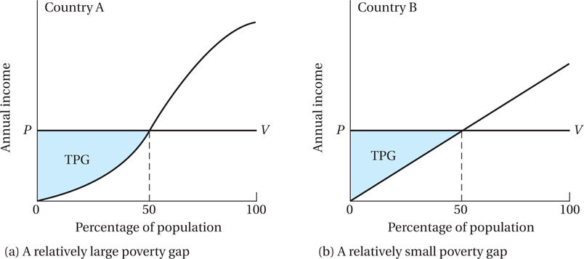
Poverty: choice of aggregation formula

Slide 18
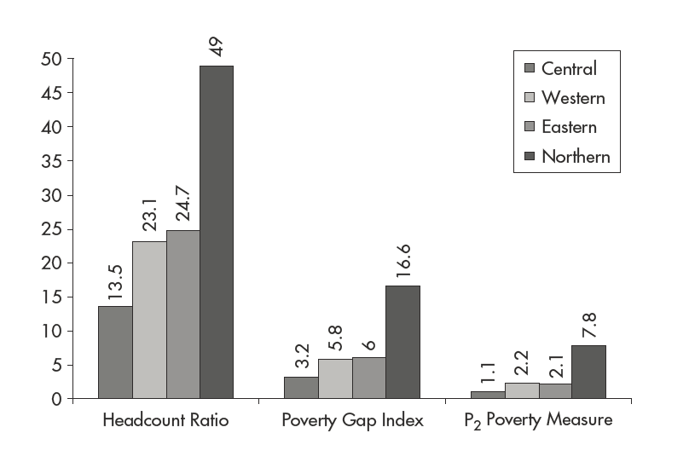
Different poverty measures tell different pieces of the story
Poverty Index Values for Four Rural Regions in Uganda, 2009–2010
2x
3x
4x
Source: Uganda Bureau of Statistics, 2010.

Slide 19
Different poverty measures tell different pieces of the story

Slide 20
Inequality

Slide 21
Inequality
Definition : Some people experiencing lower levels of well-being than others.
Measures that differ in choices regarding:
  how to measure well-being (what indicators of living standards to consider).
  how to aggregate information for many people.
Common measure of income inequality:
  Kuznets ratio
  Lorenz curve
  Gini coefficient (Gini index)

Slide 22
Inequality
A common method is to divide the population into successive quintiles (fifths) or deciles (tenths) according to ascending income levels and then determine what proportion of the total national income is received by each income group.
A common measure of income inequality is the ratio of the incomes received by the top 20% and bottom 40% of the population.
  This ratio is sometimes called the Kuznets ratio.

Slide 23
Inequality
Cumulative Share of Income (Percent)
100
Different way of representing much of the same information about well-being of everyone in the population: Lorenz curve diagram.
45 degree line
Lorenz Curve
0
100
Cumulative Share of Population (Percent)

Slide 24
Inequality
What do we learn about how distributions differ in countries A and B in each of these diagrams?

Slide 25
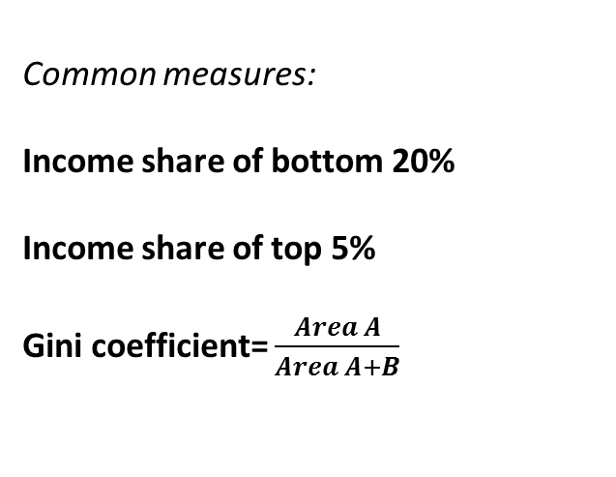
Inequality
Cumulative Share of Income (Percent)
100
Common measures:
Income share of bottom 20%
Income share of top 5%
Gini coefficient= $\frac{Area A}{Area A+B}$
45 degree line
A
Lorenz Curve
B
0
100
Cumulative Share of Population (Percent)

Slide 26
Inequality
Select Income Distribution Statistics
Country | Gini Coefficient | Share of income or consumption (Percent)
 |  | Poorest 20 percent of population | Richest 20 percent of population
Ethiopia Hungary Turkey United States Costa Rica Brazil South Africa | .30 .31 .39 .41 .51 .55 .63 | 9.3 8.4 5.7 5.4 3.9 2.9 2.7 | 39.4 39.9 45.1 45.8 55.9 58.6 68.2
Data Source: World Bank, 2012.

Slide 27
Inequality
Discussion question:
  Should we care about inequality?
  Is inequality a bad thing?
  Should the government tax high-income individuals to give subsidy to low-income individuals?
One of the foundations of capitalist society (free market)!

Slide 28
Inequality
What about “extreme” inequality?
Extreme income inequality leads to economic inefficiency:
  Low-income individuals cannot access capital, education, etc. to fully participate in the economy/society.
  Highest saving is done by the middles class, not the rich.
    The rich have a lower rate of marginal saving (spending on luxury goods, not capital goods)
Extreme income inequality often leads to:
  rent seeking activities (changing the rules in favor of the rich).
  populist policies/leaders.
  to social instability.
Extreme income inequality is unfair (value judgement!).

Slide 29
Vulnerability

Slide 30
Vulnerability
General definition: “significant risk” of “significant future reductions” in well-being.
Arises when:
  people are exposed to shocks, and
  they do not have good ways to keep their consumption from dropping off when hit by shocks
More specific definitions would differ in:
  Objective risk or perceived risk?
  What is significant risk? What is significant loss?
  Temporary or permanent?
  Arising out of what sorts of shocks?

Slide 31
Vulnerability
It is nearly impossible to construct a satisfactory measure of vulnerability, because vulnerability is
  forward-looking (i.e. pertains to things that haven’t happened yet).
  probabilistic (i.e. pertains to things that might not happen, even among people who must fear them).
But data that follow poverty patterns over time suggest significant vulnerability
  Of the somewhat poor to becoming very poor, and
  Of the non-poor to becoming poor.
Possible solutions: safety nets like unemployment insurance, etc.

Slide 32
Relationship between Growth Poverty, and Inequality

Slide 33
Growth, poverty, and inequality
Most development actors would agree that the aim in development is for some combination of economic growth and reductions in poverty, inequality, and vulnerability.
Is it true that policymakers should just “focus on increasing growth rates, and let poverty reduction take care of itself?”
Another way of putting it: If policymakers are successful in spurring economic growth, will they necessarily achieve development success in a broader and fuller sense?
  Is rapid growth always accompanied by rapid reductions in poverty and vulnerability?
  Is this true even when policymakers make few explicit efforts to reduce poverty and vulnerability?
What about the trade-off between the two?
  “Pie” versus the “slice of pie” argument!

Slide 34
Growth, poverty, inequality
To begin studying these questions, let’s probe deeper into the “micro foundations” of growth by asking:
What do we know must be happening in the socioeconomic system when economic growth is rapid?
How might these changes that underlie growth also reduce poverty?
How might these changes that underlie growth fail to reduce poverty?

Slide 35
How might successful growth policies reduce poverty?
If economic growth is rapid, rates of investment and asset creation (broadly defined) must be high.
What types of assets, and under what sorts of circumstances, might asset creation fail to generate many benefits for the poor?
  Growth policies that explicitly create new assets owned or used by the poor, that address the financial constraints of the poor, that extend the reach of markets into more remote areas, and that emphasize accumulation of assets that stimulate the demand for unskilled labor or goods produced by the poor are more likely to bring poverty reduction than other policies that are equally successful at producing growth in average income.
  However, asset creation might fail to generate benefits for the poor when the assets are owned by non-poor people, when the goods they produce more of are consumed mostly by the non-poor and when the methods of production do not use much low-skill labor.

Slide 36
How might poverty reduction policies slow or speed growth?
They might slow growth by:
redistributing income from those who save to those who don’t.
weakening incentives for work and investment.
They might speed growth by:
releasing the poor from “financial constraints” that prevent them from investing in high-return projects.
encouraging them to invest in human capital (conditional cash transfer programs).

Slide 37
Empirical relationships between growth and poverty reduction

Slide 38
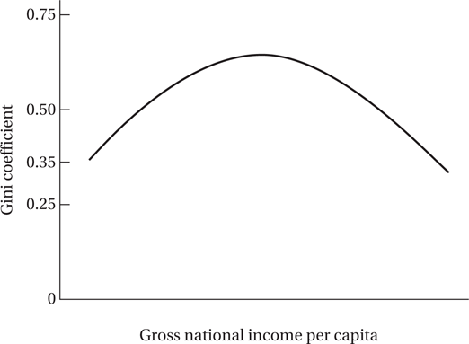
Relationship between economic growth and inequality: Kuznets’ Inverted-U Hypothesis

Slide 39
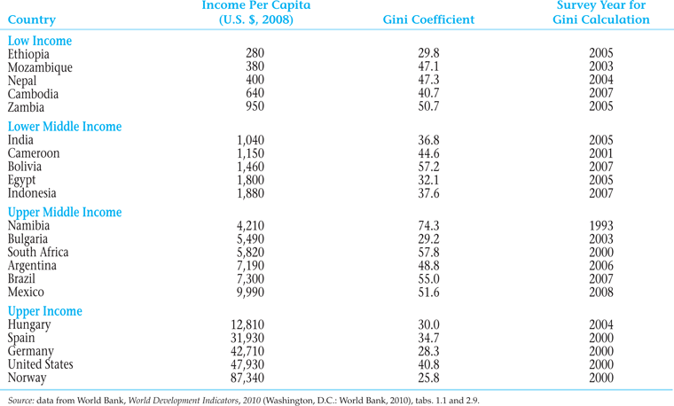
Income and Inequality in Selected Countries

Slide 40
Recent trends in world’s income inequality

Slide 41
World Income Inequality
At the 2011 World Economic Forum in Davos, income inequality and corruption were singled out as the two most serious challenges facing the world.
Of total world income, 42 per cent goes to those who make up the richest 10 per cent of the world’s population, while just 1 per cent goes to those who make up the poorest 10 per cent.
Income inequality among countries in the world rose sharply between the 1980s and the mid-1990s, before levelling off and then falling after 2000.
Countries with very high inequality are clustered in South America and southern Africa. Countries with low inequality are mostly in Europe. Canada and the U.S. have medium income inequality.
Source: Conference Board of Canada
http://www.conferenceboard.ca/hcp/hot-topics/worldInequality.aspx?AspxAutoDetectCookieSupport=1
http://www.conferenceboard.ca/hcp/Details/society/income-inequality.aspx

Slide 42
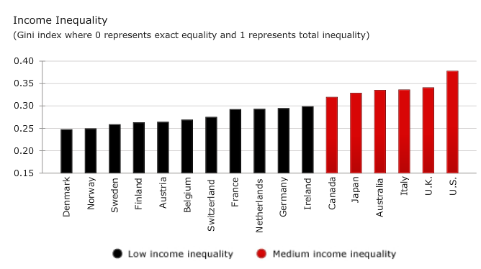
World Income Inequality

Slide 43
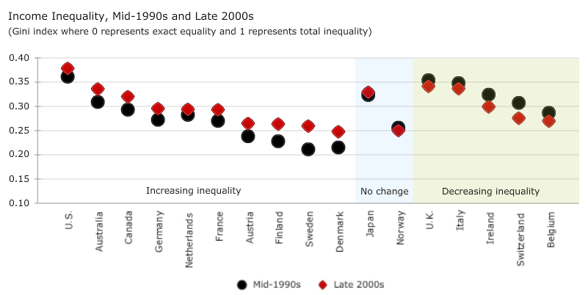
World Income Inequality

Slide 44
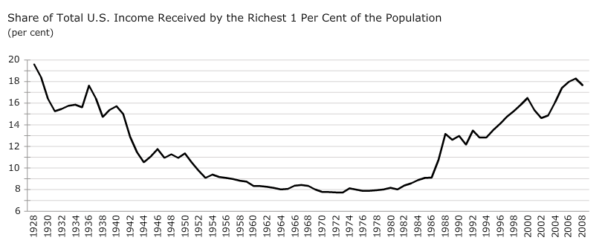
World Income Inequality

Slide 45
Other measures of development

Slide 46
Other measures of development
Income per capit
  Measures of inequality (e.g. Gini coefficient)
Indicators of Health and Education
Human Development Index (HDI)
  decent standard of living
  a long and healthy life
  knowledge
Inequality-Adjusted Human Development Index (IHDI)
Multidimensional Poverty Index (MPI)
Each of these indicators tell a different story about development and poverty!

Slide 47
Human Development Index (HDI)
HDI ranks all countries on a scale of 0 (lowest human development) to 1 (highest human development).
Traditional HDI:
  Used by the UNDP until 2010,
  But it is still widely referenced.
  Based on three goals or end products of development, corresponding to health, education, and income:
    longevity as measured by life expectancy at birth,
    knowledge as measured by adult literacy (2/3) and gross school enrollment ratio (1/3),
    standard of living as measured by real per capita GNI (PPP)
The HDI ranks countries into four groups: low human development (0.0 to 0.499), medium human development (0.50 to 0.799), high human development (0.80 to 0.90), and very high human development (0.90 to 1.0).
The UNDP changed the calculation of the HDI in 2010 (New HDI)
  The same measures;
  But different calculation (e.g., geometric mean versus arithmetic mean).

