Slide 1
Sessions 3 and 4
Theories of economic growth and development
(Part 2)

Slide 2
0. Economic nationalism
1. Modernization theory
  Rostow's Linear-Stages-of-Growth-Model
  Harrod-Domar growth model
2. Structural-change theory
  Lewis model
3. Dependency theory
4. Neoclassical theory of development
  Solow growth model
  Endogenous growth models
5. Institutional theory of development (Session 9)

Slide 3
4. Neoclassical theory of development
First gaining prominence with the rise of several conservative governments in the developed world during the 1980s, neoclassical theories represent a radical shift away from International Dependence Theories.
Neoclassical theories argue that governments should not intervene in the economy; in other words, these theories are claiming that an unobstructed free market is the best means of inducing rapid and successful development.
Competitive free markets unrestrained by excessive government regulation are seen as being able to naturally ensure that the allocation of resources occurs with the greatest efficiency possible and the economic growth is raised and stabilized.
It is important to note that there are several different approaches within the realm of neoclassical theory, each with subtle, but important, differences in their views regarding the extent to which the market should be left unregulated.

Slide 4
4. Neoclassical theory of development
Different views of the neoclassical theory:
  free market approach
  public-choice theory
  market-friendly approach
Of the three, both the free-market approach and public-choice theory contend that the market should be totally free, meaning that any intervention by the government is necessarily bad. Public-choice theory is arguably the more radical of the two with its view, closely associated with libertarianism, that governments themselves are rarely good and therefore should be as minimal as possible.
The market-friendly approach, unlike the other two, is a more recent development and is often associated with the World Bank. This approach still advocates free markets but recognizes that there are many imperfections in the markets of many developing nations and thus argues that some government intervention is an effective means of fixing such imperfections.

Slide 5
The 1960s and 1970s
Empirical observations
  Human capital and technical change are important (countering capital fundamentalism).
  Even peasants respond to economic incentives (countering structuralism).
  Growth through capital accumulation and technical change is possible even in agriculture (countering some versions of dualism).
Theoretical themes
  Technical change is critical for understanding growth.
  Human capital is important, too.
  Neoclassical decision-makers deliver ideal growth, so it might be better to pull government out of the economy.

Slide 6
The simple neoclassical growth model
Assumptions
  Neoclassical production functions Y=F(K,L)
  Investment in capital is financed by saving
  People save a fixed proportion s of income
  There is no technical change
  Labor grows at rate n
  All factors are always fully employed

Slide 7
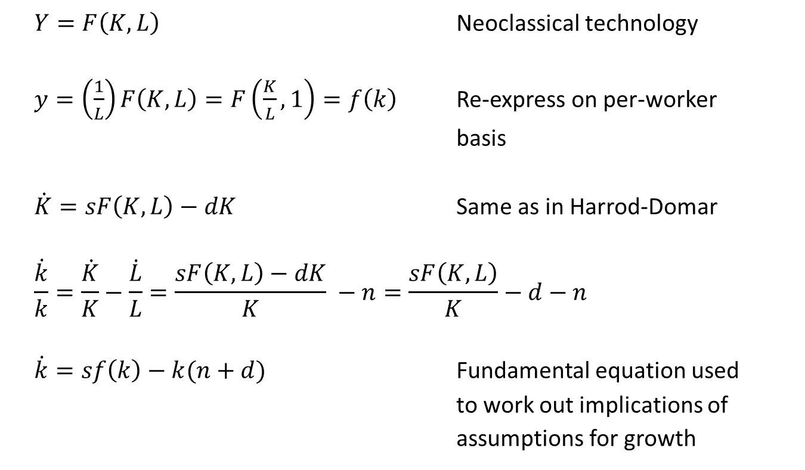
Simple neoclassical growth model
  $Y=F\left(K,L\right)$ Neoclassical technology
  $y=\left(\frac{1}{L}\right)F\left(K,L\right)=F\left(\frac{K}{L},1\right)=f\left(k\right)$ Re-express on per-worker
  basis
  $\dot{K}=sF\left(K,L\right)−dK$ Same as in Harrod-Domar
  $$\frac{\dot{k}}{k}=\frac{\dot{K}}{K}−\frac{\dot{L}}{L}=\frac{sF\left(K,L\right)−dK}{K} −n=\frac{sF\left(K,L\right)}{K}−d−n$$
  $\dot{k}=sf\left(k\right)−k(n+d)$ Fundamental equation used
  to work out implications of
  assumptions for growth

Slide 8
Simple neoclassical growth model
Output per Worker (k)
k(n+d)
k(n+d)
Output per Worker (k)
f(k)
s²f(k)
sf(k)
s¹f(k)
k^{s}
Capital per Worker (k)
k¹
k²
Capital per Worker (k)

Slide 9
Simple neoclassical growth model
Implications and interpretation:
No growth in steady state equilibrium
An increase in the saving rate increases growth in the short run, and raises the long-run level of income per capita, but does not lead to a sustained (for the long run) increase in the growth rate.
This model must be incomplete, because we do observe sustained growth over long periods.

Slide 10
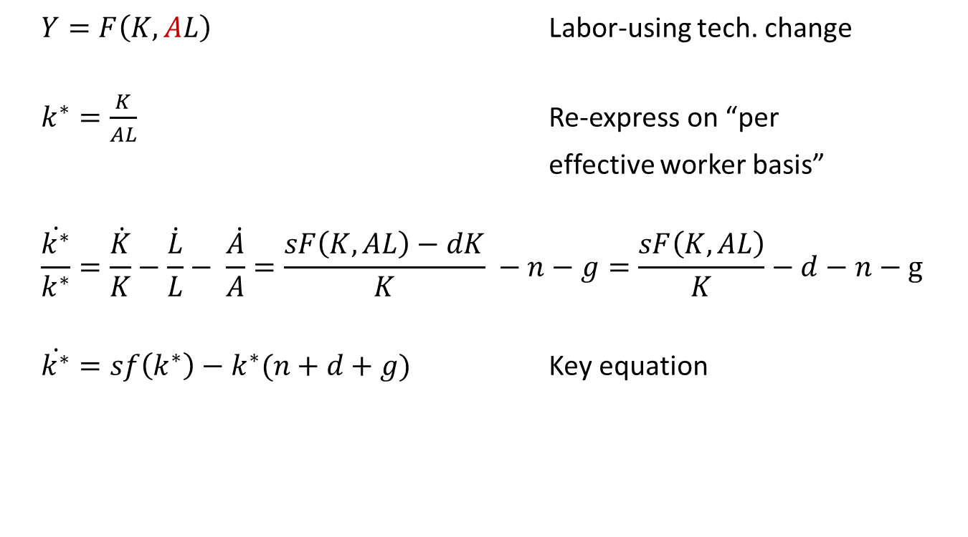
Neoclassical growth with technical change
  $Y=F\left(K,AL\right)$ Labor-using tech. change
  $k^{∗}=\frac{K}{AL}$ Re-express on “per
  effective worker basis”
  $$\frac{\dot{k^{∗}}}{k^{∗}}=\frac{\dot{K}}{K}−\frac{\dot{L}}{L}− \frac{\dot{A}}{A}=\frac{sF\left(K,AL\right)−dK}{K} −n−g=\frac{sF\left(K,AL\right)}{K}−d−n−g$$
  $\dot{k^{∗}}=sf\left(k^{∗}\right)−k^{∗}(n+d+g)$ Key equation

Slide 11
Neoclassical growth with technical change
Output per Effective Worker (y*)
k*(n+g+d)
sf(k*)
k*^{s}
Capital per Effective Worker (k*)

Slide 12
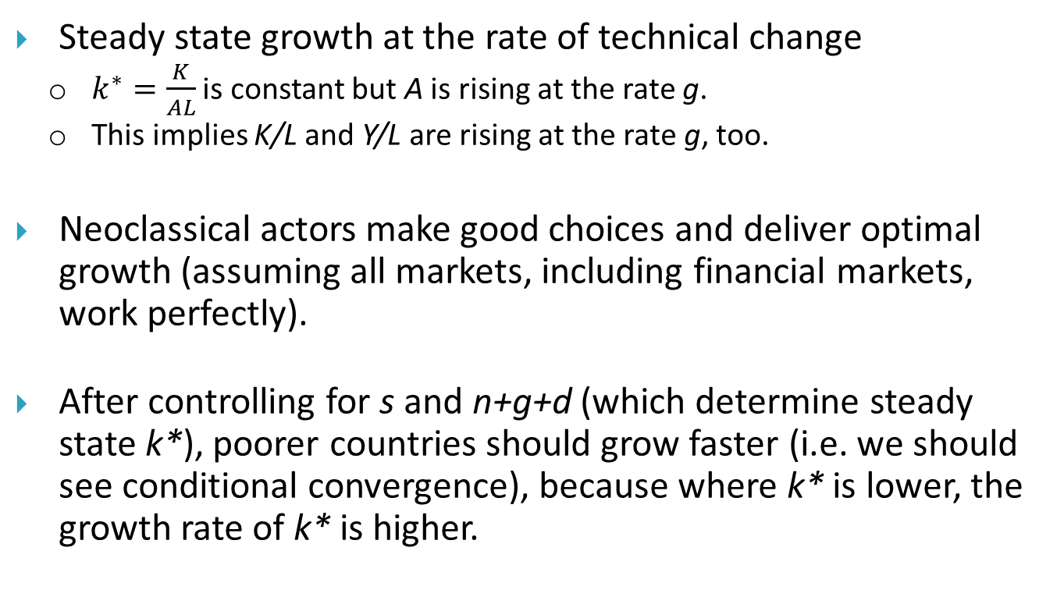
Neoclassical growth with technical change
Steady state growth at the rate of technical change
  $k^{∗}=\frac{K}{AL}$ is constant but A is rising at the rate g.
  This implies K/L and Y/L are rising at the rate g, too.
Neoclassical actors make good choices and deliver optimal growth (assuming all markets, including financial markets, work perfectly).
After controlling for s and n+g+d (which determine steady state k*), poorer countries should grow faster (i.e. we should see conditional convergence), because where k* is lower, the growth rate of k* is higher.

Slide 13
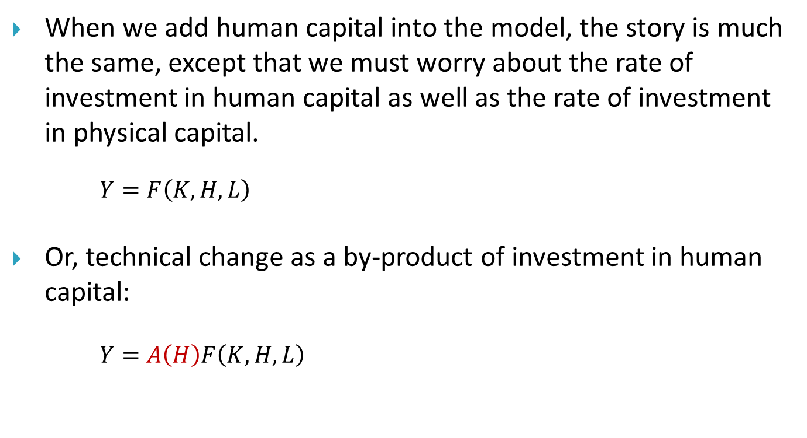
Neoclassical growth with technical change and human capital
When we add human capital into the model, the story is much the same, except that we must worry about the rate of investment in human capital as well as the rate of investment in physical capital.
$Y=F\left(K,H,L\right)$
Or, technical change as a by-product of investment in human capital:
$Y=A\left(H\right)F\left(K,H,L\right)$

Slide 14
Convergence (catch-up) theory
Convergence: The tendency for per capita income (or output) to grow faster in lower-income countries than in higher-income countries so that lower-income countries are “catching up” over time. When countries are hypothesized to converge not in all cases but other things being equal (particularly savings rates, labor force growth, and production technologies), then the term conditional convergence is used.
  If lower-income countries consistently grew faster than higher-income countries, their average income levels would eventually catch up with developed country levels.
Unfortunately, data on growth rates exhibit no strong tendency for poor countries to grow more rapidly.

Slide 15
There is no systematic tendency for the poorest to catch up

Slide 16
Technical change as result of purposeful activity: R&D, innovation, and productivity (endogenous versus exogenous growth models)
In the previous models, the rate of technical change was “exogenous”.
In “endogenous” growth models, technology and productivity advances as the outcome of purposeful activities such as R&D, technology transfer, etc.
  Technology is characterized by increasing returns to scale and producers engage in imperfect competition.
  Monopoly profits serve as the reward for creating technologies.
    Though they may under-state the social benefit of invention, leading to under-investment in the absence of intervention.
  Entrepreneurs keep devoting more labor to research and development activities.
Governments might have reason to intervene to improve research and growth outcomes.
  Markets do many things well, but not everything.
  Governments might consider patent protection as a way to create the profits that reward research and development.
Under these assumptions countries might grow at different rates even in the long run.

Slide 17
Structural adjustment programs:
Structural adjustment programs (SAPs) consist of loans provided by the International Monetary Fund (IMF) and the World Bank to countries that experience economic crises to reduce the borrowing country’s fiscal imbalances in the short term and to adjust their economies for successful long-term growth.
SAPs generally recommend free market programs and policies such as privatization, deregulation, the reduction of trade barriers which limit the role of the state in the economy in the benefit of free market mechanisms.
SAPs were often criticized for implementing generic free-market policies regardless of the socio-economic status, infrastructure, and required institutions in the target country (SAPRIN, 2004).

Slide 18
Structural adjustment programs:
It is worth mentioning that in a recent report by the World Bank, it is argued that development thinking has shifted from modernization and structural adjustment programs to poverty reduction.
According to this report, “under the former system, poor countries were encouraged to undergo social and economic structural transformations as part of their development, creating industrialization and intentional industrial policy.
Poverty reduction rejects this notion, consisting instead of direct budget support for social welfare programs that create macroeconomic stability leading to an increase in economic growth” (World Bank, 2012). More precisely, as Stone and Wright (2007) describe, “long gone are the ‘one-size-fits-all, silver-bullet policy packages regularly prescribed for all countries’ in favour of context-specific and more cross-disciplinary approaches to development”.

Slide 19
Washington Consensus:
The Washington Consensus was originally a set of 10 economic policy prescriptions considered to constitute the "standard" reform package promoted for crisis-wracked developing countries by Washington, D.C.–based institutions such as the International Monetary Fund (IMF), World Bank, and key U.S. government agencies such as the US Treasury Department.
The phrase “Washington Consensus” has come to be used fairly widely in a second, broader sense, to refer to a more general orientation towards a strongly market-based approach (sometimes described as market fundamentalism or neoliberalism).
However, it did not always accord with realities in developing countries that were successful.

Slide 20
The Washington Consensus on the Role of the State in Development and Its Subsequent Evolution
    Toward “a new consensus”:
      New emphasis on government's responsibility toward poverty alleviation and inclusive growth
      Provision of fundamental public goods
      Importance of health and education
      A recognition that markets can fail
      Governments can help secure conditions for an effective market based economy

Slide 21
New views on economic growth

Slide 22
What causes rapid economic growth?
Answers at three levels:
(Proximate sources) The kinds of change in socioeconomic activity that give rise to economic growth and the related choices through which those changes come about.
(Economic determinants) The types of policies, institutions, external market conditions, and other circumstances that are taken as given by people within the socioeconomic system, and that affect how willing and able people are to make the choices associated with the proximate sources of growth.
(Political determinants) The political conditions that lead policymakers to put good policies and institutions into place.

Slide 23
Proximate sources of growth
Output can grow through:
Accumulation of physical capital (more rapid than the rate of growth of population)
Accumulation of human capital (increasing average skill level of workforce)
Improvements in technology and technical efficiency (through research, development, dissemination, purchase and adoption of new technologies)

Slide 24
Proximate sources of growth
A production function describes how the maximum quantity of output could be produced is related to the quantities of production factors it employs.
Y = F(L,K; A)
We expect:
  Positive but diminishing marginal product of L
  Positive but diminishing marginal product of K
  Positive function of A

Slide 25
Proximate sources of growth
At the aggregate level, productivity may also grow through re-allocations of labor across activities that:
Shift labor from sectors or firms where the value of the marginal product of labor (VMPL) is lower to sectors or firms where the VMPL is higher
Shift labor out of unemployment into employment
Shift labor out of rent-seeking activities into productive activities

Slide 26
Proximate sources of growth
Accumulation of assets
Improved efficiency in utilization of assets
Accumulation of physical capital
  Machines, inventory
  Infrastructure
Accumulation of human capital
Improvements in technology
Shifting labor from less to more productive uses
  between sectors, between firms
Reducing waste
  reducing corruption
  reducing “rent-seeking”
  reducing unemployment

Slide 27
Proximate sources of growth
Growth and development accounting studies seek to quantify the relative importance of factor accumulation (i.e. rising quantities of physical or human capital per worker) and growth in total factor productivity (i.e. all other proximate sources of growth) for explaining historical growth and differences across countries in GDP per worker.
Often they find that factor accumulation and TFP growth each explain about half of overall growth.
They also find that differences in capital per worker and differences in TFP each explain about half of the cross-country differences.

Slide 28
Proximate sources of growth
Empirical observations suggest that developing countries have room to improve in all of these areas:
  Physical capital per worker
  Human capital per worker
  Level of technology and technical efficiency
  Efficiency in allocation of labor across sectors and firms
  Unemployment and under-employment
  Rent-seeking and other wasteful activities

Slide 29
Determinants of growth
Why do capital accumulation, technical change, improvements in efficiency and reductions in waste happen more rapidly in some countries than others?
Determinants considered in cross-country growth regression literature:
  Current policy (openness to international trade, fiscal discipline)
  Geography (distance from equator, landlocked)
  Long-lasting social characteristics (languages, religions)
  Legacy of earlier policies (education stock)
  Institutional heritage (colonizers, legal systems)
  Current institutions beyond codified policies (property rights, corruption, bureaucracy)

Slide 30
Determinants of growth
Researchers have run many cross-country growth regression studies, but this literature allows researchers to draw few strong policy conclusions, because the literature:
  Has no single guiding framework
  Suffers from econometric problems
  Has generated results that differ from study to study
  Employs only very crude policy measures
Nonetheless, some consensus seems to be emerging:
  Humanly devised policies and institutions more important than geography and physical constraints.
  Education, openness to trade, macroeconomic stability, and respect for property rights may be especially important.
      But how helpful are conclusions at this level of generality?

Slide 31
Determinants of growth
What decisions must be made, and by which decision makers, to:
  Accumulate physical capital
  Accumulate human capital
  Advance technology
  Move labor from less to more productive activities
Notice that all of these activities require investment at the micro level.
To understand growth we must understand what encourages and discourages people from undertaking investments of many types.

Slide 32
Deeper determinants of growth
If good policy is capable of encouraging investment and productivity advance, what prevents some countries from undertaking good policies?

Slide 33
5. Institutional theory of development
Since the late 1990s, the view that poor-quality institutions are the root cause of economic problems in developing countries has become widespread (Chang, 2011).
Institutional theorists suggest that the institutional environment can strongly influence the development of formal structures, often stronger than other factors including market forces.
For example, Acemoglu et al. (2005) argue that although cultural and geographical factors may matter for economic performance, differences in economic institutions are the major source of cross-country differences in economic growth and prosperity.
The World Bank also recognizes that effective, transparent, and accountable institutions lie at the core of development. According to the World Bank (2012), institutions “establish the formal and informal rules that determine whether the public sector acts in its own interests or on behalf of all citizens”.

Slide 34
Poverty trap

Slide 35
Poverty traps: is poverty self-enforcing?
Macro poverty traps
  Why do some countries seem stuck with low rates of investment, innovation and growth?
  Is it possible that poverty is itself a barrier to growth?
Macro poverty traps
  Why do some households seem to be stuck in deep poverty, failing to grow their incomes, even while their richer neighbors manage to save, invest and grow their incomes?
  Why might they fail to make high-return investments?
Poverty trap: two equilibria
“Big push” theory

