Slide 1
Sessions 3 and 4
Theories of economic growth and development
(Part 1)

Slide 2
At the macro level, successful development involves some combination of:
Economic growth
Reductions in poverty
Reductions in inequality
Reductions in vulnerability

Slide 3
What is economic growth?
The rate of increase in a country’s average income.
Economic growth is usually measured as the average annual rate of growth in real gross domestic product (GDP) or GDP per capita.
  Current, constant, and PPP GDP per capita.

Slide 4
What is the relationship between economic growth and development?
Economic growth is necessary for development.
But economic growth is not sufficient for full development success.
  Why?

Slide 5
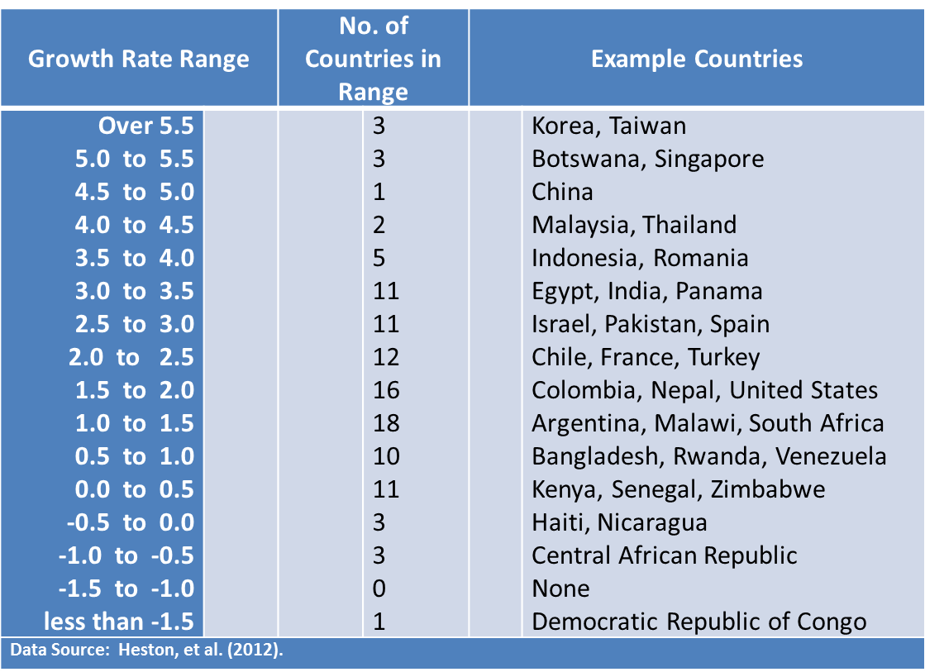
What counts as rapid or slow growth?
Average Annual Growth Rates of GDP per capita, 1960-2010
Double in 13 years
Double in 36 years
Never double

Slide 6
Theories of Economic Development

Slide 7
0. Economic nationalism
1. Modernization theory
  Rostow's Linear-Stages-of-Growth-Model
  Harrod-Domar growth model
2. Structural-change theory
  Lewis model
3. Dependency theory
4. Neoclassical theory of development
  Solow growth model
  Endogenous growth models
5. Institutional theory of development (Session 9)

Slide 8
(0.) Economic nationalism
Economic nationalism refers to an ideology which favors policies that emphasize domestic control of the economy, labor, and capital formation, even if this requires the imposition of tariffs and other restrictions on the movement of labor, goods and capital.
In many cases, economic nationalists oppose globalization or at least question the benefits of unrestricted free trade.
Economic nationalism may include such doctrines as protectionism, mercantilism, or import substitution.
This policy was implemented in most of current industrialized countries. Notable examples include the development and industrialization of Germany and the United States in the 19th century and later in Japan.
Notes:
  Against economic theories (Adam Smith);
  Developing countries’ claim that current industrialized countries did the same in the past;
  Some experts point to Brexit and the election of Trump as a possible revival of these policies.

Slide 9
1. Modernization theory
Modernization refers to the transition from a “pre-modern” or “traditional” to a “modern” society.
  Modern = West?
According to the modernization theory, all societies progress through similar stages of development. Therefore, today’s underdeveloped countries are in a similar situation to that of today’s developed countries at some time in the past, and thus the task is to help underdeveloped countries to accelerate their progress along this common path of development by investments, technology transfer, and closer integration into the world market (Rostow, 1960; Unger, 2010).
  In other words, modernization theory assumes that with assistance, traditional countries can be brought up to the same level of development as more developed countries independent of their culture, history, etc.
  Also, development became synonymous with rapid, aggregate economic growth.

Slide 10
1. Modernization theory
The Linear-Stages-of-Growth-Model (Rostow):
  Traditional society
  Precondition to take off
  Take-off
  Drive to maturity
  Age of high consumption
Compare to Karl Marx’ stages of history!
  Primitive communism
  Slave society
  Feudalism
  Capitalism
  Socialism
  Communism
Best described by the Harrod-Domar growth model

Slide 11
The Harrod-Domar growth model (AK model)
Assumptions
  We need u units of labor and v units of capital to produce one unit of output
    no human capital
    rigid technology
    constant returns to scale
    constant marginal product of capital
  Investment in capital is financed by saving
  People save a fixed proportion s of income
  There is no technical change
  Labor grows at rate n
  We always have more labor than can be employed by the current quantity of capital

Slide 12
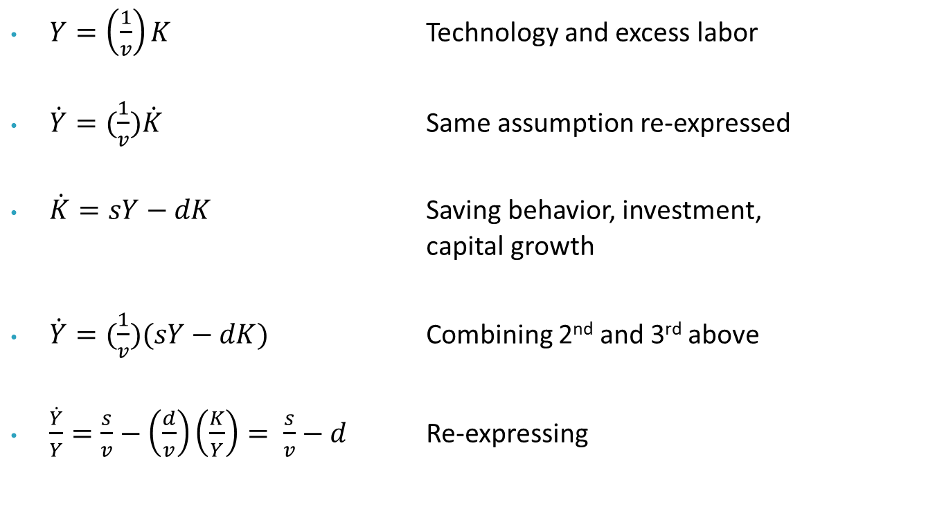
The Harrod-Domar growth model
$Y=\left(\frac{1}{v}\right)K$ Technology and excess labor
$\dot{Y}=(\frac{1}{v})\dot{K}$ Same assumption re-expressed
$\dot{K}=sY−dK$ Saving behavior, investment, capital growth
$\dot{Y}=(\frac{1}{v})(sY−dK)$ Combining 2nd and 3rd above
$\frac{\dot{Y}}{Y}=\frac{s}{v}−\left(\frac{d}{v}\right)\left(\frac{K}{Y}\right)= \frac{s}{v}−d$ Re-expressing

Slide 13
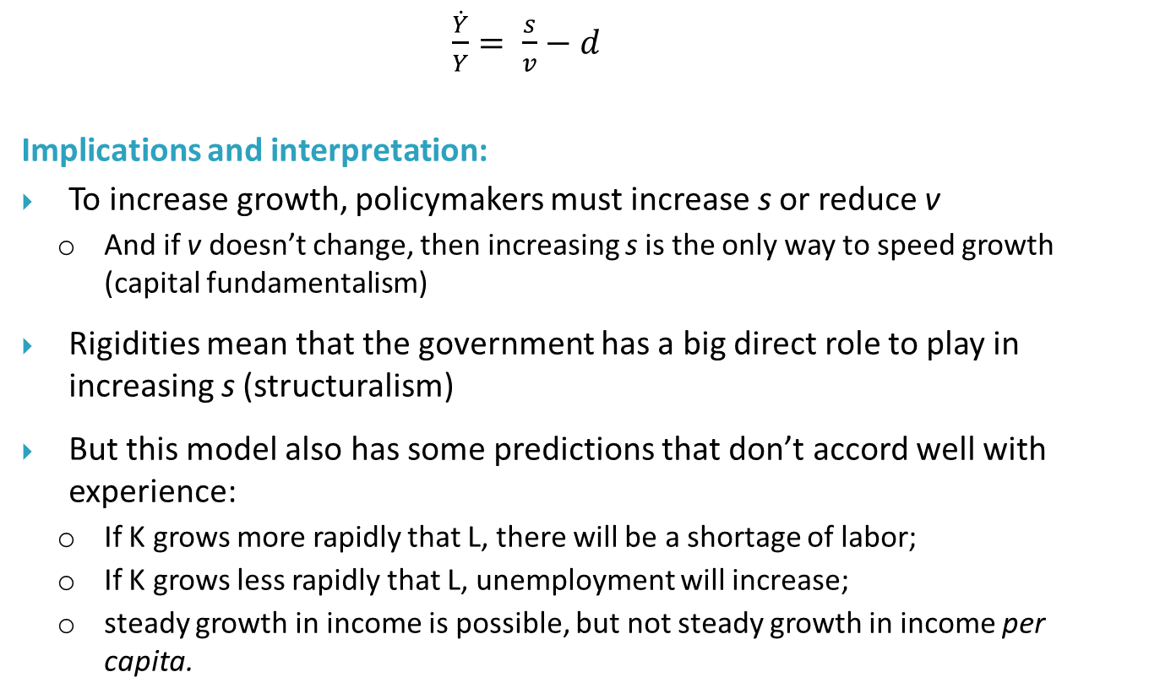
The Harrod-Domar growth model
$\frac{\dot{Y}}{Y}= \frac{s}{v}−d$
Implications and interpretation:
To increase growth, policymakers must increase s or reduce v
  And if v doesn’t change, then increasing s is the only way to speed growth (capital fundamentalism)
Rigidities mean that the government has a big direct role to play in increasing s (structuralism)
But this model also has some predictions that don’t accord well with experience:
  If K grows more rapidly that L, there will be a shortage of labor;
  If K grows less rapidly that L, unemployment will increase;
  steady growth in income is possible, but not steady growth in income per capita.

Slide 14
1. Modernization theory
The modernization theory has been criticized because:
The modernization of a society usually requires the destruction of the indigenous culture and its replacement with a supposedly more “Westernized” one which may not be compatible with the culture, socio-economic status, and background of the country.
  While the modernization theorists agree that modernization might cause radical changes and violence in traditional societies, they believe it is worth the price.
There is no valid argument that all countries must follow the same path!
Current developing countries are not the same as developing countries in the past:
  Lower resources;
  Lower GDP per capita (relative to the rest of the world)
  Higher population growth
  Etc.
Moreover, there are opportunities that did not exist in the past:
  International trade benefits
  Experience of other countries (global knowledge; institutions, etc.)

Slide 15
2. Structural-change theory
Structural-change theory deals with policies focused on changing the economic structures of developing countries from being composed primarily of subsistence agricultural practices to being a "more modern, more urbanized, and more industrially diverse manufacturing and service economy."
There are two major forms of structural-change theory:
  W. Lewis' model, which views the traditional sector as consisting of large amounts of surplus labor which can be utilized to spur the development of a modern industrial sector.
  Hollis Chenery's patterns of development approach, which holds that different countries become wealthy via different trajectories. The pattern that a particular country will follow, in this framework, depends on its size and resources, and potentially other factors including its current income level and comparative advantages relative to other nations.

Slide 16
The Lewis model
Assumptions
  Marginal product of labor virtually zero in traditional sector
  Standard production function in modern sector
    No human capital
    No technical change
  Producers in traditional sector do not maximize profits and do not save
  Producers in modern sector maximize profits and save all of income
  Wages are stuck at some traditional level in traditional sector
  Workers migrate to the modern sector if paid the traditional wage plus a premium

Slide 17
The Lewis model
VMP_{L} in the Capitalist Sector
Capitalist
Income
Wage level
VMP_{L} after reinvestment
of capitalist income
Payments to Labor in
Capitalist Sector
Initial VMP_{L}
L₁
L₂
Labor Employed in Capitalist Sector (L)

Slide 18
The Lewis model
Implications and interpretation:
Growth is only possible through accumulation of capital in the modern sector.
Producers in the modern sector see a wage that is “too high,” so government should encourage them to expand employment further.
Since the modern sector produces substitutes for imports, government should support the sector by protecting it from international competition.
Agriculture plays a purely passive role in growth.
  Neglect the agriculture sector: it does not have any future; Plus, by investing in agriculture and possible increase of wages in this sector, labor will no have an incentive to more to the modern sector.

Slide 19
2. Structural-change theory
Structural-change approaches to development economics have faced criticism for their emphasis on urban development at the expense of rural development which can lead to a substantial rise in inequality between internal regions of a country.
The two-sector surplus model, which was developed in the 1950s, has been further criticized for its underlying assumption that predominantly agrarian societies suffer from a surplus of labor. Actual empirical studies have shown that such labor surpluses are only seasonal and drawing such labor to urban areas can result in a collapse of the agricultural sector. The patterns of development approach has been criticized for lacking a theoretical framework.

Slide 20
3. Dependency theory (International dependence theory)
The dependency theory rejects the modernization theory arguing that underdeveloped countries are not merely primitive versions of developed countries, but have their own unique features and structures and are in a situation of being the weaker members in a world market economy.
A central notion of the dependency theory is that resources flow from a “periphery” of poor and underdeveloped states to a “core” (or “center”) of wealthy states, enriching the latter at the expense of the former (Gunder Frank, 1966; Dos Santos, 1970).
The theory became popular in the 1960s and 1970s as a criticism of modernization theory and because of continued widespread poverty in the world.
  Still popular among anti-globalization movement and some developing countries.

Slide 21
3. Dependency theory
The theory generally argues that developing countries are poor because of the rich countries, either because of colonial history and resource extraction; or because of the institutions the colonial powers left behind; or because of the current relationship between the rich and poor countries.
You also find other theories under the umbrella of the dependency theory:
  Neocolonial dependence theory
  False paradigm model
  Dualistic-development thesis

Slide 22
3. Dependency theory
Some of the proponents of the dependency theory were strong supporters of “import substitution industrialization” which advocates the reduction of a country’s foreign dependency through the local production of industrialized products and replacing foreign import with domestic production (ECLAC, 1950).
  Import-substitution versus Export-promotion (will be discussed in Session 7)
Dependency theory faded away in the 1990s with the economic growth of India and East Asian economies, suggesting that countries that pursued trade-based development policies showed a better performance than countries that followed import substitution industrialization policies.
Moreover, while free market theorists generally agree with dependency theorists’ complaints, they find their policy recommendations incorrect as those policies just deepen the disparity between the developed nations and the underdeveloped countries.

