Slide 1
Session 2
What is development?
What are development objectives?

Slide 2
What is development?

Slide 3
Motivation
What motivates you to check out a course in development economics?
Some questions to ask:
  Why are some people and countries so much poorer than others?
  How did some countries become prosperous?
  What can governments do to reduce poverty and encourage the spread of prosperity?
Such questions motivate interest in the subject of development, which encompasses the many ways material, physical, and social living standards might improve and the processes and policies that help bring those improvements about.

Slide 4
Some progress …
The facts and figures on the following slides offer glimpses of the concerns that motivate many to study development.
1. World War II; Cold War; Decolonization ; President Truman; Marshall Plan
2. 1992:
Divide between the rich and poor countries widening
dominance of high-income industrialized nations in the global order
Disintegration of the Soviet Union and end of the Cold War; The U.S. won the cold war.
European Union’s single market project
Crises in BRICS countries: Many developing nations, including Brazil, Russia, India, China, and South Africa (now sometimes grouped by the media as the “BRICS”), found themselves in precarious conditions if not full-scale crisis.
  Brazil—like most of Latin America—was still struggling to emerge from the 1980s’ debt crisis.
  Russia was descending into depression after the collapse of its Soviet economy.

Slide 5
Some progress …
3. Since 1992:
Moving from a sharp dualism between a rich Center and a backward Global South periphery to more dynamic and complex relationships.
Growth in Asia and BRICS;
  Asia has been growing at an average rate almost triple that of high-income Western countries,
  growth returned to Africa, heralding the promise of an era of global convergence.
Health has improved strongly, with dramatic declines in child mortality; and the goal of universal primary education is coming into sight.
Poverty has fallen. While about two-fifths of the global population lived in extreme poverty in 1990, the fraction has fallen to about one-fifth today.
4. But still big issues to resolve …

Slide 6
Historical growth experience
Four-minute video in which statistician Hans Rosling provides a visual history of growth and development around the world over the last 200 years:
http://www.flixxy.com/200-countries-200-years-4-minutes.htm

Slide 7
But still big issues …
The future of economic development and poverty reduction is far from assured.
Many people who have come out of poverty remain vulnerable, the natural environment is deteriorating, and national economic growth remains uncertain.
The number of people living in poverty in Africa and other places has yet to decline.
The average income of those remaining poor has still not risen above its long-term level of just 70 cents per day.
Climate change talks, also launched in 1992, proceeded at a very slow pace, even as greenhouse gas emissions reached record levels and the impacts of climate change had become all too visible in low-income countries, threatening to reverse progress in South Asia as well as Africa.

Slide 8
Some issues …
5 percent of the world population lives in countries with per capita income at the U.S. level or higher.
50 percent live in countries with per capita income 1/5th of the U.S. level or less.
10 percent live in countries with per capita income 1/30th the U.S. level or less.

Slide 9
Figure 1- Distribution of the World’s Population
Across Countries at Different Levels of Per Capita GDP in 2010
Luxembourg, Qatar
50 %
5%

Slide 10
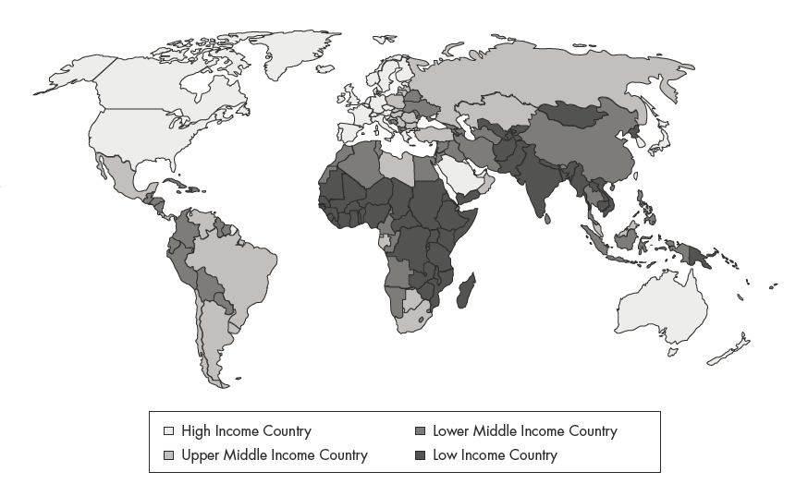
Geographic Distribution of Countries by Average Income Level
Low= Income per capita less than $1005
High = Income per capital greater than $12,275

Slide 11
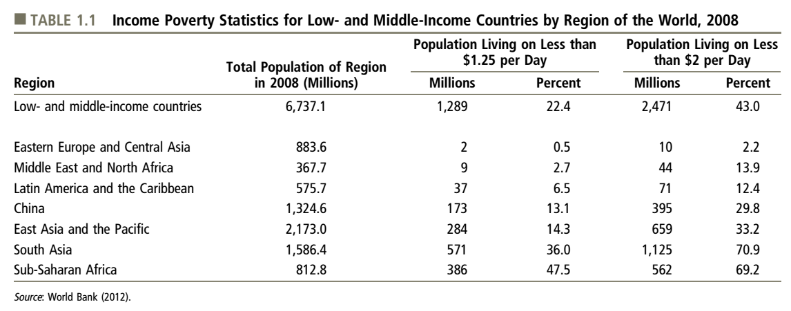
Other global living standards statistics
Motivation

Slide 12
Other global living standards statistics
Looking beyond average income:
nearly 1 billion people live on less than $1 per day
75 percent of the world’s poorest people live in middle income countries
nearly 90 percent of the world’s population lives on less than $10 per day
  To compare: minimum wage in Ontario is CAD 14 (or USD 10).
Looking beyond income:
life expectancy at birth is just 51 years in Sub-Saharan Africa
almost half the world’s population lacks access to improved sanitation

Slide 13
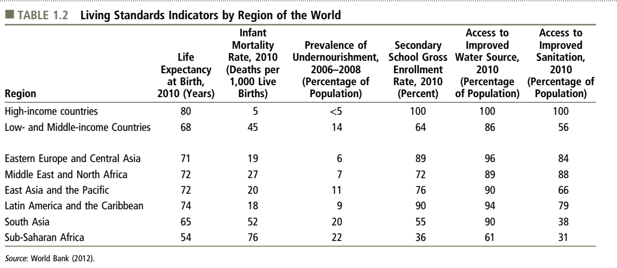
Income poverty differs greatly in breadth and depth across countries

Slide 14
Defining development as an objective and as a process

Slide 15
Development as an objective
The objective in development is sustained improvement in the well-being of a country’s many people, with special emphasis on improvements for the poor,
…where a person’s well-being is a summary assessment of how good or bad her life circumstances are, paying attention at a minimum to the quantities and qualities of the goods and services she consumes, the activities to which she allocates her time, and her hopes and fears regarding the future.

Slide 16
Development as an objective; Another look
The Three Objectives of Development:
    Increase availability of life-sustaining goods
    Raise levels of living
    Expand range of economic and social choices
Defining the development objective

Slide 17
Development as a process
Development involves a web of socio-economic change through which widespread and sustained improvements in well-being come about.
  Assets
  Socioeconomic system
  Institutions

Slide 18
Development as a process
The accumulation of “assets” is central to the development process.
We define the term assets very broadly to include any physical, mental, or social resources or attributes that expand in a long-lasting way an economy’s capacity to provide the goods, services, security, and opportunities from which people derive their well-being.
  Examples: farm; business assets such as irrigation ditches, machines, and inventories; infrastructure assets such as roads, telecommunications systems, and wells for safe drinking water; human assets such as education, job training, and health; and technological assets such as knowledge and use of improved methods for cultivating rice.

Slide 19
Development as a process
The quantity, quality, and types of assets that an economy creates in any period of time and the way the value generated by the assets is distributed across diverse groups are determined within a developing country’s “socioeconomic system”.
  A country’s socioeconomic system encompasses the many activities of its people, who seek the best for themselves and their families and who interact with each other in many market and nonmarket forums.
Their interactions in market and nonmarket forums are governed by “institutions”, which we define as sets of formal rules and informal norms, together with related enforcement mechanisms, that constrain people’s choices in specific arenas.
  High-quality institutions discourage people from engaging in socially detrimental activities such as theft and fraud, and they encourage mutually beneficial trade and cooperation.

Slide 20
We will use economics to help us:
Structure our study of how the socioeconomic system works
Understand what must happen within this system to deliver successful development
Identify which of the necessary activities private actors will tend to do well and which they won’t, and thus where governments and NGOs might intervene in the system to improve development outcomes
Wrestle with how to make government and NGO interventions as successful as possible (by thinking carefully about good policy design and good governance of policy implementation)

Slide 21
Analytical framework
Households and individuals
Markets for goods and services
Labor markets
Financial markets
Non-market forums (e.g. communities)
Environment
Private institutions
Policies and public sector institutions
Socio-economic system
21

Slide 22
Within this framework, the process of development requires:
Economic growth, which requires people investing in:
    irrigation ditches, machines, buildings
    roads, wells, power plants
    education, health, job training
    creation and adoption of new technologies
More detailed changes in assets, markets and institutions that allow incomes and well-being to rise for many groups throughout society, as people:
    Receive or invest in new assets
    Enjoy increases in wages or prices for goods and services they produce on farms or in family enterprises
    Enjoy reductions in prices for goods they consume or use as inputs
    Enjoy help through private safety nets from people whose incomes are rising
    Enjoy assistance through new public safety nets

Slide 23
Within this framework, people make many development-enhancing choices, but
Development performance may be far from ideal in the absence of intervention
Development actors may be able to improve development performance by intervening
..but only if
  policymakers are motivated to pursue development
  their policies are well designed
  their policies are well implemented

Slide 24
Good analysis of policy impacts is vital
Resources are scarce, so each policy must work as well as possible and policymakers must
  Avoid doing what the private sector would do
  Create excellent policy designs
  Create public sector institutions that guide policy implementers into high quality implementation
  Pursue continual improvement through research, experimentation and evaluation.
To encourage improvements for many groups throughout society, policymakers must piece together packages of policies. And to do this well, they must
  Understand who benefits and loses from any one policy.

Slide 25
Policy impacts
Households and individuals
Markets for goods and services
Labor markets
Financial markets
Non-market forums (e.g. communities)
Environment
Private institutions
Policies and public sector institutions
Socio-economic system
Directly affected
Others
25

Slide 26
The tools of economic analysis will help us…
Identify types of policies that are most likely to be complementary to the development activities of private actors
Examine the differentiated and multidimensional impacts of specific policies
Examine how those impacts depend on the details of design and implementation
Identify ways to reduce corruption and improve policy implementation
Learn from on-going research, experimentation, monitoring and evaluation

Slide 27
Millennium Development Goals

Slide 28
MDGs
What values and priorities are suggested by the Millennium Development Goals?
When these goals are emphasized, what is de-emphasized but perhaps also relevant to development?
(find it at:
http://www.un.org/millenniumgoals/)

Slide 29
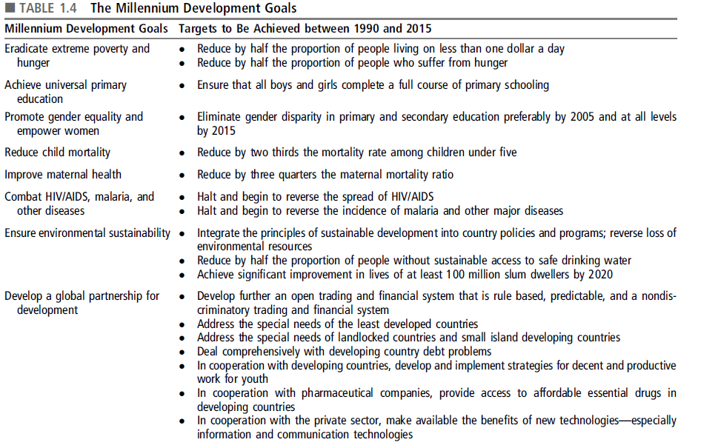

Slide 30
Well-being

Slide 31
As discussed:
The objective in development is sustained improvement in the well-being of a country’s many people, with special emphasis on improvements for the poor.

Slide 32
A working definition of well-being
A person’s well-being is a summary assessment of how good or bad her life circumstances are, paying attention at a minimum to the quantities and qualities of the goods and services she consumes, the activities to which she allocates her time, and her hopes and fears regarding the future.
How does this relate to happiness?

Slide 33
The pursuit of well-being by households
How do households in developing countries spend income and acquire goods and services?
How do households in developing countries cope with fluctuations and shocks?
How households in developing countries build better futures through investment

Slide 34
The determinants of well-being
Determinants are features of households’ circumstances that they take as given in the present moment and that help determine how much well-being they achieve.
Some features are exogenous to households – beyond their influence. Many other features of households’ circumstances are endogenous, or influenced by their choices.
Determinants are levers with which policymakers might be able to raise households’ well-being.

Slide 35
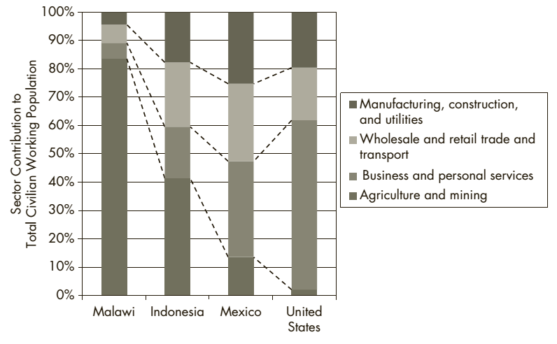
How households in developing countries earn income
FIGURE 2.1 Percentage Distribution of Civilian Workers across Sectors in Countries at Different Income Levels

Slide 36
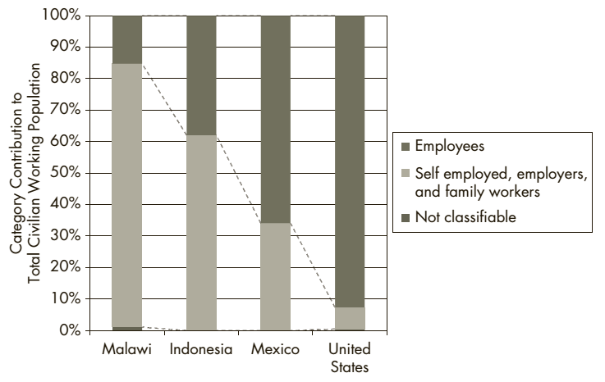
How households in developing countries earn income
FIGURE 2.2 Percentage Distribution of Civilian Workers by Employment Status in Countries at Different Income Levels

Slide 37
Characteristics of the Developing World

Slide 38
Characteristics of the Developing World
There are common characteristics among developing countries – on average and with great diversity - in comparison with developed countries:
    1. Lower Levels of Living and Productivity
    2. Lower Levels of Human Capital (health, education, skills)
    3. Higher Levels of Inequality and Absolute Poverty
    Absolute Poverty
    World Poverty
    4. Higher Population Growth Rates
    Crude Birth rates

Slide 39
Characteristics of the Developing World
    5. Greater Social Fractionalization
    6. Larger Rural Populations but Rapid Rural-to-Urban Migration
    7. Lower Levels of Industrialization and Manufactured Exports
    8. Adverse Geography
    Resource endowments

Slide 40
Characteristics of the Developing World
9. Underdeveloped Financial and Other markets
Imperfect markets
Incomplete information
10. Colonial Legacy and External Dependence
Institutions
Private property
Personal taxation
Taxes in cash rather than in kind

