Slide 1
Introduction to Evidence-Based Practice (EBP)
Department of Health Sciences
Fall 2018
Shermeen Nizami, Ph.D.

Slide 2
Module Learning Outcomes
Upon completion of this module, students will be able to:
  Describe fundamental concepts in health research (care/research link)
  Discuss the EBP model
  Map the EBP model to the care/research link

Slide 3
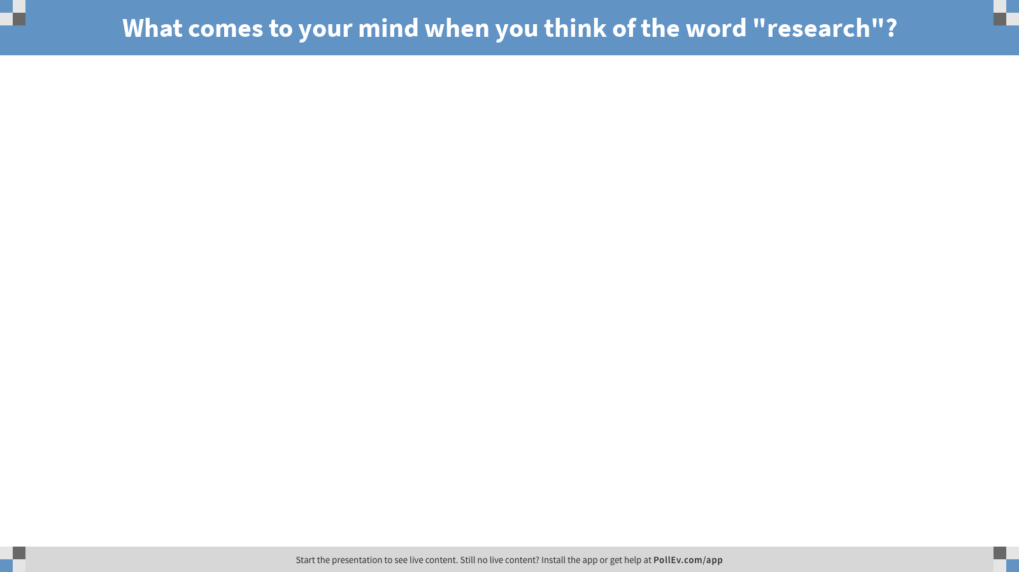
Notes:
Poll Title: What comes to your mind when you think of the word "research"?
https://www.polleverywhere.com/free_text_polls/iJEruKAfOnbsbJv

Slide 4
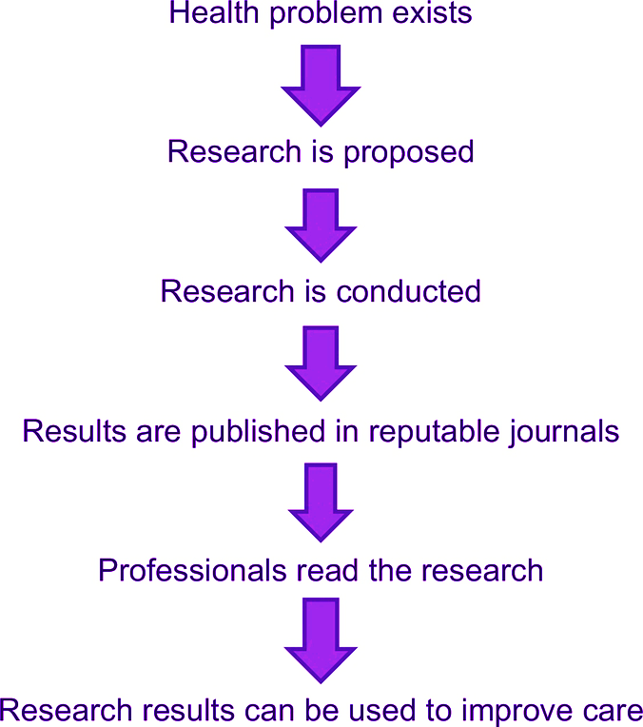
Davies (2018): Chapter 1
Care/Research Link
Davies, B., & Logan, J. (2018). Reading research: a user-friendly guide for health professionals (6th ed.). Elsevier Canada.

Slide 5
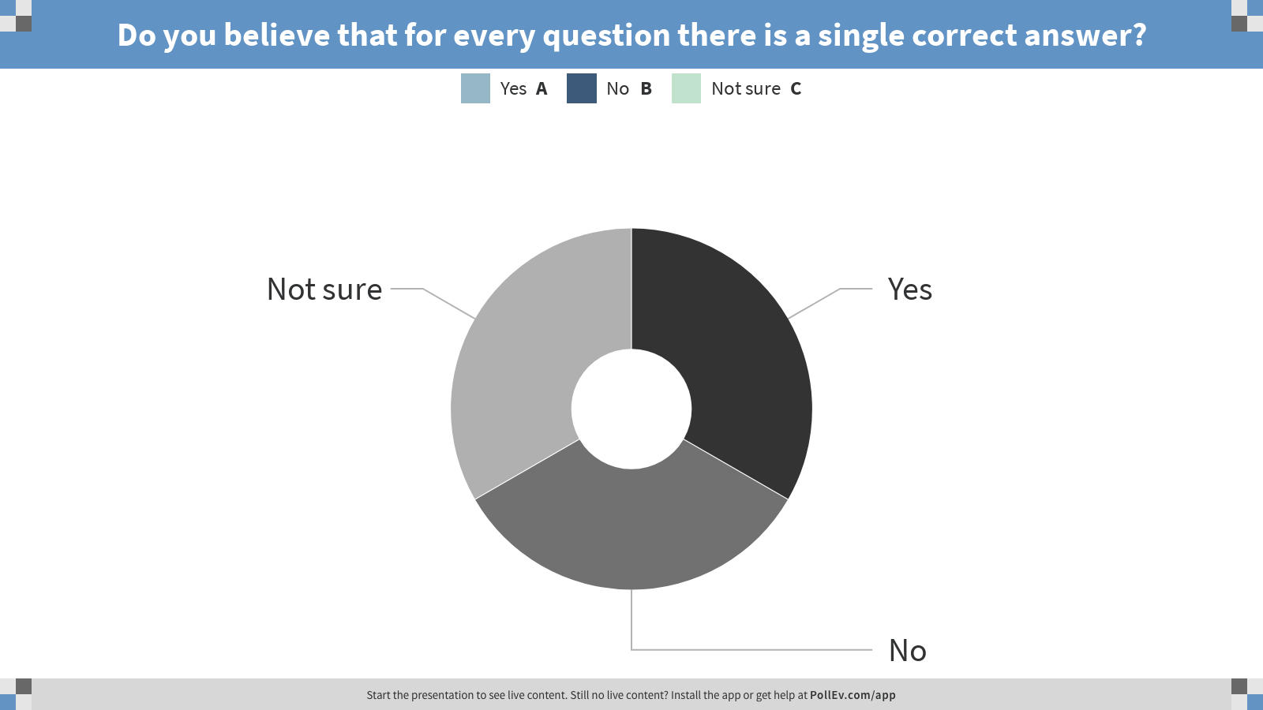
Notes:
Poll Title: Do you believe that for every question there is a single correct answer?
https://www.polleverywhere.com/multiple_choice_polls/uluklNKYeatRrz0

Slide 6
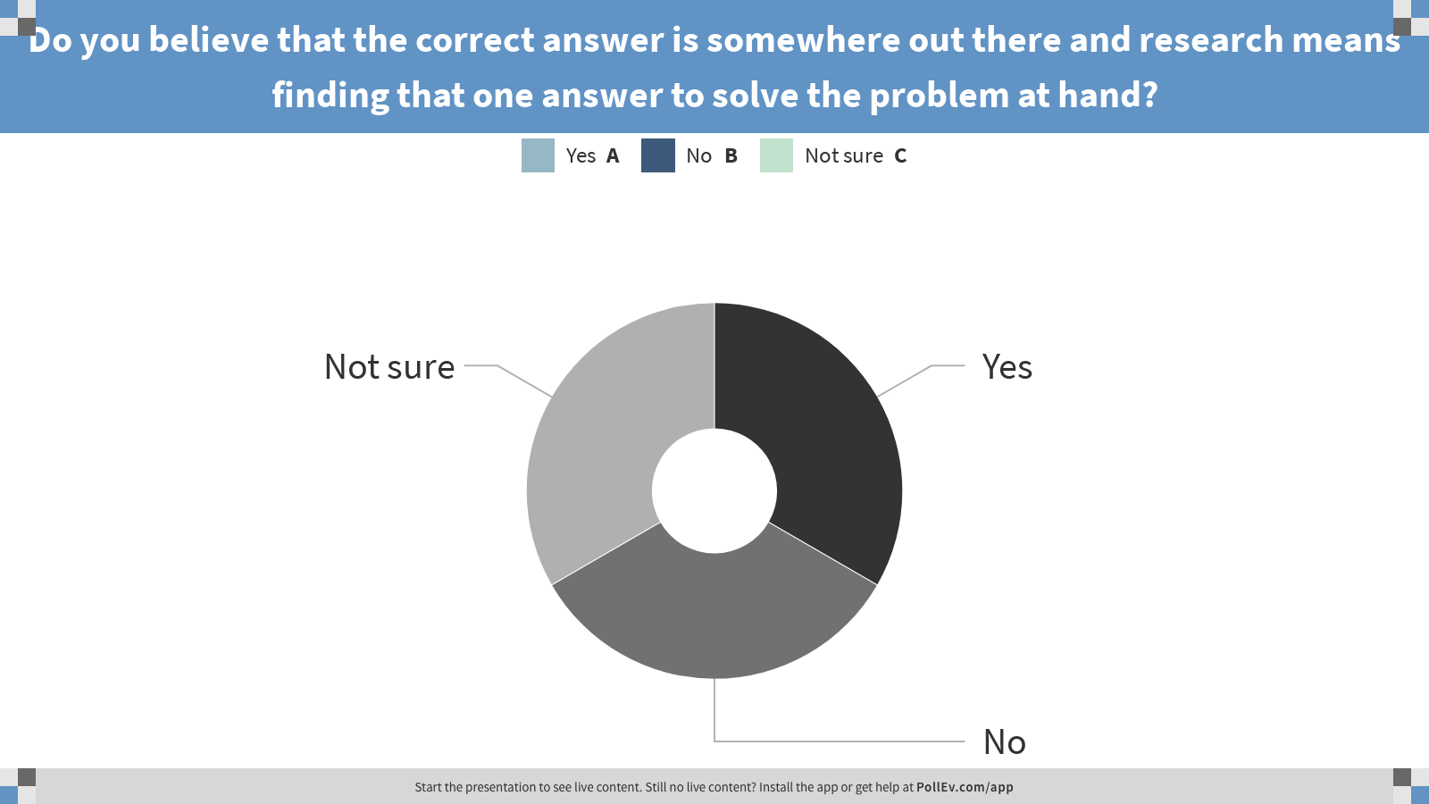
Notes:
Poll Title: Do you believe that the correct answer is somewhere out there and research means finding that one answer to solve the problem at hand?
https://www.polleverywhere.com/multiple_choice_polls/sa063qjGaronpCI

Slide 7
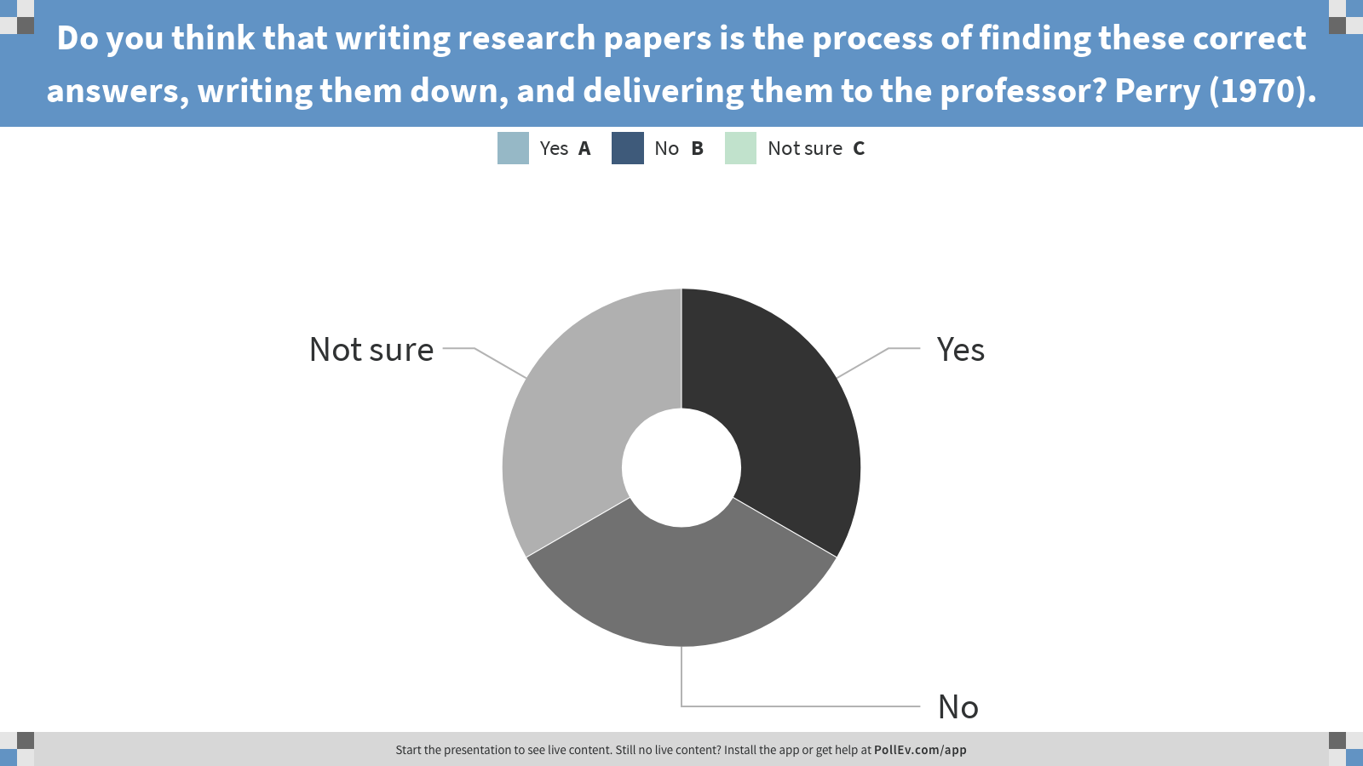
Notes:
Poll Title: Do you think that writing research papers is the process of finding these correct answers, writing them down, and delivering them to the professor? Perry (1970).
https://www.polleverywhere.com/multiple_choice_polls/Vmgjea0MRyiUH3G

Slide 8
What is Evidence-Based Practice (EBP)?
“Evidence based practice (EBP) is the integration of the
best available research evidence with clinical expertise
and patients' unique perspectives and circumstances to
optimize healthcare outcomes [1]. EBP knowledge and
skills have become foundational principles for all health
care professionals [2].”
Tilson, J. K. (2010). Validation of the modified Fresno test: assessing physical therapists’ evidence based practice knowledge and skills. BMC Medical Education, 10, 38. https://doi.org/10.1186/1472-6920-10-38

Slide 9
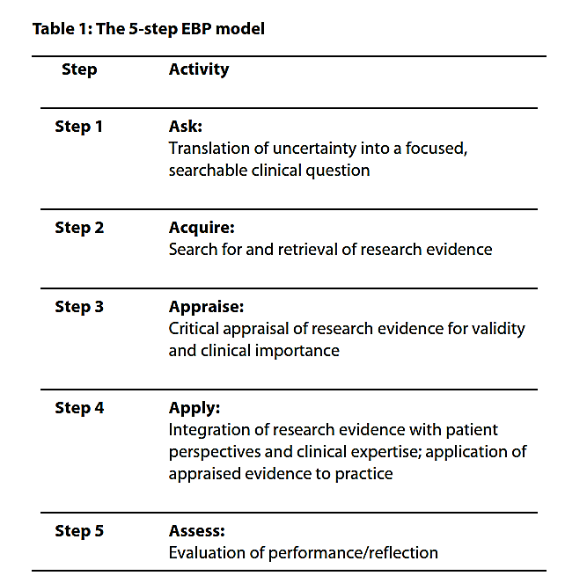
The 5-step EBP model
Tilson, J. K. (2010). Validation of the modified Fresno test: assessing physical therapists’ evidence based practice knowledge and skills. BMC Medical Education, 10, 38. https://doi.org/10.1186/1472-6920-10-38

Slide 11
Module Learning Outcomes
Upon completion of this module, students will be able to:
  Describe fundamental concepts in health research (care/research link)
  Discuss the EBP model
  Map the EBP model to the care/research link

