Slide 1
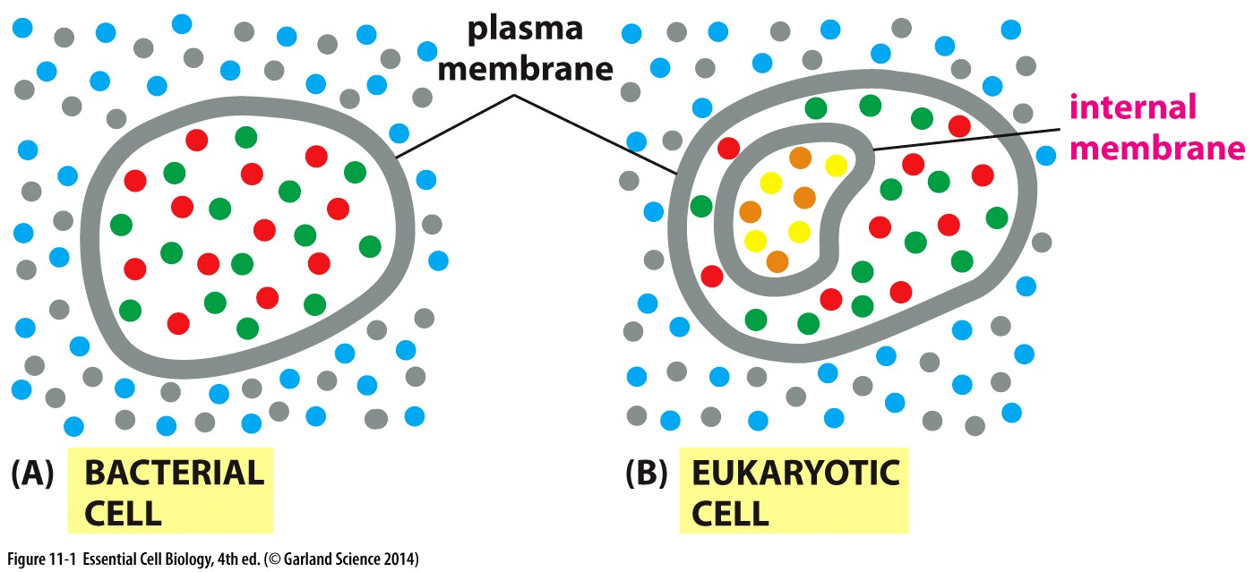

Slide 2
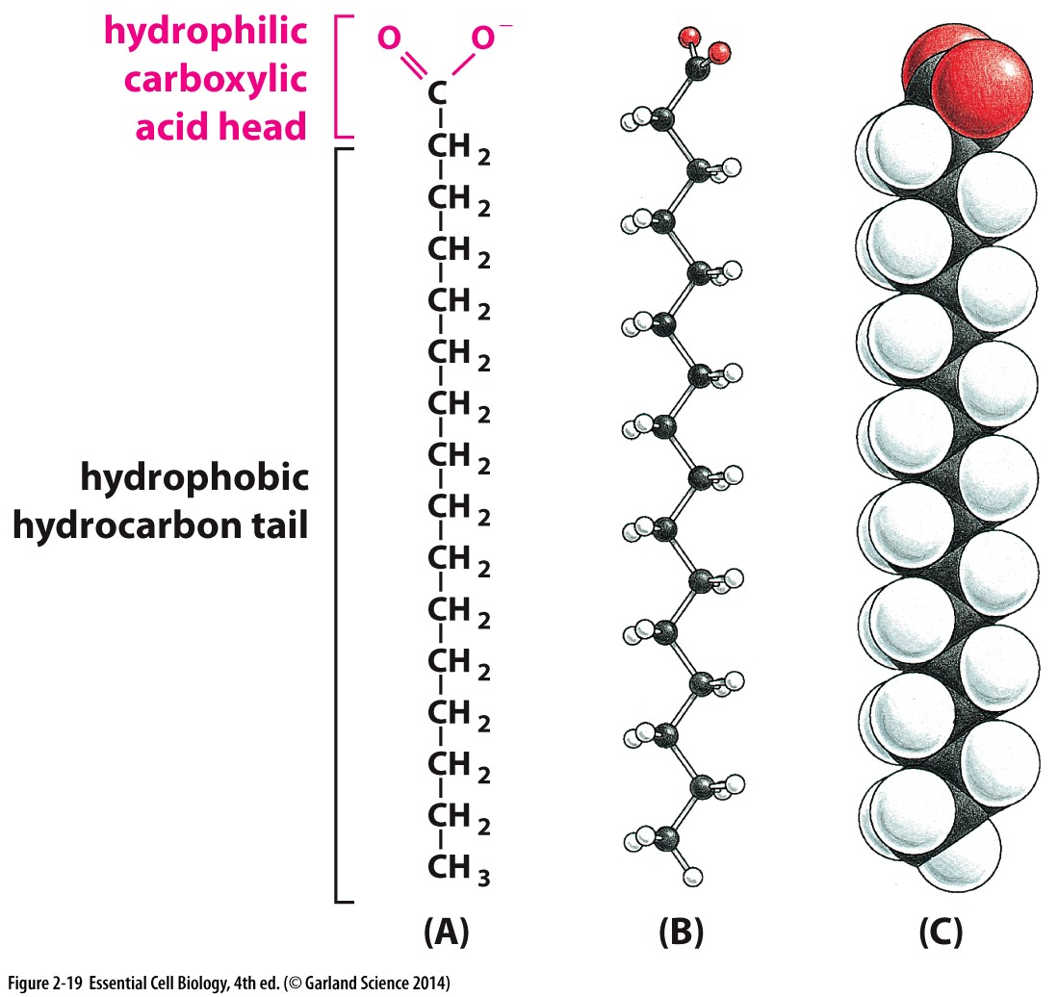
Fatty acids
Contain a hydrophobic tail and carboxyl head
They are amphipathic molecules
Saturated Fatty acids
  Single bonds between carbons in the tail
unsaturated fatty acid
  hydrocarbon tails contains carbons with double bonds

Slide 3
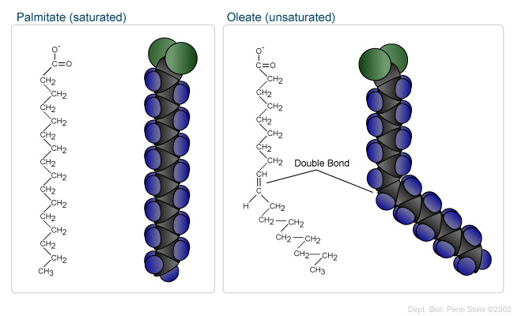
Saturated vs unsaturated

Slide 4
Lipids
Diverse group of compounds like fatty acids, which are soluble in organic solvents and fat
Formation of lipid bilayer in the cell membrane

Slide 5
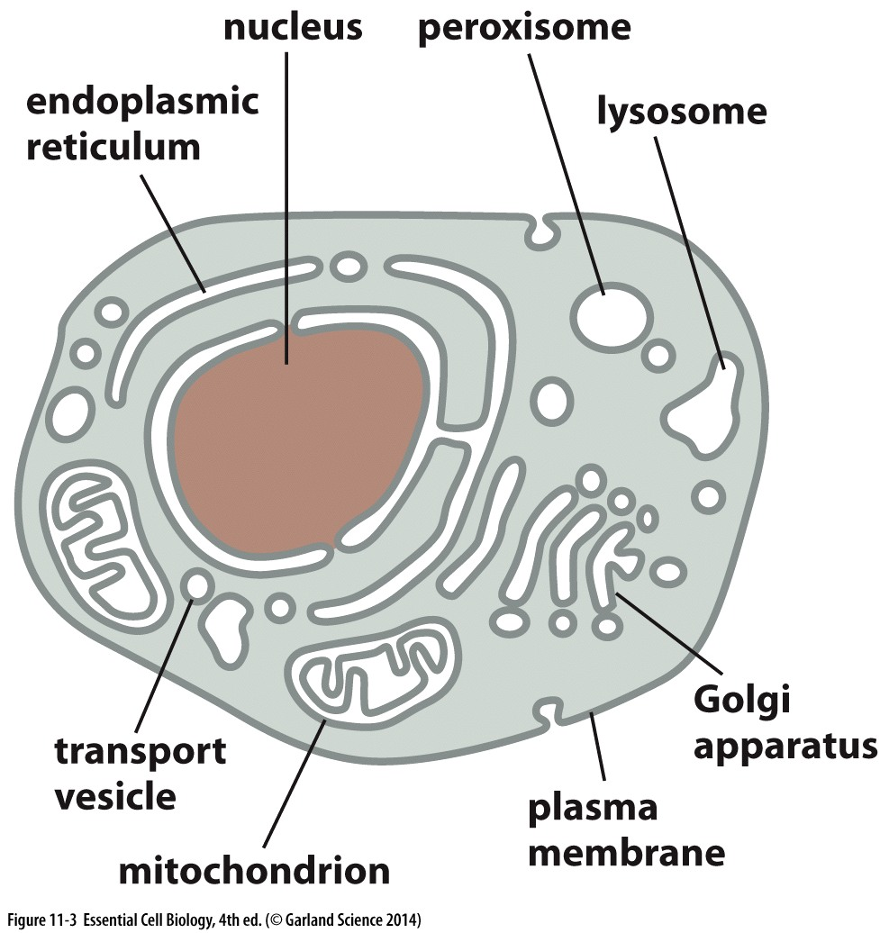

Slide 6
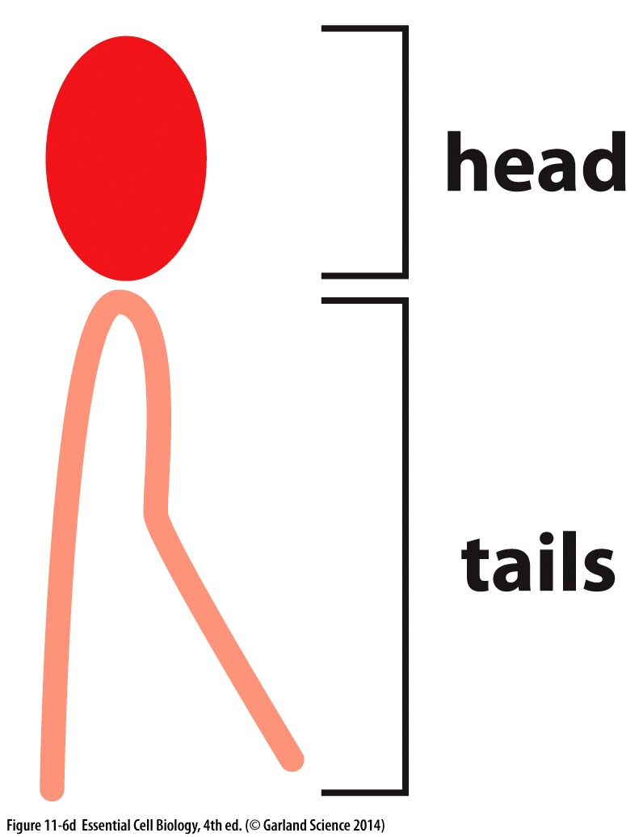
Lipid bilayer
Phospholipids are the most common lipids in cell membrane
Hydrophilic head can change
  Glycolipids have sugar as hydrophilic head
  Cholesterol contains an OH group

Slide 7
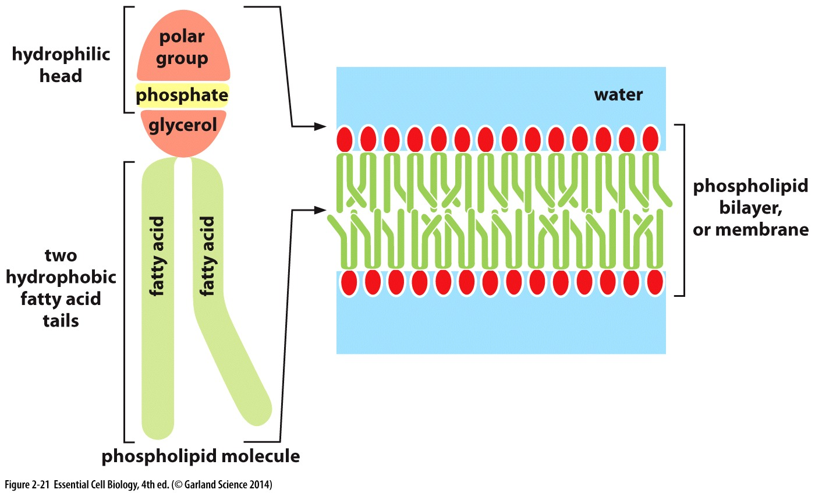

Slide 8
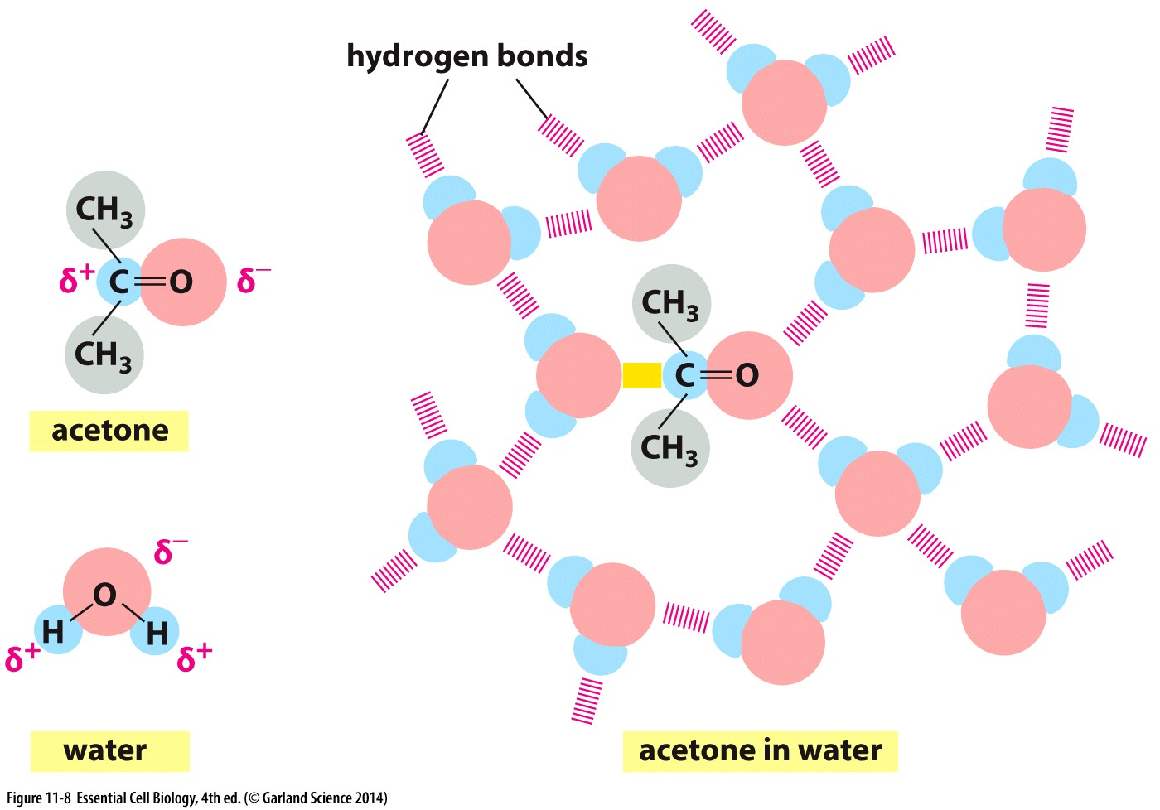

Slide 9
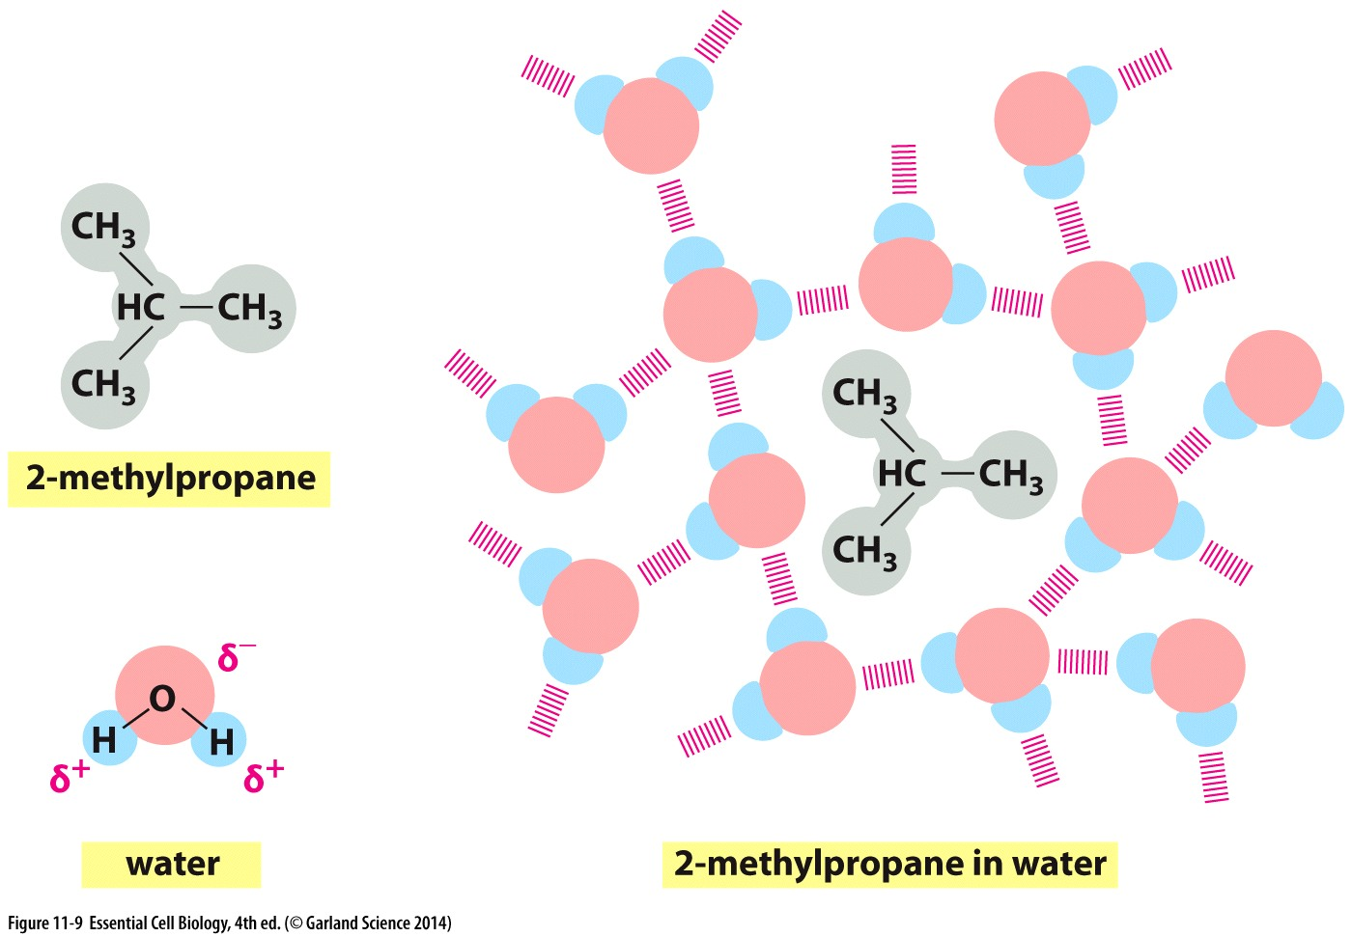

Slide 10
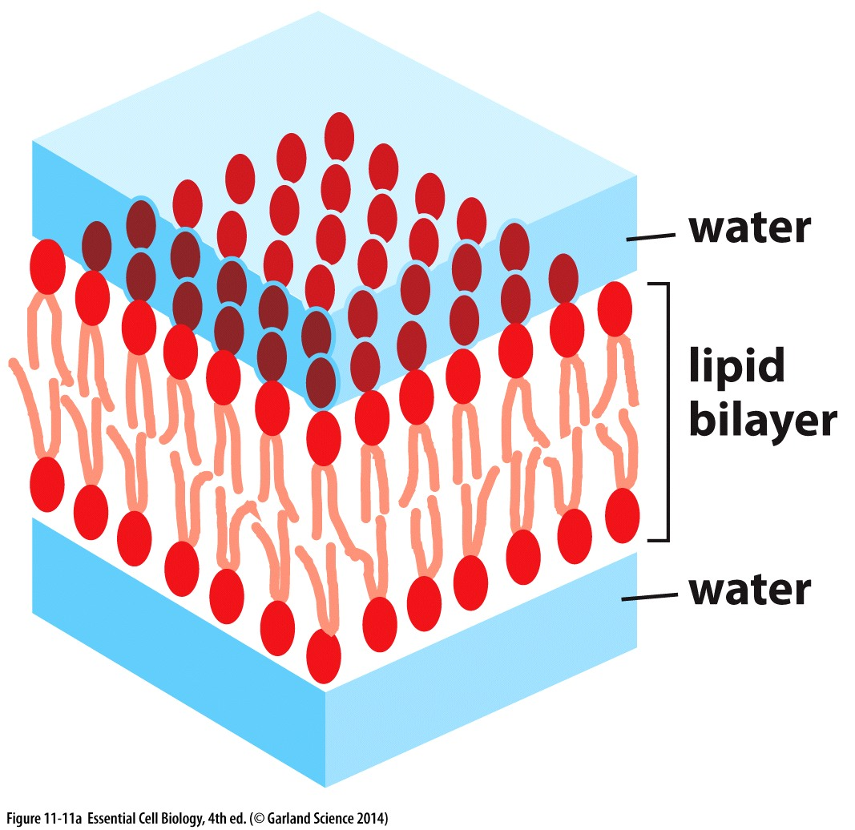
Lipid bilayer
Amphipathic property of the bilayer, arranges the membrane into a favourable formation

Slide 11
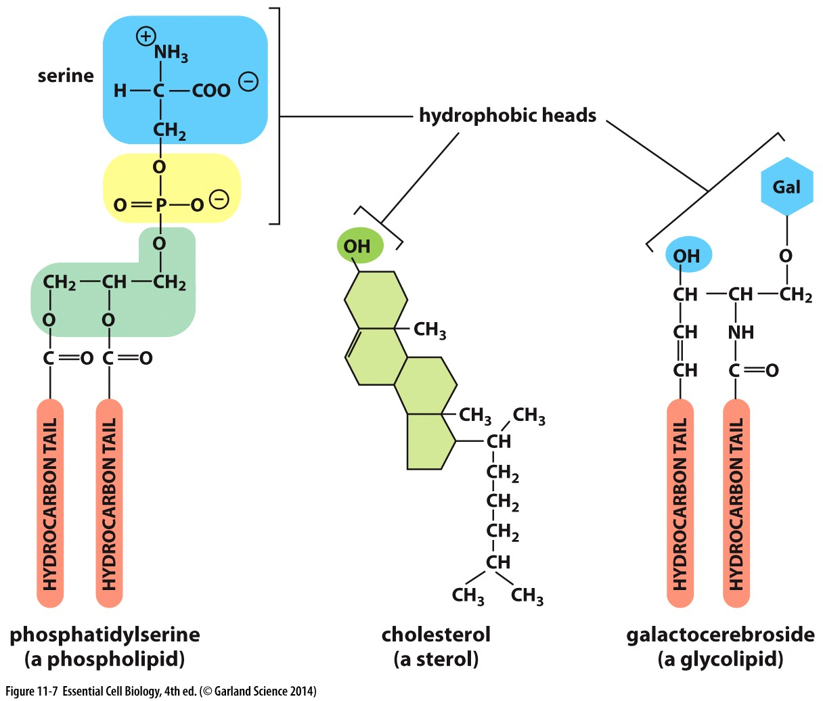
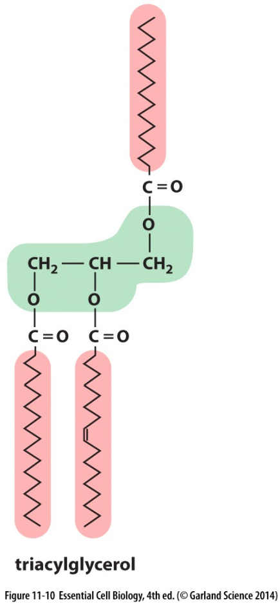
Types of lipids
Phospholipids
Cholesterol
Glycolipids
Fats
triacylglycerol

Slide 12
Lipid bilayer composition
Hydrocarbon tail defines fluidity of the membrane
  Shorter tail results in higher fluidity
  Unsaturated hydrocarbon increases fluidity
Cholesterol modulates cell membrane fluidity in animal cells

Slide 13
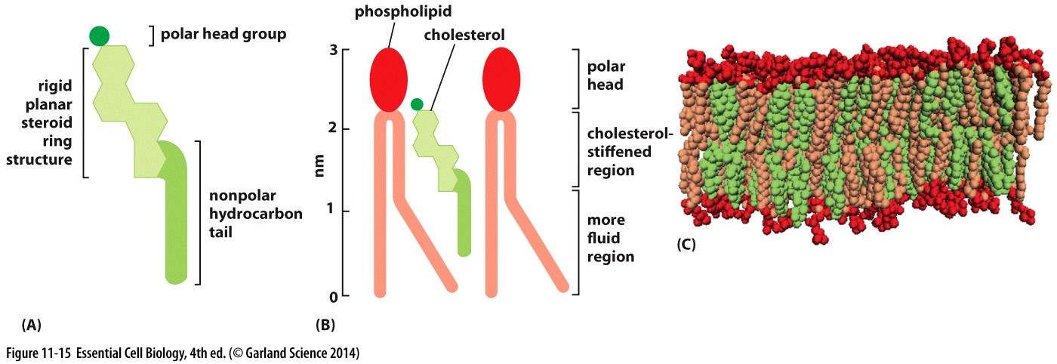
Cholesterol
Fits in the spaces between phospholipids
  Less permeable
  Less flexible

Slide 14
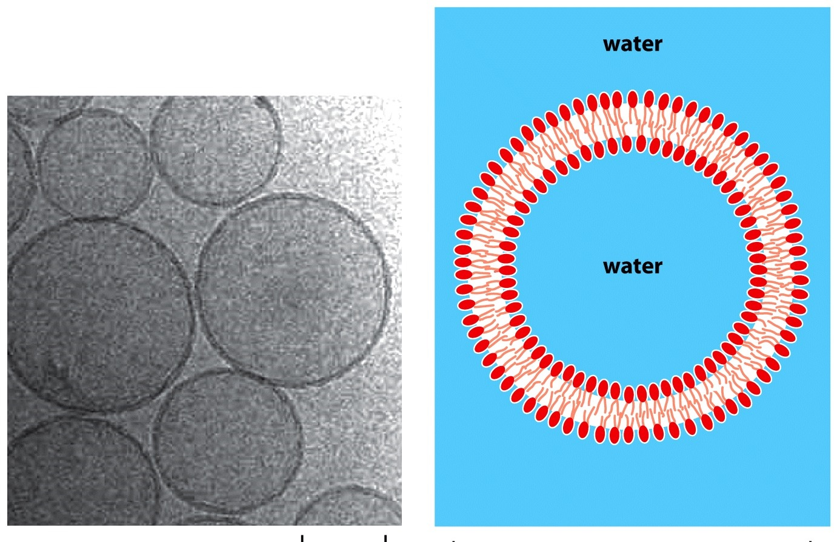
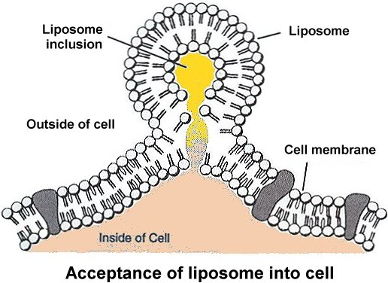
Liposome
Liposomes : vesicles formed from phospholipids
Used in drug delivery

Slide 15
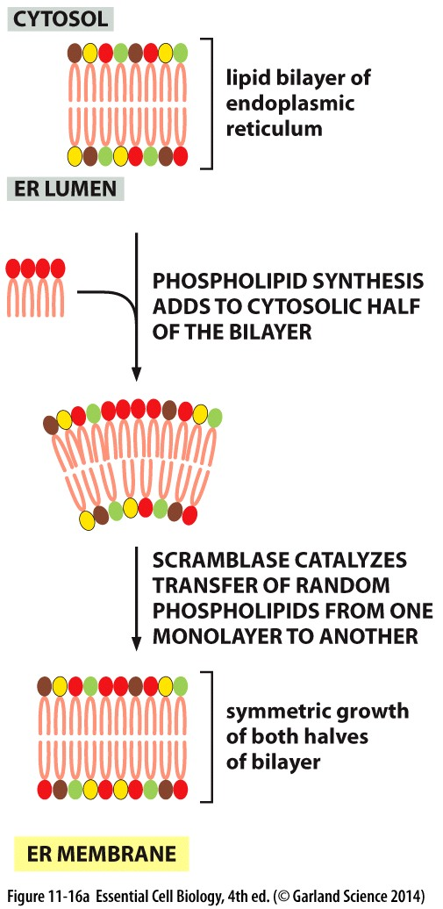
Lipid synthesis in ER
Takes place in ER
  Uses fatty acids to synthesize phospholipids
Scramblase transfers phospholipids between monolayers

Slide 16
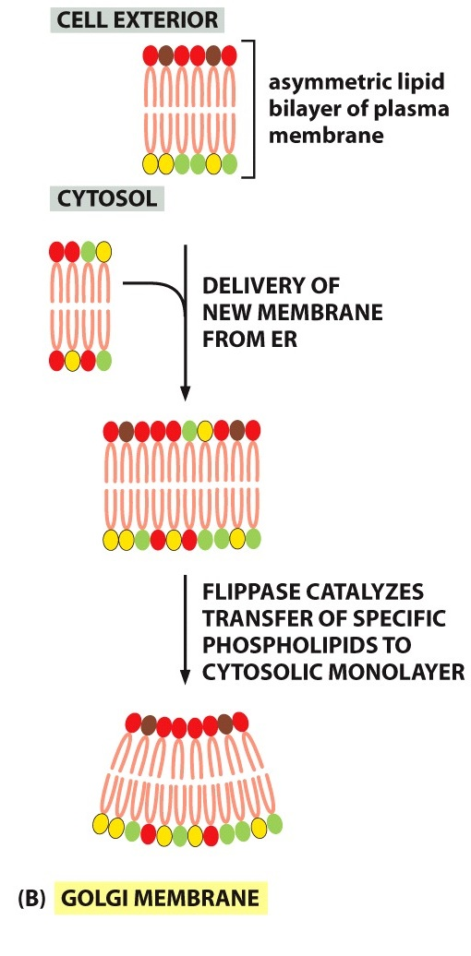
Golgi Apparatus
In Golgi apparatus phospholipids are removed from one monolayer and added to the other
  Flippase facilitates this process
  Provides asymmetry in membrane
Glycolipids obtain their sugar groups in Golgi

Slide 17
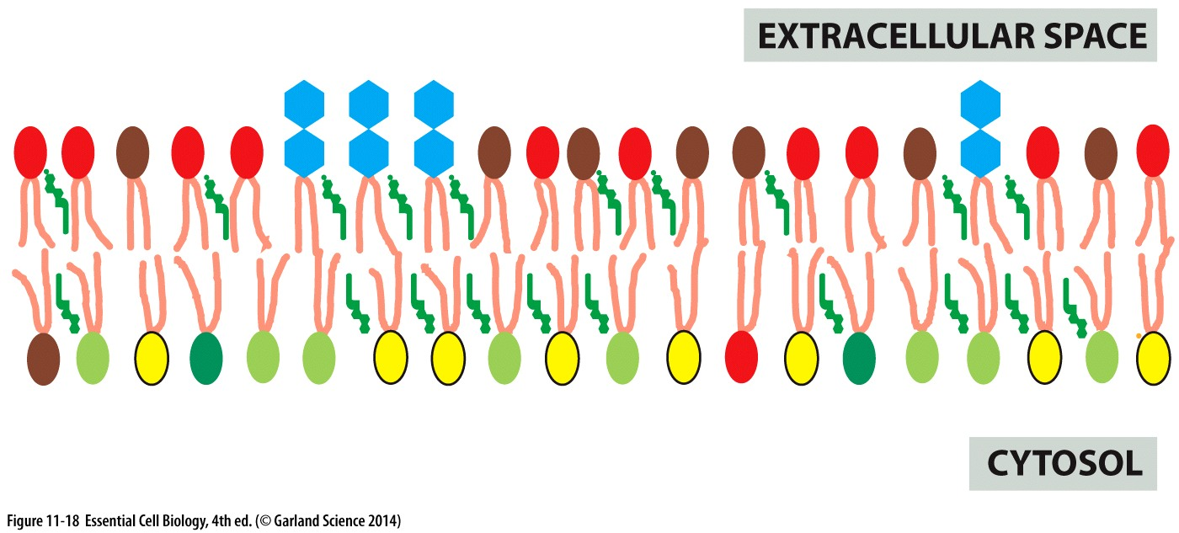

Slide 18
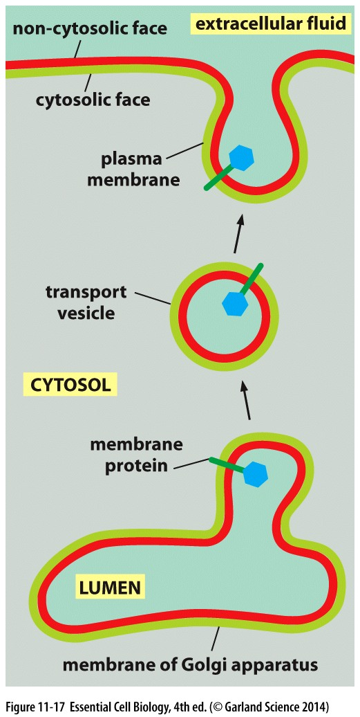

Slide 19
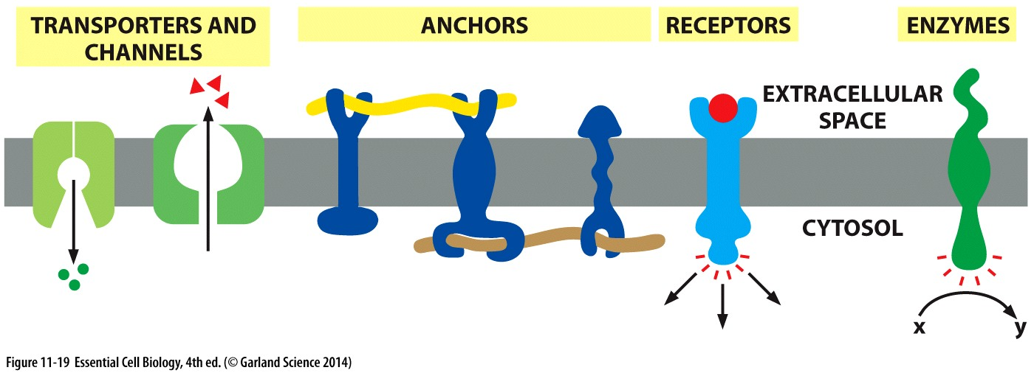
Membrane proteins
Most of the membrane functions are carried out by its proteins
  Transport
  Anchors
  Receptors
  Enzymes

Slide 20
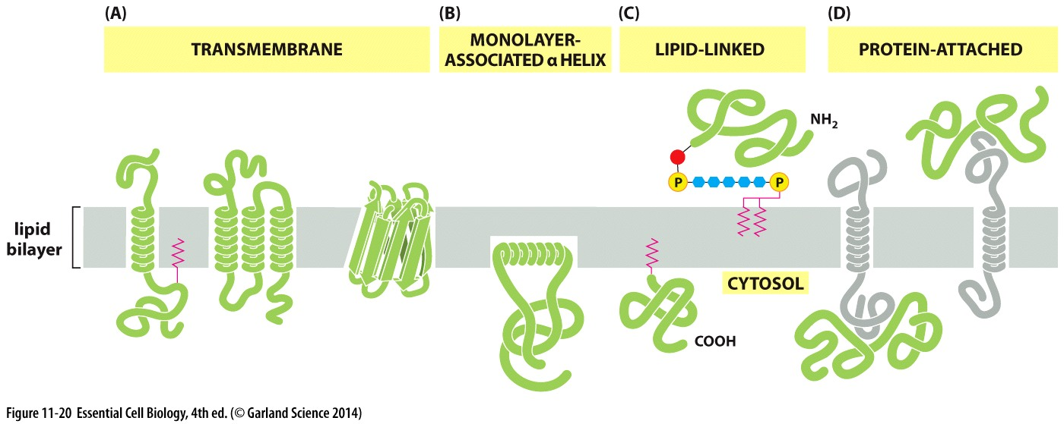
Membrane proteins
Integral membrane proteins
  Transmembrane protein
  Monolayer α-helix
  Lipid-linked
Peripheral membrane proteins
  Protein-attached

Slide 21
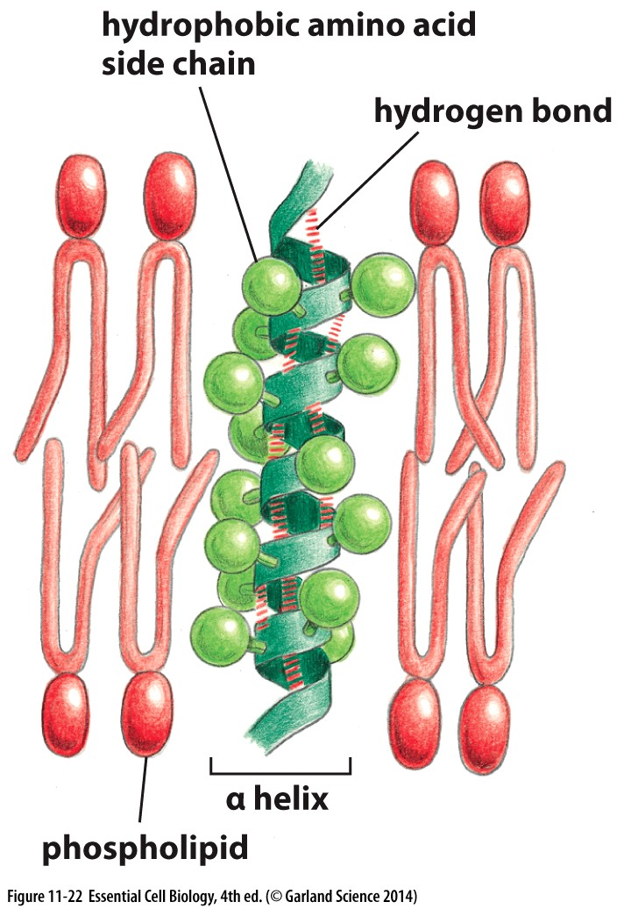
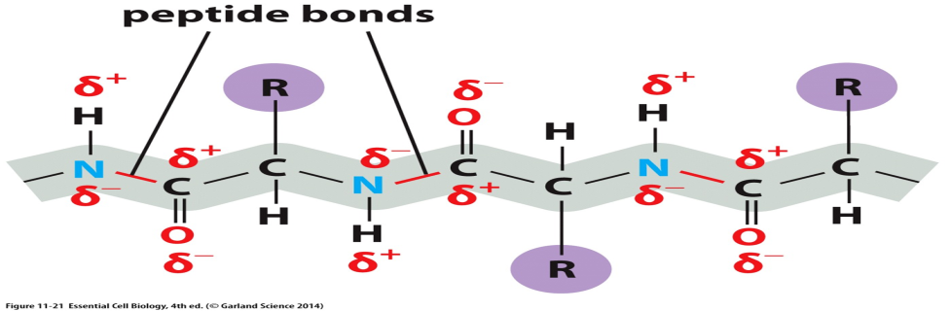
Membrane proteins
Transmembrane proteins contain α-helices that goes through the membrane bilayer
  They contain hydrophobic side chains
  Polar bonds between amino acids
Single pass trans-membrane proteins

Slide 22
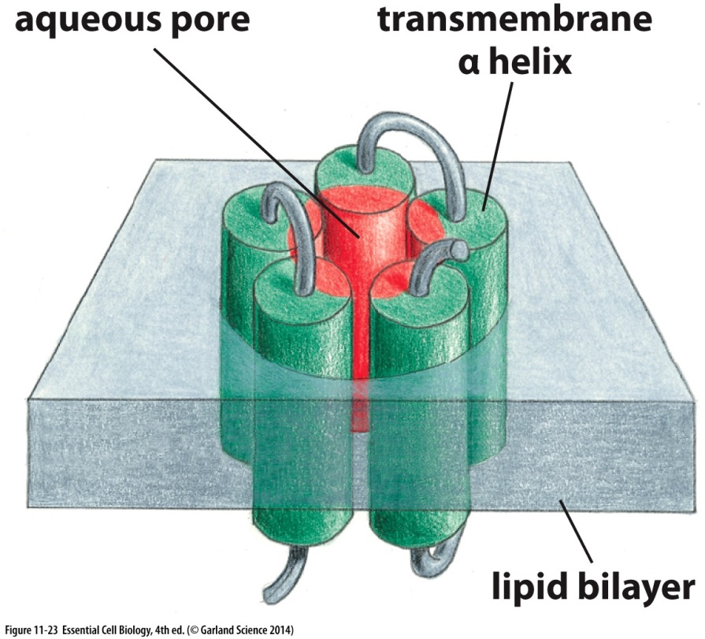
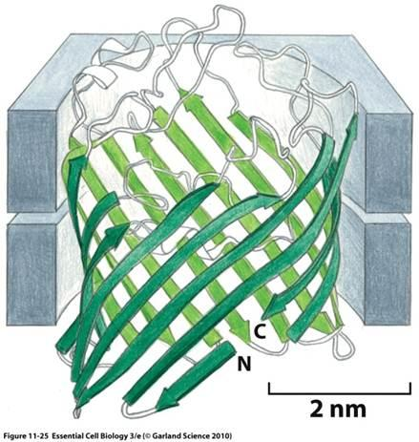
Membrane proteins
Multipass
  Amphipathic regions
  Channels and aqueous pores
β-sheets form β-barrel in porin proteins
  Mitochondria
  Bacteria

Slide 23
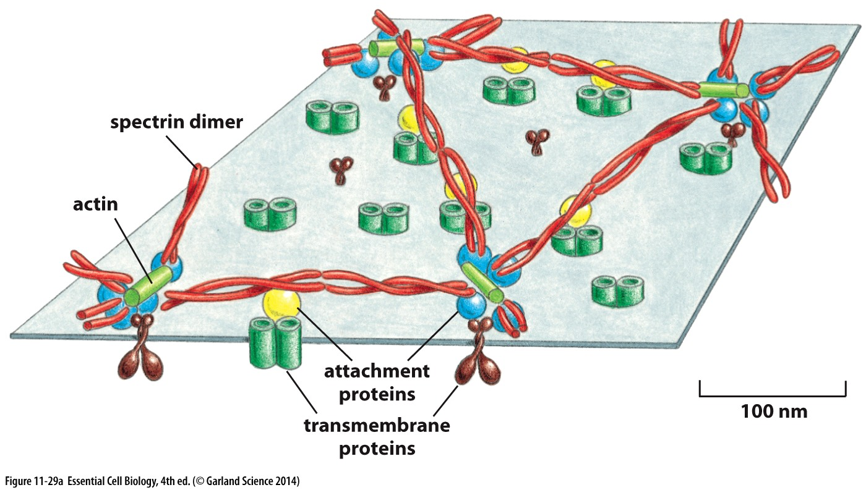
Cell cortex
Plants, yeast and some bacteria have cell wall
Animal cells require proteins, called cell cortex

Slide 24
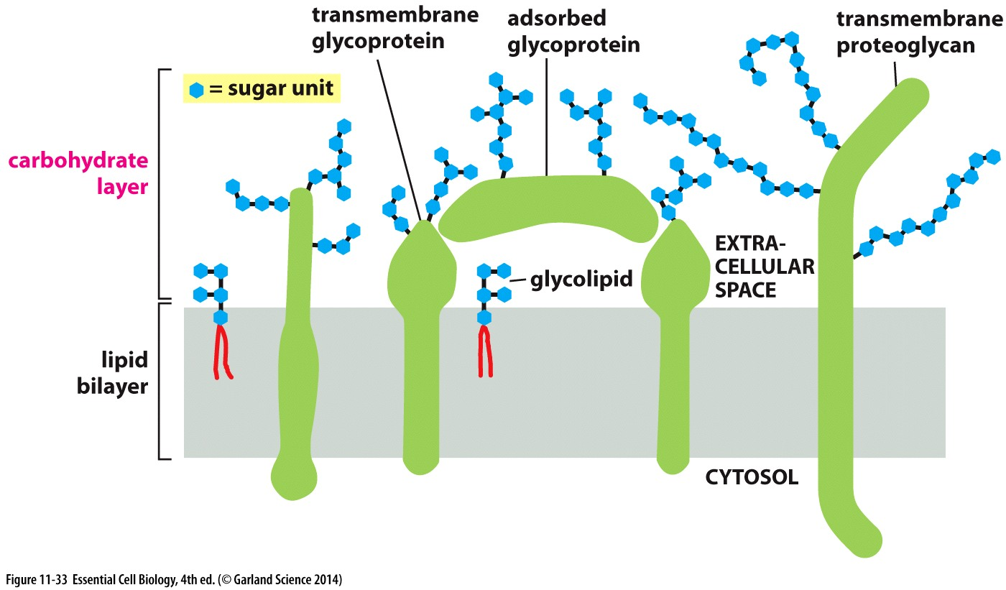
Plasma membrane surface
Carbohydrates cover the plasma membrane
Glycoproteins are found in outer layer of the plasma membrane
Carbohydrates on the outer membrane form glycocalyx
  Glycoprotein
  Glycolipids
  proteoglycan

Slide 25
Chapter 12
Transport across cell membrane

Slide 26
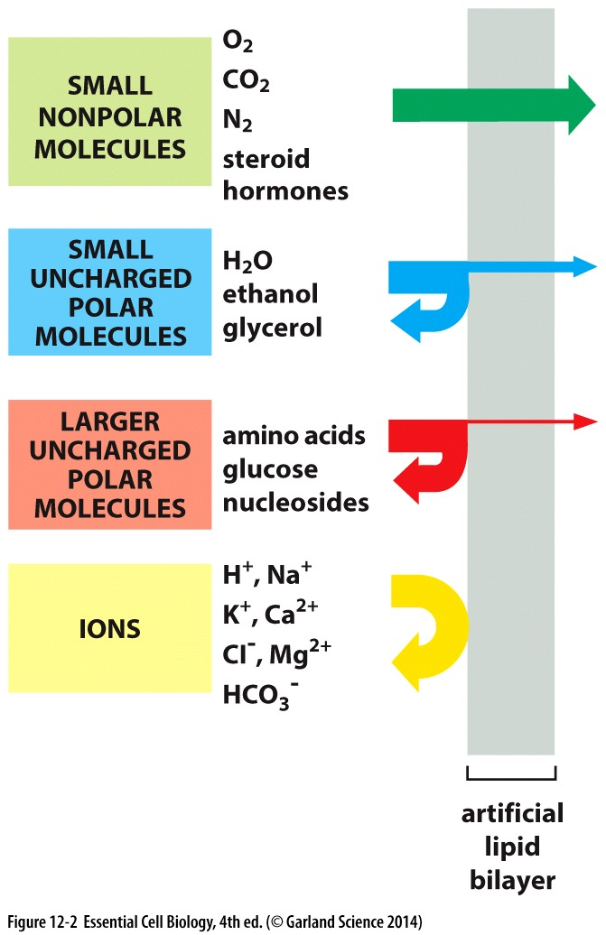
Transport across membrane
Transport proteins facilitate transfer of small molecules across the membrane
Simple diffusion doesn’t require proteins

Slide 27
Ion concentration
Ion concentration must remain equal inside and outside the cell
  K⁺ most abundant cation inside the cell
  Na⁺ most abundant cation outside the cell
Imbalance of charges creates membrane potential

Slide 28
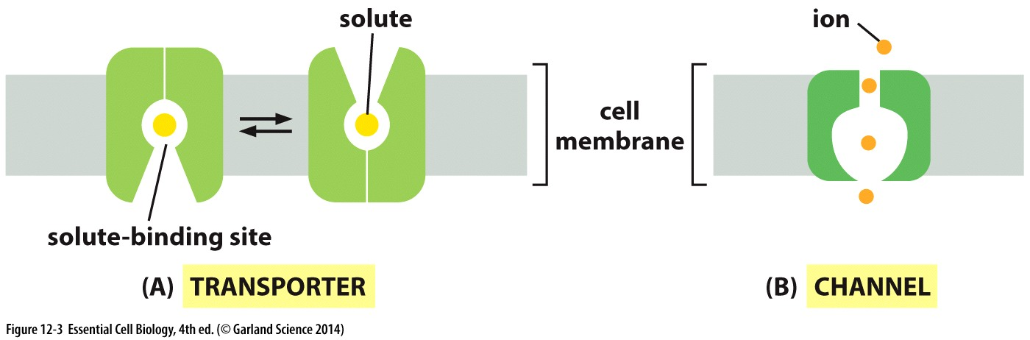
Membrane transport
Transporters
  Molecule or protein must fit into its binding site
  Very specific
Channels
  Molecules transfer based on their size and charge

Slide 29
Membrane transport
Molecules move from high concentration to low concentration
Passive transport
  Molecules go through channels due to diffusion
Active transport
  Movement against concentration gradient
  Requires pumps

Slide 30
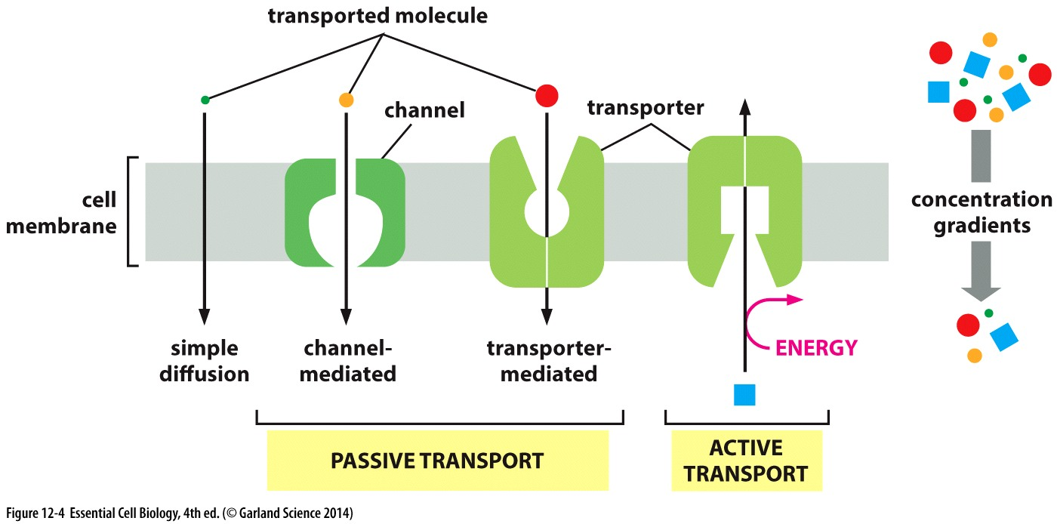

Slide 31
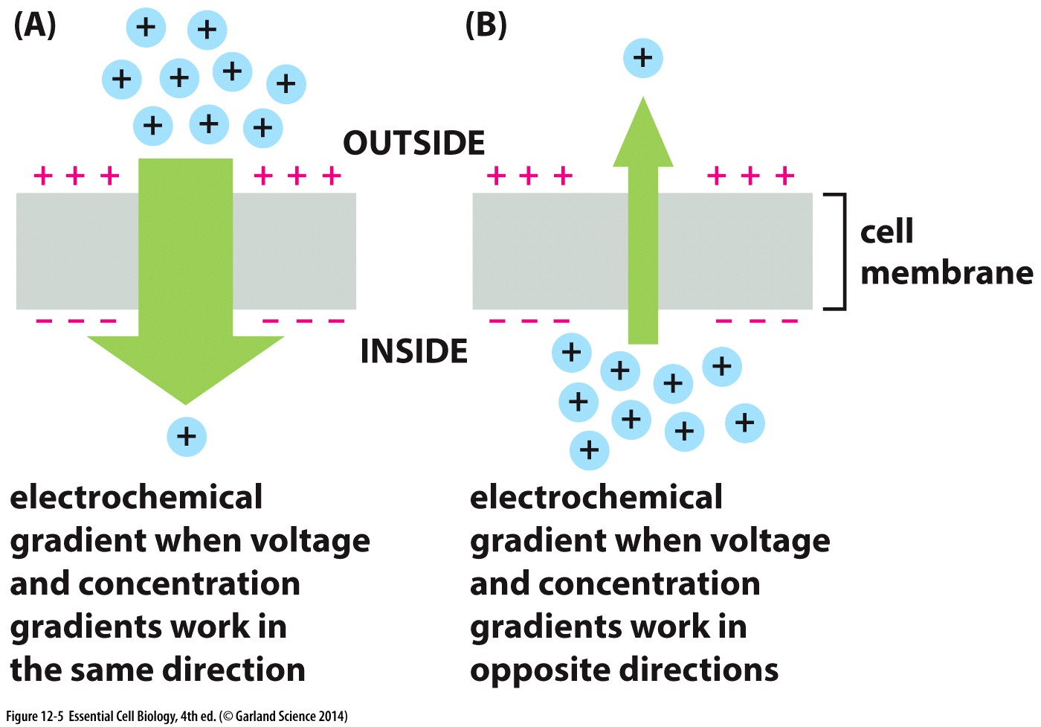

Slide 32
Membrane transport
Osmosis: movement of water down its concentration gradient
Osmolarity: total concentration of solute inside the cell
Cell wall, vacuoles and cytoplasm texture resist osmotic swelling

Slide 33
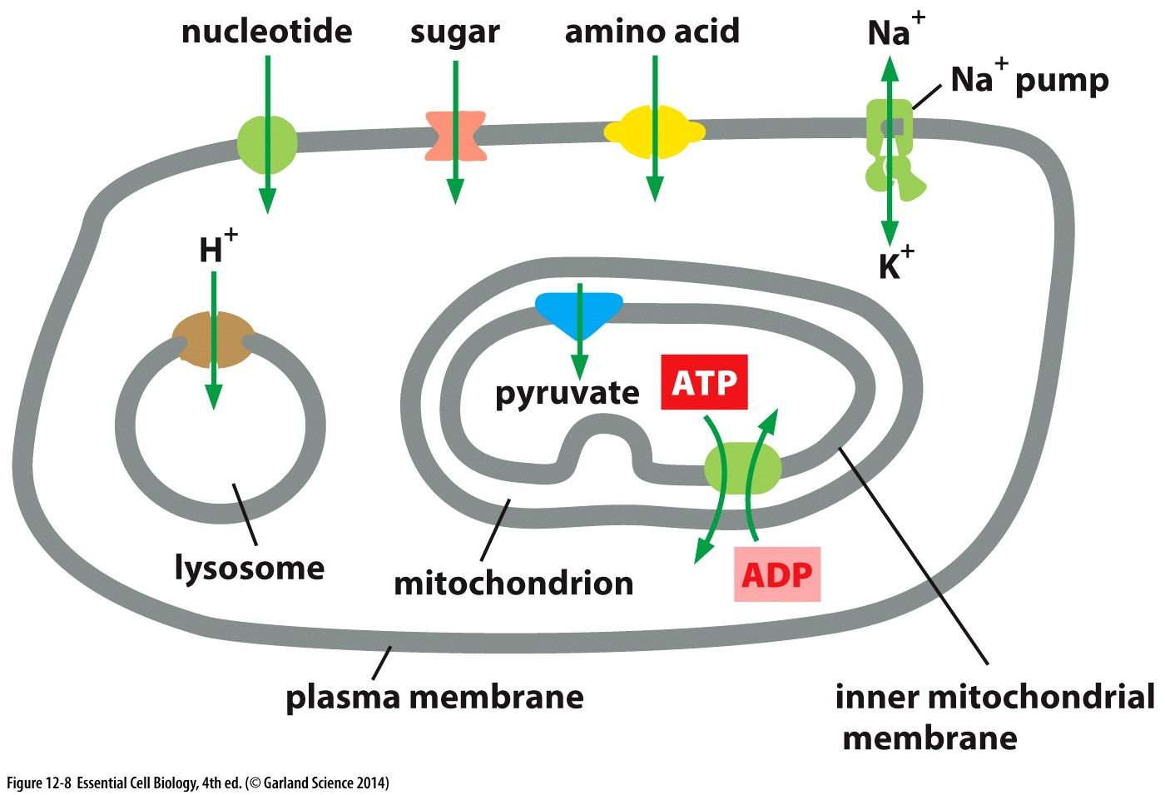
Transporters
Transporters carry different molecules across the membrane
Different organelles requires different types of transporters

Slide 34
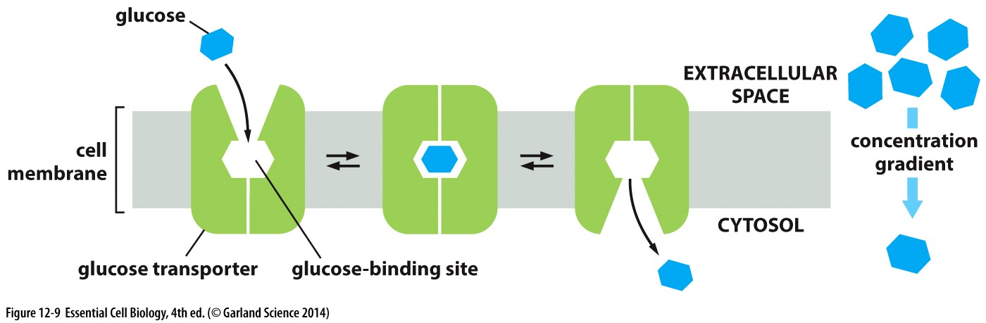
Transporters
Passive transporters
  Glucose transporters
  Highly selective proteins

Slide 35
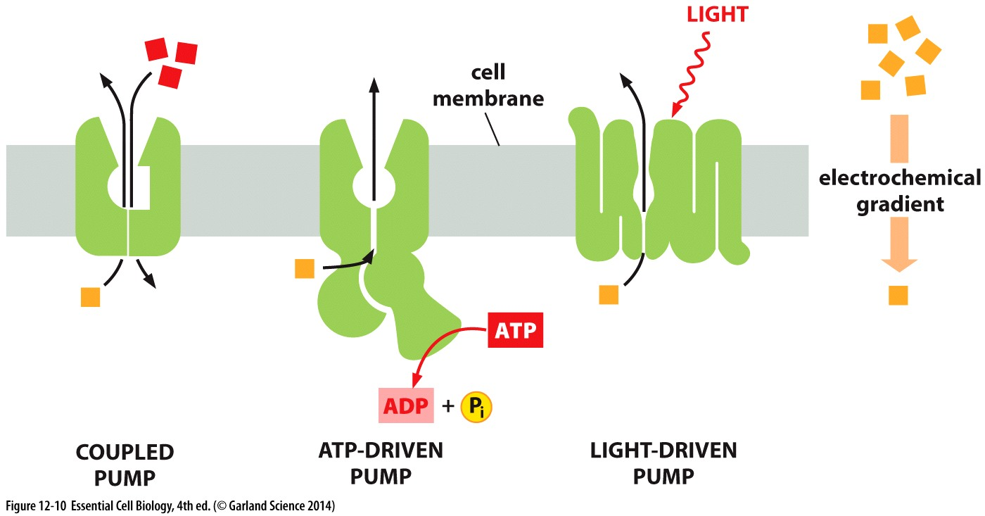
Pumps
Pumps carry active transport in three main ways
  ATP-driven
  Coupled pumps
  Light-driven

Slide 36
Na⁺ Pump
Na⁺ transport is coupled by K⁺ import
Inhibition of any steps in the Na⁺ Pump halts the process completely
  Ouabain is an inhibitor of this process
Creates high Na⁺ concentration in the extracellular space

Slide 37
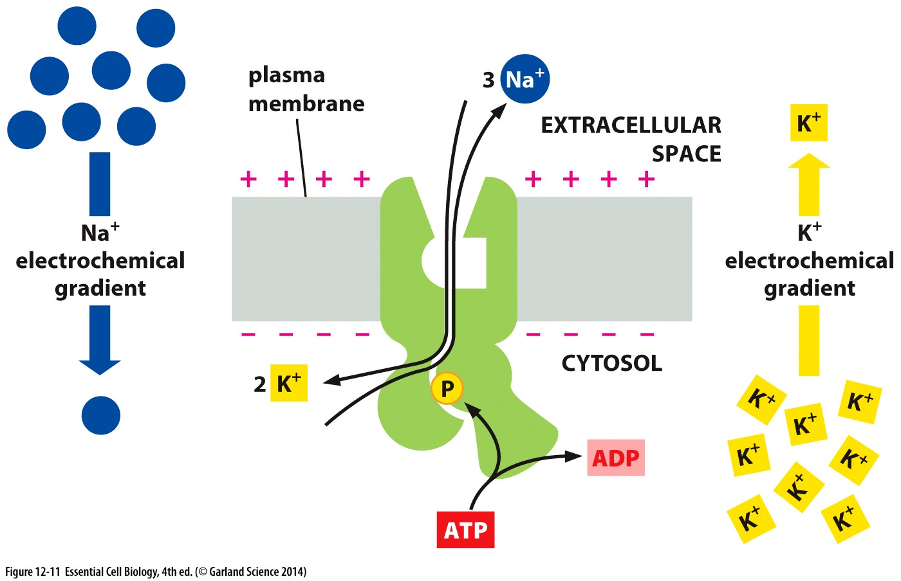

Slide 38
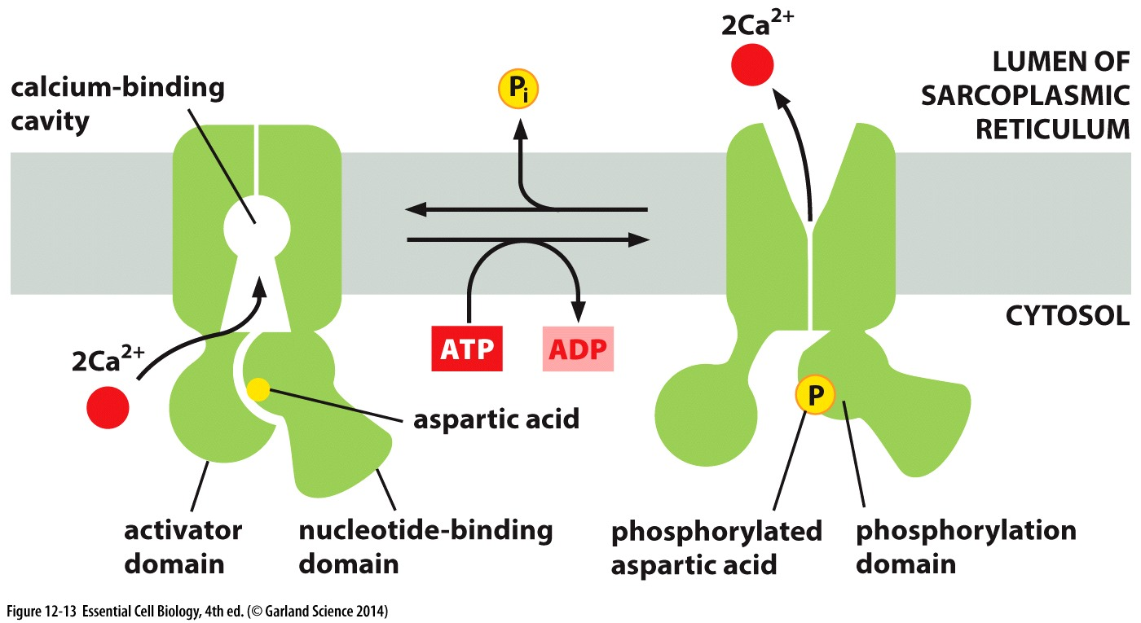

Slide 39
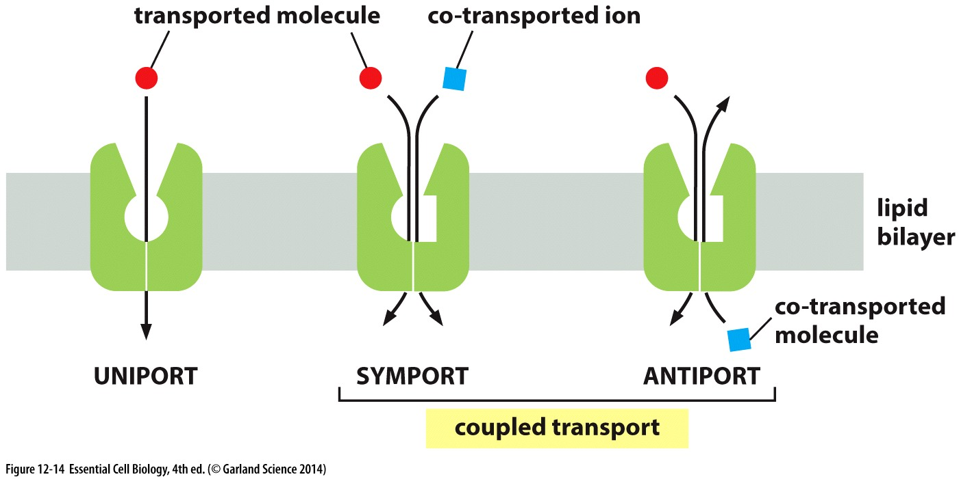
Coupled pumps
movement of one solute down its gradient provides energy for the movements of the other solute
  Symport
  Antiport

Slide 40
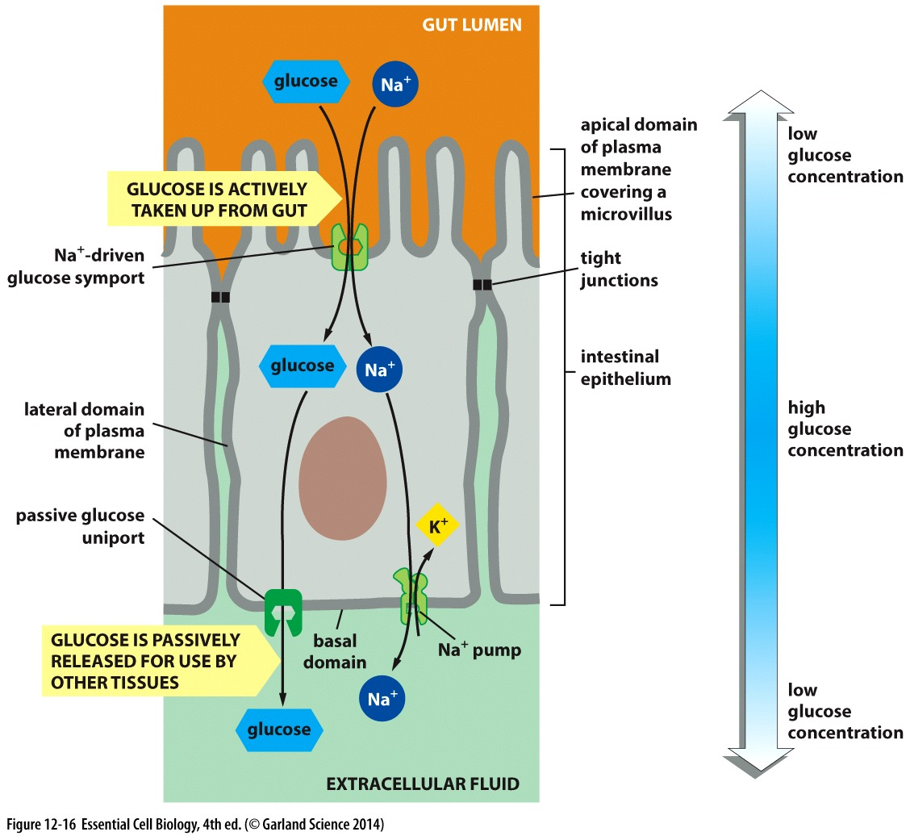
Glucose transport in gut
Na⁺ moves down its gradient with glucose because of binding advantages
This is a symport transport
Glucose is then transported down its gradient from epithelial cells for use by other tissues using uniport

Slide 41


