Slide 1
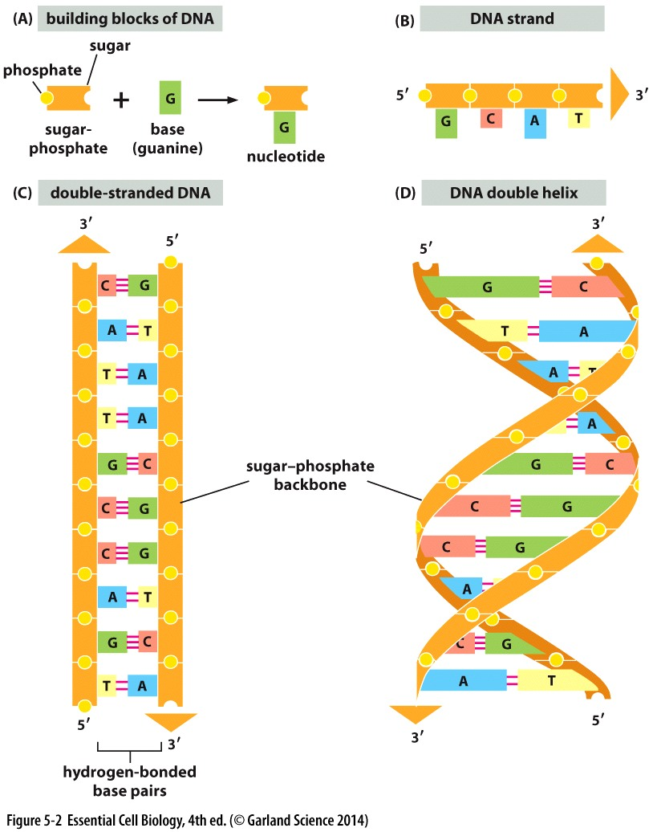
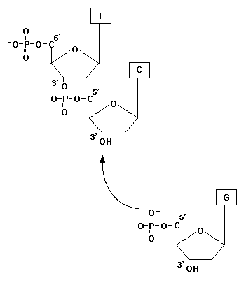
Building blocks of DNA
Position of 3` and 5` is very important

Slide 2
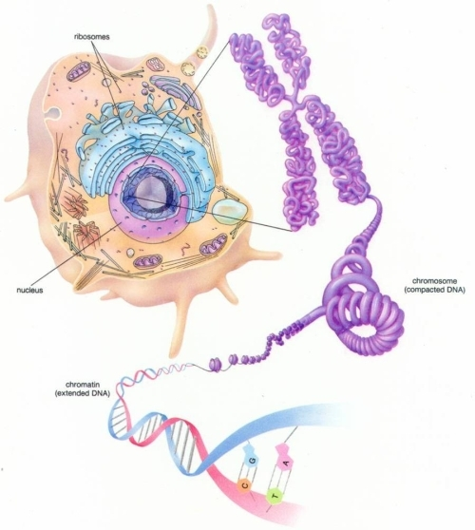
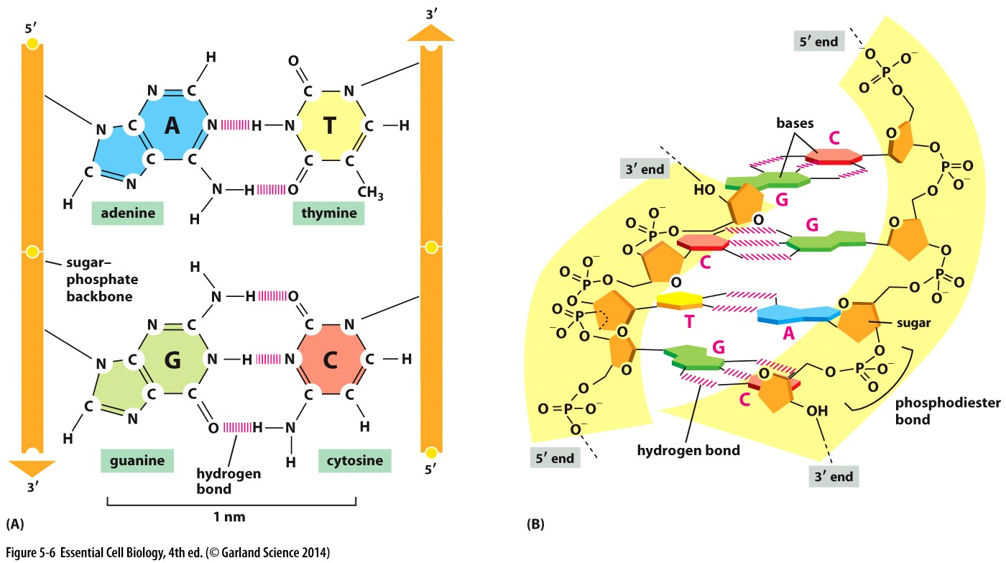
DNA

Slide 3
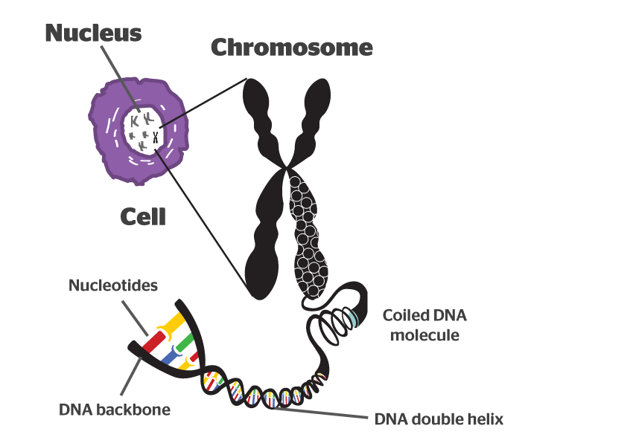
Chromosome
DNA is highly packaged in the nucleus

Slide 4
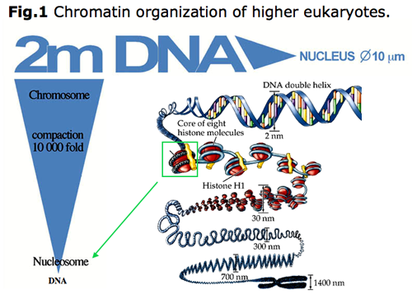
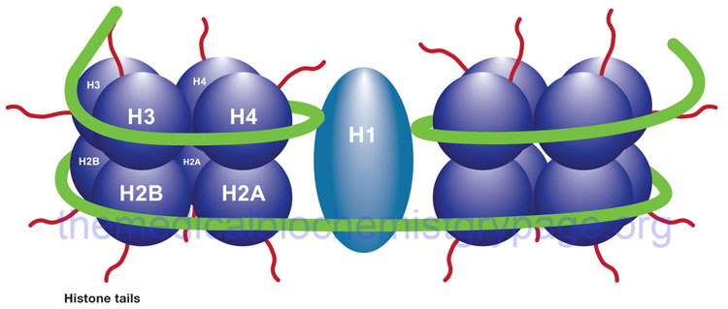
DNA Packaging
Chromatin
Nucleosome
Histones
from http://www.chromatintoronto.ca/projects.html

Slide 5
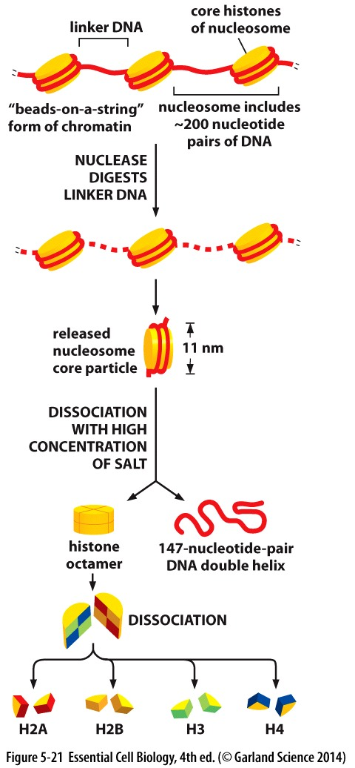
nucleosome
The basic unit of chromosome is nucleosome
Nucleosome makes up chromatin
DNA + Protein = chromatin

Slide 6
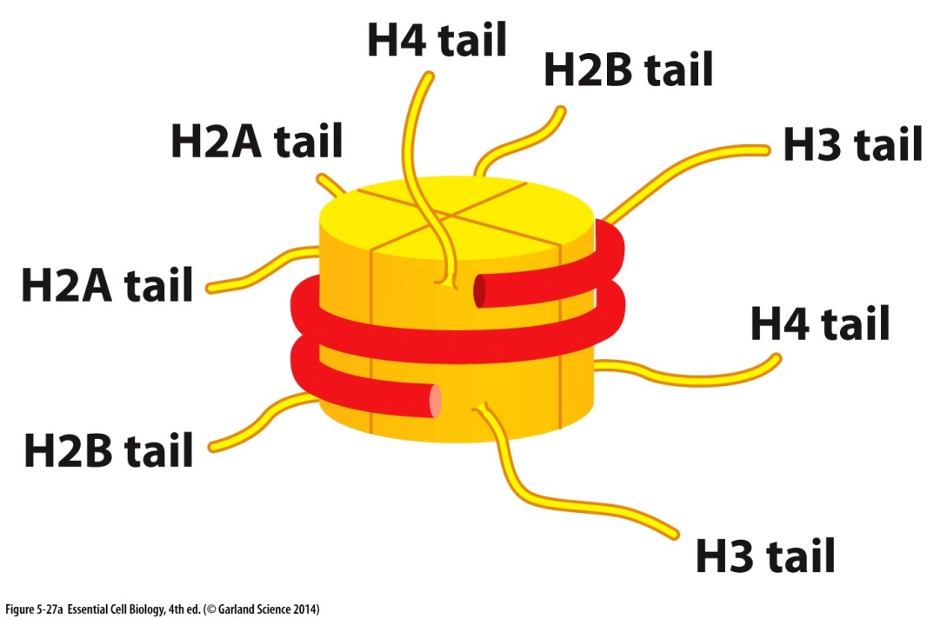
Access to DNA
Chromatin remodeling
Histone modification
  Acetylation
  Methylation

Slide 7
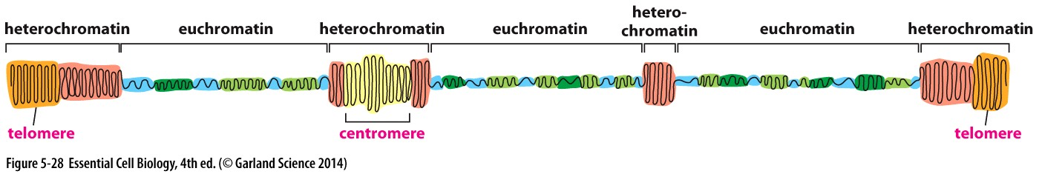
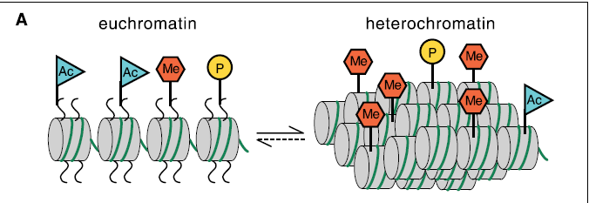
Euchromatin
  Lightly packed DNA
  Transcriptionally active
Heterochromatin
  Tightly packed DNA
  Transcriptionally repressed DNA
Thomas Jenuwein and C. David Allis. Translating the Histone Code. Science 293 2001

Slide 8
DNA Replication

Slide 9
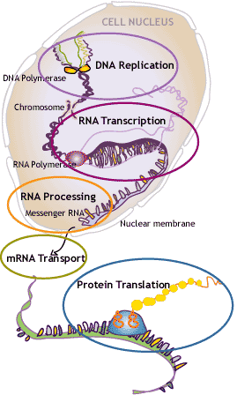
Today
DNA replication
Transcription
Translation

Slide 10
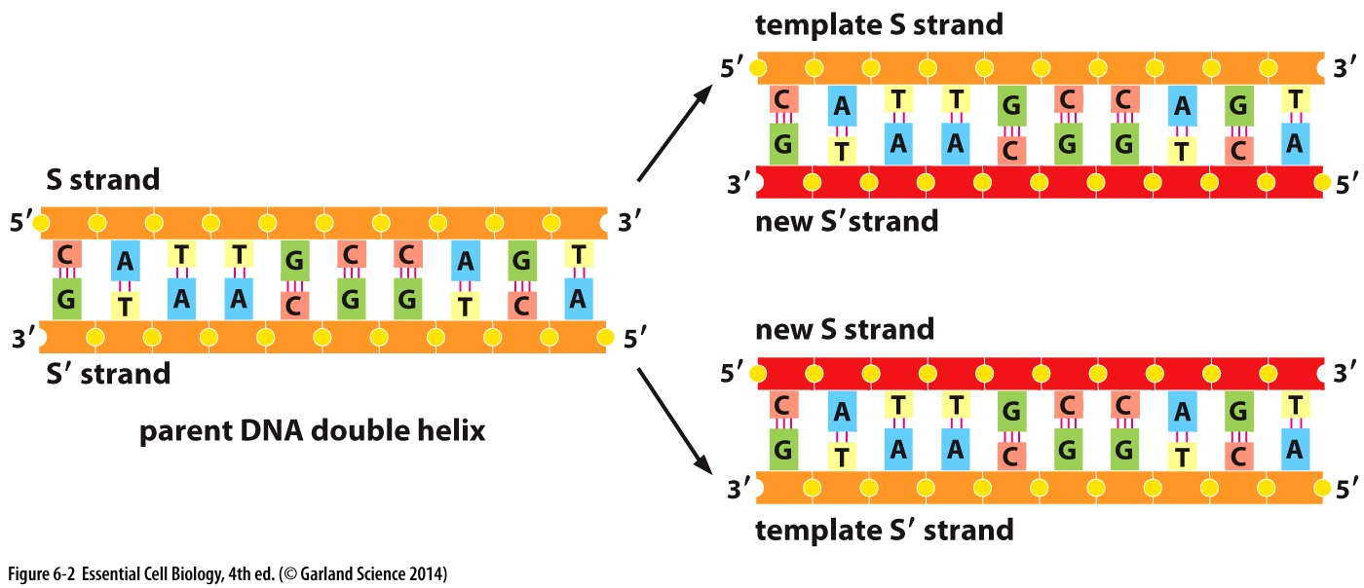
DNA replication
Template strand is replicated into two newly synthesized strands
DNA synthesis is semi-conservative

Slide 11
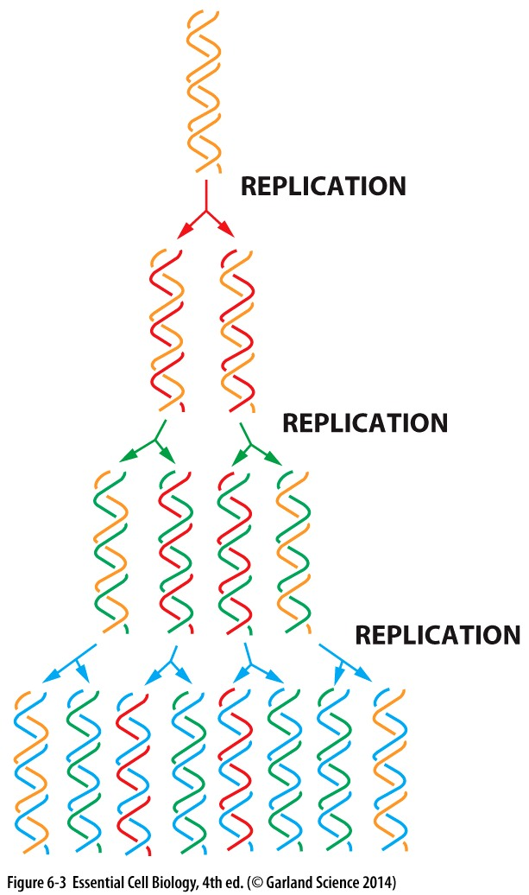

Slide 12
DNA replication
A template strand is used to replicate a newly synthesized strand of DNA
Replication origin is the starting point for DNA replication
  Hydrogen bond is broken
  A-T rich areas are preferred

Slide 13
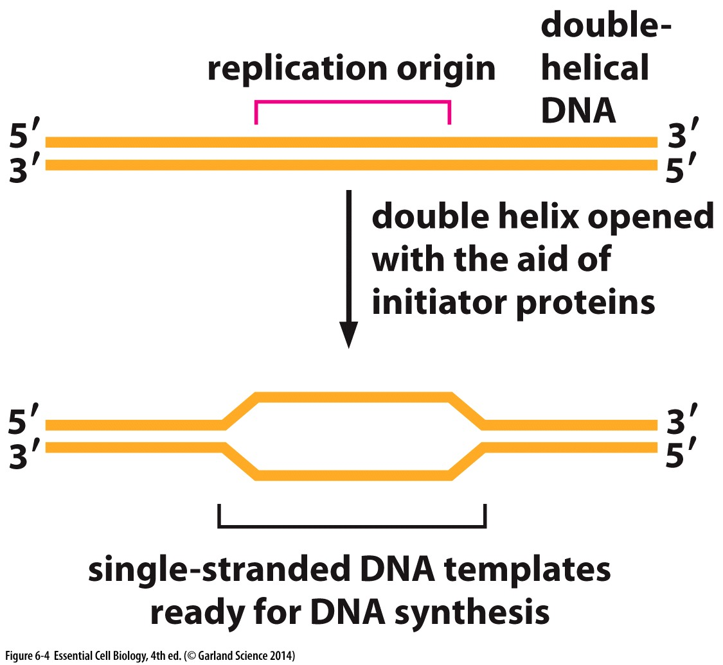
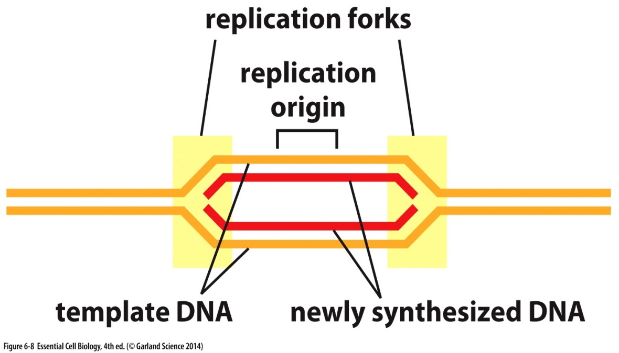
Replication Origin
Requires initiator proteins
Breaks the bonds between bases
In simple eukaryotes like yeast and bacteria it is about 100 bp
Formation of replication fork

Slide 14
Replication process
Helicase unwinds the DNA double helix
DNA polymerase attaches to the leading strand and starts synthesizing the new DNA
Primase adds RNA primer
Okazaki fragments are added by DNA polymerase
DNA Ligase
5’ to 3’

Slide 15
DNA replication
Replication fork formation
DNA polymerase adds new nucleotides to the growing strand
Replication is always in 5’ to 3’ direction
Leading strand
Lagging strand
  Primase
  Okazaki fragments

Slide 16
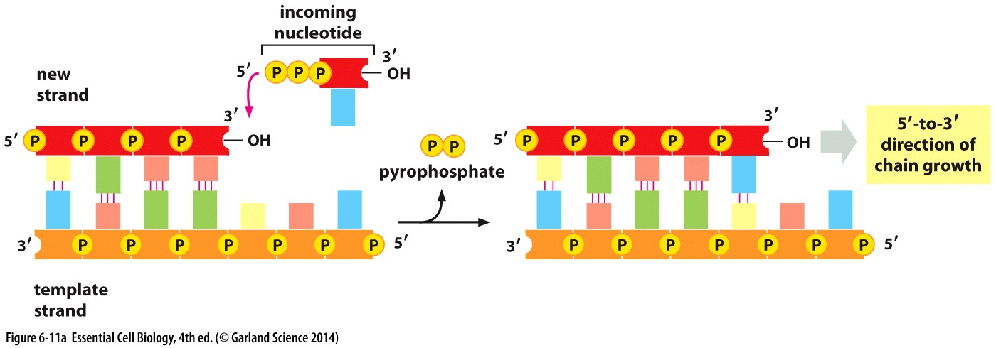
DNA Polymerase
The process is 5` to 3`
The energy is generated from hydrolysis of each dNTP

Slide 17
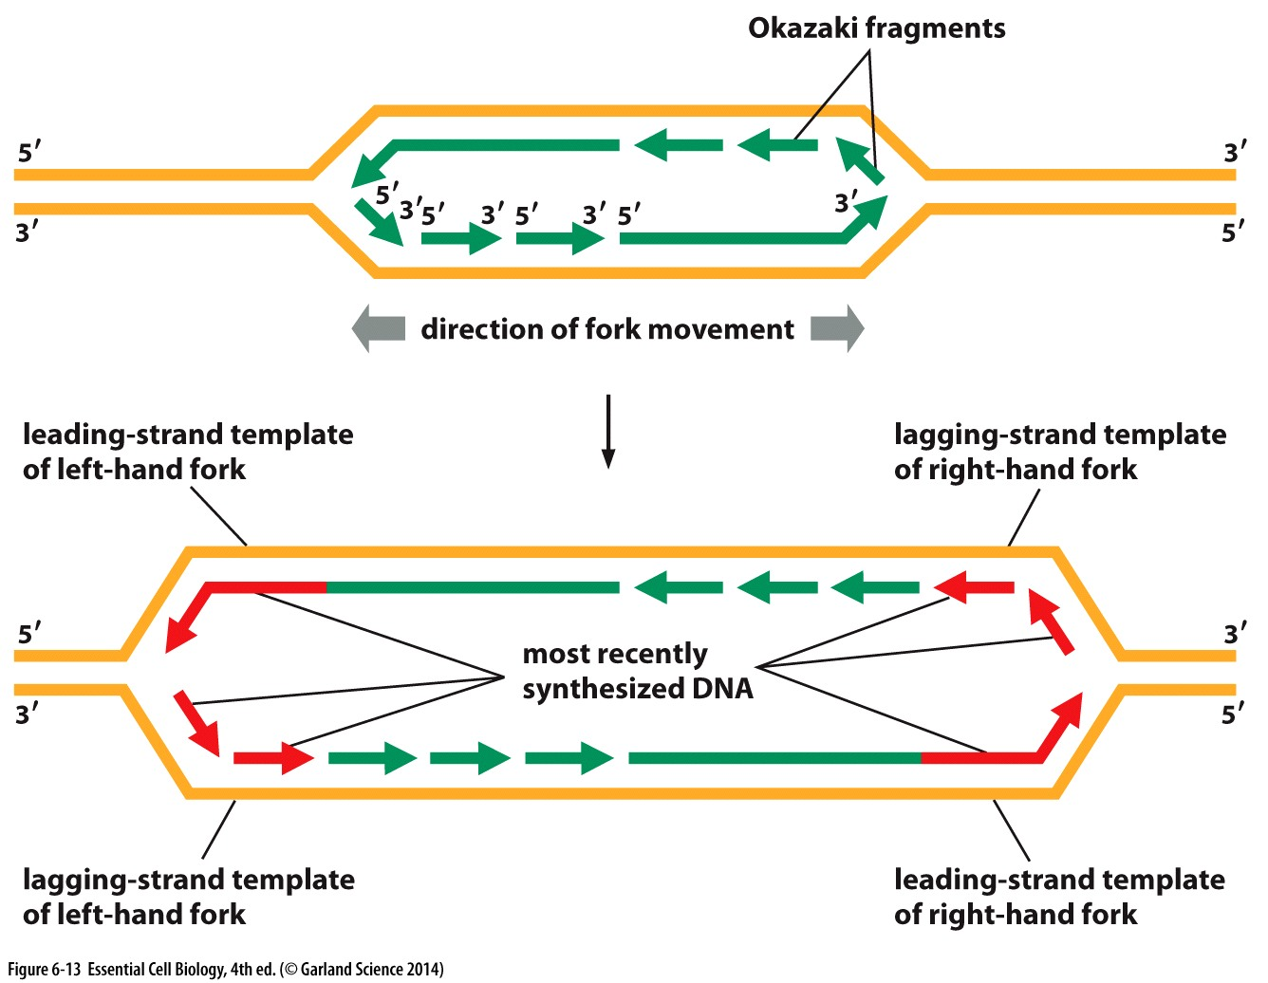

Slide 18
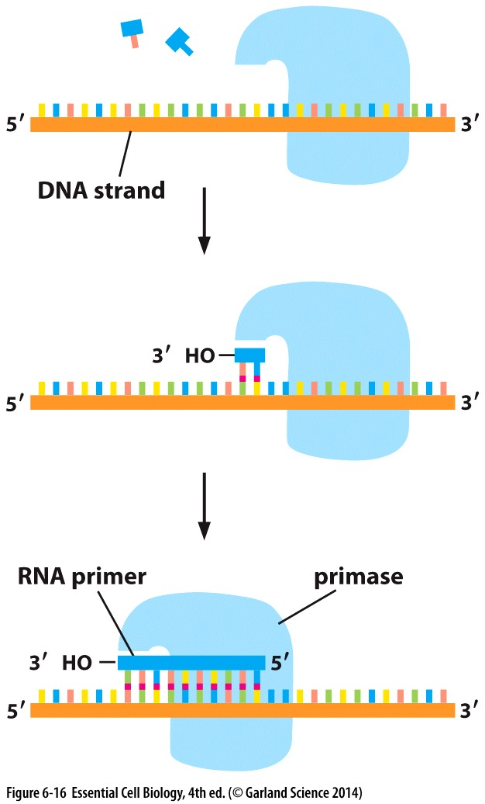
Primase
Primase adds RNA primers
It is an example of RNA polymerase
RNA is removed by DNA repair polymerase
DNA ligase joins fragments

Slide 19
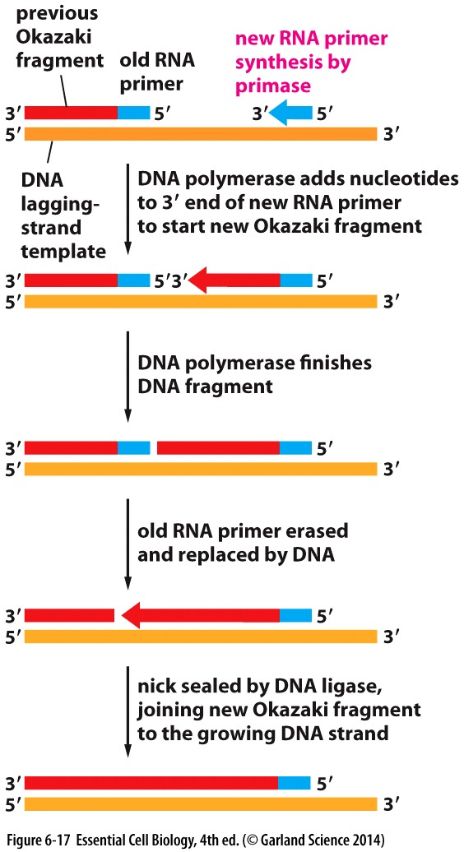
Okazaki fragment
Short fragments of DNA

Slide 20
Replication Machinery
DNA helicases
DNA topoisomerase
Single strand DNA binding protein
Primase
DNA polymerase
Sliding clamp
RNA primer

Slide 21
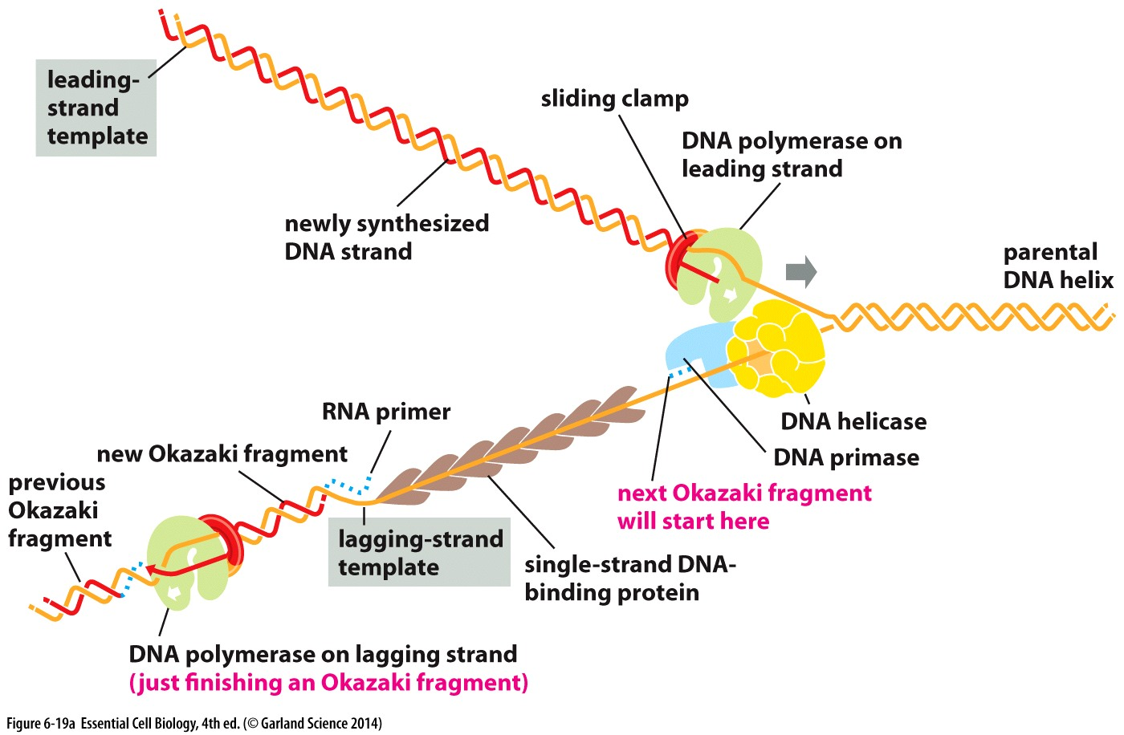
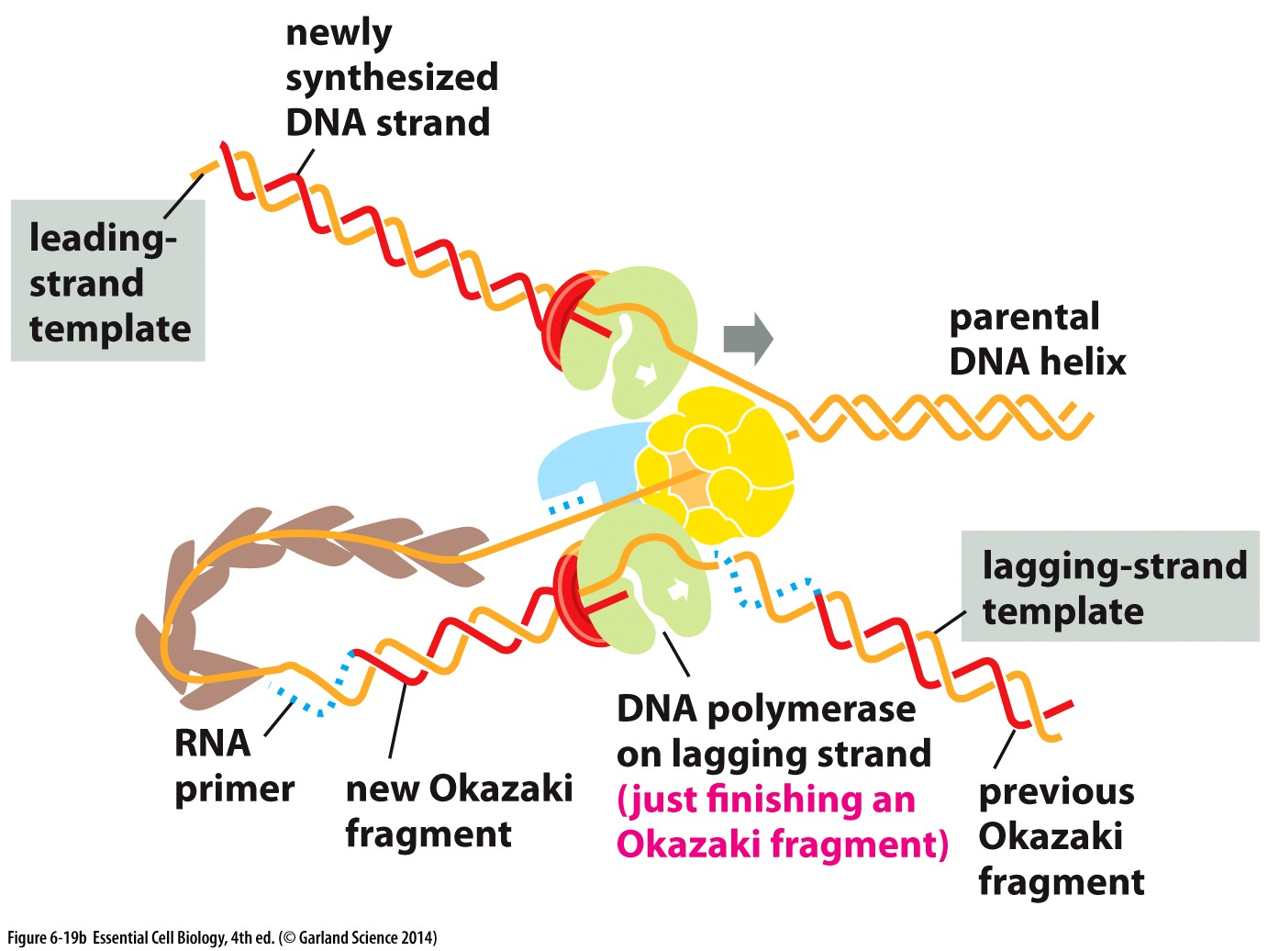

Slide 22
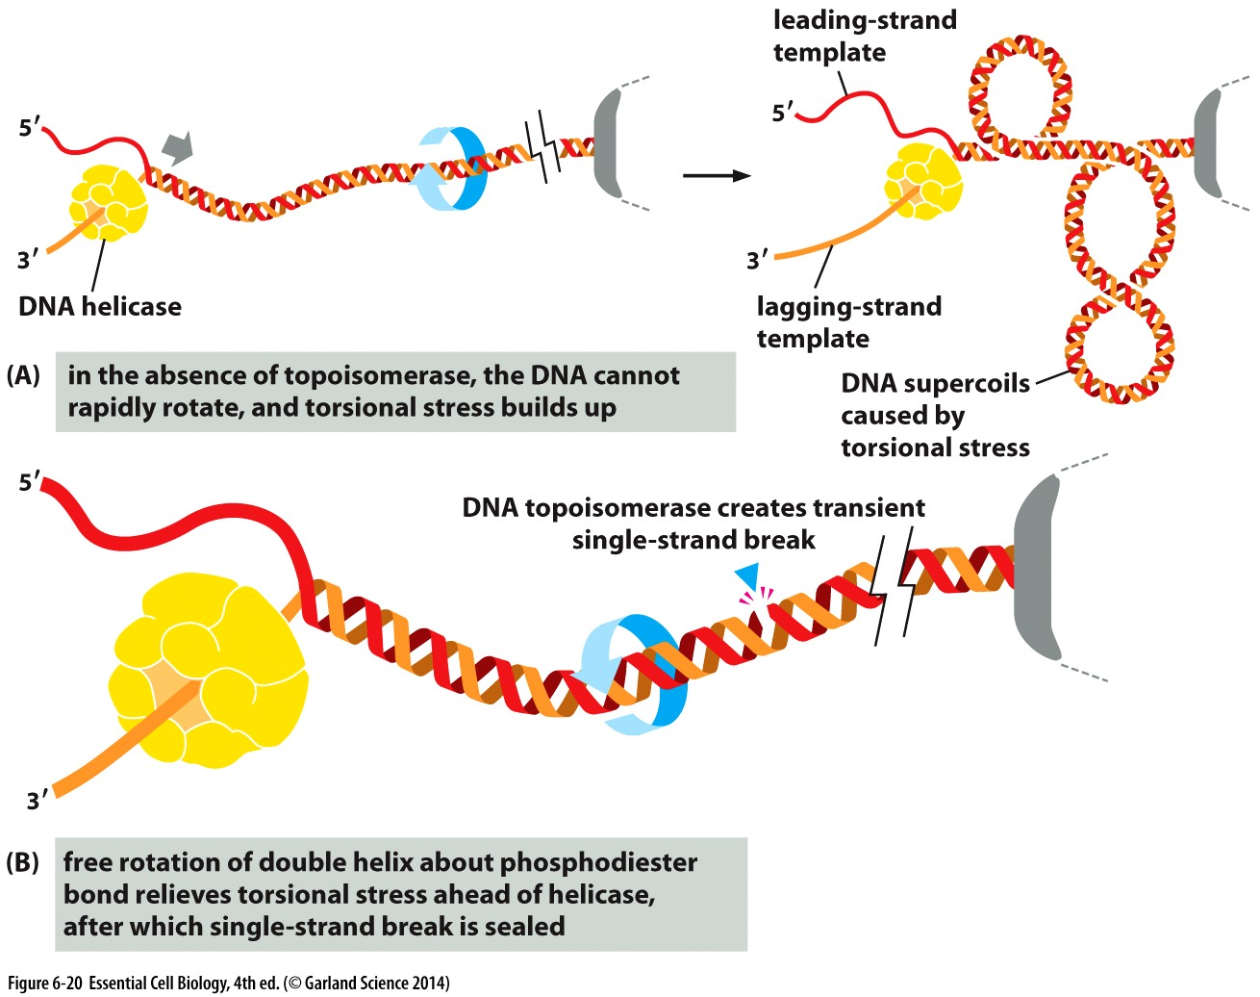

Slide 23
http://sites.fas.harvard.edu/~biotext/animations/replication1.swf

Slide 24
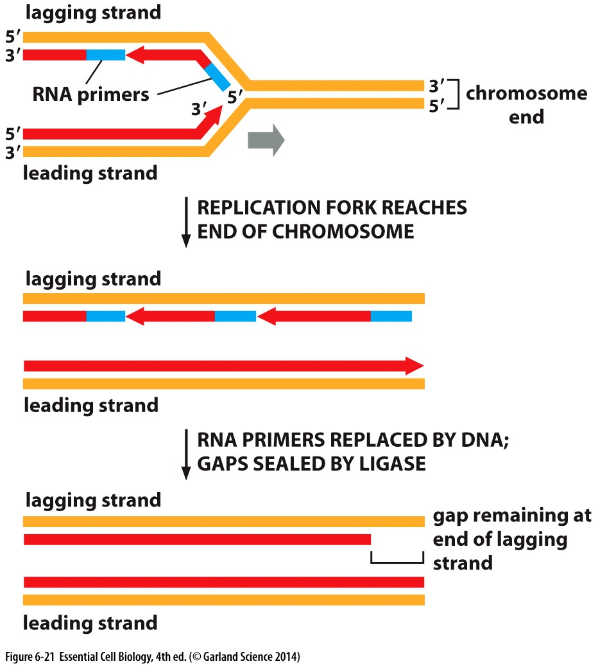
Telomerase Replication
Telomeres are long repetitive sequences at the end of the DNA strand
Telomerase extends DNA at the lagging strand

Slide 25
DNA repair
Damage can occur exogenously or endogenously
  Replication stress
  UV radiation
    Thymine dimer
  Radical oxygen species
    Metabolic by-product
Depuration
Deamination

Slide 26
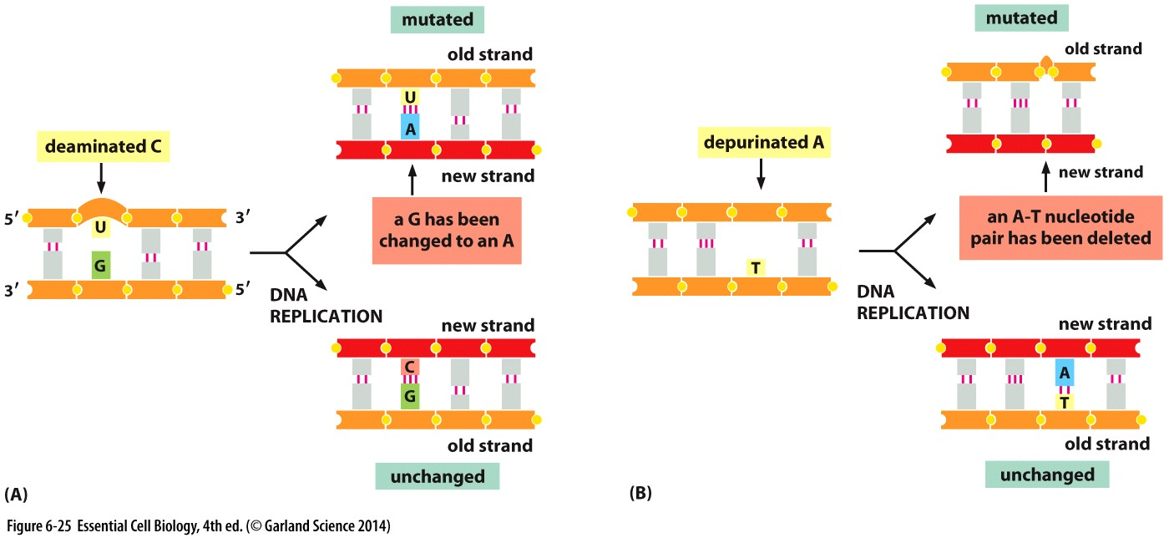
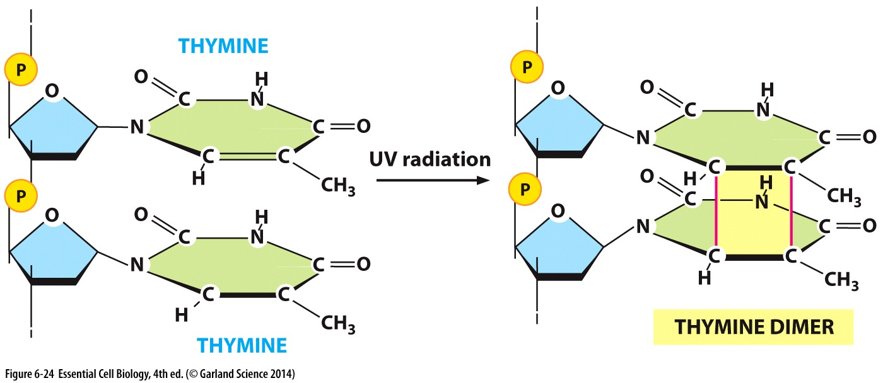

Slide 27
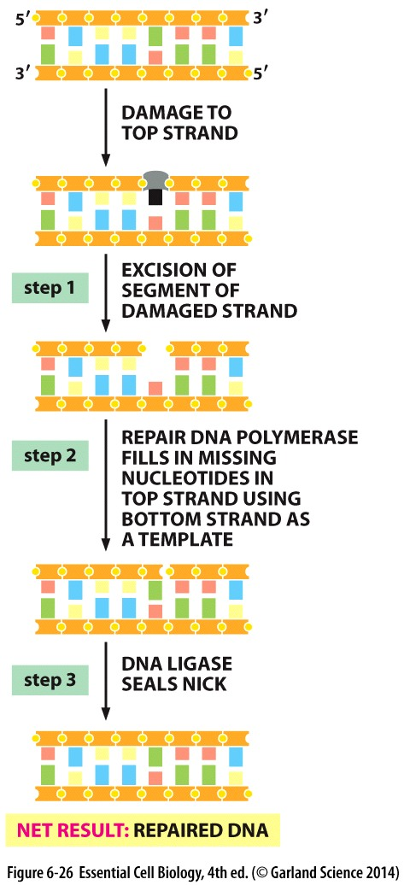
Repair mechanism
Recognize damage
Remove damaged/mismatched nucleotide
Add correct nucleotide
Gap filling

Slide 28
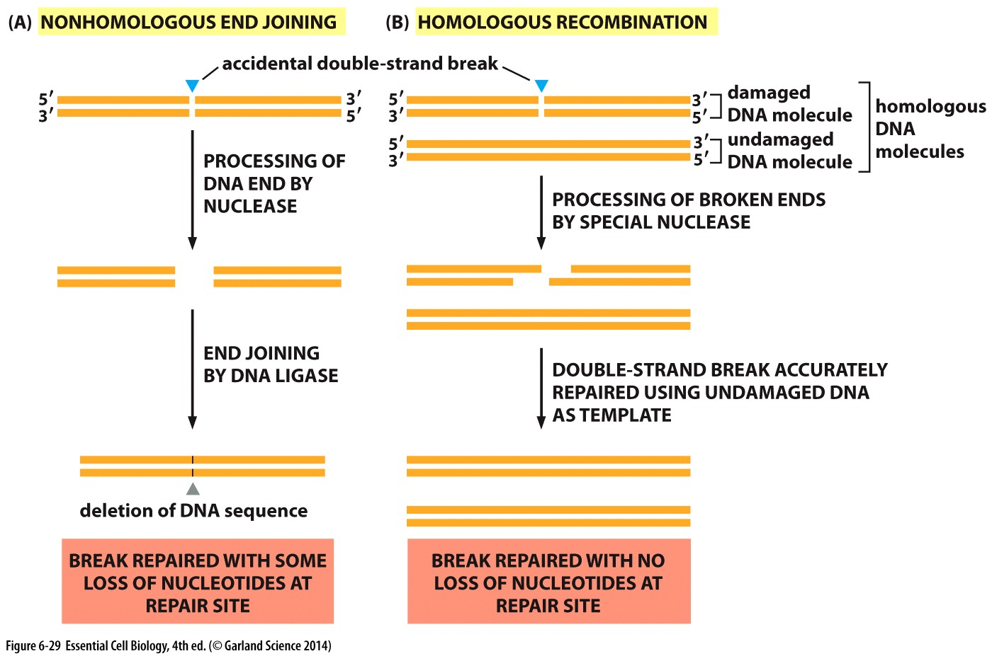
DNA double stranded break
Non-homologous end joining: Error prone repair
Homologous recombination: Error free repair

Slide 29
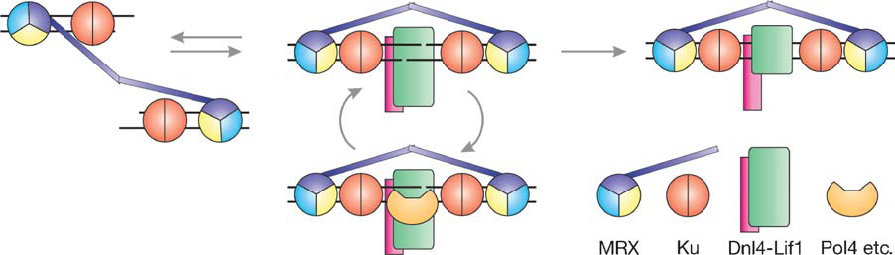
Non-Homologous End Joining
Recognition and recruitment of repair factors to the site of DNA break
Bringing broken ends to close proximity
Ligation and gap filling

Slide 30
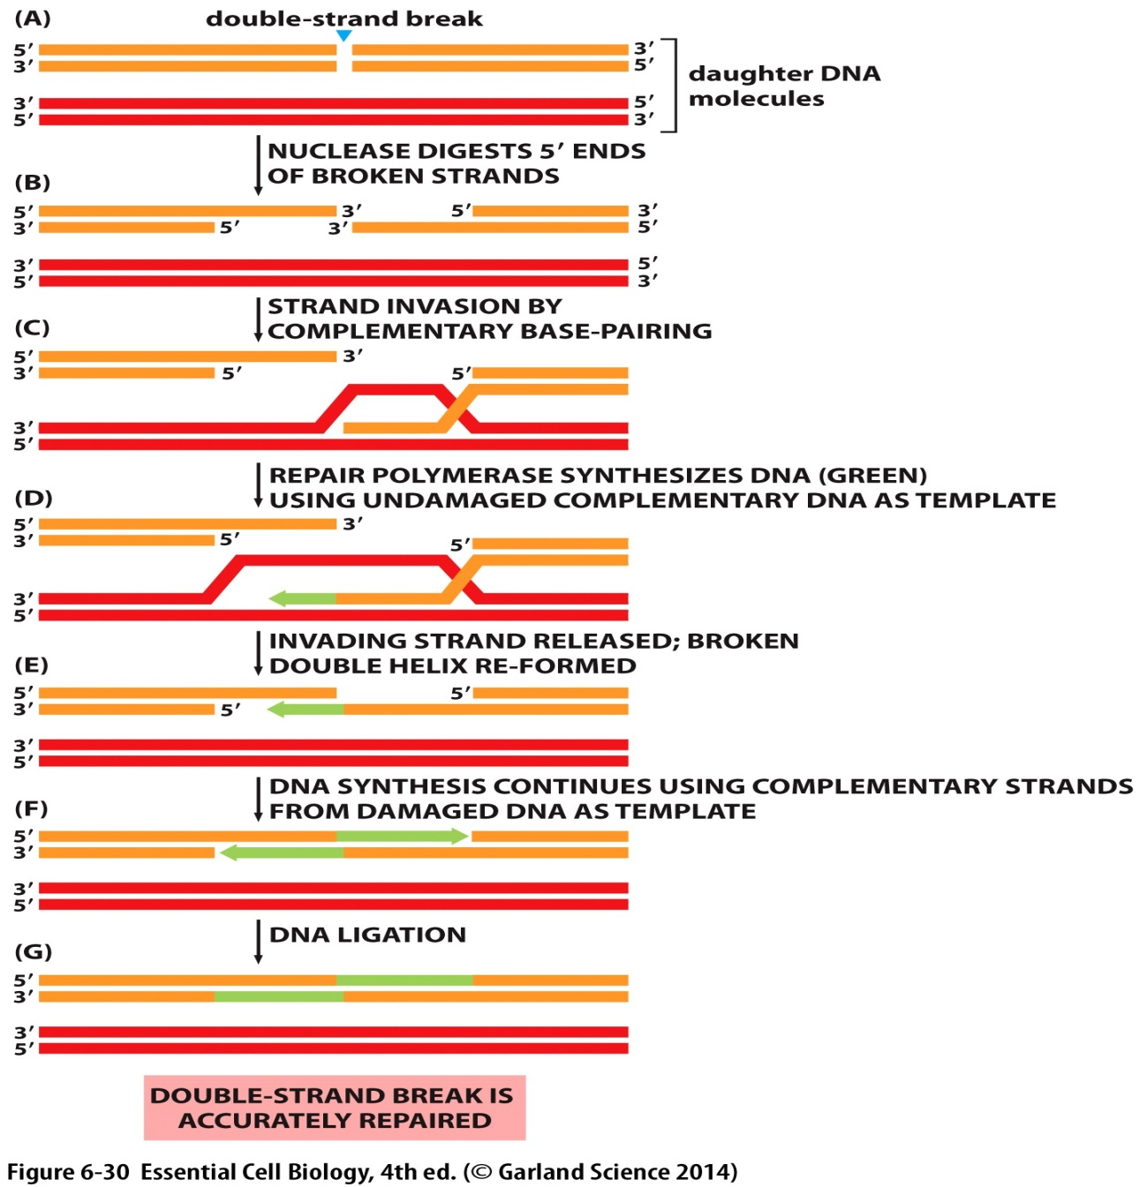
Homologous recombination

Slide 31
Central Dogma

Slide 32
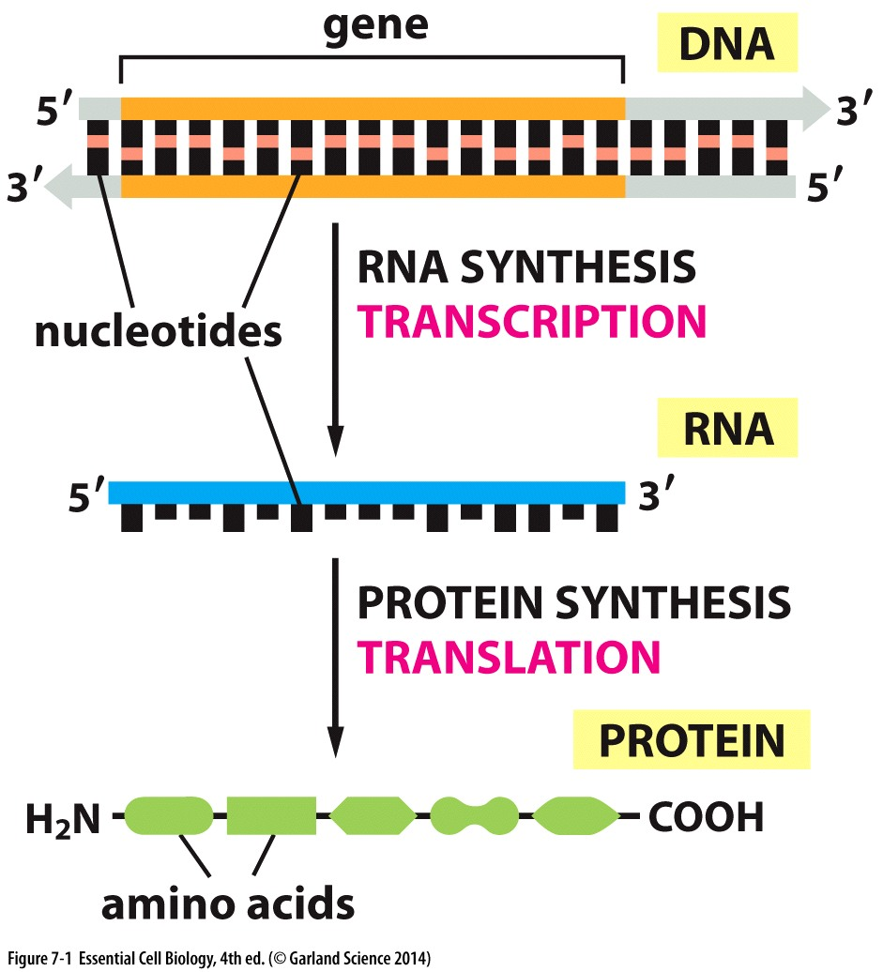
Central dogma of molecular biology

Slide 33
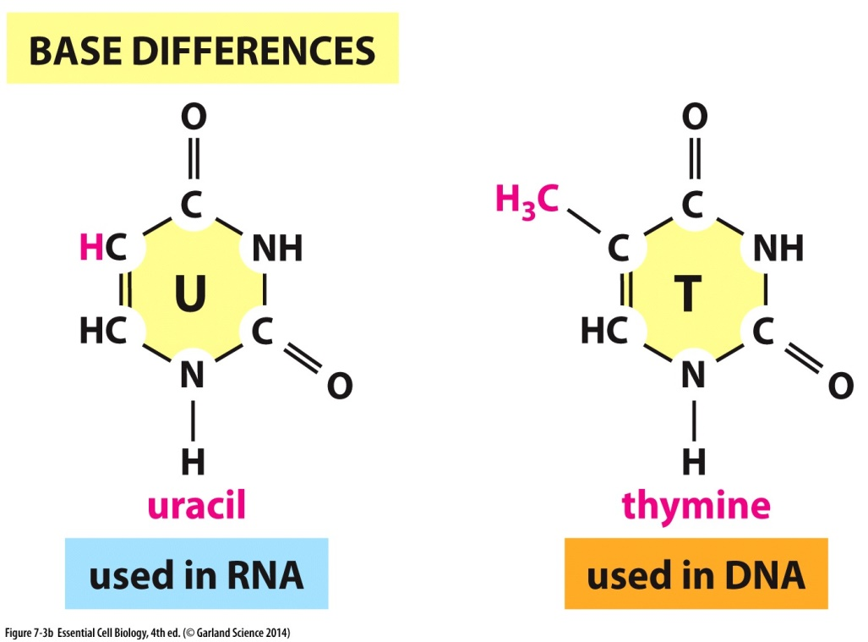
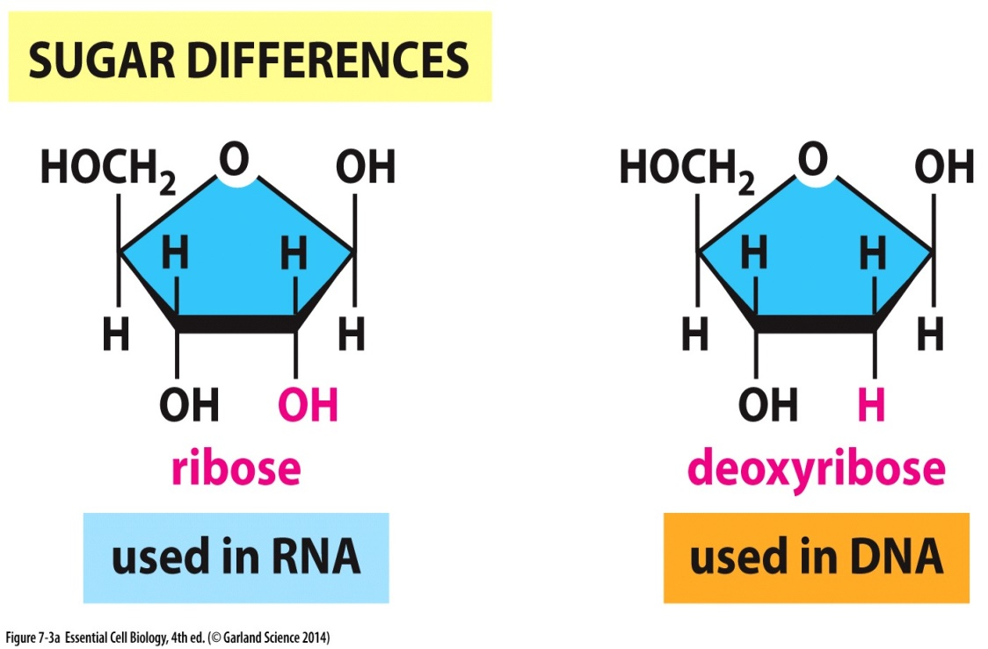
Ribonucleic Acid (RNA)
Composed of nucleotides
Ribose sugar
Uracil

Slide 34
Various Types of RNA
mRNA
  Encodes protein
tRNA
  Shuttles amino acids
rRNA
  Make up ribosome structures
miRNA
  Gene expression

Slide 35
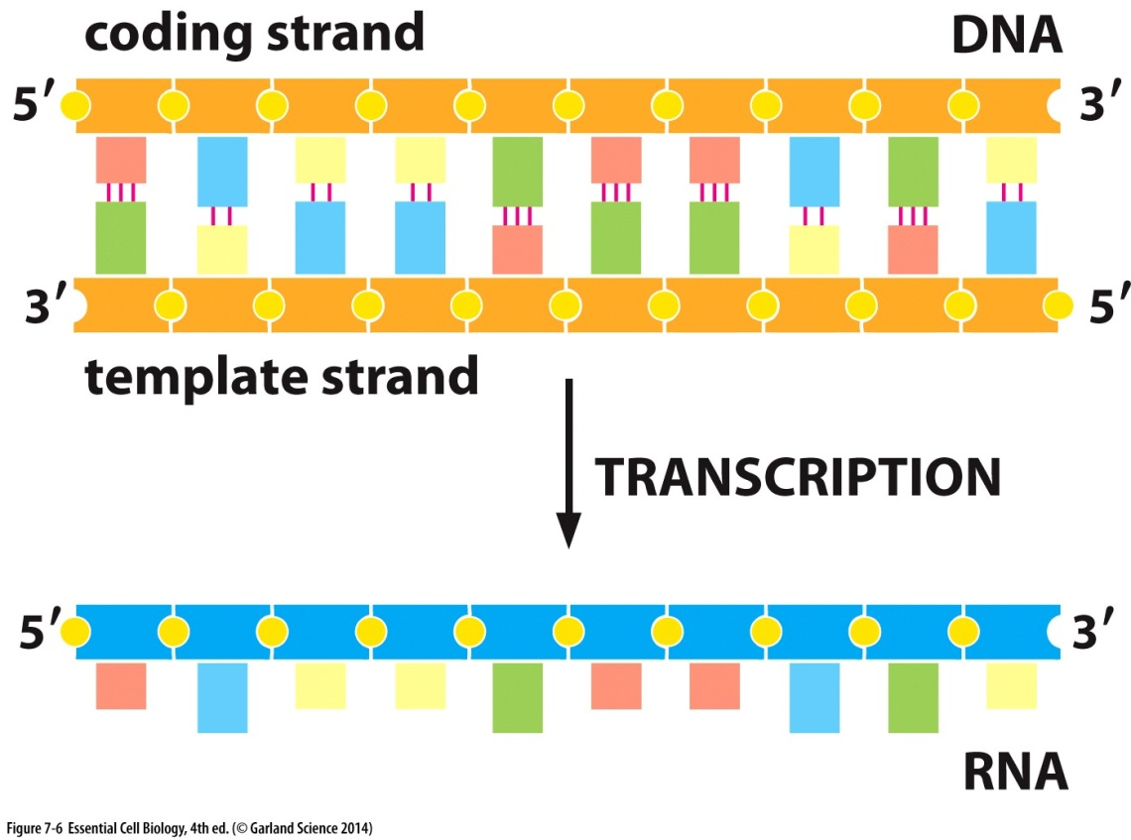
Template strand
Template strand is used to transcribe the RNA

Slide 36
Transcription
Initiation
  Promoter recognition
Unwinding DNA double helix
RNA synthesis
Termination

Slide 37
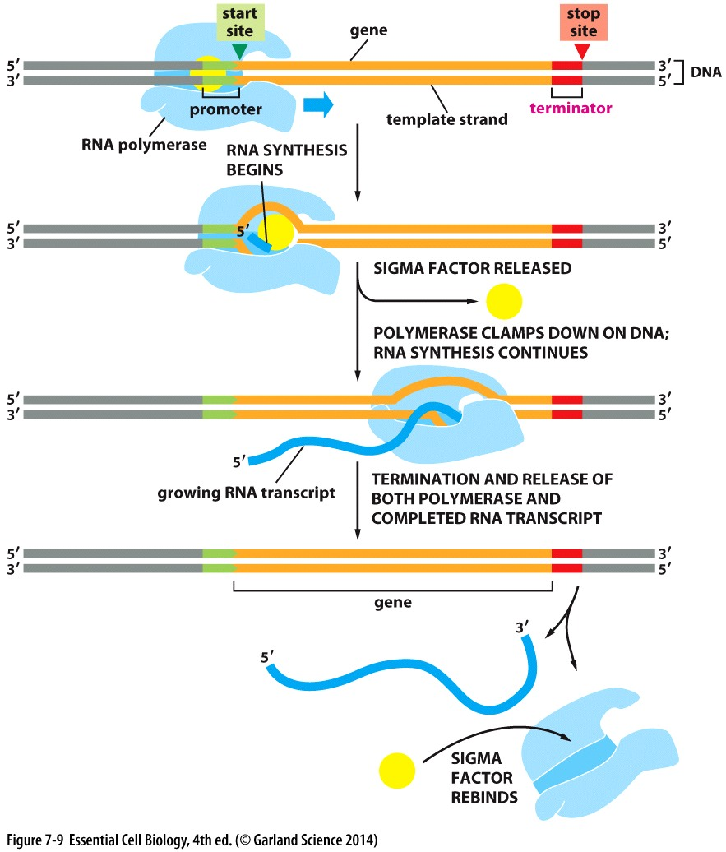
Prokaryotic transcription

Slide 38
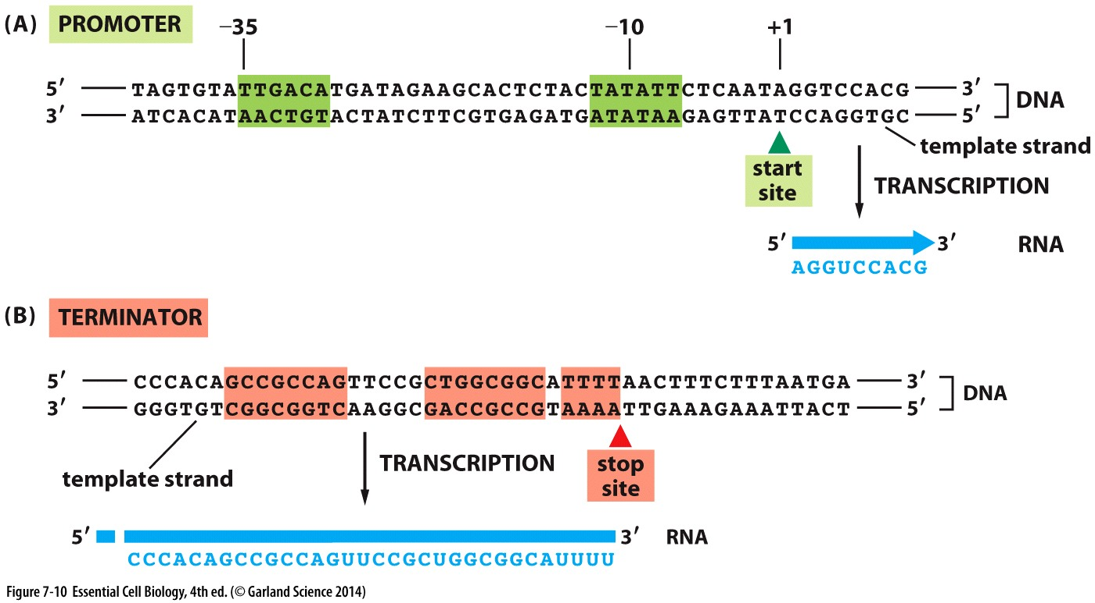
Transcription Initiation
Promoter region
RNA polymerase
  Sigma factor

Slide 40
Transcription termination
Regions in the DNA signal transcription termination
These regions will be transcribed

Slide 41
Eukaryotic vs Prokaryotic Transcription
RNA Polymerase
  Eukaryotes have three different types
Transcription factors
  Absent in prokaryotic cells
Regulatory DNA sequences
  More complex regulation in eukaryotic cells
Nucleosome structure
  Chromatin remodeling

Slide 42
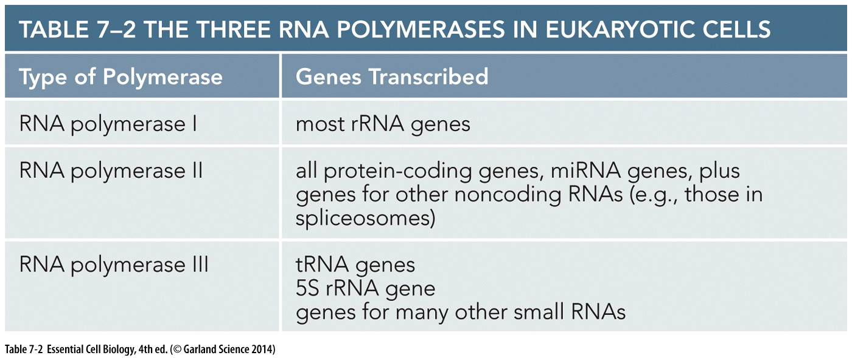
RNA polymerases

Slide 43
Transcription initiation
Transcription Factors
  TFIID
  TFIIB
TATA box
  TATA-binding protein (TBP)

Slide 44
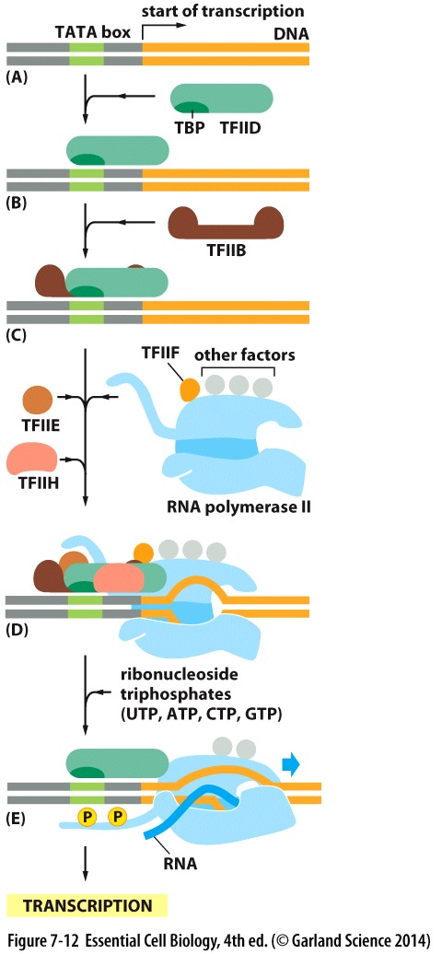
Eukaryotic transcription
Recognition of TATA box by TBP on TFIID
Recruitment of TFIIB
Assembly of transcription factors and RNA polymerase
TFIIH
  Unwinding DNA
  polymerase phosphorylation
RNA polymerase starts RNA synthesis

Slide 46
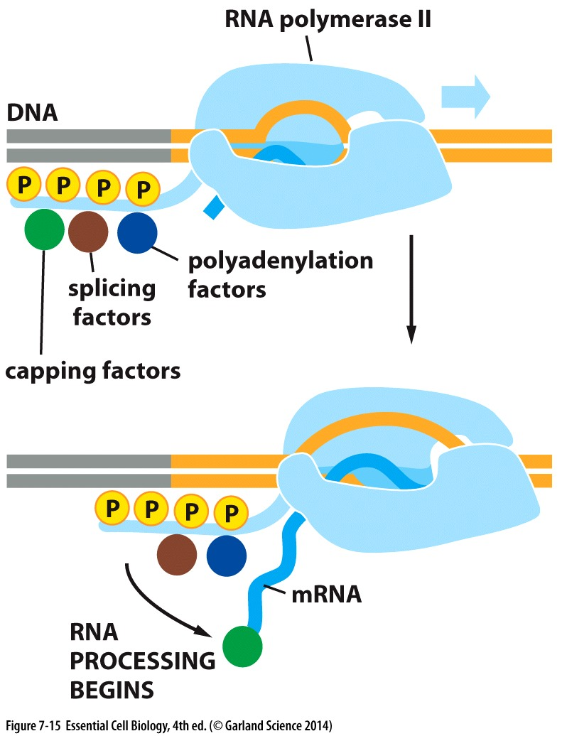
mRNA processing
Capping
  Addition of guanine bearing a methyl to the 5` end
Polyadenylation
  Addition of poly-A tail to the 3` end
Splicing

Slide 47
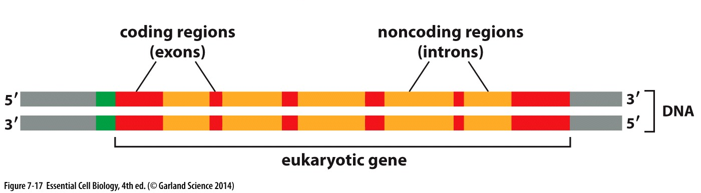
Intron and Exon
Coding region of DNA is interrupted by non coding regions
Introns
  Intervening sequence
Exon
  Expressed sequence

Slide 48
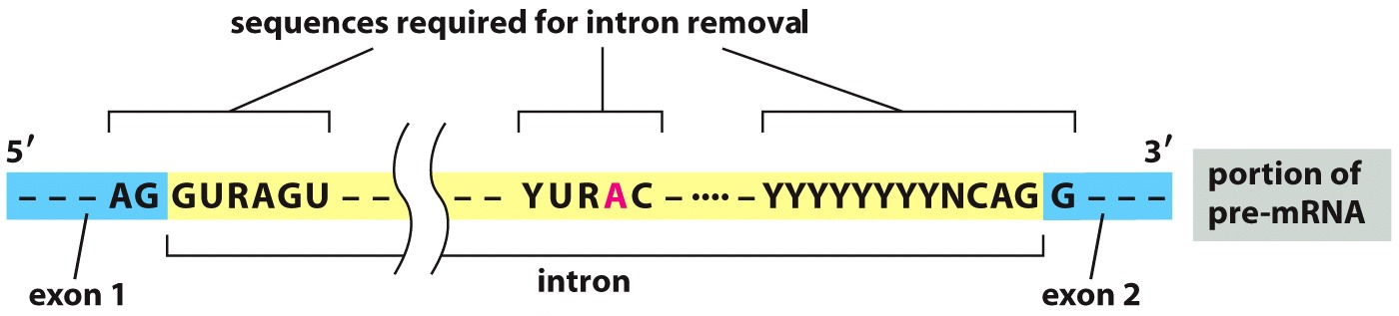
RNA splicing
Remove intron and connect exons to produce functional mRNA
  Sequences in the pre-mRNA signal introns
  Requires snRNA with other proteins forming snRNPs
  Splicesome
N= any nucleotide Y= A or G R= U or C

Slide 49
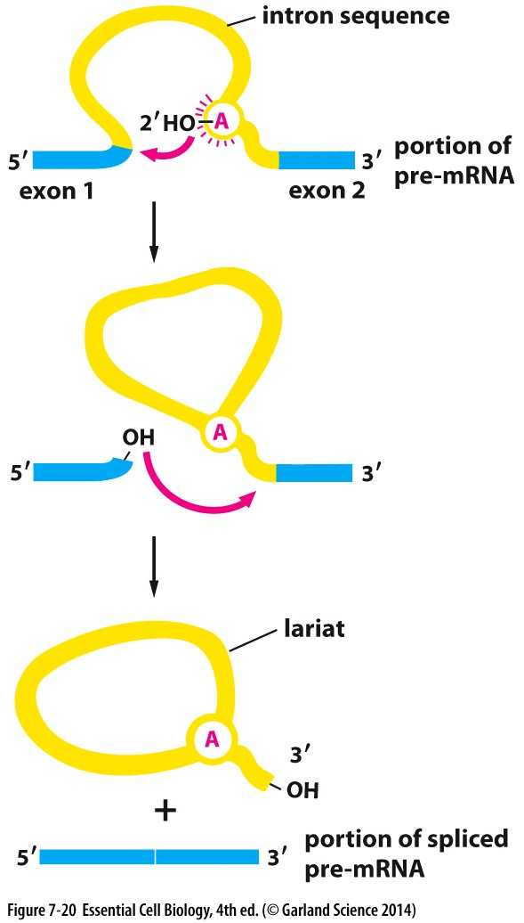

Slide 50
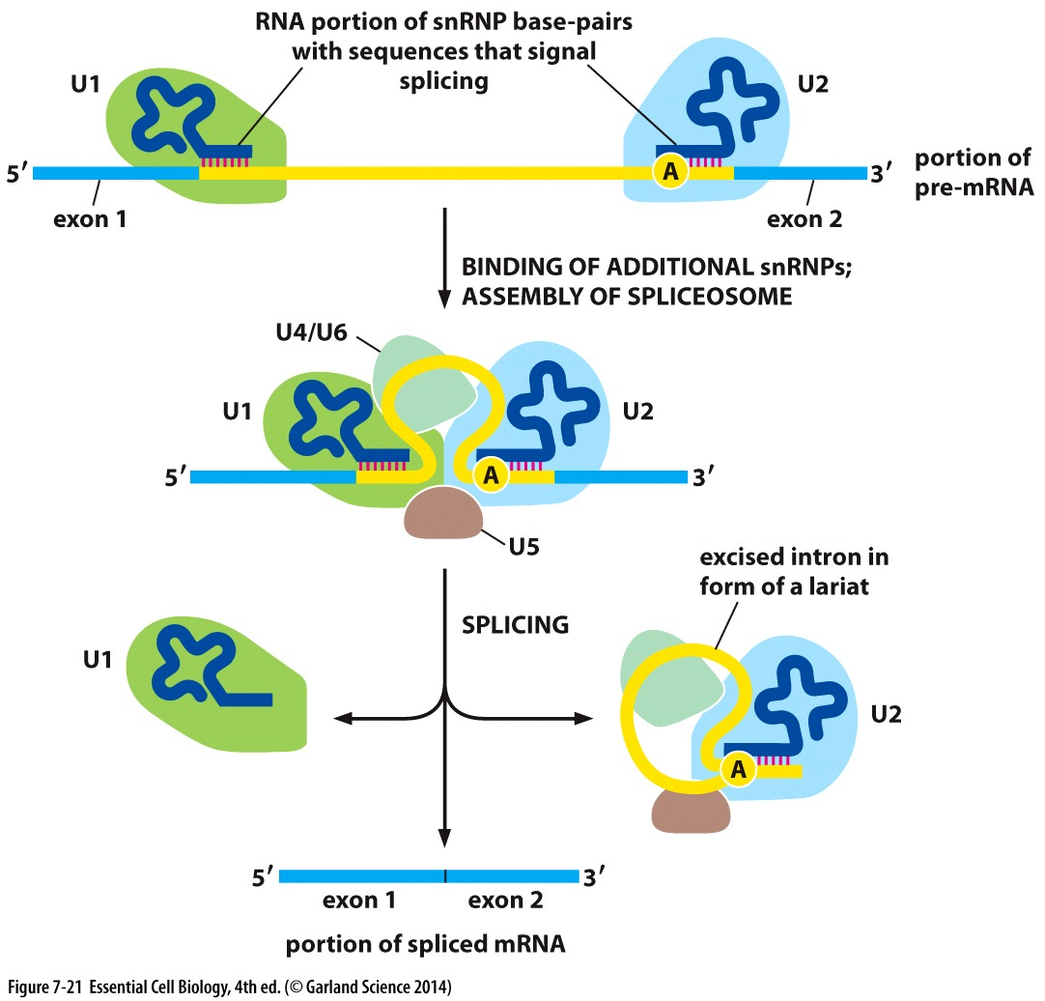
snRNPs bind to lariant branch point and 5` end
Recruitment of other snRNPs
Assembly of slpiceosome
Removal of intron

Slide 51
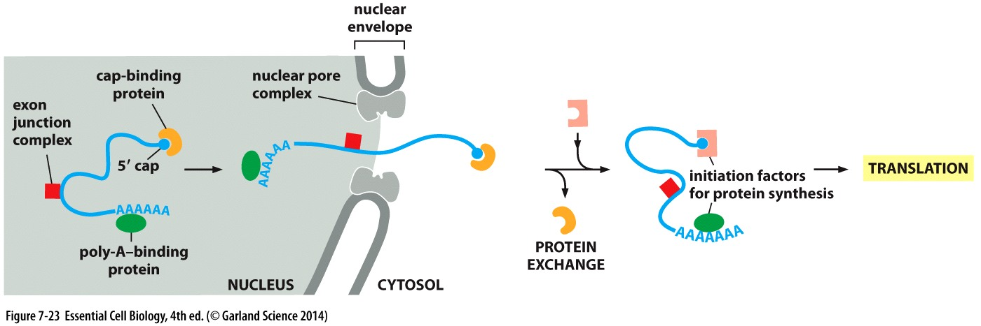

Slide 52
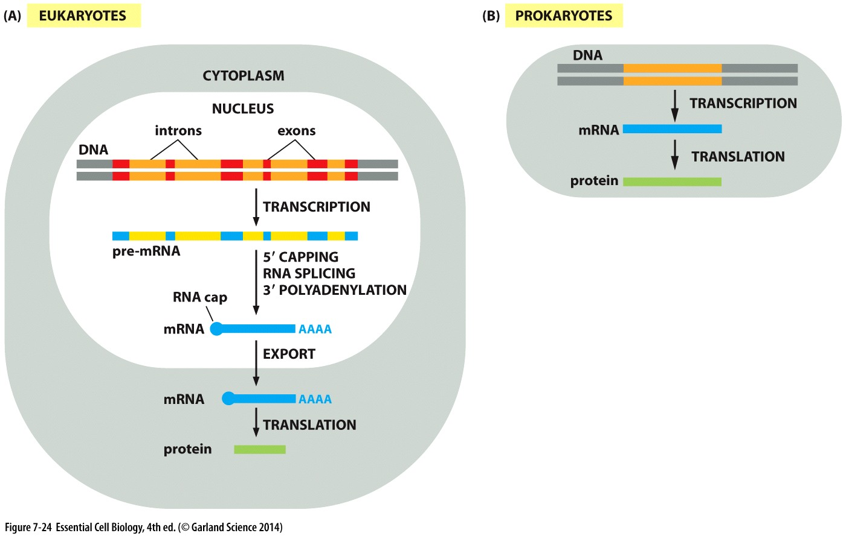

Slide 53
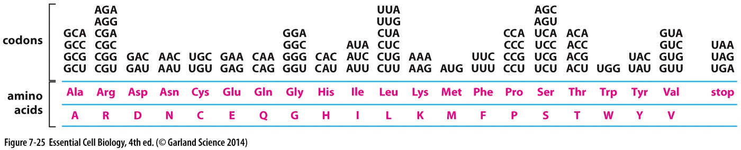
Protein
Are composed of amino acids
There are 20 different amino acids
Each amino acids is coded by 3 nucleotides termed codon
Genetic code
Reading frame is used for translation

Slide 54
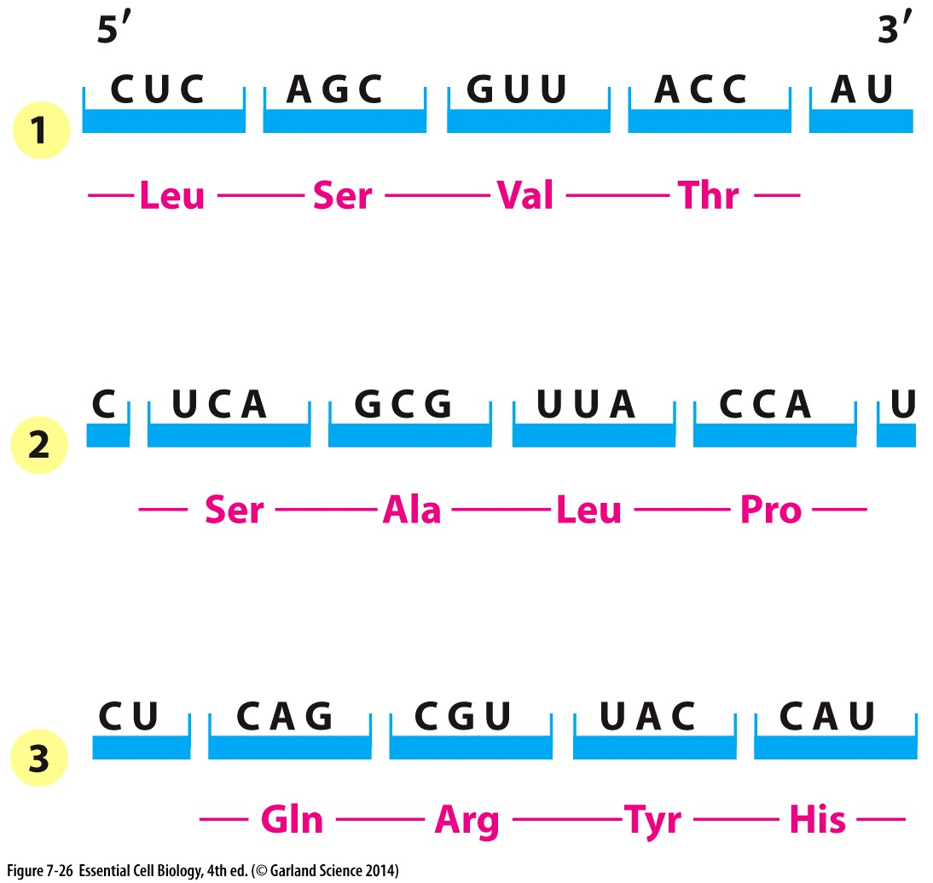
Reading frame
Same mRNA can give different protein sequence depending on the reading frame

Slide 55
Translation
mRNA
tRNA
rRNA
Ribosome
Translation initiation factors

Slide 56
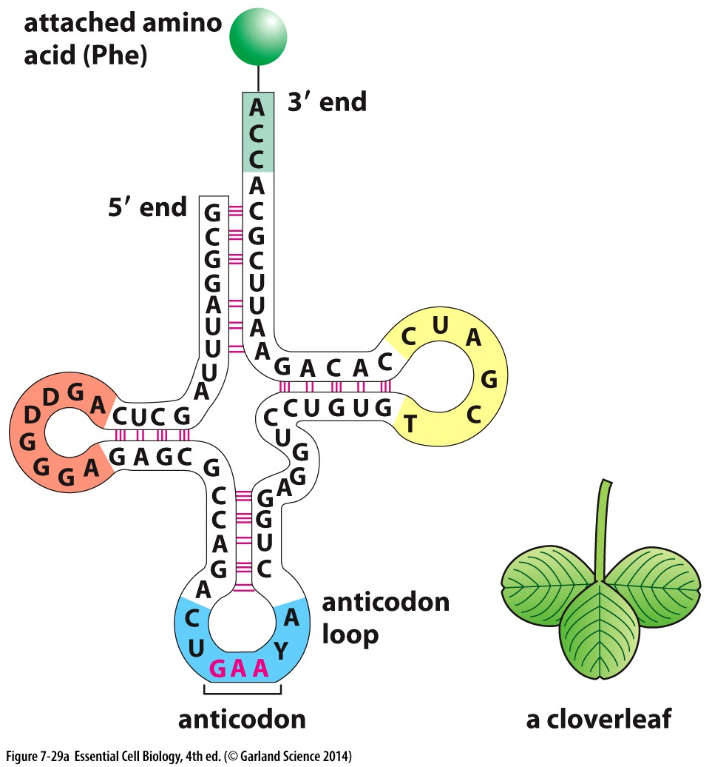
tRNA
Recognizes and attaches to codons
Anticodon
Amino acid bound end

Slide 57
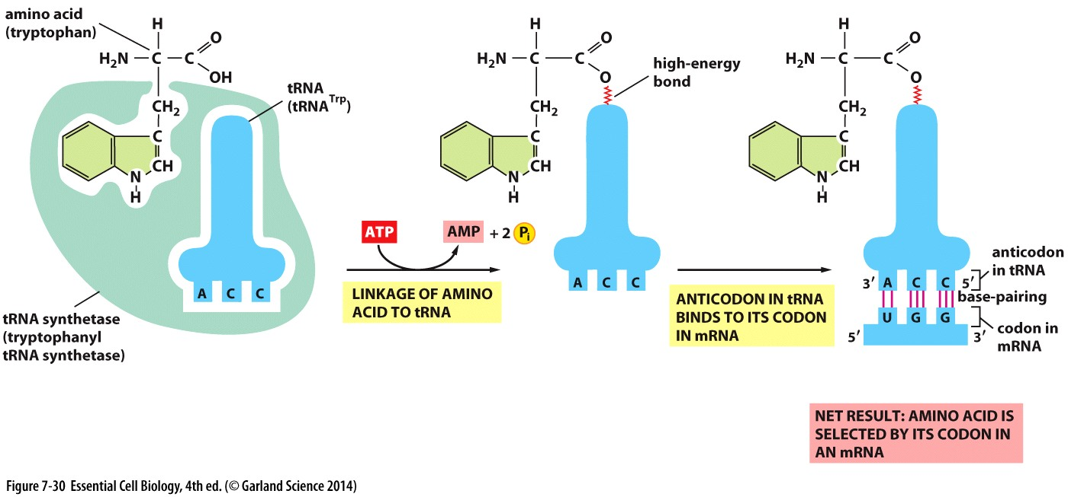
tRNA synthase
Covalently couples amino acids to its corresponding tRNA

Slide 58
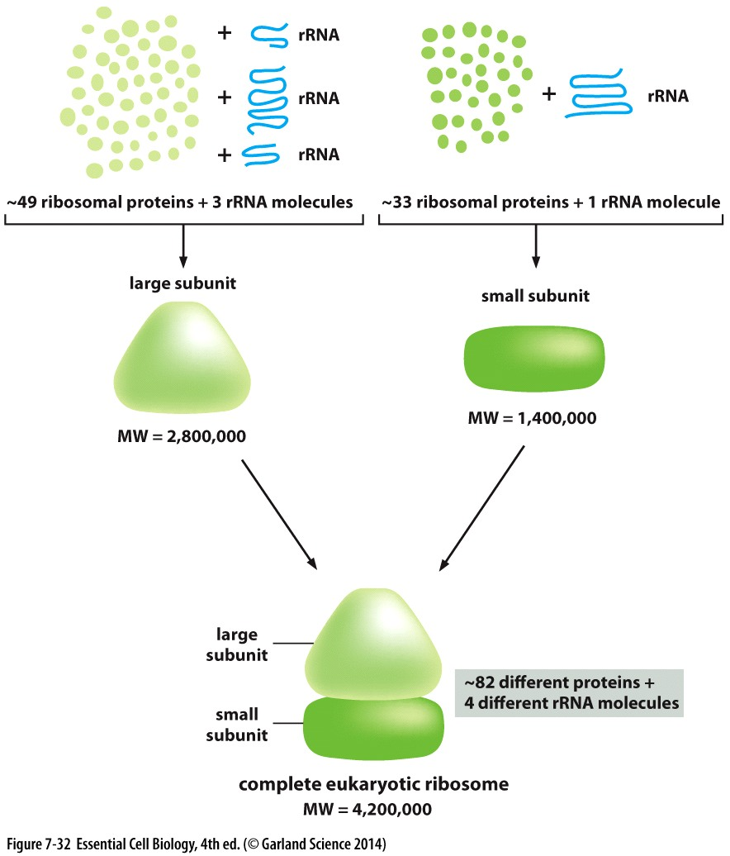
Ribosome
Ribosomes are composed of several ribosomal proteins and ribosomal RNAs
  Large subunit
  Small subunit
Ribozymes

Slide 59

Ribosomal subunits
Large subunit forms polypeptide chain by covalently binding the amino acids together
Small subunit matches tRNA to its corresponding codons on mRNA

Slide 60
Translation process
Translation initiation
  Scanning for start codon
Elongation
  tRNA translocation across the mRNA
Termination
  Binding of release factor

Slide 61

Translation Initiation
AUG is the start codon
  Initiator tRNA
  Translation initiation factors
Binding of large ribosomal subunit
Translation elongation

Slide 62

Elongation
New tRNA enters the A site
Amino acid is covalently bound to the polypeptide chain
Translocation
Ejection

Slide 63

Termination
Stop codons
  UAA, UGA, UAG
Release factors
Addition of H₂O
Termination

Slide 64

Prokaryotic translation
Initiation requires ribosome binding sequence
Ribosome can bind to mRNA directly
mRNAs are Polycistronic

Slide 65

Translation and antibiotics
Polyribosomes
Inhibitory drugs are used as antibiotics
Fungi are sources of many antibiotics

