Slide 1
PROTEINS

Slide 2
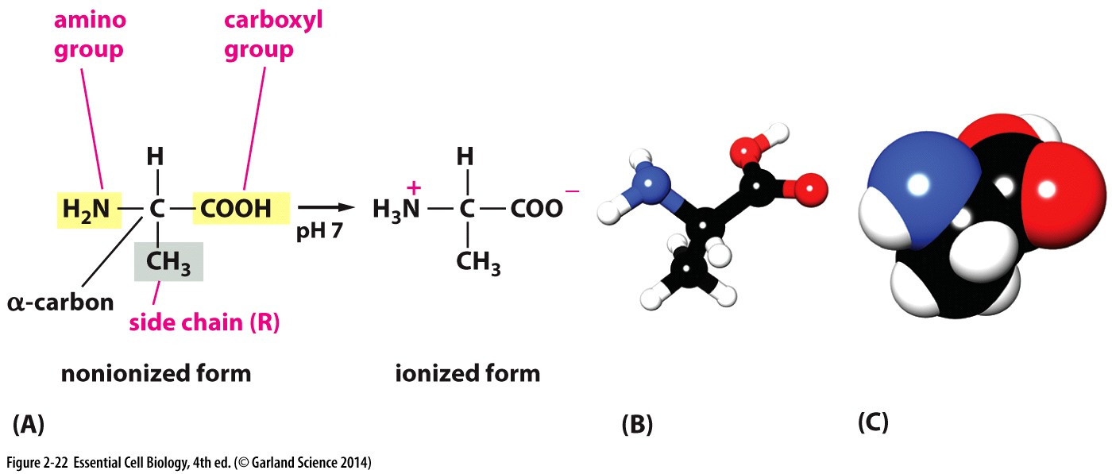
Amino acids
Subunits of proteins
20 amino acids

Slide 3
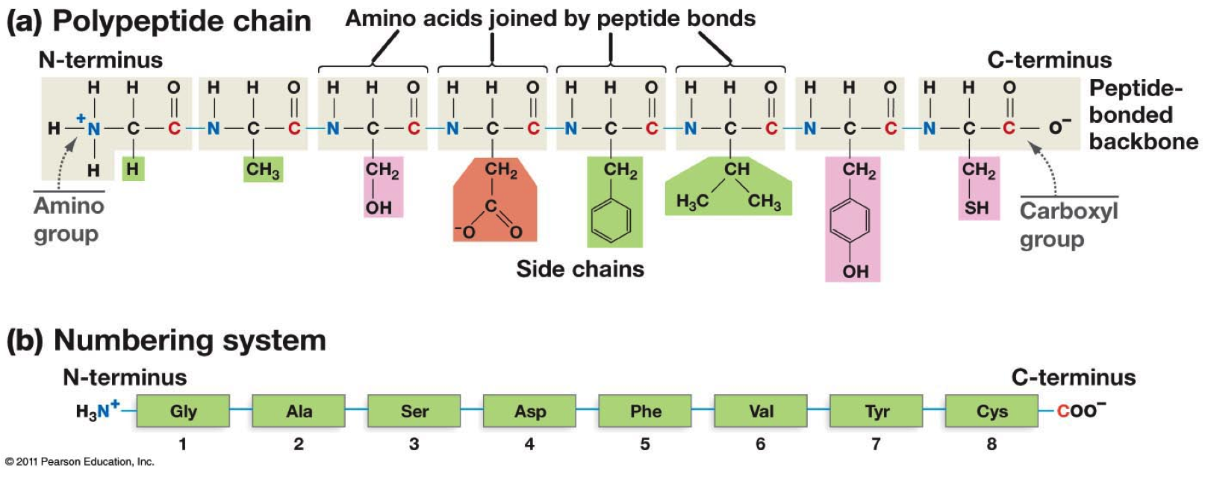
Polypeptides

Slide 4
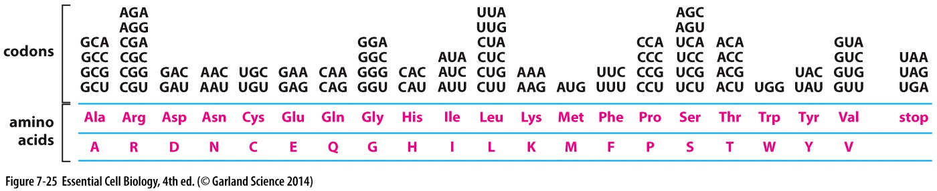
Protein
Are composed of amino acids
There are 20 different amino acids
Each amino acids is coded by 3 nucleotides termed codon
Genetic code
Reading frame is used for translation

Slide 5
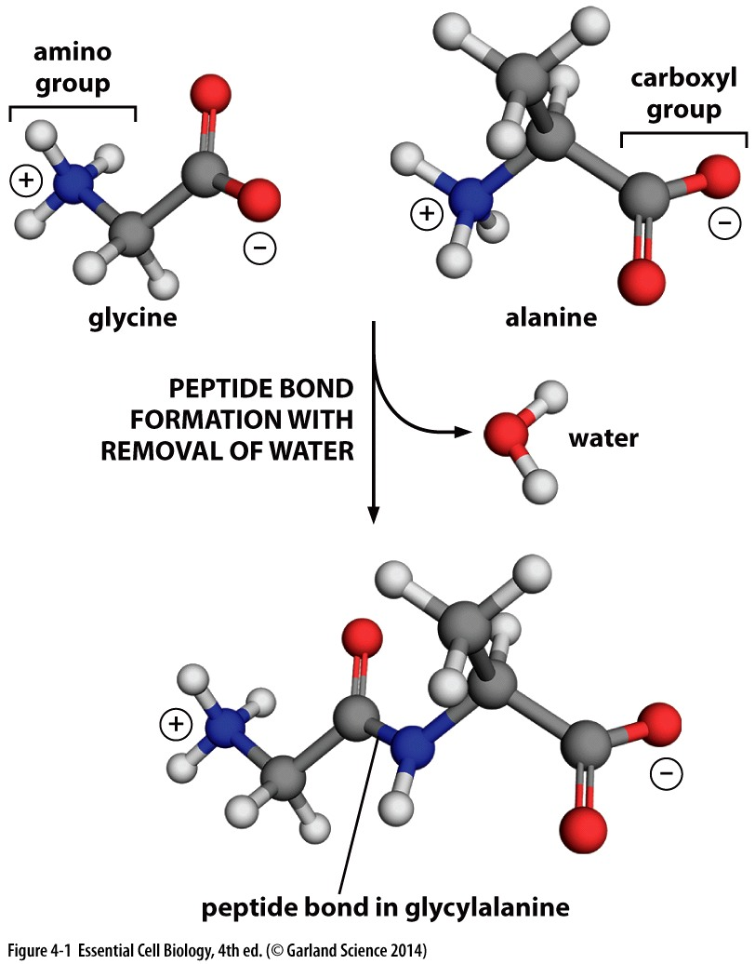

Slide 6
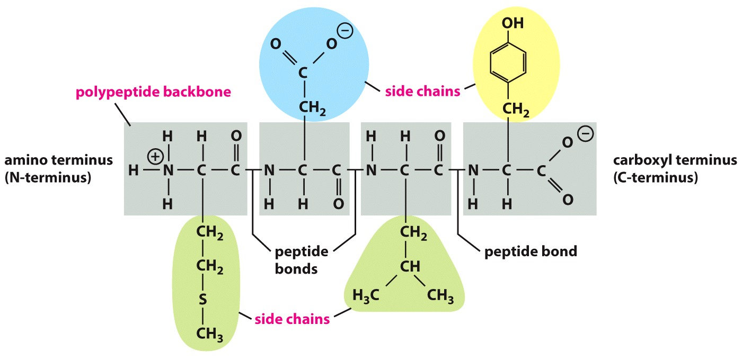
Protein structure
Chain of amino acids
Peptide bonds hold amino acids together
Polypeptide chain

Slide 7
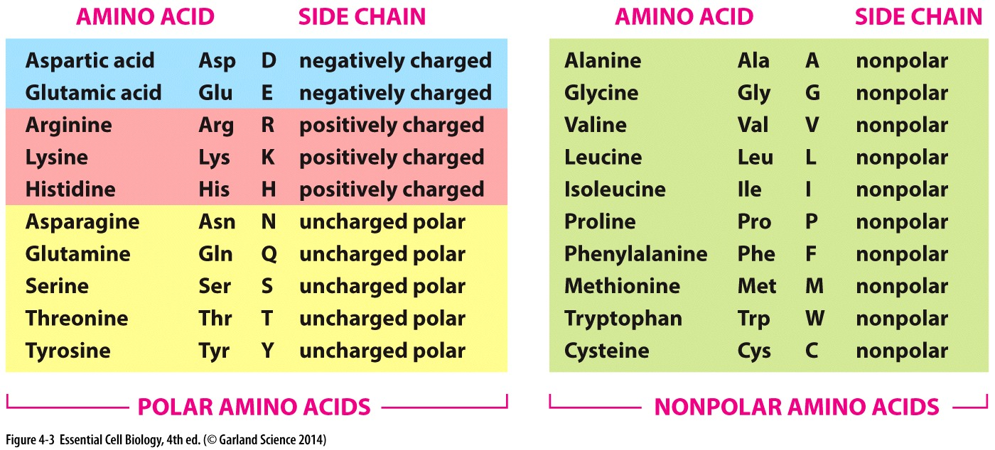

Slide 8
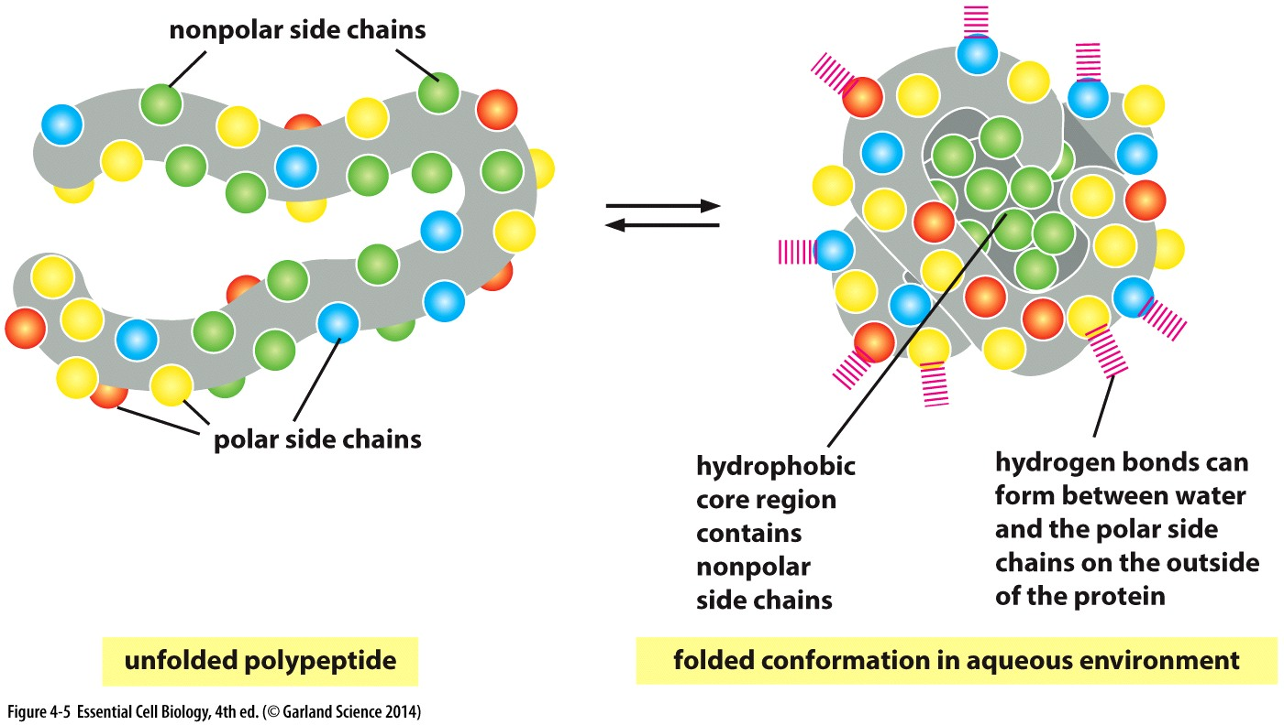
Protein folding
Polar and non-polar side chains play a crucial role in protein folding

Slide 9
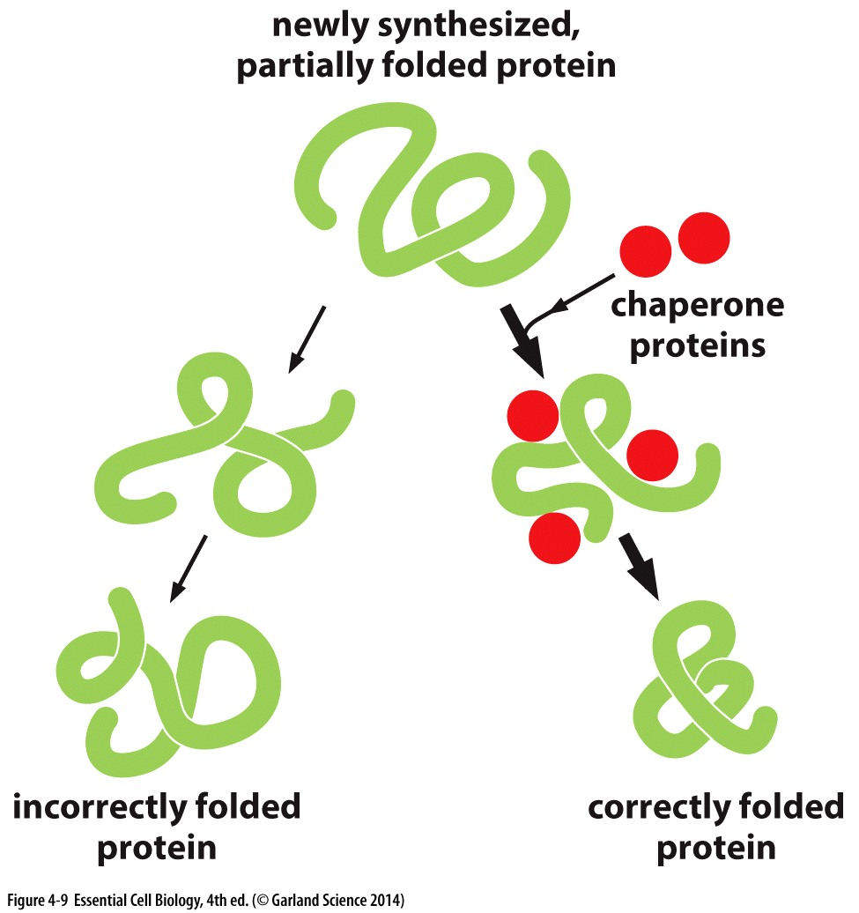
Protein folding
Proteins fold into a 3D structure
Denaturation unfolds the protein
Chaperones fold proteins into the correct conformation

Slide 10
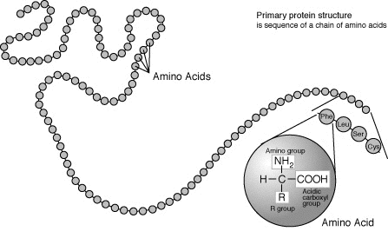
Primary structure

Slide 11
Protein secondary structure
The α helix
  stabilized by hydrogen bonds between nearby residues
The β sheet
  stabilized by hydrogen bonds between adjacent segments that may not be nearby

Slide 12
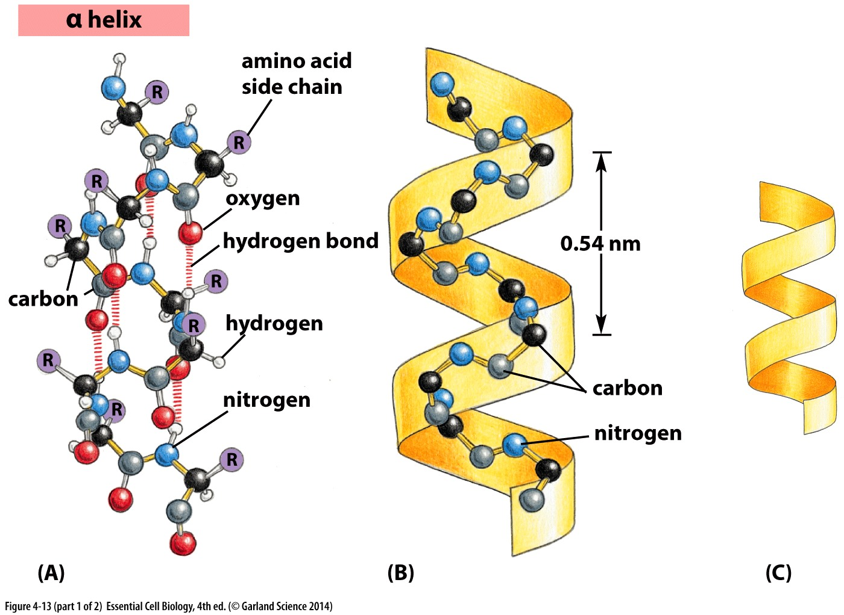

Slide 13
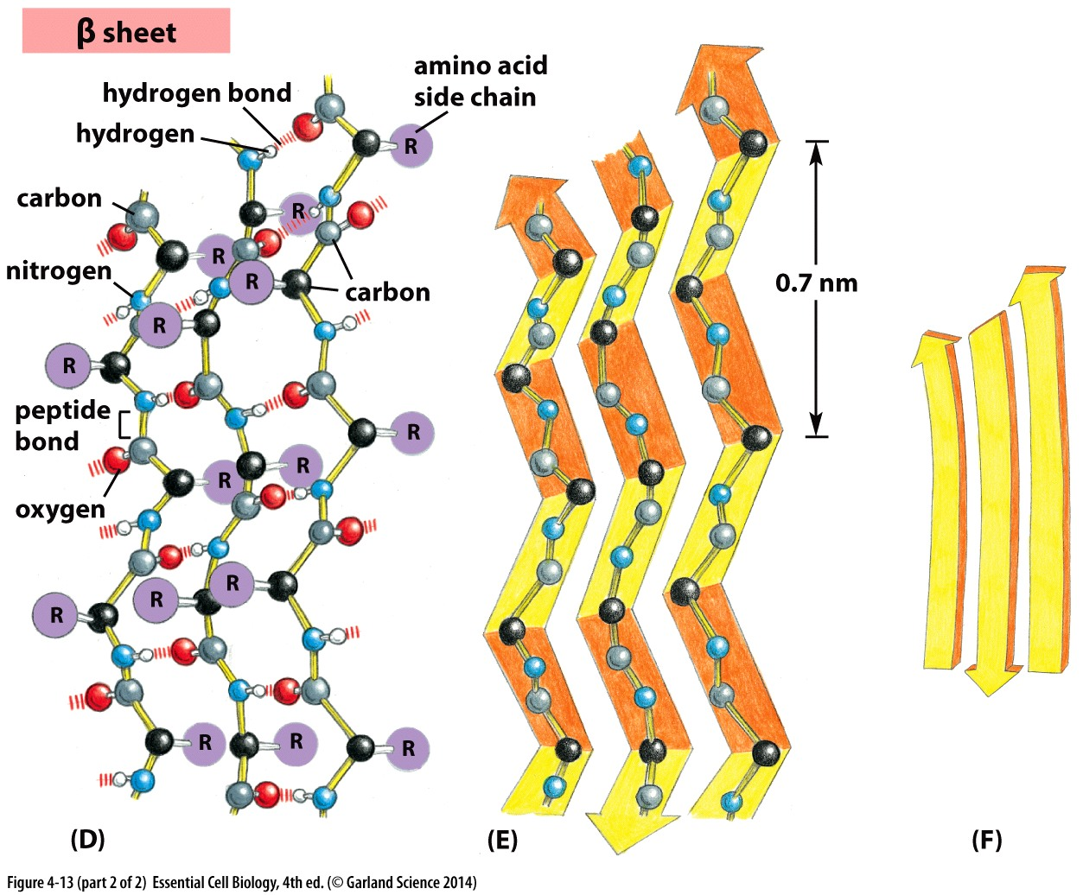

Slide 14
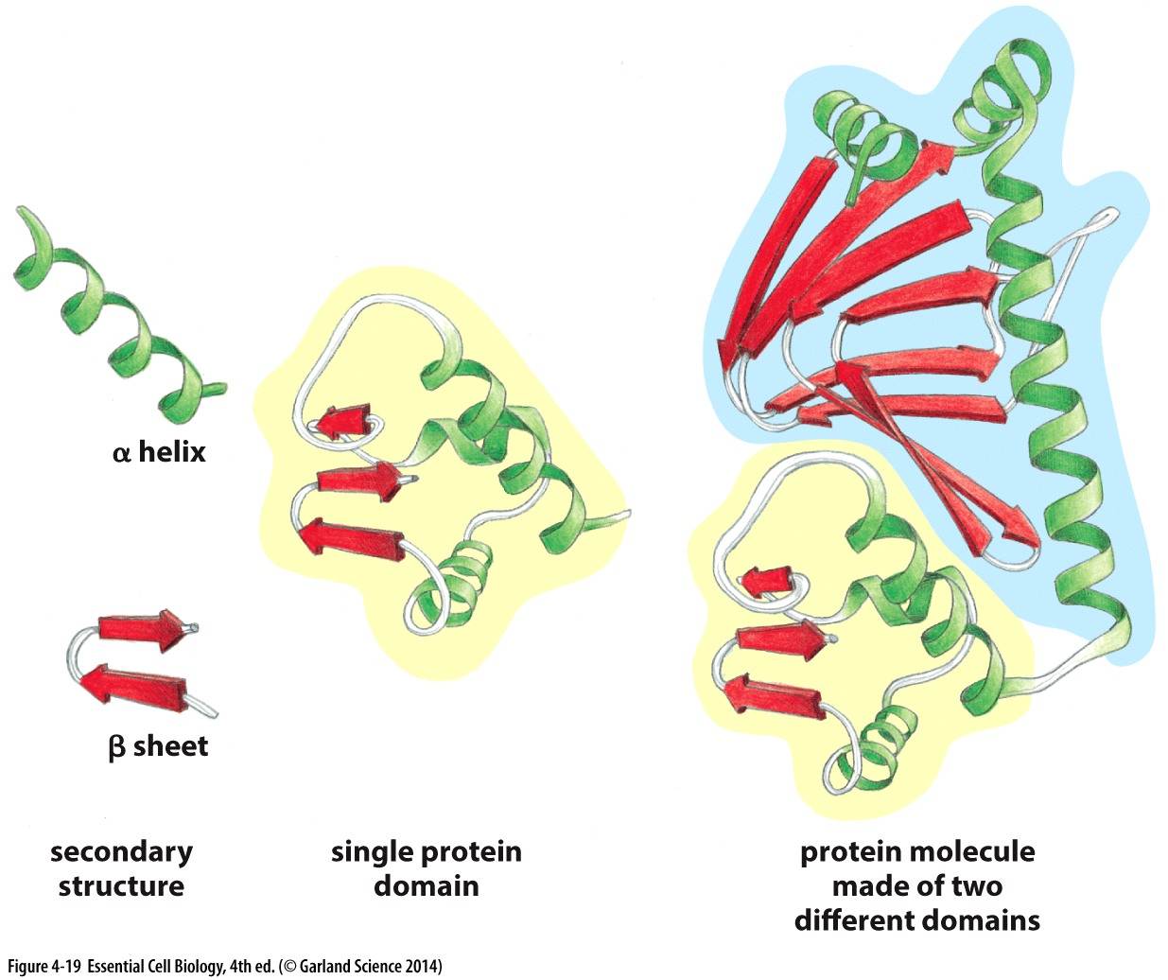
Other protein structures
Tertiary structure
  Involves the way the random coils, alpha helices and beta sheets fold in respect to each other.
Quaternary structure
  Complex of several
  polypeptide chains
Protein domains

Slide 15
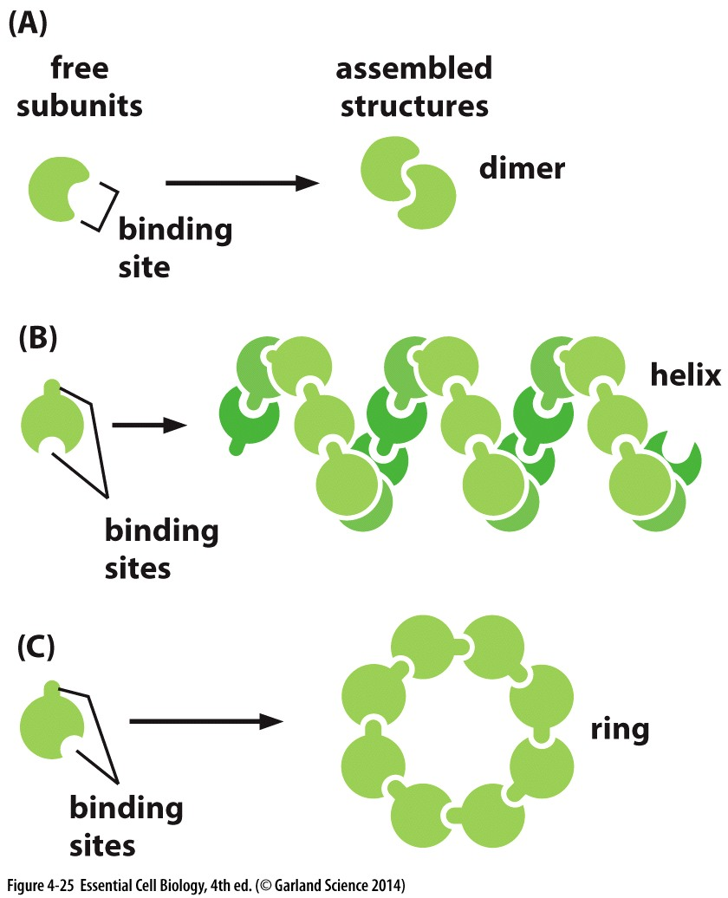
Protein families
Protein subunits
  Dimer
  Tetramer

Slide 16
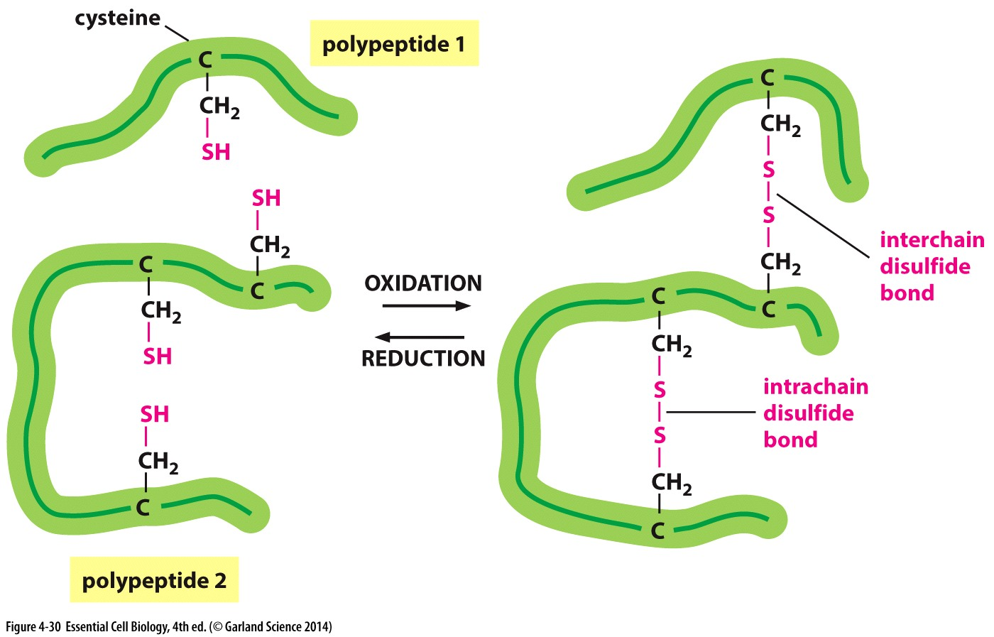
Disulfide bonds

Slide 17
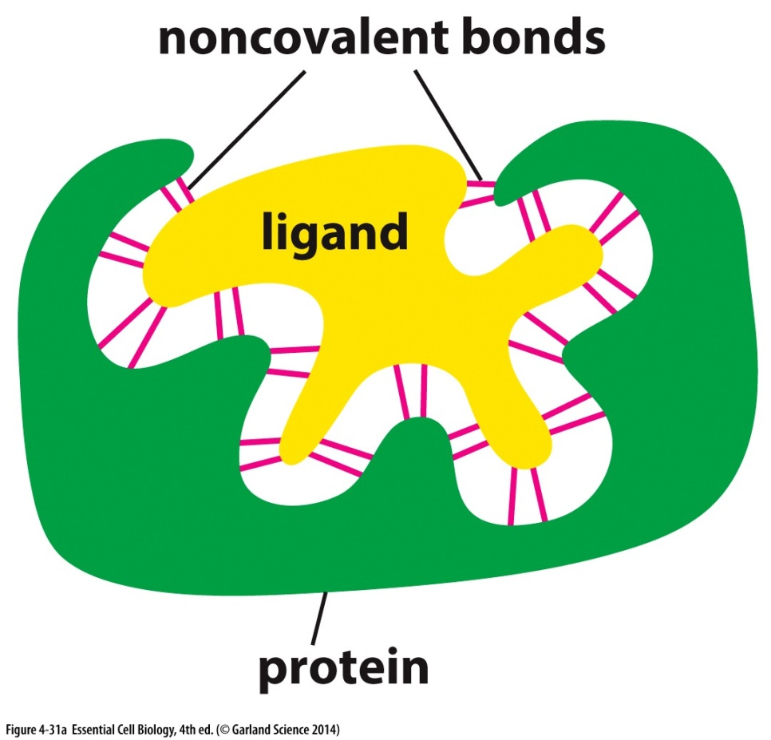
Protein binding
Protein interaction with other proteins or molecules is essential to its function
High specificity in
interaction
Ligands
  Form weak interactions
  with proteins at the
  binding site

Slide 18
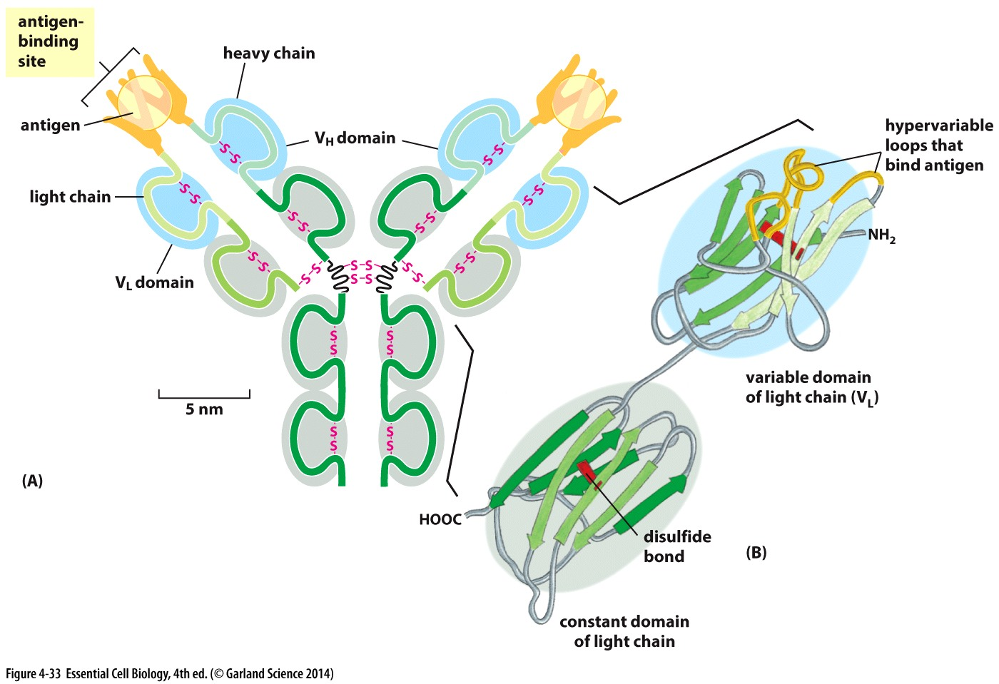
Antibodies
Produced by immune system in response to foreign molecules
Recognize a target molecule, antigen

Slide 19
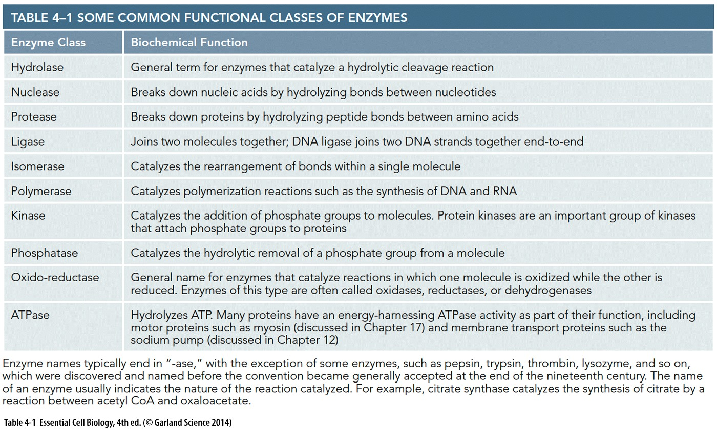
Enzymes
Enzymes bind to substrates to perform a function
Speed up chemical reactions
They have high specificity to their substrate

Slide 20
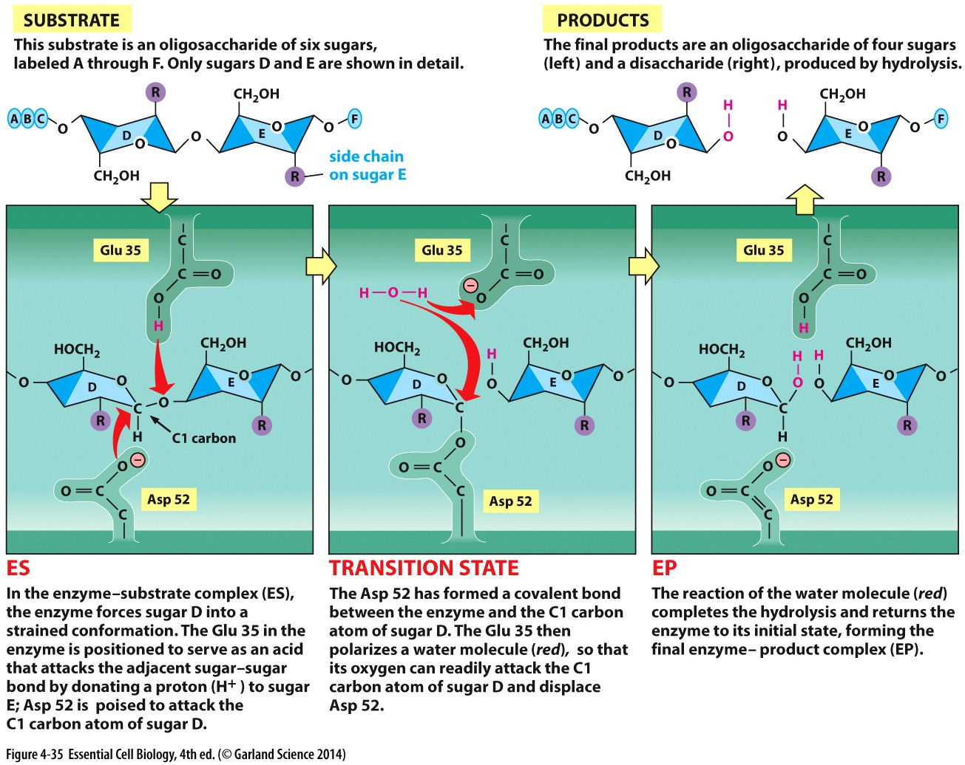
Lysozyme
Cuts polysaccharide chains in bacterial cell wall by hydrolysis
Transition state
Active site

Slide 21
Protein regulation
Protein can be regulated
  Gene expression
  Protein degradation
  Protein modification

Slide 22
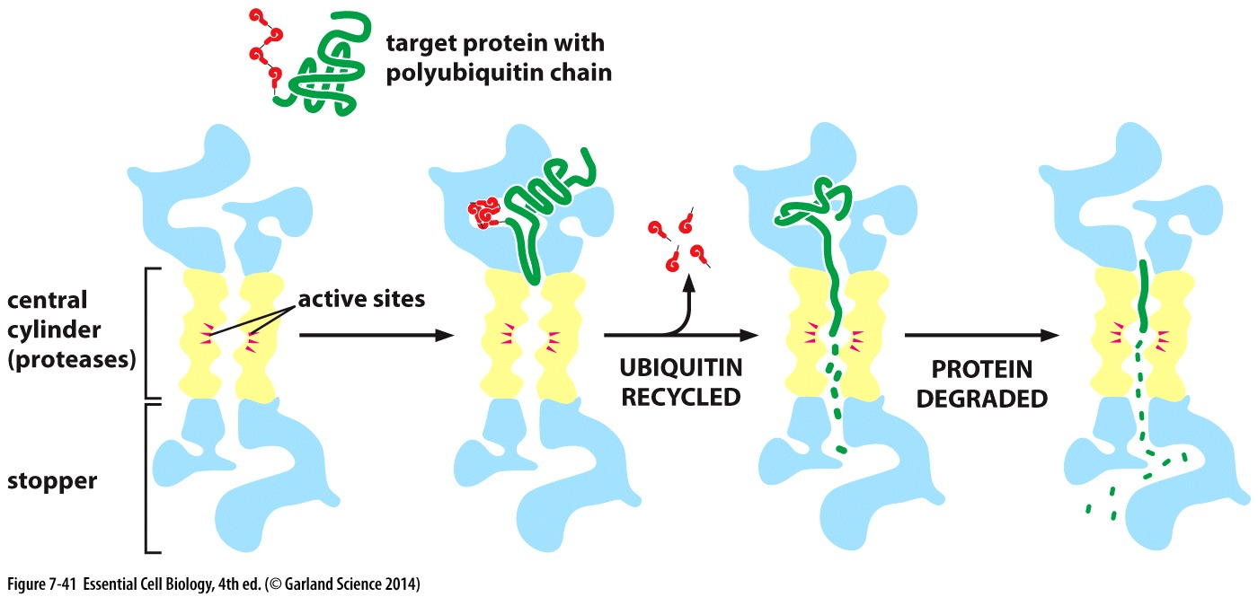
Protein degradation
Proteolysis is the process of breaking down the protein to amino acid
  Proteases
  Proteosome

Slide 23
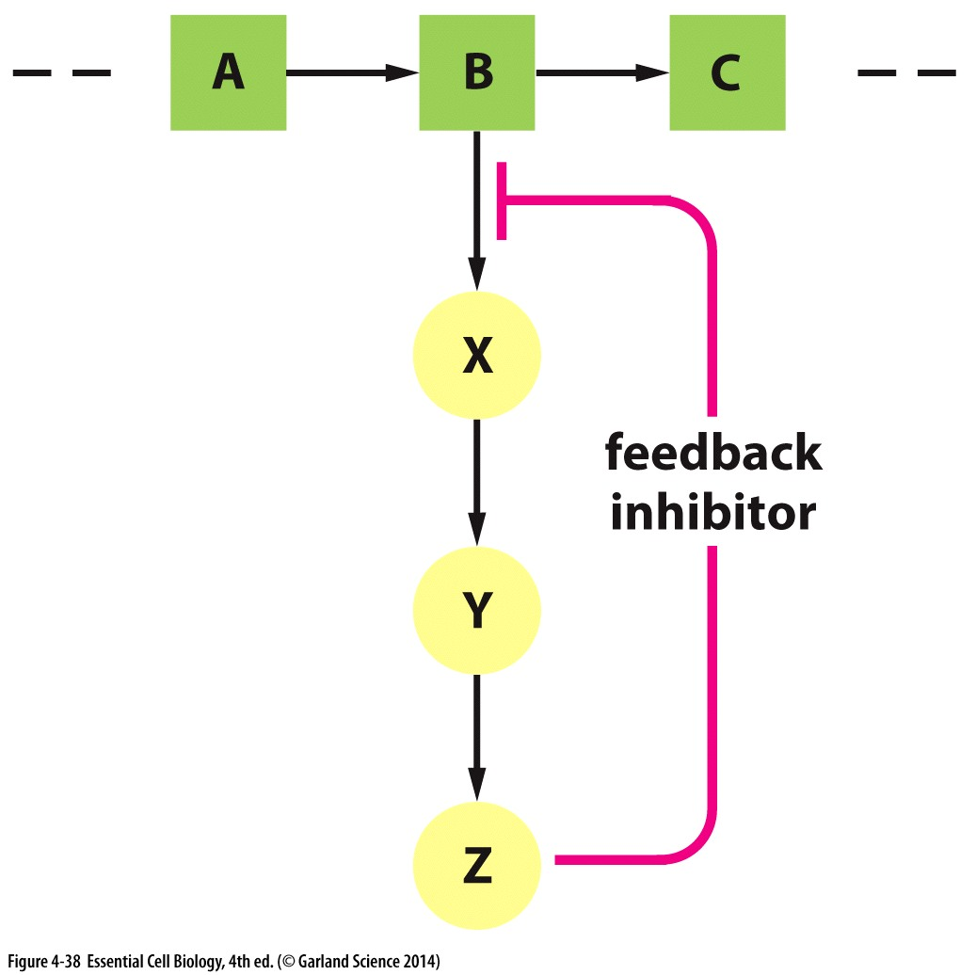
Enzymes’ activity
Feedback inhibition
  Final product inhibits the enzyme
  Negative regulation
  Positive regulation

Slide 24
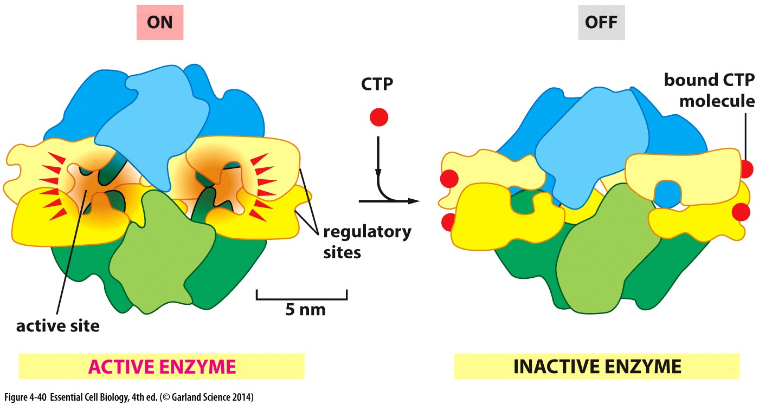
Enzyme’s activity
Allosteric enzymes
  Active site and regulatory site
  Conformational changes regulates the activity of the protein

Slide 25
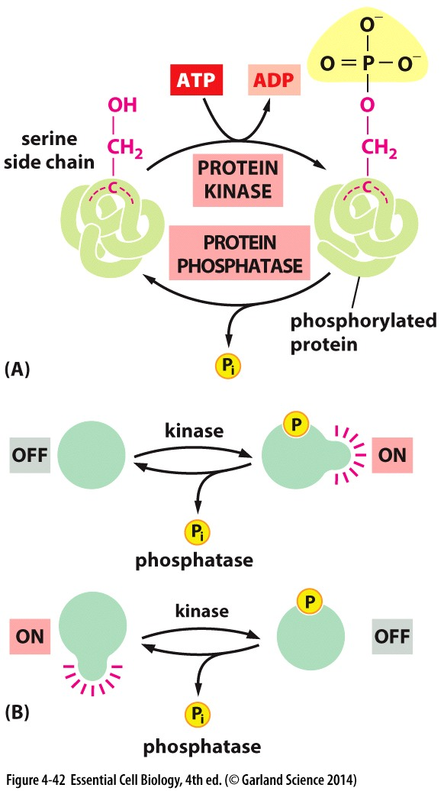
Phosphorylation
Addition of a phosphate group to proteins by kinases
It’s a reversible reaction, carried out by phosphatases

Slide 26
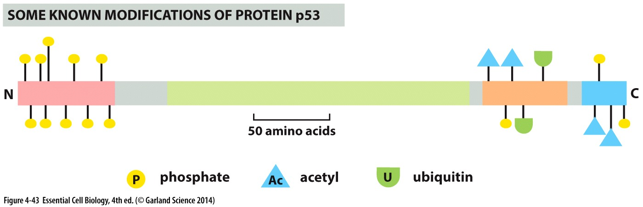
Protein modification
Signaling and localization of protein
Protein-protein interaction
GTP-binding protein involved in signaling
Protein movement

Slide 27
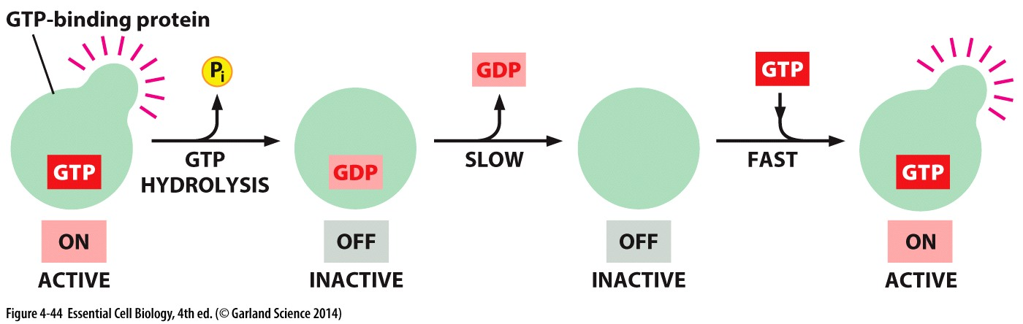
Protein modification
GTP binding protein act as on/off switches

Slide 28
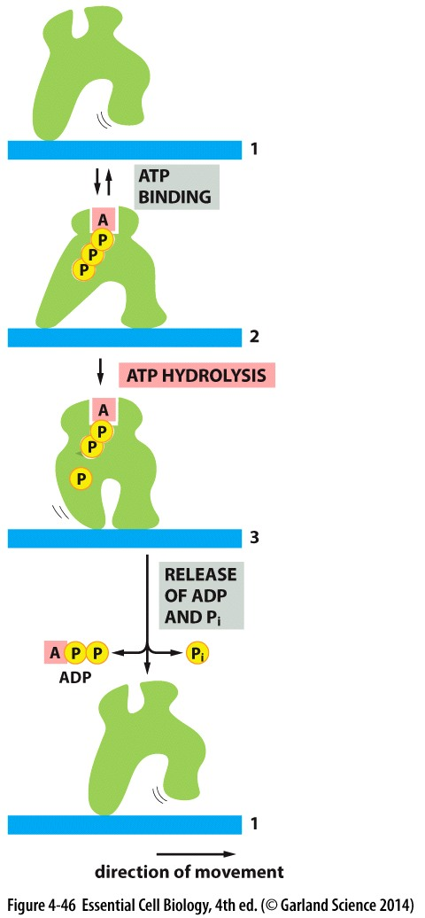
Protein modification
Movement of eukaryotic cell are powered by ATP-hydrolysis in motor proteins

