Slide 1
Last Lecture
Gene Expression

Slide 2
Gene expression
Gene expression is a process by which the cell selectively direct the synthesis of proteins and RNAs
Differences in expression of a gene can give rise to cells that are dramatically different in structure and function despite having the same DNA

Slide 3
Different cells, different proteins
Housekeeping proteins are proteins that are common in all the cells of multicellular organism
  RNA polymerase
  Proteins involved in Glycolysis
  DNA repair proteins
Specialized proteins for different cell types

Slide 4
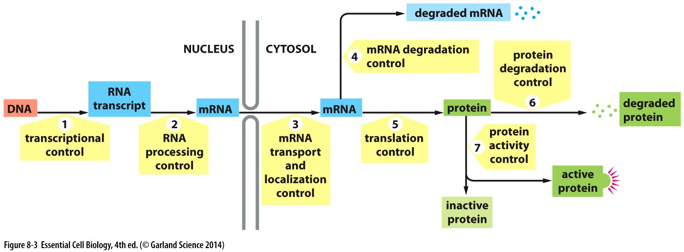
Gene expression regulation
When and how often genes are transcribed
How RNA is spliced and processed
Which mRNA is exported
Rate at which mRNA is degraded
Which mRNAs are translated
Selecting proteins for degradation
Control proteins activity

Slide 5
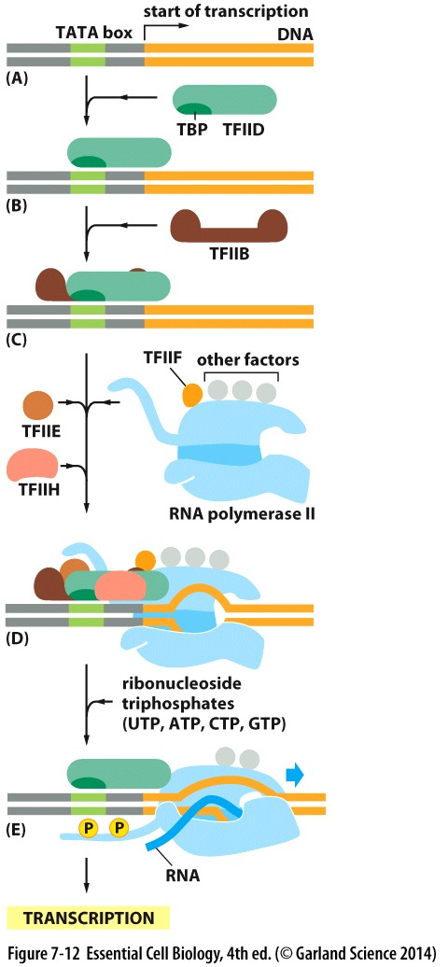
Transcription
Promoter region is the binding site for RNA polymerase
Transcription initiation site is where RNA synthesis begins

Slide 6
Regulatory DNA sequences
Sequences that are used to switch genes on or off
Sequences are recognized by transcription regulators proteins
These DNA-protein interactions have high affinity and specificity

Slide 7
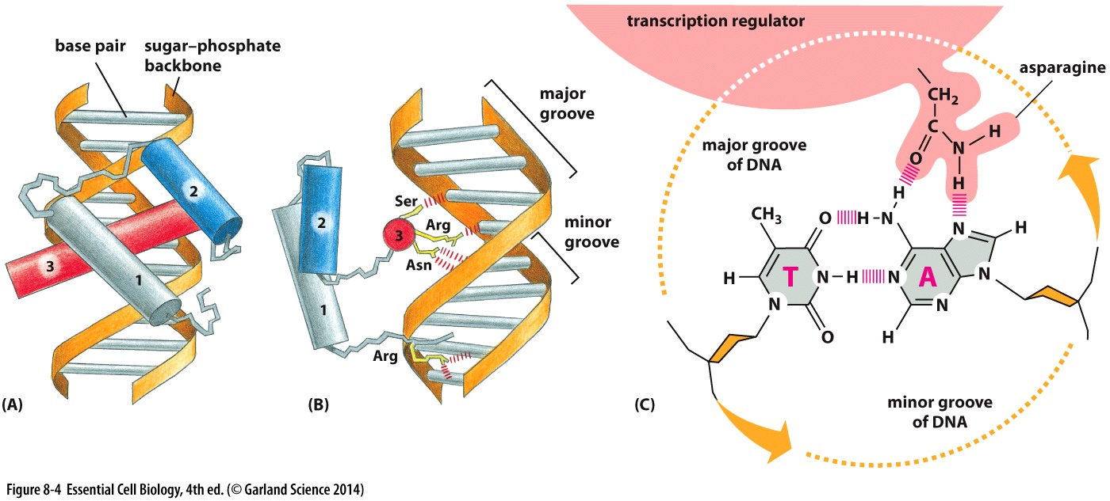

Slide 8
Operon
Genes are clustered on the chromosome and transcribed from a single promoter giving a long mRNA
  Operons
Abundance of tryptophan dictates enzyme biosynthesis

Slide 9
Tryptophan Biosynthesis
Operator: Short sequence within the promoter
Tryptophan repressor
It operates based on its interaction with tryptophan molecules
  Binding of tryptophan causes change in 3D confirmation of tryptophan repressor and its binding to operator region

Slide 10
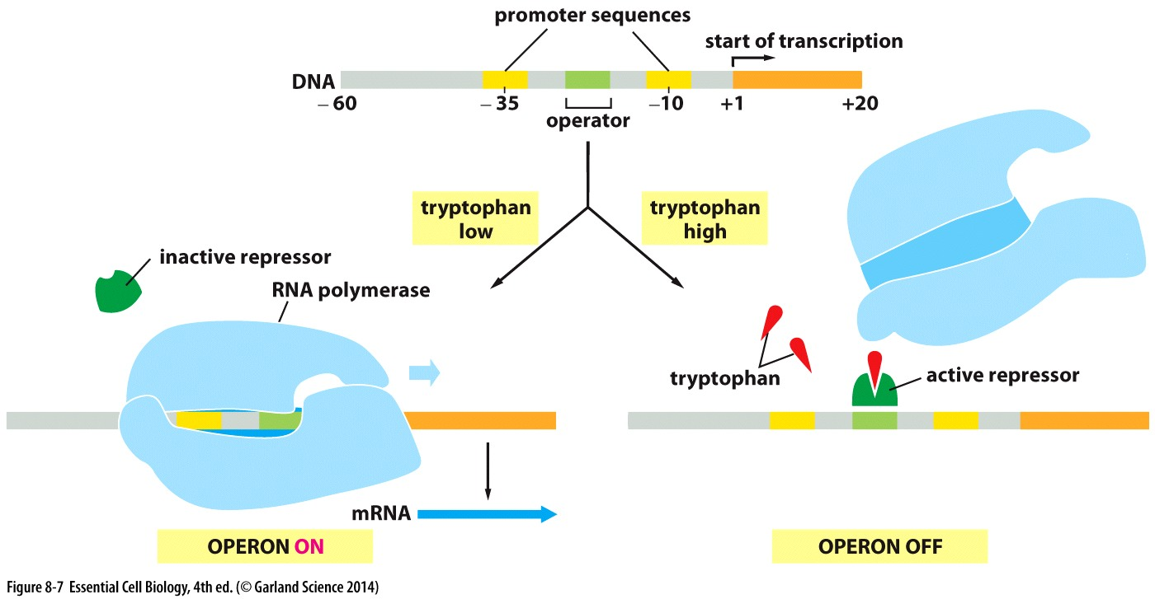

Slide 11
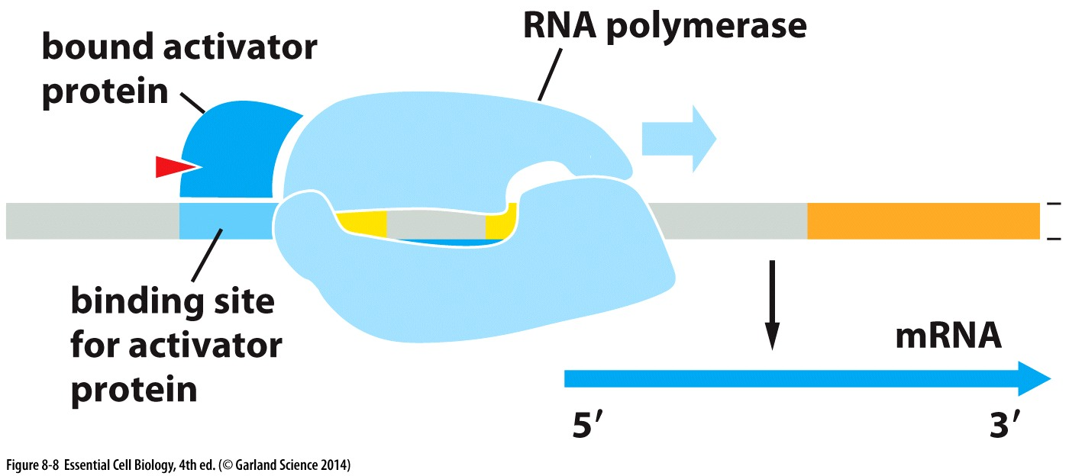
Repressors and Activators
Repressors switch genes off and activators switch genes on
Activators bind close to promoters and facilitate initiation of transcription by making a poorly functional promoter, fully functional
They must interact with a second molecule in order to bind to DNA

Slide 12
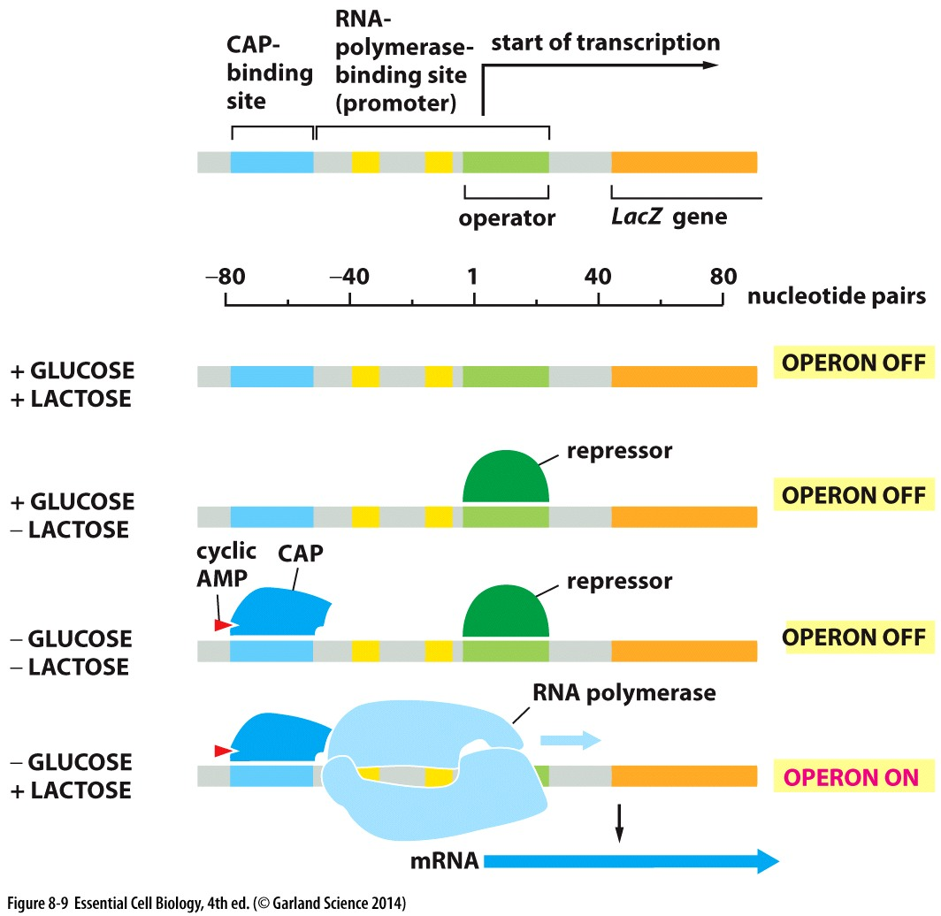
Lac Operon
Encodes for proteins that digest disaccharide lactose
  In the absence of glucose, cAMP is produced and CAP is activated
  In the absence of lactose, lac repressor switches the operon off

Slide 13
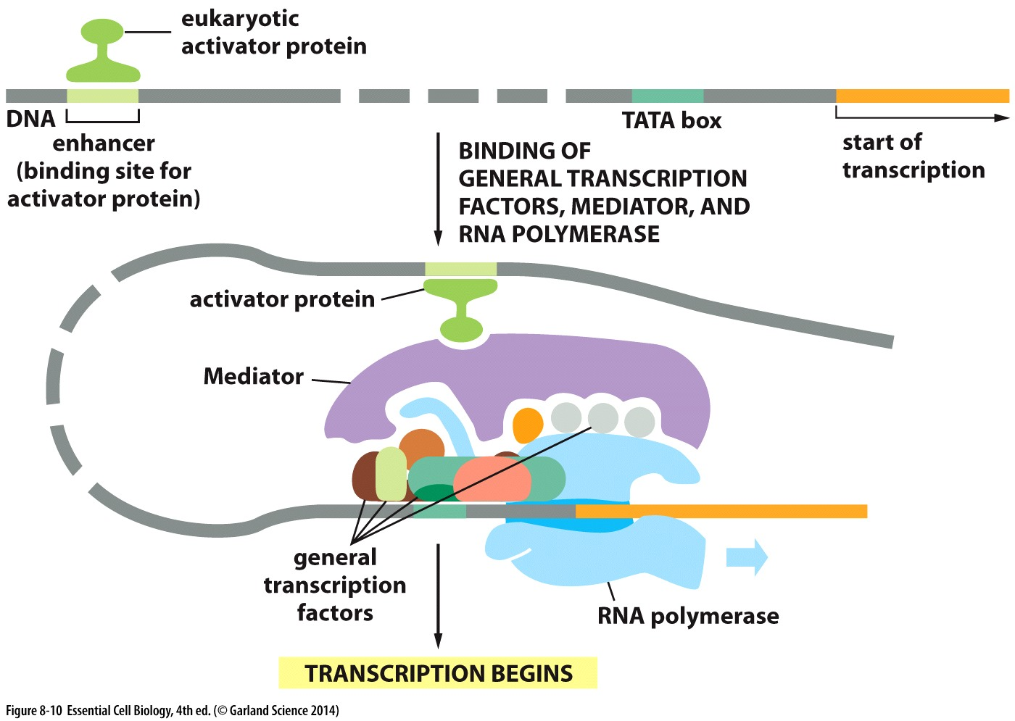
Eukaryotic transcription regulators
Enhancers are transcription activators
DNA loops to allow interaction between proteins in
enhancer region and
promoter region
Mediators

Slide 14
Chromatin remodeling
Nucleosomes can inhibit transcription initiation
Chromatin remodeling complexes can alter chromatin structure
Histone acetyl transferase adds acetyl group to lysines and enhances accessibility to DNA

Slide 15
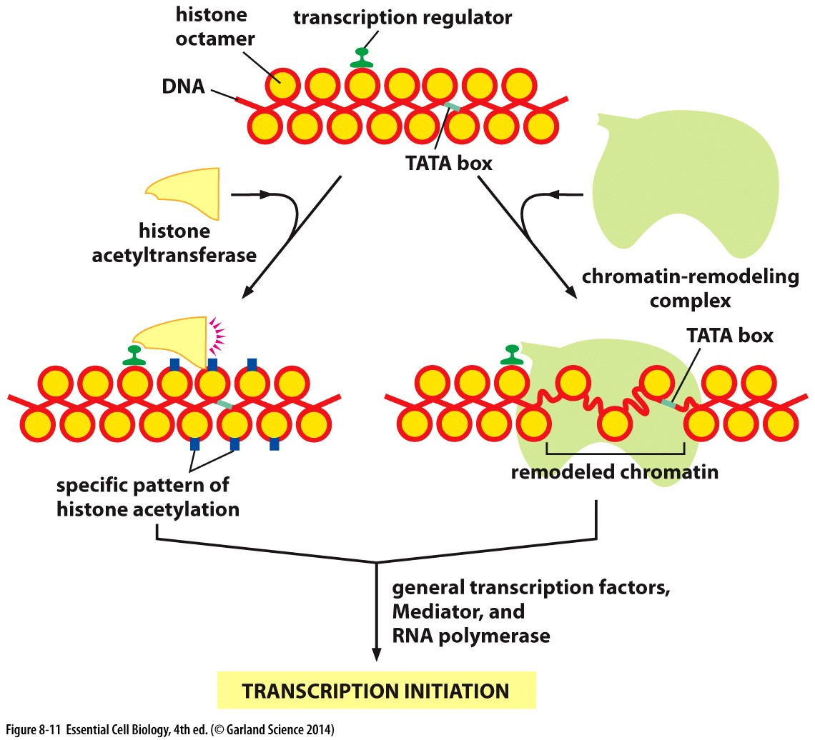

Slide 16
Specialized cell types
Multicellular organisms have specialized ways to form differentiated cell types
Cells that are differentiated into specialized cell types must maintain and remember their gene expression as they divide
  Cell memory

Slide 17
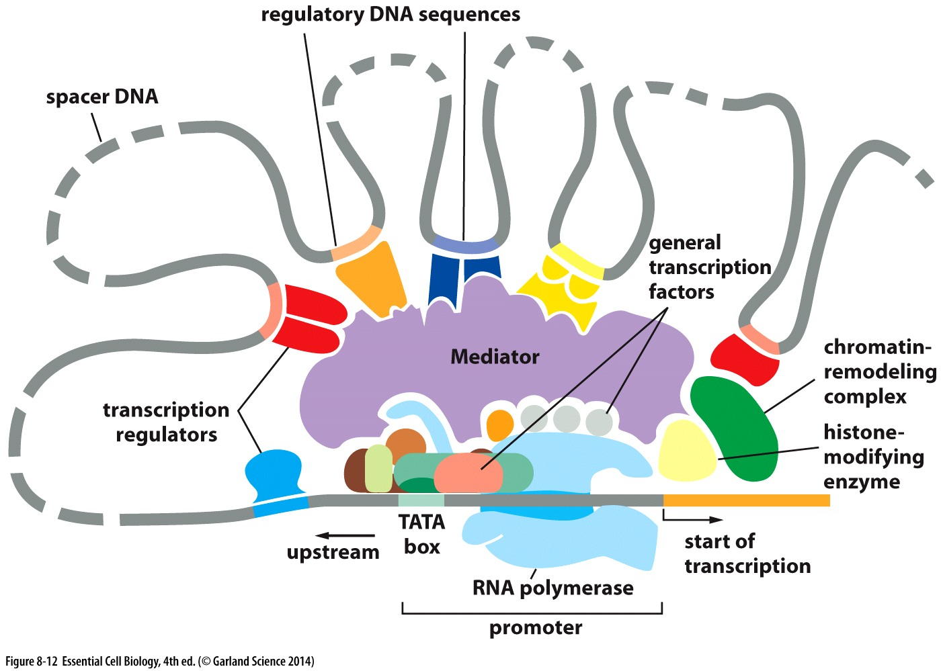
Transcription regulators
Combinational control: group of regulators control gene transcription and expression

Slide 18
Gene expression coordination
A single transcription regulator can switch a group of genes on or off
Cortisol receptor protein
  Form a complex with cortisol in order to bind to DNA
  Increase levels of several genes including tyrosine aminotransferase

Slide 19
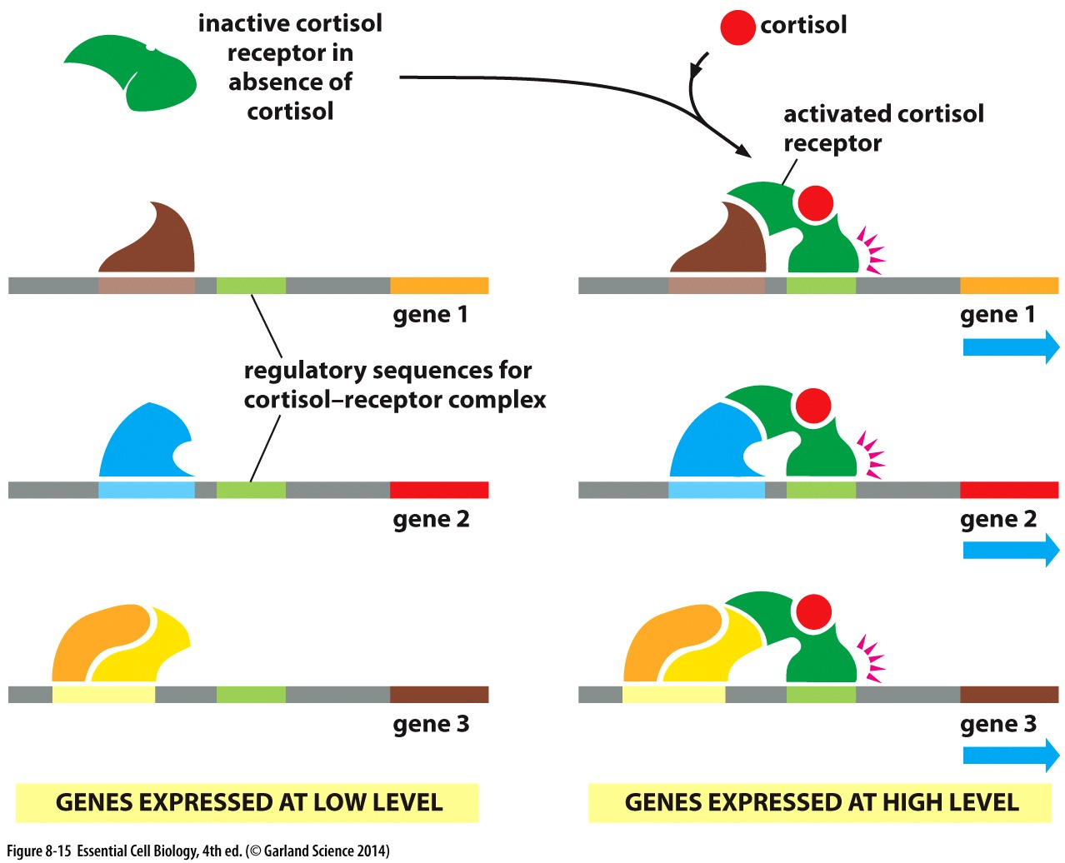

Slide 20
Cell types
Regulatory proteins play a role in diversity of cells in multicellular organisms
Some transcription regulators can switch one cell type to another
  MyoD introduction into fibroblast forms muscle-like cells
  Nerve-specific transcription regulators can convert liver cells to neurons

Slide 21
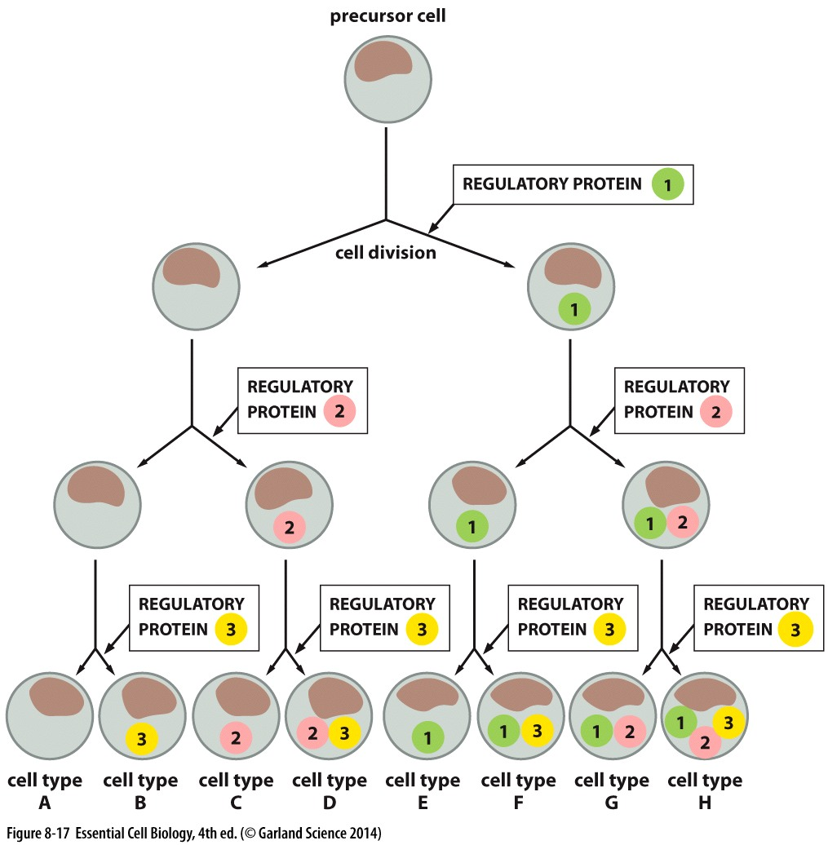

Slide 22
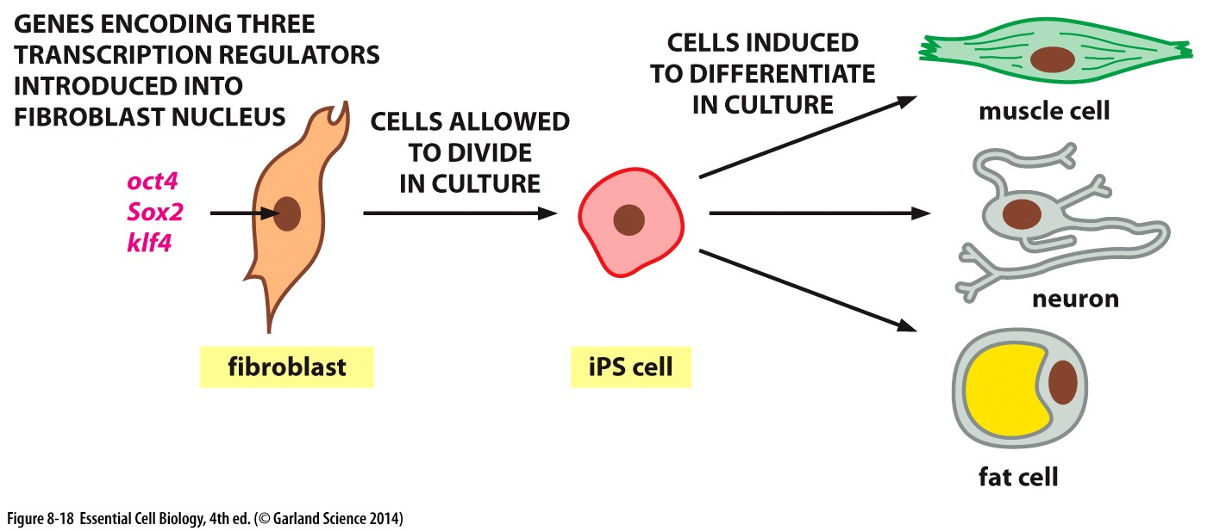
Induced pluripotent
Transcription regulators can change differentiated cells to pluripotent stem cells

Slide 23
Epigenetics inheritance
Transcription regulators are passed on to daughter cells
Proliferating cells must maintain their
  Positive feedback loop: master regulator activates transcription of its gene and other regulatory genes
  DNA methylation of specific cytosine bases attracts proteins that block transcription
  Histone modification can control cell identity too

Slide 24
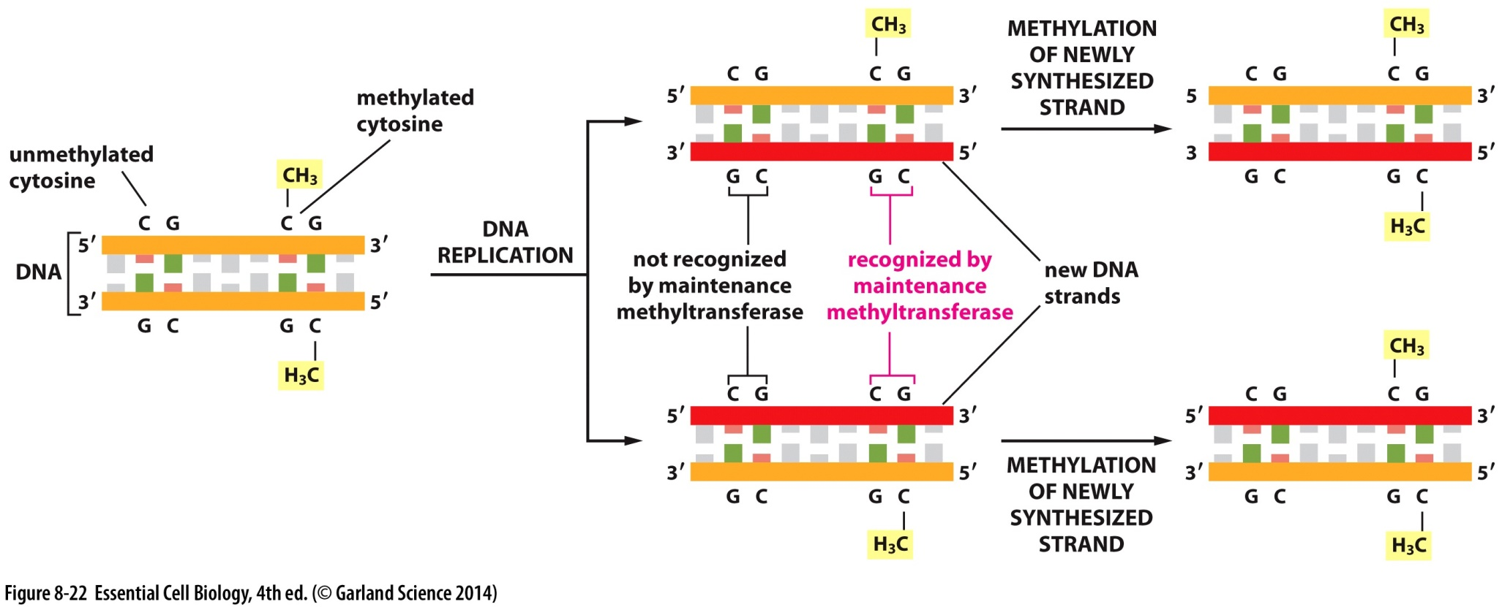

Slide 25
Post-transcriptional controls
Regulating gene expression after transcription
  Alternative RNA splicing
  Post-translational modifications on proteins
  mRNA degradation
  Regulatory RNAs

Slide 26
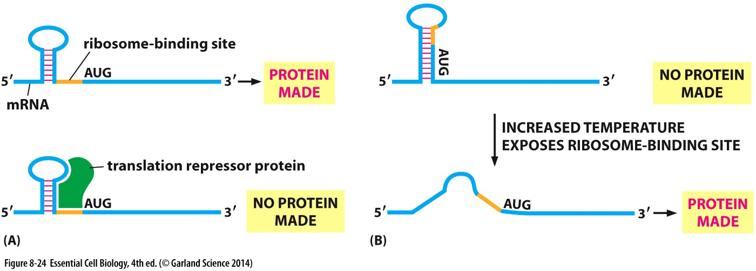
mRNA degradation and translation
mRNA lifetime is dictated by sequences within its UTR both upstream and downstream of the coding region
Bacterial mRNA contain binding sequence upstream of AUG

Slide 27
Regulatory RNAs
Non-coding RNAs have various functions
  In protein synthesis
  Gene expression
Micro RNA
Small interfering RNAs
Long non-coding RNAs

Slide 28
Micro RNAs
Small RNAs that base pair with mRNAs and reduce their stability and translation
  They can silence multiple mRNAs as long as they have a sequence in common
  Occupy small regions in the genome due to their size
RNA-induced Silencing Complex (RISC)
  miRNA with specialized proteins
  Searches for mRNAs that are complementary to miRNA molecule
Notes:
22 nt

Slide 29
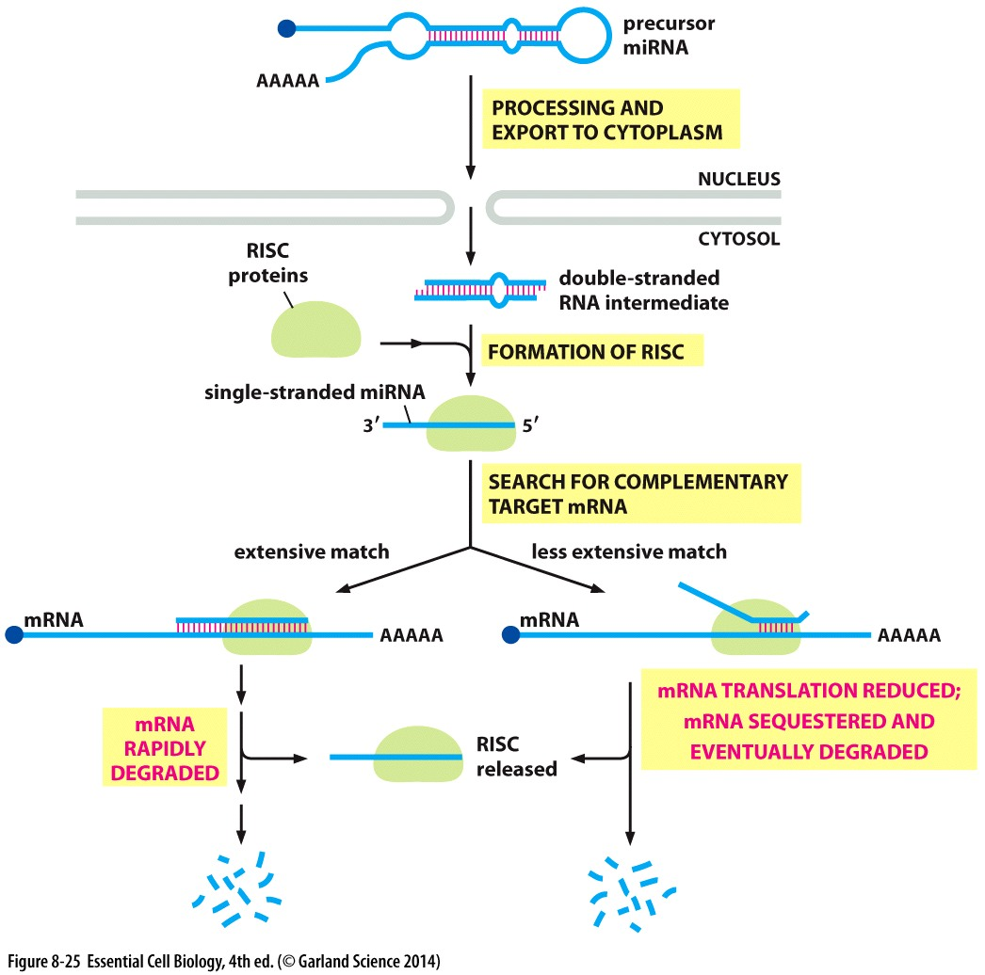

Slide 30
Small interfering RNA (siRNA)
RNA interference (RNAi) is a defence mechanism used against viruses and foreign RNA molecules
  Double stranded RNA is cut
  Producing siRNA
  RISC searches for complementary RNA

Slide 31
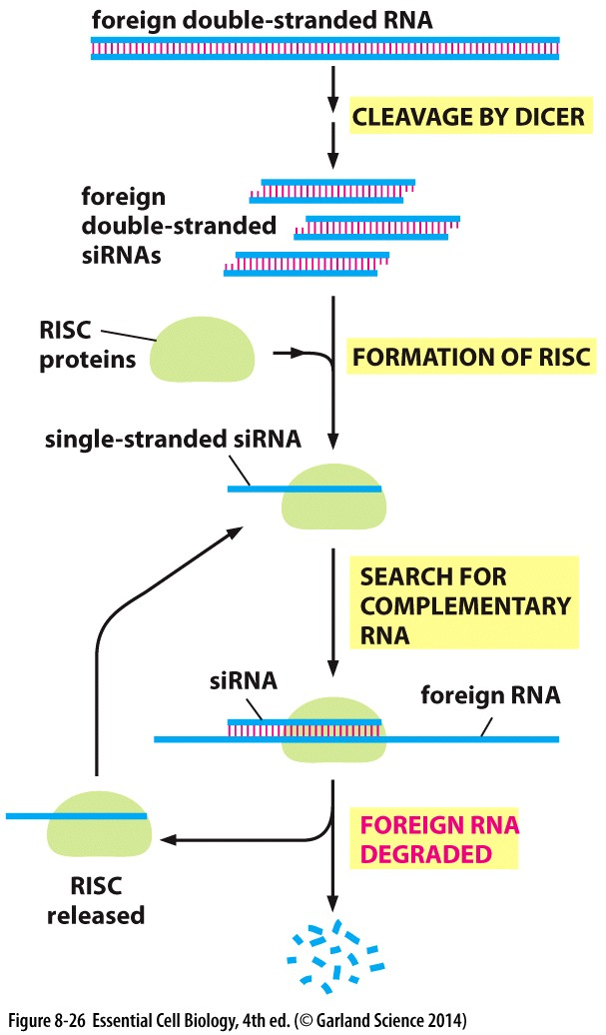
Notes:
Andrew fire and craig mello 1998, noble prize 2006

Slide 32
Long noncoding RNAs
RNA molecules over 200 bases in length
Xist is 17000 nucleotide long
  Inactivates one of the X chromosomes in female mammals
  Produced by one of X chromosomes
  Attracts enzymes and chromatin remodeling complexes forming heterochromatin regions

