Slide 1
Tissue Maintenance and Renewal
Stem Cell and
Cancer

Slide 2
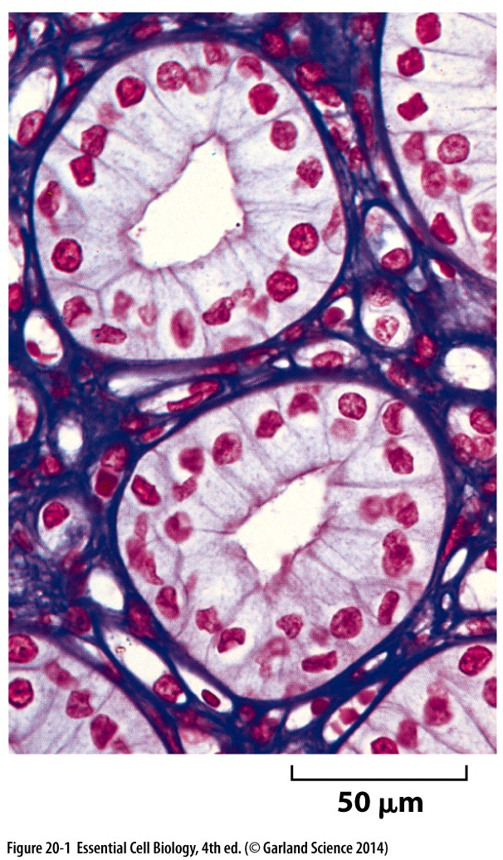
Tissue
From Cells to Tissues
  In multicellular organism cells are organized into Tissues
  Extracellular matrix
    Extracellular molecules secreted by the cell, providing support and structure
  Cell junctions
    Links cells together

Slide 3
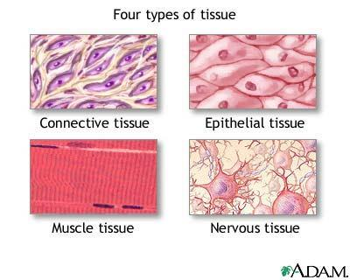
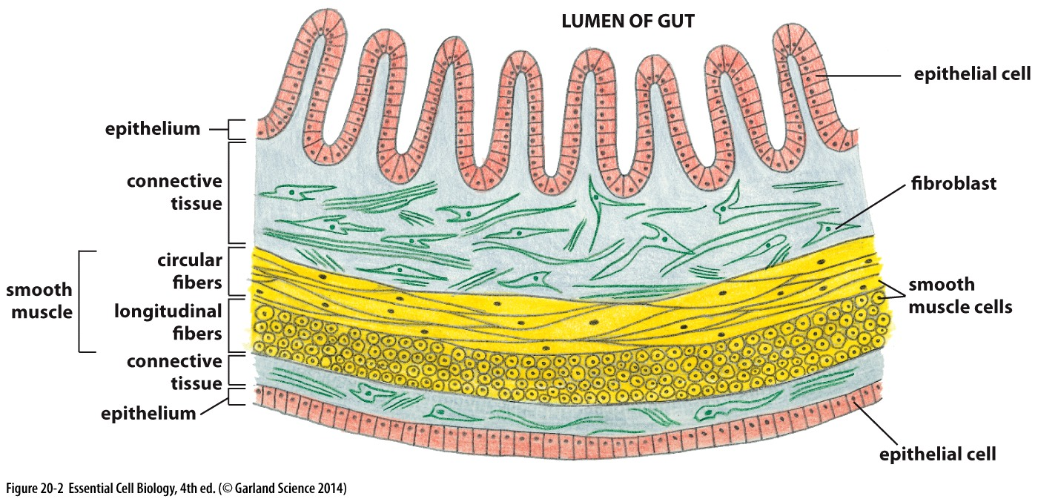
Animal Tissues
Connective
Nervous
Muscular
Epithelial

Slide 4
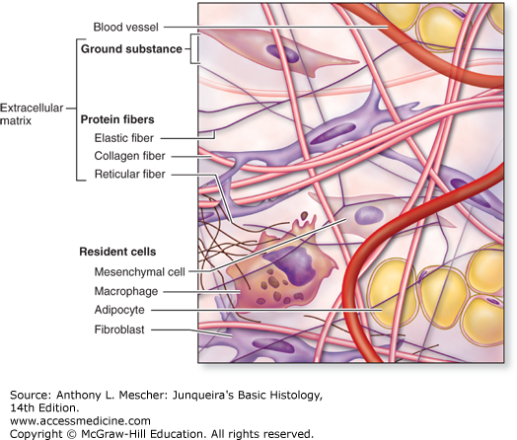
Connective tissues
Plenty of extracellular matrix
  Mechanical loads
  Collagen
  Elastin
  Specialized
  polysaccharide molecules

Slide 5
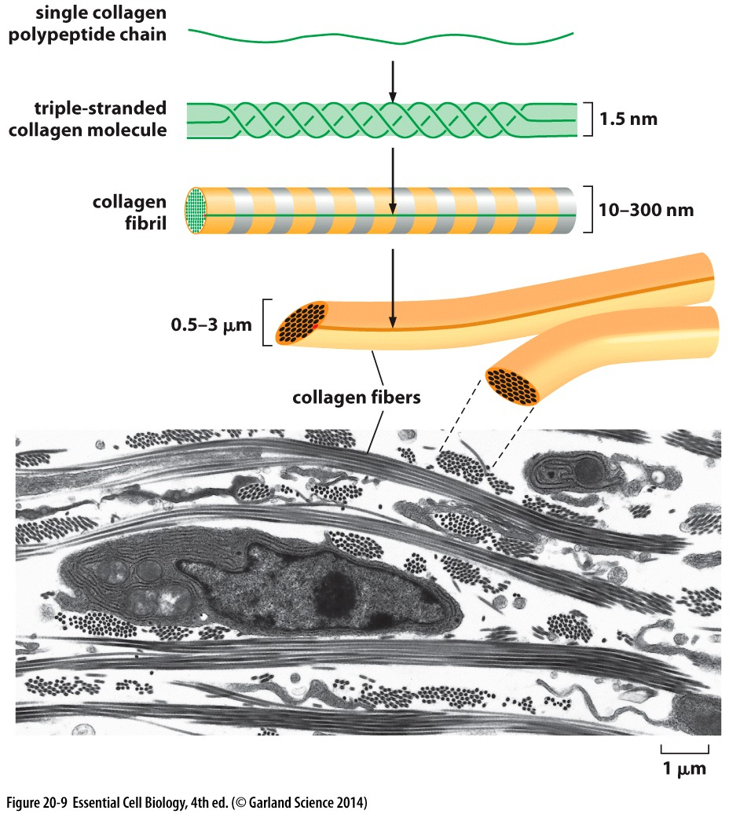
Collagen
A fibrous protein, long triple stranded helical structure
  Procollagen
  Collagen fibrils
  Collagen fibres
Manufactured by
  Fibroblasts
  Osteoblasts

Slide 6
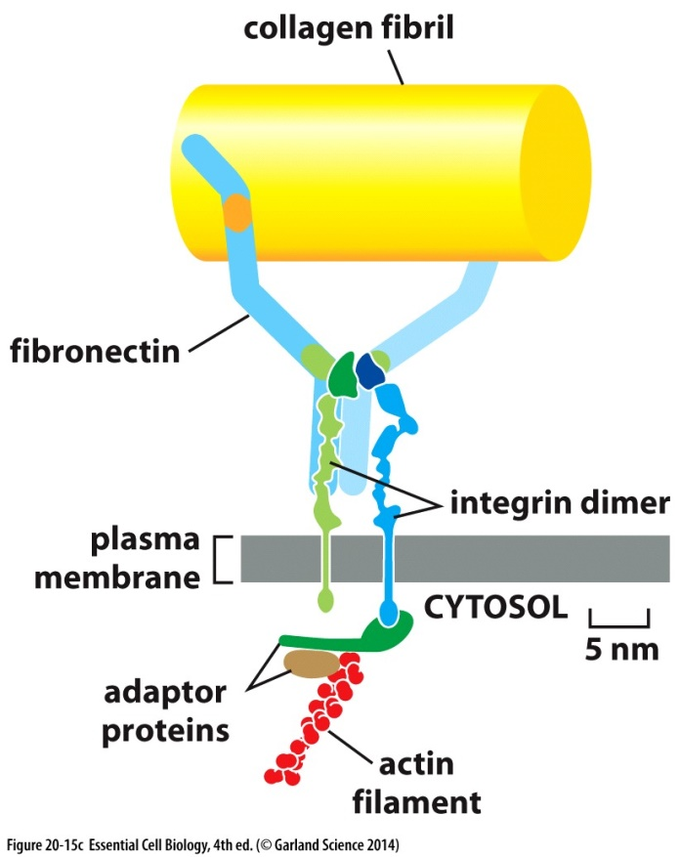
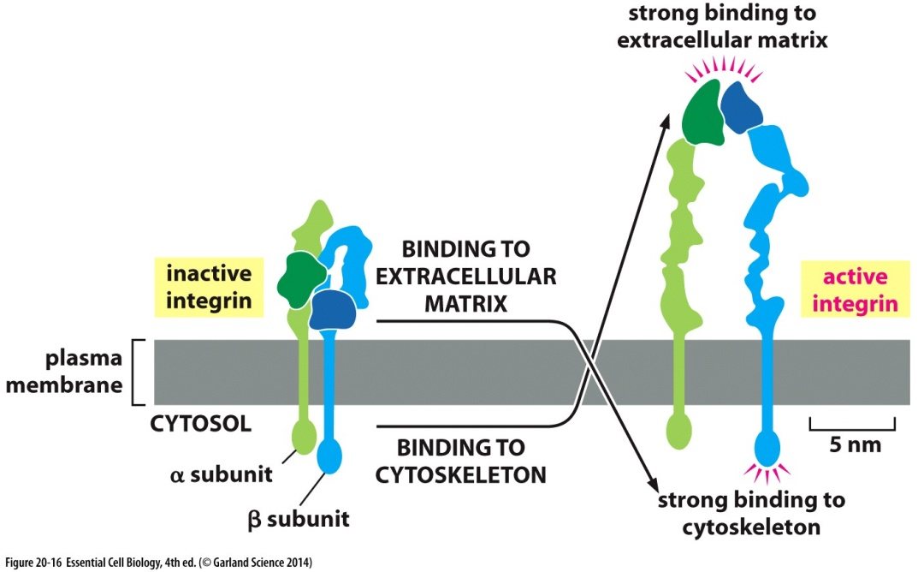
Cell attachment
Fibronectin connects collagen from the matrix to integrin on the cell
Extracellular and intracellular signals can activate integrin

Slide 7
Polysaccharides
Glycosaminoglycan (GAGs) resist compression
  Extremely hydrophilic
  Linked to proteins to make proteoglycan
    provide hydrated spaces around the cell
    Bind to secreted signals
    Regulate cell migration

Slide 8
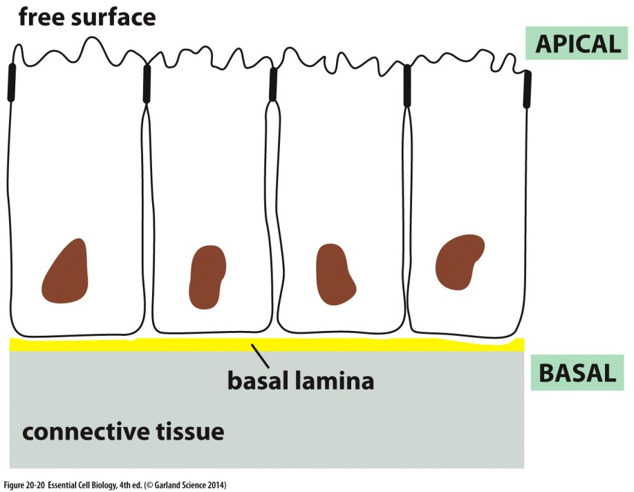
Epithelial cells
Sheets of connected cells
  Apical
    Exposed to fluids
  Basal
    Attached to connective tissues – basal lamina
    Collagen and laminin

Slide 9
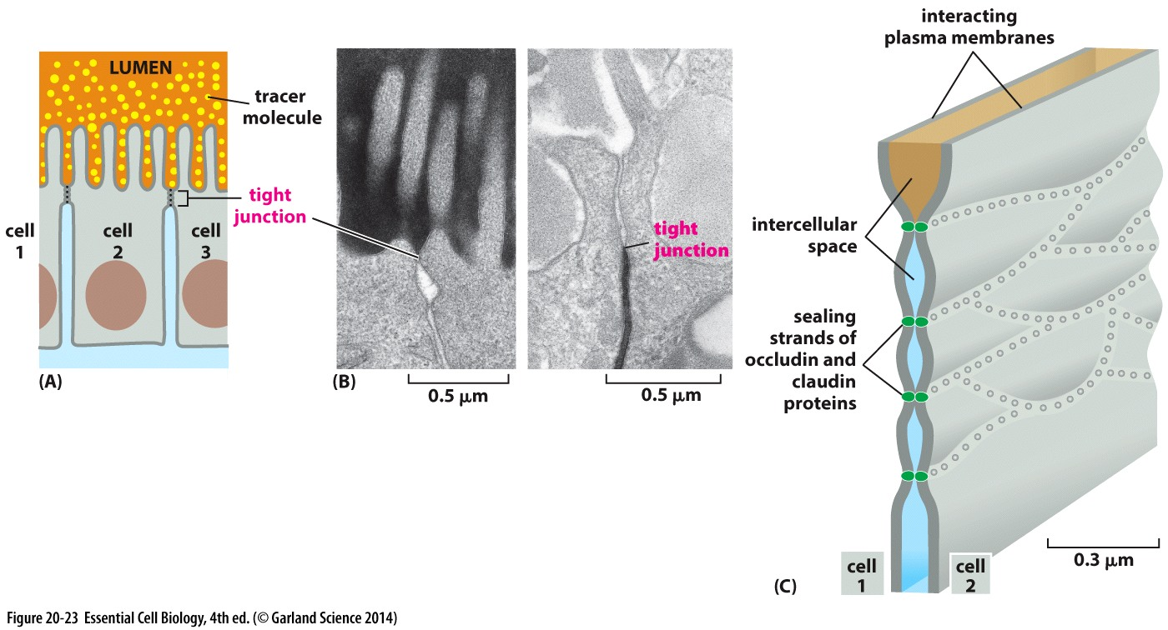
Cell junctions
Tight junctions
  Tight seals to prevent leakage of water soluble molecules
  Claudins and occludin

Slide 10
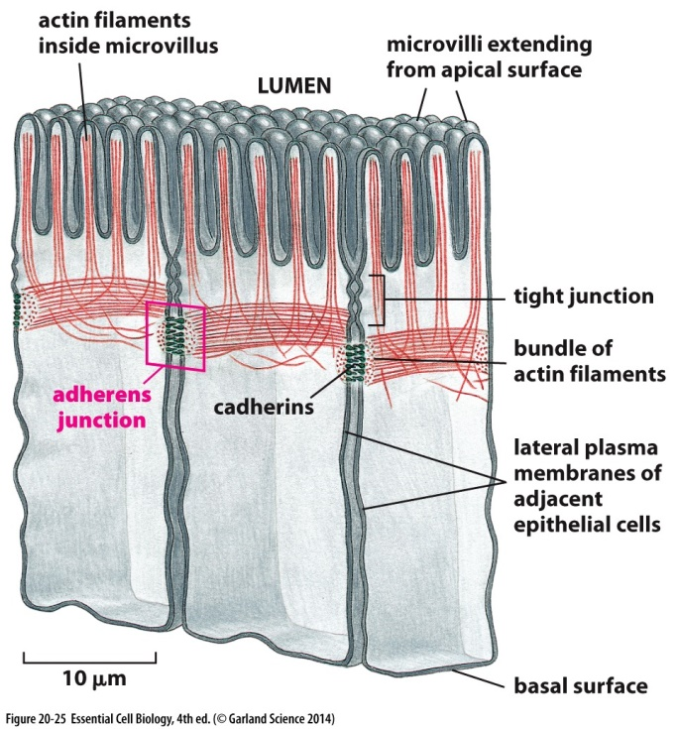
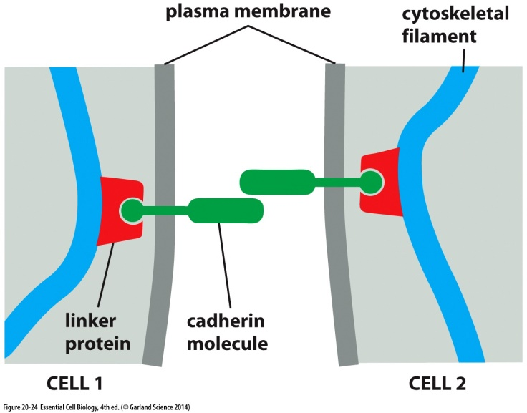
Cell junction
Junctions providing mechanical strength
  Adherens junctions
    Cadherin connected to actin filaments

Slide 11
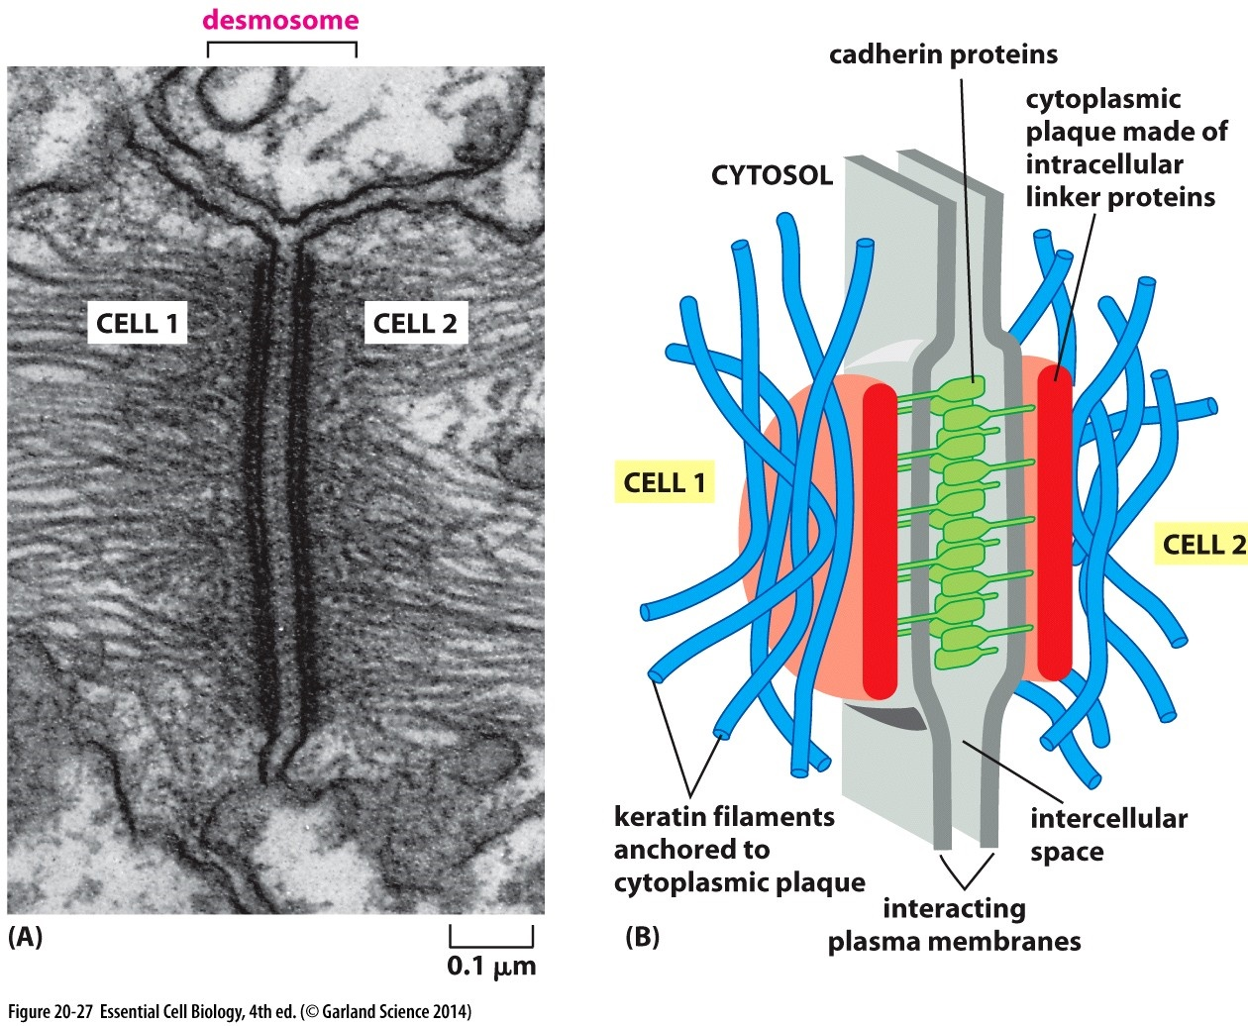
Cell junction
Junctions providing mechanical strength
  Desosome
    Cadherin connects to keratin filaments

Slide 12
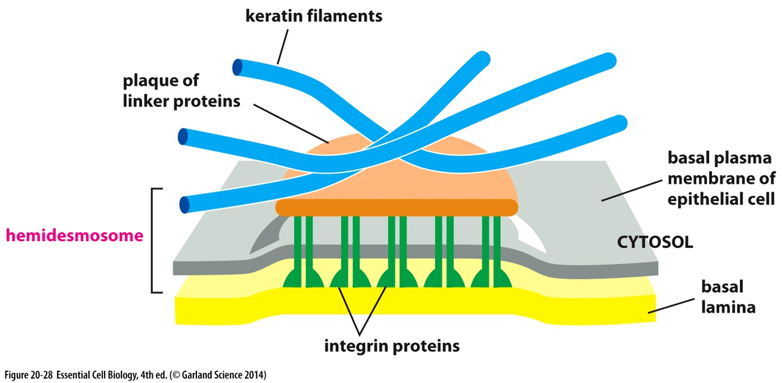
Cell junctions
Junctions providing mechanical strength
  Hemidesosome
    Attachment of integrins to laminin in basal lamina and keratin filaments inside the cell

Slide 13
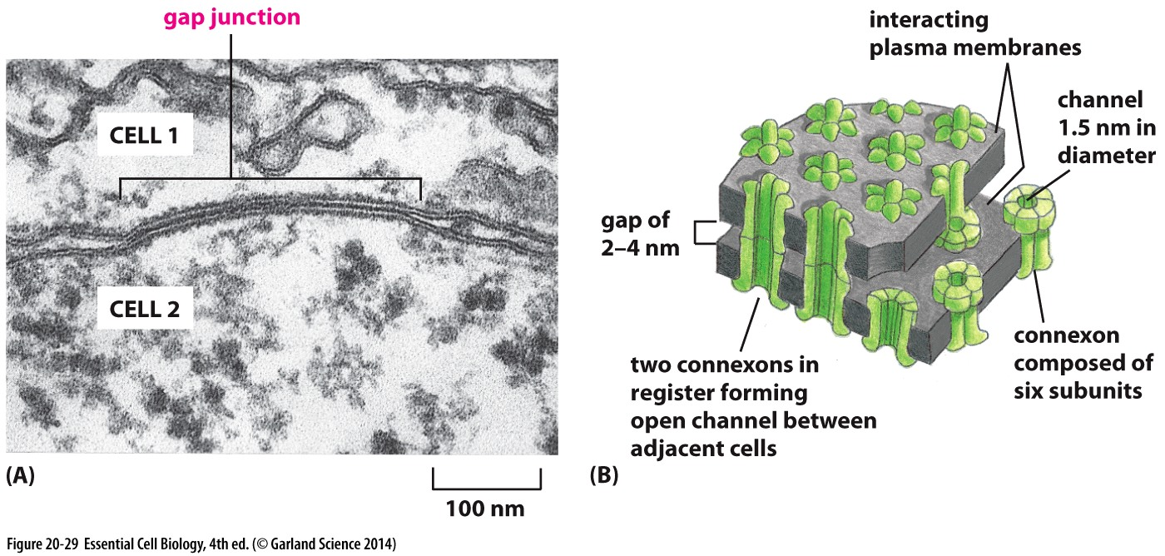
Gap junction
Narrow gap between two cell membranes that are parallel and close to each other
  Connexons

Slide 14
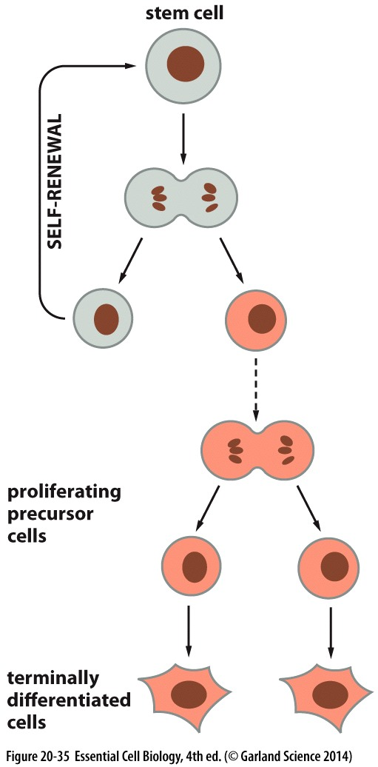
Stem Cells
Terminally differentiated cells: cells that need continual replacement and are unable to divide
Precursor cells: cells that replace terminally differentiated cells
Stem cells: self-renewing cells that derive precursor cells

Slide 15
Stem cells
Single type of stem cell can give rise to different types of differentiated cells
  Intestine stem cells produce goblet cells and secretory cells
  Hemopoiesis the process of blood cell formation, produces red blood cells and different types of white blood cells from hemopoitic stem cells

Slide 16
Embryonic stem cells
Transfusing specialized stem cells can generate differentiated cells
  Mouse hemopoietic stem cells
  Bone marrow transplant
ES cells can proliferate indefinitely in culture and remain unrestricted making them pluripotent

Slide 17
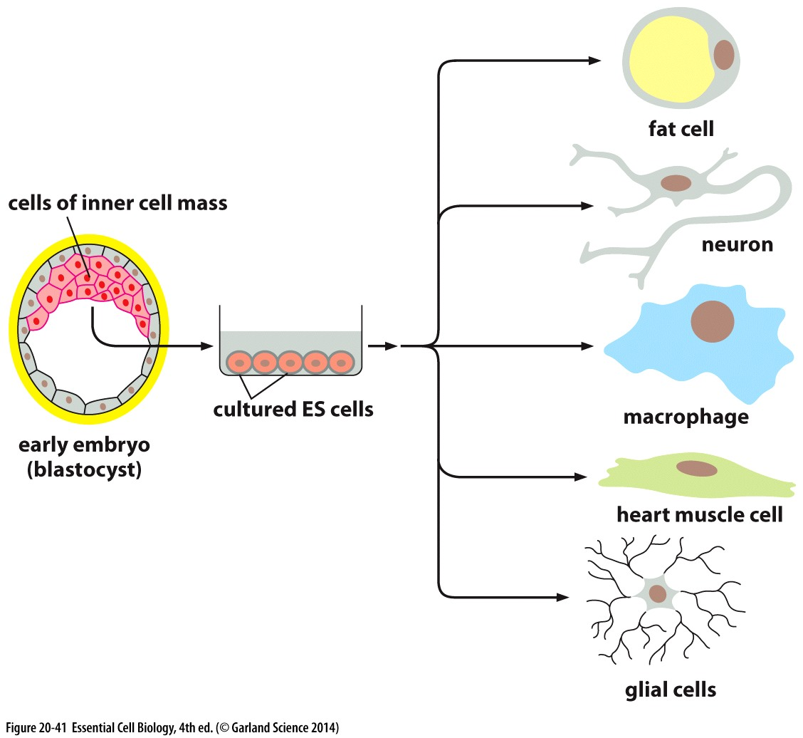

Slide 18
Induced pluripotent stem cells
Introduction of 3 transcription regulator genes can change cells of an adult tissue to ES cell
  Oct3/4
  Sox2
  Klf4
Low rate of conversion
Can be used to test drugs or toxins

Slide 19
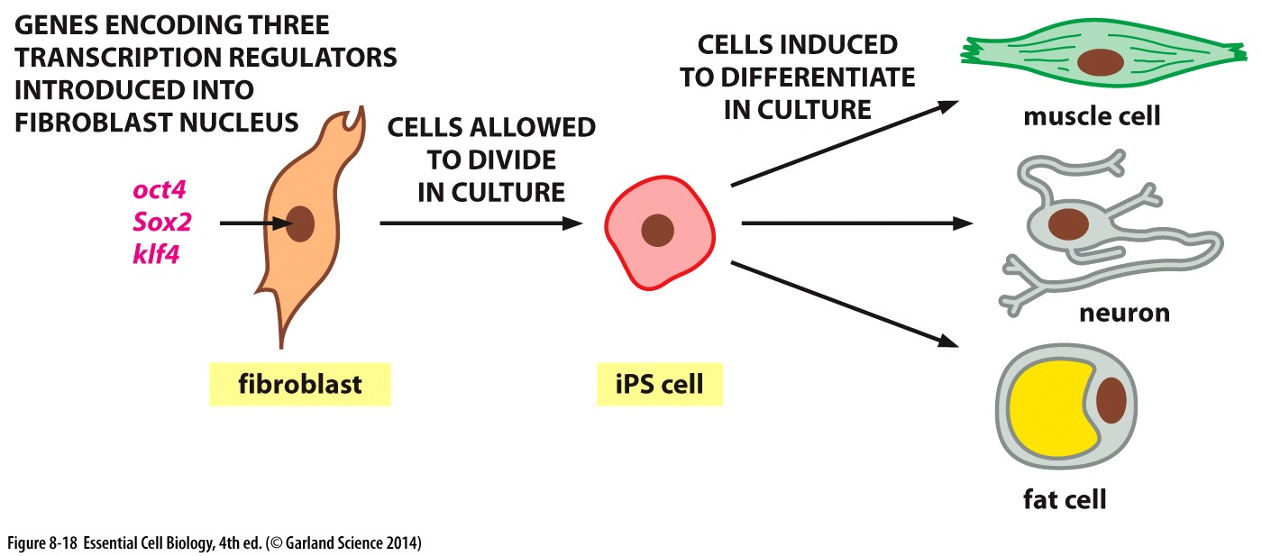
Induced pluripotent
Transcription regulators can change differentiated cells to pluripotent stem cells

Slide 20
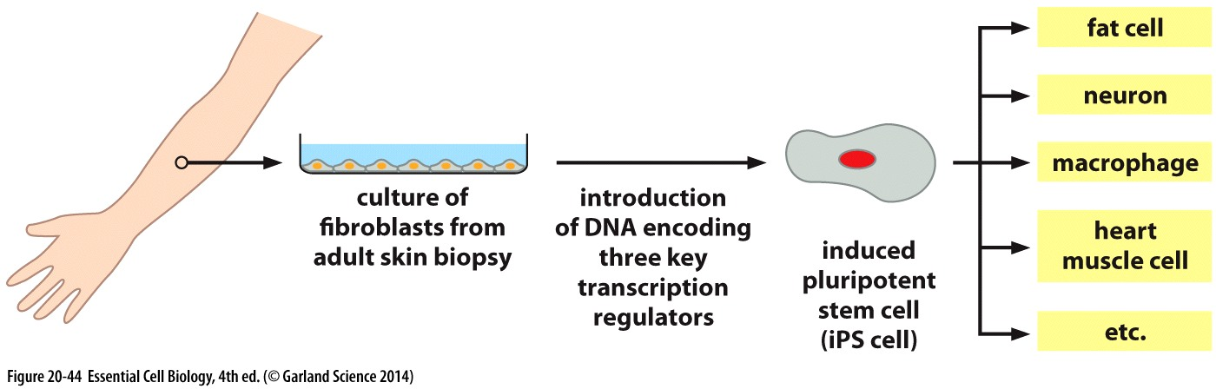
Induced pluripotent stem cells

Slide 21
Cloning
What is cloning ?
  A set of cells or individuals that are genetically identical and descendant from the same ancestral cell
Reproductive cloning: cloning of an entire organism
  Nuclear transplantation
Therapeutic cloning

Slide 22
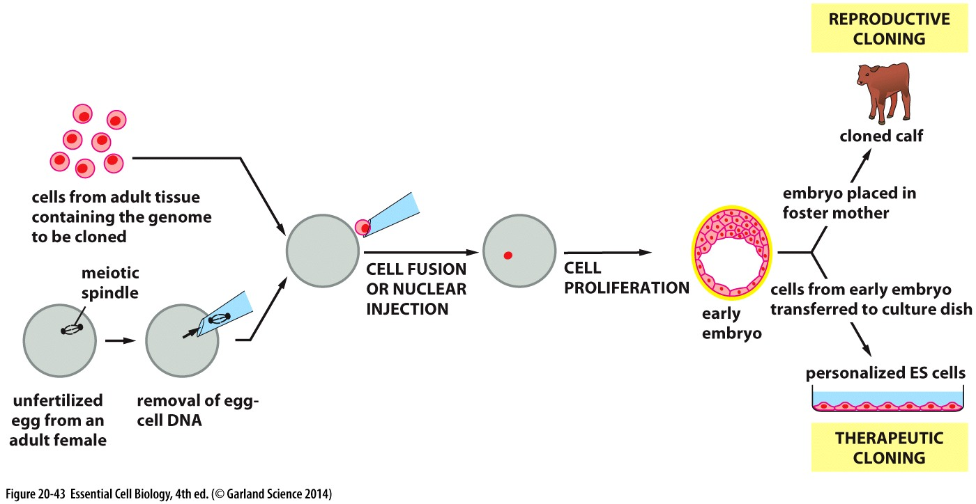

Slide 23
Cancer
Disease of tissue renewal
Cancer cells
  Proliferate in defiance of normal constraints
  Invade and occupy other cells territories
Tumors are formed from cells that proliferate but remain in one location
  Benign
Tumors that can invade other tissues
  Malignant
Metastases

Slide 24
Epidemiology
Epidemiology: statistical analysis of human population looking for factors that correlate with disease incidence
Viruses play a role in cervical cancer
  Human papillomavirus (HPV)

Slide 25
Mutations
One of the causes of cancer are somatic mutations arising in somatic cells
Mutagens are environmental agents that cause changes in the genetic code
  Radiation
  Chemical carcinogens
Genetic instability results from mutations that increase replication errors and maintenance of the genome

Slide 26
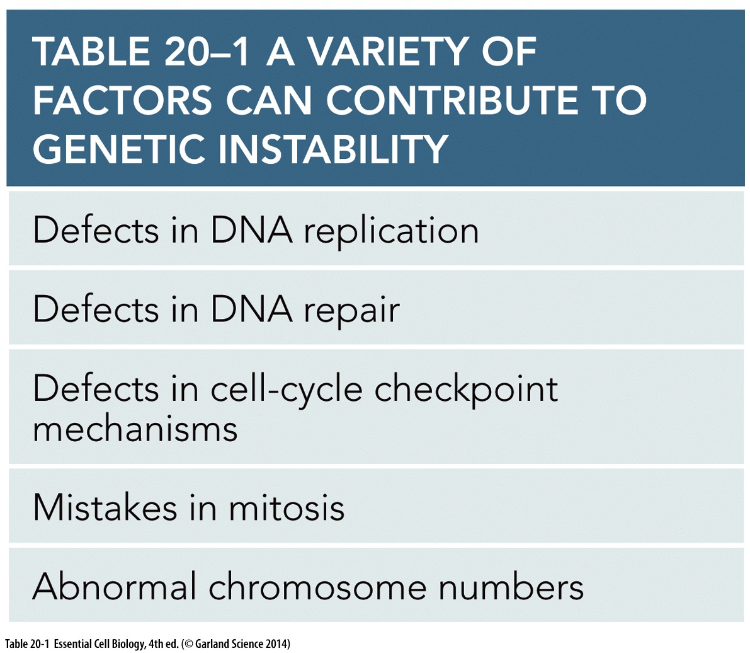
Genetic instability

Slide 27
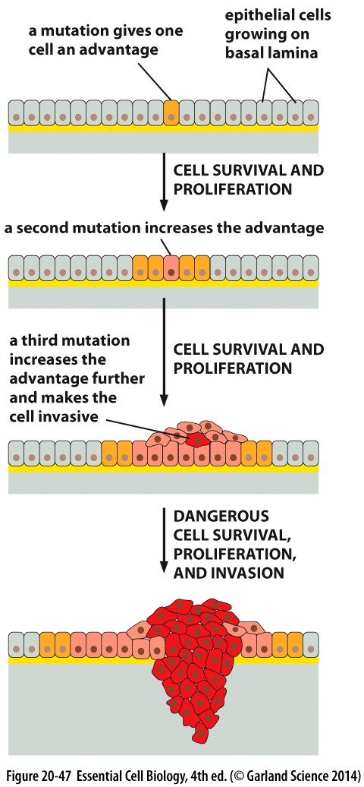
Cancer cell evolution
Cancer causing mutations give competitive advantage to cancer cells

Slide 28
Cancer cells have reduced dependency from other cells
  Mutation in Ras gene
Can survive stress and escape apoptosis
  p53 is inactivated in 50% of cancer cells
Can proliferate indefinitely
  Actively produce telomerase
Genetically unstable, high rate of mutation and abnormal chromosome numbers
They have abnormal metabolism
They are abnormally invasive
  Lack cadherin
They can survive and proliferate in abnormal locations

Slide 29
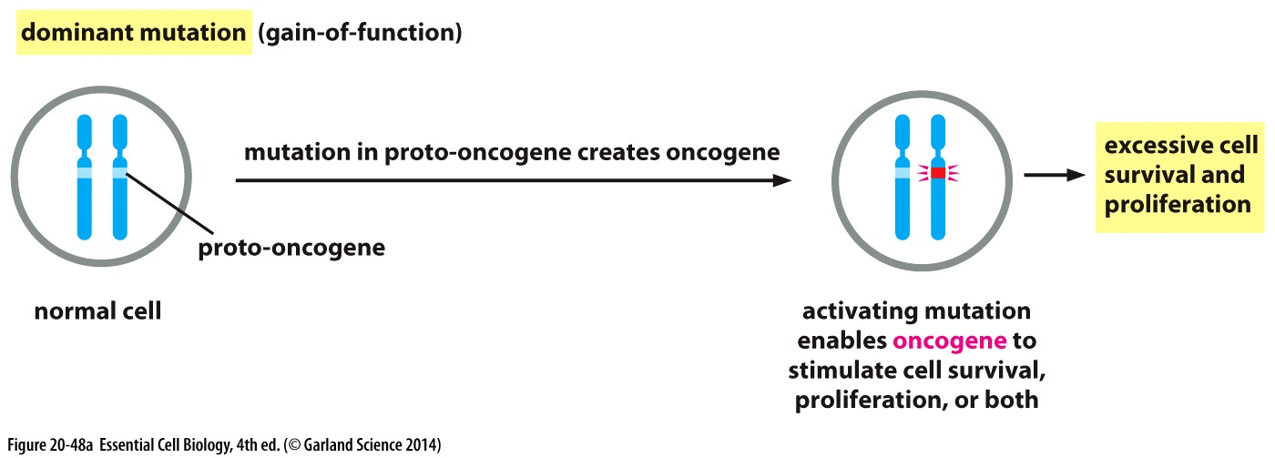
Oncogenes
Gain of function mutations: mutations which result in hyperactivity of a protein
oncogenes carry gain of function mutations unlike their normal genes which are called proto-oncogenes

Slide 30
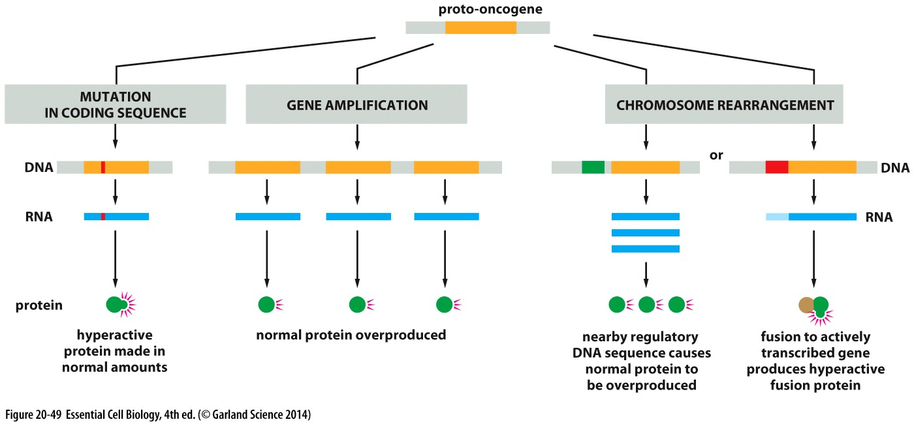
Oncogenes

Slide 31
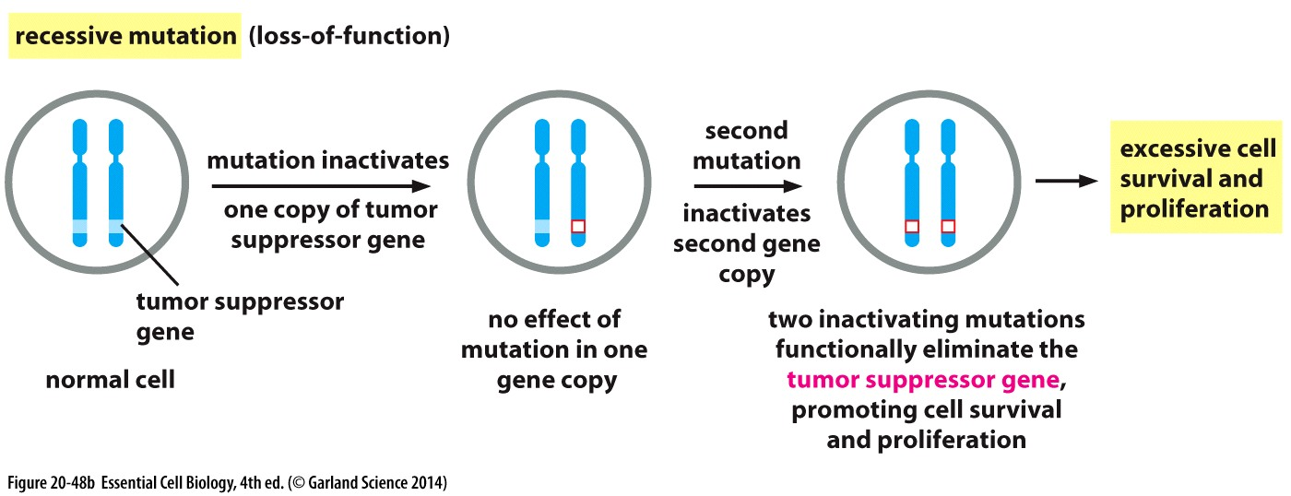
Tumor suppressor
Loss of function mutation causes inactivity of genes
Tumor suppressor genes have mutations that causes their inactivity
Epigenetics can effect tumor suppressor genes

Slide 32
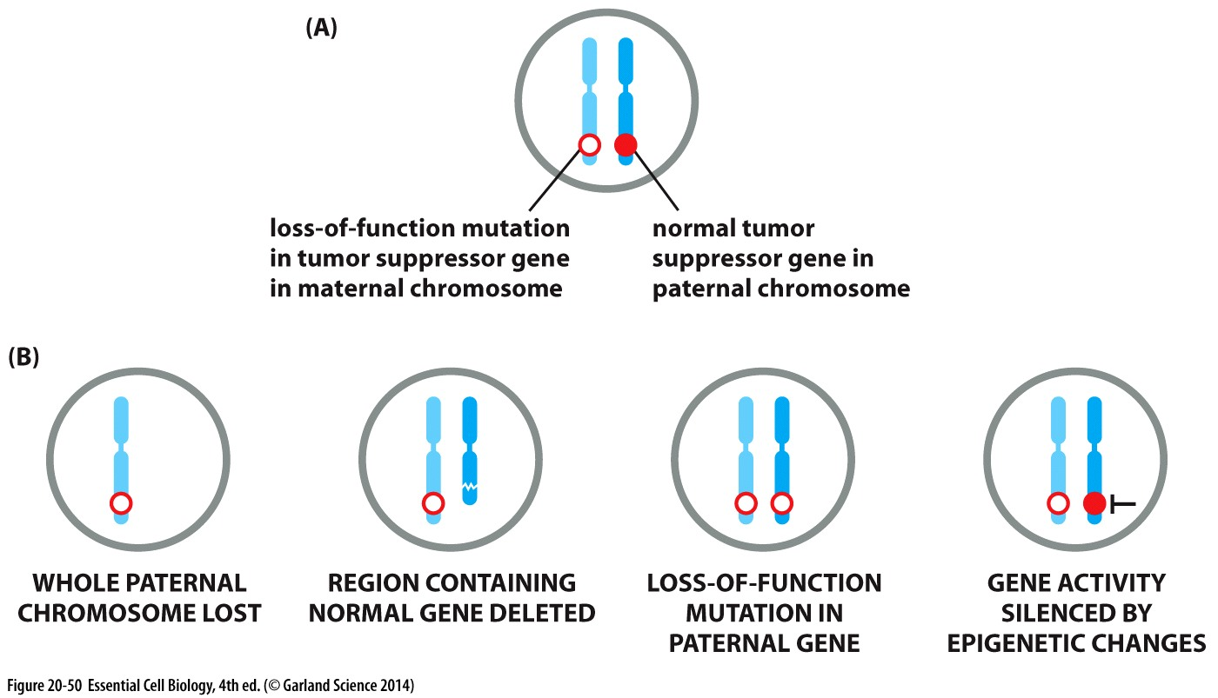

Slide 33
Target pathways
Pathways that are targeted by mutations are more important than the type of mutations
Most genes mutated in tumors fall in few specific pathways
  DNA damage response
  Cell growth
  Cell proliferation

Slide 34
Treatment
Random mutations in tumor cells makes it challenging to fight cancer
Treatments include
  Surgery
  Chemotherapy
  Inhibitory drugs
    Pathway specific
    Protein specific
  Antibodies

