Slide 1
Chapter 18
The Cell-Division Cycle

Slide 2
Cell cycle
Process of duplication of cell contents and division is the cell cycle
  Different phases
    G1
    S
    G2
    Mitosis and cytokinesis
Cell cycle regulation

Slide 3
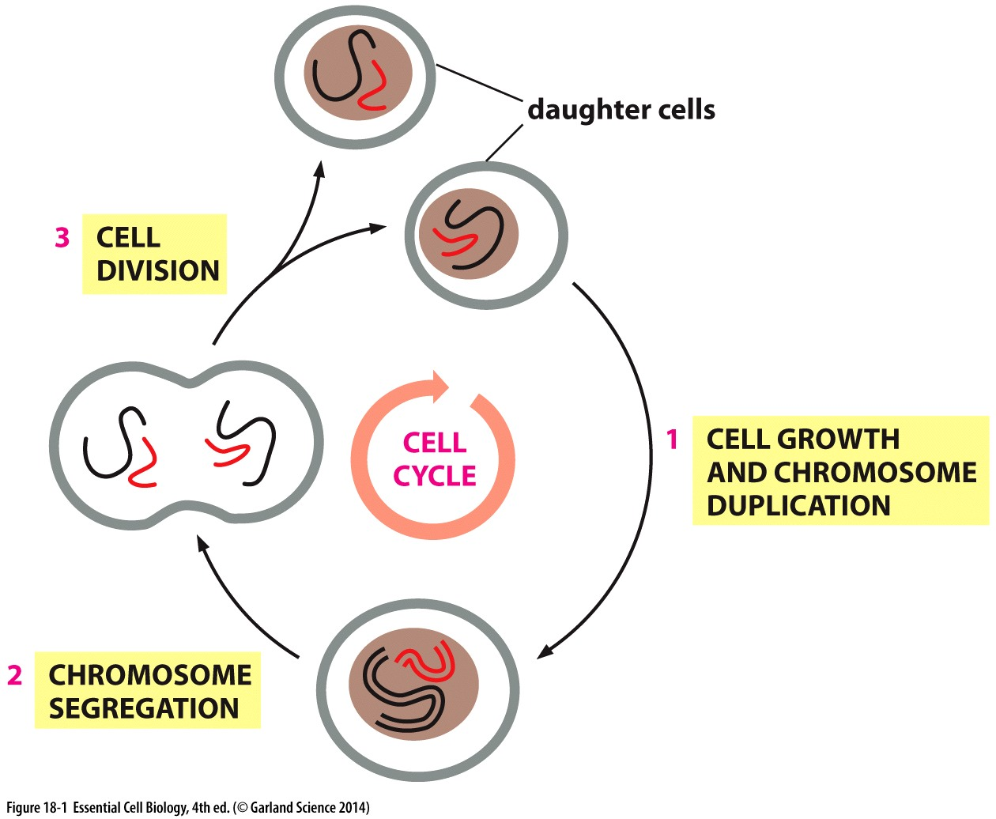
Cell cycle
Duplication and segregation of genetic information

Slide 4
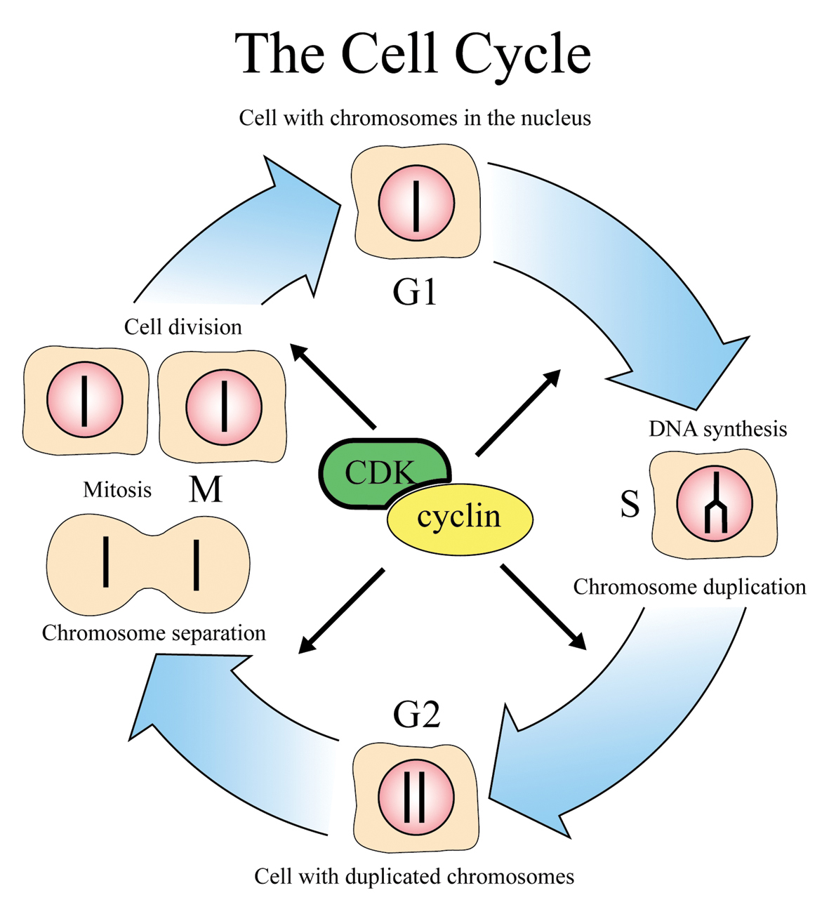
Cell cycle phases
M phase
  Mitosis
  Cytokinesis
Interphase
  G1
  S
  G2
http://www.nobelprize.org/nobel_prizes/medicine/laureates/2001/cellcycle_eng.jpg

Slide 5
Cell cycle control
Cell cycle control system
  Checkpoints : pauses the cell cycle and checks for errors
  G1/S checkpoint
  G2/M checkpoint
  Mitotic spindle checkpoint

Slide 6
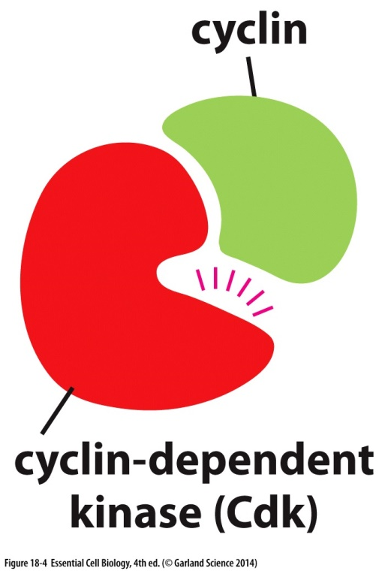
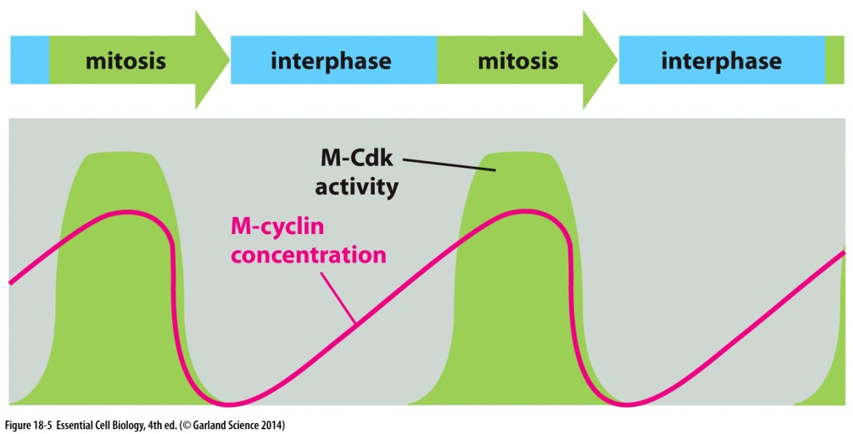
Cell cycle control
Kinases and phosphatases control and regulate cell cycle control proteins
Activation of cell-cycle kinases requires binding of cyclin proteins
  Cdks

Slide 7
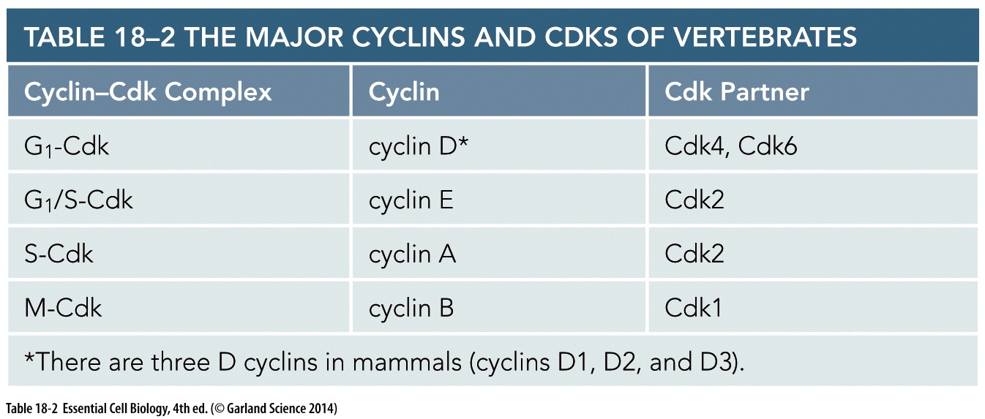
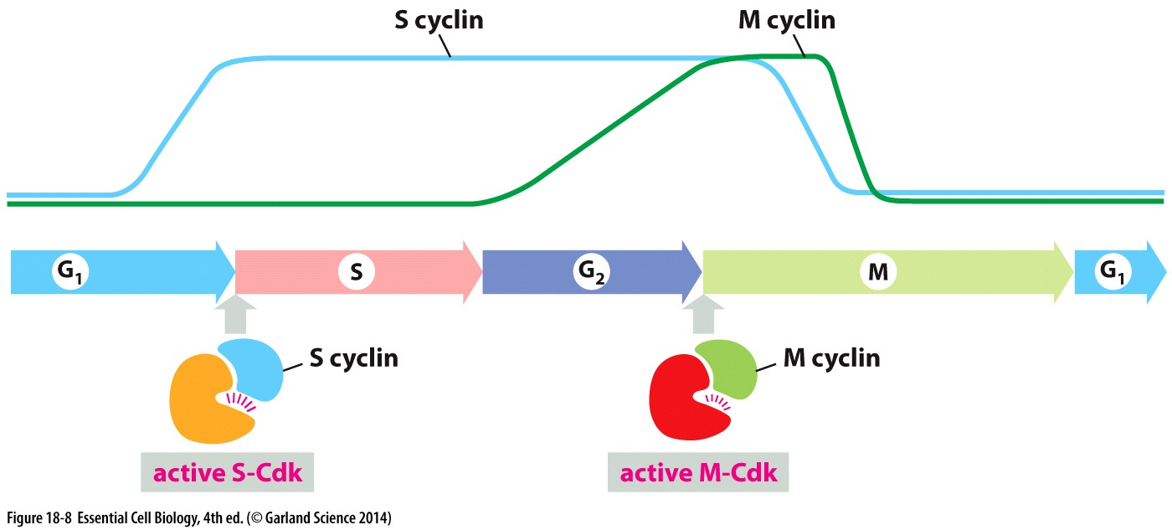
Cyclin-Cdks

Slide 8
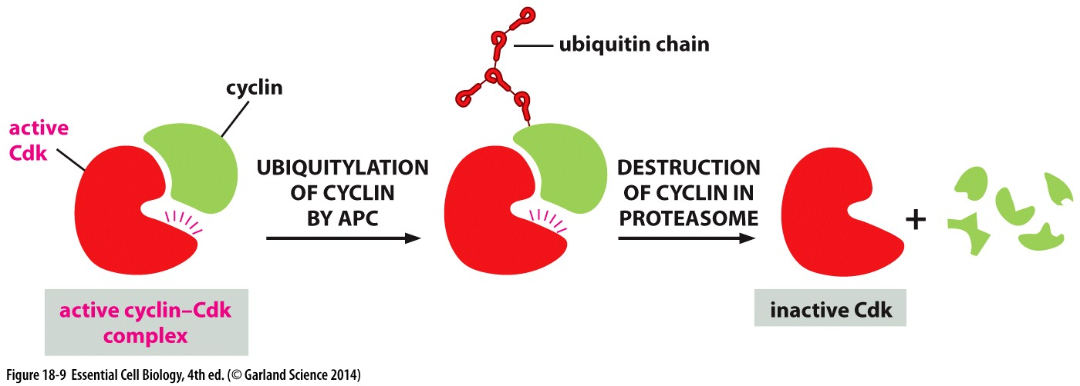
Cyclin regulation
Protein concentration is rate of protein synthesis over rate of protein degradation
APC regulates Cyclin degradation
Cyclin degradation drives transition from one phase to next

Slide 9
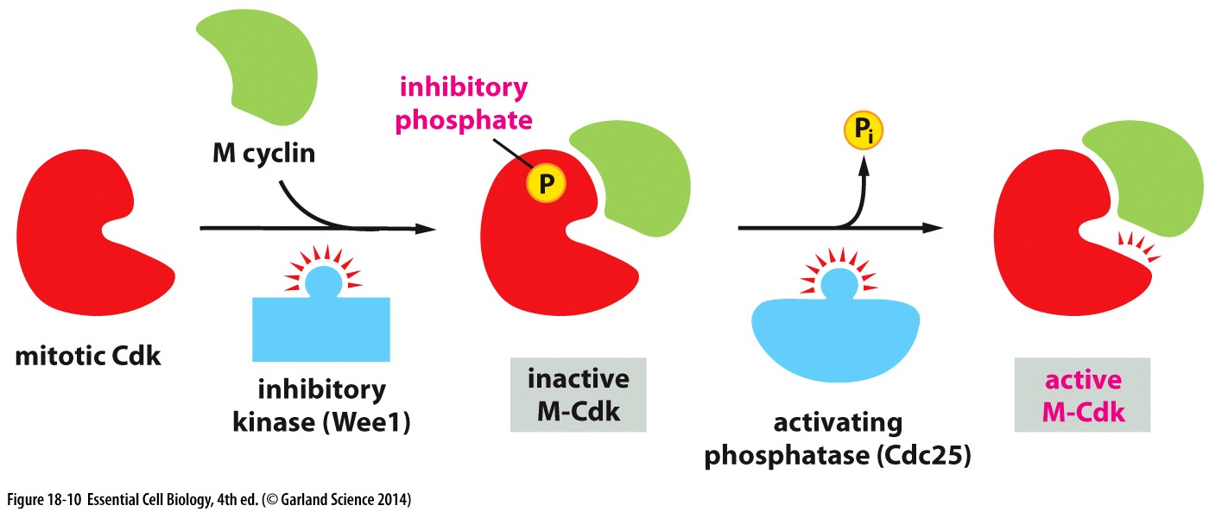
Cdk-Cyclin activity
Inhibitory phosphates deactivates Cdk-Cyclin
Activity of Cdk-Cyclin is regulated by kinases and phosphatases

Slide 10
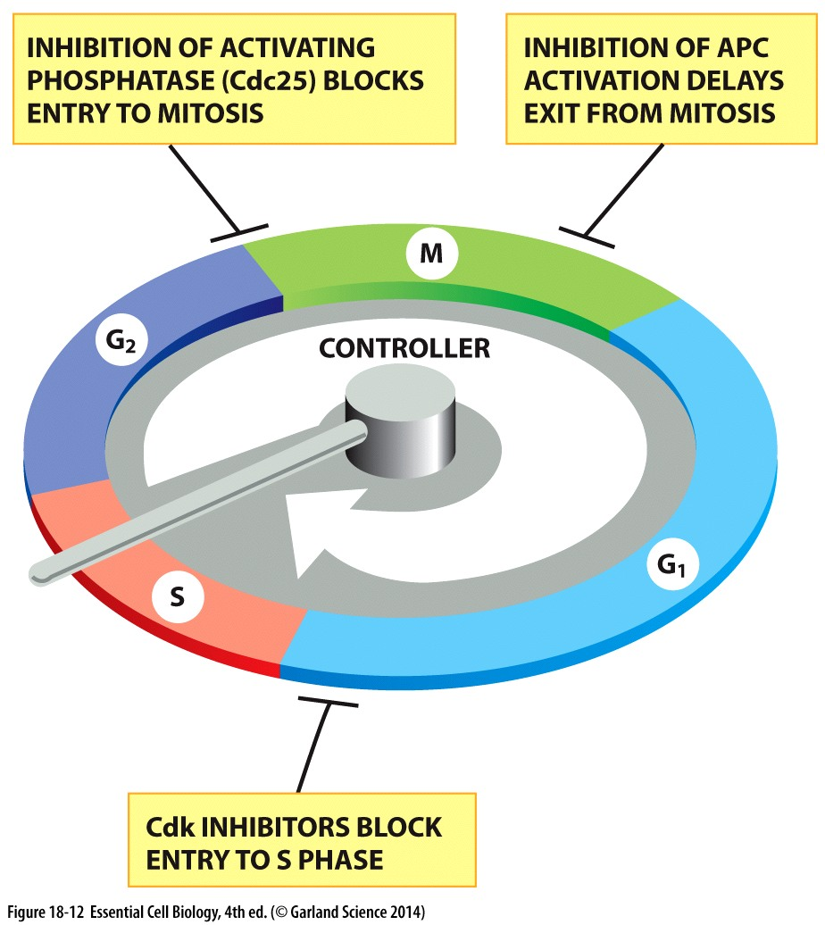

Slide 11
G1 phase
Cell growth, metabolic activity and repair
Cells at G1 enter S phase, remain in G1 or enter G₀ depending on the cell size and extracellular signals

Slide 12
G1 phase
M and S Cyclin-Cdk complexes must be deactivated before entry to G1 phase
How is this possible ?

Slide 13
Mitogens
Extracellular signals which stimulates multiplication of mammalian cells are called mitogens
  Triggers synthesis of G1 and G1/S cyclin
  Proteins involved in DNA replication
Rb protein negatively regulates cell duplication

Slide 14
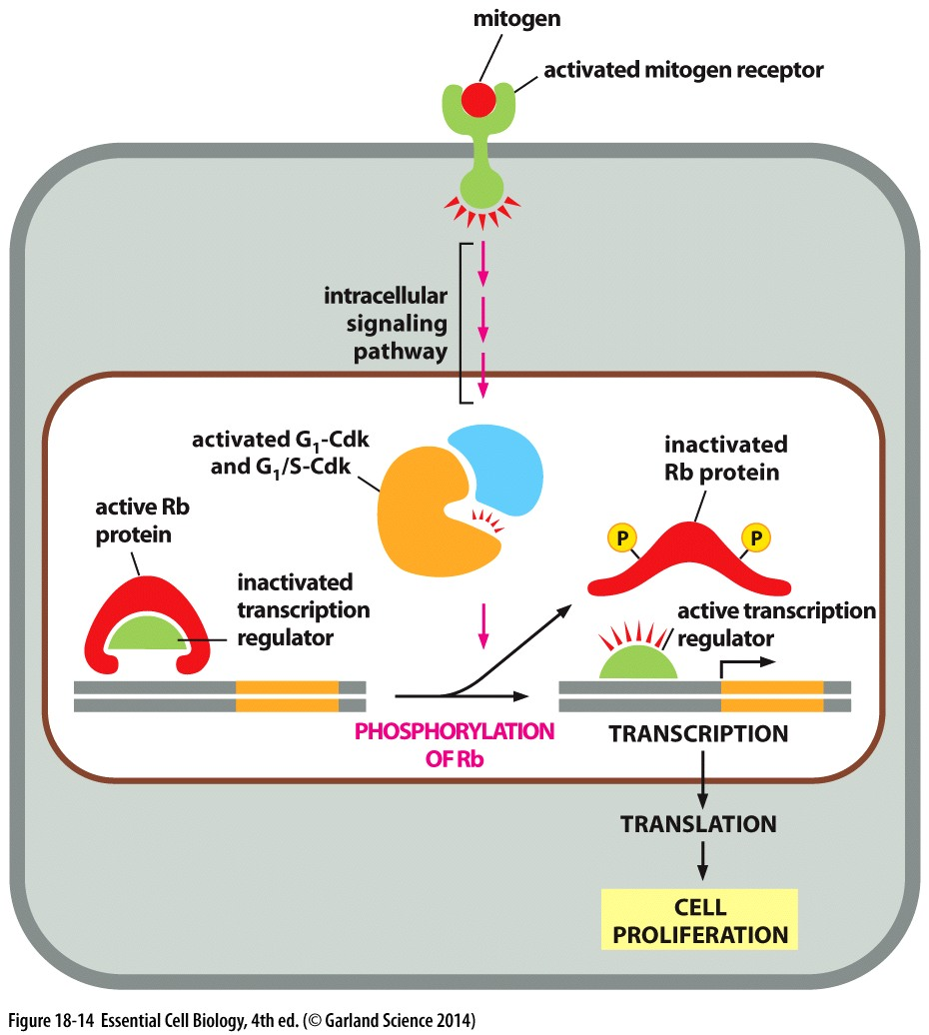

Slide 15
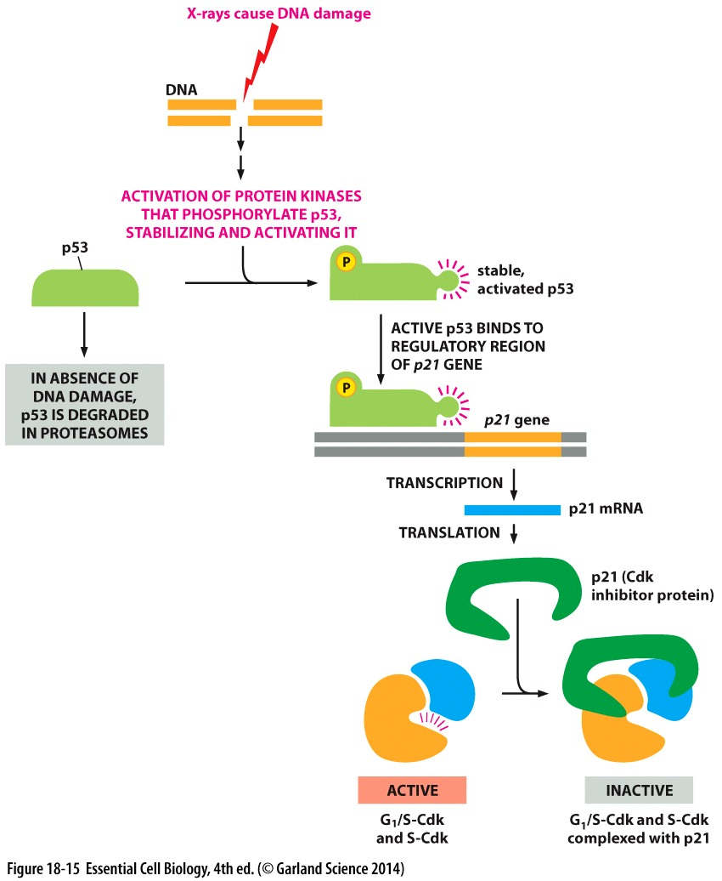
DNA damage
DNA damage will
pause cell cycle progression
Induction of DNA
damage in G1 to S
  p53
  p21
  G1/S Cdk and S Cdk

Slide 16
Non-dividing state
Cell division can permanently stop
  Nerve cells
  Muscle cells
Repression of genes encoding CdKs and Cyclin
Some cells temporarily stop division
  Liver cells

Slide 17
S phase
DNA replication is initiated by S-Cdk
  Origin of replication
  Origin recognition complex
  Cdc6
  Pre-replicative complex
  S-Cdk

Slide 18
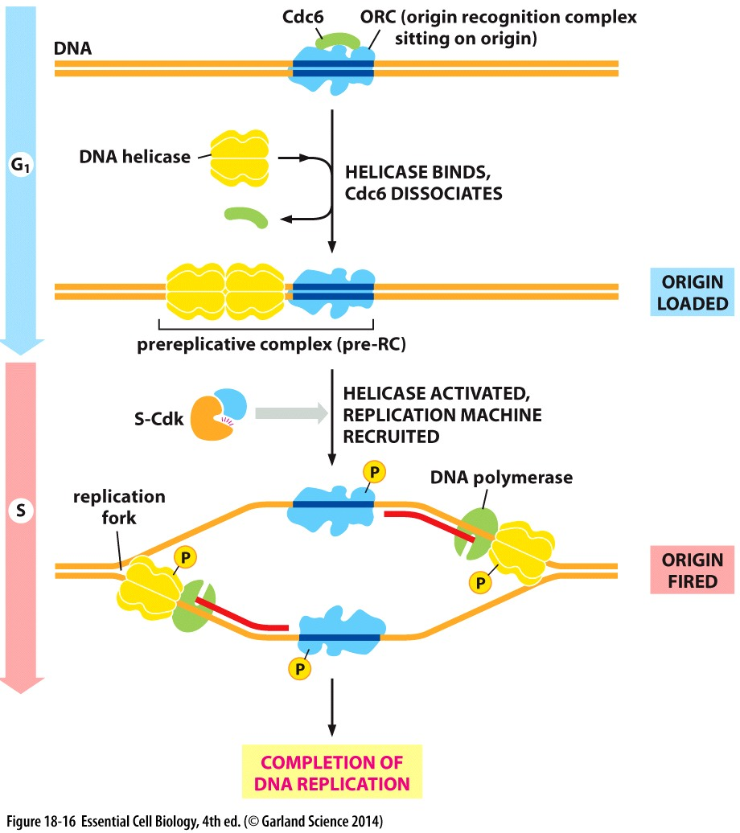

Slide 19
M phase
Very short time relative to cell cycle
Consists of
  Mitosis
  Cytokinesis
Cytoskeletal machines
  Pull duplicated chromosomes apart
  Divide cytoplasm into two halves

Slide 20
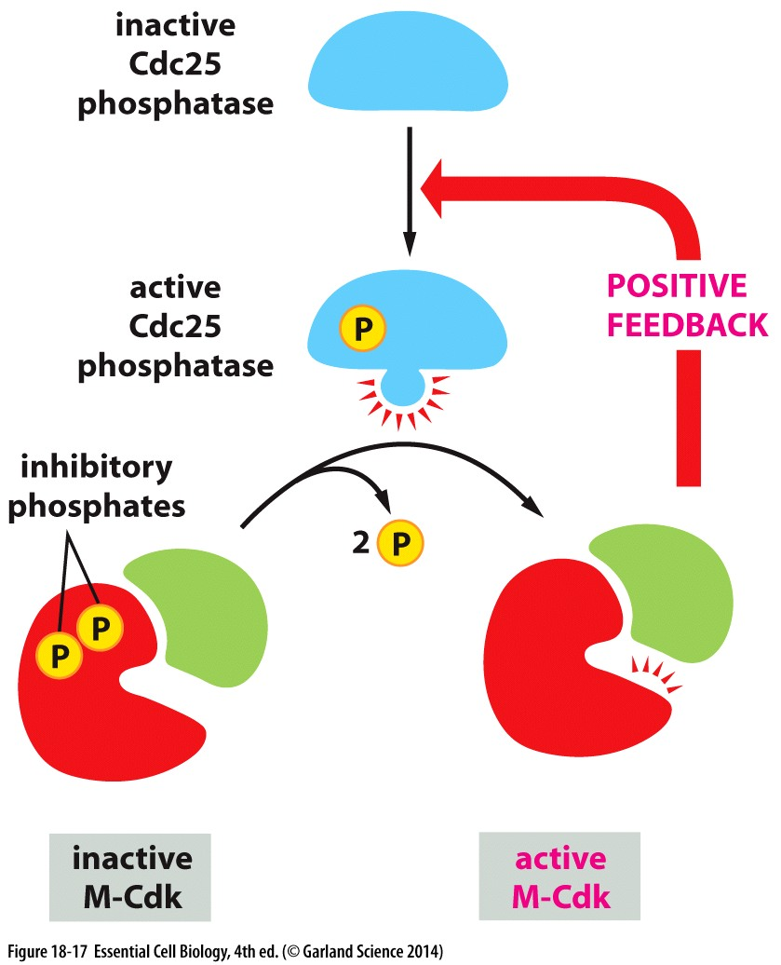
Entry into M phase
M-Cdk regulates the early stage of M phase
  Assembly of the mitotic spindle
M-Cdk is activated at the
end of G2
It phosphorylates Cdc25
which activates it
Its activated form blocks
inhibitory kinase Wee1

Slide 21
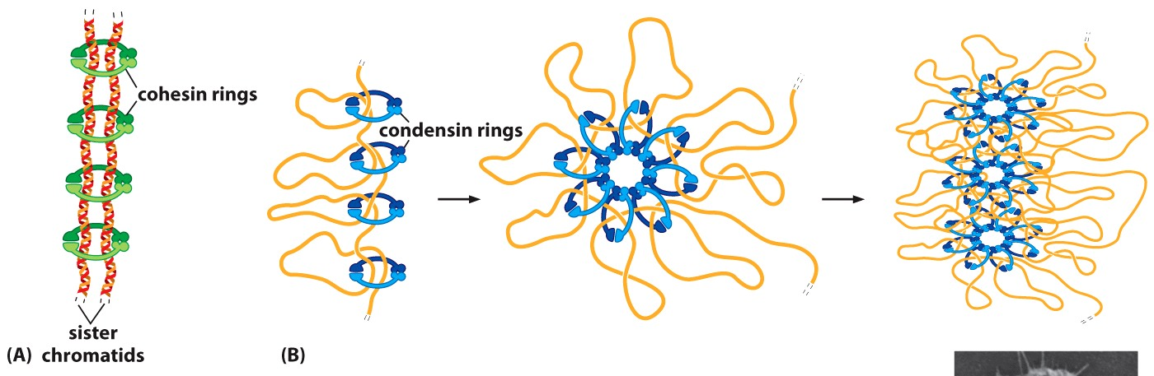
Cohesins and Condensin
Duplicated chromosomes are condensed at the M phase entry, condensins carry out this function
Cohesins hold sister chromatids together

Slide 22
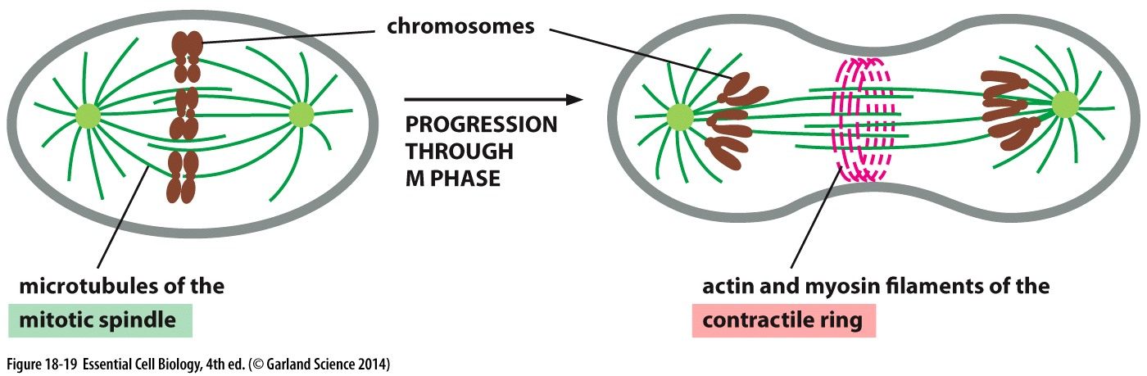
Cytoskeletal assembly
Mitotic spindle carries out nuclear division
  Composed of microtubules and motor proteins
Contractile ring carries out cytoplasmic division
  Actin filaments and myosin filaments

Slide 23
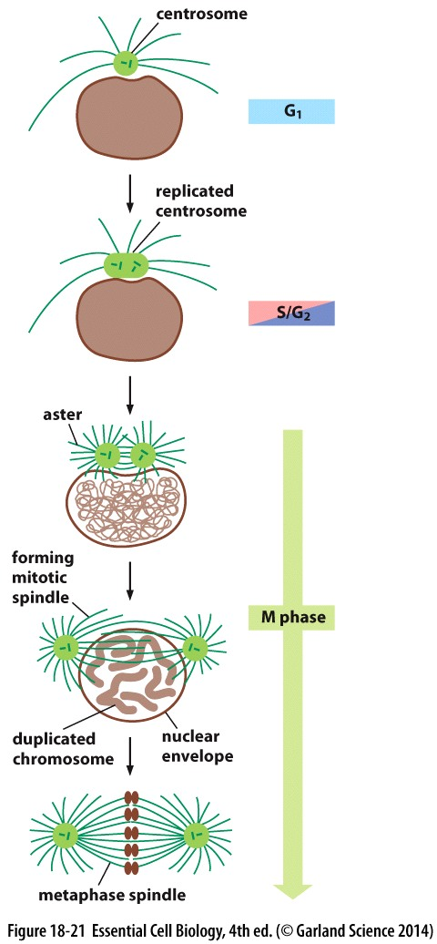
Centrosome
Centrosome is the principal
microtubule-organizing center
Centrosome duplication is
triggered by G1/S-Cdks and S-Cdks
Centrosome cycle

Slide 24
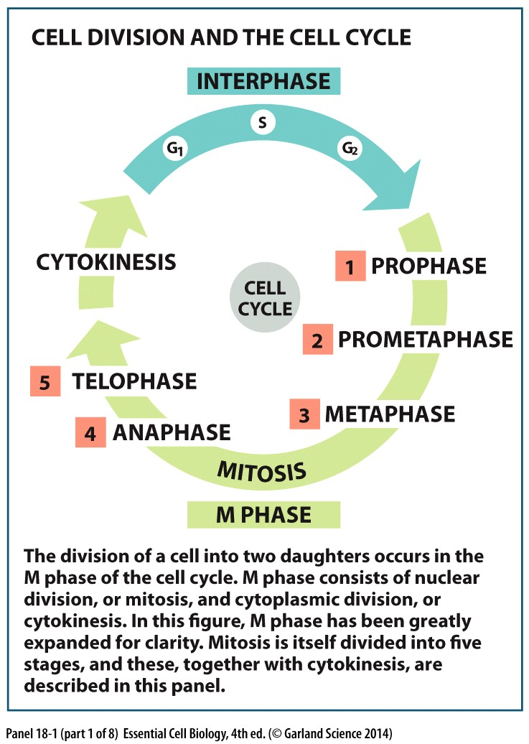

Slide 25
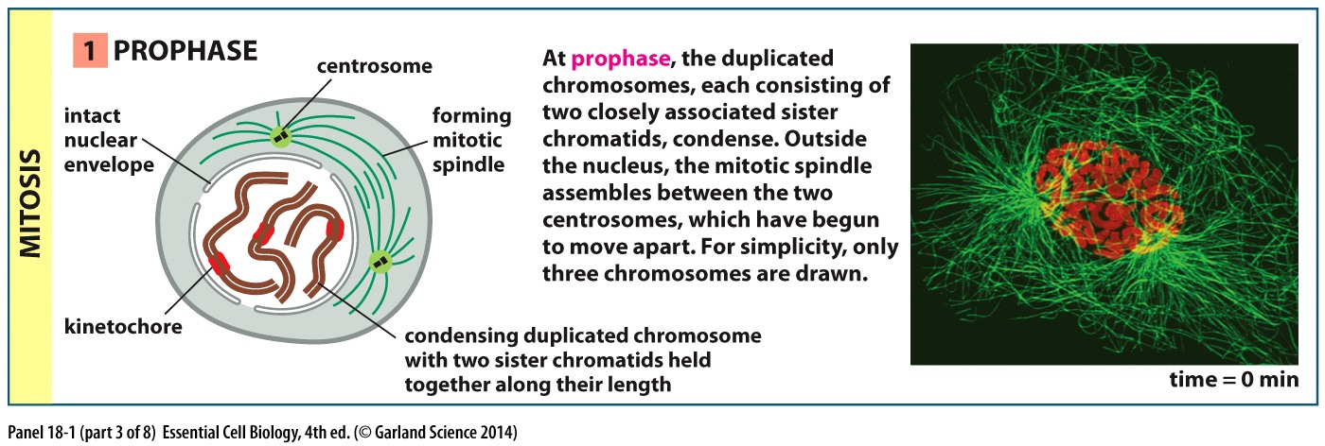
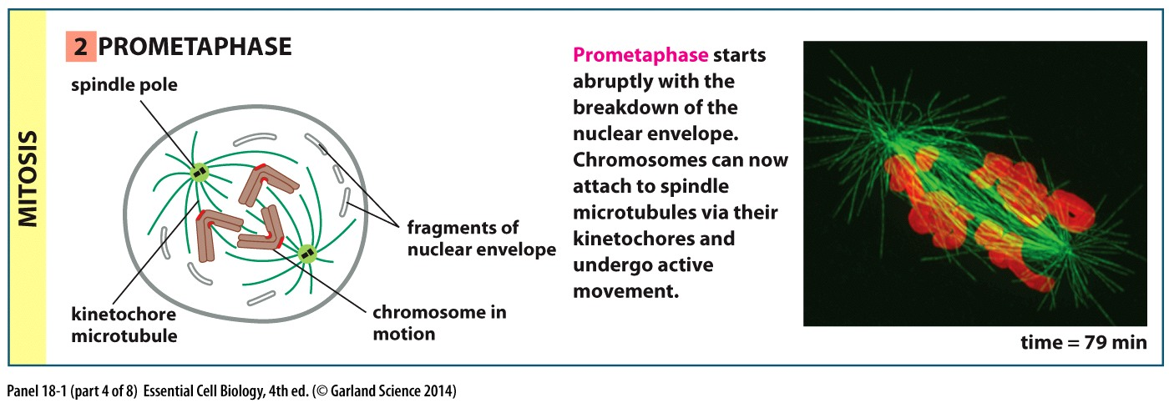

Slide 26
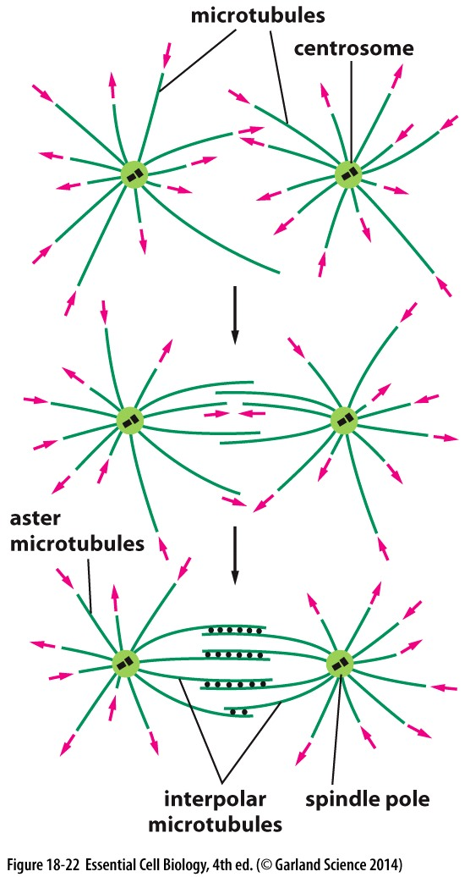
Mitotic spindle
Mitotic spindle assembly begins in prophase
Microtubules polymerize and depolymerize
  Cdk phosphorylates mitotic associated proteins
Interaction between microtubules extended from two centromeres forms the basic frame work of mitotic spindle
Spindle pole
Interpolar microtubules

Slide 27
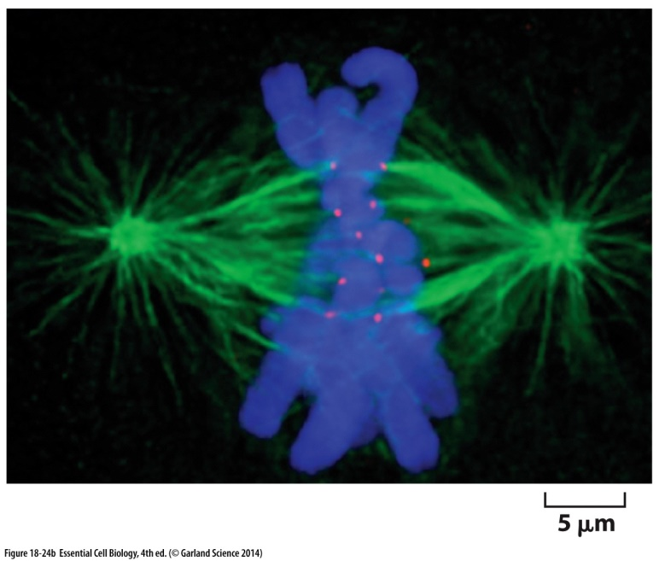
Chromosome attachment
Disassembly of nuclear envelope start at prometaphase
  Phosphorylation causes disassembly of nuclear pore protein and intermediate filaments of lamina
Kenitochores

Slide 28
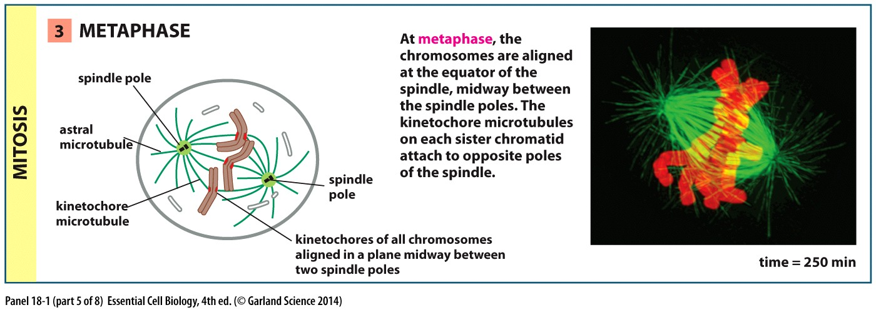
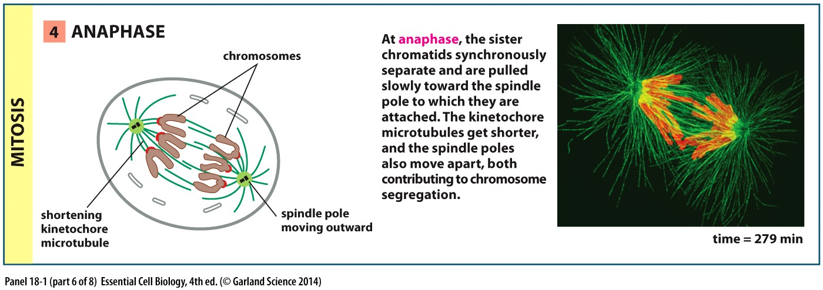

Slide 29
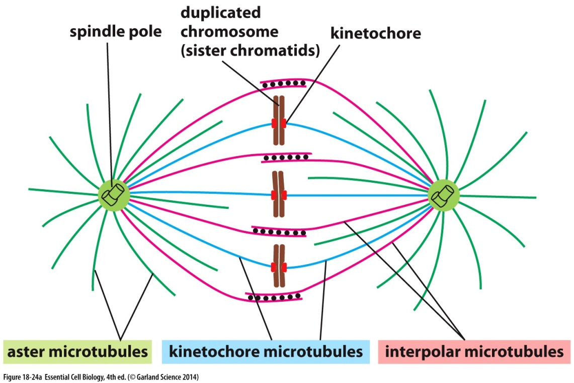
Spindle equator
Metaphase plate is formed when duplicated chromosomes are aligned halfway between the two spindle poles
Disrupting attachment of kinetochore or sister chromatids will
cause shift towards
the spindle pole

Slide 30
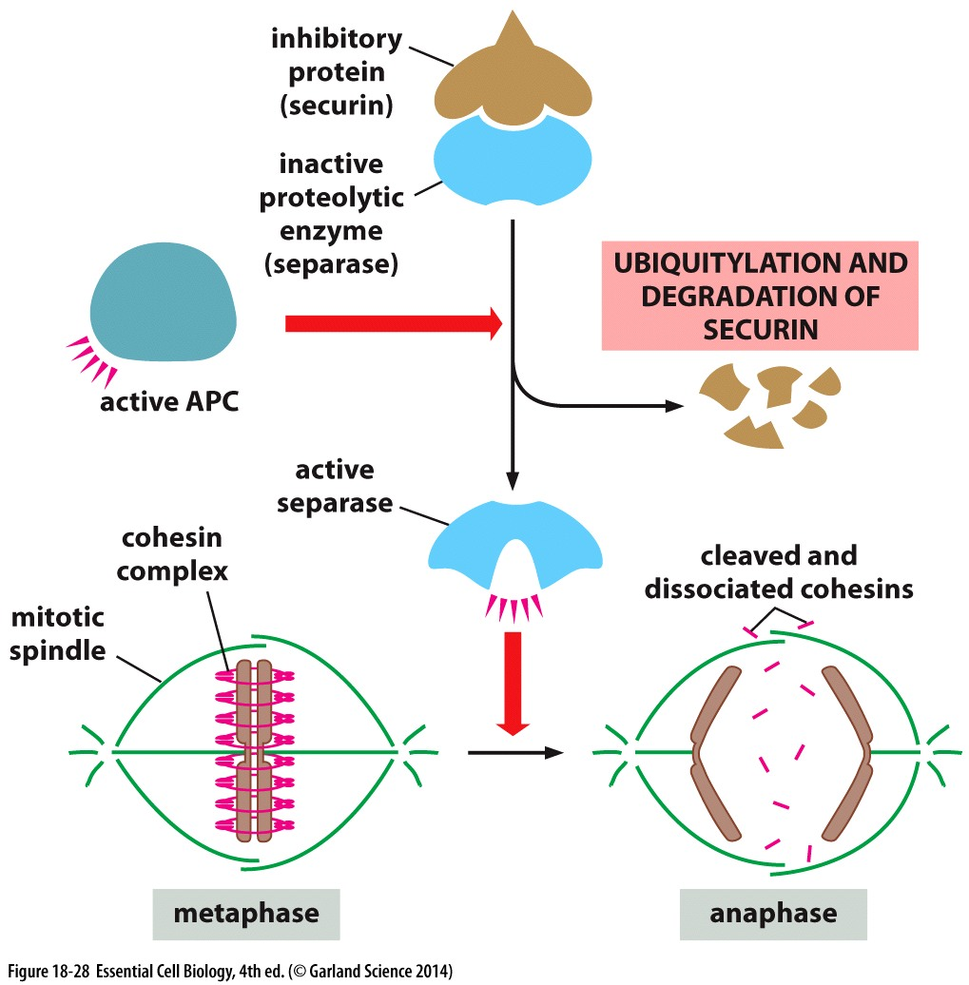
Sister-chromatid separation
Linkage between sister chromatids are broken in anaphase
Separase beaks cohesin
linkage
  Sercurin inhibits separase
  APC regulates Securin

Slide 31
Chromosome segregation
Anaphase A
  Kenitochores are shorten
  Loss of tubulin subunits
Anaphase B
  Spindle poles movement
  Members of kinesin and dynemin families

Slide 32
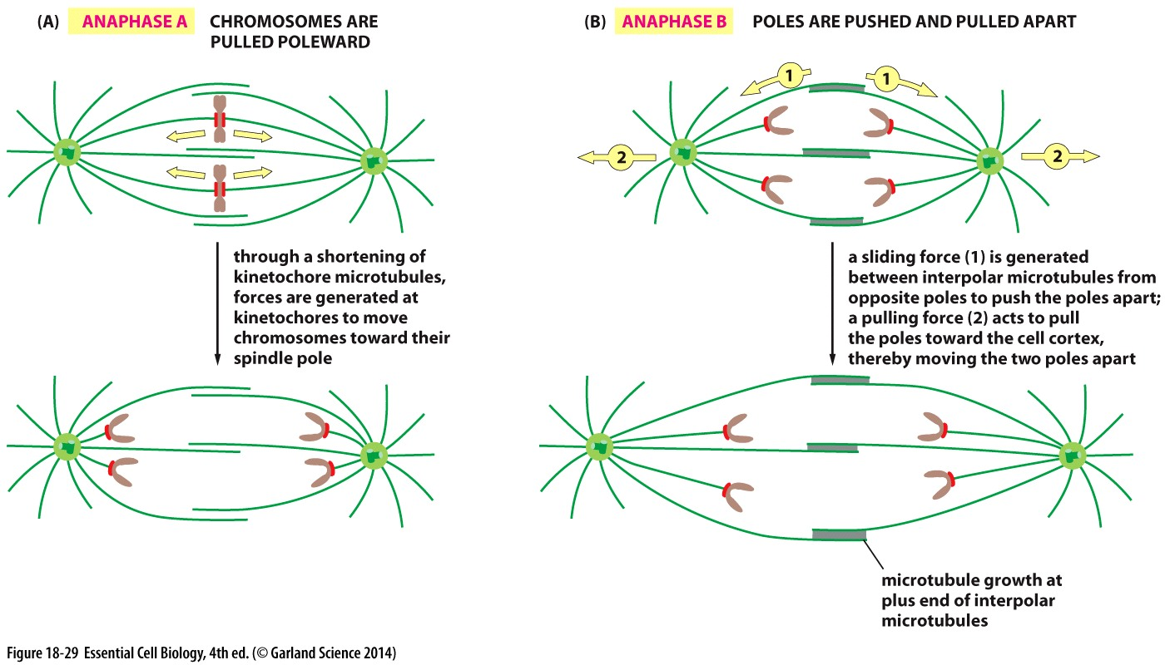

Slide 33
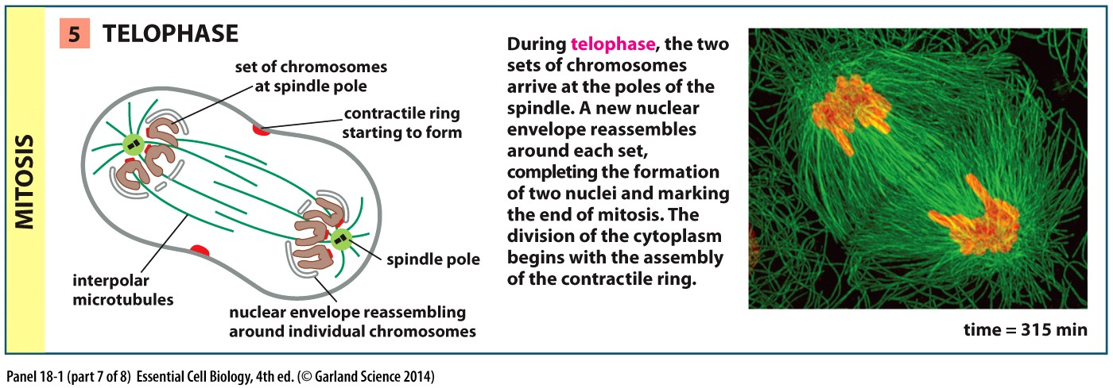
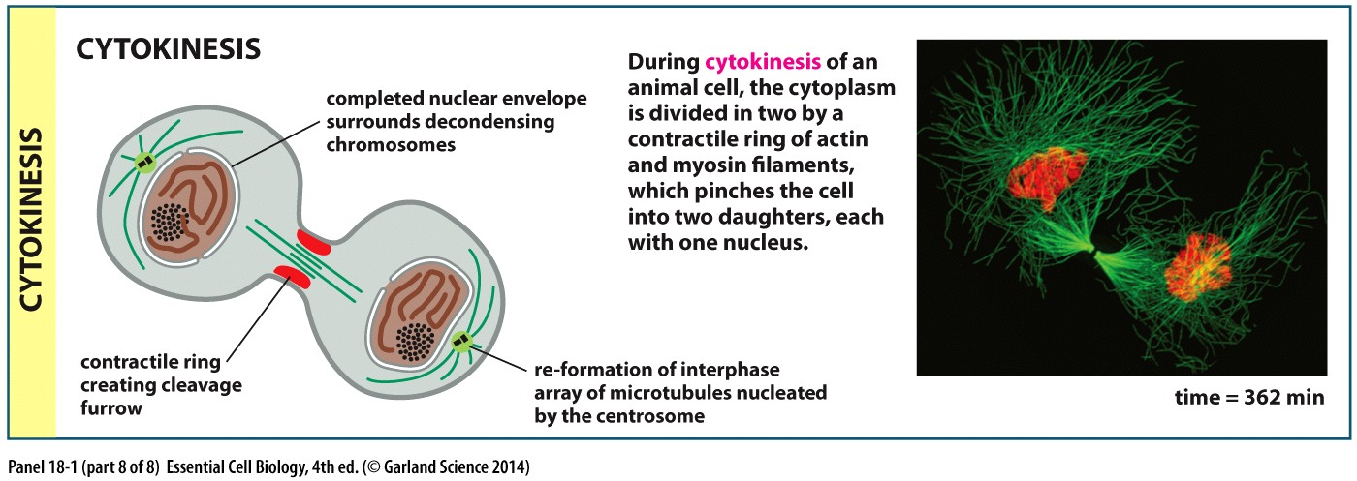

Slide 34
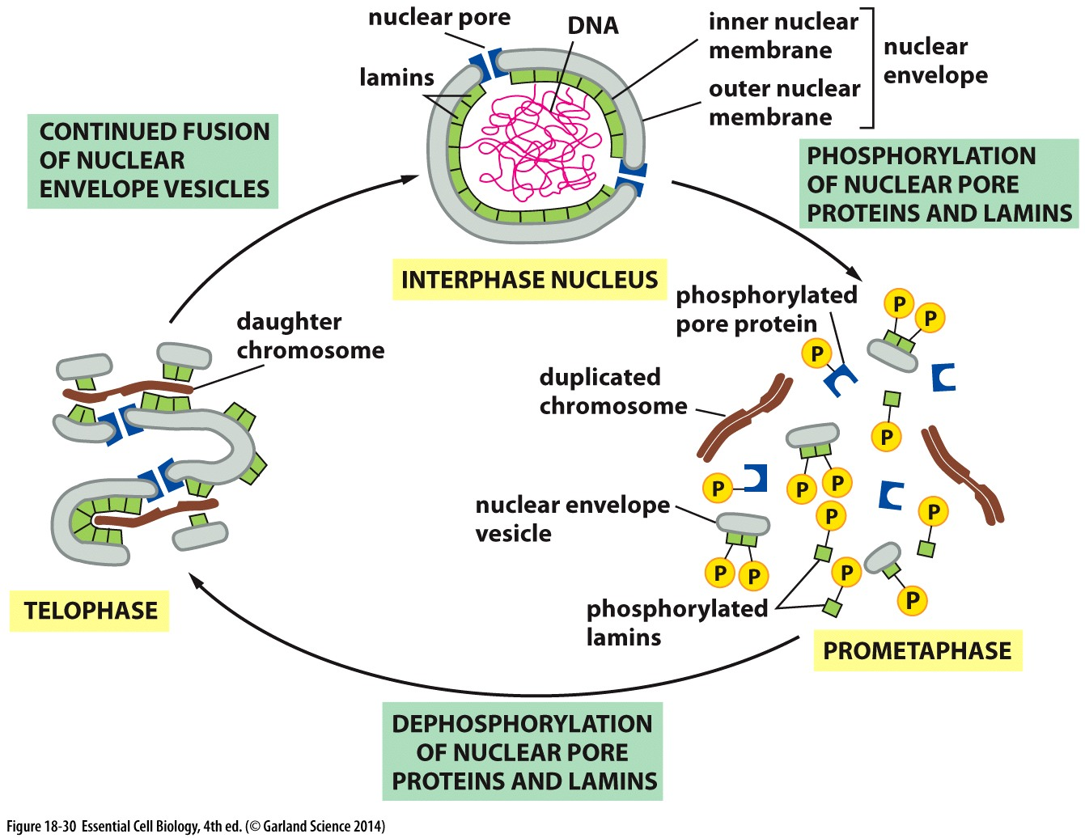
Nuclear envelope formation
Nuclear envelope re-assembles during telophase and mitotic spindle disassembles

Slide 35
Cytokinesis
Begins in Anaphase but not completed until the formation of two daughter nuclei
Depends on actin and myosin filaments which form the contractile ring
Mitotic spindle determines plane of cytokinesis and its timing

Slide 36
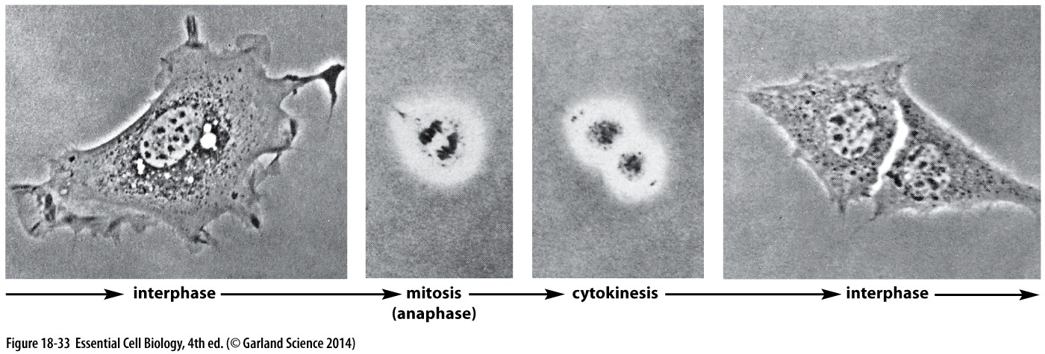
Contractile ring
Composed of actin and myosin filaments attached to membrane associated proteins
It’s a transient structure
Mammalian fibroblast cells in culture ??
  Substratum
  Integrin

Slide 37
Other organelles
Mitochondria and chloroplast are present in large numbers
ER is continuous with nucleus membrane and organized by microtubules
  Its intact during mitosis and cut in two during cytokinesis
Golgi apparatus fragments during mitosis and associate with spindle microtubules

Slide 38
Cell number and size
Programmed cell death or apoptosis regulates cell number
Extracellular signals control cell death, size and division

Slide 39
Apoptosis
Apoptosis is the most common form of programmed cell death which is activated by an intracellular death program --- Suicide
  Structures formed by cells are not needed
  Balance cell division

Slide 40
Intracellular proteolytic cascade
Cells going through apoptosis don’t damage neighbouring cells unlike cell necrosis
  Cell shrinks
  Cytoskeleton collapses
  Nuclear envelope disassembles
Macrophages
Caspases
  Initiator
  Executioner

Slide 41
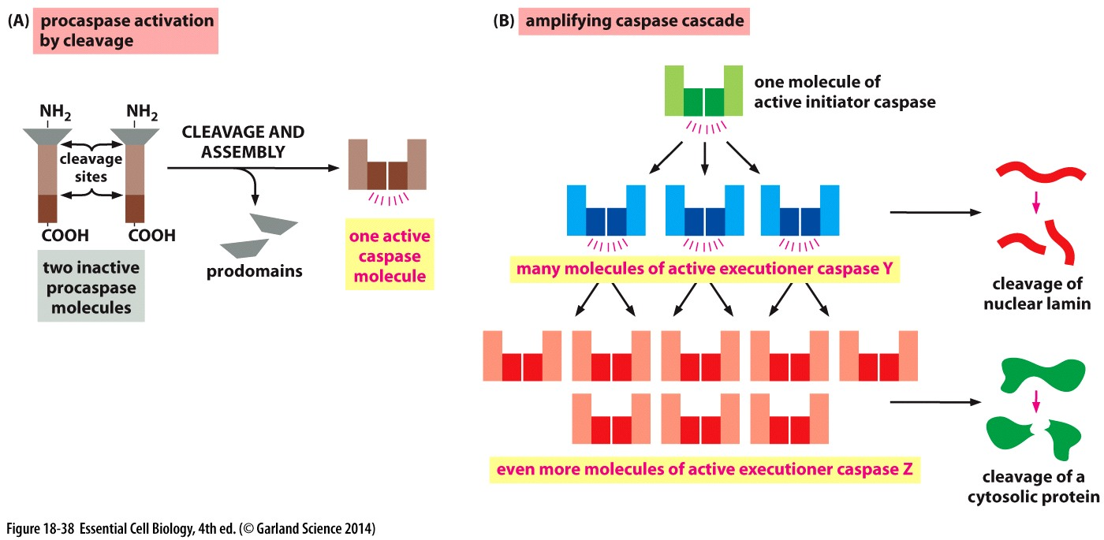
Caspases
Procaspases inactive precursor of caspases
Initiator caspases
Executioner caspases

Slide 42
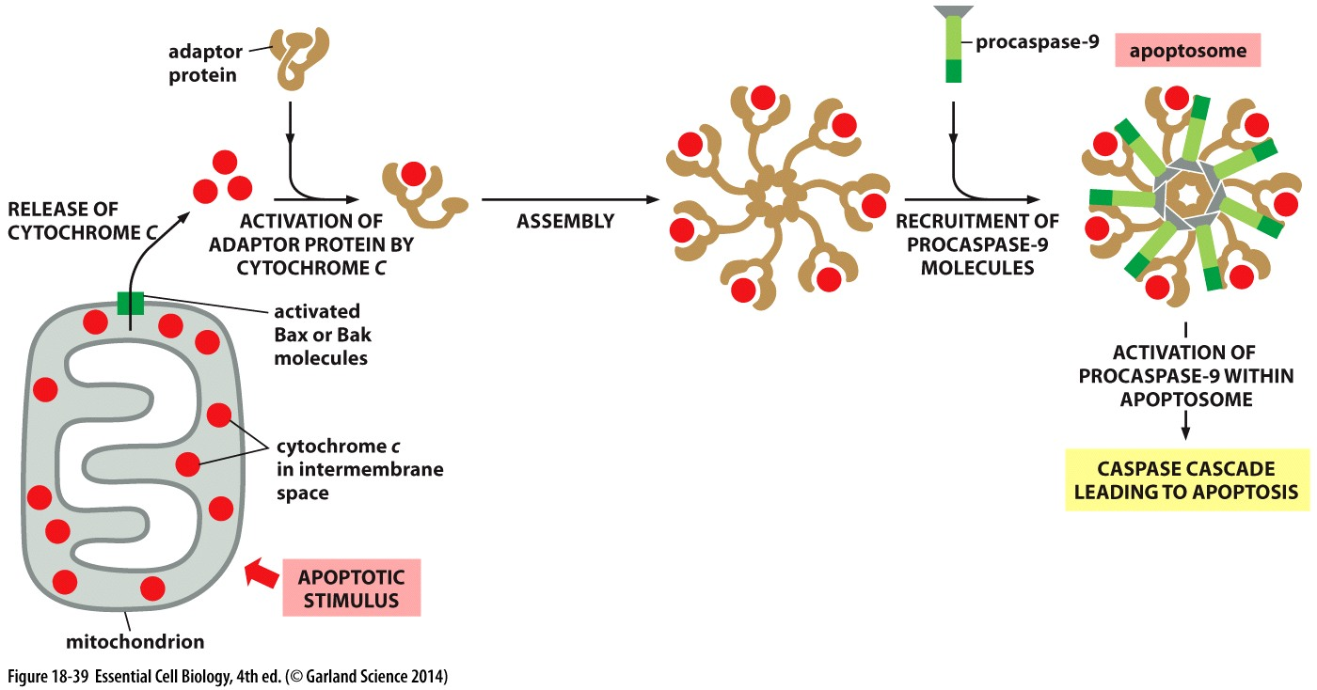
Bcl2 family
Main proteins involved in activation and inhibition of caspase proteins are part of Bcl2 family
  Cytochrom c
  Apoptosome
  Bax
  Bak

Slide 43
Extracellular signals
These signals can activate apoptosis through Bcl2 family
Death receptors are cell-surface proteins activated by extracellular response
  Fas is activated by Fas ligand present on killer lymphocytes

Slide 44
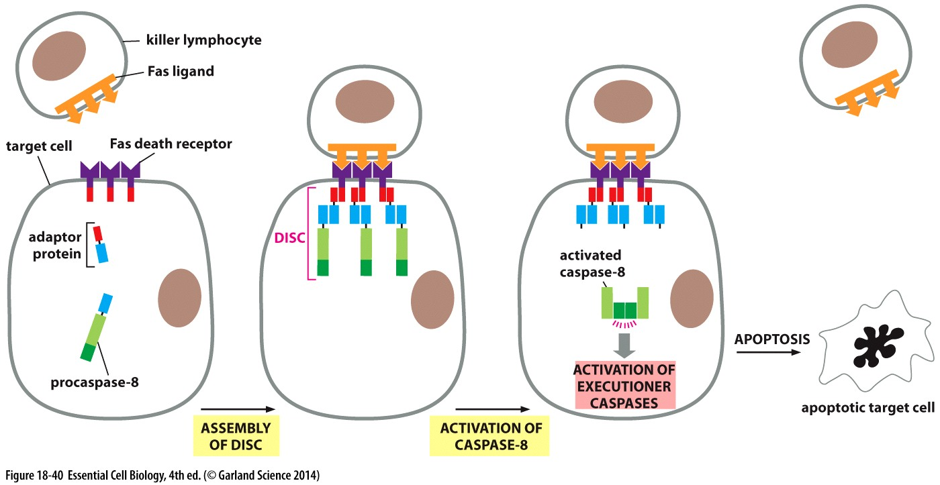

Slide 45
Survival, growth and division
Other than nutrients, signals from other cells are required for cell growth and division
These signals are usually soluble proteins secreted by cells or surface proteins
  Survival factor
  Mitogens
  Growth factor

Slide 46
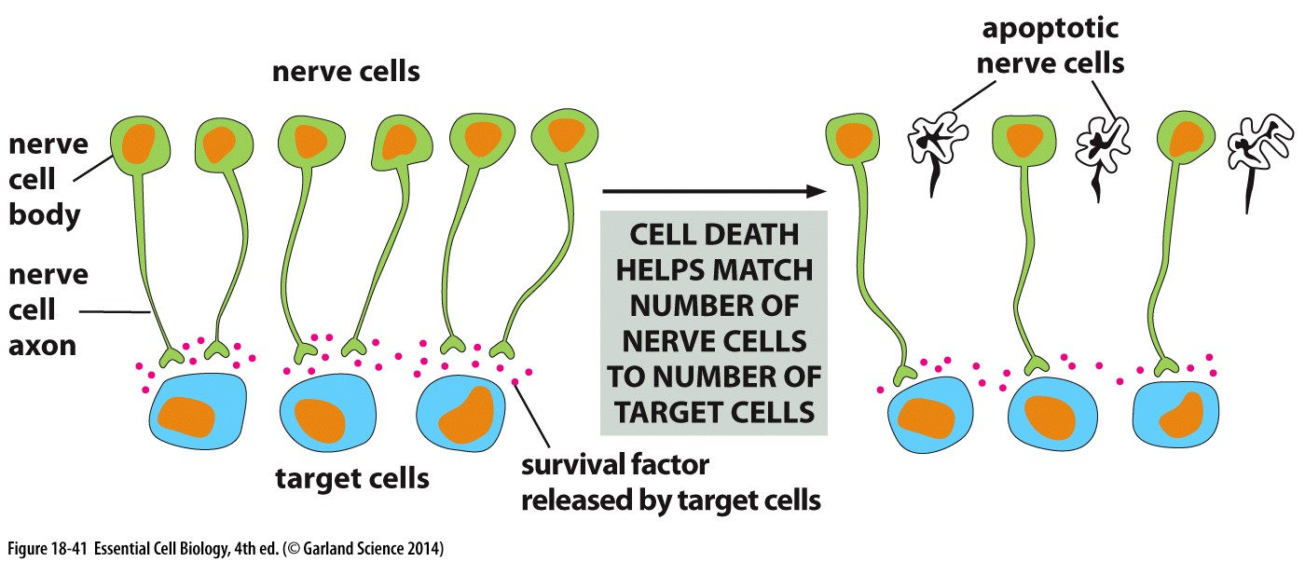
Survival Factors
Cells require signals from other cells to survive, otherwise the caspase-dependent intracellular program gets activated
Nerve cells are produced in excess in the developing nervous system

Slide 47
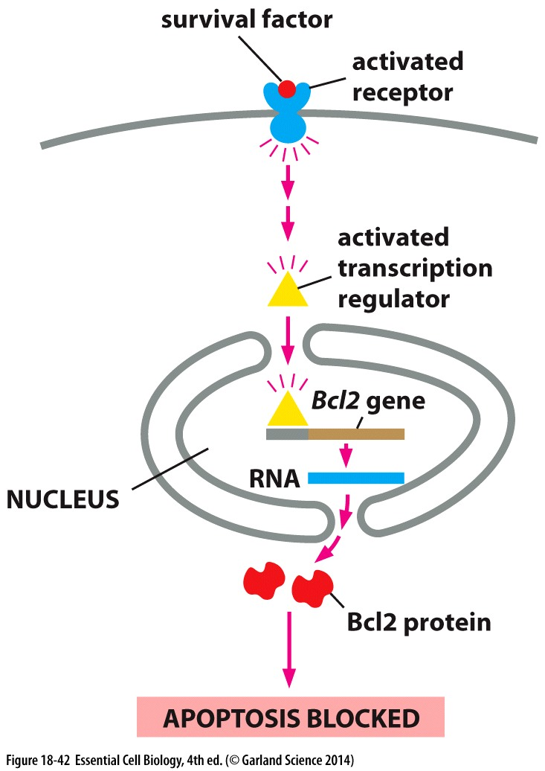

Slide 48
Mitogens
Stimulate cell division by facilitating transition from G1 to S phase
PGDF – platelet derived growth factor binds to tyrosine kinases

Slide 49
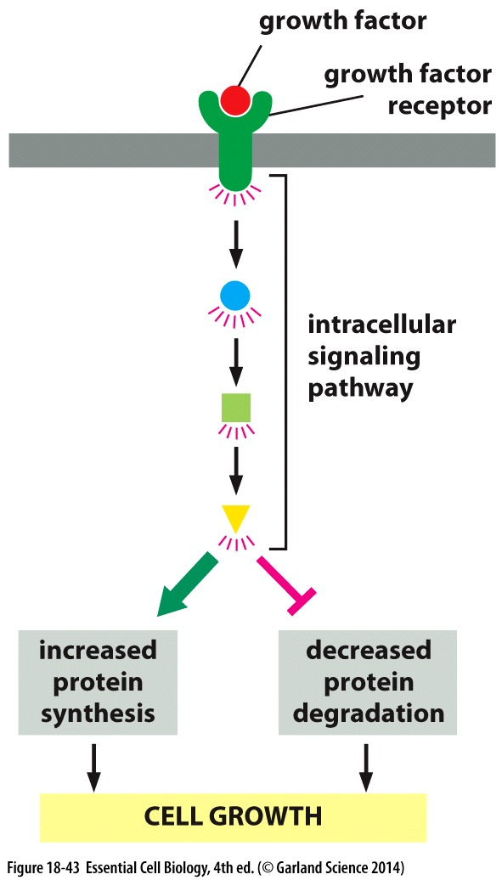
Growth factors
Growth of animal cells depends on signals from other cells called growth factors
Cell growth is independent of cell cycle control
PDGF can act both as mitogen and growth factor

