Slide 1

Essentials of Services Marketing,
3rd Edition
Instructor Supplements

Slide 2
Chapter 3
Positioning Services in Competitive Markets

Slide 3
Chapter 3 Outline
3.1 Understand how customer, competitor, and company analyses (i.e., the 3 Cs) help to develop a customer-driven services marketing strategy.
3.2 Know the key elements of a positioning strategy (i.e., STP) and explain why they are so crucial for service firms.
3.3 Segment customers on the basis of needs before using other common bases to
further identify and profile the segments.
3.4 Distinguish between important and determinant attributes for segmentation.
3.5 Use different service levels for segmentation.

Slide 4
Chapter 3 Outline
3.6 Target service customers using the four focus strategies for competitive advantage.
3.7 Position a service to distinguish it from its competitors.
3.8 Understand how to use positioning maps to analyze and develop competitive
strategy.
3.9 Develop an effective positioning strategy.

Slide 5
3.1
Understand how customer, competitor, and company analyses (the 3 Cs) help to develop a customer-driven services marketing strategy.

Slide 6
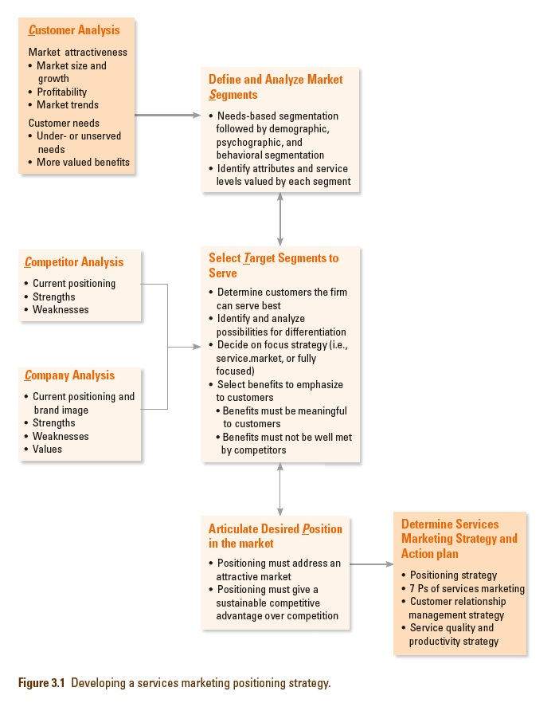
3.1 Customer, competitor, and company analyses
Developing a services marketing positioning strategy

Slide 7
3.1 Customer, Competitor and Company Analysis
Customer analysis:
      Overall examination of market characteristics
      Customer needs and related characteristics and behaviors
Competitor analysis:
      Current positioning
      Strengths and weaknesses
Company analysis:
      Current brand positioning and image
      Resources
      Limitations and constraints

Slide 8
3.2
Know the key elements of a positioning strategy (i.e., STP) and explain why they are so crucial for service firms.

Slide 9
3.2 Segmentation, Targeting, and Positioning
Segmentation:
      Dividing population of possible customers into groups with common service-related characteristics
      Similar needs within same segment, different needs between segments
Targeting:
      Choose one/more segments to focus on
Positioning:
      Unique place in the minds of customers
      Differentiation forms first step to creating unique positioning

Slide 10
3.3
Segment customers on the basis of needs before using other common bases to further identify and profile the segments.

Slide 11
3.3 Segmenting Service Markets
Firms vary widely in ability to serve different types of customers
      Adopt strategy of market segmentation, identifying those parts of market can serve best
      A market segment is
      composed of a group of
      buyers sharing common:
        Characteristics
        Needs
        Purchasing behavior
        Consumption patterns
11

Slide 12
3.3 Segmenting Service Markets
Various ways to segment markets:
      Demographics: on its own will not result in meaningful segments
      Psychographic segmentation: useful for strengthening brand identity and creating emotional connection
      Behavioral segmentation: focuses on observable behavior
      Needs-based segmentation: focuses on what customers truly want in a service

Slide 13
3.3 Segmenting Service Markets
Developing the Right Service Concept for a Specific Segment
Use research to identify and prioritize which attributes of a given service are important to specific market segments
Individuals may set different priorities according to:
      Purpose of using the service
      Who makes decision
      Timing of use
      Whether service is used alone or with a group
      Composition of that group

Slide 14
3.4
Distinguish between important and determinant attributes for segmentation.

Slide 15
3.4 Important versus Determinant Service Attributes
Consumers usually choose between alternative service offerings based on perceived differences between them
Attributes that distinguish competing services from one another are not necessarily the most important ones
Determinant attributes determine buyers’ choices between competing alternatives:
      Service characteristics that are important to purchasers
      Customers see significant differences between competing alternatives on these attributes

Slide 16
3.5
Use different service levels for segmentation.

Slide 17

3.5 Segmenting Based on Service Levels
Need to make decisions on service levels―level of performance firm plans to offer on each attribute
      Easily quantified attributes are easier to understand and generalizable (e.g., vehicle speed, physical dimensions)
      Qualitative attributes are ambiguous and subject to individual interpretation (e.g., physical comfort, noise levels)
17

Slide 18
3.6
Target service customers using the four focus strategies for competitive advantage

Slide 19
3.6 Considerations for Using the Focus Strategies
Fully focused:
      Limited range of services to narrow and specific market
Opportunities:
      Developing recognized expertise in a well-defined niche may provide protection against would-be competitors
      Allows firms to charge premium prices

Slide 20
3.6 Considerations for Using the Focus Strategies
Risks:
      Market may be too small to generate needed volume of business
      Demand for a service may be displaced by generic competition from alternative products
      Purchasers in chosen segment may be susceptible to economic downturn
Market focused:
      Narrow market segment with wide range of services
      Need to make sure firms have operational capability to do an deliver each of the different services selected
      Need to understand customer purchasing practices and preferences

Slide 21
3.6 Considerations for Using the Focus Strategies
Service focused:
      Narrow range of services to fairly broad market
      As new segments are added, firm needs to develop knowledge and skills in serving each segment
Unfocused:
      Broad markets with wide range of services
      Many service providers fall into this category
      Danger of becoming a “jack of all trades and master of none”

Slide 22
3.7
Position a service to distinguish it from its competitors.

Slide 23
3.7 Distinguishing a service from its competitors
Four Principles of Positioning Strategy
Must establish position for firm or product in minds of target customers
Position should provide one simple, consistent message
Position must set firm/product apart from competitors
A company cannot be all things to all people; it must focus its efforts
Jack Trout

Slide 24
3.7 Distinguishing a service from its competitors
Six Questions for Effective Positioning Strategy
What does our firm currently stand for in the minds of current and potential customers?
What types of customers do we serve now, and which ones would we like to target in future?
What is value proposition for each of our current service products, and what market segments is each one targeted at?

Slide 25
3.7 Distinguishing a service from its competitors
Six Questions for Effective Positioning Strategy
How does each of our service products differ from competitors’?
How well do customers in chosen target segments perceive our service products as meeting their needs?
What changes must we make to our offerings to strengthen our competitive position?
Avoid the trap of investing too heavily in points of differences that are easily copied.

Slide 26
3.8
Understand how to use positioning maps to analyze and develop competitive strategy.

Slide 27
3.8 Using positioning maps
Great tool to visualize competitive positioning and map developments of time
Useful way to represent consumer perceptions of alternative products graphically
Typically confined to two attributes, but 3-D models can be used to portray positions on three attributes simultaneously
Also known as perceptual maps
Information about a product can be obtained from market data, derived from ratings by representative consumers, or both

Slide 28
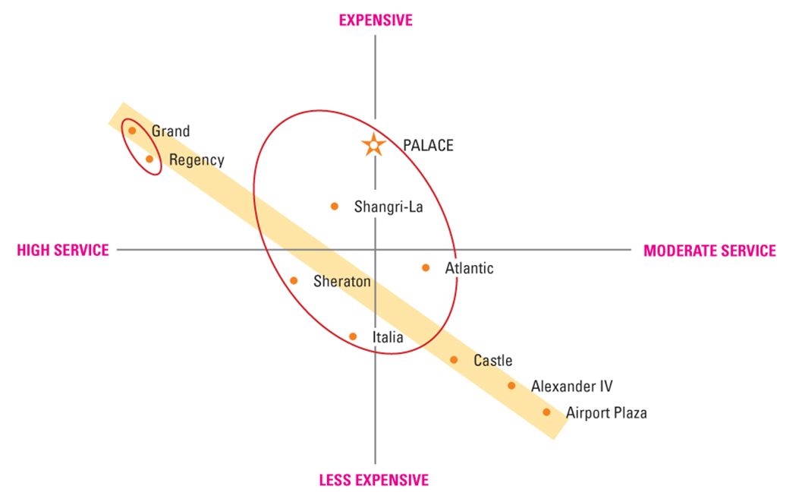
3.8 Using positioning maps
Positioning of Belleville Hotels: Service Level vs. Price

Slide 29
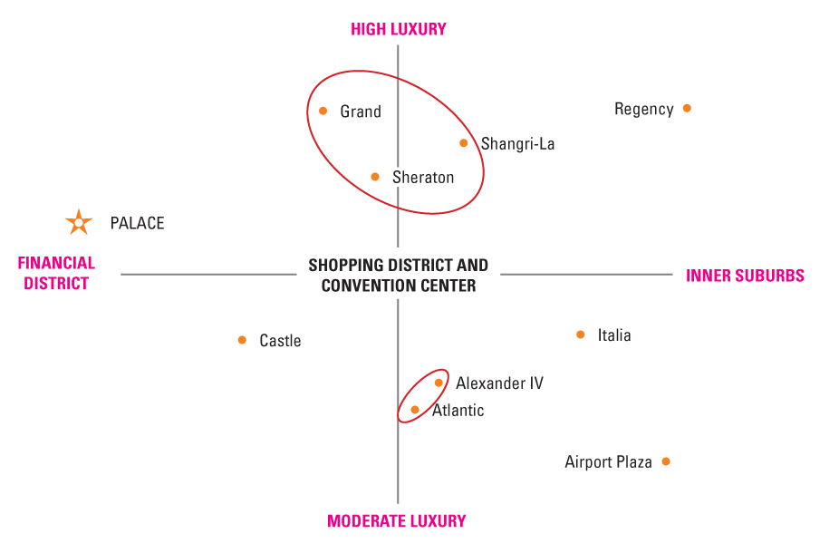
3.8 Using positioning maps
Positioning of Belleville Hotels:
Location vs. Physical Luxury

Slide 30
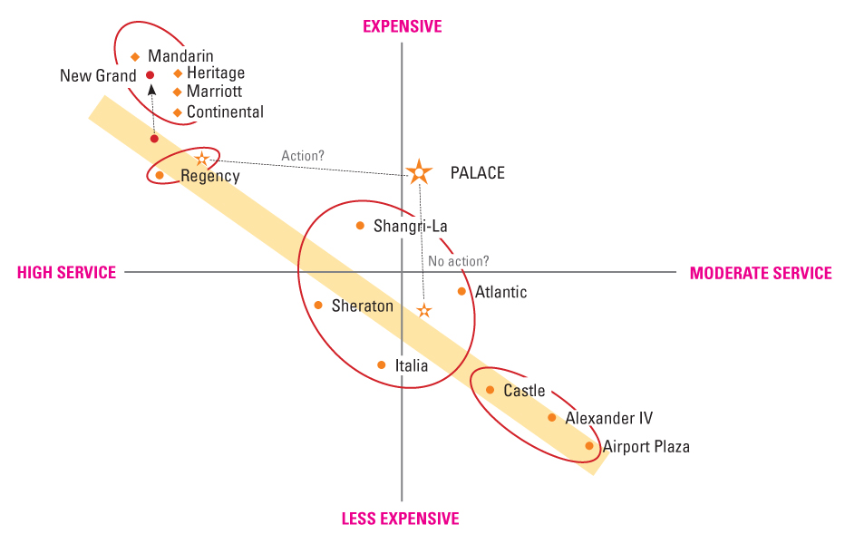
3.8 Using positioning maps
Future Positioning of Belleville Hotels:
Service Level vs. Price

Slide 31
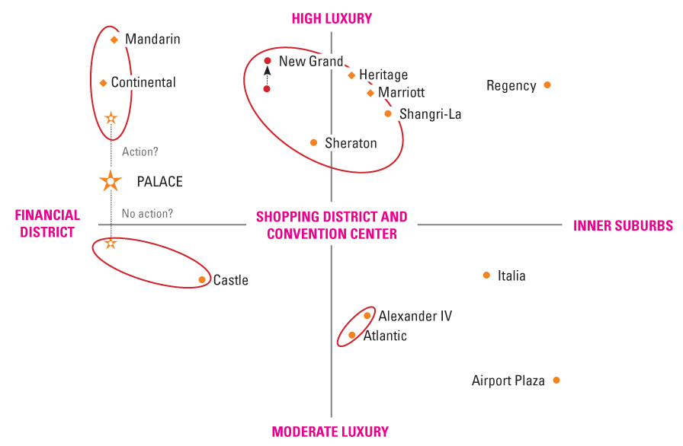
3.8 Using positioning maps
Future Positioning of Belleville Hotels: Location vs. Physical Luxury

Slide 32
3.8 Using positioning maps
Positioning Maps Help Managers to Visualize Strategy
Positioning maps display relative performance of competing firms on key attributes
Research provides inputs to development of positioning maps―challenge is to ensure that
      Attributes employed in maps are important to target segments
      Performance of individual firms on each attribute accurately reflects perceptions of customers in target segments

Slide 33
3.8 Using positioning maps
Positioning Maps Help Managers to Visualize Strategy
Predictions can be made of how positions may change in light of future developments
Simple graphic representations are often easier for managers to grasp than tables of data or paragraphs of prose
Charts and maps can facilitate “visual awakening” to threats and opportunities, suggest alternative strategic directions

Slide 34
3.9
Develop an effective positioning strategy.

Slide 35
3.9 Developing an Effective Positioning Strategy
Segmentation, targeting and positioning integrates with customer, competitor and company analyses to give us a positioning statement
Target audience:
      Specific group(s) of people that the brand wants to sell to and serve
Frame of reference:
      Category the brand is competing in

Slide 36
3.9 Developing an Effective Positioning Strategy
Point of difference
      Most compelling benefit offered by brand that stands out from competitors
Reason to believe
      Proof that brand can deliver the benefits that are promised

Slide 37
Thank you.

