Slide 1
12
Setting the Right Price

Slide 2
Learning Outcomes
Explain the importance of price
Describe the four-step pricing process
Recognize the legalities and ethics of
setting a price

Slide 3
The Importance of Price
Marketing plays a large role in the determination of price
A price that satisfies
  Balance of internal price with external pricing determinants
1
Notes:
The internal pricing (determined by financial and accounting formulas) and the external pricing determinants (determined by an understanding of marketing and the external environment) must be considered to ensure a price that satisfies the consumer and the bottom line.

Slide 4
What Is Price?
Price
  That which is given up in exchange to acquire a good or service
  Includes the time lost while waiting for the good or service
Reasonable price = perceived value at the time of transaction
1
Notes:
The price paid is based on the satisfaction consumers expect to receive from a product and not necessarily the satisfaction they actually receive. Price can relate to anything with perceived value, not just money.

Slide 5
The Importance of Price to
Marketing Managers
Price
Revenue
Profits
1
Notes:
Revenue = price x number of units sold
Revenue - expenses = profit
To earn a profit, managers must choose a price that is not too high or too low—a price that is equal to the perceived value to the consumer.

Slide 6
Trends
Product proliferation and empowered buyers:
  Buyers carefully evaluate the price of each one against the value of existing products
Increased availability of bargain-priced private and generic brands:
  Downward pressure on overall prices
Market share pressures:
  Firms resort to cutting prices
The Internet:
  Comparison shopping easier
1
Notes:
Consumer Market
Business Market—buyers are more price sensitive and better informed

Slide 7
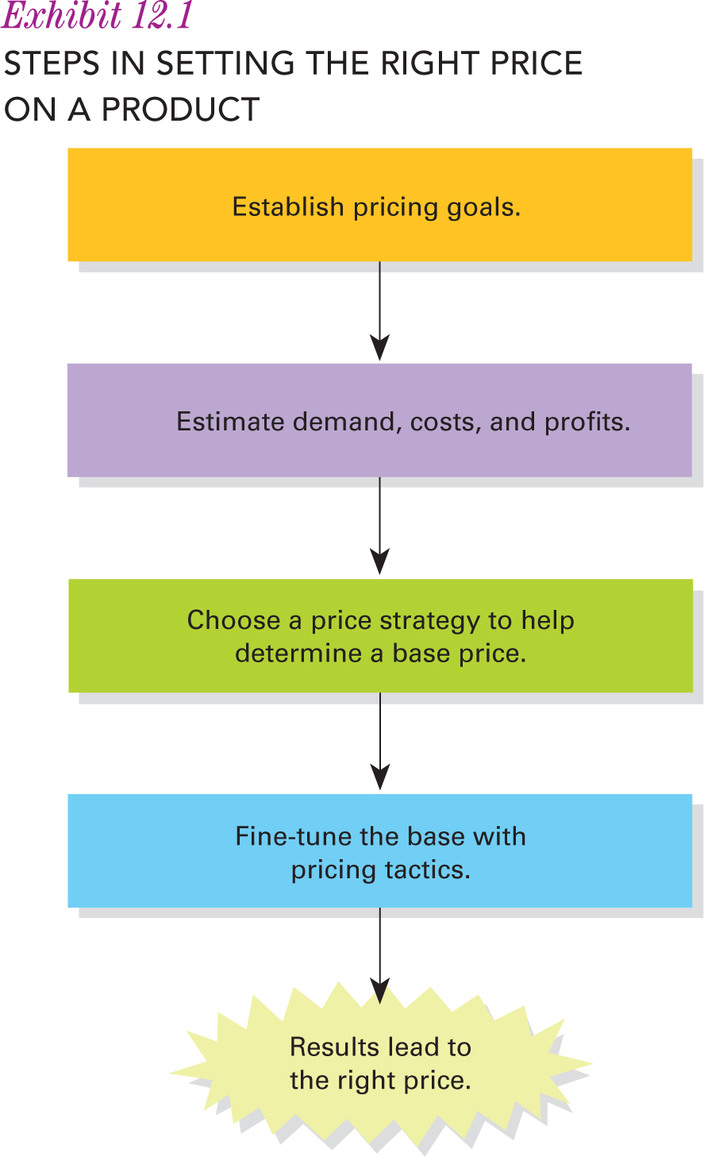
The Four-Step Pricing Process
2
Notes:
There is no easy formula here; while there are numbers, there are also considerations that go into setting a price that go beyond numbers.

Slide 8
Step 1—Establish Pricing Goals
Pricing Goals
Status Quo
Sales Oriented
Profit
Oriented
2
Notes:
When establishing pricing goals, managers must consider the product’s demand, costs, profits, and so forth as it progresses through its life cycle. This process usually means trade-offs occur in terms of meeting the target customer’s needs, being competitive, having considerations for changing economic conditions, and meeting the company’s overall objectives.

Slide 9
Profit-Oriented Pricing Objectives
Profit Maximization
Price so that total revenue is as large as possible relative to total costs
Satisfactory Profits
Reasonable level of profit
Often connected to CSR
Target Return on Investment
Most common
Price to achieve a particular ROI
2
Notes:
Profit maximization does not always mean unreasonable high prices. Can maximize profits by expanding revenue by increasing customer satisfaction, or reduce costs through efficiency, or both.
Satisfactory profits = level of profit consistent with the level of risk.
Target return – target ROI is a percentage that puts a firm’s profits into perspective by showing profits relative to investment.

Slide 10
Sales-Oriented Pricing Objectives
Market Share
Product sales as a percentage of total sales within the industry
Generally expressed in terms of revenue
Sales Maximization
Ignore profits, competition, and the marketing environment as long as sales are rising
Short-term focus
Many believe market share indicates effectiveness
2
Notes:
Larger market shares have indeed often meant higher profits, thanks to greater economies of scale, market power, and the ability to recruit and compensate top-quality management. But not always the case—extreme competition in some industries limits market share growth, so companies have switched from market share objectives to ROI objectives.
Sales maximization—if a company is strapped for funds or wants to sell off excess inventory.

Slide 11
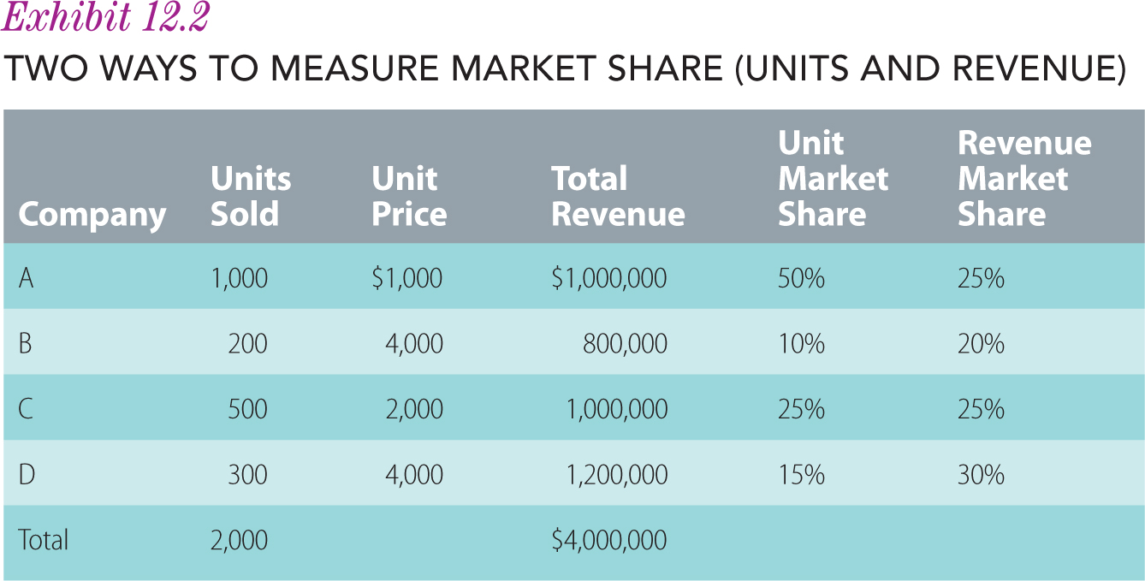

Slide 12
Status-Quo Pricing Objectives
Status Quo
Maintain existing prices
Meet competition prices
Requires little planning—passive policy
2
Notes:
Often, firms competing in an industry with an established price leader simply meet the competition’s prices. These industries typically have fewer price wars than those with direct price competition. In other cases, managers regularly shop competitors’ stores to ensure that their prices are comparable.

Slide 13
Step 2—Estimate Demand, Costs, and Profits
Introductory Stage
High price
Growth Stage
Prices stabilize
Maturity Stage
Price decreases as competition increases
Distribution channels are a cost factor as need to intensify
Recover development costs
Demand relatively inelastic
Price-sensitive market—then at or below market
Competition enters increasing supply
Product appeal has widened
Economies of scale lower costs so can pass savings on
Prices across competitors stabilize and price reductions do little as competition just follows
Decline Stage
Further price reductions as the few remaining competitors try to recoup as much as possible
Prices could even go up if the remaining product becomes a specialty good
Demand rises
Demand is limited
2
Notes:
After establishing pricing goals in Step 1, managers should then estimate total revenue at a variety of prices. Next, they should determine the corresponding costs for each price. They are then ready to estimate how much profit, if any, and how much market share can be earned at each possible price. Demand can be estimated by looking at the product life cycle.

Slide 14
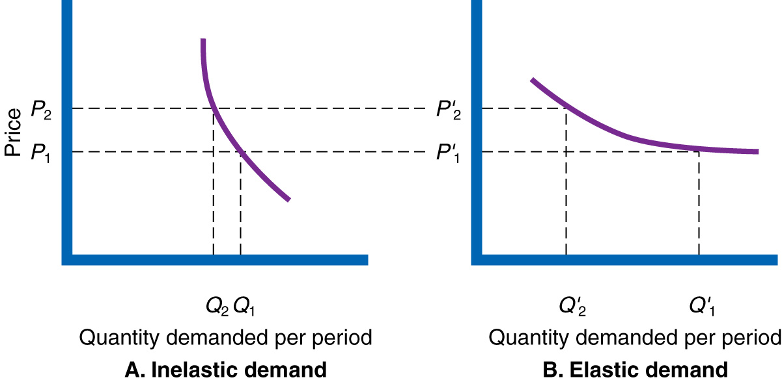
Figure 11.4
Demand Curves

Slide 15
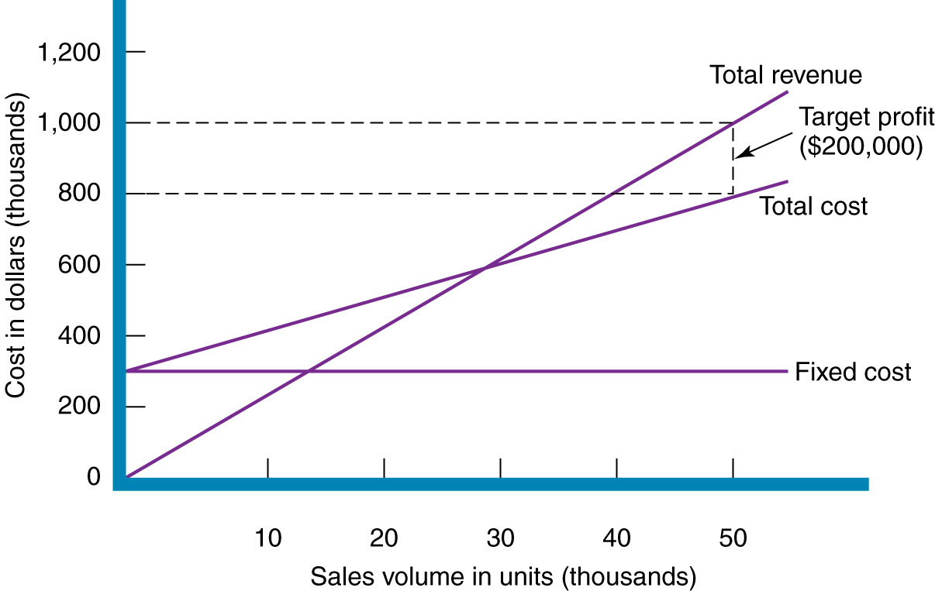
General Pricing Approaches
Figure 11.6
Break-Even Chart for Determining Price

Slide 16
Step 3—Choose a Price Strategy
Pricing framework should be an extension of the pricing goals
Price strategy defines the initial price, which sets the course for price direction over the
life cycle
2

Slide 17
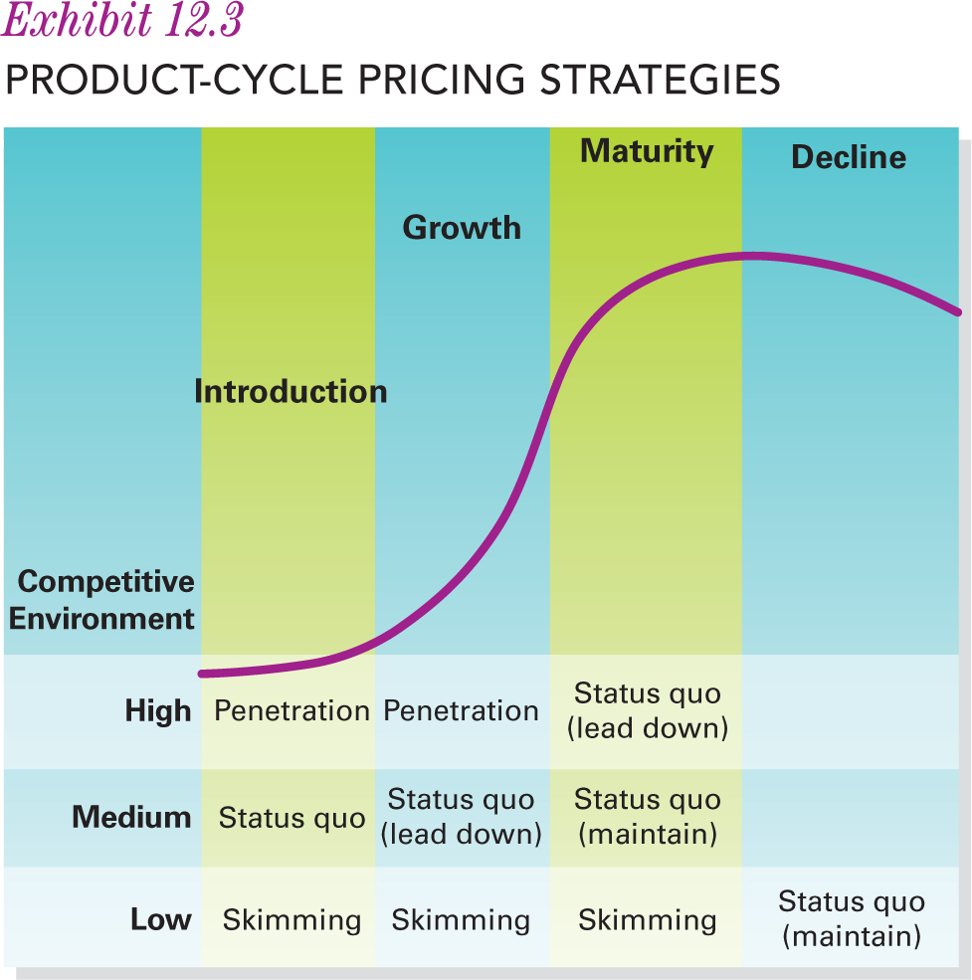
Step 3—Choose a Price Strategy
The marketing manager’s chosen price strategy defines the initial price and the intended direction for price movements over the product life cycle
2
Notes:
The price strategy sets a competitive price in a specific market segment that is based on a well-defined positioning strategy. Changing a price level from premium to prestige may require a change in the product itself, the target customers served, the promotional strategy, or the distribution channels.
A company’s freedom in pricing a new product and devising a price strategy depends on the market conditions and the other elements of the marketing mix.

Slide 18
Step 3—Choose a Price Strategy
Problem today:
  Strategic pricing decisions are made without an understanding of the likely response from buyers and competition
  Pricing decisions are made without a process for managing the pricing activity as the environment changes
2
Notes:
Marketing managers should make pricing decisions based on market research and serious planning—those that do consider their product positioning demand and cost, the company’s long-term goals, and and the product life cycle stage and then choose one of three basic approaches to pricing.

Slide 19
Step 3—Choose a Price Strategy
Consider the product positioning and then choose one of three approaches:
  Price skimming
  Penetration pricing
  Status quo pricing
2

Slide 20
Price Skimming
When?
  New products
  Perceived to have unique advantages
How?
  High to start and then lower prices over time
When?
  Market is willing buy at the premium
  Product is protected legally
  Cannot expand production rapidly due to technology issues
Why?
  Recover production costs quickly
  Test the market at a high price and then lower if sales too slow
  Better to go in high and reduce than go in low and increase
2
Notes:
High introductory price
Heavy promotion
Successful skimming is not limited to products—services do the same.

Slide 21
Penetration Pricing
What?
  Charging a relatively low price for a product initially
Why?
  To capture a large share of the market—reduce production costs
  Market share objective
  Lower profit per unit sold so volume of sales is critical
  Low price can discourage competition from entering
When?
  Price-sensitive market
  Demand is elastic
  Competitive market, relatively homogeneous products, potentially large market
  Low fixed-cost structure; each sale contributes large amount to
  fixed costs
2
Notes:
If the volume of sales does not materialize then the company will face huge losses. Also a penetration policy with a prestige product can prove disastrous.

Slide 22
Status Quo Pricing
What?
  Meeting the competition or going-rate pricing
  Charging a price identical or very close to competition
Why?
  Simple
  But it ignores demand and costs
2

Slide 23
Step 4—Use a Price Tactic
Set a base price—general price level that the company plans to sell at
Fine-tune the base price using a variety of pricing tactics
  Provides the opportunity to adjust for unforeseen events in the marketplace
2

Slide 24
Step 4—Use a Price Tactic
Discounts and Allowances
Quantity Discounts
Cash Discounts
Functional Discounts
Seasonal Discounts
2
Notes:
Quantity discounts: When buyers are charged a lower unit price when buying either in multiple units or at more than a specified dollar amount, they are receiving a quantity discount. A cumulative quantity discount is a deduction from list price that applies to the buyer’s total purchases made during a specific period; it is intended to encourage customer loyalty. A noncumulative quantity discount is a deduction from list price that applies to a single order rather than to the total volume of orders placed during a certain period. It is intended to encourage orders in large quantities.
A cash discount is a price reduction offered to a consumer, an industrial user, or a marketing intermediary in return for prompt payment of a bill.
Functional discounts: When distribution channel intermediaries, such as wholesalers or retailers, perform a service or function for the manufacturer (for example, setting up retail displays or extending credit), they must be compensated (generally a percentage discount off base).
Seasonal discount is a price reduction for buying merchandise out of season.

Slide 25
Value-Based Pricing
Competition
Consumer
Value Price
2
Notes:
Starts with the consumer, considers the competition, and then determines the price. The consumer-driven organization seeks to determine the bundle of attributes the consumer wants and what value they place on them. Must also consider competition—as consumers assign value based on relative to alternatives.

Slide 26
Geographic Pricing
FOB Origin
Uniform Delivered
Zone
Freight Absorption
Basing-Point
2
Notes:
The buyer absorbs the freight costs from the shipping point (“free on board”). The farther buyers are from sellers the more they pay, because transportation costs generally
increase with the distance merchandise is shipped.
The seller pays the actual freight charges and bills every purchaser an identical, flat freight charge.
A modification of uniform delivered pricing. Rather than using a uniform freight rate for its total market, the firm divides it into segments or zones and charges a flat rate per zone.
Seller pays all the freight—used in intensely competitive markets as a way to break in or be more competitive.
Designate a location as a basing point and charges all buyers the freight cost from that point regardless of the city from which the goods are shipped. This is not very popular any longer.

Slide 27
Other Pricing Tactics
Single Price
All goods and services at the same price
Removes price comparison from the buying process
Flexible Price
Different customers pay different prices
Allows the seller flexibility with respect to competition
Professional Services
Used by people who have specialized training
Price sensitivity is limited so consumer will bear the price given
Good when dealing with price-conscious consumers
Lack of consistent profit
Must be ethical
2

Slide 28
Other Pricing Tactics
Price Lining
A line of products with prices set at several price points within
Reduces confusion for both seller and buyer
Loss Leader
Selling a product near or even below cost in the hope that shoppers will buy other items once in the store
Odd-Even
Using odd numbers in the price to connote a bargain
Does limit flexibility as prices rise and fall for the seller
2

Slide 29
Other Pricing Tactics
Price Bundling
Two or more products in a single package for a special price
Many issues related to consumer behaviour to consider here
Two-Part
Charging two separate amounts to consume a single good or service
Membership fee and and then a flat fee for use
Can attract consumers who will not pay a high upfront fee for limited use
2

Slide 30
Legality and Ethics
Bait Pricing
Lure customers in through false or misleading advertising
Use of high pressure in-store to sell up
Deceptive Pricing
Promoting a product or price saving that is not actually available or a low price on a limited number of products
Promote a discount from regular price which has not been the regular price
Price Fixing
When two or more companies conspire to set a price—establish a floor in a bidding situation or setting the market price that consumers will pay
Selling a product above the advertised price
Double ticketing
3
Notes:
All pricing tactics are enforced by the Competition Act. Challenge is enforcement and penalties.

Slide 31
Legality and Ethics
Predatory Pricing
Set a price very low with the intent of driving competition out
Difficult to prove as must show willful intent
Resale Price Maintenance
Cannot dictate the price that retailer sells at or the retailer’s price minimum
Manufacturers can provide an MSR but cannot discriminate against retailers that do not adhere to the MSR
Price Discrimination
Charge different prices for different buyers of goods of like quality and grade within the same time period to reduce competition
Promotional money can be offered to channel members to stimulate support but it must be offered proportionally
3

Slide 32
Your Turn
You are starting your own lawn care service this summer. Discuss the various pricing objectives you could use.
Choose a pricing objective and then decide on a pricing strategy.
Now determine which pricing tactics you will employ to achieve your objectives.

