Slide 2
IN THIS CHAPTER, YOU WILL LEARN:
the IS curve and its relation to:
  the Keynesian cross
  the loanable funds model
the LM curve and its relation to:
  the theory of liquidity preference
how the IS-LM model determines income and the interest rate in the short run when P is fixed
1

Slide 3
Context
Chapter 10 introduced the model of aggregate demand and aggregate supply.
Long run:
  prices flexible
  output determined by factors of production & technology
  unemployment equals its natural rate
Short run:
  prices fixed
  output determined by aggregate demand
  unemployment negatively related to output

Slide 4
Context
This chapter develops the IS-LM model,
the basis of the aggregate demand curve.
We focus on the short run and assume the price level is fixed (so the SRAS curve is horizontal).
Chapters 11 and 12 focus on the closed-economy case. Chapter 13 presents the open-economy case.

Slide 5
The Keynesian cross
A simple closed-economy model in which income is determined by expenditure.
(due to J. M. Keynes)
Notation:
  I = planned investment
  PE = C + I + G = planned expenditure
  Y = real GDP = actual expenditure
Difference between actual & planned expenditure = unplanned inventory investment

Slide 6
Elements of the Keynesian cross
consumption function:
govt policy variables:
for now, planned
investment is exogenous:
planned expenditure:
equilibrium condition:
actual expenditure = planned expenditure

Slide 7
Graphing planned expenditure
PE
planned
expenditure
PE =C +I +G
MPC
1
income, output, Y

Slide 8
Graphing the equilibrium condition
PE
planned
expenditure
PE =Y
45º
income, output, Y

Slide 9
The equilibrium value of income
PE
planned
expenditure
PE =Y
PE =C +I +G
income, output, Y
Equilibrium
income

Slide 10
An increase in government purchases
PE
PE =Y
At Y₁,
there is now an unplanned drop in inventory…
PE =C +I +G₂
PE =C +I +G₁
ΔG
…so firms increase output, and income rises toward a new equilibrium.
Y
PE₁ = Y₁
ΔY
PE₂ = Y₂

Slide 11
Solving for ΔY
equilibrium condition
in changes
because I exogenous
because ΔC = MPC ΔY
Collect terms with ΔY on the left side of the equals sign:
Solve for ΔY :

Slide 12
The government purchases multiplier
Definition: the increase in income resulting from a $1 increase in G.
In this model, the govt
purchases multiplier equals
Example: If MPC = 0.8, then
An increase in G causes income to increase 5 times
as much!

Slide 13
Why the multiplier is greater than 1
Initially, the increase in G causes an equal increase in Y: ΔY = ΔG.
But #Y g #C
g further #Y
g further #C
g further #Y
So the final impact on income is much bigger than the initial ΔG.

Slide 14
An increase in taxes
PE
PE =Y
Initially, the tax increase reduces consumption and therefore PE:
PE =C₁ +I +G
PE =C₂ +I +G
ΔC = −MPC×ΔT
At Y₁, there is now an unplanned
inventory buildup…
…so firms reduce output, and income falls toward a new equilibrium
Y
PE₂ = Y₂
ΔY
PE₁ = Y₁

Slide 15
Solving for ΔY
eq’m condition in changes
I and G exogenous
Solving for ΔY :
Final result:

Slide 16
The tax multiplier
def: the change in income resulting from
a $1 increase in T :
If MPC = 0.8, then the tax multiplier equals

Slide 17
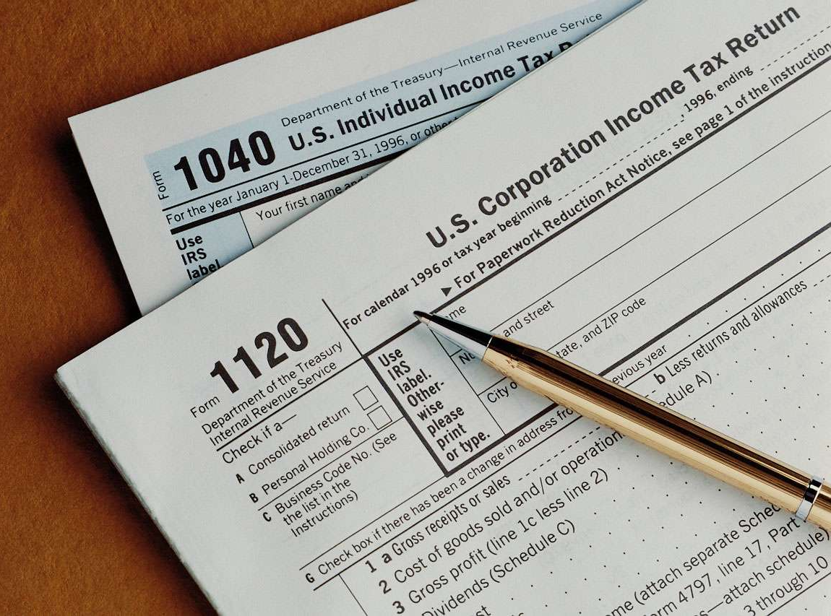
The tax multiplier
…is negative:
A tax increase reduces C,
which reduces income.
…is greater than one
(in absolute value):
A change in taxes has a
multiplier effect on income.
…is smaller than the govt spending multiplier:
Consumers save the fraction (1 – MPC) of a tax cut,
so the initial boost in spending from a tax cut is
smaller than from an equal increase in G.

Slide 18
NOW YOU TRY
Practice with the Keynesian cross
Use a graph of the Keynesian cross
to show the effects of an increase in planned investment on the equilibrium level of income/output.
17

Slide 19
ANSWERS
Practice with the Keynesian cross
PE
PE =Y
At Y₁,
there is now an unplanned drop in inventory…
PE =C +I₂ +G
PE =C +I₁ +G
ΔI
…so firms increase output, and income rises toward a new equilibrium.
Y
PE₁ = Y₁
ΔY
PE₂ = Y₂
18

Slide 20
The IS curve
def: a graph of all combinations of r and Y that result in goods market equilibrium
i.e. actual expenditure (output)
= planned expenditure
The equation for the IS curve is:

Slide 21
Deriving the IS curve
PE
PE =Y
PE =C +I (r₂ )+G
ir g hI
PE =C +I (r₁ )+G
g hPE
ΔI
g hY
Y₁
Y₂
Y
r
r₁
r₂
IS
Y₁
Y₂
Y

Slide 22
Why the IS curve is negatively sloped
A fall in the interest rate motivates firms to increase investment spending, which drives up total planned spending (PE ).
To restore equilibrium in the goods market, output (a.k.a. actual expenditure, Y )
must increase.

Slide 23
The IS curve and the loanable funds model
(a) The L.F. model
(b) The IS curve
r
S₂
S₁
r
r₂
r₂
r₁
r₁
I (r )
IS
S, I
Y₂
Y₁
Y

Slide 24
Fiscal Policy and the IS curve
We can use the IS-LM model to see
how fiscal policy (G and T ) affects
aggregate demand and output.
Let’s start by using the Keynesian cross
to see how fiscal policy shifts the IS curve…

Slide 25
Shifting the IS curve: ΔG
PE
PE =Y
PE =C +I (r₁ )+G₂
At any value of r, hG g hPE g hY
PE =C +I (r₁ )+G₁
…so the IS curve shifts to the right.
The horizontal distance of the
IS shift equals
Y₁
Y₂
Y
r
r₁
ΔY
IS₁
IS₂
Y₁
Y₂
Y

Slide 26
NOW YOU TRY
Shifting the IS curve: ΔT
Use the diagram of the Keynesian cross or loanable funds model to show how an increase in taxes shifts the IS curve.
If you can, determine the size of the shift.
25

Slide 27
ANSWERS
Shifting the IS curve: ΔT
PE
PE =Y
PE =C₁ +I (r₁ )+G
At any value of r,
hT g iC g iPE
PE =C₂ +I (r₁ )+G
…so the IS curve shifts to the left.
Y₂
Y₁
Y
The horizontal distance of the
IS shift equals
r
r₁
ΔY
IS₂
IS₁
Y₂
Y₁
Y
26

Slide 28
The theory of liquidity preference
Due to John Maynard Keynes.
A simple theory in which the interest rate
is determined by money supply and
money demand.

Slide 29
Money supply
r
interest
rate
The supply of
real money
balances
is fixed:
M/P
real money balances

Slide 30
Money demand
r
interest
rate
Demand for
real money
balances:
L (r )
M/P
real money balances

Slide 31
Equilibrium
r
interest
rate
The interest rate adjusts
to equate the supply and demand for money:
r₁
L (r )
M/P
real money balances

Slide 32
How the Bank of Canada raises the interest rate
r
interest
rate
To increase r, Bank of Canada reduces M
r₂
r₁
L (r )
M/P
real money balances

Slide 33
CASE STUDY:
Monetary Tightening & Interest Rates
π in Canada went from around 3% at the beginning of the 1970s to over 12% at the end of the 1970s following the two oil price shocks.
The Bank of Canada reacted to this increase in π by decreasing the growth rate of the money supply
The growth rate of real M1 turned negative by the end of the 1970s.
How do you think this policy change
would affect nominal interest rates?

Slide 34
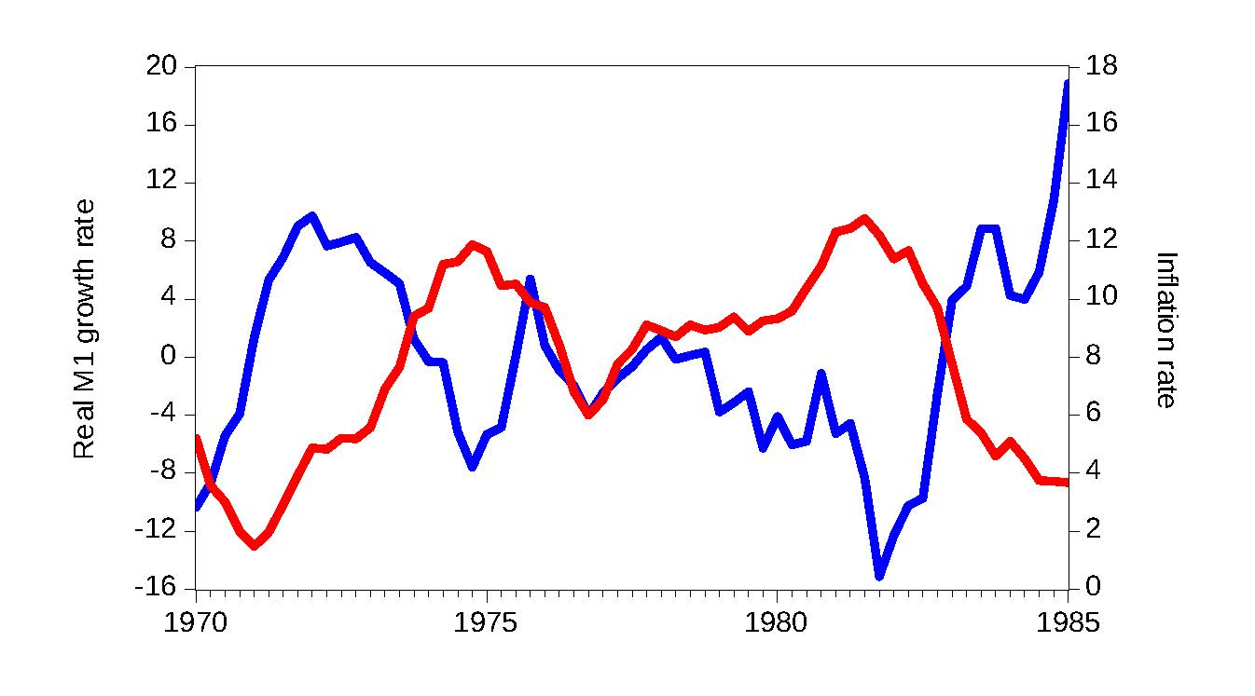
Canada, money growth and inflation, 1970-1985
Real M1 growth (left scale)
Inflation (right scale)
Fall in the growth rate of money

Slide 35
Monetary Tightening & Interest Rates, cont.
The effects of a monetary tightening
on nominal interest rates
short run
long run
model
liquidity preference
(Keynesian)
Quantity theory, Fisher effect
(Classical)
prices
sticky
flexible
prediction
Δi > 0
Δi < 0
actual
outcome
1/1979: i = 10.8%
1/1980: i = 13.5%
1/1979: i = 10.8%
1/1985: i = 9.5%

Slide 36
The LM curve
Now let’s put Y back into the money demand function:
The LM curve is a graph of all combinations of r and Y that equate the supply and demand for real money balances.
The equation for the LM curve is:

Slide 37
Deriving the LM curve
(a) The market for
real money balances
(b) The LM curve
r
r
LM
r₂
r₂
L (r , Y₂ )
r₁
r₁
L (r , Y₁ )
M/P
Y₁
Y₂
Y

Slide 38
Why the LM curve is upward sloping
An increase in income raises money demand.
Since the supply of real balances is fixed, there is now excess demand in the money market at the initial interest rate.
The interest rate must rise to restore equilibrium in the money market.

Slide 39
How ΔM shifts the LM curve
(a) The market for
real money balances
(b) The LM curve
r
r
LM₂
LM₁
r₂
r₂
r₁
r₁
L (r , Y₁ )
M/P
Y₁
Y

Slide 40
NOW YOU TRY
Shifting the LM curve
Suppose a wave of credit card fraud causes consumers to use cash more frequently in transactions.
Use the liquidity preference model to show how these events shift the LM curve.
39

Slide 41
ANSWERS
Shifting the LM curve
(a) The market for
real money balances
(b) The LM curve
r
r
LM₂
LM₁
r₂
r₂
L (r , Y₁ )
r₁
r₁
L (r , Y₁ )
M/P
Y₁
Y
40

Slide 42
The short-run equilibrium
The short-run equilibrium is the combination of r and Y that simultaneously satisfies the equilibrium conditions in the goods & money markets:
r
LM
IS
Y
Equilibrium
interest
rate
Equilibrium
level of
income

Slide 43
The Big Picture
Keynesian
cross
IS
curve
IS-LM
model
Explanation of short-run fluctuations
Theory of liquidity preference
LM curve
Agg. demand
curve
Model of Agg. Demand and Agg. Supply
Agg. supply
curve

Slide 44
Preview of Chapter 12
In Chapter 12, we will
  use the IS-LM model to analyze the impact of policies and shocks.
  learn how the aggregate demand curve comes from IS-LM.
  use the IS-LM and AD-AS models together to analyze the short-run and long-run effects of shocks.
  use our models to learn about the
  Great Depression.

Slide 45
CHAPTER SUMMARY
Keynesian cross
  basic model of income determination
  takes fiscal policy & investment as exogenous
  fiscal policy has a multiplier effect on income
IS curve
  comes from Keynesian cross when planned investment depends negatively on interest rate
  shows all combinations of r and Y
  that equate planned expenditure with
  actual expenditure on goods & services
44

Slide 46
CHAPTER SUMMARY
Theory of liquidity preference
  basic model of interest rate determination
  takes money supply & price level as exogenous
  an increase in the money supply lowers the interest rate
LM curve
  comes from liquidity preference theory when
  money demand depends positively on income
  shows all combinations of r and Y that equate demand for real money balances with supply
45

Slide 47
CHAPTER SUMMARY
IS-LM model
  Intersection of IS and LM curves shows the unique point (Y, r ) that satisfies equilibrium in both the goods and money markets.
46

