Slide 1
Notes:
The material in this chapter is the basis of much of the remaining material in this book. So, the time your students spend mastering this material will pay dividends throughout the semester.
This PowerPoint contains many in-class exercises to break up the lecture and help students learn the concepts. Depending on your students’ backgrounds, some of these exercises may be too easy. You can “hide” or delete the corresponding slides to get through the chapter more quickly.

Slide 2
IN THIS CHAPTER, YOU WILL LEARN:
facts about the business cycle
how the short run differs from the long run
an introduction to aggregate demand
an introduction to aggregate supply in the short run and long run
how the model of aggregate demand and aggregate supply can be used to analyze the short-run and long-run effects of “shocks.”
1

Slide 3
Facts about the business cycle
GDP growth in Canada averages 2–3 percent per year over the long run with large fluctuations in the short run.
Consumption and investment fluctuate with GDP, but consumption tends to be less volatile and investment more volatile than GDP.
Unemployment rises during recessions and falls during expansions.

Slide 4
Canada, growth rates of real GDP, consumption, 1982-2015
Real GDP growth rate
Consumption growth rate
Notes:
The shaded vertical bars denote recessions.
Recession dates for Canada are from the CD Howe: Turning Points: Business Cycles in Canada since 1926, https://www.cdhowe.org/pdf/Commentary_366.pdf
This graph also shows the growth rate of consumption. It’s easy to see that consumption is usually less volatile than income. Consumers prefer smooth consumption, so they use saving as a buffer against income shocks.
Source: Statistics Canada. Table 380-0064 - Gross domestic product, expenditure-based, quarterly (dollars unless otherwise noted), CANSIM (database)

Slide 5
Canada, growth rates of real GDP, consumption, investment, 1982-2015
Inv growth rate
Cons growth rate
Real GDP
growth rate
Notes:
The shaded vertical bars denote recessions.
Recession dates for Canada are from the CD Howe: Turning Points: Business Cycles in Canada since 1926, https://www.cdhowe.org/pdf/Commentary_366.pdf
This graph shows consumption growth and GDP growth, the same data from the previous slide, but now the vertical axis has a much bigger scale to accommodate the addition of investment growth.
The point: Investment is far more volatile than GDP or consumption.
Source: Statistics Canada. Table 380-0064 - Gross domestic product, expenditure-based, quarterly (dollars unless otherwise noted), CANSIM (database)

Slide 6
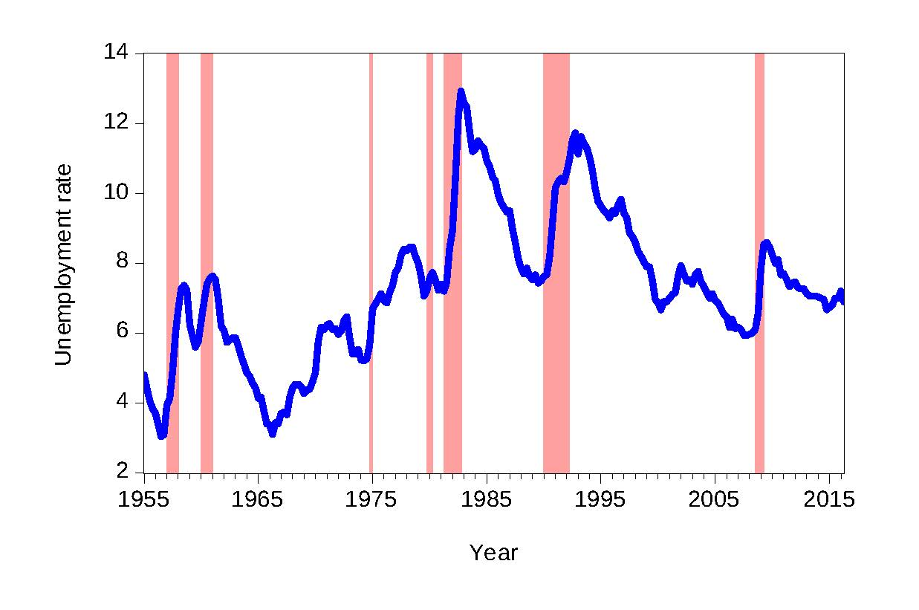
Canada, unemployment rate, 1955-2015
Notes:
The unemployment rate rises during recessions and falls during expansions.
Recession dates for Canada are from the CD Howe: Turning Points: Business Cycles in Canada since 1926, https://www.cdhowe.org/pdf/Commentary_366.pdf
Source: Statistics Canada. Table 380-0064 - Gross domestic product, expenditure-based, quarterly (dollars unless otherwise noted), CANSIM (database)

Slide 7
Time horizons in macroeconomics
Long run
Prices are flexible, respond to changes in supply or demand.
Short run
Many prices are “sticky” at a predetermined level.
The economy behaves much differently when prices are sticky.

Slide 8
Recap of classical macro theory
(Chaps. 3-8)
Output is determined by the supply side:
  supplies of capital, labour
  technology
Changes in demand for goods & services
(C, I, G ) only affect prices, not quantities.
Assumes complete price flexibility.
Applies to the long run.
Notes:
This slide recaps an important lesson from classical theory, which stands in sharp contrast to what we are about to cover now.

Slide 9
When prices are sticky…
…output and employment also depend on demand, which is affected by:
  fiscal policy (G and T )
  monetary policy (M )
  other factors, like exogenous changes in
  C or I

Slide 10
Why are prices sticky?
Alan Blinder, an economist, in a study asked many firms and managers how and why prices are sticky? He found that:
  on average the typical firm adjusts its price once or twice a year
  there are large differences among firms in the frequency of price adjustment.
  among the theories that explain why prices are sticky, coordination failures was cited as the most important reason to explain price stickiness.
Notes:
Chapters 10–12 focus on the closed economy case.
In an open economy, the list of things that affect aggregate demand is a bit longer. (See Chapter 13.)

Slide 11
The model of aggregate demand and supply
The paradigm most mainstream economists
and policymakers use to think about economic fluctuations and policies to stabilize the economy
Shows how the price level and aggregate output are determined
Shows how the economy’s behavior is different
in the short run and long run

Slide 12
Aggregate demand
The aggregate demand curve shows the relationship between the price level and the quantity of output demanded.
Chapters 10–12 develop the theory of aggregate demand in more detail.

Slide 13
Aggregate supply in the long run
Recall from Chap. 3:
In the long run, output is determined by
factor supplies and technology
is the full-employment or natural level of output, at which the economy’s resources are fully employed.
“Full employment” means that
unemployment equals its natural rate (not zero).
Notes:
Some textbooks also use the term “potential GDP” to mean the full-employment level of output.

Slide 14
The long-run aggregate supply curve
P
LRAS
does not depend on P,
so LRAS is vertical.
Y
Notes:
Why the LRAS curve here is vertical, where in microeconomics we have learned that the supply curves were mostly upward-sloping?
“P” on the vertical axis is the economy’s overall price level – the average price of EVERYTHING. A 10% increase in the price level means that, on average, EVERYTHING costs 10% more. Thus, a firm can get 10% more revenue for each unit it sells. But the firm also pays an average of 10% more in wages, prices of intermediate goods, advertising, and so on. Thus, the firm has no incentive to increase output.

Slide 15
Long-run effects of an increase in M
P
LRAS
An increase in M shifts AD to the right.
In the long run, this raises the price level…
P₂
P₁
AD₂
AD₁
…but leaves output the same.
Y
Notes:
[The textbook does a fall in AD (Figure 10-8 on p.297); this slide does an increase.]
Notice that the results in this graph are exactly as we learned in Chapter 5: a change in the money supply affects the price level, but not the quantity of output. Here, we are seeing these results on a graph with different variables on the axes (P and Y).

Slide 16
Aggregate supply in the short run
Many prices are sticky in the short run.
For now (and through Chap. 12), we assume
  all prices are stuck at a predetermined level in the short run.
  firms are willing to sell as much at that price level as their customers are willing to buy.
Therefore, the short-run aggregate supply (SRAS) curve is horizontal:
Notes:
The assumption that all prices are fixed in the short run is extreme. Chapter 14 derives the SRAS curve under more realistic assumptions.
Yet, the extreme assumption here is worth making.
The short-run response of output & employment to policies and shocks is the same (qualitatively) whether the SRAS curve is upward-sloping or horizontal. But the horizontal SRAS curve makes the analysis much simpler: a shift in AD leaves P unchanged in the short run. This greatly simplifies analysis in the IS-LM-AD model (Chapters 11 and 12).
(With an upward-sloping SRAS curve, a shock to the IS and AD curves would change prices in the short run in addition to changing output. The change in prices would change the real money supply, which would shift the LM curve.)

Slide 17
The short-run aggregate supply curve
P
The SRAS curve is horizontal:
The price level is fixed at a predetermined level, and firms sell as much as buyers demand.
SRAS
Y

Slide 18
Short-run effects of an increase in M
P
In the short run when prices are sticky,…
…an increase in aggregate demand…
SRAS
AD₂
AD₁
Y
…causes output to rise.
Y₁
Y₂
Notes:
[The textbook (Figure 10-10 on p.298) does a decrease in AD, this slide does an increase.]
.

Slide 19
The SR & LR effects of ΔM > 0
A = initial equilibrium
P
LRAS
B = new short-run eq’m after Fed increases M
P₂
C
B
SRAS
A
AD₂
AD₁
C = long-run equilibrium
Y
Y₂
Notes:
[The textbook does a decrease in aggregate demand, Figure 10-12 on p.300. This slide presents an increase in aggregate demand.]
This slide puts together the pieces that have been developed over the previous slides: the short-run and long-run effects, as well as the adjustment of prices over time that causes the economy to move from the short-run equilibrium at point B to the long-run equilibrium at C.
The economy starts at point A; output and unemployment are at their natural rates. The Fed increases the money supply, shifting AD to the right. In the short run, prices are sticky, so output rises. The new short-run equilibrium is at point B in the graph.
In order for firms to increase output, they hire more workers, so unemployment falls below the natural rate of unemployment, putting upward pressure on wages. The high level of demand for goods & services at point B puts upward pressure on prices.
Over time, as prices become unstuck, they begin to rise in response to these pressures. The price level rises and the economy moves up its (new) AD curve, from point B toward point C.
This process stops when the economy gets to point C: output again equals the natural rate of output, and unemployment again equals the natural rate of unemployment, so there is no further pressure on prices to change.

Slide 20
How shocking!!!
shocks: exogenous changes in agg. supply or demand
Shocks temporarily push the economy away from full employment.
Example: exogenous decrease in velocity

Slide 21
The effects of a negative demand shock
AD shifts left, depressing output and employment
in the short run.
P
LRAS
B
A
SRAS
Over time, prices fall and the economy moves down its demand curve toward full employment.
C
AD₁
P₂
AD₂
Y
Y₂
Notes:
Note the economy’s self-correction mechanism:
When in a recession, the economy—left to its own devices—fixes itself: the gradual adjustment of prices helps the economy recover from the shock and return to full employment.
Of course, before the economy has finished self-correcting, a period of low output and high unemployment is endured.

Slide 22
Supply shocks
A supply shock alters production costs, affects the prices that firms charge. (also called price shocks)
Examples of adverse supply shocks:
  Bad weather reduces crop yields, pushing up
  food prices.
  Workers unionize, negotiate wage increases.
  New environmental regulations require firms to reduce emissions. Firms charge higher prices to help cover the costs of compliance.
Favorable supply shocks lower costs and prices.

Slide 23
CASE STUDY:
The 1970s oil shocks
Early 1970s: OPEC coordinates a reduction in the supply of oil.
Oil prices rose
11% in 1973
68% in 1974
16% in 1975
Such sharp oil price increases are supply shocks because they significantly impact production costs and prices.
Notes:
Oil is required to heat the factories in which goods are produced, and to fuel the trucks that transport the goods from the factories to the warehouses to Walmart stores. A sharp increase in the price of oil, therefore, has a substantial effect on production costs.

Slide 24
CASE STUDY:
The 1970s oil shocks
The oil price shock shifts SRAS up, causing output and employment to fall.
P
LRAS
B
SRAS₂
In absence of
further price shocks, prices will fall over time and economy moves back toward full employment.
A
A
SRAS₁
AD
Y
Y₂
Notes:
And, as output falls from Ybar to Y2 in the graph, we would expect to see unemployment increase above the natural rate of unemployment.
Note the phrase “in absence of further price shocks.” As we will see shortly, just as the economy was recovering from the first big oil shock, a second one came along.

Slide 25
CASE STUDY:
The 1970s oil shocks
Predicted effects
of the oil shock:
  inflation #
  output $
  unemployment #
…and then a gradual recovery.
Notes:
This slide first summarizes the model’s predictions from the preceding slide, and then presents data (from the text, p.305) that supports the model’s predictions.

Slide 26
CASE STUDY:
The 1970s oil shocks
Late 1970s:
As economy
was recovering,
oil prices shot up again, causing another huge supply shock!
Notes:
Data source: See p.306 of the textbook.
This second shock was associated with the revolution in Iran.

Slide 27
CASE STUDY:
The 1980s oil shocks
1980s:
A favorable supply shock—
a significant fall in oil prices.
As the model predicts,
inflation and unemployment fell.
Notes:
A few slides back, we analyzed the effects of an adverse supply shock. It might be worth noting that the predicted effects of a favorable supply shock are just the opposite: in the short run, the price level (or inflation rate) falls, output rises, and unemployment falls.
Looking at the graph: at first glance, it may seem that the fall in oil prices doesn’t occur until 1986. But remind students to look at the left-hand scale, on which 0 is in the middle, not at the bottom. Oil prices fell about 10% in 1982, and generally fell during most years between 1982 and 1986.

Slide 28
CHAPTER SUMMARY
1. Long run: prices are flexible, output and employment are always at their natural rates, and the classical theory applies.
Short run: prices are sticky, shocks can push output and employment away from their natural rates.
2. Aggregate demand and supply:
a framework to analyze economic fluctuations
27

Slide 29
CHAPTER SUMMARY
3. The aggregate demand curve slopes downward.
4. The long-run aggregate supply curve is vertical, because output depends on technology and factor supplies, but not prices.
5. The short-run aggregate supply curve is horizontal, because prices are sticky at predetermined levels.
28

Slide 30
CHAPTER SUMMARY
6. Shocks to aggregate demand and supply cause fluctuations in GDP and employment in the short run.
29

