Slide 2
Introduction
In the Solow model of Chapter 7,
  the production technology is held constant.
  income per capita is constant in the steady state.
Neither point is true in the real world:
  1900–2015: Canada real GDP per person grew by a factor of 9.26, or 2.17% per year.
  examples of technological progress abound
  (see next slide).

Slide 3
Examples of technological progress
Average yield for corn and wheat has tripled in Canada since 1915.
The real price of computer power has fallen an average of 30% per year over the past three decades.
2000: 361 million Internet users, 740 million cell phone users
2015: 3.1 billion Internet users, 4.9 billion cell phone users
2001: iPod capacity = 5gb, 1000 songs. Not capable of playing episodes of Game of Thrones.
2015: iPod touch capacity = 64gb, 16,000 songs. Can play episodes of Game of Thrones.

Slide 4
Technological progress in the Solow model
A new variable: E = labour efficiency
Assume:
Technological progress is labour-augmenting:
it increases labour efficiency at the exogenous rate g:

Slide 5
Technological progress in the Solow model
We now write the production function as:
where L × E = the number of effective workers.
  Increases in labour efficiency have the
  same effect on output as increases in
  the labour force.

Slide 6
Technological progress in the Solow model
Notation:
y = Y / LE = output per effective worker
k = K / LE = capital per effective worker
Production function per effective worker:
y = f(k)
Saving and investment per effective worker:
s y = s f(k)

Slide 7
Technological progress in the Solow model
(δ + n + g) k = break-even investment:
the amount of investment necessary
to keep k constant.
Consists of:
  δ k to replace depreciating capital
  n k to provide capital for new workers
  g k to provide capital for the new “effective” workers created by technological progress

Slide 8
Technological progress in the Solow model
Investment, break-even investment
Δk = s f(k) − (δ +n +g)k
(δ+n +g ) k
sf(k)
k*
Capital per
worker, k

Slide 9
The Golden Rule with technological progress
To find the Golden Rule capital stock,
express c* in terms of k*:
c* = y* − i*
= f (k* ) − (δ + n + g) k*
c* is maximized when
MPK = δ + n + g
or equivalently,
MPK − δ = n + g
In the Golden
Rule steady state,
the marginal product of capital net of depreciation equals the
pop. growth rate plus the rate of tech progress.

Slide 10
Growth empirics: Balanced growth
Solow model’s steady state exhibits
balanced growth—many variables grow
at the same rate.
  Solow model predicts Y/L and K/L grow at the same rate (g), so K/Y should be constant.
  This is true in the real world.
  Solow model predicts real wage grows at same rate as Y/L, while real rental price is constant.
  Also true in the real world.

Slide 11
Growth empirics: Convergence
Solow model predicts that, other things equal, poor countries (with lower Y/L and K/L) should grow faster than rich ones.
If true, then the income gap between rich & poor countries would shrink over time, causing living standards to converge.
In real world, many poor countries do NOT grow faster than rich ones. Does this mean the Solow model fails?

Slide 12
Growth empirics: Convergence
Solow model predicts that, other things equal, poor countries (with lower Y/L and K/L) should grow faster than rich ones.
No, because “other things” aren’t equal:
  In samples of countries with
  similar savings & pop. growth rates,
  income gaps shrink about 2% per year.
  In larger samples, after controlling for differences in saving, pop. growth, and human capital, incomes converge by about 2% per year.

Slide 13
Growth empirics: Convergence
What the Solow model really predicts is
conditional convergence—countries converge
to their own steady states, which are determined by saving, population growth, and education.
This prediction comes true in the real world.

Slide 14
Growth empirics: Factor accumulation vs. production efficiency
Differences in income per capita among countries can be due to differences in:
  1. capital—physical or human—per worker
  2. the efficiency of production
Studies:
  Both factors are important.
  The two factors are correlated: countries with higher physical or human capital per worker also tend to have higher production efficiency.

Slide 15
Policy issues
Are we saving enough? Too much?
What policies might change the saving rate?
How do a country’s institutions affect production efficiency and capital accumulation?
What policies might encourage faster technological progress?

Slide 16
Policy issues:
Evaluating the rate of saving
Use the Golden Rule to determine whether
Canada’s saving rate and capital stock are
too high, too low, or about right.
  If (MPK − δ) > (n + g ),
  Canadian economy is below the Golden Rule steady state and should increase s.
  If (MPK − δ) < (n + g ),
  Canadian economy is above the Golden Rule steady state and should reduce s.

Slide 17
Policy issues:
Evaluating the rate of saving
To estimate (MPK − δ), use three facts about Canada’s economy:
  1. k = 2.y
  The capital stock is roughly twice the size of one year’s GDP.
  2. δk = 0.1 y
  About 10% of GDP is used to replace depreciating capital.
  3. MPK × k = 0.25 y
  Capital income is about 25% of GDP.

Slide 18
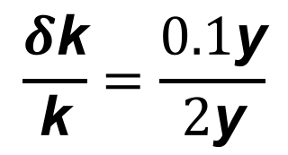
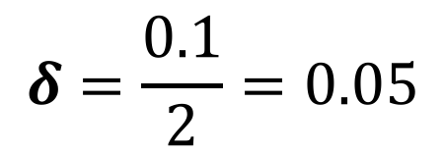
Policy issues:
Evaluating the rate of saving
1. k = 2 y
2. δk = 0.1 y
3. MPK × k = 0.25 y
To determine δ, divide 2 by 1:
$$δ=\frac{0.1}{2}=0.05$$
$$\frac{δ\text{k}}{\text{k}}=\frac{0.1\text{y}}{2\text{y}}$$

Slide 19

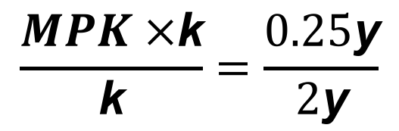
Policy issues:
Evaluating the rate of saving
1. k = 2 y
2. δk = 0.1 y
3. MPK × k = 0.25 y
To determine MPK, divide 3 by 1:
$$\frac{MPK ×\text{k}}{\text{k}}=\frac{0.25\text{y}}{2\text{y}}$$
$$MPK=\frac{0.25}{2}=0.125$$
Hence, MPK − δ = 0.125 − 0.05 = 0.075

Slide 20
Policy issues:
Evaluating the rate of saving
From the last slide: MPK − δ = 0.075
Canada real GDP grows an average of 3% per year,
so n + g = 0.03
Thus,
MPK − δ = 0.075 > 0.03 = n + g
Conclusion:
Canada is below the Golden Rule steady state:
Increasing Canada’s saving rate would increase consumption per capita in the long run.

Slide 21
Policy issues:
How to increase the saving rate
Reduce the government budget deficit
(or increase the budget surplus).
Increase incentives for private saving:
  Reduce capital gains tax, corporate income tax, estate tax, as they discourage saving.
  Replace federal income tax with a consumption tax.
  Expand tax incentives for RRSP (individual retirement accounts) and other retirement savings accounts such as TFSA.

Slide 22
Policy issues:
How to increase the saving rate
Other incentives for increasing savings include the exemption from income taxes on capital gains and the introduction of the GST.
Exemption from income taxes on capital gains were removed in 1994.
The rationale behind the GST is that consumption taxes stimulate savings.
Individuals can avoid paying the sales tax by saving.

Slide 23
Policy issues:
Establishing the right institutions
Creating the right institutions is important for ensuring that resources are allocated to their best use. Examples:
  Legal institutions, to protect property rights.
  Capital markets, to help financial capital flow to the best investment projects.
  A corruption-free government, to promote competition, enforce contracts, etc.

