Slide 2

Money: Definition
Money is the stock
of assets that can be readily used to make transactions.

Slide 3
Money: Functions
Medium of exchange
we use it to buy stuff
Store of value
transfers purchasing power from the present to the future
Unit of account
the common unit by which everyone measures prices and values

Slide 4
Money: Types
1. Fiat money
  has no intrinsic value
  example: the paper currency we use
2. Commodity money
  has intrinsic value
  examples:
  gold coins,
  cigarettes in P.O.W. camps

Slide 5
NOW YOU TRY
Discussion Question
Which of these are money?
  a. Currency
  b. Checks
  c. Deposits in checking accounts
  (“demand deposits”)
  d. Credit cards
  e. Certificates of deposit
  (“time deposits”)
4

Slide 6
Two definitions
The money supply is the quantity of money available in the economy.
Monetary policy is the control over the money supply.
In Canada and many other countries, monetary policy is conducted by the central bank.
Some central banks are completely independent of government’s influence while others are not.

Slide 7
The central bank and monetary control
Bank of Canada was created in 1935.
The Bank of Canada (BoC) is Canada’s central bank.
The Governor of the Bank of Canada is appointed for seven year term by the federal cabinet.
The Governor and the Ministry of Finance decides on the mandate of the Bank of Canada.

Slide 8
Money supply
Money is a stock of assets used for transactions.
The quantity of money is the quantity of those assets.
For example, in the POW, the quantity of money was the number of cigarettes. This was easy to compute.
However, in the real world, measuring money is more complex

Slide 9
Money supply
Measuring money is complex because people use different assets to transact.
Currency is used as a medium of exchange.
Demand deposits, that is funds people hold in their chequing accounts are also used for transactions.
The quantity of money is therefore the sum of currency and demand deposits.

Slide 10
Money supply
Many other assets can be transferred to chequing accounts.
For example, people can transfer funds from their savings accounts to their chequing accounts.
Because it is hard to measure money, the Bank of Canada use different measures of Money.

Slide 11
Money supply measures, May 2016
symbol
assets included
amount
($ billions)
C
Currency
75.9
M1
C + demand deposits,
travelers’ checks,
other checkable deposits
755.8
M2
M1 + small time deposits,
savings deposits,
money market mutual funds,
money market deposit accounts
1421.9

Slide 12
The quantity theory of money
How is the quantity of money related to the level of income, prices or its rate of growth?
A simple theory linking the inflation rate to the growth rate of the money supply.
Begins with the concept of velocity…

Slide 13
Velocity
Basic concept: the rate at which money circulates
Definition: the number of times the average dollar bill changes hands in a given time period
Example: In 2015,
  $500 billion in transactions
  money supply = $100 billion
  The average dollar is used in five transactions in 2015
  So, velocity = 5

Slide 14
Velocity (continued)
This suggests the following definition:
where
V = velocity
T = value of all transactions
M = money supply

Slide 15
Velocity (continued)
Use nominal GDP as a proxy for total transactions.
Then,
where
P = price of output (GDP deflator)
Y = quantity of output (real GDP)
P × Y = value of output (nominal GDP)

Slide 16
The quantity equation
The quantity equation
M × V = P × Y
follows from the preceding definition of velocity.
It is an identity:
it holds by definition of the variables.

Slide 17
Money demand and the quantity equation
M/P = real money balances, the purchasing power of the money supply.
A simple money demand function:
(M/P )^{d} = k Y
where
k = how much money people wish to hold for each dollar of income.
(k is exogenous)

Slide 18
Money demand and the quantity equation
Money demand: (M/P )^{d} = k Y
Quantity equation: M × V = P × Y
The connection between them: k = 1/V
When people hold lots of money relative
to their incomes (k is large), money changes hands infrequently (V is small).

Slide 19
Back to the quantity theory of money
Starts with quantity equation
Assumes V is constant & exogenous:
Then, quantity equation becomes:

Slide 20
The quantity theory of money (continued)
How the price level is determined:
  With V constant, the money supply determines nominal GDP (P × Y ).
  Real GDP is determined by the economy’s supplies of K and L and the production function (Chapter 3).
  The price level is
  P = (nominal GDP)/(real GDP).

Slide 21
The quantity theory of money (continued)
Recall from Chapter 2:
The growth rate of a product equals
the sum of the growth rates.
The quantity equation in growth rates:

Slide 22
The quantity theory of money (continued)
π (Greek letter pi )
denotes the inflation rate:
The result from the
preceding slide:
Solve this result
for π:

Slide 23
The quantity theory of money (continued)
Normal economic growth requires a certain amount of money supply growth to facilitate the growth in transactions.
Money growth in excess of this amount leads to inflation.

Slide 24
The quantity theory of money (continued)
ΔY/Y depends on growth in the factors of
production and on technological progress
(all of which we take as given, for now).
Hence, the quantity theory predicts
a one-for-one relation between
changes in the money growth rate and
changes in the inflation rate.

Slide 25
Confronting the quantity theory with data
The quantity theory of money implies:
  1. Countries with higher money growth rates
  should have higher inflation rates.
  2. The long-run trend in a country’s inflation rate should be similar to the long-run trend in the country’s money growth rate.
Are the data consistent with these implications?

Slide 26
International data on inflation and money growth
Inflation rate
(percent)
Money supply growth
(percent)

Slide 27
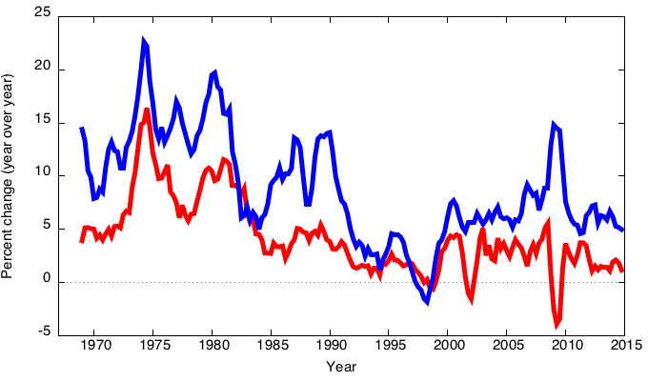
Canada inflation and money growth,
1969-2015
M2 growth rate
Inflation

Slide 28
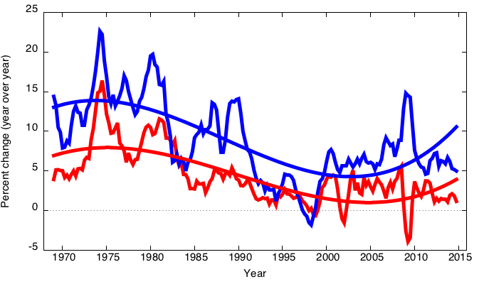
Canada inflation and money growth,
1969-2015
Inflation and money growth
have the same long-run trends,
as the quantity theory predicts.

Slide 29
Inflation and interest rates
Nominal interest rate, i
not adjusted for inflation
Real interest rate, r
adjusted for inflation:
r = i − π

Slide 30
The Fisher effect
The Fisher equation: i = r + π
Chapter 3: S = I determines r .
Hence, an increase in π causes an equal increase in i.
This one-for-one relationship is called the Fisher effect.

Slide 31
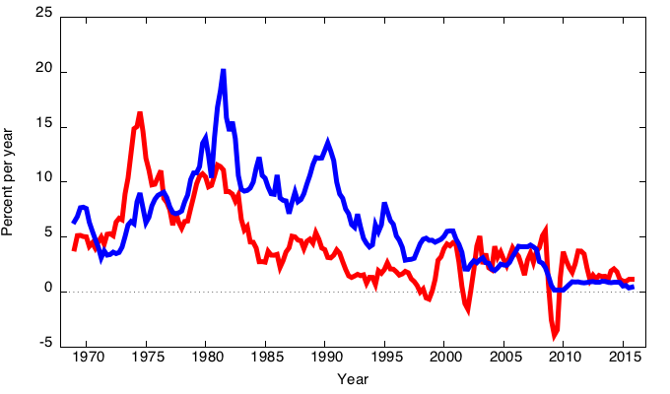
Canada inflation and nominal interest rates, 1969-2015
Nominal interest rate
Inflation rate

Slide 32
Inflation and nominal interest rates in 100 countries
Nominal
interest rate
(percent)
Turkey
Inflation rate (percent)

Slide 33
NOW YOU TRY
Applying the theory
Suppose V is constant, M is growing 5% per year,
Y is growing 2% per year, and r = 4.
  a. Solve for i.
  b. If the BoC increases the money growth rate by 2 percentage points per year, find Δi.
  c. Suppose the growth rate of Y falls to 1% per year.
    What will happen to π?
    What must the BoC do if it wishes to
    keep π constant?
32

Slide 34
ANSWERS
Applying the theory
V is constant, M grows 5% per year,
Y grows 2% per year, r = 4.
  a. First, find π = 5 − 2 = 3.
  Then, find i = r + π = 4 + 3 = 7.
  b. Δi = 2, same as the increase in the money growth rate.
  c. If the BoC does nothing, Δπ = 1.
  To prevent inflation from rising, the BoC must reduce the money growth rate by 1 percentage point per year.
33

Slide 35
Two real interest rates
Notation:
π = actual inflation rate
(not known until after it has occurred)
Eπ = expected inflation rate
Two real interest rates:
i – Eπ = ex ante real interest rate:
the real interest rate people expect at the time they buy a bond or take out a loan
i – π = ex post real interest rate:
the real interest rate actually realized

Slide 36
Money demand and the nominal interest rate
In the quantity theory of money,
the demand for real money balances
depends only on real income Y.
Another determinant of money demand:
the nominal interest rate, i.
  the opportunity cost of holding money (instead of bonds or other interest-earning assets).
So, money demand depends negatively on i.

Slide 37
The money demand function
(M/P )^{d} = real money demand, depends
  negatively on i
    i is the opp. cost of holding money
  positively on Y
    higher Y increases spending on g&s,
    so increases need for money
(“L” is used for the money demand function because money is the most liquid asset.)

Slide 38
The money demand function
When people are deciding whether to hold money or bonds, they don’t know what inflation will turn out to be.
Hence, the nominal interest rate relevant for money demand is r + Eπ.

Slide 39
Equilibrium
The supply of real money balances
Real money demand

Slide 40
What determines what?
variable how determined (in the long run)
M exogenous (the BoC)
r adjusts to ensure S = I
Y
P adjusts to ensure

Slide 41
How P responds to ΔM
For given values of r, Y, and Eπ ,
a change in M causes P to change by the same percentage—just like in the quantity theory of money.

Slide 42
What about expected inflation?
Over the long run, people don’t consistently
over- or under-forecast inflation,
so Eπ = π on average.
In the short run, Eπ may change when people
get new information.
E.g.: The BoC announces it will increase M
next year. People will expect next year’s P to be higher, so Eπ rises.
This affects P now, even though M hasn’t changed yet...

Slide 43
How P responds to ΔE π
For given values of r, Y, and M ,

Slide 44
The classical view of inflation
The classical view:
A change in the price level is merely a change in the units of measurement.
Then, why is inflation
a social problem?

Slide 45
The social costs of inflation
…fall into two categories:
1. costs when inflation is expected
2. costs when inflation is different than people had expected

Slide 46
The costs of expected inflation:
1. Shoe leather Cost
Definition: the costs and inconveniences of reducing money balances to avoid the inflation tax.
If π increases, i increases (why?),
so people reduce their real money balances.
Remember: In long run, inflation does not
affect real income or real spending.
So, same monthly spending but lower average money holdings means more frequent trips to the bank to withdraw smaller amounts of cash.

Slide 47
The costs of expected inflation:
2. Menu Costs
Definition: The costs of changing prices.
Examples:
  cost of printing new menus
  cost of printing & mailing new catalogs
The higher is inflation, the more frequently firms must change their prices and incur these costs.

Slide 48
The costs of expected inflation:
3. Relative Price Distortions
Firms facing menu costs change prices infrequently.
Example:
A firm issues new catalog each January.
As the general price level rises throughout the year, the firm’s relative price will fall.
Different firms change their prices at different times, leading to relative price distortions . . .
. . . causing microeconomic inefficiencies in the allocation of resources.

Slide 49
The costs of expected inflation:
4. Unfair Tax Treatment
Some taxes are not adjusted to account for inflation, such as the capital gains tax.
Example:
  Jan 1: you buy $10,000 worth of BCE stock
  Dec 31: you sell the stock for $11,000,
  so your nominal capital gain is $1,000 (10%).
  Suppose π = 10% during the year.
  Your real capital gain is $0.
  Yet, you must pay taxes on your $1,000 nominal gain!

Slide 50
The costs of expected inflation:
5. General Inconvenience
Inflation makes it harder to compare nominal values from different time periods.
This complicates long-range financial planning.

Slide 51
Additional cost of unexpected inflation:
Arbitrary Redistribution of Purchasing Power
Many long-term contracts not indexed,
but based on Eπ.
If π turns out different from Eπ , then some gain at others’ expense.
Example: borrowers & lenders
  If π > Eπ , then (i − π) < (i − Eπ )
  and purchasing power is transferred from lenders to borrowers.
  If π < E π, then purchasing power is transferred from borrowers to lenders.

Slide 52
Additional cost of high inflation:
Increased Uncertainty
When inflation is high, it’s more variable and unpredictable:
π turns out different from Eπ more often,
and the differences tend to be larger,
though not systematically positive or negative.
So, arbitrary redistributions of wealth more likely.
This increases uncertainty, making risk-averse people worse off.

Slide 53
One benefit of inflation
Nominal wages are rarely reduced, even when the equilibrium real wage falls.
This hinders labour market clearing.
Inflation allows the real wages to reach equilibrium levels without nominal wage cuts.
Therefore, moderate inflation improves the functioning of labour markets.

Slide 54
Hyperinflation
Common definition: π ≥ 50% per month
All the costs of moderate inflation described
above become HUGE under hyperinflation.
Money ceases to function as a store of value, and may not serve its other functions (unit of account, medium of exchange).
People may conduct transactions with barter or a stable foreign currency.

Slide 55
What causes hyperinflation?
Hyperinflation is caused by excessive money supply growth.
When the central bank prints money, the price level rises.
If it prints money rapidly enough, the result is hyperinflation.

Slide 56
A few examples of hyperinflation
country | period | CPI Inflation % per year | M2 Growth % per year
Israel | 1983-85 | 338% | 305%
Brazil | 1987-94 | 1,256 | 1,451
Bolivia | 1983-86 | 1,818 | 1,727
Ukraine | 1992-94 | 2,089 | 1,029
Argentina | 1988-90 | 2,671 | 1,583
Dem. Republic of Congo / Zaire | 1990-96 | 3,039 | 2,373
Angola | 1995-96 | 4,145 | 4,106
Peru | 1988-90 | 5,050 | 3,517
Zimbabwe | 2005-07 | 5,316 | 9,914

Slide 57
Why governments create hyperinflation
When a government cannot raise taxes or sell bonds, it must finance spending increases by printing money.
In theory, the solution to hyperinflation is simple: stop printing money.
In the real world, this requires drastic and painful fiscal restraint.

Slide 58
The classical dichotomy
Real variables: Measured in physical units—quantities and relative prices, for example:
  quantity of output produced
  real wage: output earned per hour of work
  real interest rate: output earned in the future
  by lending one unit of output today
Nominal variables: Measured in money units, e.g.,
  nominal wage: Dollars per hour of work.
  nominal interest rate: Dollars earned in future
  by lending one dollar today.
  the price level: The amount of dollars needed
  to buy a representative basket of goods.

Slide 59
The classical dichotomy
Recall: Real variables were explained in Chapter 3, nominal ones in Chapter 5.
Classical dichotomy:
the theoretical separation of real and nominal variables in the classical model, which implies nominal variables do not affect real variables.
Neutrality of money: Changes in the money supply do not affect real variables.
In the real world, money is approximately neutral in the long run.

Slide 60
CHAPTER SUMMARY
Velocity: the ratio of nominal expenditure to money supply, the rate at which money changes hands
Quantity theory of money
  assumes velocity is constant
  concludes that the money growth rate determines the inflation rate
  applies in the long run
  consistent with cross-country and time-series data
59

Slide 61
CHAPTER SUMMARY
Nominal interest rate
  equals real interest rate + inflation rate
  the opp. cost of holding money
Fisher effect: Nominal interest rate moves
one-for-one with expected inflation.
Money demand
  depends only on income in the quantity theory
  also depends on the nominal interest rate
  if so, then changes in expected inflation affect the current price level
60

Slide 62
CHAPTER SUMMARY
Costs of inflation
Expected inflation
shoe leather costs, menu costs,
tax & relative price distortions,
inconvenience of correcting figures for inflation
Unexpected inflation
all of the above plus arbitrary redistributions of wealth between debtors and creditors
61

Slide 63
CHAPTER SUMMARY
Hyperinflation
caused by rapid money supply growth when money printed to finance govt budget deficits
stopping it requires fiscal reforms to eliminate
govt’s need for printing money
62

Slide 64
CHAPTER SUMMARY
Classical dichotomy
In classical theory, money is neutral—does not affect real variables.
So, we can study how real variables are determined w/o reference to nominal ones.
Then, money market eq’m determines price level and all nominal variables.
Most economists believe the economy works this way in the long run.
63

