Slide 2
IN THIS CHAPTER, YOU WILL LEARN:
What determines the economy’s total output/income
How the prices of the factors of production are determined
How total income is distributed
What determines the demand for goods and services
How equilibrium in the goods market is achieved
1

Slide 3
Outline of model
A closed economy, market-clearing model
Supply side
  factor markets (supply, demand, price)
  determination of output/income
Demand side
  determinants of C, I, and G
Equilibrium
  goods market
  loanable funds market

Slide 4
Factors of production
K = capital:
tools, machines, and structures used in production
L = labour:
the physical and mental efforts of workers

Slide 5
The production function: Y = F (K , L)
Shows how much output (Y ) the economy can produce from K units of capital and L units of labour
Reflects the economy’s level of technology
Exhibits constant returns to scale

Slide 6
Returns to scale: a review
Initially Y₁ = F (K₁ , L₁ )
Scale all inputs by the same factor z:
K₂ = zK₁ and L₂ = zL₁
(e.g., if z = 1.2, then all inputs are increased by 20%)
What happens to output, Y₂ = F (K₂, L₂ )?
If constant returns to scale, Y₂ = zY₁
If increasing returns to scale, Y₂ > zY₁
If decreasing returns to scale, Y₂ < zY₁

Slide 7
Returns to scale: Example 1
constant returns to scale for any z > 0

Slide 8
Returns to scale: Example 2
increasing returns to scale for any
z > 1

Slide 9
NOW YOU TRY
Returns to scale
Determine whether each of these production functions has constant, decreasing, or increasing returns to scale:
(a)
(b)
8

Slide 10
NOW YOU TRY
Answers, Part (a)
constant returns to scale for any z > 0
9

Slide 11
NOW YOU TRY
Answers, Part (b)
constant returns to scale for any z > 0
10

Slide 12
Assumptions
Technology is fixed.
The economy’s supplies of capital and labour are fixed at:

Slide 13
Determining GDP
Output is determined by the fixed factor supplies and the fixed state of technology:

Slide 14
The distribution of national income
determined by factor prices,
the prices per unit firms pay for the factors of production
  wage = price of L
  rental rate = price of K

Slide 15
Notation
W = nominal wage
R = nominal rental rate
P = price of output
W /P = real wage
(measured in units of output)
R /P = real rental rate

Slide 16
How factor prices are determined
Factor prices are determined by supply and demand in factor markets.
Recall: Supply of each factor is fixed.
What about demand?

Slide 17
Demand for labour
Assume markets are competitive:
each firm takes W, R, and P as given.
Basic idea:
A firm hires each unit of labour
if the cost does not exceed the benefit.
  cost = real wage
  benefit = marginal product of labour

Slide 18
Marginal product of labour (MPL )
Definition:
The extra output the firm can produce
using an additional unit of labour
(holding other inputs fixed):
MPL = F (K, L +1) – F (K, L)

Slide 19
NOW YOU TRY
Compute & graph MPL
L Y MPL
0 0 n.a.
1 10 ?
2 19 ?
3 27 8
4 34 ?
5 40 ?
6 45 ?
7 49 ?
8 52 ?
9 54 ?
10 55 ?
a. Determine MPL at each
value of L.
b. Graph the production
function.
c. Graph the MPL curve with
MPL on the vertical axis and
L on the horizontal axis.
18

Slide 20
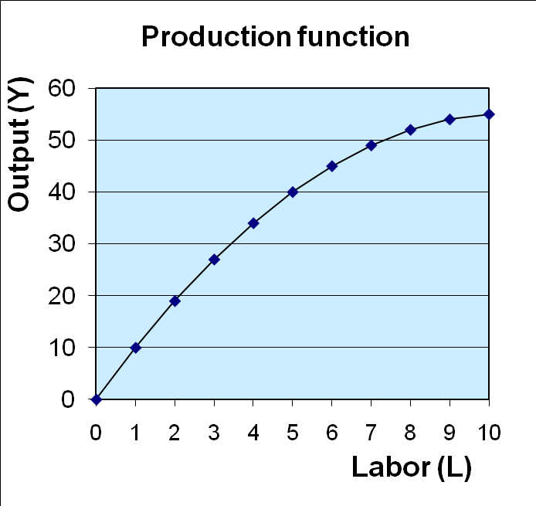
ANSWERS
Compute & graph MPL
19

Slide 21
MPL and the production function
Y
output
As more labour is added, MPL falls
MPL
1
MPL
1
Slope of the production function equals MPL
MPL
1
L
labour

Slide 22
Diminishing marginal returns
As one input is increased (holding other inputs constant), its marginal product falls.
Intuition:
If L increases while holding K fixed
  machines per worker falls,
  worker productivity falls.

Slide 23
NOW YOU TRY
Identifying diminishing returns
Which of these production functions have diminishing marginal returns to labour?
22

Slide 24
ANSWERS
Identifying diminishing returns
No, MPL = 15 for all L
Yes, MPL falls as L rises
Yes, MPL falls as L rises
23

Slide 25
NOW YOU TRY
MPL and labour demand
L Y MPL
0 0 n.a.
1 10 10
2 19 9
3 27 8
4 34 7
5 40 6
6 45 5
7 49 4
8 52 3
9 54 2
10 55 1
Suppose W/P = 6.
If L = 3, should firm hire more or less labour? Why?
If L = 7, should firm hire more or less labour? Why?
24

Slide 26
ANSWERS
MPL and labour demand
L Y MPL
0 0 n.a.
1 10 10
2 19 9
3 27 8
4 34 7
5 40 6
6 45 5
7 49 4
8 52 3
9 54 2
10 55 1
If L = 3, should firm hire more or less labour?
Answer: MORE, because the benefit of the 4th worker (MPL = 7) exceeds its cost (W/P = 6)
If L = 7, should firm hire more or less labour?
Answer: LESS, because the 7th worker adds MPL = 4 units of output but costs the firm W/P = 6.
25

Slide 27
MPL and the demand for labour
Units of output
Each firm hires labour
up to the point where MPL = W/P.
Real wage
MPL, labour demand
Units of labour, L
Quantity of labour demanded

Slide 28
The equilibrium real wage
Units of output
labour
supply
The real wage adjusts to equate
labour demand with supply.
Equilibrium real wage
MPL, labour demand
Units of labour, L

Slide 29
Determining the rental rate
We have just seen that MPL = W/P.
The same logic shows that MPK = R/P:
  Diminishing returns to capital:
  MPK falls as K rises
  The MPK curve is the firm’s demand curve
  for renting capital.
  Firms maximize profits by choosing K
  such that MPK = R/P.

Slide 30
The equilibrium real rental rate
Units of output
Supply of capital
The real rental rate adjusts to equate
demand for capital with supply.
equilibrium R/P
MPK, demand for capital
Units of capital, K

Slide 31
The neoclassical theory of distribution
States that each factor input is paid its marginal product
A good starting point for thinking about income distribution

Slide 32
How income is distributed to L and K
Total labour income =
Total capital income =
If production function has constant returns to scale, then
national
income
labour
income
capital
income

Slide 33
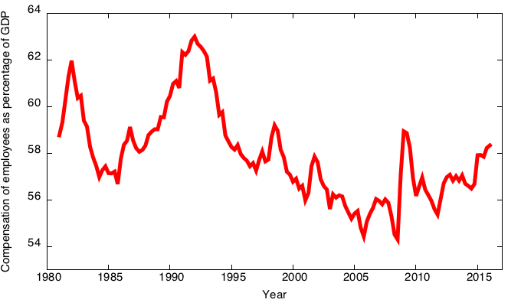
Labour income as a percentage of GDP, Canada 1981-2015

Slide 34
The Cobb-Douglas production function
The Cobb-Douglas production function has constant factor shares:
α = capital’s share of total income:
  capital income = MPK × K = αY
  labour income = MPL × L = (1 – α )Y
The Cobb-Douglas production function is:
where A represents the level of technology.

Slide 35
The Cobb-Douglas production function
Each factor’s marginal product is proportional to its average product:

Slide 36
Annual growth in labour productivity and real wages
Theory: wages depend on labour productivity
Time period | Labour productivity growth | Real wage growth
1961-2007 | 1.7% | 1.7%
1961-1973 | 3.0% | 3.9%
1973-1981 | 1.3% | 1.4%
1981-1989 | 1.2% | 0.3%
1989-2000 | 1.5% | 0.8%
2000-2007 | 1.0% | 1.2%

Slide 37
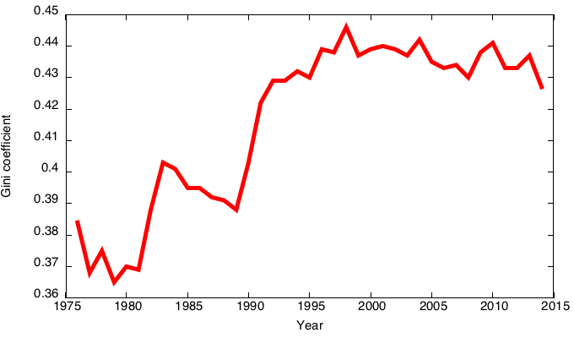
The growing gap between rich & poor in Canada
A rise in the Gini coefficient indicates an increase in inequality
Gini coefficient

Slide 38
Explanations for rising inequality
1. Rise in capital’s share of income, since capital income is more concentrated than labour income
2. From The Race Between Education and Technology by Goldin & Katz
  Technological progress has increased the demand for skilled relative to unskilled workers.
  Due to a slowdown in expansion of education, the supply of skilled workers has not kept up.
  Result: Rising gap between wages of skilled and unskilled workers.

Slide 39
Outline of model
A closed economy, market-clearing model
Supply side
  factor markets (supply, demand, price)
  determination of output/income
Demand side
  determinants of C, I, and G
Equilibrium
  goods market
  loanable funds market
DONE ✓
DONE ✓
Next ➔

Slide 40
Demand for goods and services
Components of aggregate demand:
  C = consumer demand for g&s
  I = demand for investment goods
  G = government demand for g&s
  (closed economy: no NX )

Slide 41
Consumption, C
Disposable income is total income minus total taxes: Y – T.
Consumption function: C = C (Y – T )
Definition: Marginal propensity to consume (MPC) is the change in C when disposable income increases by one dollar.

Slide 42
The consumption function
C
C (Y –T )
The slope of the consumption function is the MPC.
MPC
1
Y – T

Slide 43
Investment, I
The investment function is I = I (r )
where r denotes the real interest rate,
the nominal interest rate corrected for inflation.
The real interest rate is:
  the cost of borrowing
  the opportunity cost of using one’s own funds to finance investment spending
So, I depends negatively on r

Slide 44
The investment function
r
Spending on investment goods
depends negatively on the real interest rate.
I (r )
I

Slide 45
Government spending, G
G = govt spending on goods and services
G excludes transfer payments
(e.g., Social Security benefits,
unemployment insurance benefits)
Assume government spending and total taxes are exogenous:

Slide 46
The market for goods & services
Aggregate demand:
Aggregate supply:
Equilibrium:
The real interest rate adjusts
to equate demand with supply.

Slide 47
The loanable funds market
A simple supply–demand model of the financial system.
One asset: “loanable funds”
  demand for funds: investment
  supply of funds: saving
  “price” of funds: real interest rate

Slide 48
Demand for funds: investment
The demand for loanable funds . . .
  comes from investment:
  Firms borrow to finance spending on plant & equipment, new office buildings, etc. Consumers borrow to buy new houses.
  depends negatively on r,
  the “price” of loanable funds
  (cost of borrowing).

Slide 49
Loanable funds demand curve
r
The investment curve is also the demand curve for loanable funds.
I (r )
I

Slide 50
Supply of funds: saving
The supply of loanable funds comes from saving:
  Households use their saving to make bank deposits, purchase bonds and other assets. These funds become available to firms to borrow and finance investment spending.
  The government may also contribute to saving
  if it does not spend all the tax revenue it receives.

Slide 51
Types of saving
Private saving = (Y – T ) – C
Public saving = T – G
National saving, S
  = private saving + public saving
  = (Y –T ) – C + T – G
  = Y – C – G

Slide 52
Notation: Δ = change in a variable
For any variable X, ΔX = “change in X ”
Δ is the Greek (uppercase) letter Delta
Examples:
If ΔL = 1 and ΔK = 0, then ΔY = MPL.
More generally, if ΔK = 0, then
Δ(Y − T ) = ΔY − ΔT , so
ΔC = MPC × (ΔY − ΔT )
= MPC ΔY − MPC ΔT

Slide 53
NOW YOU TRY
Calculate the change in saving
Suppose MPC = 0.8 and MPL = 20.
For each of the following, compute ΔS :
  a. ΔG = 100
  b. ΔT = 100
  c. ΔY = 100
  d. ΔL = 10
52

Slide 54
ANSWERS
Calculate the change in saving
53

Slide 55
Budget surpluses and deficits
If T > G, budget surplus = (T – G )
= public saving.
If T < G, budget deficit = (G – T )
and public saving is negative.
If T = G , balanced budget, public saving = 0.
The U.S. government finances its deficit by issuing Treasury bonds–i.e., borrowing.

Slide 56
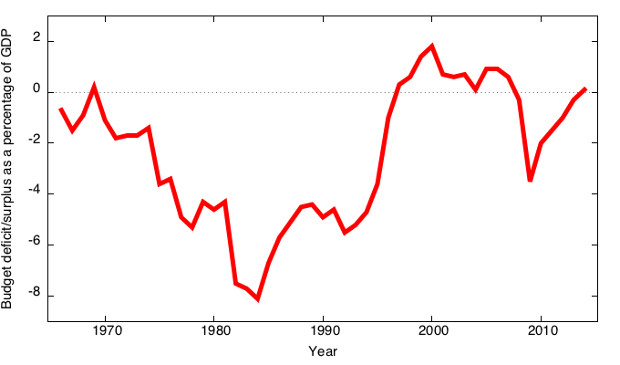
Canada government surplus/deficit,
1961-2014

Slide 57
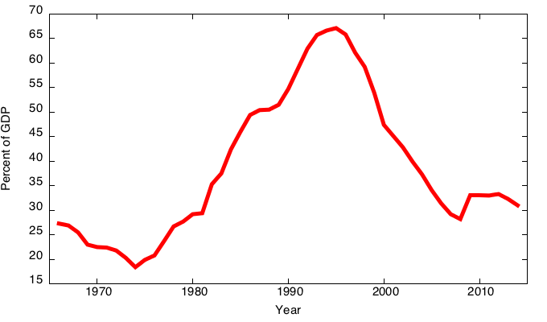
Canada government debt to GDP ratio,
1965-2014

Slide 58
Loanable funds supply curve
r
National saving does not depend on r,
so the supply curve is vertical.
S, I

Slide 59
Loanable funds market equilibrium
r
Equilibrium real interest rate
I (r )
Equilibrium level of investment
S, I

Slide 60
The special role of r
r adjusts to equilibrate the goods market and the loanable funds market simultaneously:
If L.F. market in equilibrium, then
Y – C – G = I
Add (C +G ) to both sides to get
Y = C + I + G (goods market eq’m)
Thus,
Eq’m in L.F. market
Eq’m in goods market

Slide 61
Digression: mastering models
To master a model, be sure to know:
1. Which of its variables are endogenous and which are exogenous.
2. For each curve in the diagram, know:
  a. definition
  b. intuition for slope
  c. all the things that can shift the curve
3. Use the model to analyze the effects of each item in 2c.

Slide 62
Mastering the loanable funds model
Things that shift the saving curve:
  public saving
    fiscal policy: changes in G or T
  private saving
    preferences
    tax laws that affect saving
      401(k)
      IRA
      replace income tax with consumption tax

Slide 63
CASE STUDY:
The 2008-2009 fiscal stimulus surplus
In response to the financial crisis in 2009, the Govt of Canada introduced its “Action Plan” and increased expenditure by a large amount.
  increases in program spending: ΔG > 0
This policy reduces national saving:

Slide 64
CASE STUDY:
The 2008-2009 fiscal stimulus surplus
1. The increase in the deficit reduces saving…
r
r₂
2. …which causes the real interest rate to rise…
r₁
3. …which reduces the level of investment.
I (r )
I₂
I₁
S, I

Slide 65
NOW YOU TRY
The effects of saving incentives
Draw the diagram for the loanable funds model.
Suppose the tax laws are altered to provide more incentives for private saving.
(Assume that total tax revenue T does not change)
What happens to the interest rate and investment?
64

Slide 66
Mastering the loanable funds model (continued)
Things that shift the investment curve:
  some technological innovations
    to take advantage of some innovations,
    firms must buy new investment goods
  tax laws that affect investment
    e.g., investment tax credit

Slide 67
An increase in investment demand
r
…raises the interest rate.
An increase
in desired investment…
r₂
r₁
But the equilibrium level of investment cannot increase because the
supply of loanable
funds is fixed.
I₂
I₁
S, I

Slide 68
Saving and the interest rate
Why might saving depend on r ?
How would the results of an increase in investment demand be different?
  Would r rise as much?
  Would the equilibrium value of I change?

Slide 69
An increase in investment demand when saving depends on r
r
An increase in investment demand raises r,
which induces an increase in the quantity of saving,
which allows I
to increase.
r₂
r₁
I(r)₂
I(r)
I₁
I₂
S, I

Slide 70
CHAPTER SUMMARY
Total output is determined by:
  the economy’s quantities of capital and labour
  the level of technology
Competitive firms hire each factor until its marginal product equals its price.
If the production function has constant returns to scale, then labour income plus capital income equals total income (output).
69

Slide 71
CHAPTER SUMMARY
A closed economy’s output is used for consumption, investment, and government spending.
The real interest rate adjusts to equate
the demand for and supply of:
  goods and services.
  loanable funds.
70

Slide 72
CHAPTER SUMMARY
A decrease in national saving causes the interest rate to rise and investment to fall.
An increase in investment demand causes the interest rate to rise but does not affect the equilibrium level of investment if the supply of loanable funds is fixed.
71

