Slide 2
Gross Domestic Product:
Expenditure and Income
Two definitions:
  Total expenditure on domestically produced
  final goods and services.
  Total income earned by domestically located
  factors of production.
Expenditure equals income because
every dollar a buyer spends
becomes income to the seller.

Slide 3
The Circular Flow
Income ($)
Labour
Households
Firms
Goods
Expenditure ($)

Slide 4
Value added
Value added: The value of output minus
the value of the intermediate goods
used to produce that output

Slide 5
NOW YOU TRY
Identifying value added
A farmer grows a bushel of wheat
and sells it to a miller for $1.00.
The miller turns the wheat into flour
and sells it to a baker for $3.00.
The baker uses the flour to make a loaf of
bread and sells it to an engineer for $6.00.
The engineer eats the bread.
Compute value added at each stage
of production and GDP.
4

Slide 6
Final goods, value added, and GDP
GDP = value of final goods produced
= sum of value added at all stages of production.
The value of the final goods already includes the value of the intermediate goods, so including intermediate and final goods in GDP would be double counting.

Slide 7
The expenditure components of GDP
consumption, C
investment, I
government spending, G
net exports, NX
An important identity:
Y = C + I + G + NX
value of total output
aggregate expenditure

Slide 8
Consumption (C)
Definition: The value of all goods and services bought by households. Includes:
  Durable goods
  last a long time.
  E.g., cars, home appliances
  Nondurable goods
  last a short time.
  E.g., food, clothing
  Services
  are intangible items purchased by consumers.
  E.g., dry cleaning,
  air travel

Slide 9
Canada Consumption, 2015
$ billions
% of GDP
Consumption
998
56.5
Durables and Semi Durables
226
12.8
Nondurables
230
13.0
Services
543
30.7

Slide 10
Investment (I)
Spending on capital, a physical asset used in future production
Includes:
  Business fixed investment
  Spending on plant and equipment
  Residential fixed investment
  Spending by consumers and landlords on housing units
  Inventory investment
  The change in the value of all firms’ inventories

Slide 11
Canada Investment, 2015
$ billions
% of GDP
Investment
445
25.2
Business fixed
320
18.1
Residential
121
6.8
Inventory
4
0.2

Slide 12
Investment vs. capital
Note: Investment is spending on new capital.
Example (assumes no depreciation):
  1/1/2016:
  Economy has $10 trillion worth of capital
  During 2016:
  Investment = $2 trillion
  1/1/2017:
  Economy will have $12 trillion worth of capital

Slide 13
Stocks vs. Flows
Flow
Stock
A stock is a
quantity measured
at a point in time.
E.g.,
“Canada’s capital stock was $10 trillion on January 1, 2016.”
A flow is a quantity measured per unit of time.
E.g., “Canada’s investment was $2 trillion during 2016.”

Slide 14
Stocks vs. Flows: Examples
Stock
Flow
a person’s wealth
a person’s
annual savings
# of people with university degrees
# of new university graduates this year
the govt debt
the govt budget deficit

Slide 15
NOW YOU TRY
Stock or Flow?
The balance on your credit card statement
How much time you spend studying
The size of your MP3/iTunes collection
The inflation rate
The unemployment rate
14

Slide 16
Government spending (G)
G includes all government spending on goods and services.
G excludes transfer payments
(e.g., unemployment insurance payments) because they do not represent spending on goods and services.

Slide 17
Government spending (G)
In Canada, government expenses can be broken down into three main categories: transfer payments to persons and other levels of government (about 50% of total spending), other program payments and public debt charges.
Transfer payments to persons consist mostly of elderly benefits, child tax benefits and employment insurance benefits.

Slide 18
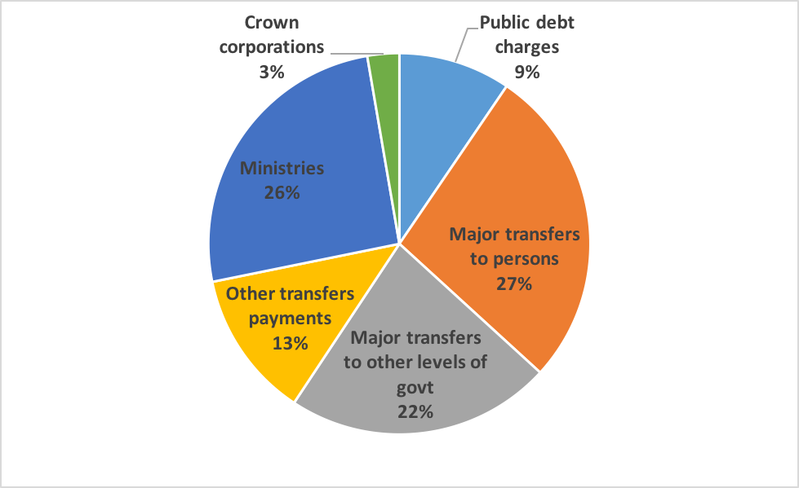
Canada’s Government spending 2014-15

Slide 19
Net exports (NX)
NX = exports – imports
  Exports: the value of g&s sold to other countries
  Imports: the value of g&s purchased from other countries
Hence, NX equals net spending from abroad on our g&s

Slide 20
Canada Net Exports, 2015
 | $ billions | % of GDP
Net exports of g&s | –1 | 0
Exports | 573 | 32.4
Goods | 489 | 27.7
Services | 84 | 4.7
Imports | 574 | 32.5
Goods | 466 | 26.4
Services | 108 | 6.1

Slide 21
NOW YOU TRY
An expenditure-output puzzle?
Suppose a firm:
produces $10 million worth of final goods
only sells $9 million worth
Does this violate the
expenditure = output identity?
20

Slide 22
Why output = expenditure
Unsold output goes into inventory,
and is counted as “inventory investment” . . . whether or not the inventory buildup was intentional.
In effect, we are assuming that
firms purchase their unsold output.

Slide 23
GDP:
An important and versatile concept
We have now seen that GDP measures:
  total income
  total output
  total expenditure
  the sum of value added at all stages
  in the production of final goods

Slide 24
GNP vs. GDP
Gross national product (GNP):
Total income earned by the nation’s factors of production, regardless of where located.
Gross domestic product (GDP):
Total income earned by domestically-located factors of production, regardless of nationality.
GNP – GDP = factor payments from abroad
minus factor payments to abroad
Examples of factor payments: wages, profits, rent, interest & dividends on assets

Slide 25
GNP vs. GDP in Select Countries, 2012
Country | GNP | GDP | GNP – GDP (% of GDP)
Bangladesh | 127,672 | 116,355 | 9.7
Japan | 6,150,132 | 5,961,066 | 3.2
China | 8,184,963 | 8,227,103 | -0.5
United States | 16,514,500 | 16,244,600 | 1.7
India | 1,837,279 | 1,858,740 | -1.2
Canada | 1,821,424 | 1,779,635 | 2.3
Greece | 250,167 | 248,939 | 0.5
Iraq | 216,453 | 215,838 | 0.3
Ireland | 171,996 | 210,636 | -18.3
GNP and GDP in millions of current U.S. dollars.

Slide 26
Real vs. nominal GDP
GDP is the value of all final goods and services produced.
Nominal GDP measures these values using current prices.
Real GDP measures these values using the prices of a base year.
Value of 2016 $100 in 1980: $290.37

Slide 27
NOW YOU TRY
Real and nominal GDP
 | 2010 |  | 2011 |  | 2012
 | P | Q | P | Q | P | Q
good A | $30 | 900 | $31 | 1,000 | $36 | 1,050
good B | $100 | 192 | $102 | 200 | $100 | 205
Compute nominal GDP in each year.
Compute real GDP in each year using 2010 as the base year.
26

Slide 28
Real GDP controls for inflation
Changes in nominal GDP can be due to:
  changes in prices
  changes in quantities of output produced
Changes in real GDP can only be due to changes in quantities because real GDP is constructed using constant base-year prices.

Slide 29
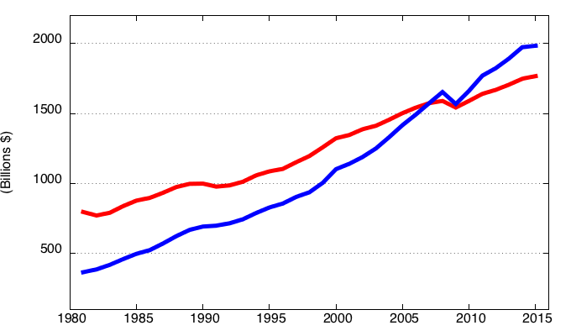
Canada Nominal and Real GDP,
1981-2015
Real GDP (Chained 2007 dollars)
Nominal GDP

Slide 30
GDP deflator
Inflation rate: the percentage increase in the overall level of prices.
One measure of the price level: GDP deflator
Definition:

Slide 31
NOW YOU TRY
GDP deflator and the inflation rate
 | Nom. GDP | Real GDP | GDP deflator | Inflation rate
2010 | $46,200 | $46,200 |  | n.a.
2011 | 51,400 | 50,000
2012 | 58,300 | 52,000
Use your previous answers to compute
the GDP deflator in each year.
Use GDP deflator to compute the inflation rate from 2010 to 2011 and from 2011 to 2012.
30

Slide 32
NOW YOU TRY
Answers
 | Nom. GDP | Real GDP | GDP deflator | Inflation rate
2010 | $46,200 | $46,200 | 100.0 | n.a.
2011 | 51,400 | 50,000 | 102.8 | 2.8%
2012 | 58,300 | 52,000 | 112.1 | 9.1%
31

Slide 33
Consumer price index (CPI)
A measure of the overall level of prices
Published by Statistics Canada (StatsCan)
Uses:
  tracks changes in the typical household’s
  cost of living
  adjusts many contracts for inflation (“COLAs”)
  allows comparisons of dollar amounts over time

Slide 34
How Statistics Canada constructs the CPI
1. Survey consumers to determine composition of the typical consumer’s “basket” of goods
2. Every month, collect data on prices of all items in the basket; compute cost of basket
3. CPI in any month equals

Slide 35
How Statistics Canada constructs the CPI
4. Movements in the price of the goods and services included in the CPI are weighted according to their relative importance in the total expenditures of consumers.
5. To estimate the price change experienced by Canadians, Statistics Canada obtains CPI price sample from different regions, goods and services, and from various types and locations of retail outlets.

Slide 36
NOW YOU TRY
Compute the CPI
Basket: 20 pizzas, 10 compact discs
Prices:
pizza CDs
2012 $10 $15
2013 11 15
2014 12 16
2015 13 15
For each year, compute:
the cost of the basket
the CPI (use 2012 as the base year)
the inflation rate from the preceding year
35

Slide 37
NOW YOU TRY
Answers
Cost of Inflation
basket CPI rate
2012 $350 100.0 n.a.
2013 370 105.7 5.7%
2014 400 114.3 8.1%
2015 410 117.1 2.5%
36

Slide 38
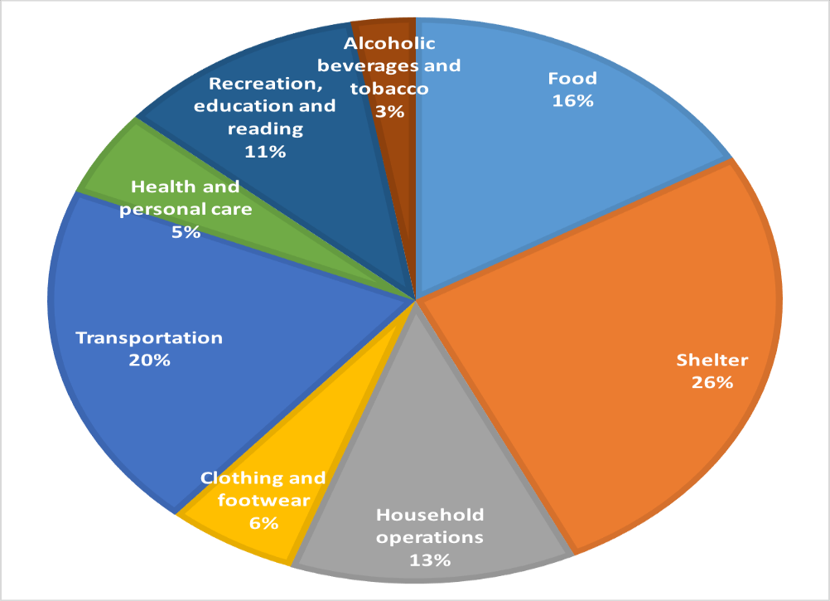
The composition of the CPI “basket”in Canada

Slide 39
Why the CPI may overstate inflation
Substitution bias:
The CPI uses fixed weights, so it cannot reflect consumers’ ability to substitute toward goods whose relative prices have fallen.
Introduction of new goods:
The introduction of new goods makes consumers better off and, in effect, increases the real value of the dollar. But it does not reduce the CPI because the CPI uses fixed weights.
Unmeasured changes in quality:
Quality improvements increase the value of the dollar but are often not fully measured.

Slide 40
CPI vs. GDP deflator
Prices of capital goods:
  included in GDP deflator (if produced domestically)
  excluded from CPI
Prices of imported consumer goods:
  included in CPI
  excluded from GDP deflator
The basket of goods:
  CPI: fixed
  GDP deflator: changes every year

Slide 41
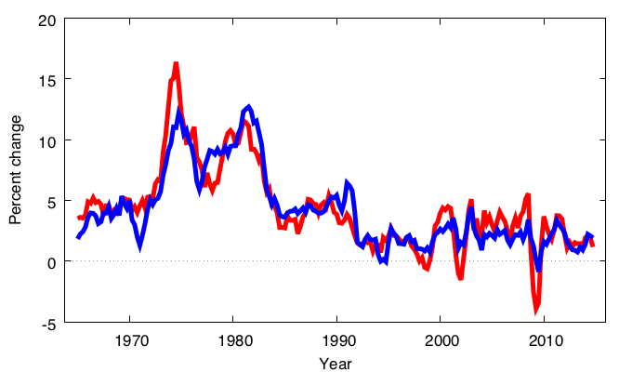
The inflation rate as measured by the GDP Deflator and the CPI, Canada
GDP deflator
CPI

Slide 42
Categories of the population
Employed
working at a paid job
Unemployed
not employed but looking for a job
Labour force
the amount of labour available for producing goods and services; all employed plus unemployed persons
Not in the labour force
not employed, not looking for work

Slide 43
Two important labour force concepts
Unemployment rate
percentage of the labour force that is unemployed
Labour force participation rate
the fraction of the adult population that “participates” in the labour force, i.e. is working or looking for work

Slide 44
NOW YOU TRY
Computing labour statistics
Canada adult population by group, June 2016
Number employed = 18.054 million
Number unemployed = 1.326 million
Adult population = 29.574 million
Calculate
  the labour force
  the unemployment rate
  the labour force participation rate
43

Slide 45
NOW YOU TRY
Computing percentage changes
Suppose
  population increases by 1%
  labour force increases by 3%
  number of unemployed persons increases by 2%
Compute the percentage changes in the labour force participation and unemployment rates.
44

Slide 46
Labour Force Survey (LFS)
Every month, Statistics Canada provides important data on the labour market, including the unemployment rate and the participation rate.
These statistics come from the Labour Force Survey (LFS).
The LFS is based on the responses of about 56,000 households or the responses of about 100,000 adults (aged 15 years and older).

Slide 47
The Survey of Employment, Payrolls and Hours (SEPH)
The SEPH is another survey that Statistics Canada conducts to get more timely information on the labour market, especially on earnings, hours worked by industry at the national and provincial level.
The SEPH provides greater details on earnings and non-farm industry employment compared to the LFS.

Slide 48
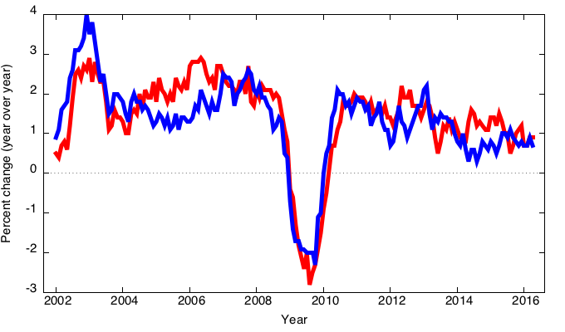
Employment growth LFS versus SEPH
LFS
SEPH

Slide 49
Unemployment, GDP, and Okun’s Law
The negative relationship between unemployment and GDP is known as Okun’s law.
In Canada, Okun’s law indicates that a one percent increase in real GDP leads to a half-percentage decrease in unemployment.

Slide 50
Okun’s Law: Canada 1959-2012

Slide 51
CHAPTER SUMMARY
Gross domestic product (GDP) measures both total income and total expenditure on the economy’s output of goods & services.
Nominal GDP values output at current prices;
real GDP values output at constant prices. Changes in output affect both measures,
but changes in prices only affect nominal GDP.
GDP is the sum of consumption, investment, government purchases, and net exports.
50

Slide 52
CHAPTER SUMMARY
The overall level of prices can be measured
by either:
  the consumer price index (CPI),
  the price of a fixed basket of goods purchased by the typical consumer, or
  the GDP deflator,
  the ratio of nominal to real GDP.
The unemployment rate is the fraction of the labour force that is not employed.
51

