Slide 2
Important issues in macroeconomics
Macroeconomics—the study of the economy as a whole—addresses many topical issues, e.g.:
What causes recessions?
How can problems in the housing market spread to the rest of the economy?
What is the government budget deficit?
How does it affect workers, consumers, businesses, and taxpayers?
Notes:
1

Slide 3
Important issues in macroeconomics
Macroeconomics—the study of the economy as a whole—addresses many topical issues, e.g.:
Why does the cost of living keep rising?
Why are so many countries poor? What policies might help them grow out of poverty?
What is the trade deficit? How does it affect a country’s well-being?
Notes:
2

Slide 4
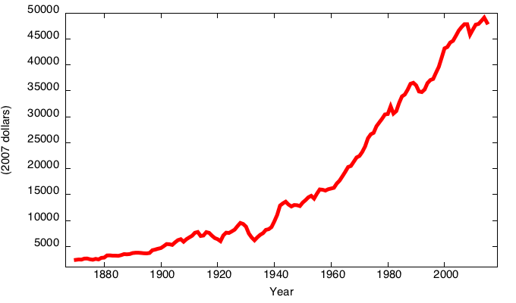
Canadian Real GDP per capita
(2007 dollars)
2008-2009 recession
1990s recession
Oil price shocks
1980s recession
Great depression
World War I

Slide 5
Canada Inflation Rate, 1915-2015
(% per year)
First
oil price shock
Second
oil price shock
World War I
Great Depression
2008-2009 recession

Slide 6
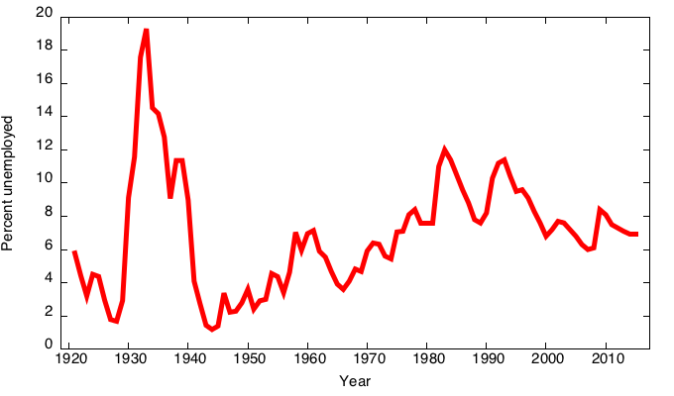
Canada Unemployment Rate, 1921-2015 (% of labour force)
Great depression
1990s recession
Oil price shocks
World War II
1980s recession
2008 recession

Slide 7
Economic models
…are simplified frameworks to illustrate complex processes, mostly using mathematical techniques.
  irrelevant details are stripped away
…are used to:
  show relationships between variables
  explain the economy’s behavior
  devise policies to improve economic performance
Notes:
6

Slide 8
Example of a model:
Supply & demand for new cars
Shows how various events affect price and quantity of cars
Assumes the market is competitive: each buyer and seller is too small to affect the market price
Variables
  Q^{d} = quantity of cars that buyers demand
  Q^{s} = quantity that producers supply
  P = price of new cars
  Y = aggregate income
  P_{s} = price of steel (an input)
Notes:
7

Slide 9
The demand for cars
Demand equation: Q ^{d} = D (P,Y )
Shows that the quantity of cars consumers demand is related to the price of cars and aggregate income
Notes:
8

Slide 10
The market for cars: Demand
Demand equation:
Q ^{d} = D (P,Y )
P
Price
of cars
The demand curve shows the relationship between quantity demanded and price, other things equal.
D
Q Quantity of cars
Notes:
9

Slide 11
The market for cars: Supply
Supply equation:
Q ^{s} = S (P,P_{S} )
P
Price
of cars
S
The supply curve shows the relationship between quantity supplied and price, other things equal.
D
Q Quantity of cars
Notes:
10

Slide 12
The market for cars: Equilibrium
P
Price
of cars
S
equilibrium price
D
Q Quantity of cars
equilibrium
quantity
Notes:
11

Slide 13
The effects of an increase in income
Demand equation:
Q ^{d} = D (P,Y )
P
Price
of cars
S
An increase in income increases the quantity
of cars consumers demand at each price…
P₂
P₁
D₂
D₁
Q Quantity of cars
…which increases the equilibrium price and quantity.
Q₁
Q₂
Notes:
12

Slide 14
The effects of a steel price increase
Supply equation:
Q ^{s} = S (P,P_{S} )
P
Price
of cars
S₂
S₁
An increase in P_{s} reduces the quantity of cars producers supply at each price…
P₂
P₁
D
…which increases the market price and reduces the quantity.
Q Quantity of cars
Q₂
Q₁
Notes:
13

Slide 15
Endogenous vs. exogenous variables
The values of endogenous variables
are determined in the model.
The values of exogenous variables
are determined outside the model:
The model takes their values and behavior
as given.
In the model of supply & demand for cars,
  endogenous: P, Q ^{d}, Q ^{s}
  exogenous: Y, P_{s}
Notes:
14

Slide 16
NOW YOU TRY
Supply and Demand
1. Write down demand and supply equations for smartphones, include two exogenous variables in each equation.
2. Draw a supply–demand graph for smartphones.
3. Use your graph to show how a change in one of your exogenous variables affects the model’s endogenous variables.
15

Slide 17
The use of multiple models
No one model can address all the issues we care about.
E.g., our supply–demand model of the car market…
  can tell us how a fall in aggregate income affects price & quantity of cars.
  cannot tell us why aggregate income falls.
Notes:
16

Slide 18
The use of multiple models
So we will learn different models for studying different issues (e.g., unemployment, inflation, long-run growth).
For each new model, you should keep track of:
  its assumptions
  which variables are endogenous,
  which are exogenous
  the questions it can help us understand,
  those it cannot
Notes:
17

Slide 19
Prices: flexible vs. sticky
Market clearing: An assumption that prices are flexible, adjust to equate supply and demand.
In the short run, many prices are sticky—
adjust sluggishly in response to changes in supply or demand. For example:
  many labour contracts fix the nominal wage
  for a year or longer
  many magazine publishers change prices
  only once every 3 to 4 years
Notes:
18

Slide 20
Prices: flexible vs. sticky
The economy’s behavior depends partly on whether prices are sticky or flexible:
  If prices are sticky (short run),
  demand may not equal supply, which explains:
    unemployment (excess supply of labour)
    why firms cannot always sell all the goods
    they produce
  If prices are flexible (long run), markets clear and economy behaves very differently.
Notes:
19

Slide 21
CHAPTER SUMMARY
Macroeconomics is the study of the economy as a whole, including
  growth in incomes
  changes in the overall level of prices
  the unemployment rate
Macroeconomists attempt to explain the economy and to devise policies to improve its performance.
20

Slide 22
CHAPTER SUMMARY
Economists use different models to examine different issues.
Models with flexible prices describe the economy in the long run; models with sticky prices describe the economy in the short run.
Macroeconomic events and performance arise from many microeconomic transactions, so macroeconomics uses many of the tools of microeconomics.
21

