Slide 1
Team
Dynamics

Slide 2
Definition, Types of Teams, Levels of Interdependence & Advantages / Challenges

Slide 3
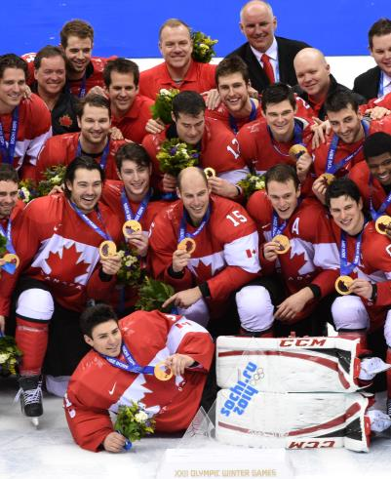
What are Teams?
Groups of two or more people
Exist to fulfill a purpose
Interdependent – interact and collaborate
Mutually accountable for achieving common goals – influence each other
Perceive themselves to be a team
Notes:
Exercise – think of the best team you were ever part of. What made it so great? / Think of the worst team you were ever part of. What made it so bad? Discuss with partner.

Slide 4
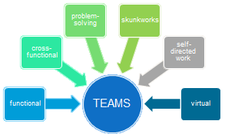
Key Types of Teams
Functional - work together daily, same manager, must coordinate their activities.
Cross-functional - different managers – teams play an integrative function – eg. From start to finish of manufacturing process to streamline shift handoffs, or solve problems that span teams. Some orgs use them permanently to mitigate against “siloing”, where each department or team is so preoccupied with their own work that they become isolated or cut off from others.
Problem solving – tasked with specific accountabilities, usually limited duration / project focus.
Skunkworks – physical separation, free from hierarchy, high performers
Self-directed – Significant decision making authorities over work processes
Virtual – Physically separated, linked online
Notes:
Skunkworks – shows a fresh perspective i.e. steve jobs took a team at apple and sperated them into a apartment their they could break away from the team and think about new fresh ideas.
Good done

Slide 5
Key Types of Teams
 | Permanence (Low / Med / High) | Skill Differentiation (Low / Med / High) | Authority Differentiation (Low / Med / High)
Functional / Departmental
Cross-functional
Self-directed
Problem solving / Task Force
Skunkworks
Self-directed
Virtual
Notes:
Functional – High P, Low to medium Skill Diff, High Authority Diff
X-Functional – Low - medium P, High Skill Diff, medium Authority Diff
Self-directed – High P, Med Skill Diff, Low Authority Diff
Problem solving / Task force – Low P, medium SD, Medium AD
Skunk works – medium P, Medium to high SK, medium AD
Virtual – varies P, med to high SD, medium AD
EXERCISE – ADV AND DISADV OF TEAMS

Slide 6
Levels of Task Interdependence
High
Reciprocal
A
B
C
Sequential
A
B
C
Pooled
Shared Resource
Low
A
B
C
Notes:
Pooled – no interaction between employee groups / departments, yet they do depend on each other; no need to group under a common manager. But for the organization to be successful, each group must work well. Coordination usually in the form of common goals, standards, rules, and routines. EG: Franchise outlets – they all interact with a head office all franchises get info from head office
Sequential – most obvious example is the assembly line. Serial: there is a clean handoff between a “supplier” and a “customer”. May not need to be grouped under common manager, but should be close geographically or connected electronically. EG – car production
Reciprocal – takes it one step further, to cyclical – most complex form of interdependence. Complex—requires constant mutual adjustment and communication. Output of one group becomes the input of the other and vice versa. To ensure success, work needs to grouped under a common manager integrated as low as possible. EG: marketing teams – products, trends, branding, etc.
Good done however know which is high and low and know how to draw each as per picture
Exercise – identify when you worked in one of these – what worked well / didn’t work well and why?

Slide 7
Team Effectiveness Model

Slide 8
Team Advantages/Challenges
Advantages
  Fits the complex nature of today’s work better
  Make better decisions, products/services
  Better information sharing
  Increase employee motivation / engagement – it depends
Challenges
  Lower performance when it doesn’t fit the nature of the work
  Investments – resources needed for team maintenance
  Social loafing – members potentially exert less effort in teams than alone
  “Groupthink” – when the desire for harmony results in poor decisions
Notes:
Good done

Slide 9
Team Design - Team Size
Smaller teams are better because:
  less process loss -- need less time to coordinate roles and resolve differences
  require less time to develop
  more engaged with team – know members, more influence on the team
  feel more responsible for team’s success
But team must be large enough to accomplish task
Notes:
Best practices with teams – on exam….. This 4-6 ppl is a nice size
-smaller teams are better b.c.
Good done

Slide 10
Team Efficacy

Slide 11
Team States - Team Efficacy
The collective belief among team members if the team’s capability to successfully completing a task is team efficacy.
Teams with high level of efficacy outperform teams with lower level of efficacy.
  High efficacy leads to team members setting ambitious goals, put forth greater effort, persist longer when faced with a challenge and view negative feedback as an opportunity.
  Low team efficacy leads to team members feeling apathy, uncertainty and a lack of direction.
In teams with high efficacy, individual team members are more likely to display coordination and cooperative type behavior.

Slide 12
Recent Research on Teams
Notes:
Not in textbok-→ important **

Slide 13
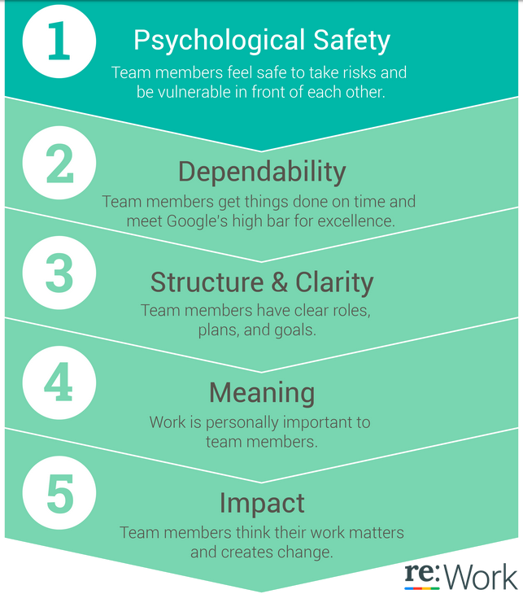
Recent Research
Google’s Self-Study
2 years - 200+ interviews with Google employees - 250 characteristics of 180+ Google teams
Hypothesis: Finding the right mixture of “who” should be on which teams
Finding: Who is on a team matters less than how the team members interact, structure their work, and view their contributions.
Notes:
Psychological safety was far and away the most important of the five dynamics we found -- it’s the underpinning of the other four. How could that be? Taking a risk around your team members seems simple. But remember the last time you were working on a project. Did you feel like you could ask what the goal was without the risk of sounding like you’re the only one out of the loop? Or did you opt for continuing without clarifying anything, in order to avoid being perceived as someone who is unaware?
Turns out, we’re all reluctant to engage in behaviors that could negatively influence how others perceive our competence, awareness, and positivity. Although this kind of self-protection is a natural strategy in the workplace, it is detrimental to effective teamwork. On the flip side, the safer team members feel with one another, the more likely they are to admit mistakes, to partner, and to take on new roles. And it affects pretty much every important dimension we look at for employees. Individuals on teams with higher psychological safety are less likely to leave Google, they’re more likely to harness the power of diverse ideas from their teammates, they bring in more revenue, and they’re rated as effective twice as often by executives.

Slide 14

Recent Research
Alex Petland, M.I.T. - Human Dynamics Laboratory
Finding – Communication plays a critical role in building successful teams. More specifically, communication patterns are the most important predictor of a team’s success – in fact, communication patterns are more important than all other factors (e.g., individual intelligence, personality, skill, and the substance of discussions) combined.
Call centres - best predictors of productivity were a team’s energy and engagement outside formal meetings. – so how to increase productivity? – synchronize break times so that everyone on a team took their break at the same time – Result – Average call length declined by 20% among lower performing teams
Notes:
Studied many teams across a diverse set of industries – healthcare, banks, call centres, etc.
Equipped people with electronic badges that collected data on individual communication behavior—tone of voice, body language, whom they talked to and how much – the content of what was discussed was irrelevant

Slide 15
Recent Research
Alex Petland, M.I.T. - Human Dynamics Laboratory
Research results – successful teams share several defining characteristics:
1. Everyone on the team talks and listens in roughly equal measure
2. Members face one another, and their conversations and non-verbal gestures are energetic.
3. Members connect directly with one another—not just with the team leader.
4. Members carry on side conversations within the team.
5. Members periodically break, go exploring outside the team, and bring information back.

Slide 16
Team Roles

Slide 17
Team Development

Slide 18
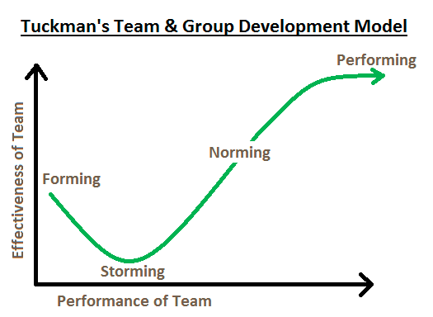
5 Stage Model of Team Development
Notes:
Forming – storming – norming – performing – adjourning
Next slide
Good done

Slide 19
5 Stages of Team Development
Forming - The individual's behavior is driven by a desire to be accepted by the others, and avoid controversy or conflict. Leaders - Direct the team and establish structure, objectives and roles clearly.
Storming - different ideas compete for consideration. Team members open up to each other and confront each other's ideas and perspectives. In some cases storming can be resolved quickly. In others, the team never leaves this stage. The maturity of some team members usually determines whether the team will ever move out of this stage. Leaders - Establish process and structure, and work to smooth conflict but not too much – allow the team to work it through. Remain positive and firm in the face of challenges to your leadership or the team's goal.
Norming - The team manages to have one goal and come to a mutual plan for the team at this stage. Some may have to give up their own ideas and agree with others in order to make the team function. In this stage, all team members take the responsibility and have the ambition to work for the success of the team's goals. Leaders - Step back and help the team take responsibility for progress towards the goal. This is a good time to arrange a social, or a team-building event.
Performing - high-performing teams are able to function as a unit as they find ways to get the job done smoothly and effectively without inappropriate conflict or the need for external supervision. Even the most high-performing teams will revert to earlier stages in certain circumstances. Leaders - Delegate as far as you sensibly can. Once the team has achieved high performance, you should aim to have as "light a touch" as possible.
Adjourning – 1977 – Leaders - take the time to celebrate its achievements, lessons learned
https://www.youtube.com/watch?v=hEJaz3sinEs
Notes:
Forming – storming – norming – performing – adjourning
Good done

Slide 20
Decision Making in Teams

Slide 21
Team Decisions - Guidelines
Team should encourage critical thinking
Sufficient team diversity
Checks/balances to avoid dominant participants
Maintain optimal team size
Introduce effective team structures

Slide 22
My 2 cents

Slide 23
My Top Tips for Effective Teams
Will creating a team help us achieve our objectives? If not, don’t bother!
Be really clear on the purpose of the team, its objectives, each person’s role, and give them the resources and decision making authority they need.
Make sure you have good project management expertise on the team – clarity and accountability on who’s doing what and by when!
Team selection is key – you want diversity, mixture of empathy and ‘devil’s advocate’
Strive for openness and transparency – if things start to slide, address it early and openly. If you have to go back to the Storming stage, then do it.

