Slide 1

Lecture 08
CENTER OF GRAVITY
CENTER OF MASS
CENTROID FOR A BODY
Section 9.1

Slide 2
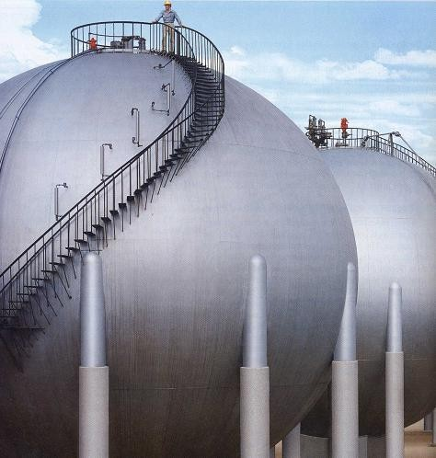
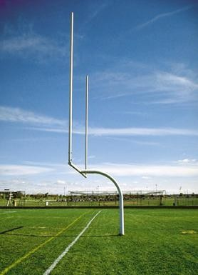
Today’s Objective : Students will:
Understand the concepts of center of gravity, center of mass, and centroid.
Be able to determine the location of these points for a system of particles or a body.

Slide 3
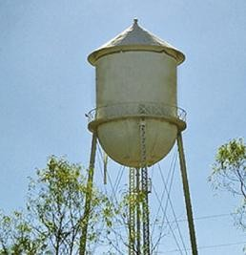
APPLICATIONS
To design the structure for supporting a water tank, we will need to know the weights of the tank and water, as well as
the locations where the resultant forces representing these distributed loads are acting.
How can we determine these weights and their locations?
3

Slide 4
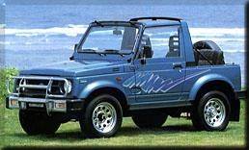
APPLICATIONS (continued)
One concern about a sport utility vehicle (SUVs) is that it might tip over while taking a sharp turn.
One of the important factors in determining its stability is the SUV’s center of mass.
Should it be higher or lower for making a SUV more stable? How do you determine its location?
4

Slide 5
CONCEPT OF CG & CM
4N
3m 1m
The center of gravity (G) is a point which locates the resultant weight of a system of particles or body.
A
•
1 N G
•
B
3 N
From the definition of a resultant force, the sum of moments due to individual particle weight about any point is the same as the moment due to the resultant weight located at G.
For the figure above, try taking moments about A and B.
Also, note that the sum of moments due to the individual particle’s weights about point G is equal to zero.
Similarly, the center of mass is a point which locates the resultant mass of a system of particles or body.
Generally, its location is the same as that of G.
5

Slide 6
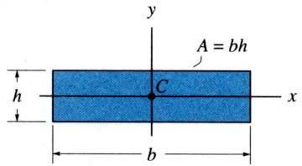
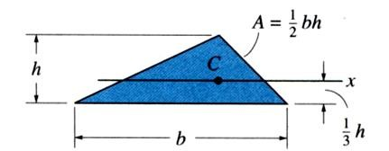
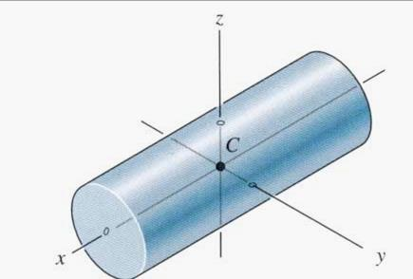
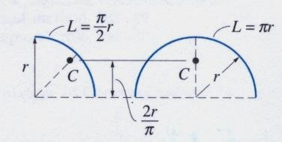
CONCEPT OF CENTROID
The centroid C is a point which defines the geometric center of an object.
The centroid coincides with the center of mass or the center of gravity only if the material of the body is homogenous (density or specific weight is constant throughout the body).
If an object has an axis of symmetry, then the centroid of object lies on that axis.
In some cases, the centroid is not located on the object.
6

Slide 7
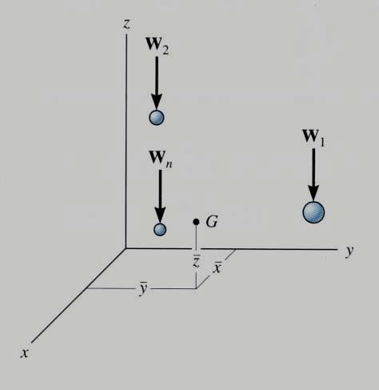

CG / CM FOR A SYSTEM OF PARTICLES
(Section 9.1)
Consider a system of n particles as shown in the figure. The net or the resultant weight is given as W_{R} = ∑W.
Summing the moments about the y-axis, we get
x W_{R} = ~x W + ~xW + ……….. + ~x W
1 1 2 2 n n
~
where x₁ represents x coordinate of W₁, etc.. Similarly, we can sum moments about the x- and z-axes to find the coordinates of G.
By replacing “W” with “m” in these equations, the coordinates of the center of mass can be found.
7
Notes:
W1 times X1,, W2 times X2

Slide 8
Σ x~ w
General Formula
Σ y~ w
i i
Σ w_{i}
Σ z~ w
i i
Σ w_{i}
x =
y =
z =
i i
Σ w_{i}
x, y, z Coordinates of C.G.
x~, y~, z~
i i i
Σ w_{i}
Coordinates of each particle
Resultant sum of particles
8
Notes:
1) Centre of gravity

Slide 9
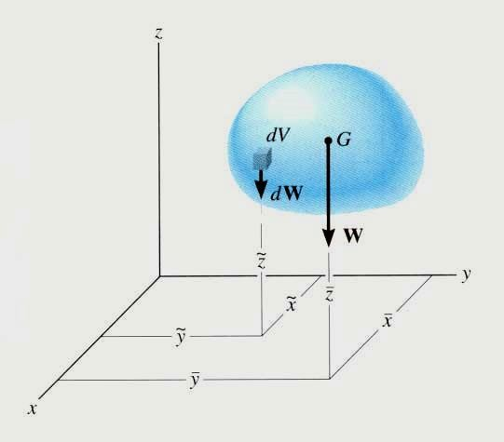
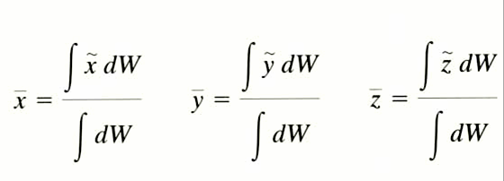
CG / CM & CENTROID OF A BODY
(Section 9.2)
A rigid body can be considered as made up of an infinite number of particles.
Hence, using the same principles as in the previous slide, we get the coordinates of G by simply replacing the discrete summation sign ( ∑ ) by the continuous summation sign ( ∫ ) and W by dW.
Similarly, the coordinates of the center of mass and the centroid of volume, area, or length can be obtained by replacing W by m, V, A, or L, respectively.
9
Notes:
Replace discrete with continuoussd

Slide 10
w = mg
Centre of Mass
Σ x~ mg
Σ y~ mg
Σ z~ mg
x =
i
Σ mg
y =
i
Σ mg
z =
i
Σ mg
Σ x~ m
Σ y~ m
Σ z~ m
x =
i
Σ m
y =
i
Σ m
z =
i
Σ m

Slide 11
General Formula
_{x =} ∫ x~ dW _{y =} ∫ y~ dW _{z =} ∫ z~ dW
∫ dW ∫ dW ∫ dW _{x =} ∫ x~ dm _{y =} ∫ y~ dm _{z =} ∫ z~ dm
∫ dm ∫ dm ∫ dm
_{x =} ∫ x~ dV _{y =} ∫ y~ dV _{z =} ∫ z~ dV
∫ dV ∫ dV ∫ dV _{x =} ∫ x~ dA _{y =} ∫ y~ dA _{z =} ∫ z~ dA
∫ dA ∫ dA ∫ dA
_{x =} ∫ x~ dL _{y =} ∫ y~ dL _{z =} ∫ z~ dL
∫ dL ∫ dL ∫ dL

Slide 12
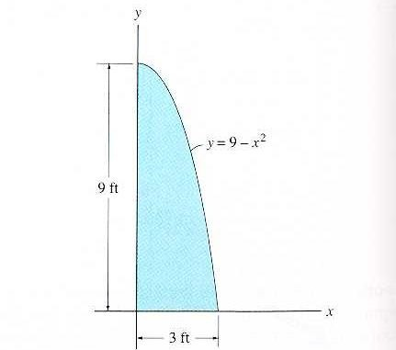

_{x =} ∫ x~ dA
_{y =} ∫ y~ dA
Distance From: Y axis
To: Centroid of slice
∫ dA
∫ dA
x = ~x
Distance From: X axis
To: Centroid of slice
y
dA = Slice
y
2
= ~y
dx
Notes:
Vertical slice, width is dx
Height is 9 – x^2x^2
Circled part is the height

Slide 13
PROBLEM SOLVING
∫ ~x dA
∫ ~y dA
^{x =} ∫ dA
^{y =} ∫ dA
2
dA = y dx = (9 − x ) dx
~_{x}
x=3
∫ dA = A = ∫ (9 − x )dx
2
x=0
⎡ x³ ⎤³
∫ dA = A = ⎢9x − _{3 ⎥}
⎣
⎦₀
y
⎡⎛
3³ ⎞ ⎛ 0³ ⎞⎤
∫ dA = A = ⎢⎜9(3) − ₃ ⎟ − ⎜9(0) − ₃ ⎟⎥
⎣⎝
⎠ ⎝
⎠⎦
⎛
27 2
3
⎞
∫ dA = A = 27 −
= (27) = 18 ft
2
⎜
₃ ⎟
dx
⎝
⎠

Slide 14
∫ ~x dA
∫ ~y dA
dA = y dx = (9 − x² ) dx X~ = X
^{x =} ∫ dA
^{y =} ∫ dA
~_{x}
x=3 3
∫ x~dA = ∫ x(9 − x² )dx = ∫ (9x − x³ )dx
x=0 0
~
⎡9x² x⁴ ⎤³
∫ xdA = _{⎢ 2} − _{4 ⎥}
⎣
⎦₀
y
⎡⎛ 9(3)²
3⁴ ⎞ ⎛ 9(0)²
0⁴ ⎞⎤
~
∫ xdA = ⎢⎜
− ₄ ⎟ − ⎜
− ₄ ⎟⎥
⎣⎝
2
⎠ ⎝
2
⎠⎦
∫ x~dA = ^{⎛ 81} − ^{81 ⎞} = ⁸¹
⎜ ₂ ₄ ⎟
⎠
∫ x~dA ⁸¹ 9
4
∫ dA 18 8
⎝
4
dx
x =
= =

Slide 15
_{y =} ∫ y~ dA
dA = y dx = (9 − x² ) dx
~
2
∫ dA
y = y = (9 − x )
∫ dA = 18
1 1
x=3
2 2
∫ y~dA =
∫
¹ (9 − x² )(9 − x² )dx
~
2
x
x=0
3
~
∫
∫ ydA =
1
2
(9 − x² )² dx
0
3
~
∫
∫ ydA =
1
2
(81 − 18x² + x⁴ )dx
y
0
∫ ydA = [
x + x ]
~
3 5 3
1
81x −
18
3
1
2
5 0
∫ ydA = [
− 0]
~y = ^{y}
2
~
81(3) −
3
5
1
18
3
(3) + (3)
1
2
5
~
∫ ydA = 64.8
dx
y = ^{∫ y~ dA} = ^{64.8} = 3.6 ft
∫ dA 18
Notes:
Triple integration

Slide 16
STEPS FOR DETERMING AREA CENTROID
Choose an appropriate differential element dA at a general point (x,y).
Hint: Generally, if y is easily expressed in terms of x
(e.g., y = x² + 1), use a vertical rectangular element.
If the converse is true, then use a horizontal rectangular element.
Express dA in terms of the differentiating element dx (or dy).
Determine coordinates (x~, ~y ) of the centroid of the rectangular element in
terms of the general point (x,y).
Express all the variables and integral limits in the formula using either x or y depending on whether the differential element is in terms of dx or dy, respectively, and integrate.
Note: Similar steps are used for determining CG, CM, etc. These steps will become clearer by doing a few examples.

Slide 17
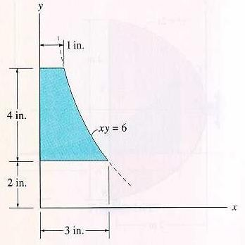

Required: Locate the centroid y of the shaded area
PROBLEM SOLVING
y=6 _{⎛ 6 ⎞}
∫ dA = ∫ ⎜ ⎟dy = 6 ln y
6
2
= 6.59 in²
⎝ ^{y} ⎠
y=2
~y = y
x
dy
6
6
∫
6
y
~
∫
= ( y)
2
6
2
∫ ydA = ( y)xdy
∫ ~ydA = 24 in³
dy = 6 y
2
24
y =
= 3.64 in
6.59

Slide 18
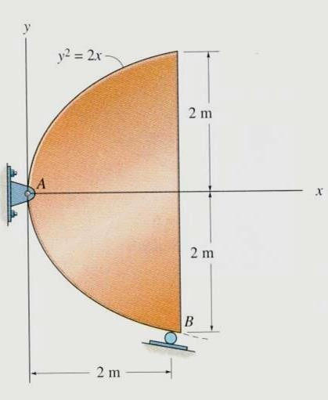
CONCEPT QUIZ
The steel plate with known weight and non- uniform thickness and density is supported as shown. Of the three parameters (CG, CM, and centroid), which one is needed for determining the support reactions? Are all three parameters located at the same point?
  (center of gravity, no)
  (center of gravity, yes)
  (centroid, yes)
  (centroid, no)
When determining the centroid of the area above, which type of differential area element requires the least computational work?
A) Vertical
C) Polar
B) Horizontal
D) Any one of the above.
Notes:
Center of gravity, no

Slide 19
Required: Locate the centroid y of the shaded area
PROBLEM SOLVING
y=6 _{⎛ 6 ⎞}
∫ dA = ∫ ⎜ ⎟dy = 6 ln y
6
2
= 6.59 in²
⎝ ^{y} ⎠
y=2
~y = y
x
dy
6
6
∫
6
y
~
∫
= ( y)
2
6
2
∫ ydA = ( y)xdy
∫ ~ydA = 24 in³
dy = 6 y
2
24
y =
= 3.64 in
6.59

Slide 20
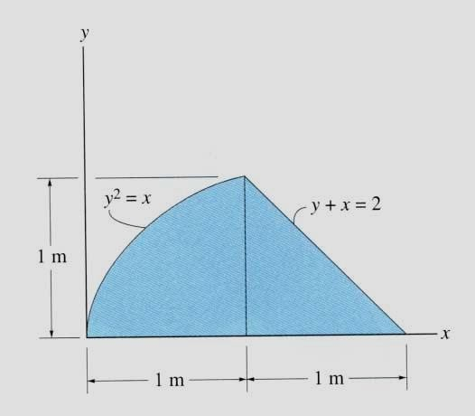
PROBLEM SOLVING
Given: The area as shown.
Find:
Plan:
The x of the centroid.
Follow the steps.
Solution
Choose dA as a horizontal rectangular strip.
dA = ( x₂ – x₁) dy
= ((2 – y) – y²) dy
(x_{1,},y)
(x₂,y)
3. x = ( x₁ + x₂) / 2
= 0.5 (( 2 – y)
~
+ y² )

Slide 21
PROBLEM SOLVING (continued)
~
4. x = ( ∫_{A} x dA ) / ( ∫ dA )
A
1
∫ dA =
∫ ( 2 – y – y ) dy
2
A
0
[ 2 y – y² / 2 – y³ / 3] ¹ =
1.167 m²
0
1
∫ x~ dA =
1
= 0.5 ∫ ( 4 – 4 y +
=
=
₀∫ 0.5 ( 2 – y +
y² ) ( 2 – y – y² ) dy
A
_{y}2
– y⁴ ) dy
0
0.5 [ 4 y –
1.067 m³
4 y² / 2
+ y³ / 3
– y⁵ / 5 ] ¹
0
x = 1.067 / 1.167
= 0.914 m

Slide 22
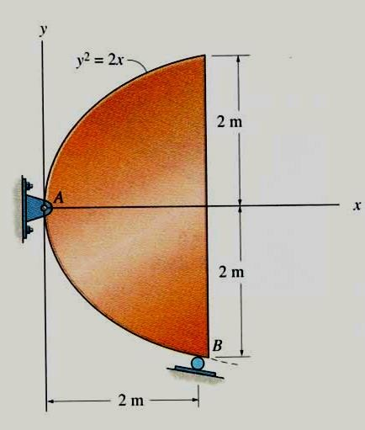
ATTENTION QUIZ
1. If a vertical rectangular strip is chosen as the differential element, then all the variables, including the integral limit, should be in terms of _ .
A) x
C) z
B) y
D) Any of the above.
2. If a vertical rectangular strip is chosen, then what are the values of
~x and y~?
A) (x , y) C) (x , 0)
B) (x / 2 , y / 2)
D) (x , y / 2)

