Slide 1
MTH 330
Calculus and Geometry
Chapter 9: Vector Calculus
Instructor: Saeid Samiezadeh
Email: saeid.samiezadeh@ryerson.ca
Office: VIC-746

Slide 2
9.1: Functions of Several Variables

Slide 3
Chapter 9. Vector Calculus
Objectives:
In this section we combine the concept of parametric curves with vectors.

Slide 4

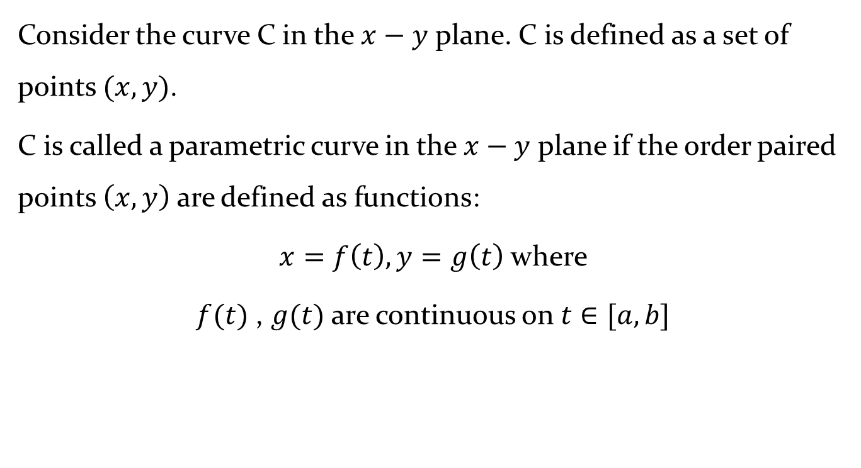
Definition: Curves in the $x−y$ plane
Consider the curve C in the $x−y$ plane. C is defined as a set of points $(x,y)$.
C is called a parametric curve in the $x−y$ plane if the order paired points $\left(x,y\right)$ are defined as functions:
$x=f\left(t\right), y=g\left(t\right)$ where
$f(t)$ , $g(t)$ are continuous on $t∈[a,b]$

Slide 5
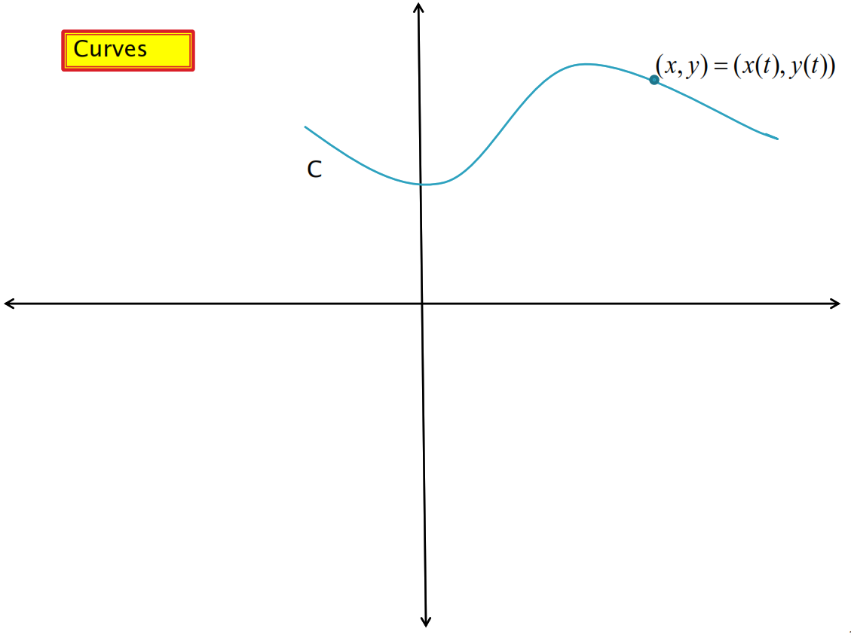

Definition: Curves in the $x−y$ plane

Slide 6
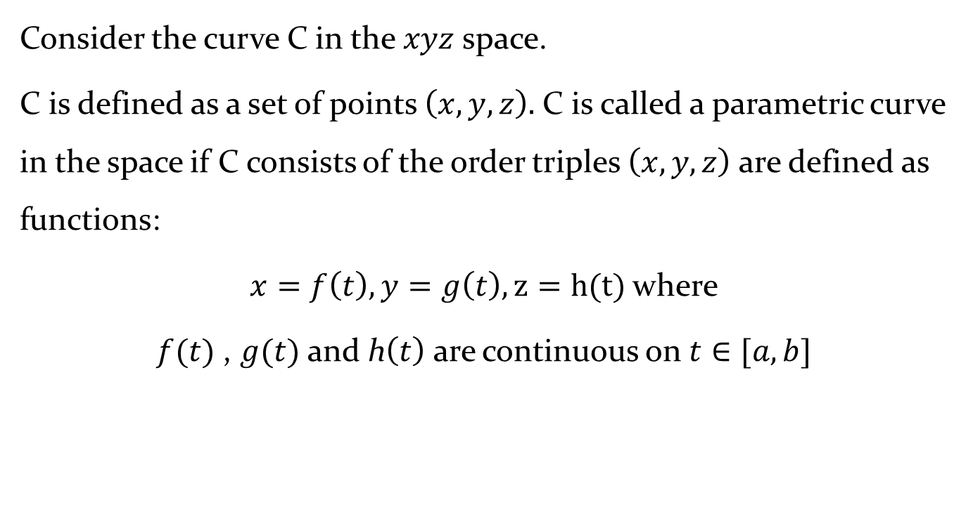
Definition: Curves in the space
Consider the curve C in the $xyz$ space.
C is defined as a set of points $\left(x,y,z\right).$ C is called a parametric curve in the space if C consists of the order triples $\left(x,y,z\right)$ are defined as functions:
$x=f\left(t\right), y=g\left(t\right), z=h(t)$ where
$f(t)$ , $g(t)$ and h$\left(t\right)$ are continuous on $t∈[a,b]$

Slide 7
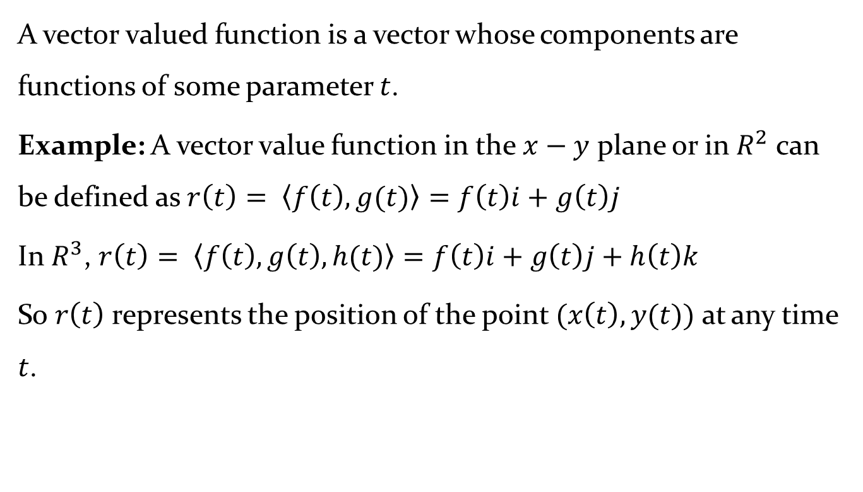

Definition: Vector Valued Function
A vector valued function is a vector whose components are functions of some parameter $t$.
Example: A vector value function in the $x−y$ plane or in $R^{2}$ can be defined as $r\left(t\right)= \left\langle f\left(t\right),g(t)\right\rangle =f\left(t\right)i+g\left(t\right)j$
In $R^{3}$, $r\left(t\right)= \left\langle f\left(t\right),g\left(t\right),h(t)\right\rangle =f\left(t\right)i+g\left(t\right)j+h\left(t\right)k$
So $r\left(t\right)$ represents the position of the point $(x\left(t\right),y(t))$ at any time $t$.

Slide 8
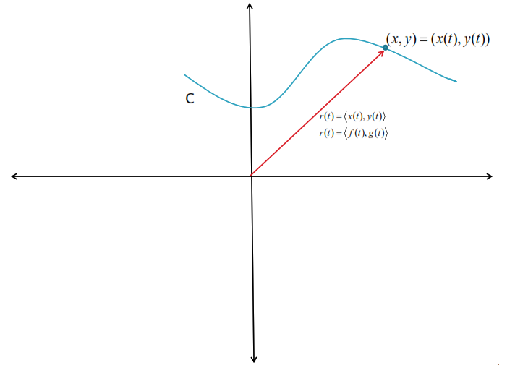
Definition: Vector Valued Function

Slide 9
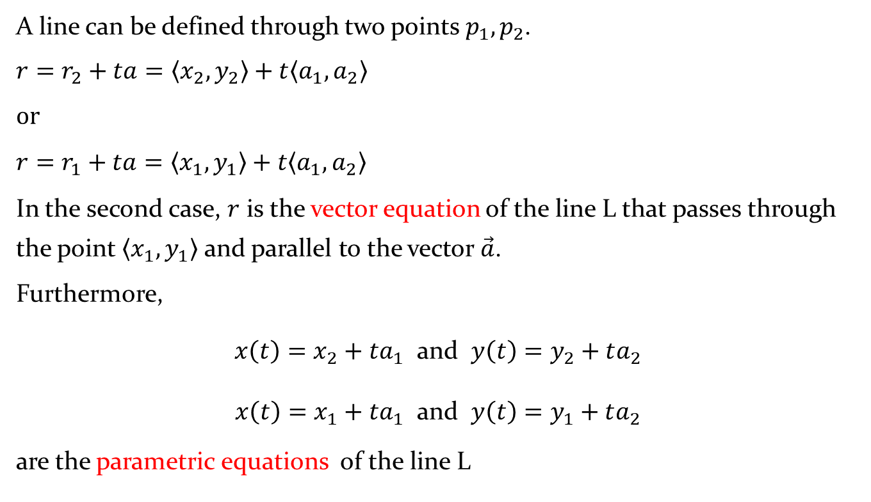
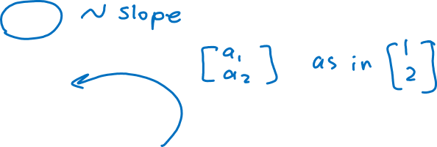
Review: Vector equation of a line and parametric equations of a line
A line can be defined through two points $p_{1}, p_{2}$.
$$r=r_{2}+ta=\left\langle x_{2},y_{2}\right\rangle +t\left\langle a_{1},a_{2}\right\rangle$$
$$or$$
$$r=r_{1}+ta=\left\langle x_{1},y_{1}\right\rangle +t\left\langle a_{1},a_{2}\right\rangle$$
In the second case, $r$ is the vector equation of the line L that passes through the point $\left\langle x_{1},y_{1}\right\rangle$ and parallel to the vector $\vec{a}$.
Furthermore,
$x\left(t\right)=x_{2}+ta_{1}$ and $y\left(t\right)=y_{2}+ta_{2}$
$x\left(t\right)=x_{1}+ta_{1}$ and $y\left(t\right)=y_{1}+ta_{2}$
are the parametric equations of the line L
Notes:
$$\left\langle x_{2}−x_{1} , y_{2}−y_{1}\right\rangle =\left\langle a_{1}, a_{2}\right\rangle$$

Slide 10
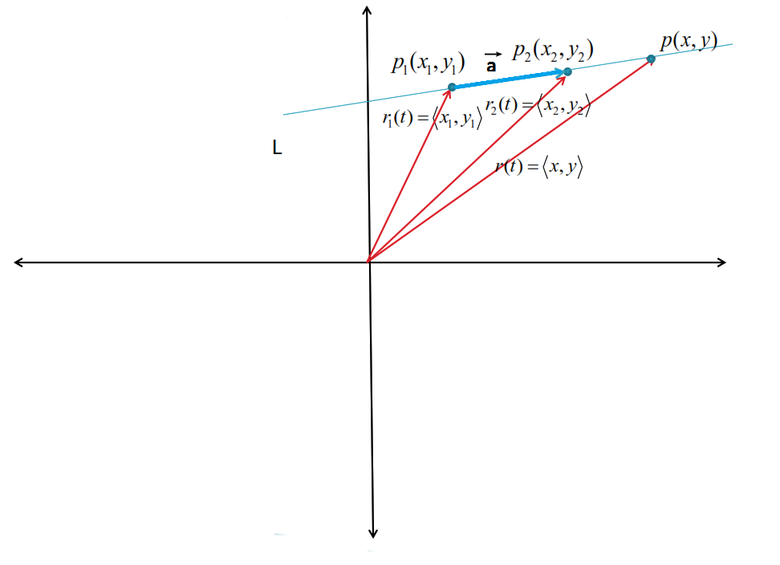
Review: Vector equation of a line and parametric equations of a line

Slide 11
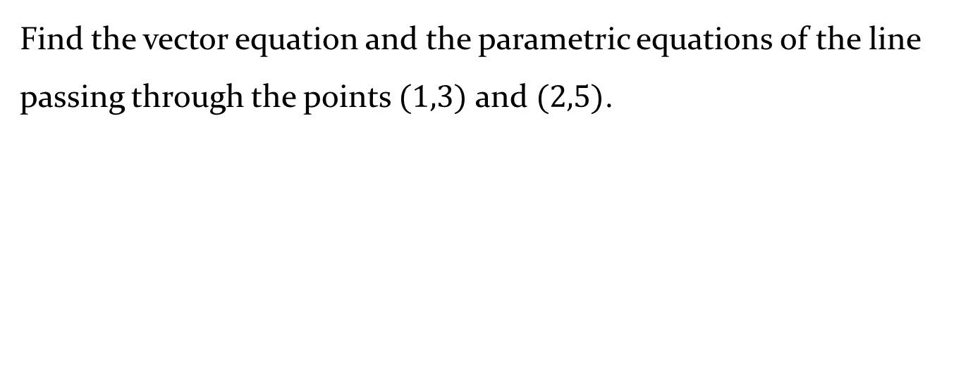
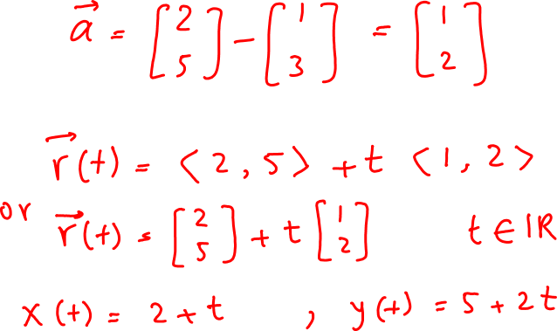
Example 1
Find the vector equation and the parametric equations of the line passing through the points $(1,3)$ and $(2,5)$.

Slide 12
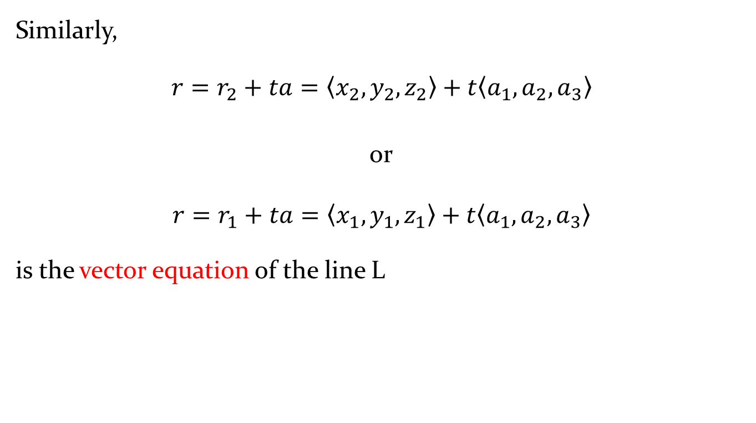
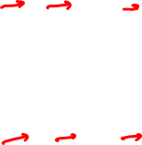
Review: Vector equation of a line and parametric equations of a line in the space
Similarly,
$$r=r_{2}+ta=\left\langle x_{2},y_{2},z_{2}\right\rangle +t\left\langle a_{1}, a_{2}, a_{3}\right\rangle$$
or
$$r=r_{1}+ta=\left\langle x_{1},y_{1},z_{1}\right\rangle +t\left\langle a_{1}, a_{2}, a_{3}\right\rangle$$
is the vector equation of the line L

Slide 13
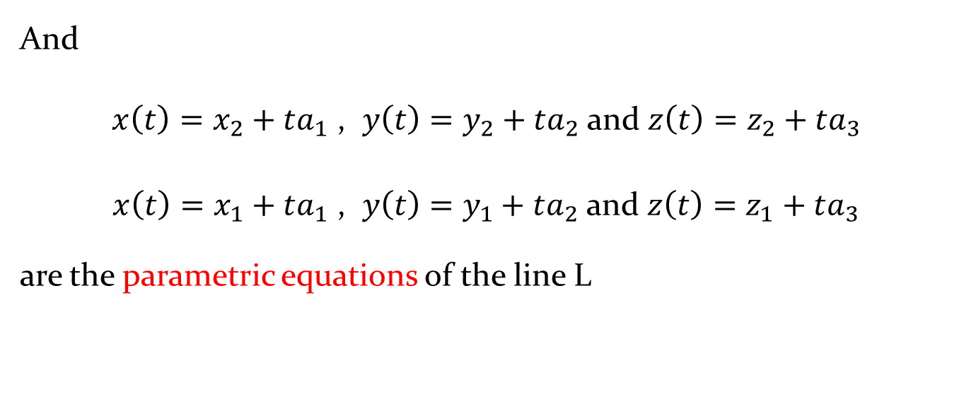
Review: Vector equation of a line and parametric equations of a line in the space
And
$x\left(t\right)=x_{2}+ta_{1}\text{ , }y\left(t\right)=y_{2}+ta_{2}$ and $z\left(t\right)=z_{2}+ta_{3}$
$x\left(t\right)=x_{1}+ta_{1}\text{ , }y\left(t\right)=y_{1}+ta_{2}$ and $z\left(t\right)=z_{1}+ta_{3}$
are the parametric equations of the line L

Slide 14



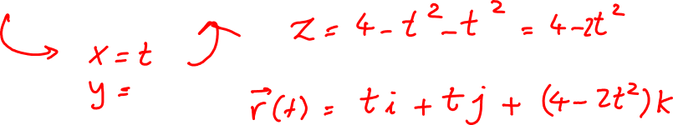
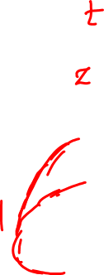
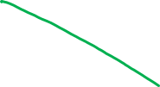






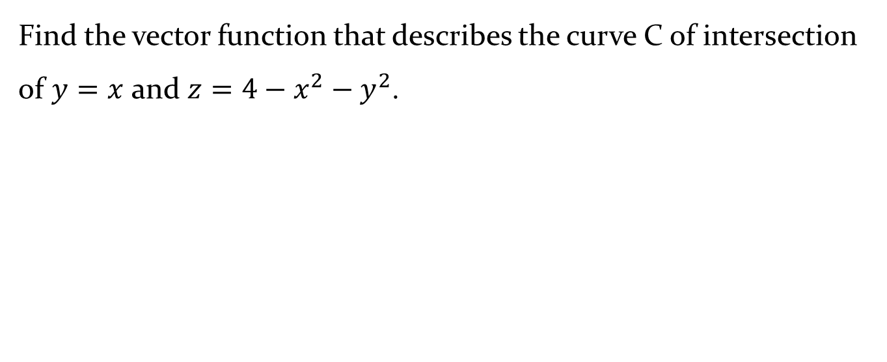





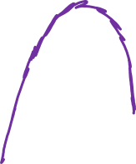


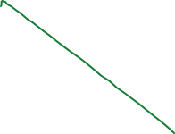


Example 2
Find the vector function that describes the curve C of intersection of $y=x$ and $z=4−x^{2}−y^{2}$.

Slide 15
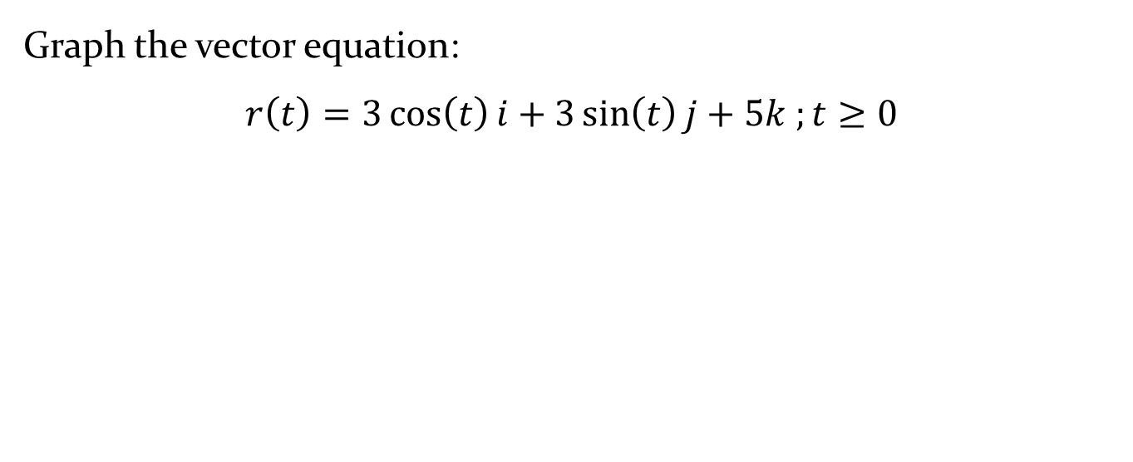
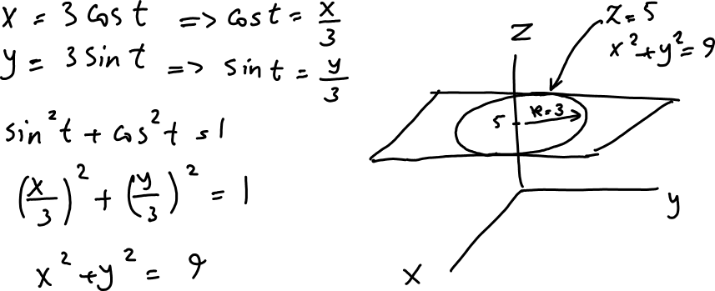

Example 3
Graph the vector equation:
$$r\left(t\right)=3\cos\left(t\right)i+3\sin\left(t\right)j+5k ;t≥0$$

Slide 16
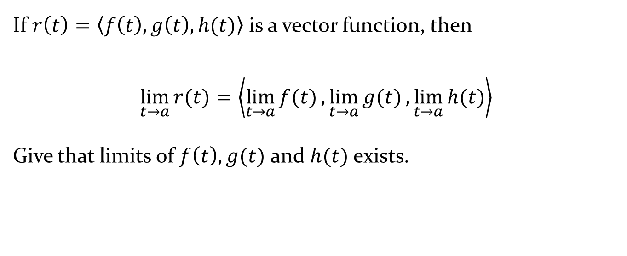
Definition: Limits of Vector Functions
If $r\left(t\right)=\left\langle f\left(t\right), g\left(t\right), h(t)\right\rangle$ is a vector function, then
$$\lim_{t→a}{r(t)}=\left\langle \lim_{t→a}{f(t)},\lim_{t→a}{g(t)},\lim_{t→a}{h(t)}\right\rangle$$
Give that limits of $f\left(t\right), g(t)$ and $h(t)$ exists.

Slide 17
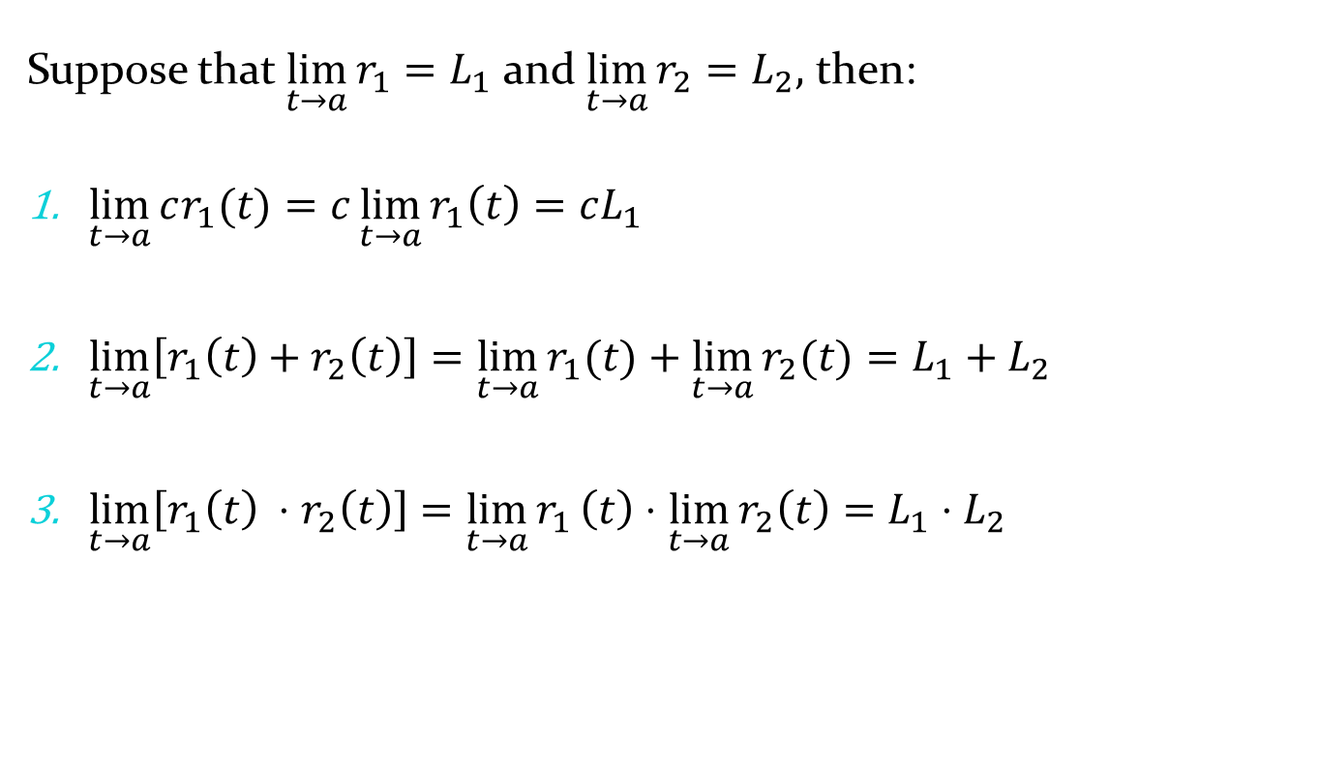
Theorem 9.1.1
Suppose that $\lim_{t→a}{r_{1}}=L_{1}$ and $\lim_{t→a}{r_{2}}=L_{2},$ then:
$\lim_{t→a}{cr_{1}(t)}=c\lim_{t→a}{r_{1}\left(t\right)}=cL_{1}$
$\lim_{t→a}\left[r_{1}\left(t\right)+r_{2}\left(t\right)\right]=\lim_{t→a}{r_{1}(t)}+\lim_{t→a}{r_{2}(t)}=L_{1}+L_{2}$
$\lim_{t→a}\left[r_{1}\left(t\right) ⋅r_{2}\left(t\right)\right]=\lim_{t→a}{r_{1}}\left(t\right)⋅\lim_{t→a}{r_{2}\left(t\right)}=L_{1}⋅L_{2}$

Slide 18
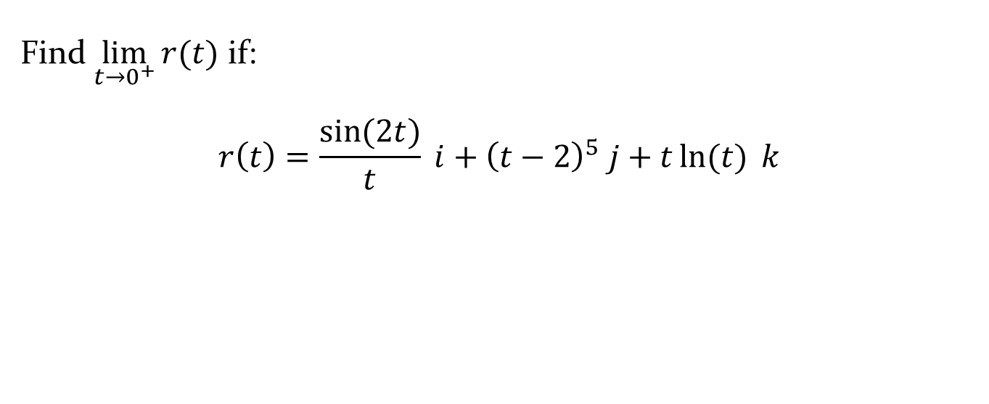
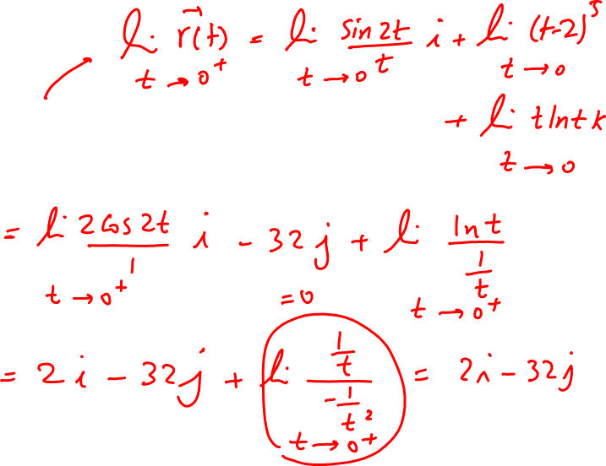
Example 4
Find $\lim_{t→0^{+}}{r(t)}$ if:
$$r\left(t\right)=\frac{\sin{(2t)}}{t} i+{\left(t−2\right)}^{5} j+t\ln{(t)} k$$

Slide 19
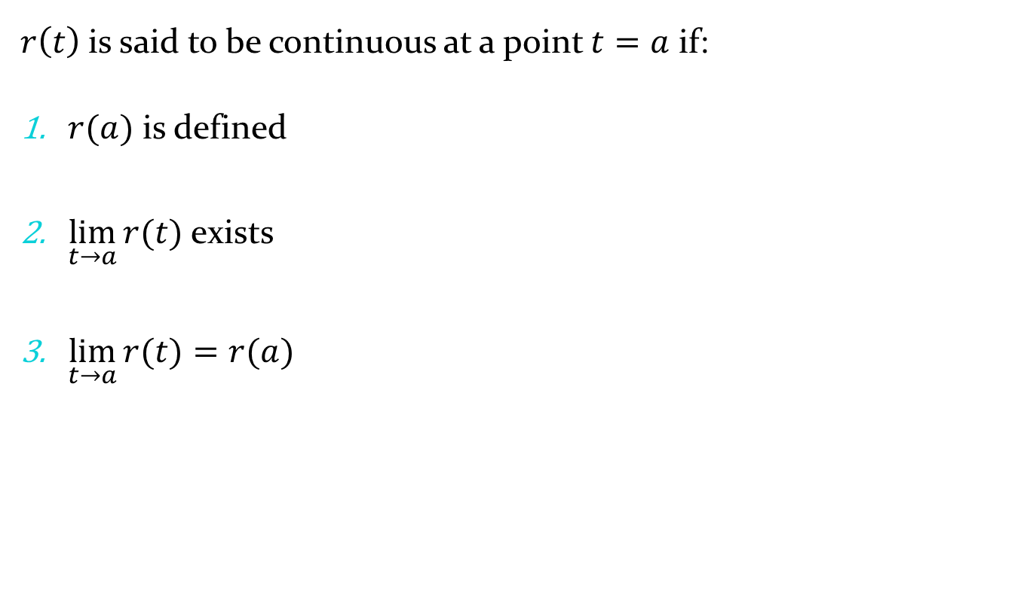
Definition: Continuity of Vector Functions
$r\left(t\right)$is said to be continuous at a point $t=a$ if:
$r(a)$ is defined
$\lim_{t→a}{r(t)}$ exists
$\lim_{t→a}{r(t)}=r(a)$

Slide 20
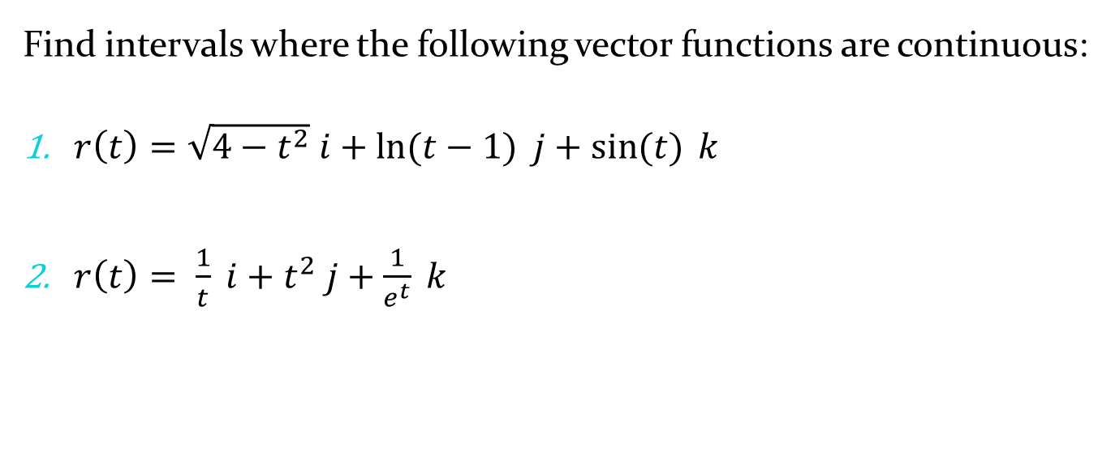
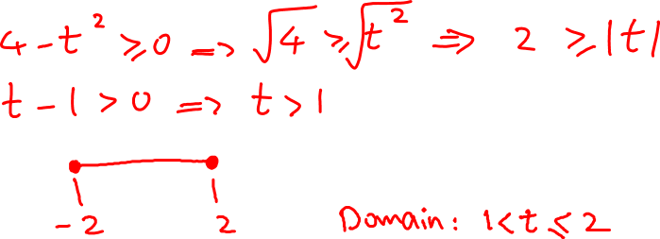


Example 5
Find intervals where the following vector functions are continuous:
$r\left(t\right)=\sqrt{4−t^{2}} i+\ln{(t−1)} j+\sin{(t)} k$
$r\left(t\right)= \frac{1}{t} i+t^{2} j+\frac{1}{e^{t}} k$

Slide 21
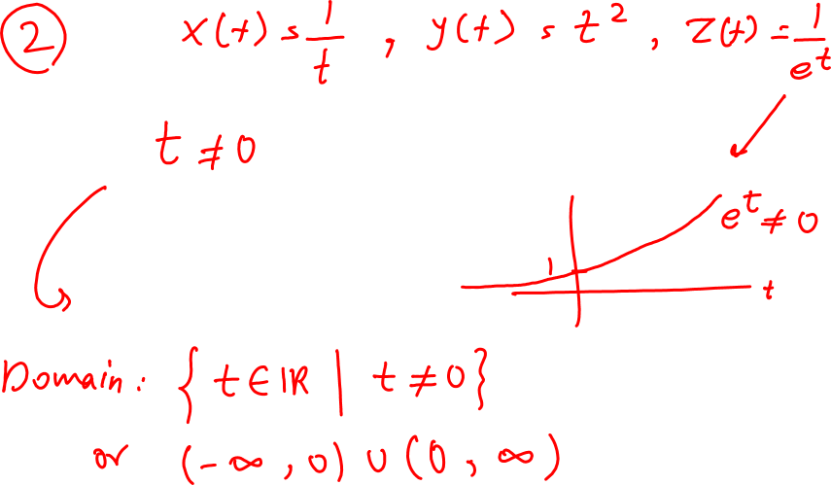
Example 5 - Solution

Slide 22
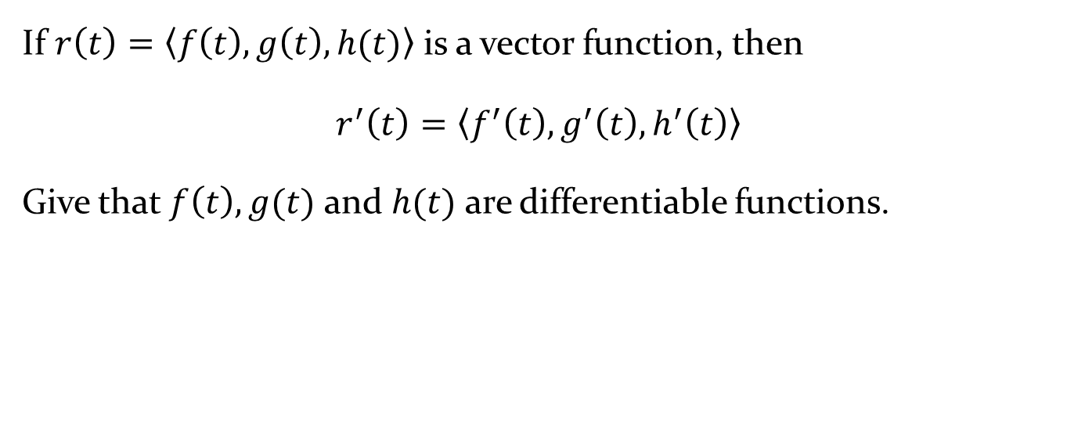
Definition: The Derivative of Vector Functions
If $r\left(t\right)=\left\langle f\left(t\right), g\left(t\right), h(t)\right\rangle$ is a vector function, then
$$r^{′}\left(t\right)=\left\langle f^{′}\left(t\right),g^{′}\left(t\right),h^{′}\left(t\right)\right\rangle$$
Give that $f\left(t\right), g(t)$ and $h(t)$ are differentiable functions.

Slide 23
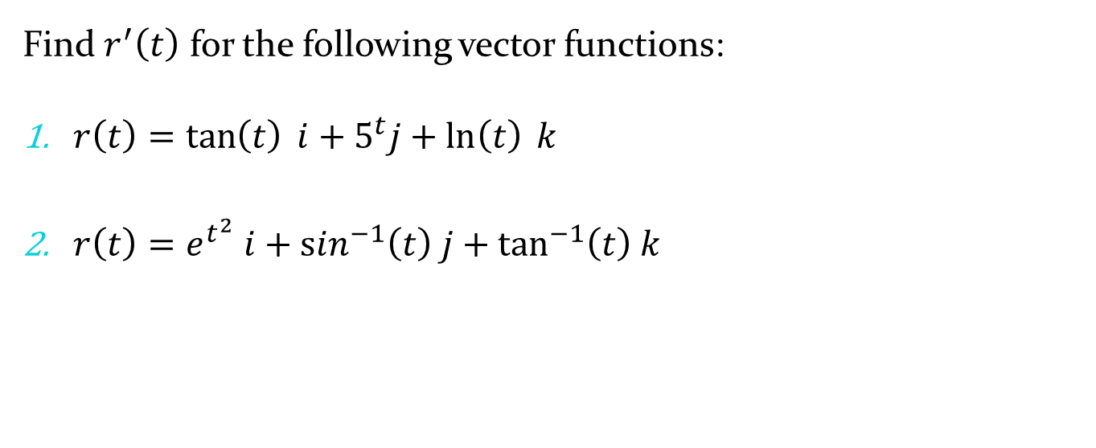
Example 6
Find $r^{′}\left(t\right)$ for the following vector functions:
$r\left(t\right)=\tan\left(t\right) i+5^{t}j+\ln\left(t\right) k$
$r\left(t\right)=e^{t^{2}} i+\sin^{−1}\left(t\right) j+\tan^{−1}\left(t\right) k$

Slide 24
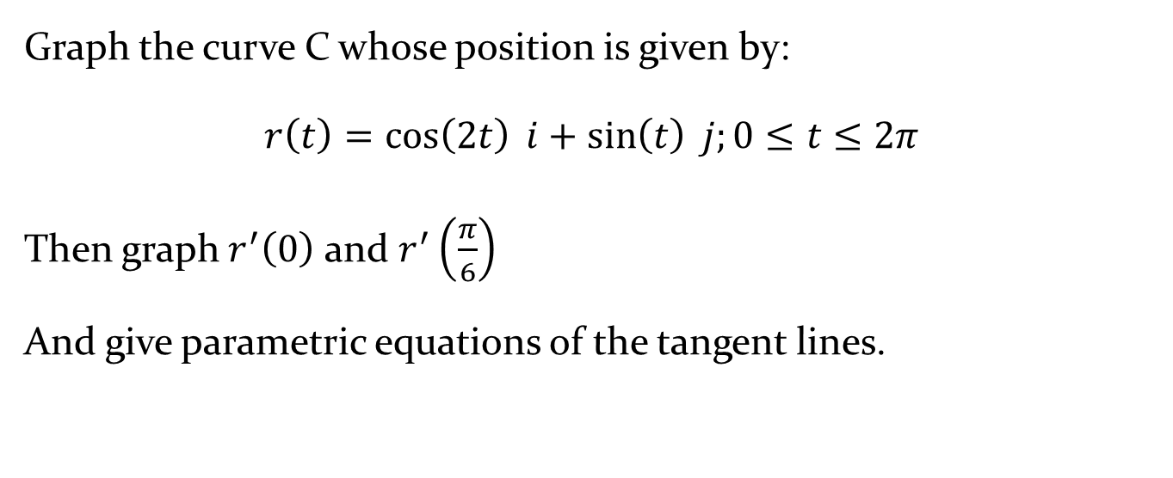
Example 7
Graph the curve C whose position is given by:
$$r\left(t\right)=\cos\left(2t\right) i+\sin\left(t\right) j;0≤t≤2π$$
Then graph $r^{′}\left(0\right)$ and $r^{′}\left(\frac{π}{6}\right)$
And give parametric equations of the tangent lines.

Slide 25
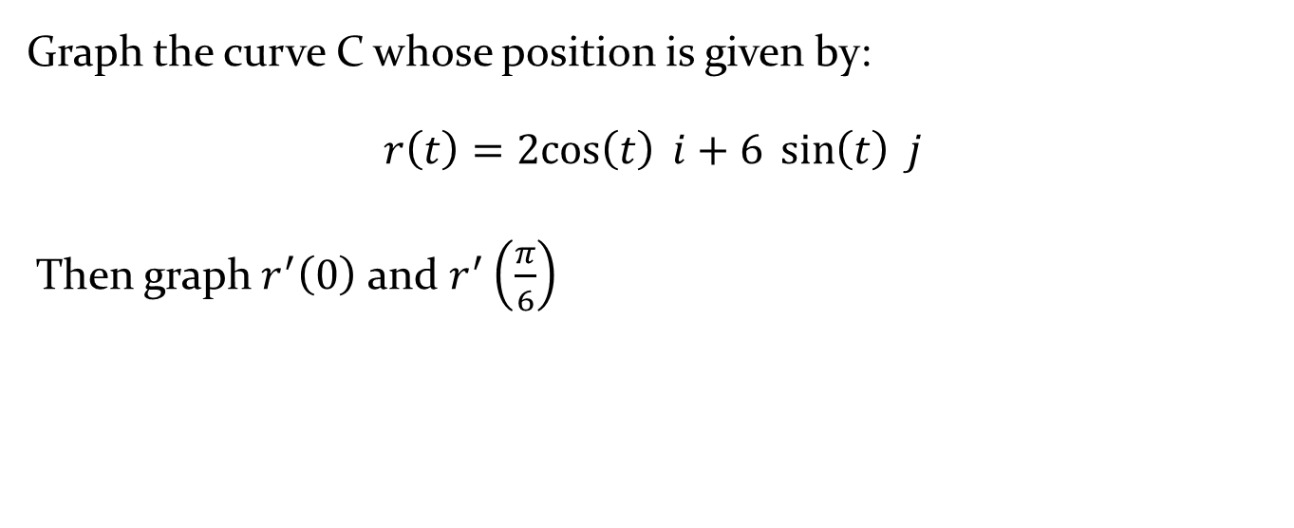
Example 8
Graph the curve C whose position is given by:
$$r\left(t\right)=2cos\left(t\right) i+6 \sin\left(t\right) j$$
Then graph $r^{′}\left(0\right)$ and $r^{′}\left(\frac{π}{6}\right)$

Slide 26
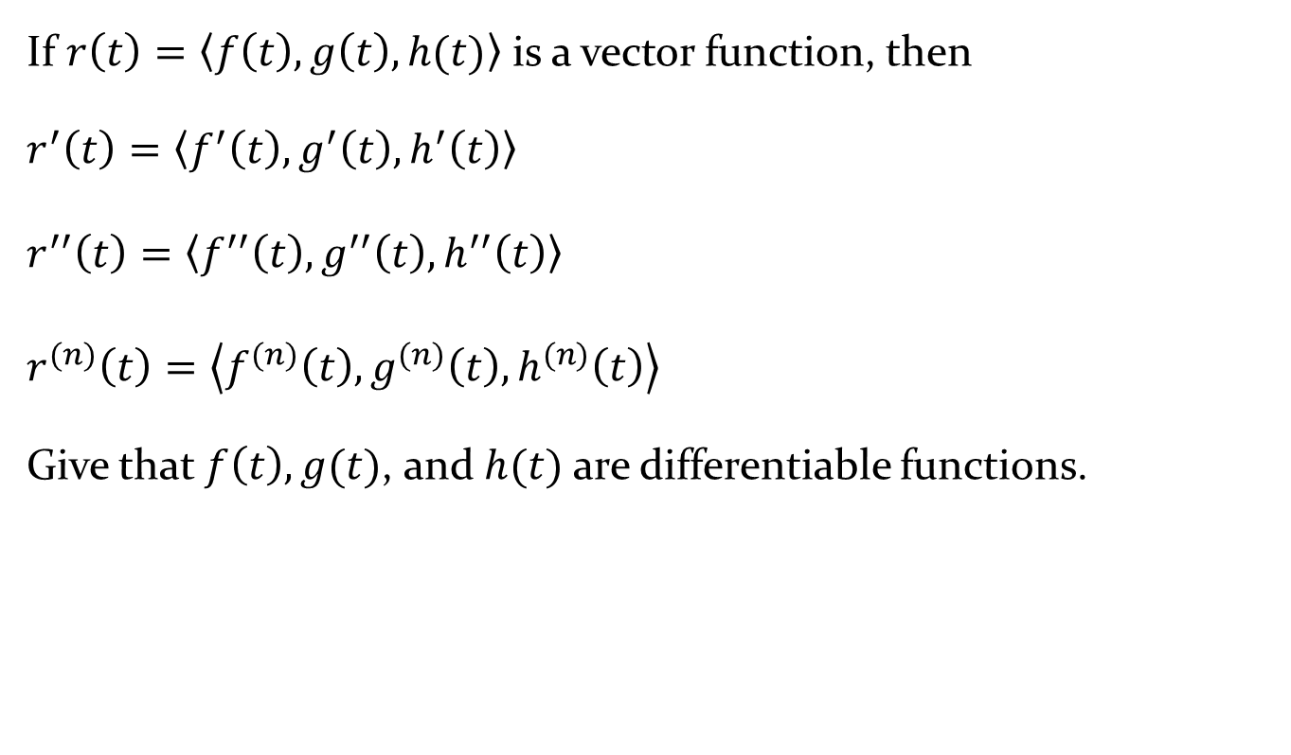
Definition: Higher Derivatives of Vector Functions
If $r\left(t\right)=\left\langle f\left(t\right), g\left(t\right), h(t)\right\rangle$ is a vector function, then
$$r^{′}\left(t\right)=\left\langle f^{′}\left(t\right),g^{′}\left(t\right),h^{′}\left(t\right)\right\rangle$$
$$r^{′′}\left(t\right)=\left\langle f^{′′}\left(t\right),g^{′′}\left(t\right),h^{′′}\left(t\right)\right\rangle$$
$$r^{(n)}\left(t\right)=\left\langle f^{(n)}\left(t\right),g^{(n)}\left(t\right),h^{(n)}\left(t\right)\right\rangle$$
Give that $f\left(t\right), g(t)$, and $h(t)$ are differentiable functions.

Slide 27
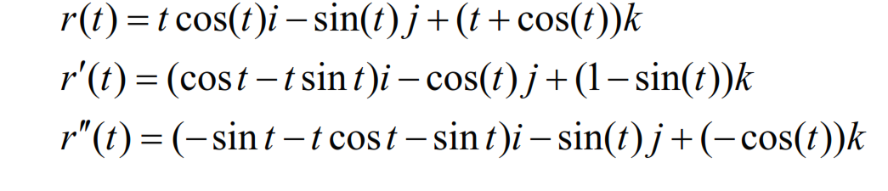
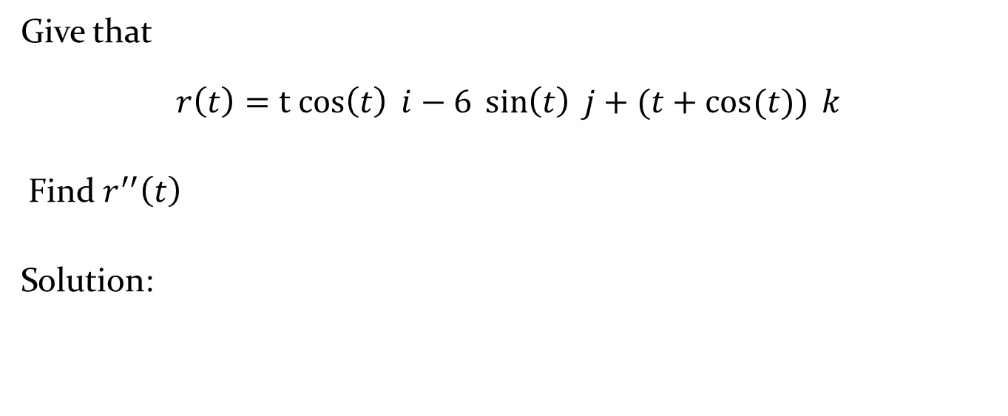
Example 9
Give that
$$r\left(t\right)=t cos\left(t\right) i−6 \sin\left(t\right) j+(t+\cos{(t)) }k$$
Find $r^{′′}\left(t\right)$
Solution:

Slide 28
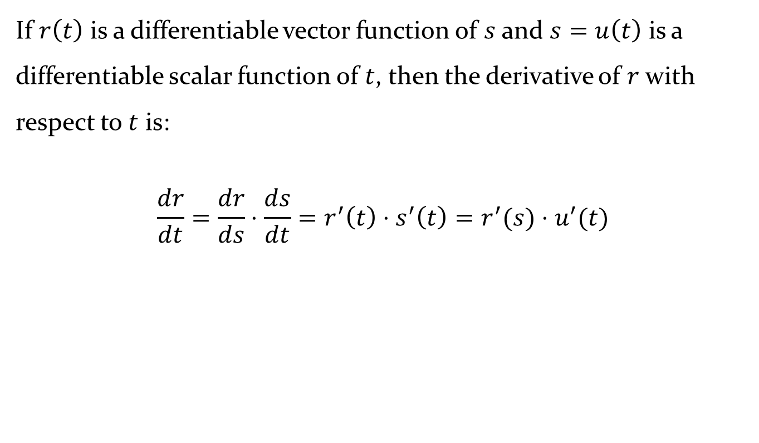
Definition 9.1.3: Chain Rule
If $r\left(t\right)$ is a differentiable vector function of $s$ and $s=u\left(t\right)$ is a differentiable scalar function of $t$, then the derivative of $r$ with respect to $t$ is:
$$\frac{dr}{dt}=\frac{dr}{ds}⋅\frac{ds}{dt}=r^{′}\left(t\right)⋅s^{′}\left(t\right)=r^{′}(s)⋅u^{′}(t)$$

Slide 29
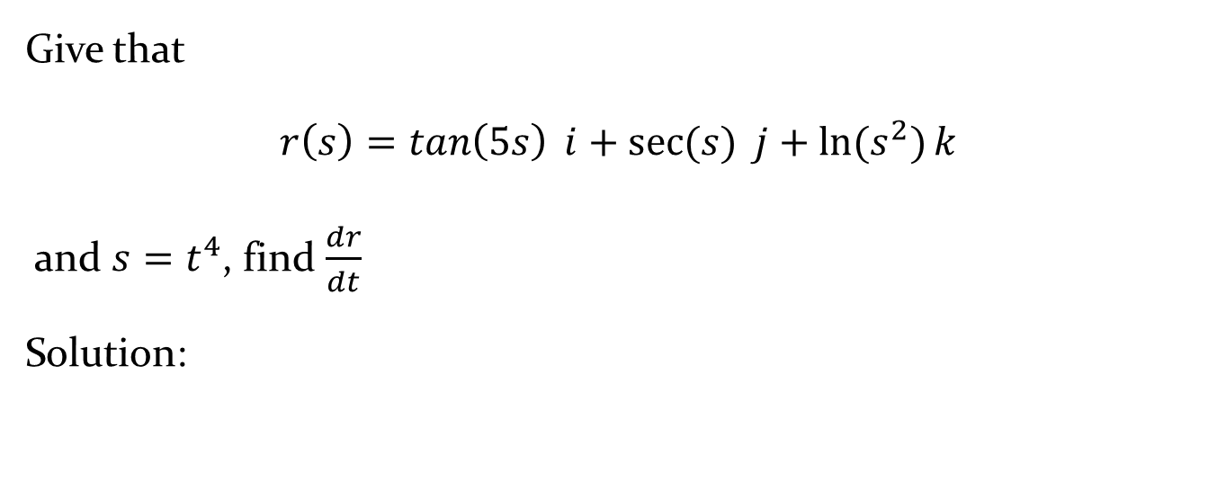
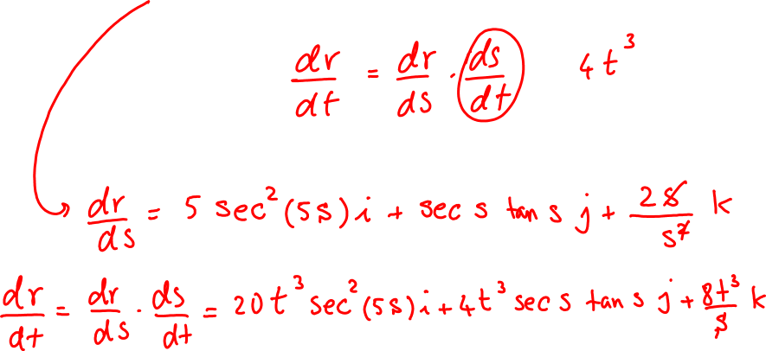
Example 10
Give that
$$r\left(s\right)=\tan\left(5s\right) i+\sec{(s)} j+\ln{(s^{2})}k$$
and $s=t^{4}$, find $\frac{dr}{dt}$
Solution:

Slide 30
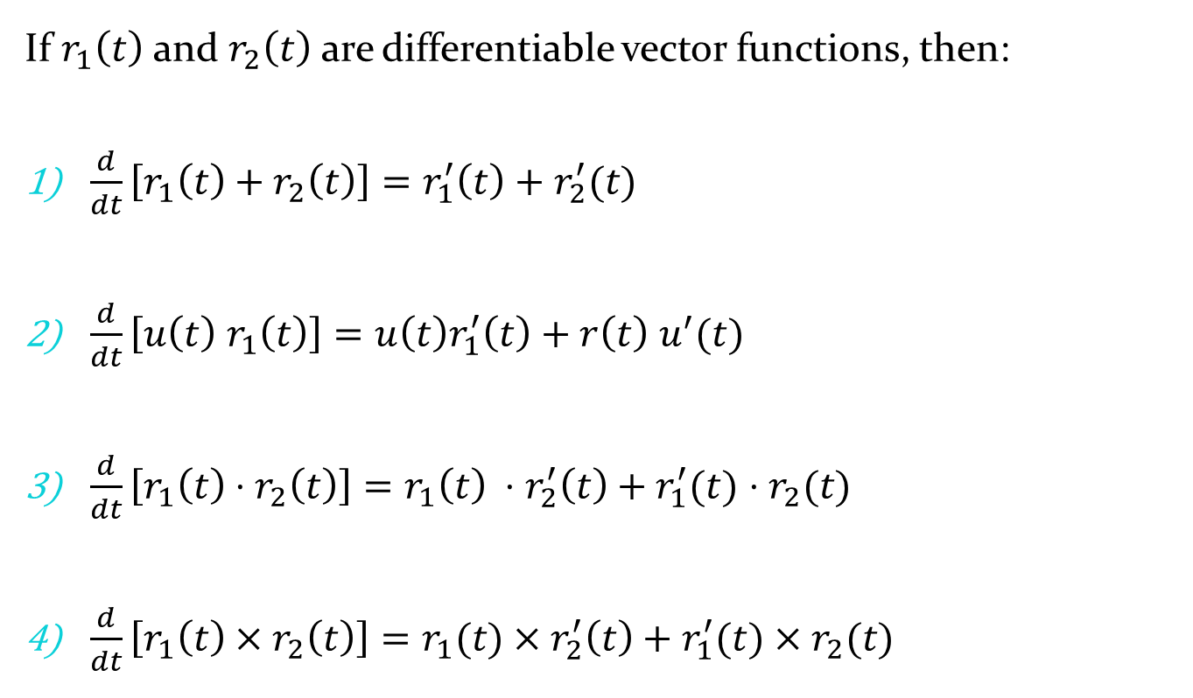
Rule of Differentiation
If $r_{1}\left(t\right)$ and $r_{2}\left(t\right)$ are differentiable vector functions, then:
$\frac{d}{dt}\left[r_{1}\left(t\right)+r_{2}\left(t\right)\right]=r_{1}^{′}\left(t\right)+r_{2}^{′}(t)$
$\frac{d}{dt}\left[u\left(t\right) r_{1}\left(t\right)\right]={u\left(t\right)r}_{1}^{′}\left(t\right)+r\left(t\right) u^{′}(t)$
$\frac{d}{dt}\left[r_{1}\left(t\right)⋅r_{2}\left(t\right)\right]=r_{1}\left(t\right) ⋅r_{2}^{′}\left(t\right)+r_{1}^{′}(t)⋅r_{2}(t)$
$\frac{d}{dt}\left[r_{1}\left(t\right)×r_{2}\left(t\right)\right]=r_{1}(t)×r_{2}^{′}\left(t\right)+r_{1}^{′}(t)×r_{2}(t)$

Slide 31
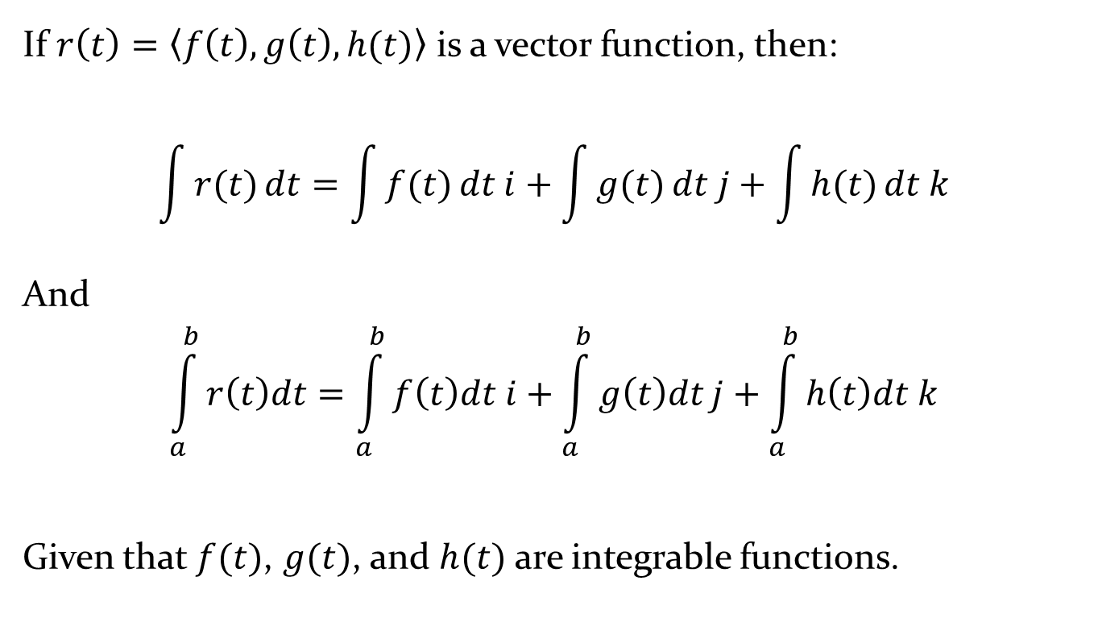
Definition: Integrals of Vector Functions
If $r\left(t\right)=\left\langle f\left(t\right), g\left(t\right), h(t)\right\rangle$ is a vector function, then:
$$\int{r(t)}dt=\int{f(t)}dt i+\int{g(t)}dt j+\int{h(t)}dt k$$
And
$$\int_{a}^{b}{r\left(t\right)dt}=\int_{a}^{b}{f\left(t\right)dt i+\int_{a}^{b}{g\left(t\right)dt}j+\int_{a}^{b}{h\left(t\right)dt k}}$$
Given that $f(t)$, $g(t)$, and $h(t)$ are integrable functions.

Slide 32
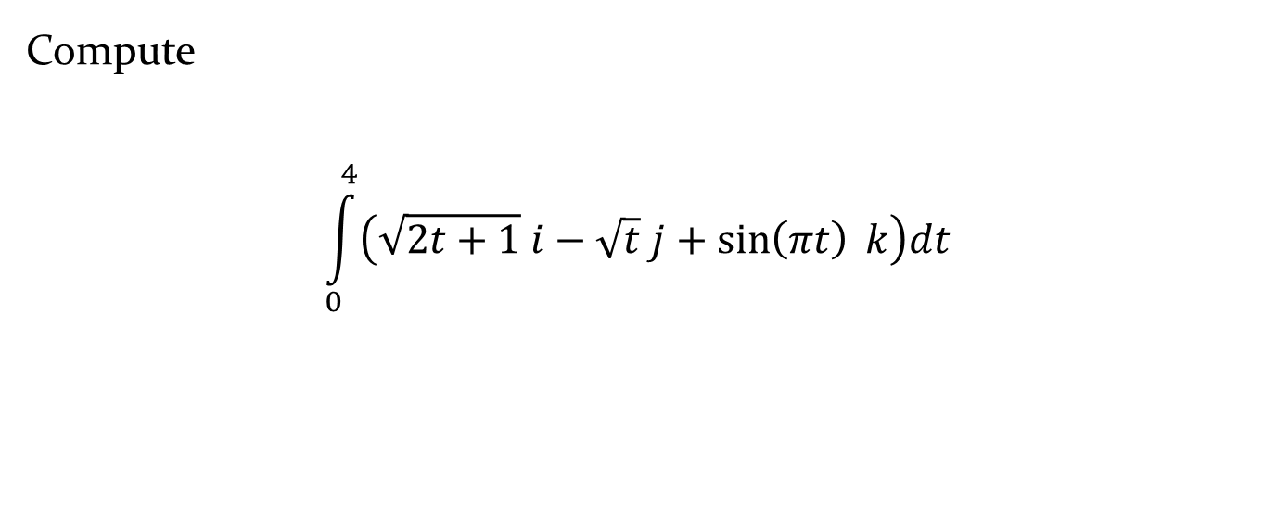
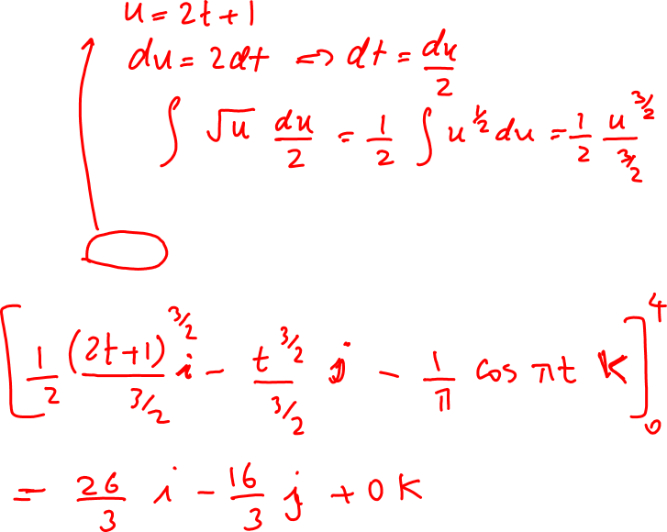
Example 11
Compute
$$\int_{0}^{4}{\left(\sqrt{2t+1} i−\sqrt{t} j+\sin\left(πt\right) k\right)dt}$$

Slide 33
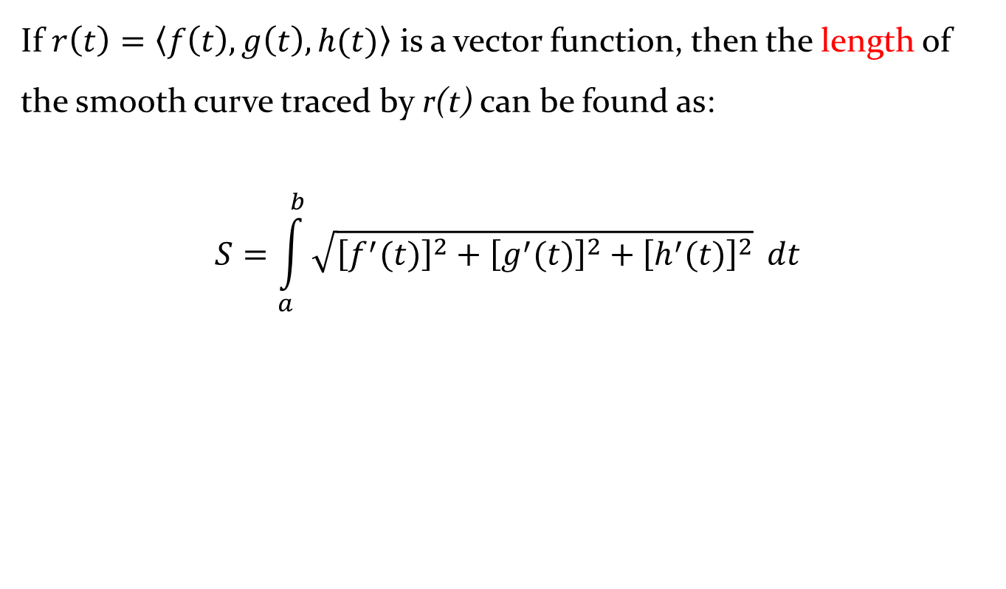

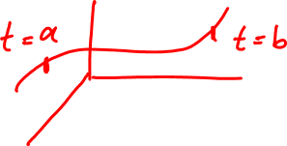


Definition: Length of a space curve
If $r\left(t\right)=\left\langle f\left(t\right), g\left(t\right), h(t)\right\rangle$ is a vector function, then the length of the smooth curve traced by r(t) can be found as:
$$S=\int_{a}^{b}{\sqrt{{\left[f^{′}(t)\right]}^{2}+{\left[g^{′}(t)\right]}^{2}+{\left[h^{′}(t)\right]}^{2}}} dt$$

Slide 34
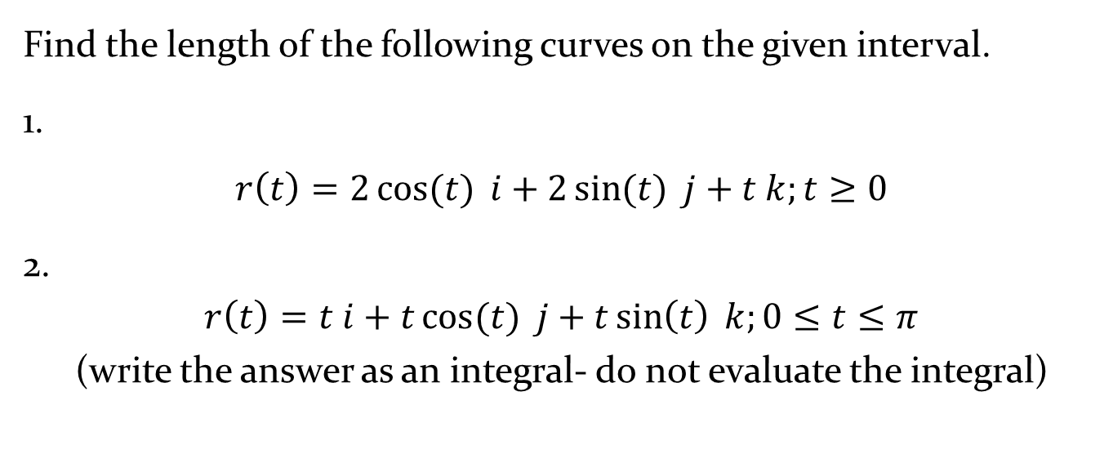
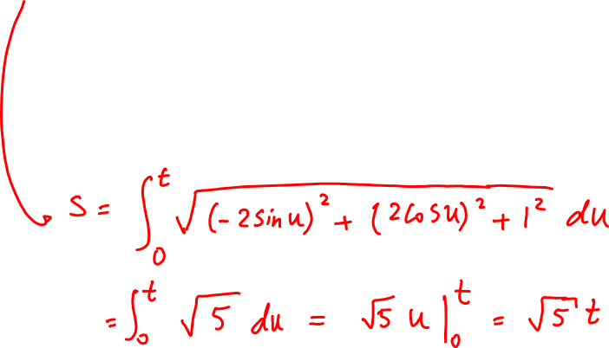
Example 12
Find the length of the following curves on the given interval.
1.
$$r\left(t\right)=2\cos{(t)} i+2\sin{(t)} j+t k;t≥0$$
2.
$$r\left(t\right)=t i+t\cos{(t)} j+t\sin\left(t\right) k;0≤t≤π$$
(write the answer as an integral- do not evaluate the integral)

Slide 35
Example 12 - Solution

