Slide 1
Chapter
3
Strategic Planning for Competitive Advantage
Kaleem Mahmood
BUSI2204A
Fall 2017

Slide 2
Learning Outcomes
Strategic planning
Key terms:
  Mission statement
  Goals / Objectives
  Core competence
  Sustainable Competitive Advantage
Growth strategy
  Business portfolio analysis
  Market-product analysis
Marketing planning process

Slide 3
The Nature of Strategic Planning
… the organization’s objectives and resources
… evolving market opportunities
Strategic planning
Creating and maintaining a fit between …
1

Slide 4
The Nature of Strategic Planning
Corporate Planning
SBU
Individual businesses that are related
SBU
Individual businesses that are related
Individual businesses that are related
Business Unit
Marketing
Corporate
Individual businesses that are related
1

Slide 5
Corporate Strategy
  Setting the mission for a firm as a whole
1

Slide 6
Business Unit Strategy
  A business unit is an identifiable unit, within a large company, that markets a set of related products to a clearly defined group of customers. Examples? http://www.bayer.com/
1

Slide 7
Functional Strategy
  Functional areas: e.g., marketing, etc…
  Deals with questions of how the function can best support the business unit strategy.
  Decisions relating to the implementation of a specific business function
1

Slide 8
Key Terms
Mission Statement
Goals / Objectives
Core Competencies
Sustainable Competitive Advantage
2

Slide 9
Mission statement
  A statement of the organization’s purpose
Be be market-oriented, rather than product-oriented
  Product-oriented:
    E.g. “We make and sell telephones” or “We are a food processing firm”.
  Market-oriented:
    defines the business in terms of satisfying customer needs.
    Examples?
      3M: We solve people’s problems by putting innovation to work for them
2

Slide 10
Goals or Objectives
    Convert the mission into targeted levels of performance to be achieved, often by a specific time.
    be clear, specific, numeric, and limited to a particular time period. Remember SMART!
Example: Increase sales by 50 percent by year end 2018
2

Slide 11
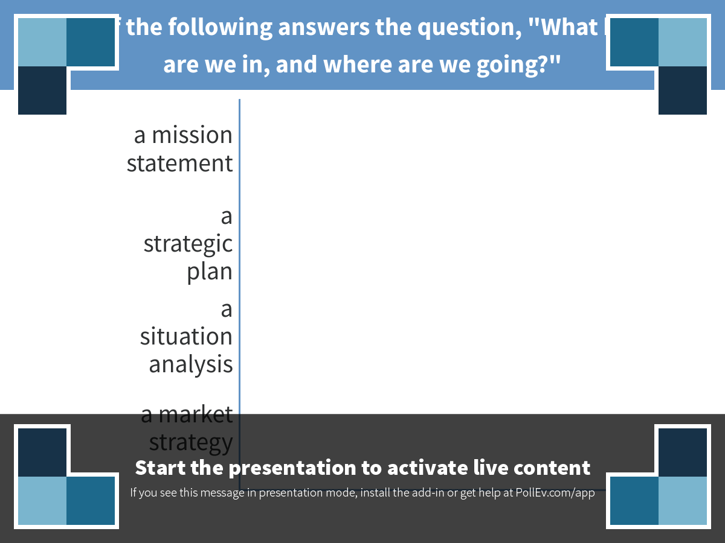
Notes:
Which of the following answers the question, "What business are we in, and where are we going?"
https://www.polleverywhere.com/multiple_choice_polls/1PZ5Le6jAVKrujC

Slide 12
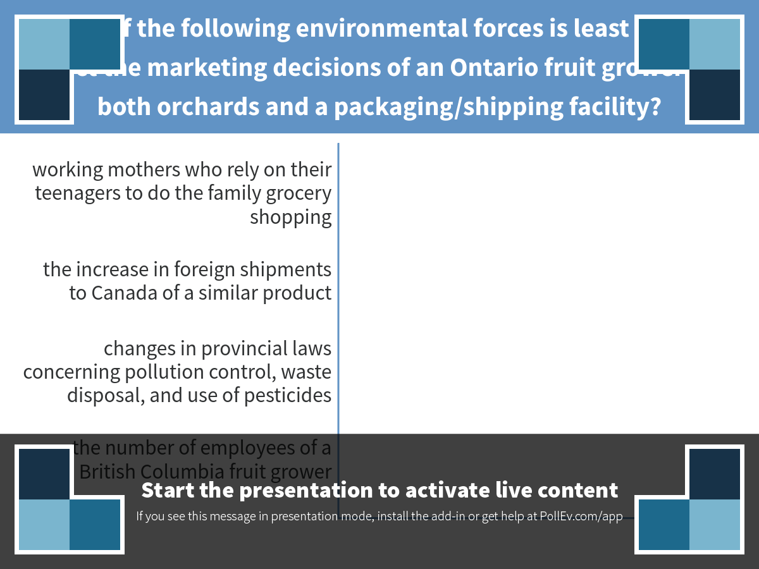
Notes:
Which of the following environmental forces is least likely to impact the marketing decisions of an Ontario fruit grower with both orchards and a packaging/shipping facility?
https://www.polleverywhere.com/multiple_choice_polls/kLQHRGRnyWpsImS

Slide 13
Distinct core competence
  an organization's special capabilities, including the skills, technologies, and resources that distinguish it from other organizations.
  Examples for 3M, Honda, Apple
2

Slide 14
Sustainable competitive advantage
  Competencies should be distinctive enough to provide a sustainable competitive advantage , a unique strength relative to competitors that is not easily copied and thus can be maintained over a long period of time.
  Strategies to develop sustainable competitive advantages:
2

Slide 15
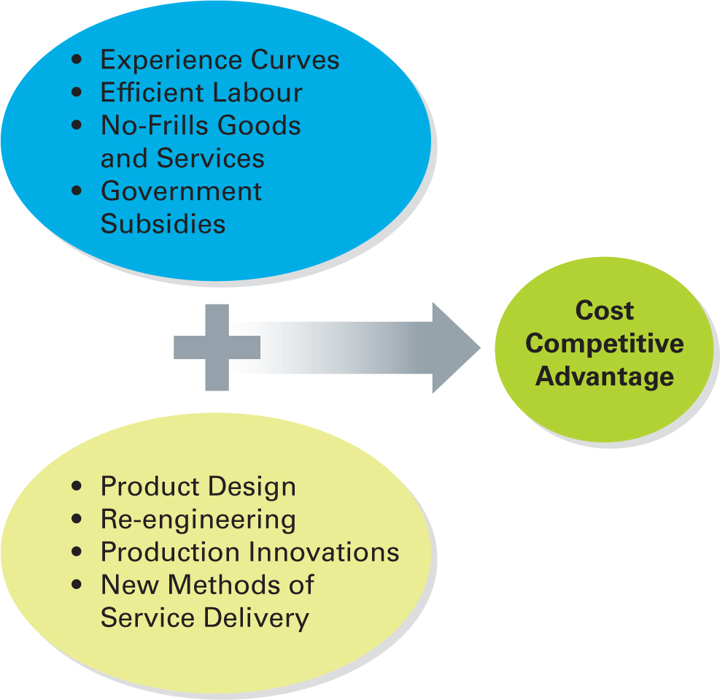
Cost Competitive Advantage
2

Slide 16
Product/Service Differentiation Competitive Advantage
A unique benefit that is valuable to buyers beyond simply offering a low price
Provides a longer-lasting competitive advantage, hence more attractive to managers
2
Notes:
Have a discussion on the product/service differentiation competitive advantage being offered by Oakley by visiting the website: http://ca.Oakley.com/en/custom.

Slide 17
Niche Competitive Advantage
Serving the needs of a segment that has good growth potential but is not crucial to the success of the major competitors
  Geographic niche
  Product niche—Booster Juice
2

Slide 18
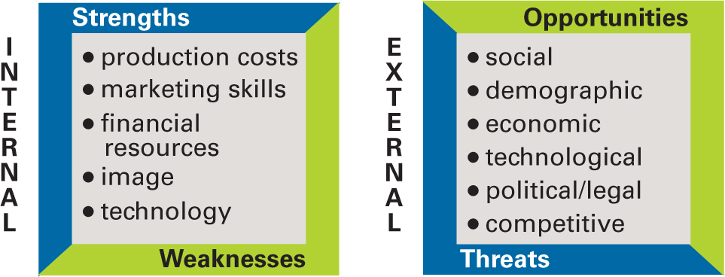
Conducting a
Situation (SWOT) Analysis
3

Slide 19
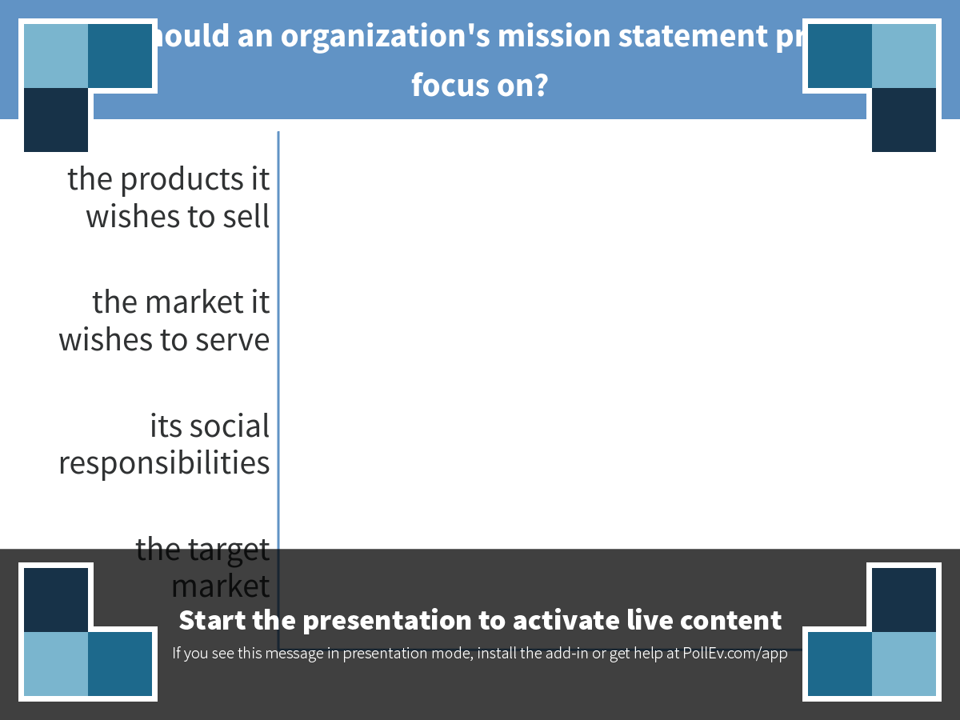
Notes:
What should an organization's mission statement primarily focus on?
https://www.polleverywhere.com/multiple_choice_polls/uUrMEw9E3UWE4WE

Slide 20
Growth Strategies
  Where do you want to go?
3

Slide 21
Growth Strategies
  Business Portfolio Analysis (BCG Portfolio Matrix):
    often used for corporate strategic planning
  (b) Market-Product Analysis (Ansoff’s Strategic Opportunity Matric)
    often used for business unit strategic planning
3

Slide 22
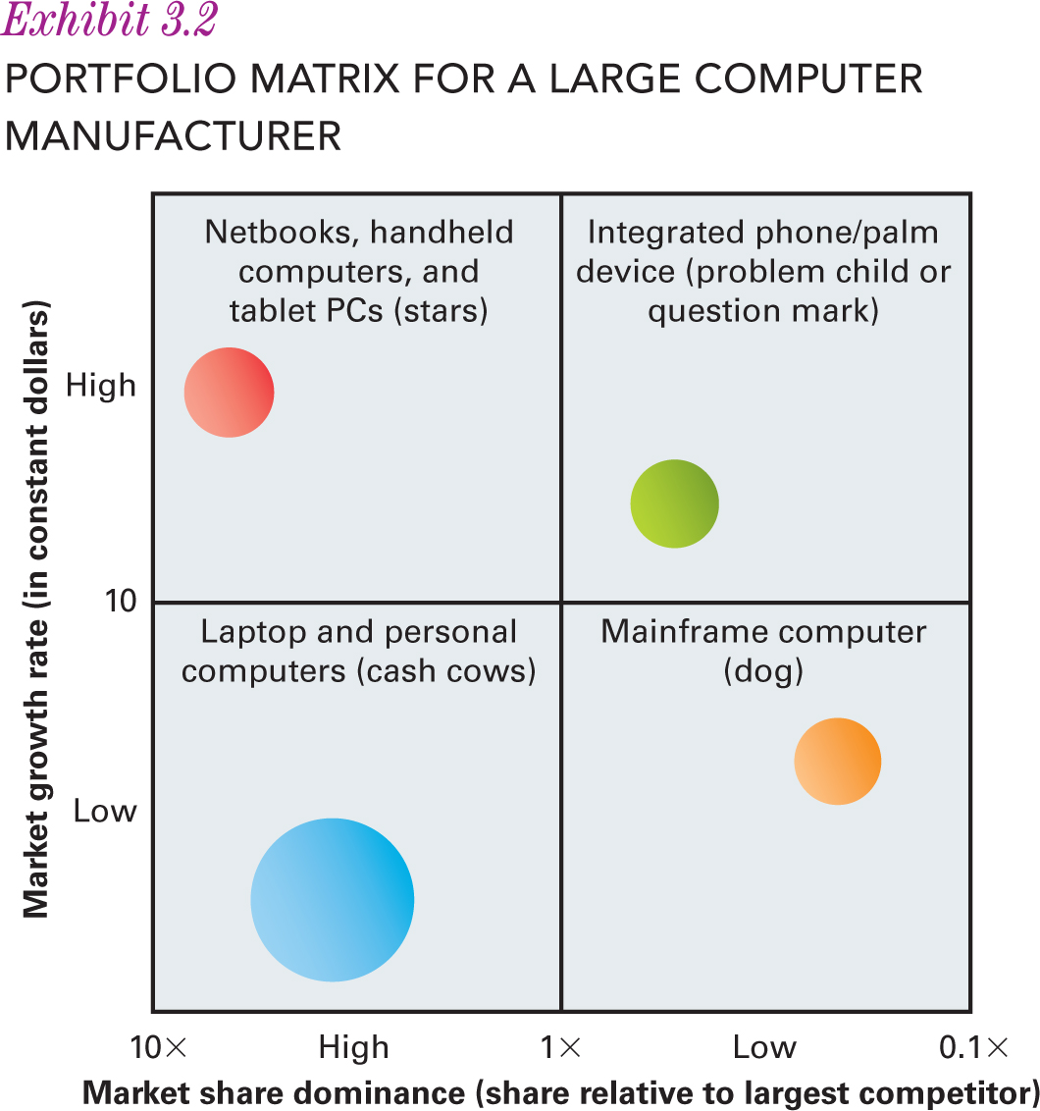
BCG Portfolio Matrix
3

Slide 23
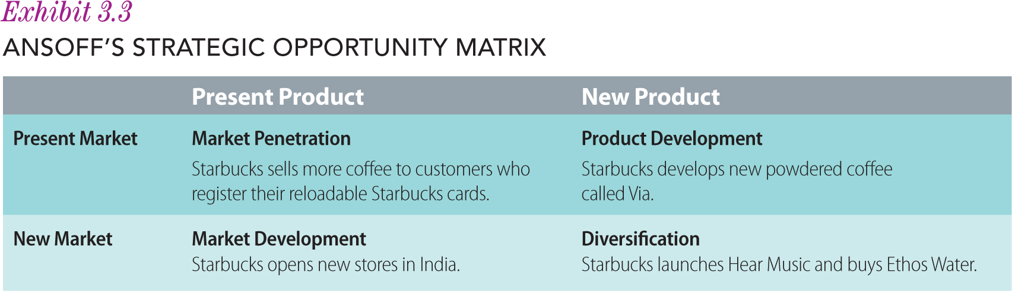
Strategic Alternatives—Developing Growth Strategies
3

Slide 24
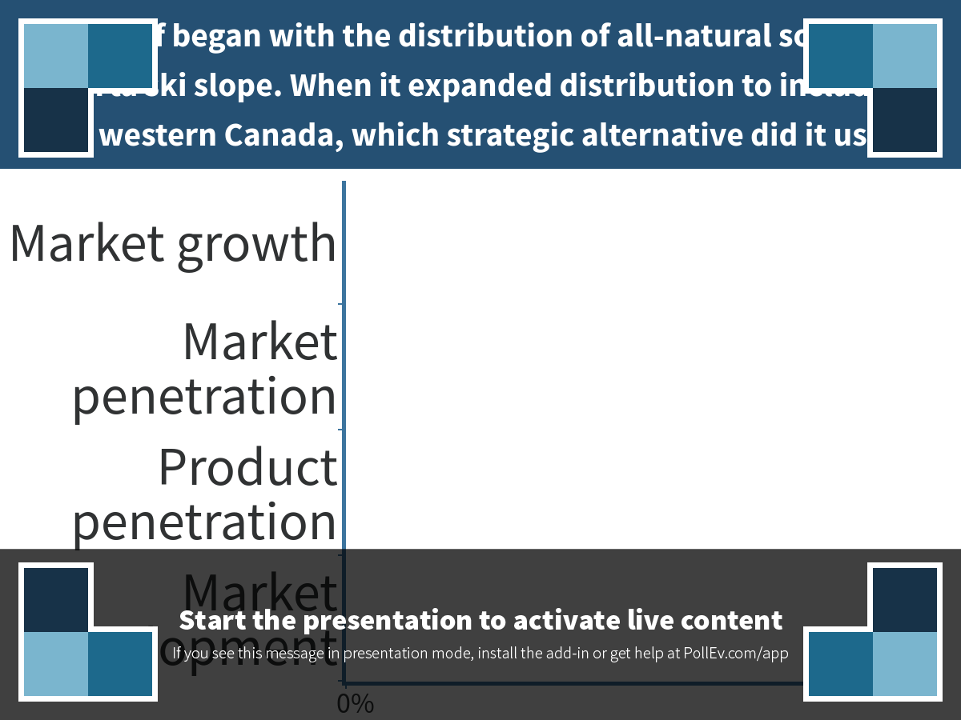
Notes:
Ski Banff began with the distribution of all-natural soda at an Alberta ski slope. When it expanded distribution to include all of western Canada, which strategic alternative did it use?
https://www.polleverywhere.com/multiple_choice_polls/1jFm9cE98yyXkXO

Slide 25
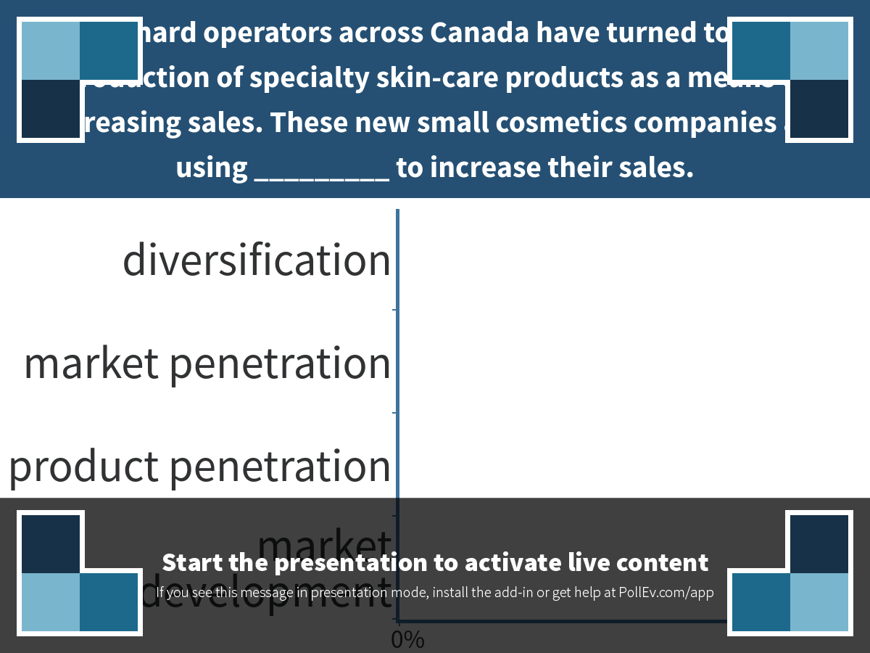
Notes:
Orchard operators across Canada have turned to the production of specialty skin-care products as a means of increasing sales. These new small cosmetics companies are using _________ to increase their sales.
https://www.polleverywhere.com/multiple_choice_polls/9SadGMR2FwaM1Bl

Slide 26
In-class Challenge
How to implement the four growth strategies for Sprott School of Business?
3

Slide 27
Marketing Planning Process
4

Slide 28
CUSTOMER ANALYSIS
COMPETITOR ANALYSIS
INTERNAL ANALYSIS
EXTERNAL ANALYSIS
Statistics
Shopping / usage behavior
Buying process
Direct / indirect competitors
Their current / previous strategies
Importance of this market to them
Likely actions and reactions
Objectives
Strengths / weaknesses
Current / past performance
Fit with other products
Cultural
Demographics
Political
Economic
Social
Technological
SEGMENTATION
Possible segments
Size of segments
Growth potential
Analysis
TARGET
MARKET
SELECTION
DIFFERENTIATION
IMPLICATIONS FOR
MARKETING STRATEGY
Benefits valued by customer
Added value from specific
combinations of benefits
Product
Price
Distribution channels
Promotion
- advertising
- sales force
POSITION
Decisions
OUTCOMES
Financial
Other
Outcomes
4

Slide 29
The Nederlander Organization
Video

Slide 30
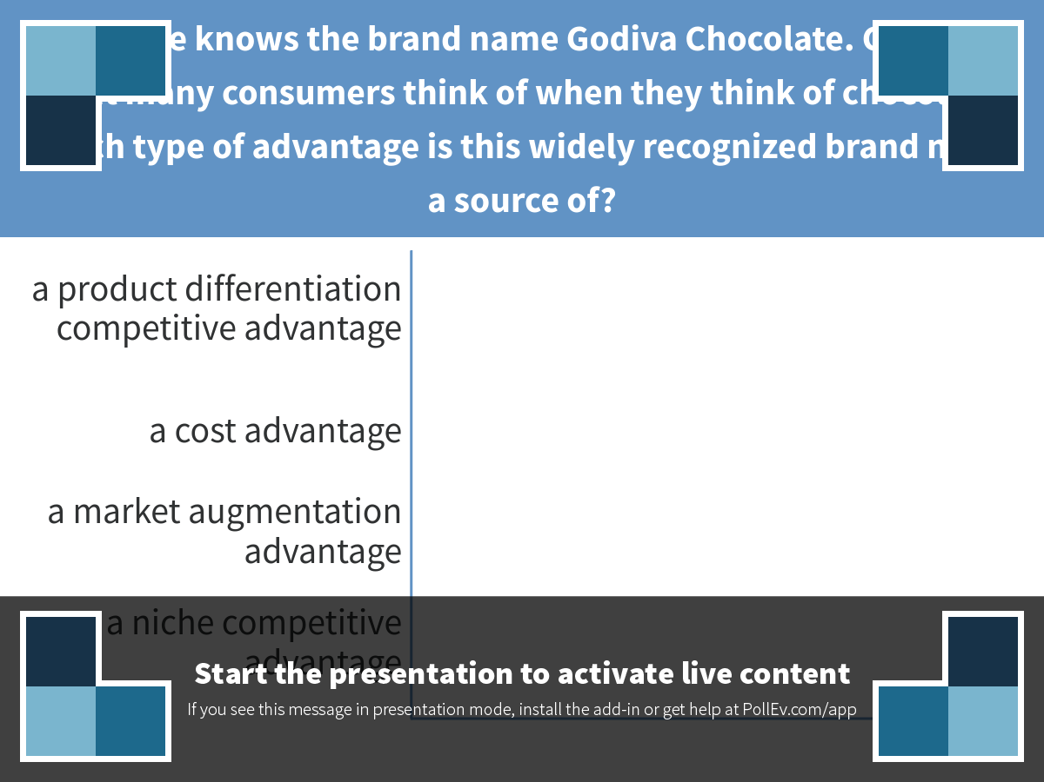
Notes:
Everyone knows the brand name Godiva Chocolate. Godiva is what many consumers think of when they think of chocolate. Which type of advantage is this widely recognized brand name a source of?
https://www.polleverywhere.com/multiple_choice_polls/FWcLjUVR4jdA6qz

