Slide 1
Chapter
2
The Marketing Environment, Social Responsibility, and Ethics
Kaleem Mahmood
BUSI2204A
Fall 2017

Slide 2
Learning Outcomes
1. Macro-environmental Factors
2. Corporate Social Responsibility

Slide 3
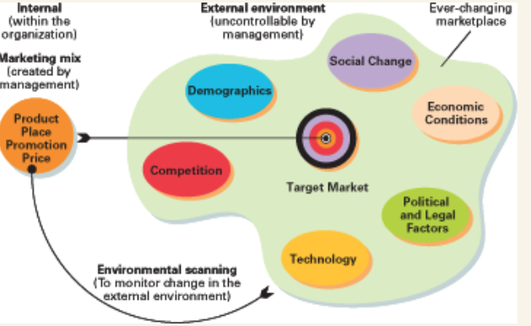
Macro-environmental Factors

Slide 4
Target Market
The External Marketing Environment
Consumers
Changes in the external environment cause new consumers to come and current ones to go.
1

Slide 5
What is a Trend?
The specific or general direction that a society is headed.
Trends are enduring phenomena that are radically impacting the way consumers behave in the marketplace and/or the way we do business.
1
Notes:
Promo = Promotion

Slide 6
Environmental Forces
Social/Cultural
Demographic
Economic
Technological
Political / Legal
Competition
1

Slide 7
1. Social/Cultural Factors
Influence Consumers
Attitudes
Values
Lifestyles
1

Slide 8
Canadian values and Perceptions
Four values that strongly influence Canadians:
  self-sufficiency
  upward mobility
  work ethic
  fairness
Perception that Canadians are:
  trustworthy
  family-oriented
  conservative
  eco-conscious
Canadians are tolerant and respectful of other cultures
1

Slide 9
2. Demographic Factors
Strongly related to behaviour
Age
Race and Ethnicity
Location
1

Slide 10
Demographic Factors
Gen-Xers
Baby Boomers
Affluent
Cynical?
Outsource day-to-day living tasks
Born 1966-1978
Time-starved
Active
Contrasting segments
Born 1947-1965
1
Notes:
Gen X – 1966-178
Gen Y – 1979-1994
Tweens
Ages 9-14
- Baby boomers – 1947-1965

Slide 11
Demographic Factors
Gen-Zers
Tweens: (aged 9 to 14)
Gen-Yers
Born 1979–1994
Cellphones
Purchase influence
Purchasing power
Key influencers in family
Early in careers
Work–life balance
Entrepreneurial
Savvy, opinionated
Networking and social media skills
Teens:
1

Slide 12
Population Shifts in Canada
More than 50% of the Canadian population lives in four major urban regions.
90% of new immigrants live in a large metropolitan market.
Movement to suburb or surrounding urban municipality
1

Slide 13
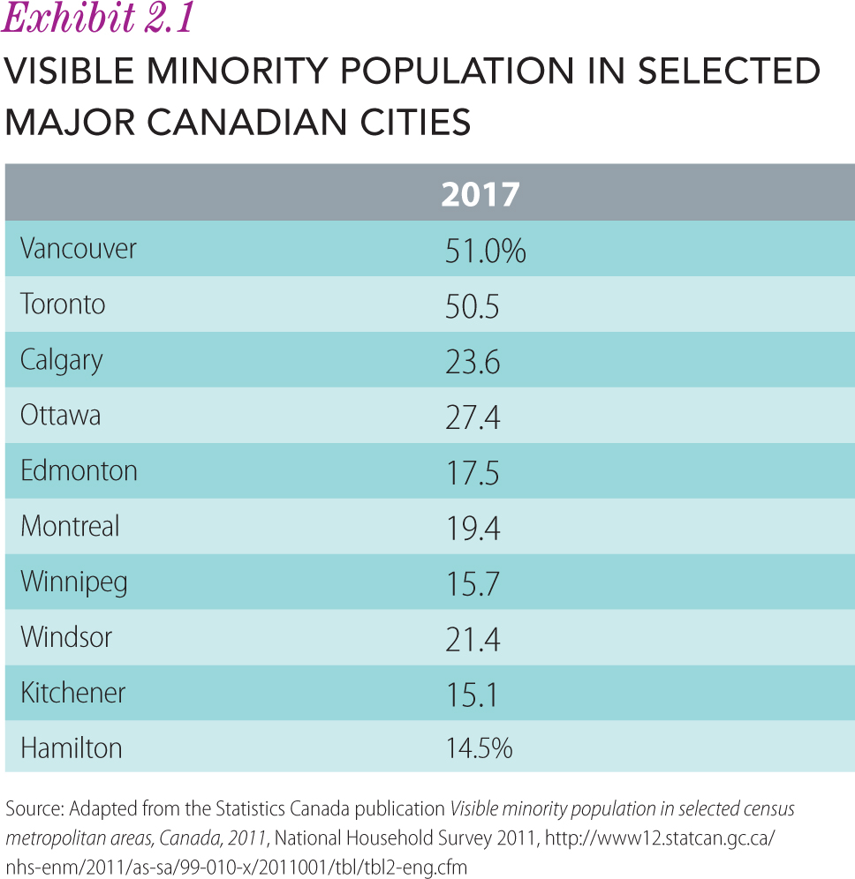
Growing Ethnic Markets
1

Slide 14
3. Economic Factors
Consumer Purchasing Behaviour
Consumer Income
Inflation
Recession
1

Slide 15
Consumers’ Incomes
Median total family income = $76,000
Education: primary determinant of earning potential
One-quarter of Canadians currently spend over 30% of their income on shelter, far exceeding the affordable housing standards.
1
Notes:
As a result of high housing costs, many Canadians have turned to credit.

Slide 16

Purchasing Power
1

Slide 17
Purchasing Power
Income
Cost of Living
Purchasing Power
1

Slide 18
Inflation
Impacts consumers’ purchasing power if salary increases don’t keep up with inflation
Inflation pressures consumers to make more economical purchases and still maintain their standard of living.
Marketers must be very cognizant of inflation on consumers’ ability to purchase.
1

Slide 19
Recession
A period of economic activity characterized by negative growth
In a recession, consumers consider the price–value relationship deliberately before making purchases.
1

Slide 20
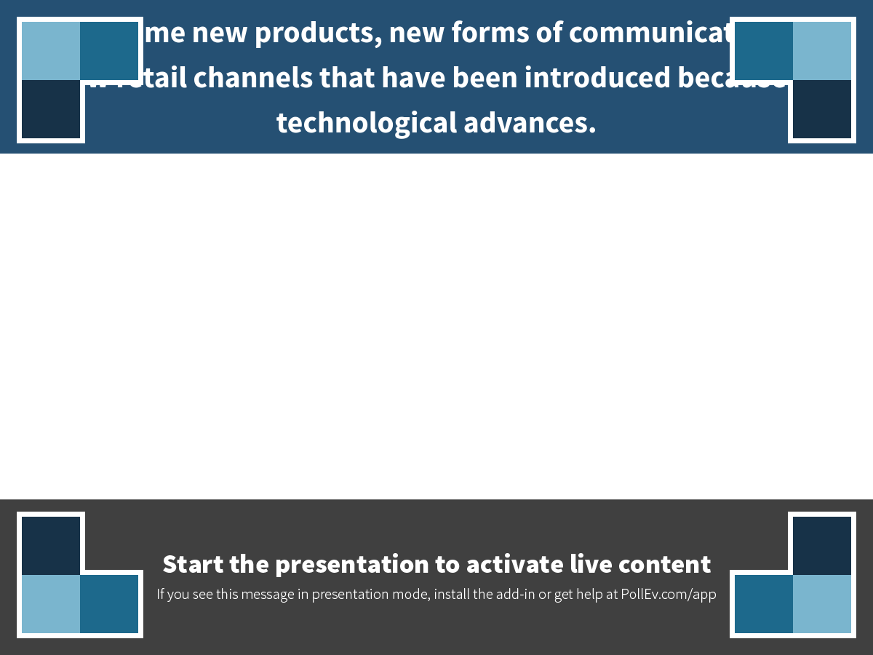
Notes:
Name some new products, new forms of communication, and new retail channels that have been introduced because of technological advances.
https://www.polleverywhere.com/free_text_polls/YSOltqXWD3GaATG

Slide 21
4. Technological Factors
External Technology Is Important.
Operate more efficiently and build a better product.
Make current products obsolete and create disruptive innovations.
Research
Entrepreneurial
Spirit
1

Slide 22
5. Political and Legal Factors
Federal Legislation
Competition Act
Provincial and Territorial Laws
Quebec's Bill 101
Alberta liquor law versus LCBO
Self-Regulation
ASC
CAB
Consumer Packaging and Labelling Act
CRTC — CASL
1

Slide 23
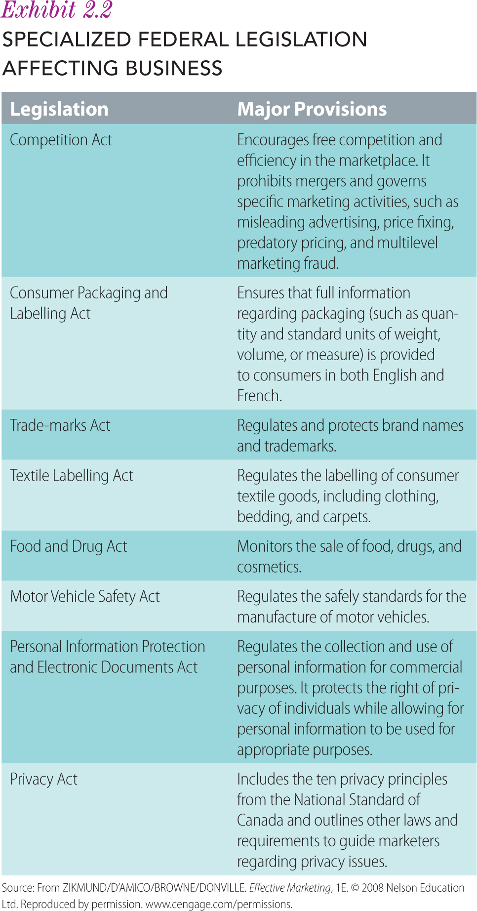
Political and Legal Factors
1

Slide 24
6. Competitive Factors
Management Has Little Control
The Number
The Size
The Degree of Interdependence
1

Slide 25
6. Competitive Factors
Direct competition
  The products are similar, either physically or conceptually.
Indirect competition
  Offer substitute goods which may be very different physically and conceptually from yours but which meet a common need.
1

Slide 26
In-class participation
Assume you manage a brand of disposable diapers.
Trends indicate that women are marrying later, having children later, and are having fewer children.
At the same time, you notice that the population in Canada is also rapidly aging.
How are these trends relevant to your business? What opportunities or threats do these trends represent to you?
1

Slide 27
Corporate Social Responsibility
Sustainability
  Outperform competition by focusing on the world’s social problems as opportunities
Profit Focus
  Leave social and environmental problems to nonprofits and government
2

Slide 28
Pyramid of
Corporate Social Responsibility
Economic performance
Philanthropic responsibilities
Ethical responsibilities
Legal responsibilities
2

Slide 29
Ethical Behaviour in Business
Ethics: standard of behaviour by which conduct is judged
  Laws are the values and standards enforced by courts.
  Ethics are the moral principles and values.
Morals: rules developed as a result of cultural norms and values
2

Slide 30
Ethical Guidelines
Help employees identify the business practices their firm recognizes as being acceptable
Can be an effective internal control on behaviour
  More desirable than external controls such as government regulation
Help employees avoid confusion when determining whether their decisions are ethical
The process of formulating the code of ethics facilitates discussion among employees.
2

