Slide 1
BUSI2204A
Session 1
Kaleem Mahmood

Slide 2
Learning Outcomes
Define marketing
Describe the evolution of marketing
Define key marketing terms
Understand the purpose of Marketing

Slide 3
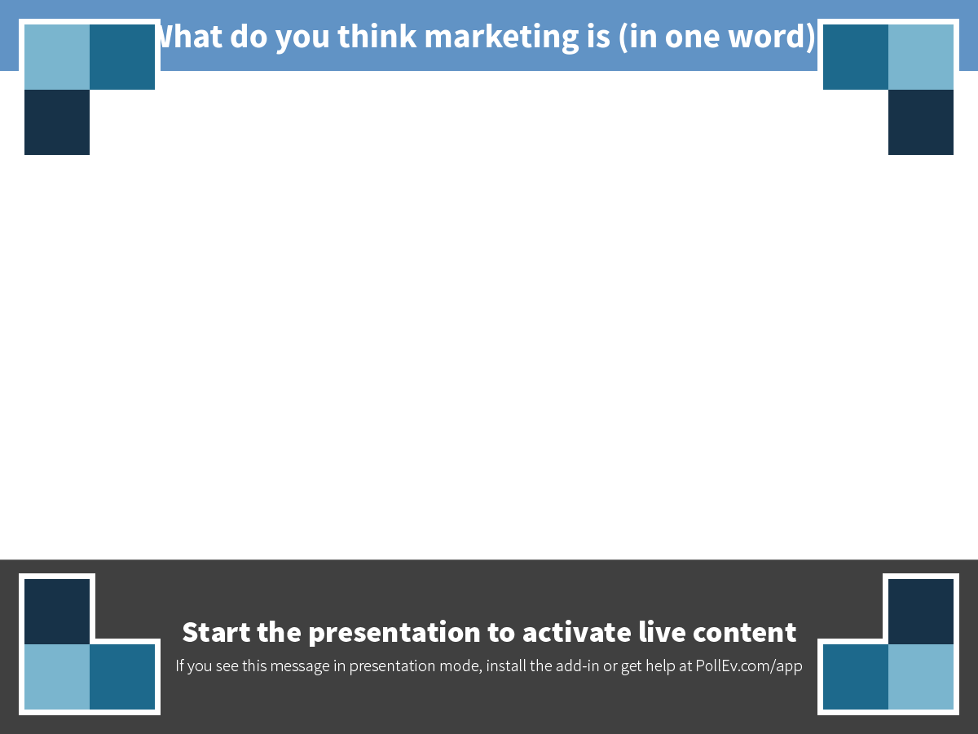
Notes:
What do you think marketing is (in one word)?
https://www.polleverywhere.com/free_text_polls/hgyyp0wDspLfq16

Slide 4
What Is Marketing?
Marketing
The activities that develop an offering in order to satisfy a customer need
Need
A state of being where we desire something that we do not posses but yearn to acquire
1

Slide 5
What Is Marketing?
Marketing is about understanding
the needs of the customer.
1

Slide 6
Need, Want, Demand?
Need: a physiological discomfort
Want: A desire for something so as to alleviate that discomforting condition
Demand: Human wants that are backed by buying power.
1

Slide 7
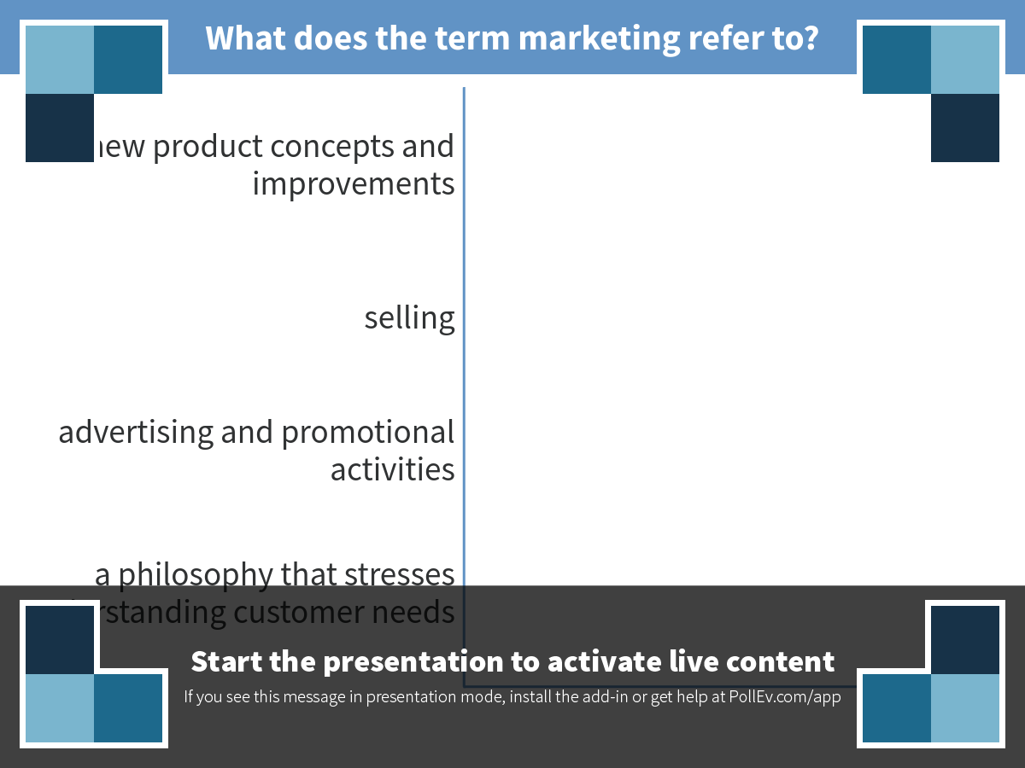
Notes:
What does the term marketing refer to?
https://www.polleverywhere.com/multiple_choice_polls/pBEnDl9gWkwckVQ

Slide 8
Marketing
A conversation with the customer rather than a distraction
The conversation is being led in innovative ways
Innovative ways that allow the consumer to talk back
1
Notes:
Instructor could talk about various social media tools that are dominating marketing conversations: Facebook, Twitter, Pinterest, Tumblr, Instagram, and so on.

Slide 9
Evolution of Marketing
Production
Orientation
Sales
Orientation
Marketing
Company
Orientation
Societal Marketing Orientation
Relationship Marketing Orientation
2

Slide 10
Production Orientation
Make it and they will buy it!
2

Slide 11
Sales Orientation
The evolution of sales techniques to convince consumers to buy
Competition now exists
2

Slide 12
Sales Orientation
“There will always, one can assume, be a need for some selling. But the aim of marketing is to make selling superfluous. The aim of marketing is to know and understand the customer so well that the product or service fits him and sells itself. Ideally, marketing should result in a customer who is ready to buy.”
—Peter F. Drucker
2
Notes:
Peter F. Drucker, Management: Tasks, Responsibilities, Practices, 2007, Transaction Publishers

Slide 13
Marketing Company Orientation
Coordination of marketing activities into one department
Goal: understand the consumer better—not just sell to them
2

Slide 14
Integrate
all the organization’s activities to satisfy customer wants and needs
Marketing
Concept
Focus
upon customer wants and needs
Achieve
long-term goals by satisfying customers, legally and responsibly
2

Slide 15
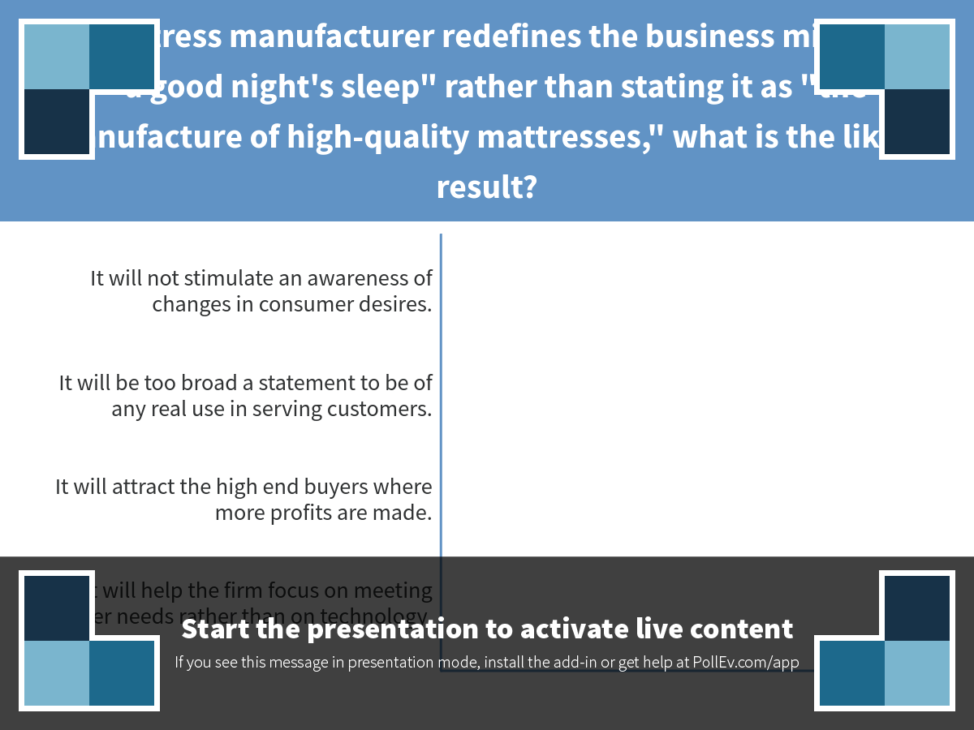
Notes:
If a mattress manufacturer redefines the business mission as "a good night's sleep" rather than stating it as "the manufacture of high-quality mattresses," what is the likely result?
https://www.polleverywhere.com/multiple_choice_polls/HosGwtly4V9wYBj

Slide 16
Societal Marketing Concept
A dual emphasis:
  Consideration of what the customer wants and what society wants!
2

Slide 17
Relationship Marketing Orientation
From “interruption to interaction”
2
Notes:
Engaging the customer beyond the one-shot sale is key to the relationship marketing orientation.

Slide 18
Relationship Marketing Orientation
Customer Satisfaction | Relationship Marketing
Focus on delighting the customer | Focus on keeping and improving relationships with customers
2

Slide 19
Building Relationships
Increase Market Share
Attract new customers
Increase existing business
Retain current customers
3
Notes:
Building relationships: attract new customers, increase existing business with customers, and retain current customers; this will lead to increased market share

Slide 20
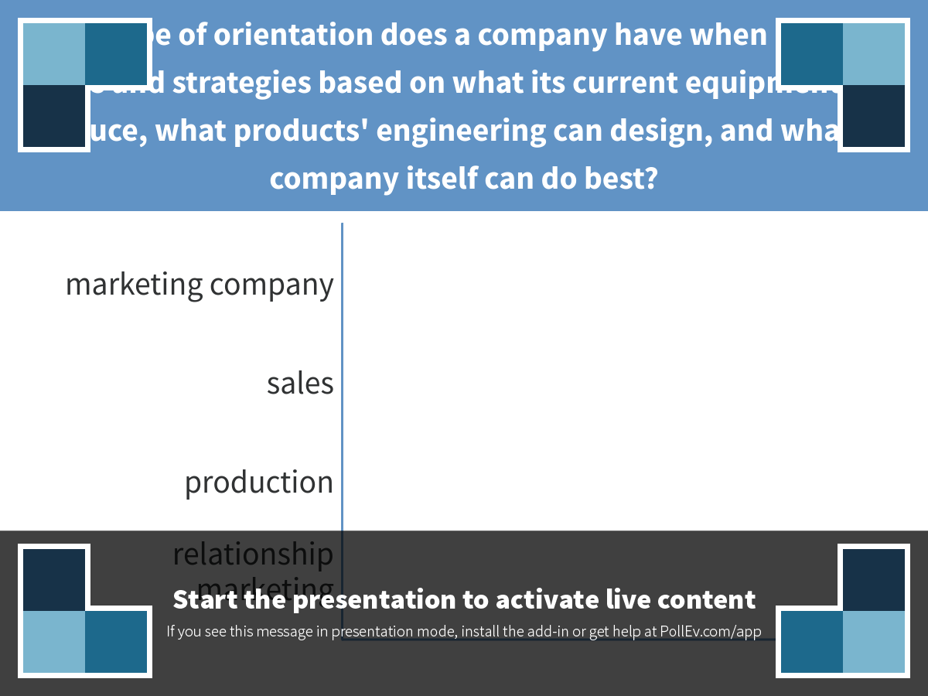
Notes:
What type of orientation does a company have when it sets its goals and strategies based on what its current equipment can produce, what products' engineering can design, and what the company itself can do best?
https://www.polleverywhere.com/multiple_choice_polls/RjltODLzM7Em7al

Slide 21
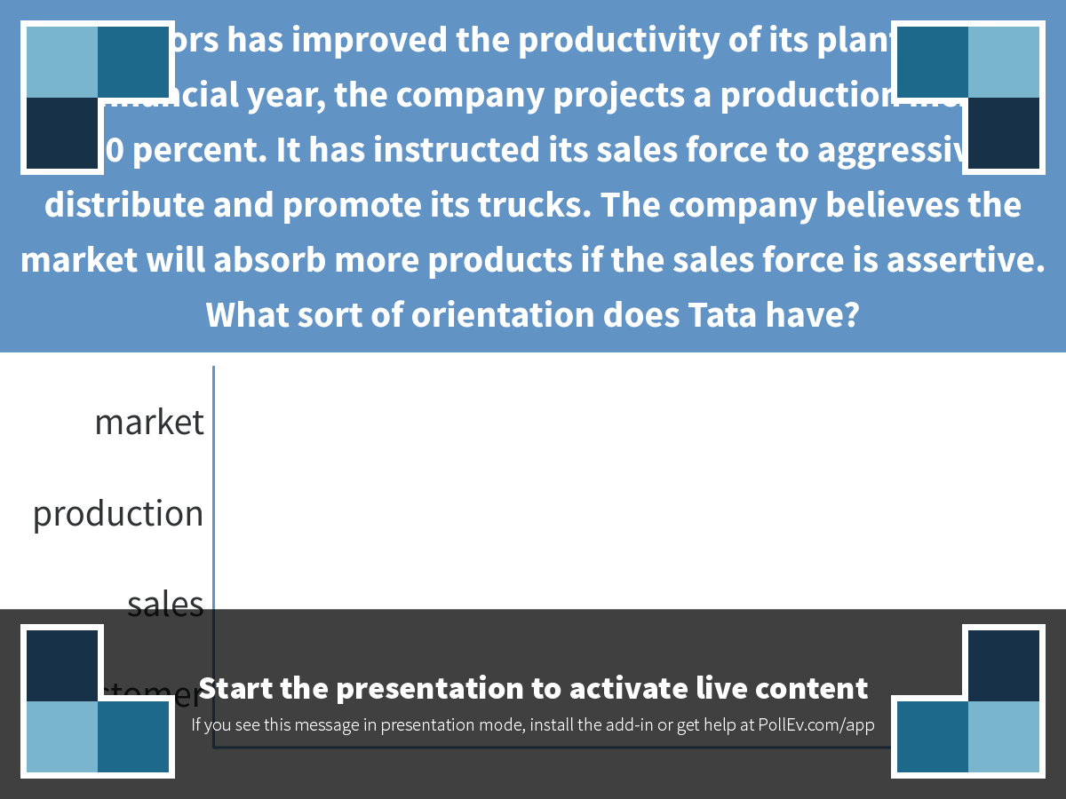
Notes:
Tata Motors has improved the productivity of its plant. For the new financial year, the company projects a production increase of 30 percent. It has instructed its sales force to aggressively distribute and promote its trucks. The company believes the market will absorb more products if the sales force is assertive. What sort of orientation does Tata have?
https://www.polleverywhere.com/multiple_choice_polls/E2TKWoJTLEv4KXI

Slide 22
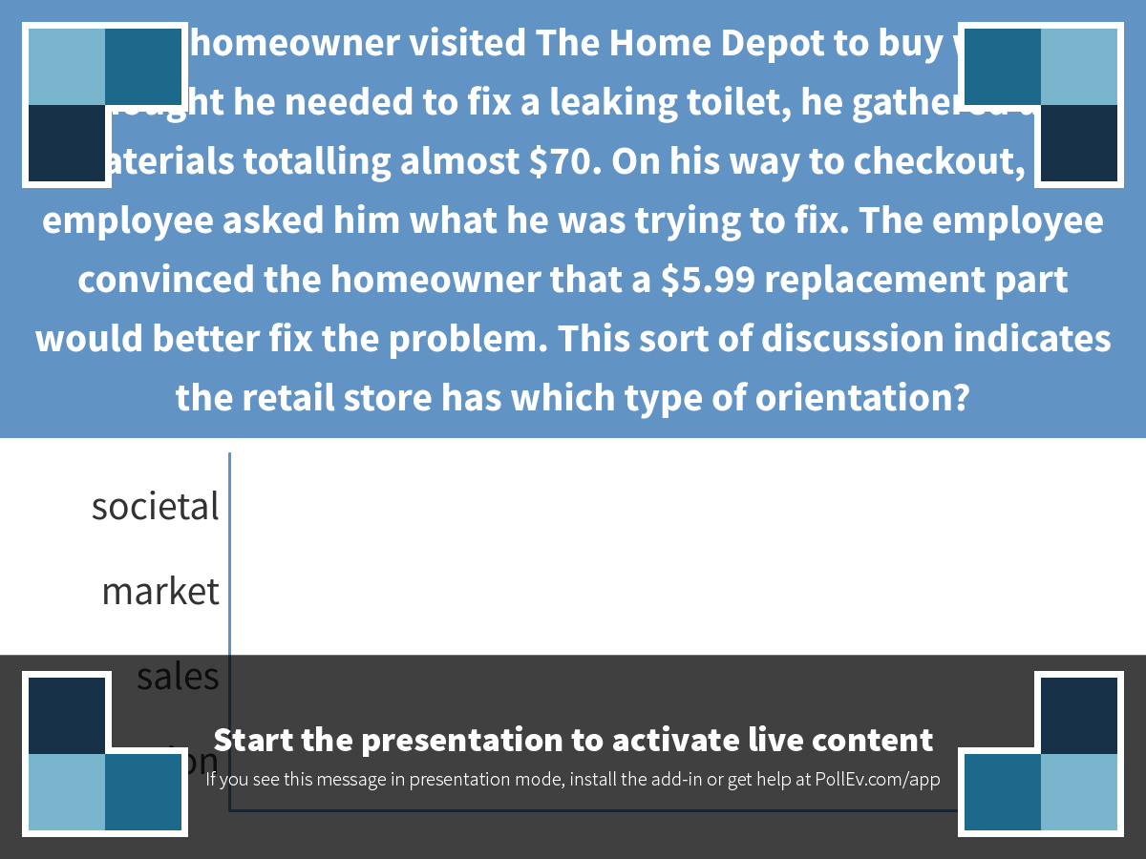
Notes:
When a homeowner visited The Home Depot to buy what he thought he needed to fix a leaking toilet, he gathered up materials totalling almost $70. On his way to checkout, an employee asked him what he was trying to fix. The employee convinced the homeowner that a $5.99 replacement part would better fix the problem. This sort of discussion indicates the retail store has which type of orientation?
https://www.polleverywhere.com/multiple_choice_polls/VqZVV6Jd6tUjTHZ

Slide 23
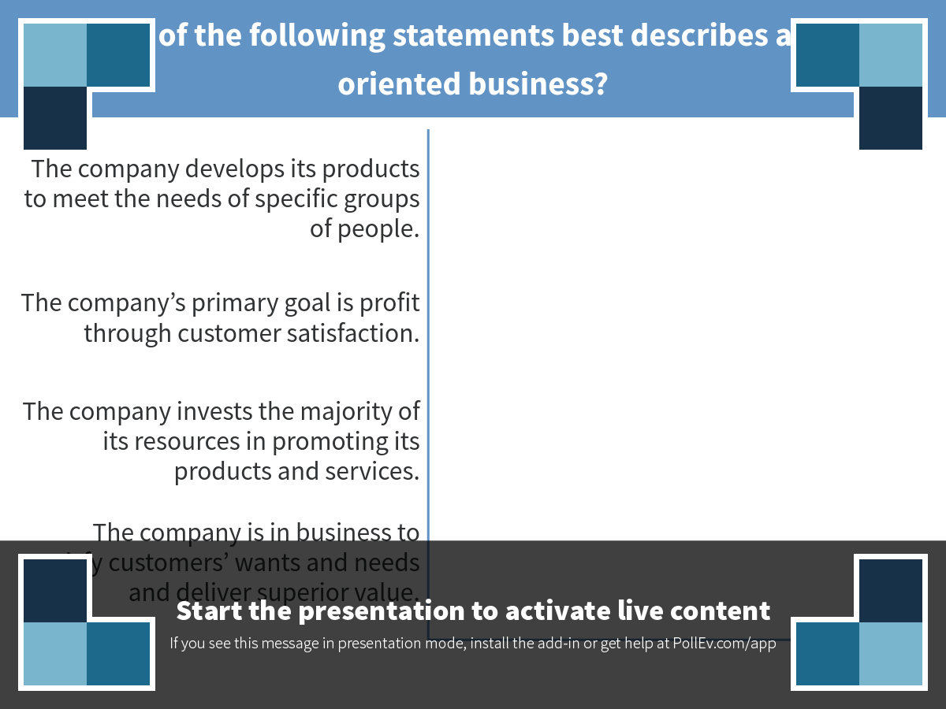
Notes:
Which of the following statements best describes a sales-oriented business?
https://www.polleverywhere.com/multiple_choice_polls/vU9uOUxiqSNIARj

Slide 24
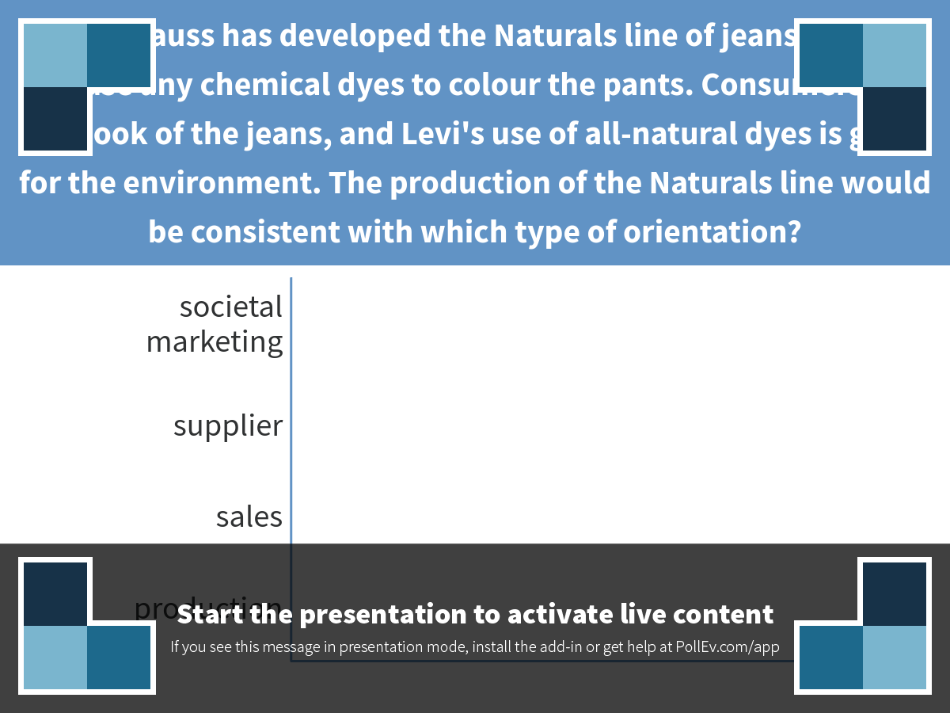
Notes:
Levi Strauss has developed the Naturals line of jeans that do not use any chemical dyes to colour the pants. Consumers like the look of the jeans, and Levi's use of all-natural dyes is good for the environment. The production of the Naturals line would be consistent with which type of orientation?
https://www.polleverywhere.com/multiple_choice_polls/P80n5DHPhSqnI0w

Slide 25
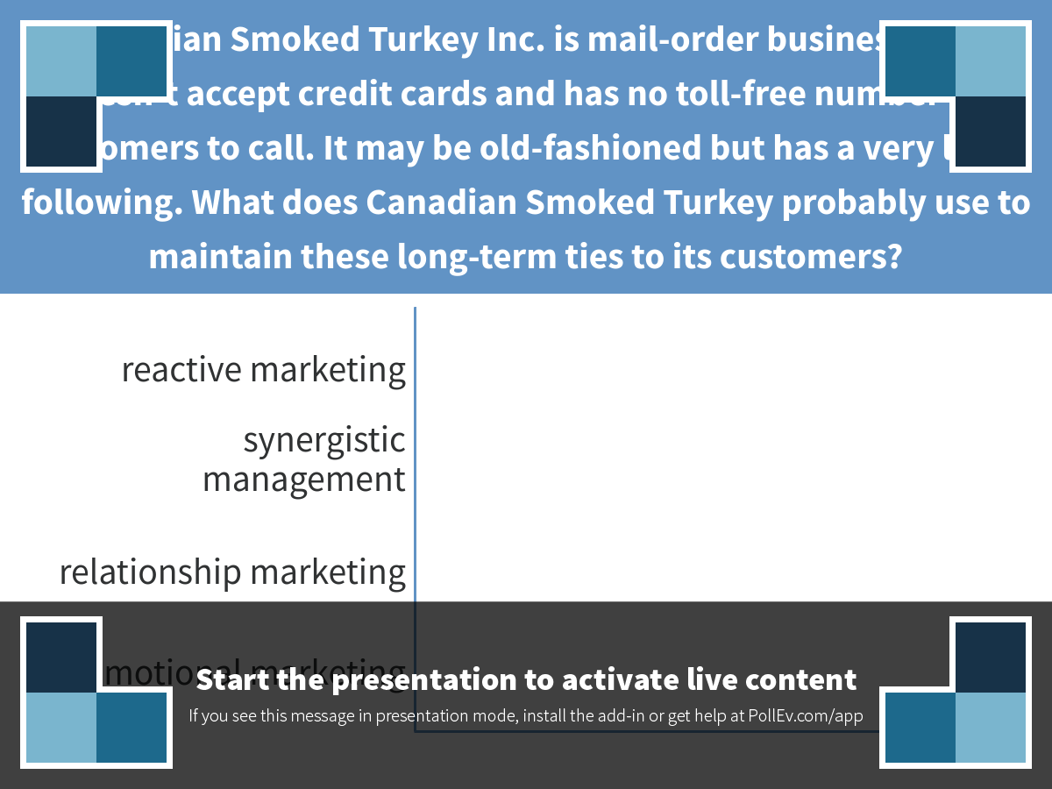
Notes:
Canadian Smoked Turkey Inc. is mail-order business that doesn't accept credit cards and has no toll-free number for customers to call. It may be old-fashioned but has a very loyal following. What does Canadian Smoked Turkey probably use to maintain these long-term ties to its customers?
https://www.polleverywhere.com/multiple_choice_polls/ng958cCctqyZ3AR

Slide 26
Geoffrey B. Small Case Video
http://nelson.cengage.com/marketing/shared/video_wrappers/video_quiz/satisfy_customer_geoffsmall.html

Slide 27
Key Marketing Terms
Customer value
Market segments
Marketing mix
3
Notes:
Exchange: people giving up one thing to receive another thing they would rather have
Customer value: the relationship between benefits and the sacrifice necessary to obtain those benefits
Market segments: groups of individuals, families, or companies that are placed together because it is believed that they share similar needs
Building relationships: the best companies view new customer attraction as the launching point for developing and enhancing a long-term relationship
Marketing mix: also known as the 4Ps of marketing—refers to product, price, place, and promotion

Slide 28
Customer Value
Value = What you get (benefits) – What you give (costs)
Q: What is the customer value of your favorite coffee shop?
3
Notes:
Communicate clearly: provide facts and the opportunity to learn more.

Slide 29
Market
  An entire set of actual and potential buyers with the desire and ability to buy a specific product.
3

Slide 30
Market
  An entire set of actual and potential buyers with the desire and ability to buy a specific product
    Individuals/ultimate consumers
    Organizational buyers
  B2B, B2C, C2C
  Buyers constitute a market.
  Sellers constitute an industry.

Slide 31
Target Market
One or more specific groups of potential consumers toward which a seller directs its marketing program
What is/are the target market(s) of Sprott School of Business?

Slide 32
Market Segments
Individuals
Companies
Families
3
1-24
Notes:
Market segments: each circle represents a demographic with shared needs

Slide 33
Marketing Mix
Customer
Product
Price
Promotion
Place
Q: What 4P related marketing activities has Sprott used to reach the target market(s)?
3

Slide 34
Product
  Anything that can be offered to a market to satisfy a need or want
  Not limited to physical objects
  Examples?
3

Slide 35
Purpose of Marketing
  Identify consumers’ needs
  Focus on consumers’ needs rather than products
  Understand customer
4

