Slide 1
Chapter 1
Brief History of Risk and Return

Slide 2
Learning Objectives
To become a wise investor, you need to know:
How to calculate the return on an investment using different methods.
The historical returns on various important types of investments.
The historical risk on various important types of investments.
The relationship between risk and return.

Slide 3
Example #1 Who Wants To Be A Millionaire?
You can retire with One Million Dollars (or more).
How? Suppose:
  You invest $300 per month.
  Your investments earn 9% per year.
  You decide to take advantage of deferring taxes on your investments.
It will take you about 36.25 years. Hmm. Too long.

Slide 4
Example #1 Who Wants To Be A Millionaire?
Instead, suppose:
  You invest $500 per month.
  Your investments earn 12% per year
  you decide to take advantage of deferring taxes on your investments
It will take you 25.5 years.
Realistic?
    $250 is about the size of a new car payment, and perhaps your employer will kick in $250 per month
    Over the last 84 years, the S&P 500 Index return was about 12%
Try this calculator: cgi.money.cnn.com/tools/millionaire/millionaire.html

Slide 5
A Brief History Of Risk And Return
Our goal in this chapter is to see what financial market history can tell us about risk and return.
There are two key observations:
  First, there is a substantial reward, on average, for bearing risk.
  Second, greater risks accompany greater returns.
These observations are important investment guidelines.

Slide 6
Dollar Returns
Total dollar return is the return on an investment measured in dollars, accounting for all interim cash flows and capital gains or losses.

Slide 7
Dollar Returns Example
 | CASE 1 | CASE 2
Ending Stock Price | $80,000 | $71,000
January 1 Value | $7,500 | $7,500
December 31 Value | 8,000 | 7,100
Dividend Income | 245 | 245
Capital Gain or Loss | 500 | -400
Suppose you purchased 100 shares of stock in TD on Jan 1. At that time, TD was selling for $75/share, so your 100 shares cost you $7,500. TD pays dividends of $2.45 per share.
Dividend income = $2.45 x 100 =$245

Slide 8
CASE 1
Suppose that as of Dec 1, TD was selling for $80, meaning the value of your stock increased by $5/share. Your 100 shares are now worth $8,000, so you have a capital gain of ($80-$75) x 100 = $500
CASE 2
If the price had dropped to $71, you would have a capital loss of ($71-$75) x 100 = -$400
Total dollar return = $245 + $500 = $745
Overall, the value of your investment increased from $7,500 to $7,500 + $745 = $8,245

Slide 9
Percent Returns
Total percent return is the return on an investment measured as a percentage of the original investment.
“How much do we get for each dollar we invest?”
Example, you buy a share of stock:

Slide 10
 | CASE 1 | CASE 2
Ending Stock Price | $80,000 | $71,000
Jan 1 Value | $75,000 | $75,000
Dec 31 Value | 80 | 71
Dividend Income | 2.45 | 2.45
Capital Gain or Loss | 5 | -4
Dividend yield is the annual stock dividend as a % of the initial stock price
Capital gains yield is the change in stock price as a % of the initial stock price
Total percent return is the return on an investment measured as a % that accounts for all cash flows and capital gains/losses
Let
P_{t} be the price of the stock at the beginning of the year
D_{t+1} be the dividend paid on the stock during the year

Slide 11
Dividend yield = D_{t+1} / P_{t}
= $2.45 / $75 = 0.0327 = 3.27%
(for each dollar we invest, we receive 3.27 cents in dividends)
Capital gains yield = (P_{t+1} – P_{t}) / P_{t}
= ($80 - $75) / $75
= 0.0667 = 6.67%
(for each dollar we invest, we get 6.67 cents in capital gains)
Total percent return = dividend yield + capital gains yield
= 3.27 cents + 6.67 cents
= 9.94 cents

Slide 12
Calculating Total Dollar & Total Percent Return
Suppose you invested $1,400 in a stock with a share price of $35.
After one year, the stock price per share is $49.
Also, for each share, you received a $1.40 dividend.
What was your total dollar return?
  $1,400 / $35 = 40 shares
  Capital gain: 40 shares times $14 = $560
  Dividends: 40 shares times $1.40 = $56
  Total Dollar Return is $560 + $56 = $616
What was your total percent return?
  Dividend yield = $1.40 / $35 = 4%
  Capital gain yield = ($49 – $35) / $35 = 40%
  Total percentage return = 4% + 40% = 44%
Note that $616 divided by $1,400 is 44%.

Slide 13
Annualizing Returns, I
You buy 200 shares of Lowe’s Companies, Inc. at $18 per share. Three months later, you sell these shares for $19 per share. You received no dividends. What is your return? What is your annualized return?
Return: (P_{t+1} – P_{t}) / P_{t} = ($19 - $18) / $18
= .0556 = 5.56%
(The 5.56% is your return for the 3 month holding period)
Effective Annual Return (EAR): The return on an investment expressed on an “annualized” basis.
1 + EAR = (1 + holding period % return)^{m}
= (1 + 0.0556)⁴
= 1.2416
Your annualized return is 24.16%
This return is
known as the holding period percentage return (3 months)

Slide 14
Annualizing Returns, II
1 + EAR = (1 + holding period percentage return)^{m}
m = the number of holding periods in a year.
In this example, m = 4 (12 months / 3 months). Therefore:
1 + EAR = (1 + .0556)⁴ = 1.2416.
So, EAR = .2416 or 24.16%.

Slide 15
$1 Investment In Canada S&P/TSX Index

Slide 16
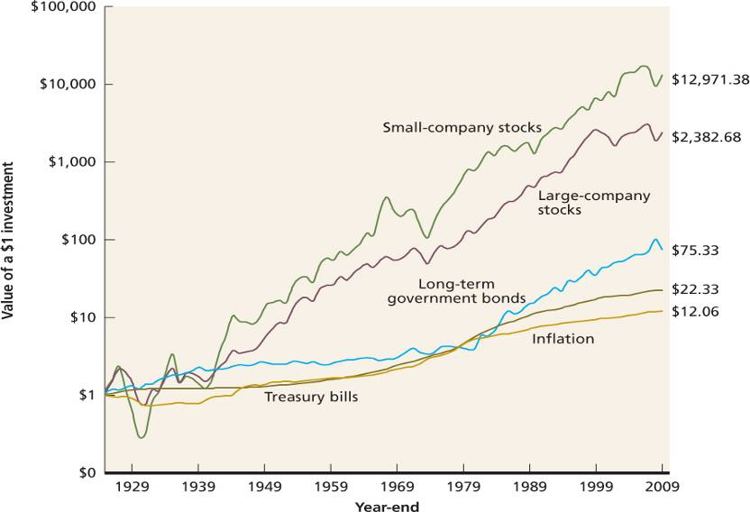
A $1 Investment in Different Types of Portfolios, 1926-2009

Slide 17
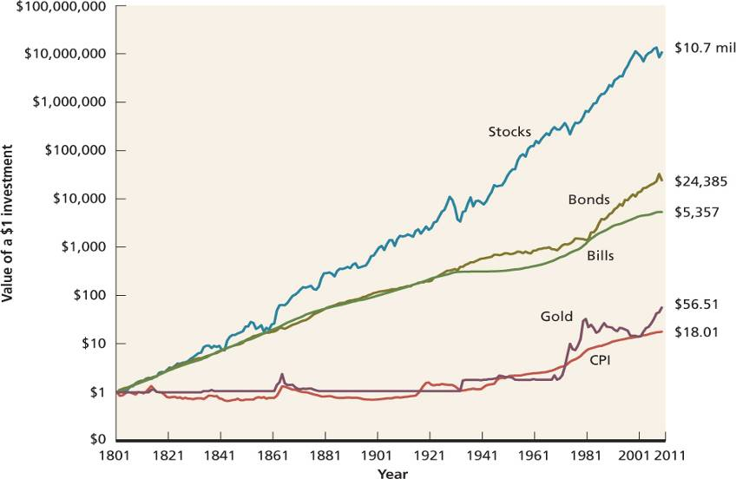
Financial Market History

Slide 18
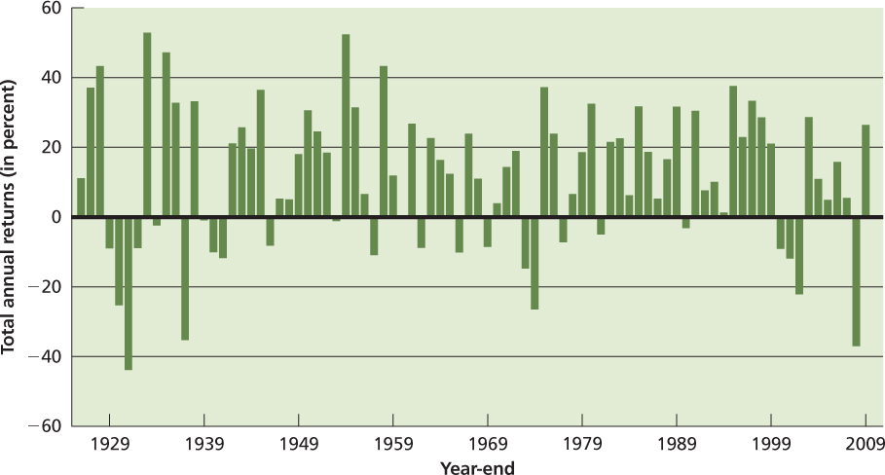
The Historical Record: Total Returns on Large-Company Stocks

Slide 19
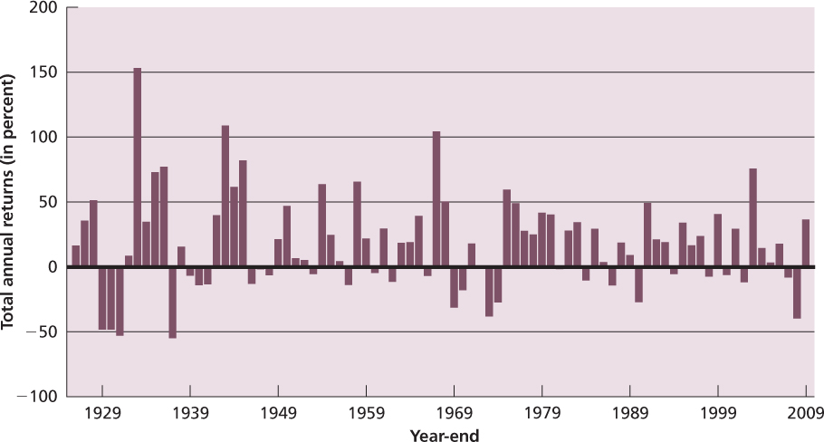
The Historical Record: Total Returns on Small-Company Stocks

Slide 20
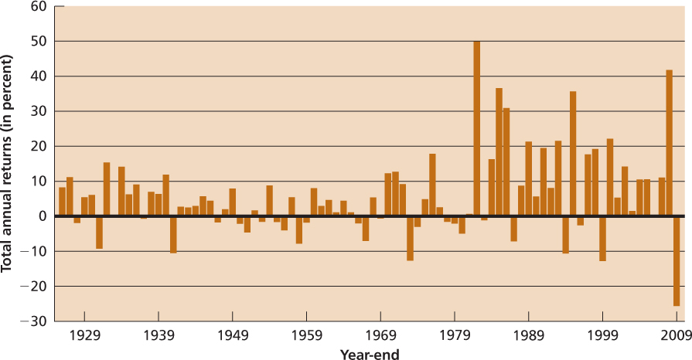
The Historical Record: Total Returns on Long-term U.S. Bonds

Slide 21
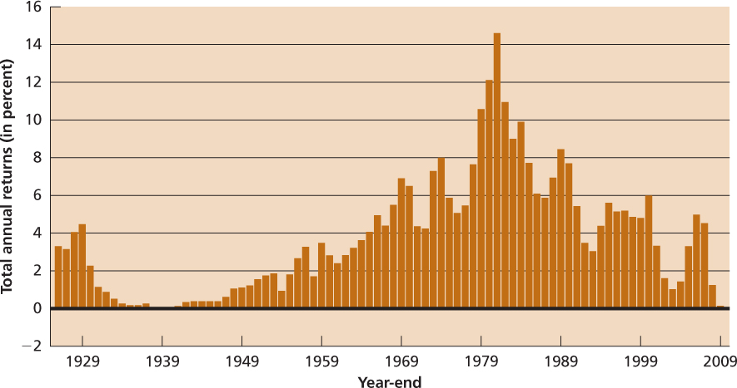
The Historical Record:
Total Returns on U.S T-Bills

Slide 22
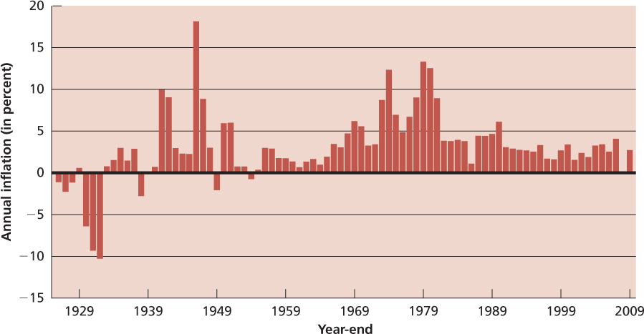
The Historical Record: Inflation

Slide 23
Historical Average Returns
A useful number to help us summarize historical financial data is the simple, or arithmetic average.
Using the data in Table 1.1, if you add up the returns for large-company stocks from 1926 through 2009, you get about 987 percent.
Because there are 84 returns, the average return is about 11.75% (987 / 84) How do you use this number?
If you are making a guess about the size of the return for a year selected at random, your best guess is 11.75%.
The formula for the historical average return is:
Notes:
You might have subtracted 1926 from 2009. Of course, you got 83, which excludes the 1926 return. To include 1926, add one. This is because the 1926 return uses year-end 1925 prices. So, 2009 – 1925 = 84.

Slide 24
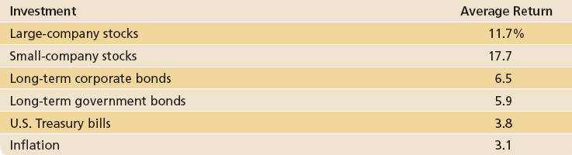
Average Annual Returns for
Five Portfolios and Inflation

Slide 25
Average Returns: The First Lesson
The government borrows $$ by issuing debt (bonds). These bonds come in different forms. The ones we focus on are Treasury bills. They have the shortest time to maturity. Because the gov can always raise taxes or print money to pay its expenses, Treasury bills are virtually free of any default risk.
Risk-free rate: The rate of return on a riskless, i.e., certain investment.
Risk premium: The extra return on a risky asset over the risk-free rate; i.e., the reward for bearing risk.
The First Lesson: There is a reward, on average, for bearing risk.
By looking at Table 1.3, (next pg.) we can see the risk premium earned by large-company stocks was 7.9%!
  Is 7.9% a good estimate of future risk premium?
  The opinion of 226 financial economists: 7.0%.
  Any estimate involves assumptions about the future risk environment and the risk aversion of future investors.

Slide 26
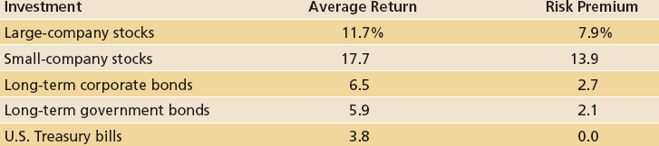
Average Annual Risk
Premiums for Five Portfolios

Slide 27
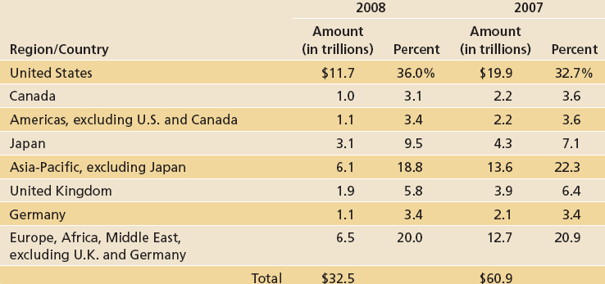
World Stock Market Capitalization

Slide 28
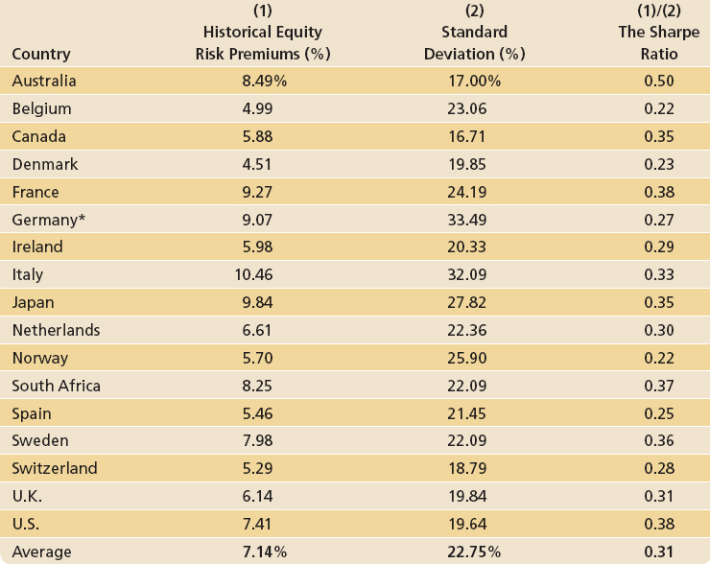
International Equity Risk Premiums

Slide 29
Why Does A Risk Premium Exist?
Modern investment theory centers on this question.
Therefore, we will examine this question many times in the chapters ahead.
We can examine part of this question, however, by looking at the dispersion, or spread, of historical returns.
We use two statistical concepts to study this dispersion, or variability: variance and standard deviation.
The Second Lesson: The greater the potential reward, the greater the risk.

Slide 30
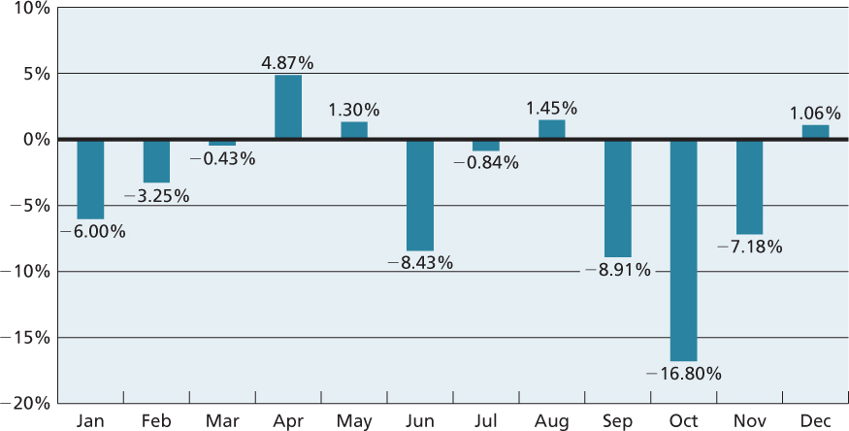
The Bear Growled and Investors Howled

Slide 31
Return Variability: The Statistical Tools
The formula for return variance is ("n" is the number of returns):
Sometimes, it is useful to use the standard deviation, which is related to variance like this:

Slide 32
Return Variability Review and Concepts
Variance is a common measure of return dispersion. Sometimes, return dispersion is also call variability.
Standard deviation is the square root of the variance.
  Sometimes the square root is called volatility.
  Standard Deviation is handy because it is in the same "units" as the average.
Normal distribution: A symmetric, bell-shaped frequency distribution that can be described with only an average and a standard deviation.
Does a normal distribution describe asset returns?

Slide 33
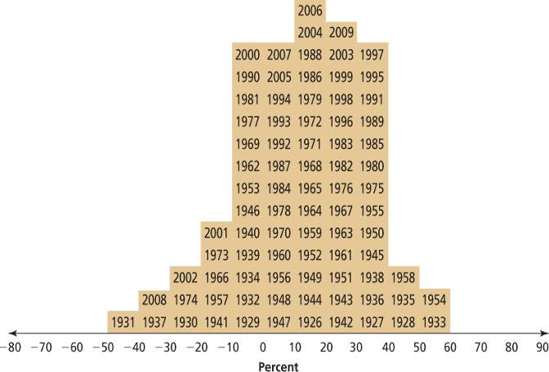
Frequency Distribution of Returns on
Common Stocks, 1926—2009

Slide 34
Example: Calculating Historical Variance and Standard Deviation
Let’s use data from Table 1.1 for Large-Company Stocks.
The spreadsheet below shows us how to calculate the average, the variance, and the standard deviation (the long way…).
Notes:
Note: Of course, one could use also the Excel functions, =Average( ), =VAR( ), and =STDEV( ).

Slide 35
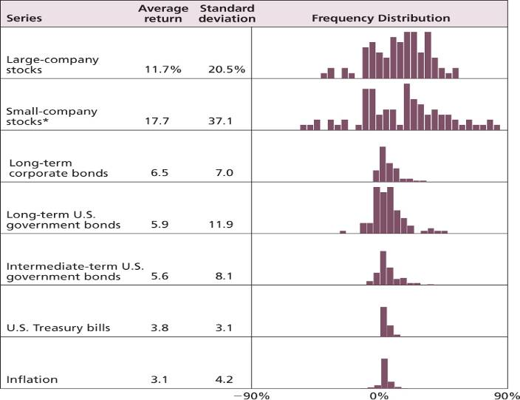
Historical Returns, Standard Deviations, and Frequency Distributions: 1926—2009

Slide 36
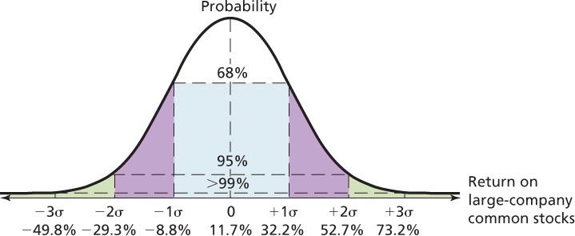
The Normal Distribution and Large Company Stock Returns

Slide 37
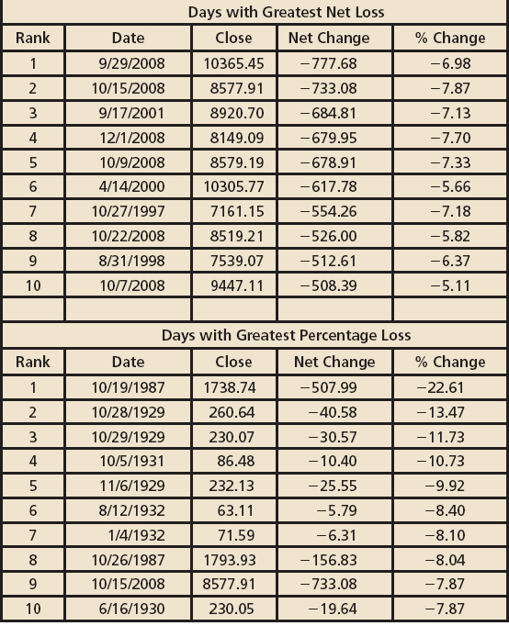
Returns on Some “Non-Normal” Days

Slide 38
Arithmetic Averages versus Geometric Averages
The arithmetic average return answers the question: “What was your return in an average year over a particular period?”
The geometric average return answers the question: “What was your average compound return per year over a particular period?”
When should you use the arithmetic average and when should you use the geometric average?
First, we need to learn how to calculate a geometric average.

Slide 39
Suppose you buy a stock for $100. Unfortunately, the first year you own it, it falls to $50. The second year, its price increases to $100, leaving you where you started (no dividends were paid).
What is your average return on this investment? Common sense seems to say it is zero since you started and ended with $100. But if we calculate the returns year-by-year, we see that you lost 50% the first year. The second year, you made 100%. Your average return over the 2 years was thus (-50% + 100%) / 2 = 25%
  So is it 0% or 25%?
The 0% is called the geometric average return. “What was your average compound return per year over a particular period?”
The 25% is called the arithmetic average return. “What was your return in an average year over a particular period?”

Slide 40
Example: Calculating a Geometric Average Return
Let’s use the large-company stock data from Table 1.1.
The spreadsheet below shows us how to calculate the geometric average return.
Geometric average return

Slide 41
Arithmetic Averages versus Geometric Averages
The arithmetic average tells you what you earned in a typical year.
The geometric average tells you what you actually earned per year on average, compounded annually.
When we talk about average returns, we generally are talking about arithmetic average returns.
For the purpose of forecasting future returns:
  The arithmetic average is probably "too high" for long forecasts.
  The geometric average is probably "too low" for short forecasts.

Slide 42
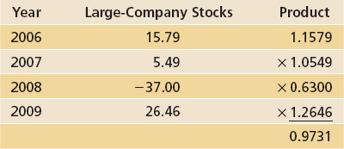
Geometric versus Arithmetic Averages

Slide 43
Risk and Return
The risk-free rate represents compensation for just waiting.
Therefore, this is often called the time value of money.
First Lesson: If we are willing to bear risk, then we can expect to earn a risk premium, at least on average.
Second Lesson: Further, the more risk we are willing to bear, the greater the expected risk premium.

Slide 44
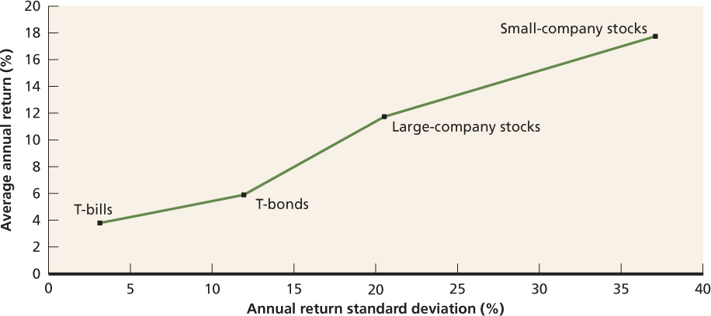
Historical Risk and Return Trade-Off

Slide 45
Dollar-Weighted Average Returns, I
Dollar-weighted average return is the average compound rate of return earned per year over a multiyear period accounting for investment inflows and outflows
There is a hidden assumption we make when we calculate arithmetic returns and geometric returns.
  We assume that the investor makes only an initial investment.
  Clearly, many investors make deposits or withdrawals through time. (add money over time as they save for retirement, or they might be forced to withdraw funds to meet unexpected needs)
How do we calculate returns in these cases?

Slide 46
Dollar-Weighted Average Returns, II
Suppose you had returns of 10% in year one and -5% in year two.
If you only make an initial investment at the start of year one:
  The arithmetic average return is 2.50%.
  The geometric average return is 2.23%.
Suppose you makes a $1,000 initial investment and a $4,000 additional investment at the beginning of year two.
  At the end of year one, the initial investment grows to $1,100 ($1000 + 10%)
  At the start of year two, your account has $5,100 ($4000 + $1100)
  At the end of year two, your account balance is $4,845. [$5100 + (-5%)]
  You have invested $5,000, but your account value is only $4,845.
So, the (positive) arithmetic and geometric returns are not correct.

Slide 47
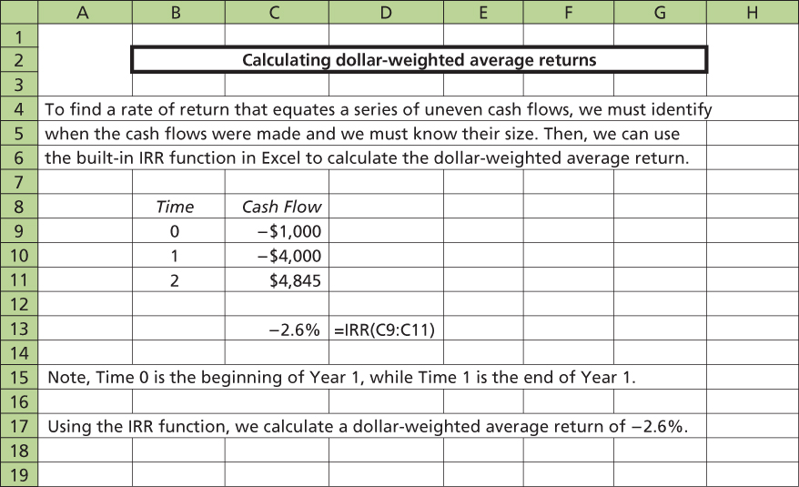
Dollar-Weighted Average Returns and IRR

Slide 48
Chapter Review
Returns
  Dollar Returns
  Percentage Returns
The Historical Record
  A First Look
  A Longer Range Look
  A Closer Look
Average Returns: The First Lesson
  Calculating Average Returns
  Average Returns: The Historical Record
  Risk Premiums

Slide 49
Chapter Review
Return Variability: The Second Lesson
  Frequency Distributions and Variability
  The Historical Variance and Standard Deviation
  The Historical Record
  Normal Distribution
  The Second Lesson
Arithmetic Returns versus Geometric Returns
The Risk-Return Trade-Off

Slide 50
Summary and Conclusions
How to calculate the return on an investment using different methods
We show how to calculate dollar returns and % returns over a time period. Returns have two parts: a capital gain (or loss) and dividend income. We also show how to convert returns over a period different from a year into annualized returns..
We demonstrate the two ways to calculate average returns over time: the arithmetic and geometric method. The arithmetic average return answers the question “What was your return in an average year over a particular period?” The geometric average return answers the question “What was your average compound return per year over a particular period?
We also examine the effect of fund flows into and out of an investment. This case calls for calculating the dollar-weighted average return

Slide 51
Summary and Conclusions
2. The historical returns on various important types of investments
In order of their historical return from highest to lowers, we discuss returns on some important portfolios:
  Small-company stocks, large-company stocks, long-term U.S government bonds, and U.S treasury bills
B. One important historical return face is that U.S. T-bill returns have barely outpaced inflation. Therefore, an investor must invest in stocks or bonds to earn a return higher than the inflation rate.
3. The historical risk on various important types of investments
Historically, the risk (as measured by SD of returns) of the portfolios described above is highest for small-company stocks. The next highest is large-company stocks, long-term government bonds and then T-bills.

Slide 52
Summary and Conclusions
B. Two key lessors from historical risk:
Risky assets, on average, earn a risk premium. That is, there is a reward for bearing risk. However, this expected reward is not realized each year.
The greater the potential reward from a risky investment, the greater the risk
4. The relationship between risk and return
When we put these two key lessons together, we concluded that there is a risk-return trade-off
The only way to earn a higher return is to take on greater risk

Slide 53
Example #1: Calculating Returns
Suppose you bought 200 shares of stock at an initial price of $42 per share. The stock paid a dividend of $2.40 per share during the following year, and the share price at the end of the year was $31. Compute your total dollar return on this investment.
Total dollar return = 200 ($31 - $42) + 200 ($2.40)
= -$1,720
Example #2: Calculating Yields
In the previous problem, what is the capital gains yield? The dividend yield? What is the total rate of return on the investment?
Capital gains yield = ($31 - $42)/$42 =-26.19%
Dividend yield = $2.40/$42 = 5.71%
Total rate of return = -26.19% + 5.71% = -20.48%

Slide 54
Example #3: Calculating Returns and Variability
Using the following returns, calculate the average returns, the variances, geometric returns and the SD for stocks A and B.
Year A B
1 14% 22%
2 3% -5%
3 -6% -15%
4 11% 28%
5 9% 17%
A: average return = [14+3+(-6)+11+9]/5 = 6.20%
B: average return = [22+(-5)+(-15)+28+17]/5 = 9.40%

Slide 55
Example #4: Risk Premiums
Consider the following common stock and T-bill returns for the period 1980-1986:
Annual risk premium = common stock return – T-bills
Year | Common Stocks | T-Bills | Risk Premium
1980 | 32.6% | 12% | 21.6%
1981 | -5% | 15.2% | -20.2%
1982 | 21.7% | 11.3% | 10.4%
1983 | 22.6% | 8.9% | 13.7%
1984 | 6.2% | 10% | -3.8%
1985 | 31.9% | 7.7% | 24.2%
1986 | 18.7% | 6.2% | 12.5%
 | 128.7 | 71.3 | 57.4

Slide 56
Average returns for common stocks = 128.7/7 = 18.4%
for T-bills = 71.3/7 = 10.2%
for risk premium = 57.4/7 = 8.2%
Variance for common stocks
= 1/6 [(0.326 – 0.184)² + (-0.05 – 0.184)² + (0.217 – 0.184)² + (0.226 – 0.184)² + (0.062 – 0.184)² + (0.319 – 0.184)² + (0.187 – 0.184)²] = 0.01848
Variance for T-bills
= 1/6 [(0.120 – 0.102)² + (0.152 – 0.102)² + (0.113 – 0.102)² + (0.089 – 0.102)² + (0.100 – 0.102)² + (0.77 – 0.102)² + (0.062 – 0.102)²] = 0.00089
Variance for risk premium
= 1/6 [(0.206 – 0.82)² + (-0.202 – 0.82)² + (0.104 – 0.82)² + (0.137 – 0.82)² + (-0.038 – 0.82)² + (0.242 – 0.82)² + (0.125 – 0.82)²] = 0.02356

Slide 57
Standard deviation for common stocks
= (0.01848)^{1/2}
=0.1359
=13.59%
Standard deviation for T-bills
=(0.00089)^{1/2}
=0.02984
=2.98%
Standard deviation for risk premium
=(0.02356)^{1/2}
=0.1528
=15.35%
Is it possible that the observed risk premium can be negative? Explain
Before the fact, the risk premium will be positive; investors demand compensation over and above the risk-free return to invest their $$ in the risky asset. After the fact, the observed risk premium can be negative if the asset’s nominal return is unexpectedly low, the risk-free return is unexpectedly high, or any combination of these two events.

Slide 58
A: σ² =186.6/4 = 46.65 B: σ² = 1365.2/4 = 341.3
A: σ = sq46.65 = 6.83
B: σ = sq341.3 = 18.47
A: geometric returns = [(1+0.14)(1+0.03)(1-0.06)(1+0.11)(1+0.09)]^{1/5} – 1 = 5.95%
B: geometric returns = [(1+0.22)(1-0.05)(1-0.15)(1+0.28)(1+0.17)]^{1/5} – 1 = 8.08%
A | B
(14-6.20)² = 60.84 | (22-9.40)² = 158.76
(3-6.20)² = 10.24 | (-5-9.40)² = 207.36
(-6-6.20)² = 84.64 | (-15-9.40)² = 595.36
(11-6.20)² = 23.04 | (28-9.40)² = 345.96
(9-6.20)² =7.84 | (17-9.40)² = 57.76
186.6 | 1365.2

