Slide 1
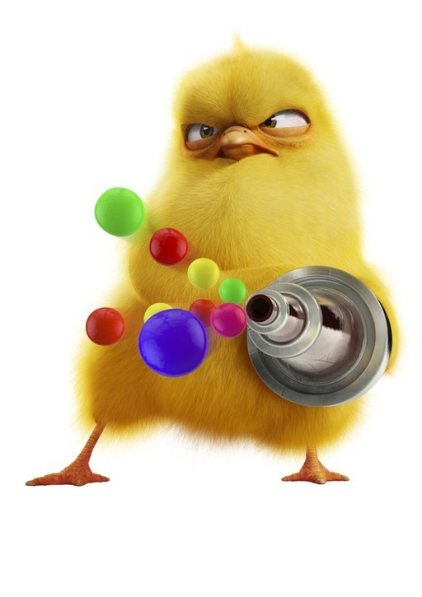
Week 5A
Culture and Values
Summer 2017

Slide 2
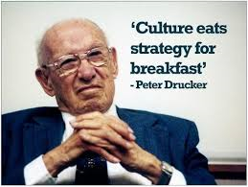
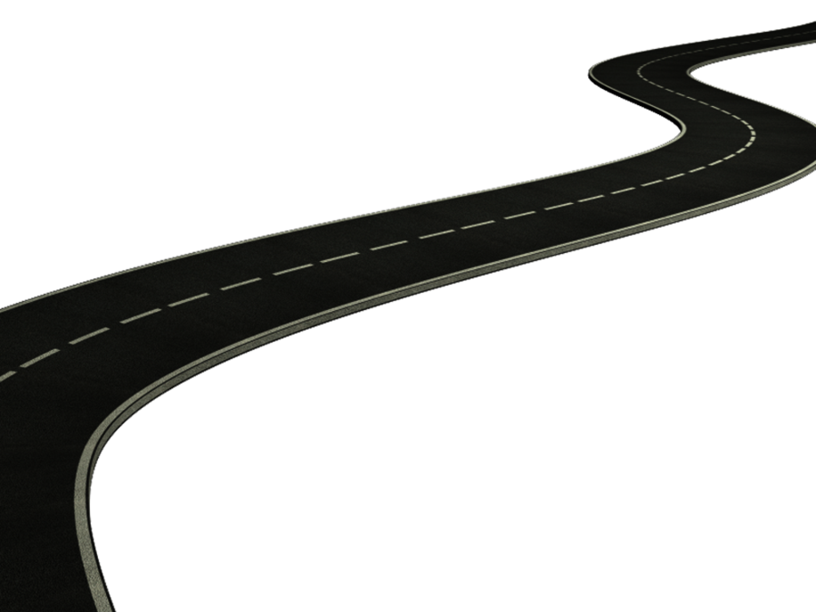
Road Map
Review Week 4
Organizational Culture
  Culture vs. Climate
  Sources of culture
  Diagnosing Culture
  Transmitting culture
  Strong Culture
Authentic Leadership
Next week
  Change up: Guest Lecture
  Christiane Fox
  Assistant Secretary to the Cabinet - Communications at Privy Council Office, Government of Canada

Slide 3
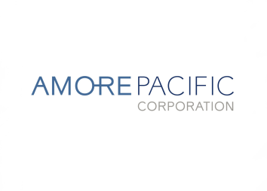

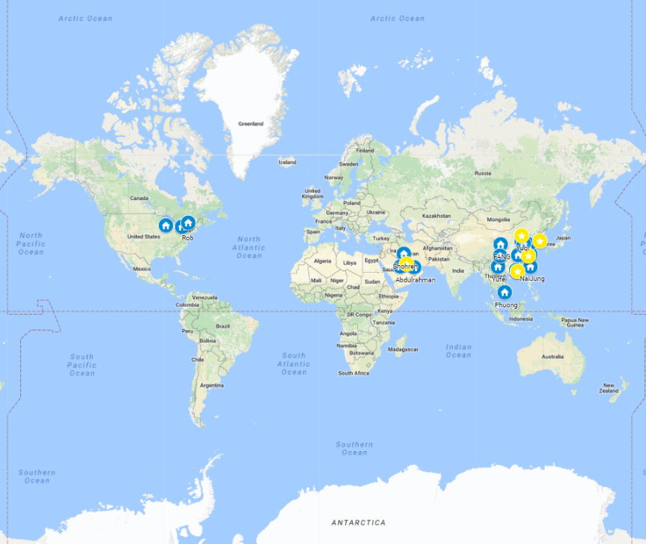


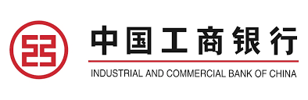
BUSI 2101: Around the world
Get into groups of four. Find one company from outside North America/Europe that Sprott students should know about but do not.
Prepare a 2 min presentation on how that company’s culture is critical to their success.
Go to our online form our online form

Slide 4

EDC: Singapore Call
Espoused Values
Culture
?

Slide 5
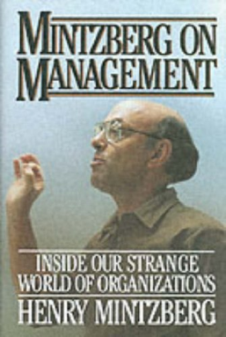
Henry Mintzberg on Culture
“Culture is the soul of the organization — the beliefs and values, and how they are manifested. I think of the structure as the skeleton, and as the flesh and blood. And culture is the soul that holds the thing together and gives it life force.”

Slide 6
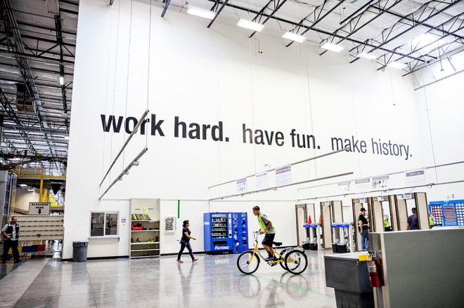
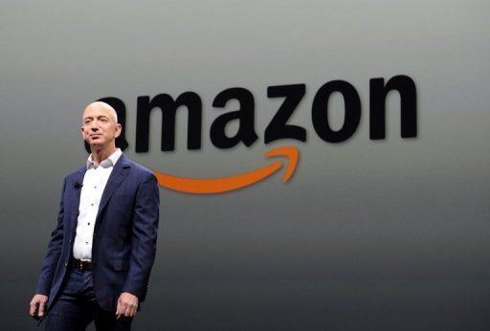
Amazon
Culture
Founder

Slide 7
Alibaba
Culture
Founder

Slide 8
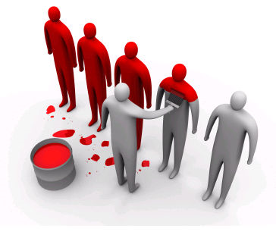
Organizational Culture
Culture (textbook): Organizational culture is the pattern of shared values, beliefs, and assumptions considered to be the appropriate way to think and act within an organization.
Culture is shared.
  Culture helps members solve problems.
  Culture is taught to newcomers.
  Culture strongly influences behaviour!

Slide 9
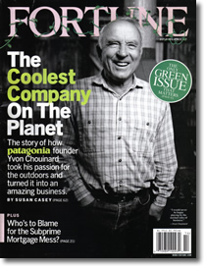
Authentic Leadership
A pattern of leader behavior that draws upon and promotes both positive psychological capacities and a positive ethical climate, to foster greater self-awareness, an internalized moral perspective, balanced processing of information, and relational transparency on the part of leaders working with followers, fostering positive self-development. Walumbwa et al. (2008).
self-awareness,
balanced processing,
relational transparency, and
an internalized moral perspective

Slide 10
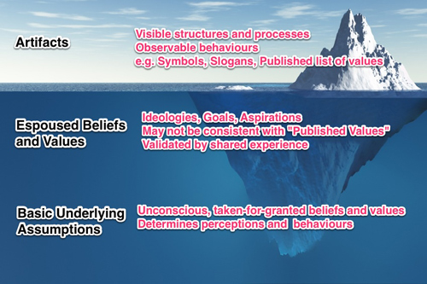
Uncovering Culture
The pattern of shared assumptions, values and beliefs that lead to certain behaviours on a team.

Slide 11
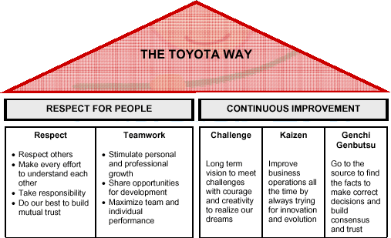
Sources of Culture
The values, beliefs, and assumptions of the founders.
The learning experiences of members
New beliefs values, and assumptions brought in by new members.
Strong cultures support organizational effectiveness when they promote.
Internal integration
External adaptation

Slide 12
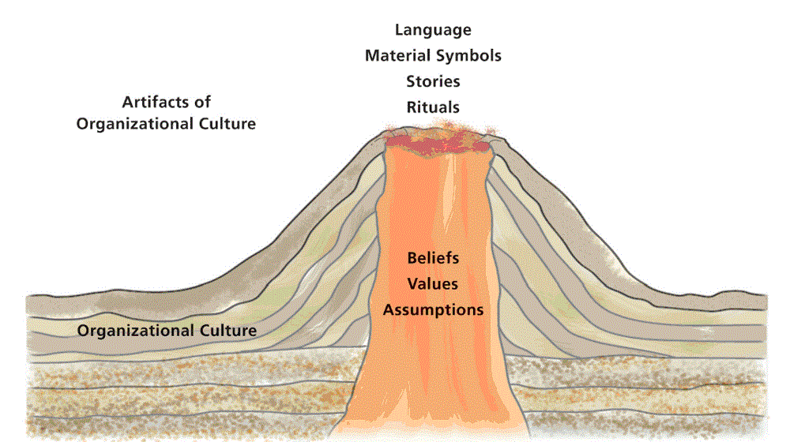
Culture – What is under the surface?
Artifacts of
Material Symbols
Organizational
Language
Culture
Rituals
Stories
Organizational
Beliefs
Culture
Values
Assumptions

Slide 13
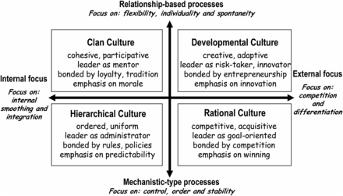
Competing Values Framework
Cultures are characterized by ‘how things are done around here’.

Slide 14
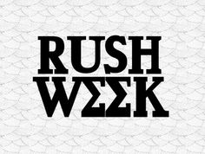
The Formation of Organizational Culture
Top
Philosophy
management
of
Selection
Organization's
organization's
criteria
culture
founders
Socialization
How can you read an organizations culture?

Slide 15
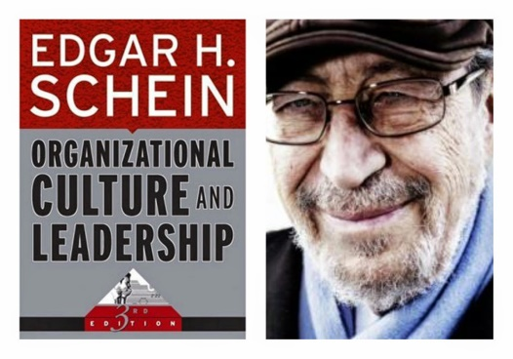
How to Manage Organizational Culture
Primary Mechanisms
What leaders pay attention to, measure and control.
How leaders react to crises.
How leaders allocate when resources are scarce.
Deliberate role modelling, coaching & teaching.
How you reward.
How you recruit, promote and fire people.
Secondary Mechanisms.
Organizational design.
Systems and procedures.
Design of work spaces.
Rites and rituals.
Stories about people and key events.
Formal statements about the organization.

Slide 16
Transmitting Culture
Transmitting Culture
Socialization
Stories
Symbols
Jargon
Rituals
Statements of principle

Slide 17
Strong Cultures
Socialization processes in “strong cultures”
Selection of entry-level candidates: (want members that fit)
Humility-inducing experiences: (new problems that will make employees buy into the org’s values)
In-the-trenches training: (members work they way up the ranks and promotion depends on proven track record)
Rewards and control systems: (members are rewarded for contributing to the success factors and behaving in accordance with cultural values
Adherence to the firm’s core values: (leaders ensure their own decisions are consistent with values therefore members are more likely to make sacrifices for the organization)
Reinforcing folklore: (stories and legends told to newcomers reinforce the cultural values)
Consistent role models: (cultural heroes and winners consistently exhibit the traits valued by the org. culture)
Advantages | Disadvantages
Clear sense of purpose Employee commitment and loyalty Pride in working for the org. Constitute a competitive adv. High performance | Resistant to change Pressure for conformity Inward focus

Slide 18
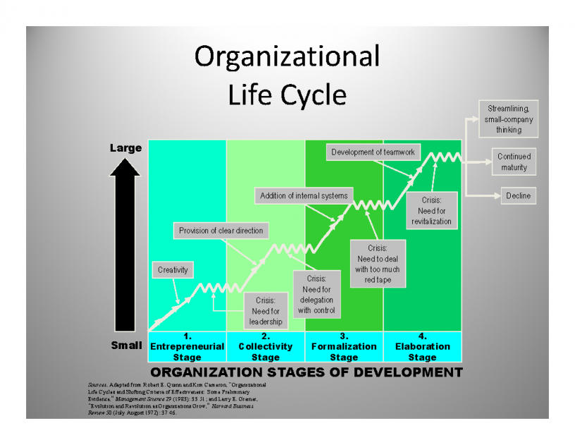
Organizational Life Cycle

Slide 19
Warning Signs: Organizational Design
Excess personnel
Tolerance of incompetence
Red tape
Disproportionate staff power
Process > Results
Scarcity of clear goals and benchmarks
Fear of embarrassment and conflict
Decline in communication
Outdated structure

Slide 20

Dominant vs. Sub Cultures
There are primary values that are accepted throughout the organization.
  Dominant culture: manifests the values shared by a majority of the organizations members
  Subcultures : usually share the dominant cultures core values as well as other values that characterize their own unit.
  Countercultures: groups who’s values are in opposition to those of the dominant culture.

Slide 21

Maintaining Culture
Creating and Maintaining Culture
Selection
  Identify and hire individuals who will fit in with the culture.
Top Management
  Senior executives establish and communicate the norms of the organization.
Socialization
  Organizations need to teach the culture to new employees.
Functions of a strong culture
  Social glue
  Boundary-defining.
  Sense of identity
  Commitment
  Behaviour guide

Slide 22
Sense and Nonsense about Culture & Climate
Culture | Climate
The way we do things | How it feels
Hard to change | Easy to change
Long term impact | Short term impact
Based on anthropology and sociology | Based on psychology
Personality | Mood
Team climate is a cultural artifact resulting from espoused values and shared tacit assumptions of the group.

Slide 23
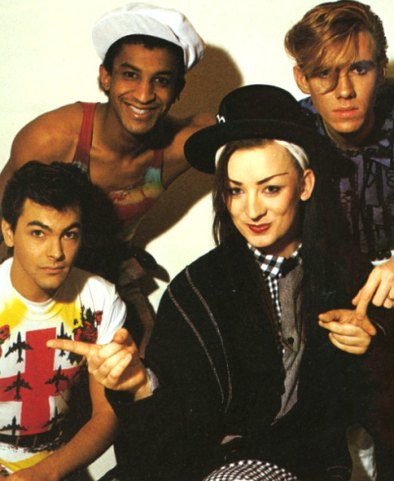
The Liabilities of Culture
Culture can have dysfunctional aspects in some instances.
  ____________________________________
  ____________________________________
  ____________________________________
Notes:
Culture as

Slide 24
Next week
GUEST LECTURE
Decision Making
Christiane Fox
Assistant Secretary to the Cabinet - Communications at Privy Council Office, Government of Canada

Slide 25
Privy Council Office
The Privy Council Office (PCO) is the hub of non-partisan, public service support to the Prime Minister and Cabinet and its decision-making structures.
  Led by the Clerk of the Privy Council, PCO helps the Government implement its vision and respond effectively and quickly to issues facing the government and the country.
  In today's world of complex economic and social issues, much of this work involves consultation and coordination – both inside and beyond the federal government. The PCO secretariats play a key role in ensuring this collaboration.
  To this end, PCO works to achieve the highest professional and ethical standards in the federal Public Service.

Slide 26
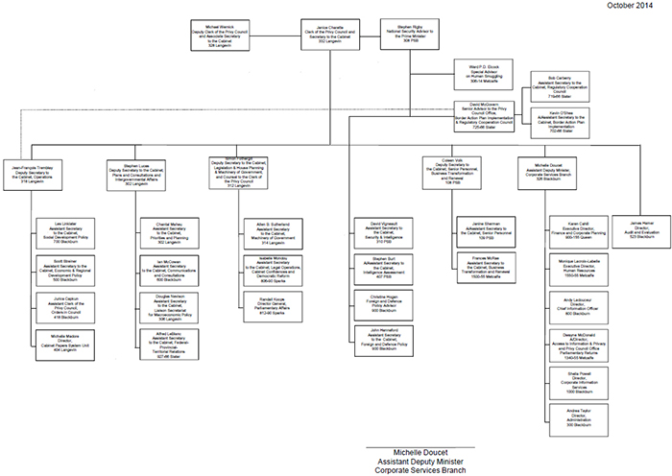
PCO - Organization

