Slide 1

Week 4B
Conflict & Negotiation
Summer 2017

Slide 2

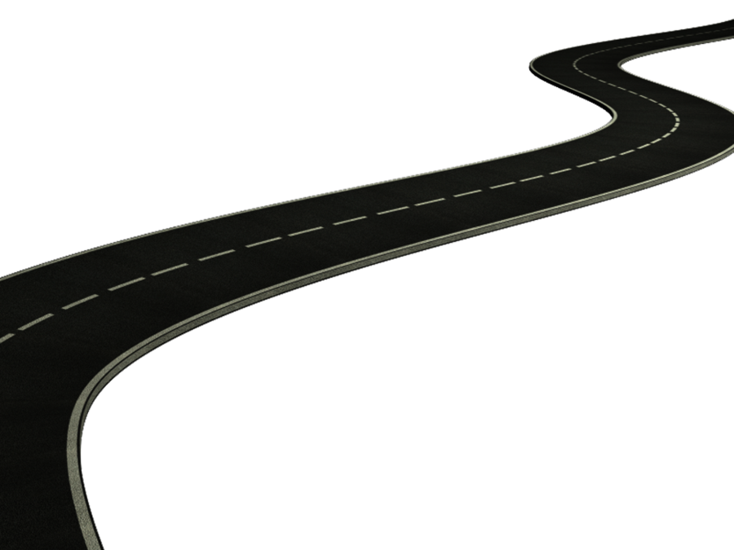
Road Map
Review Week 4A
Week 10 – Conflict and Negotiation
  Conflict
    Conflict handling strategies
  Negotiation
    Bargaining strategies
Questions for review
Next Week

Slide 3


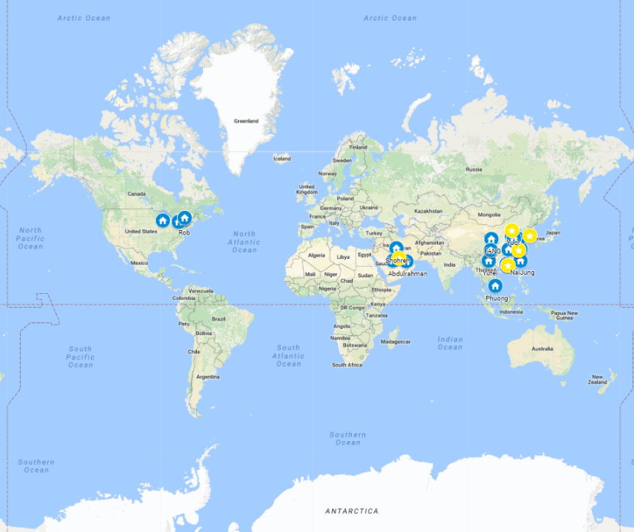



BUSI 2101: Around the world
Get into groups of four. Find one company from outside North America/Europe that Sprott students should know about but do not.
Go to our online form our online form

Slide 4

Sources of Conflict
Communication
Structure
  Size of the group
  Specialization
  Composition of the group
  Ambiguity responsibility
  Zero-sum reward systems
  Leadership style
  The diversity of goals
  Interdependency
Personal Variables
  Personality
    People high in disagreeableness, neuroticism, or self-monitoring are prone to tangle with other people more often, and to react poorly when conflict occurs
  Emotions
  Values

Slide 5
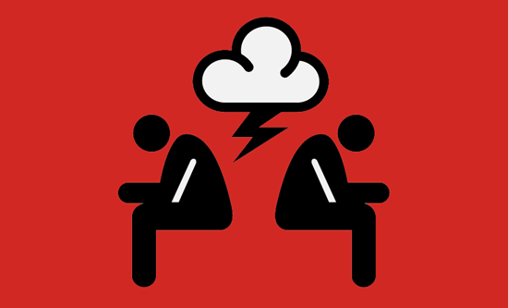
Is conflict a bad thing?
Enhanced understanding of the problem
More alternatives
Increased engagement
Critical discussion of flaws
Integration through comparison of goals
Cohesiveness within groups
Correction of power imbalances
Inhibits collaboration.
Takes up too much time.
May be perceived by outsiders as damaging.
Leads to the identification of winners and
losers.

Slide 6
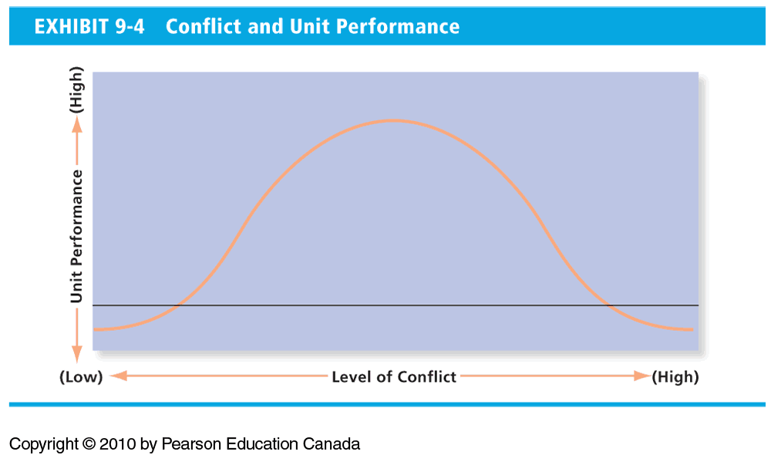
Conflict and Unit Performance

Slide 7
How should you resolve your conflict?
Key factors to examine in determining an appropriate conflict resolution strategy are:
Source of conflict
Importance of the conflict issue
Importance of long-term interpersonal relationship
Speed required in resolving conflict

Slide 8

Managing Conflict
Negotiation and Conflict Exercise
General conflict strategies
  Problem solving
  Developing super-ordinate goals
  Smoothing
  Compromising
  Avoidance
Work Related Conflict Strategies
  Expansion of resources
  Authoritative command
  Altering the human variable
  Altering the structural variables

Slide 9
Having difficult conversations
Managers spend an average of 42% of their time dealing with conflict.
Lower level managers spend more time dealing with conflict than higher level managers.
Conflict affects:
employee job satisfaction,
productivity, and
effectiveness
Approximately $25,000 per year per employee is spent on dealing with conflict
A 2011 estimate suggests that in the UK, conflict costs C$53 billion per year including:
  C$43 billion in damages
  C$10 billion in legal fees
  In addition to these costs, 8 out of 10 conflicts disrupt organizational functioning

Slide 10
Resolving Intercultural Conflicts
Those from Asian cultures show a preference for conflict avoidance, compared with Americans and Britons.
Chinese and East Asian managers prefer compromising as a strategy, contrary to North Americans.
North Americans prefer a problem-solving approach to conflicts, which yields a win-win solution.
Win-win solutions are less likely to be achieved in Asian cultures.
East Asian managers tend to ignore conflict rather than make it public.
Japanese managers tend to choose non-confrontational styles.
Westerners are more likely to choose forcing as a strategy than Asians.
North Americans expect that negotiations may lead to a legal contract; Asian cultures rely less on legal contracts and more on relational contracts.

Slide 11
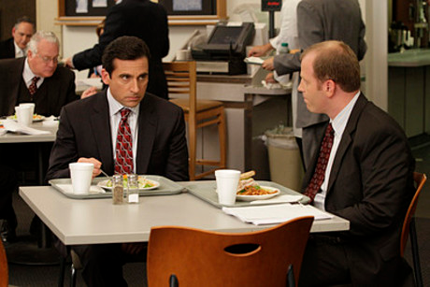
Personality Conflicts
Causes of Personality conflicts:
  Misunderstandings based on age, race, or cultural differences
  Intolerance, prejudice, discrimination, and bigotry
  Perceived inequalities
  Misunderstandings, rumours, or falsehoods about an individual or group
  Blaming for mistakes or mishaps (finger-pointing)
What should you do if you have a personality conflict?
What should you do if you observe a personality conflict?
What should a manager do if they observe a personality conflict?
Source: R. Kreitner and A. Kinicki, Organizational Behavior, 6th ed. (New York: McGraw-Hill, 2004), p. 492, Table 14-1. Reprinted by permission of McGraw-Hill Education.

Slide 12
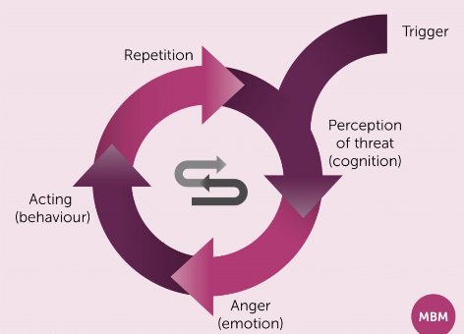
The Retaliatory Cycle
Natural tendency in confrontation is to match emotional tone and intensity

Slide 13
Third-Party Conflict Resolution
Facilitation
  Generally acquainted with both parties, working with both sides to reach an agreement.
Conciliation
  Trusted third party who provides an informal communication link between the negotiator and the opponent.
Ombudsperson
    An impartial party, widely respected, and trusted.
Peer Review
    A panel of peers who have been put together to hear both sides of the issue from the parties involved and to recommend a solution.
Mediation
  A neutral third party who facilitates a negotiated solution by using reasoning, persuasion, and suggestions for alternatives
Arbitration
  Has authority to dictate an agreement.

Slide 14

Conflict Outcomes
Three desired outcomes of conflict
  Agreement: Equitable and fair agreements are the best outcomes
  Stronger relationships: When conflict is resolved positively, this can lead to better relationships and greater trust.
  Learning: Handling conflict successfully teaches one how to do it better next time.

Slide 15
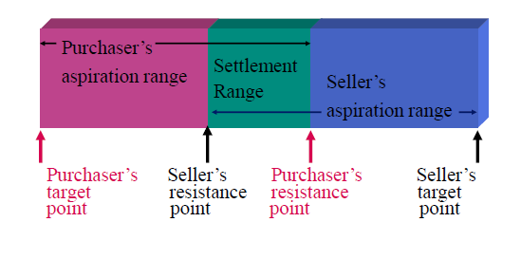
Negotiation
Negotiation is:
• An interdependent decision process
• Whereby two or more parties
• Decide what each will give and take
• In a relationship
Bargaining zone
BATNA
Reservation point

Slide 16

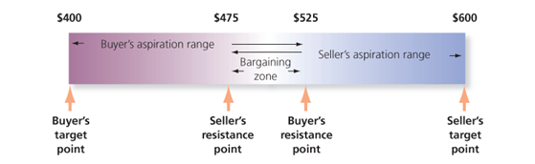
Five Steps in the Negotiation Process
Developing a strategy
Identify:
BATNA
Target Point
Resistance Point
Bargaining Zone
Defining ground rules
Clarification and
justification
Bargaining and
problem solving
Closure and
implementation

Slide 17
Positions vs Interests
Position = one party’s stand on an issue.
Interests = underlying concerns that would be affected by the resolution.
Inexperienced negotiators focus on the “dance
of positions.”
Experienced negotiators focus on the
reconciliation of underlying interests.

Slide 18
Issues in Negotiation
Gender Differences in Negotiating Styles
Women
  View the bargaining session as part of an overall relationship.
  Tend to want all parties in the negotiation to be empowered.
  Use dialogue to achieve understanding.
Men
  View the bargaining session as a separate event.
  Use dialogue to persuade.
Cultural Differences in Negotiating Style
Source: J. W. Salacuse, “Ten Ways That Culture Affects Negotiating Style: Some Survey Results,” Negotiation Journal, July 1998, pp. 221-240.

Slide 19
Issues in Negotiation
Negotiators who are agreeable or extraverted are not very successful in distributive bargaining
  Extraverts are outgoing and friendly, they tend to share more information than they should
  Agreeable people are more interested in findings ways to cooperate rather than to butt heads

Slide 20
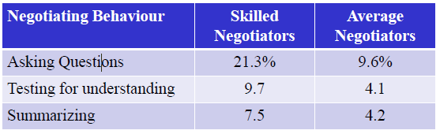
Skilled Negotiators
Compared to average negotiators, skilled negotiators:
  explore twice as many options
  spend 3 times as much time exploring common ground
  make twice as many comments related to the long-term
  are more likely to think of ranges rather than fixed points
  are more likely to view issues as independent rather than linked in sequence
  use fewer loaded terms (e.g. “generous offer”)
  make fewer immediate counter proposals

Slide 21
Interactive Groups
Group Interactive #1 (Montana)
  Neeharika Saha, Zhihui Deng, Jingyi Jiao, Nai-Jung Shao, Xinyang Liu, Anthony Bombardier-Touret, Yingfei Xu, Enayet Fareghi, Fang Chen, Tanya Chen, Yifei Xie, Kevin Li, Danielle McIntyre, Shanyao Xie, Mengqi Chen, Nadia Abbasi, Khaled Radaideh, Jason Macleod, Xin Wu, Khulud Alharbi, Donghe Zhang, Tong Lu, Hayden Cummings, Wei Zhan, Abdulrahman Abdullah , Mohammad Almutairi (25 total)
Group Interactive #2 (Colin)
  Jiying Feng, Jovunjeet Brar, Yuchen Zhang, Bohan Jiang, Khadar Mousa, Dongjun Xie, Jianxue Rao, Fariz Setyobudi, Mingyu Zhou, Yi Zeng, Xinyi Gao, Wen Zhou, Shohreh Ali Akbar Pour, Zeyao Zhou, Yuqi Cheng, Ziyi Liao, Carrie Jiang, Yusha Xiao, Yufei Nie, Phuong Le, Ruming Zhang, Qingling Sun, Lixue Cheng, Xinyue Zhu, Linzehua Gan (24 total)

Slide 22

Conflict Defined
Def: ________________________________
Conflict can be either
  Functional:__________________________
  Dysfunctional: ______________________
Types of Conflict
  Cognitive: ________________________
  Affective: _________________________

Slide 23

Conflict Resolution
Two Dimensions:
  Cooperativeness
    The degree to which one party attempts to satisfy the other party’s concerns.
  Assertiveness
    The degree to which one party attempts to satisfy his or her own concerns.

Slide 24
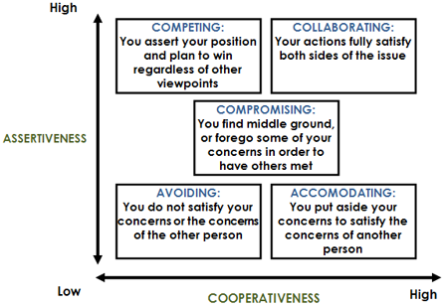
Negotiation and Conflict
What is your primary conflict-handling style?
  Textbook pg.346

Slide 25
Negotiation
A process in which two or more parties exchange goods or services and attempt to agree upon the exchange rate for them.
  Distributive bargaining
    Negotiation that seeks to divide up a fixed amount of resources; a win-lose situation.
  Integrative bargaining
    Negotiation that seeks one or more settlements that can create a win-win solution.

Slide 26
Negotiation
Negotiation is:
• An interdependent decision process
• Whereby two or more parties
• Decide what each will give and take
• In a relationship
Bargaining zone
BATNA
Reservation point
Notes:
“

Slide 27
Principled Negotiation
Fisher and Ury
  based on integrative bargaining (win-win)
  focus is on merits of specific rather than what each side says they will or will not do
    Separate people from the problem
    Focus on interests, not positions
    Invent options for mutual gain
    Insist on objective criteria

Slide 28
Questions for Preparation
What do you want here? What is your most optimistic hope? Your realistic expectation? What will you settle for?
What does the other person probably want? How will you find out?
How will you persuade the other person? What will your tactics be?

Slide 29
General Instructions
This exercise will be timed. Please do everything you can to reach a settlement within 8 minutes.
You may make up any story you wish to win as much of the $2 as possible.
However keep in mind that it matters a lot that you able to meet your deadline and actually reach a settlement; this is your most important priority.

