Slide 1
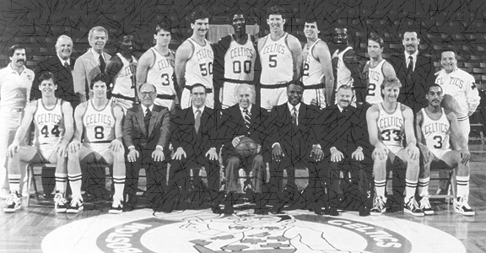
Week 4A
Teaming
Summer 2017

Slide 2
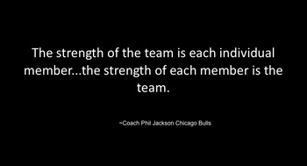
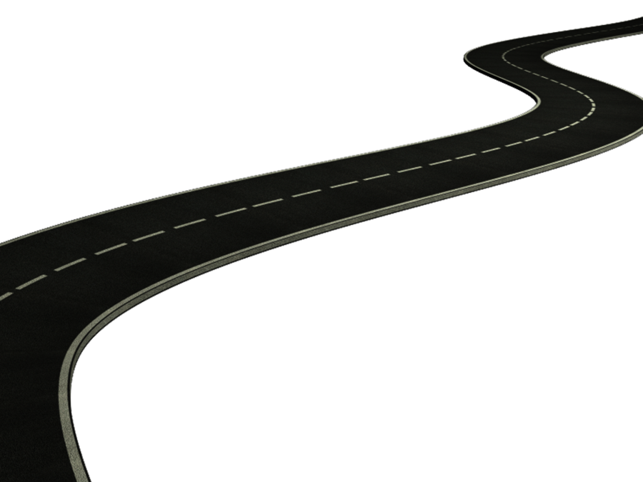


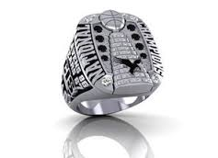
Road Map
Review Weeks 1-3
Teaming
Models of teamwork
Roles
Conflict
Communication on teams

Slide 3


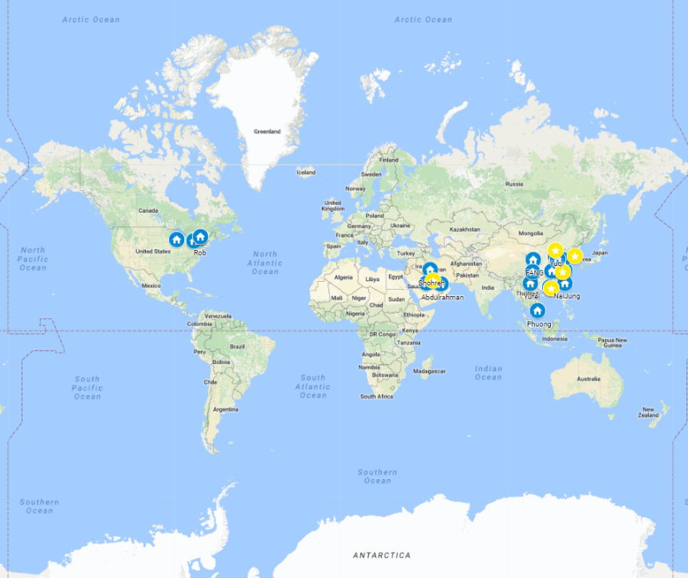



BUSI 2101: Around the world
Get into groups of four. Find one company from outside North America/Europe that Sprott students should know about but do not.
Go to our online form our online form

Slide 4

Teams
What is a team?
  “a collection of individuals who are interdependent in their tasks, who share responsibility for outcomes, who see themselves and who are seen by others as an intact social entity in one or more larger social systems (for example, business unit or corporation), and who manage their relationships across organizational boundaries"
  - Cohan & Bailey(1997)
What is teaming?
  TEAMING IS A VERB. Managers need to stop thinking of teams as static groups of individuals who have ample time to practice interacting successfully and efficiently (Amy Edmondson, 2012). Today's businesses require teamwork skills that allow you to be on teams that band and disband by the minute, requiring a more dynamic approach to how teams develop and preform.
When do we need teaming?
  Can the work be done better by more than one person?
  Is the task uncertain, complex, dynamic, or large in scope ?
  Does work create a common purpose or set of goals for the members?
  Are members of the team interdependent?
Types of teams
  See page 267

Slide 5
Types of Teams
Problem-Solving Teams
Self-Managed Teams
Cross-Functional Teams
Virtual Teams
Top Management teams
Change teams
Multi-National teams
Action Teams

Slide 6
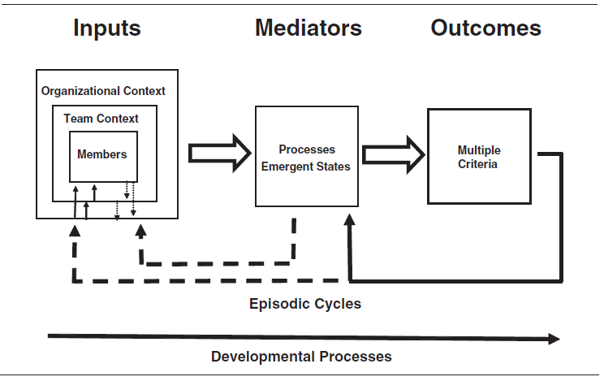
Team Effectiveness – IPOI Model
Team Effectiveness Criteria
  Output (performance)
  Social processes (viability)
  Learning (satisfaction)
An excellent resource for understanding team effectiveness:
  Mathieu, J., Maynard, T., Rapp, T. & Gilson, L. (2008). Team Effectiveness 1997-2007: A Review of Recent Advancements and a Glimpse Into the Future, Journal of Management, 34(3), 410-476.
Notes:
Mathieu, J., Maynard, T., Rapp, T. & Gilson, L. (2008). Team Effectiveness 1997-2007: A Review of Recent Advancements and a Glimpse Into the Future, Journal of Management, 34(3), 410-476.

Slide 7
Consolidated Model
Organizational Context
Task Design
Team Identity
Resources
Technology
Complex Interdependence
Training and Support
Organizational Culture
Team Competition
Simultaneous Tasks
Sequential Tasks
Current Task
Processes
Boundary Management
Team Effort
Performance Strategies
Interpersonal Interactions
Communication
Team Roles
Inputs
Team Size
Leadership
Knowledge and Skills
Team Experience
Team Effectiveness
Team Performance (Objective Organizational evaluation)
Team Satisfaction
(Team Member rating)
Team Viability
(Manager Evaluation)
Emergent States
Resiliency
Trust
Team Conflict
Team Efficacy
Team Cohesion
Task Commitment

Slide 8

Team Effectiveness – Role Theory
Team Role: a set of expected behaviours of a person in a given position in a social unit
Belbin (1993)
  Implementer
  Coordinator
  Shaper
  Plant
  Resource Investigator
  Monitor Evaluator
  Team Worker
  Completer/Finisher
  Specialist

Slide 9


Team Effectiveness – Role Theory
Role Conflict
  _______________________________
Role Ambiguity
  ______________________________
Role Overload
  ______________________________
Role Underload
  _______________________________

Slide 10
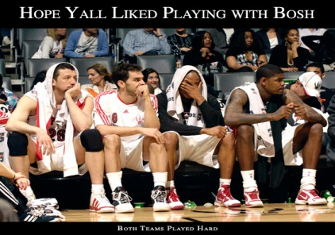
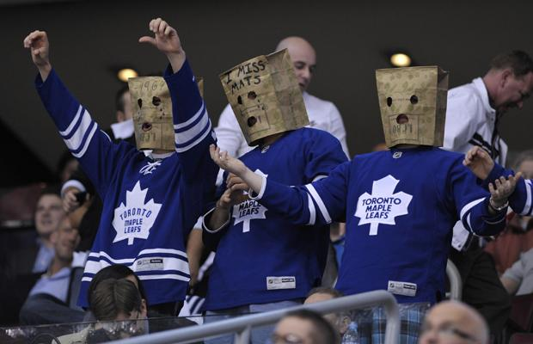
Team Norms
Acceptable standards of behaviour within a team that are shared by the group’s members.
How do norms develop?
  ____________________________
  ____________________________
  ____________________________
  _____________________________
Types of Norms
  Performance, Appearance, Social, Resources,

Slide 11
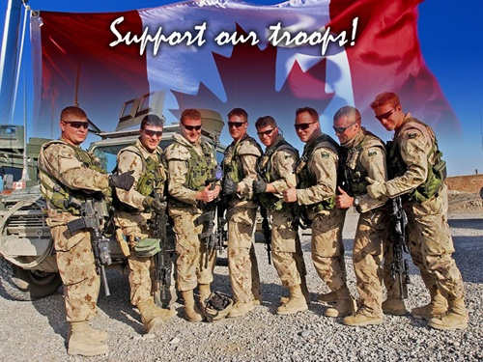
Making Norms Work
Conformity: adjusting one’s behaviour to align with the norms of the team
A norm is more likely to be enforced if:
  __________________________
  __________________________
  __________________________
  __________________________

Slide 12
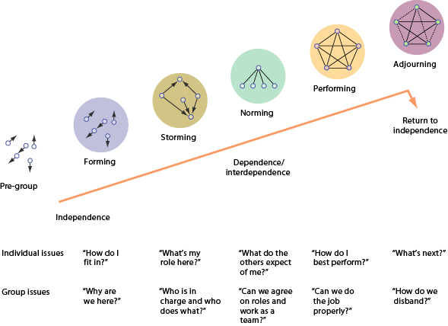
Stages of Group Development

Slide 13

Sense and Nonsense about Culture & Climate
Team Culture | Team Climate
The way we do things | How it feels
Hard to change | Easy to change
Long term impact | Short term impact
Based on anthropology and sociology | Based on psychology
The personality of team | The mood of a team
Eg. Team roles | Eg. Psychological safety
Team climate is a cultural artifact resulting from espoused values and shared tacit assumptions of the group.
13

Slide 14
The Punctuated-Equilibrium Model
(High)
Completion
Phase 2
Performance
First
Meeting
Transition
Phase 1
(Low)
A
(A+B)/2
B
Time

Slide 15

Diversity
Impact of diverse groups
  Diversity in personality, age, gender, and experience promotes conflict, which stimulates creativity and idea generation, which leads to improved decision making.
  Cultural diversity in teams
    Challenges: __________, __________, __________
      Problems usually pass with time
      (certainly by three months).
    Advantages:
    _________, __________,
    __________, __________,
    __________, __________

Slide 16
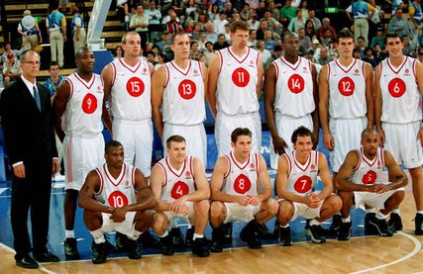
Team Cohesion
Definition “a dynamic process that is reflected in the tendency for a group to stick together and remain united in the pursuit of its instrumental objectives and/or for the satisfaction of member affective needs” (Carron et al., 1998, p. 213).
  Interpersonal cohesion(social)
  Task cohesion
  Group Pride
  Emotional cohesion

Slide 17
Psychological Safety
Team Psychological Safety is defined as a shared belief that the team is safe for interpersonal risk taking.
  Makes tough feedback and difficult conversations possible.
  Helps combat groupthink.
  Image risks at work.
    Being labeled as ignorant
    Being labelled as incompetent
    Being seen as negative
    Being seen as disruptive.
 | Very Inaccurate |  | ……. | ……. | ……. | Very Accurate
1. If you make a mistake on this team, it is often held against you. | 1 | 2 | 3 | 4 | 5 | 6 | 7
2. Members of this team are able to bring up problems and tough issues. | 1 | 2 | 3 | 4 | 5 | 6 | 7
3. People on this team sometimes reject others for being different. | 1 | 2 | 3 | 4 | 5 | 6 | 7
4. It is safe to take a risk on this team. | 1 | 2 | 3 | 4 | 5 | 6 | 7
5. It is difficult to ask other members of this team for help. | 1 | 2 | 3 | 4 | 5 | 6 | 7
6. No one on this team would deliberately act in a way that undermines my efforts. | 1 | 2 | 3 | 4 | 5 | 6 | 7
7. Working with members of this team, my unique skills and talents are valued | 1 | 2 | 3 | 4 | 5 | 6 | 7

Slide 18
The Benefits of Psychological Safety
Encourages Speaking up
Enables clarity of thought
Mitigates failure
Promotes innovation
Removes obstacles
Increases accountability
Comfort Zone
Learning Zone
High
Psychological Safety
Apathy Zone
Anxiety Zone
Low
Low
Accountability
High

Slide 19
NASA Columbia Disaster
January 17th, 2003
Shuttle Engineer Rodney Rocha reviews a video of the launch and notices a chunk of insulating foam that appeared to have fallen off the shuttle’s external tank and stuck its left wing.
“Engineers were often told not to send messages much higher than their own rung in the ladder”.
“I just couldn’t do it. I’m too low down… and she (mission Management Team Leader Linda Ham) is way up here (gestures)”
NASA expression “it’s in family”.
Great Documentary
NASA Columbia Disaster Documentary

Slide 20
Team Decision making procedures and rules
Rule | Example | Pros | Cons
Unanimous | “We all need to agree on this, so let’s get to work”
Majority-minority voting | “lets vote. Whoever has the most votes wins”.
Best member | “Tom, you’ve been through all this before, you decide”
Consensus seeking | “let’s find a solution we all can live with”
Random member | “Sarah, it’s your turn to decide, we’re good with whatever you choose”
Plop | “I think we should appoint a chairperson”, ….silence…
Self-authorized agenda | “I think we should go around the room and introduce ourselves. Ok, I’ll go first…”
Handclasp | Ryan- “I think we should go around the room and introduce ourselves.” Tim(Ryan’s friend) “Ok. I’ll go first”
Polling | “Let’s see where everyone stands”
Minority decision | “Does anyone object?”, or “we are all good, right”.
Satisficing | “This one seems to meet our criteria, let’s move on”

Slide 21
Communication and Groups
Does technology facilitate or hinder group development?

Slide 22
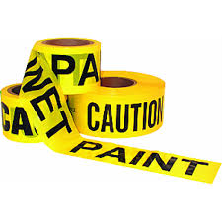
Team Boundaries
Defining teams based on their relationship with their environment (internal and external to the organization)
Internal vs. External
  Occupational, hierarchical, cultural
  Cross functional teams
Multi-Team Systems
Ability to manage the boundaries
  Team reputation & support

Slide 23
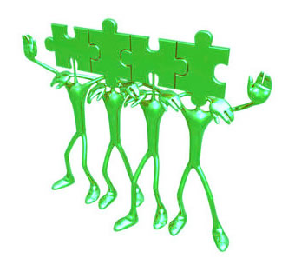
Beware! Teams Aren’t Always the Answer
Social Loafing – the tendency for some individuals to expend less effort when working collectively than when working individually.
In these situations teamwork might not be the answer:
___________________________________
___________________________________
____________________________________

Slide 24
Self-Oriented behavior and how to be a great teammate
Why do we get self-oriented behavior on teams?
Identity?
Control and Power
Goals
Acceptance and inticmacy
Advice from research, teaching and coaching.
Be Authentic
  who you are and what you can do
Show Respect
  Culture, processes, people (everyone has the power to influence the outcome dramatically)
Communicate
  Teams that engage perform better (Pentland, 2012)
Develop skills that the team needs!
  This will earn you respect!

Slide 25
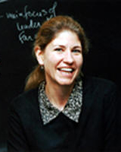

OB/OT Researchers in Canada (and the USA)
Ruth Wageman, PhD
  Visiting Scholar, Department of Psychology, Harvard University
  Director of Research, Hay Group
Research Interests
  Organizational behavior, with particular emphasis on leadership and team effectiveness.
  Professor Wageman's current research interests include the uses and misuses of power in teams, the influence of task and reward system designs on team effectiveness, and effective team coaching.
  Wageman, R., Hackman, J.R. & Lehman, E.V. (2005). Team Diagnostic Survey: Development of an instrument. Journal of Applied Behavior Science, 41, 373-398.

