Slide 1

Week 3A
Perception & Communication
Summer 2017

Slide 2
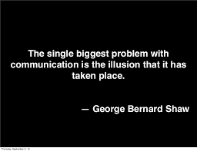
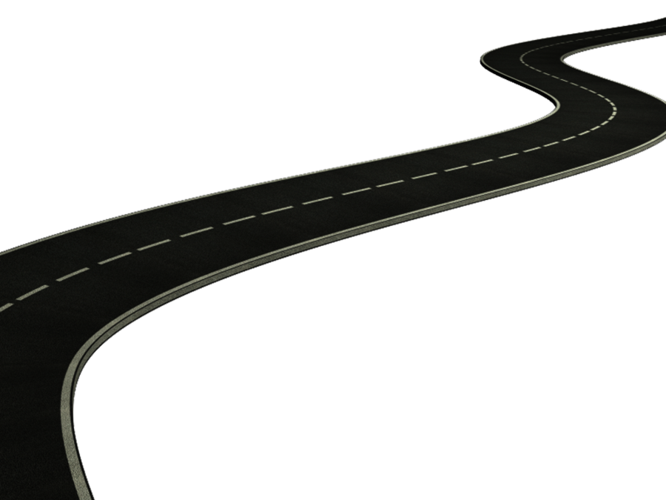
Road Map
Review Week 2
Motivation
Perception
  Perceptual errors
Communication Models
  Choosing Channels
  Barriers to Communication

Slide 3




Developing a Rewards System
Motivation & Monetary Rewards
  Individual and Group based salary
Motivation & Employee Recognition
  Private recognition, public recognition
Motivation & Job Redesign
  Job enlargement, job rotation, job enrichment
Motivation & Flexibility
  Compressed workweek, flex-time, job sharing, telecommuting

Slide 4
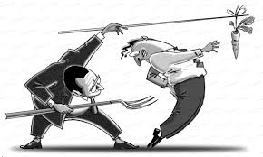
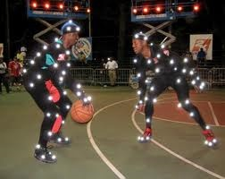
Rewards - Beware
Be sure to consider individual needs and motivation processes before designing a rewards system
Be sure to consider diversity
Be sure to consider the impact of the rewards system on intrinsic motivation
Be sure to link rewards to performance
Cognitive Evaluation Theory:
___________________________
_____________________________
  Pay fairly
  find intrinsic motivators

Slide 5

Week 3A
Perception, and Communication

Slide 6
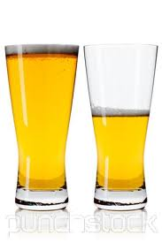
What is Perception?
Definition
The process by which individuals select, organize, and interpret their impressions in order to give meaning to their environment.
  The world that is perceived is the world that is behaviorally important
Selection (Salience)
Organization (Schemas)
Evaluation (Subjective)
Give an example that explains what perception is:
__________________________________________
__________________________________________
__________________________________________

Slide 7
Perceptions in the Business World
The world as it is perceived is the world that is behaviourally important!
  Are you a hard worker?
  Are you a leader?
  Do you have a bad attitude?
How will your perception guide your behaviour as you go to get a job?
How will others’ perception of you guide your behaviour as you start a new job?
Remember this!!!
Manage people’s perceptions and you will manage their behaviour!

Slide 8
Factors Influencing Perception
The Situation
The Perceiver
Time
Work Setting
Social Setting
Attitudes
Motives
Interests
Experience
Expectations
Perception
The Target
Salience
Motion
Sounds
Size
Background
Proximity
It is important to consider the interaction between the factors

Slide 9
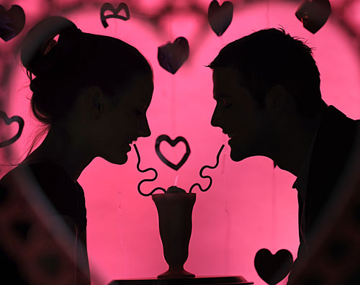
Attribution Theory
Social Perception: According to attribution theory when people observe behavior, they attempt to determine whether it is internally or externally caused
Valentines day and the Attribution Theory
  Selection (observation)
  Organization (interpretation)
  Evaluation (attribution of cause)

Slide 10
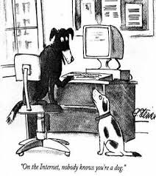
The Power of Perception Social Identity Theory
Social identity theory is based on the belief that people tend to:
  Perceive themselves and others in terms of social categories rather than as individuals.
  Assess the relative worth of groups and individuals by comparing them.
  Perceive and respond to the work not as detached observers but in terms of their social identity.
  Other things being equal, the higher the degree of similarity of perception among individuals, the more frequent and easier communication among them is likely to be

Slide 11

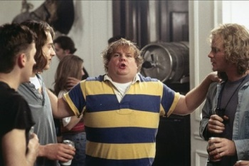
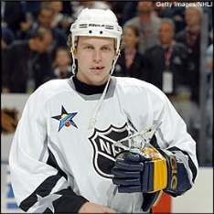
The power of perception Self-Fulfilling Prophecy
Self-fulfilling prophecy (or Pygmalion effect)
  “A” Student: If you are perceived as an A student you are more likely to behave like an A student.
  Res Party Animal: Each residence floor is full of people behaving how they think they need to behave in order to fit into other peoples expectations
  Bad Attitude: A basketball recruit becomes an attitude problem – it starts with misinterpreting a lack of confidence for laziness or a bad attitude.

Slide 12
Perception Errors
“Situations that are perceived to be real are real in their consequences.”
- W.I. Thomas
Fundamental Attribution Error: The tendency to underestimate external factors and overestimate internal factors when making judgments about others’ behaviour. example:
Self-Serving Bias: The tendency to attribute one’s successes to internal factors while putting the blame for failures on external factors.
Selective Perception: is a lot like speed reading, a very necessary perception tool
Halo Effect: is most often encountered when perceived traits are ambiguous, when moral issues are related, and when the perceiver is inexperienced with the situation or the traits.
Contrast (Recency) Effect:example, your grade on an assignment or exam can be influenced by perceptual errors
Primacy Effect: First impressions tend to stick out.

Slide 13
Perceptual Errors con’t
7. Stereotyping: perceptions of a person based on perceptions of the group to which that person belongs
8. Central Tendency: tendency to avoid extreme judgements. Easier to stick to the average, then justify a fair increase in rating
9. Perceptual Defence: filtering out that which we do not want to see. cheating in a relationship, stealing in a corporate setting, often arises when our true perceptions would force us to alter our own self image
10. Implicit person theories: Personal theories about what personality traits and abilities occur together and how these attributes are manifested in behavior.

Slide 14
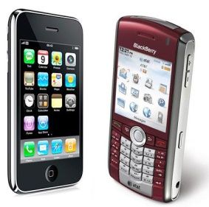
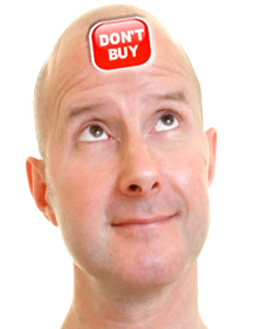
Perception and the Perceiver
Personality and Emotion
  Help you to assign meaning to the perceived world
  Helps to guide your behaviour
Personality
  The stable patterns of behaviour and consistent internal states that determine how an individual reacts to and interacts with others
Emotions
  Intense feelings that are directed at someone or something.

Slide 15
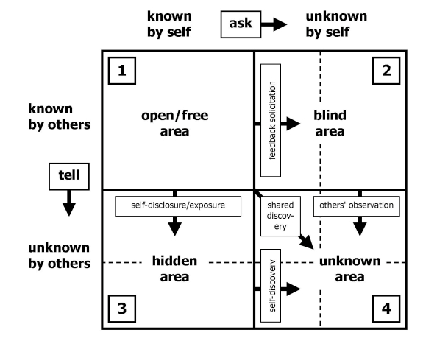
Self-Perception
The Johari Window
Self-Awareness: the ability to both seek feedback from others and to disclose one’s own feelings and thoughts.
  may be the most important competency that managers can develop.
  Perception has a major impact on communication.

Slide 16

Communication
Chapter 8

Slide 17
The Communication Process Model
Context
Context
Chooses
Encodes the
Chooses the
a message
message
channel
Considers the receiver
Sender
Receiver
Considers the sender
Provides
Decodes the
feedback
message

Slide 18
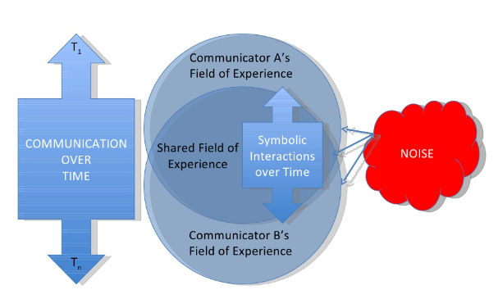
The Transactional Model of Communication
Communication: The process by which information is exchanged between communicators with the goal of achieving a mutual understanding.

Slide 19
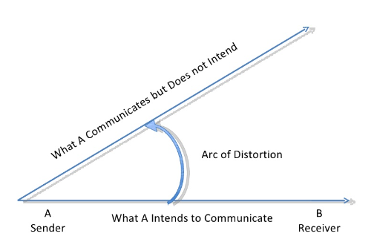
The Arc Of Distortion

Slide 20
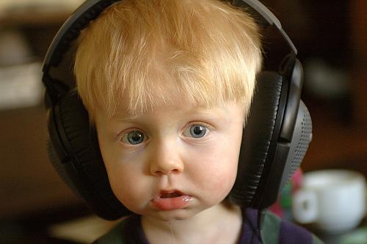
Barriers to Effective Communication
Filtering
Perceptual errors
Defensiveness
Information overload
Language
Gender
Culture
Poor relationships
Poor listening skills
Stress

Slide 21
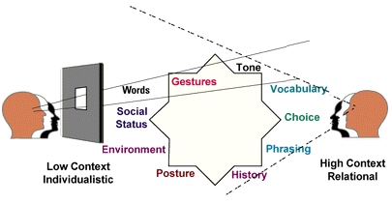
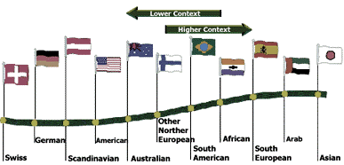
High- vs. Low-Context Cultures
Individualistic vs. Relational Cultures

Slide 22
Choosing Channels
Channels differ in their capacity to convey information.
Rich channels have the ability to:
  _______________________
  _______________________
  _______________________
  communication apprehension
  Communication under stress

Slide 23
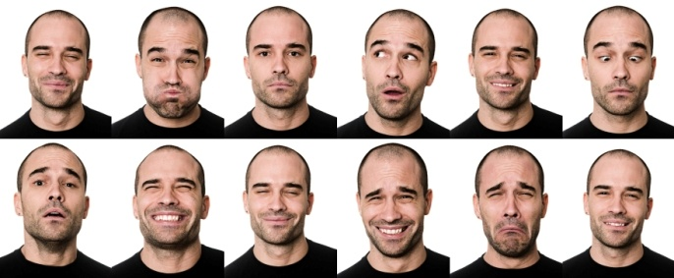
Nonverbal Communication
Messages conveyed through body movements, facial expressions, and the physical distance between the sender and the receiver.
  Kinesics: ________________________________
  Proxemics: ______________________________
Silence as Communication?
The power of nonverbal communication
#1
Say - “I really like your shirt”
but make sure they understand,
“that shirt is ugly, do not wear it again”
The power of nonverbal communication
#3
Say - “I will gladly put the lead on writing up the research analysis for the group assignment”
but make sure they understand,
“you are lazy, I have done everything, this is a joke.”
The power of nonverbal communication
#2
Say - “Would you like me to get you a cool refreshing glass of water”
but make sure they understand,
“I could beat you up in a fight and don’t you ever forget it”
The power of nonverbal communication
#4
Say - “Is there anything you would like me to do for the group project”
but make sure they understand,
“I’m really busy, I don’t want to do anything, I want to leave now.”

Slide 24
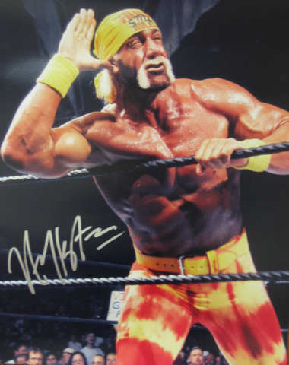
Active vs. Passive Listening
Listening is a BASIC FUNDAMENTAL SKILL
Hearing (physical process) is not the same as listening (mental process). I.e. You should get worse at hearing and better at listening in your life.
Passive Listening is Very very difficult.
Active or empathic listening: requires that the listener try to understand the speaker’s own understanding of an experience without the listener’s own interpretive structures intruding on his or her understanding of the other person.
  Intensity
    Stay focused, give space.
  Empathy
    Understand the context, communicate non-verbal.
  Acceptance
      Avoid judgement
  Responsibility for completeness (facts & feelings)
      Ask questions, paraphrasing.

Slide 25
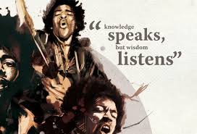
Listening Style
Listening styles (def) ‘‘attitudes, beliefs, and predispositions about the how, where, when, who, and what of the information reception and encoding process’’ (Watson et al., 1995, p. 2).
Four styles of listening orientations that individuals habitually orient toward, especially in novel situations (Imhof, 2004).
Relational Listening
Transactional Listening
Critical Listening
Analytical Listening

Slide 26

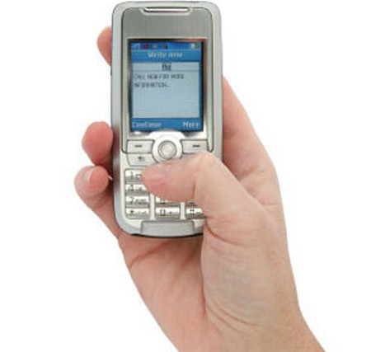
Electronic Communications:
Benefits of E-mail vs. Text message (IM)
Workload?
Significant Limitations of E-mail
  Misinterpreting the message.
  Communicating negative messages.
  Overuse of e-mail.
  E-mail emotions. (Byron, 2008)
    Neutrality effect
    Negativity effect
    Should we include emotion in emails?
  Privacy concerns
  3 Recommendations for email communication in your first job:
  __________________________________________
  __________________________________________
  __________________________________________

Slide 27
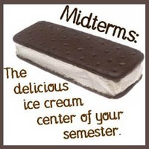
The Midterm
Content
  Weeks 1-5
  Anything covered in class, interactive, the textbook or on CuLearn.
Format
  (20 marks) 10 multiple choice
  (30 marks) 3 short/long answer questions
Timing
  11:35am to 1:35pm

Slide 28

Top Academic Journals related to this course
Academy of Management Review
Academy of Management Journal
Journal of Management
Research in Organizational Behaviour
Personnel Psychology
Administrative Science Quarterly
Organization Science
Journal of Management Studies
Organizational Behaviour and Human Decision Processes
Leadership Studies
Journal of Organizational Behaviour
Human Relations

Slide 29
Interactive Groups
Group Interactive #1 (Montana)
  Neeharika Saha, Zhihui Deng, Jingyi Jiao, Nai-Jung Shao, Xinyang Liu, Anthony Bombardier-Touret, Yingfei Xu, Enayet Fareghi, Fang Chen, Tanya Chen, Yifei Xie, Kevin Li, Danielle McIntyre, Shanyao Xie, Mengqi Chen, Nadia Abbasi, Khaled Radaideh, Jason Macleod, Xin Wu, Khulud Alharbi, Donghe Zhang, Tong Lu, Hayden Cummings, Wei Zhan, Abdulrahman Abdullah , Mohammad Almutairi (25 total)
Group Interactive #2 (Colin)
  Jiying Feng, Jovunjeet Brar, Yuchen Zhang, Bohan Jiang, Khadar Mousa, Dongjun Xie, Jianxue Rao, Fariz Setyobudi, Mingyu Zhou, Yi Zeng, Xinyi Gao, Wen Zhou, Shohreh Ali Akbar Pour, Zeyao Zhou, Yuqi Cheng, Ziyi Liao, Carrie Jiang, Yusha Xiao, Yufei Nie, Phuong Le, Ruming Zhang, Qingling Sun, Lixue Cheng, Xinyue Zhu, Linzehua Gan (24 total)

