Slide 1
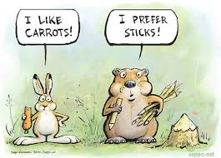
Week 2B
Motivation
BUSI 2101
Summer 2017

Slide 2
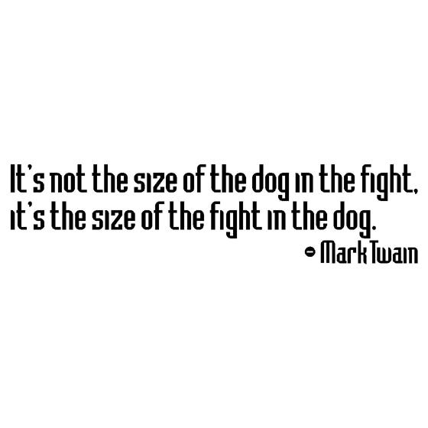

Road Map
Review Week 2A
Personality
  Trait Approach
  Interactionist Approach
Motivation
  Needs Theories of Motivation
  Process Theories of Motivation
  Hackman & Oldham

Slide 3


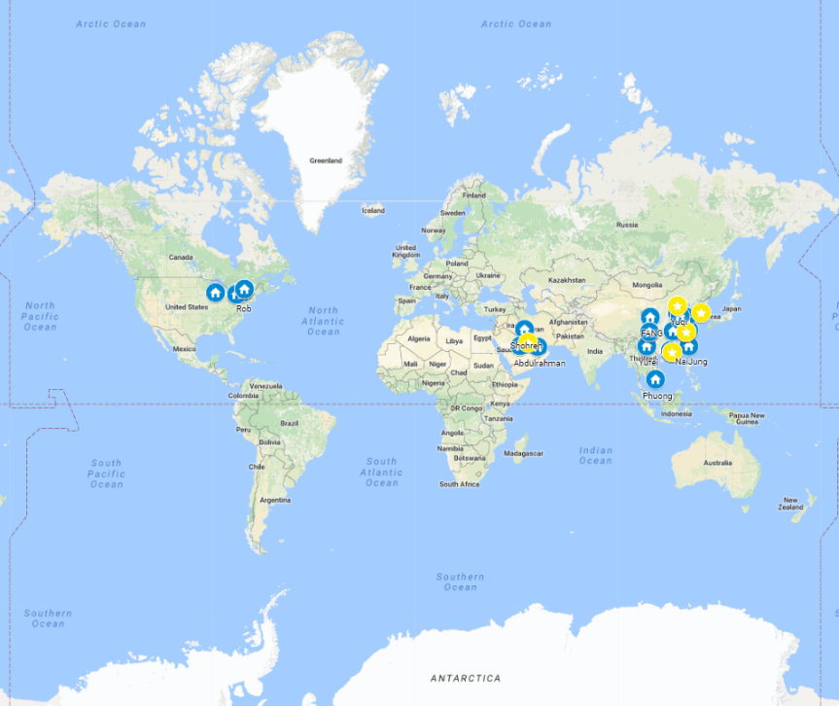



BUSI 2101: Around the world
Get into groups of four. Find one company from outside North America/Europe that Sprott students should know about but do not.
Go to our online form our online form

Slide 4

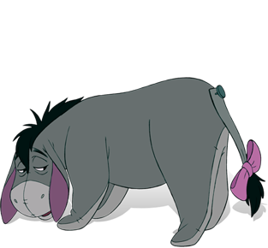
Interactionist Approach: CRA
How does the environment interact with your personality to determine behaviour?
Conditional Reasoning Approach
  Dispositional motivation – fear of failure vs. opportunity for learning.
    Exams
    Boss angry
    Competition

Slide 5

Interactionist Approach: CRA
Cognitive-Affective Processing Systems
  People search for dominant cues.
  Depending on a variety of factors (ie. emotion, culture, genetic, societal etc…) you activate mental if-then representations of the situation. This guides your action.
  Different cues activate different behaviours.

Slide 6
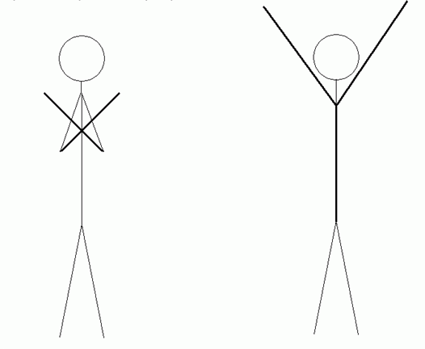
Motivation
Definition: ______________________________________________
______________________________________________
Douglas McGregor
  Theory X: _____________________________________________________
  Theory Y: _____________________________________________________
Extrinsic Motivators:
  _________________________
  _________________________
Intrinsic Motivators:
  _________________________
  _________________________

Slide 7
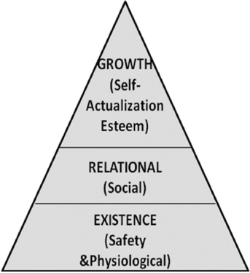
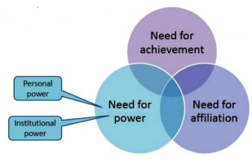
Understanding motivation
Managers need to understand motivation NOT because they can directly motivate workers, but because they often have the power to design work and influence reward systems and other conditions in the work environment that may have an influence on worker motivation.
KEY:
MOTIVATION IS AN INTERNAL STATE THAT DIRECTS THE INDIVIDUAL
PERCEPTIONS ARE CRITICAL

Slide 8

Content (Needs) Theories of Motivation
Basic Idea: If you want to motivate someone find out what they need and offer it as a reward or consequence.
  Only an unfulfilled need will motivate
  Why are week 2 and 3 so important to these theories?
Maslow = Hierarchy of Needs
Herzberg = Motivation/Hygiene Theory
Alderfer = ERG Theory
McClellend = Motivation
Critique of needs theories
Why are these theories still important?
    ________________________________
    ________________________________

Slide 9

Maslow’s Hierarchy
Lower Order Needs
Physiological
  Includes hunger, thirst, shelter, sex, and other bodily needs
Safety
  Includes security and protection from physical and emotional harm
  Higher Order Needs
Social
  Includes affection, belongingness, acceptance, and friendship
Esteem
  Includes internal esteem factors such as self-respect, autonomy, and achievement; and external esteem factors such as status, recognition, and attention
Self-actualization
  The drive to become what one is capable of becoming;
  includes growth, achieving one’s potential, and self-fulfillment
Self-
actualization
Esteem
Social
Safety
Physiological

Slide 10

McClelland (covered in Interactive)
n-Power; The need to influence and lead others, and be in control of one’s environment
(+) Socialized Power
  Seek to make things better for others/ Use power to empower others
(-) Personalized Power
  Impulsive / Personal dominance / Dictator-like
n-Affiliation: Desire for friendly/close interrelationships
(+) Affiliative interest
  Concern for relationships but not at expense of goals
  Can still give negative feedback or make tough decisions
(-) Affiliative assurance
  Seeking approval at all costs
  Avoids issues or conflicts that threaten relationship
n-Achievement: Need to accomplish goals, excel, and strive continually to do things better
  Take calculated risks
  Task-oriented
  Personal responsibility for success/failure

Slide 11

Process Theories of Motivation
Basic Idea: ___________________________________________________________________________________________________
  Expectancy Theory
  Goal Setting Theory
  Self-Efficacy Theory
  Equity Theory

Slide 12
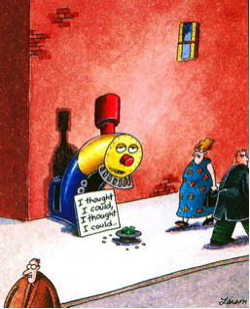
Motivating Employees: Self-Efficacy Theory
Self Efficacy (social cognitive theory): An individual’s belief that he or she is capable of performing a task.
  The higher your self efficacy the more confident you are in your ability to succeed in a task
    Enactive mastery
    Vicarious modeling
    Verbal Persuasion
    Arousal
Self-fulfilling prophecy

Slide 13
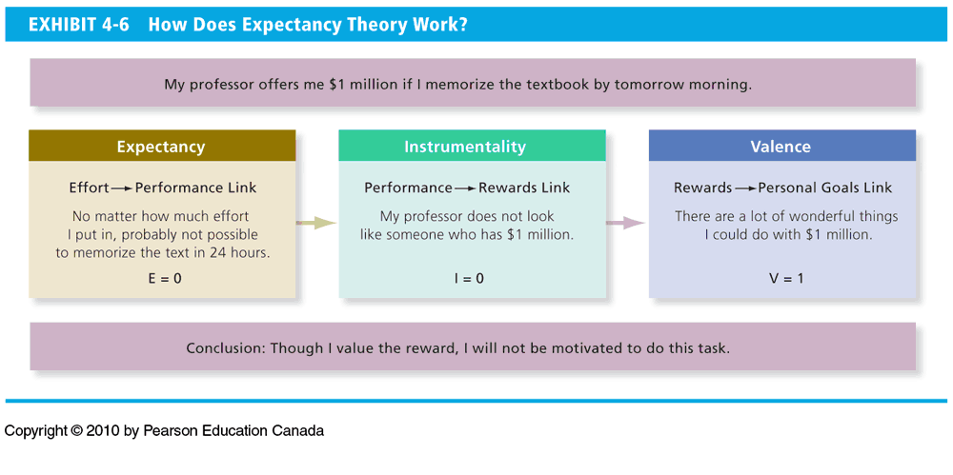
Motivating Employees: Expectancy Theory
Will Individuals be motivated to act?
Expectancy – The belief that effort is related to performance
  Effort and Performance Link
Instrumentality – The belief that performance is related to rewards
  Performance and Rewards Link
Valence - the value or importance an individual places on a reward
  Rewards and Personal Goals Link
How can you increase someone’s motivation to act?

Slide 14

Goal Setting Theory
Specific and difficult goals can:
  Direct attention
  Regulate effort
  Increase persistence
  Encourage strategies for achieving goals
SMART Goals
  S___________
  M___________
  A___________
  R___________
  T___________
Self- Efficacy

Slide 15

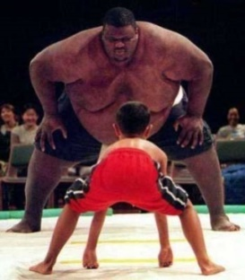
Equity Theory & Fair Process
Equity Theory
Fair Process
We compare inputs and outcomes to others
Perceptions of inequity can be demotivating
Absolute vs. Relative Outcomes
Distributive Justice: ___________________
Procedural Justice: ___________________
Interactional Justice: ___________________
Perceptions of unfairness can be demotivating

Slide 16
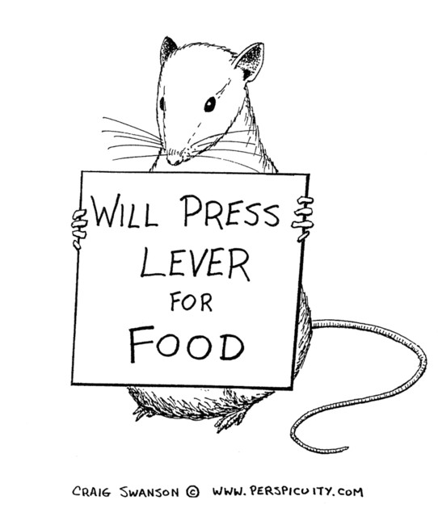
How to treat employees: Reinforcement & Punishment
Operant Conditioning
  A type of conditioning where desired voluntary behaviour leads to a reward or prevents punishment
Reinforcement: increases the likehood of a certain behaviour
  Positive Reinforcement: Following a response with something pleasant
  Negative Reinforcement: the termination or withdrawal of
  something unpleasant
Punishment – decreases the likehood of a certain behaviour
  Positive Punishment: Causing an unpleasant condition in an attempt to eliminate an undesirable behaviour
  Negative Punishment: the removal of something pleasant after the behaviour
Extinction
  Eliminating any reinforcement/punishment that is maintaining a behaviour
  Schedules of Reinforcement
    _______________________________________________________

Slide 17



Developing a Rewards System
Motivation & Monetary Rewards
  Individual and Group based salary
Motivation & Employee Recognition
  Private recognition, public recognition
Motivation & Job Redesign
  Job enlargement, job rotation, job enrichment
Motivation & Flexibility
  Compressed workweek, flex-time, job sharing, telecommuting

Slide 18
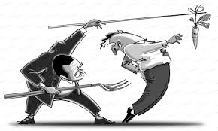
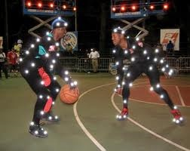
Rewards - Beware
Be sure to consider individual needs and motivation processes before designing a rewards system
Be sure to consider diversity
Be sure to consider the impact of the rewards system on intrinsic motivation
Be sure to link rewards to performance
Cognitive Evaluation Theory:
___________________________
_____________________________
  Pay fairly
  find intrinsic motivators

Slide 19
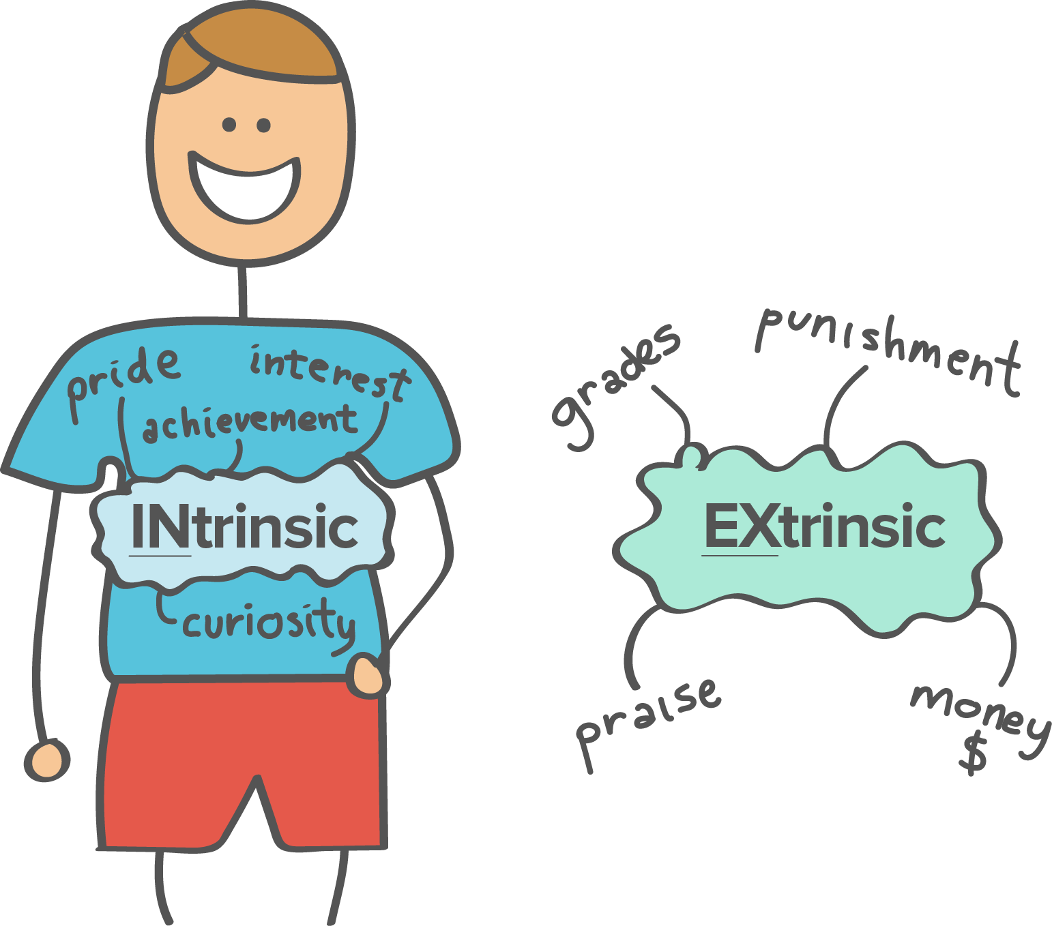
Week 2B Interactive
Motivation
  Hackman & Oldham Job Characteristics Model

Slide 20
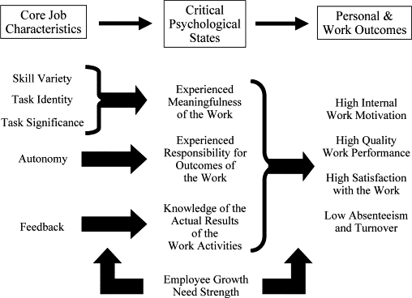

Motivation: The Job & The Individual
Hackman, J.R. & Oldham, G.R. (1980). The Job Characteristics Enrichment Model, Work Design.
Individual Differences
Knowledge & Skill
Growth-Need Strength
Satisfaction with contextual factors

Slide 21
McClelland (covered in Interactive)
n-Power; The need to influence and lead others, and be in control of one’s environment
(+) Socialized Power
  Seek to make things better for others/ Use power to empower others
(-) Personalized Power
  Impulsive / Personal dominance / Dictator-like
n-Affiliation: Desire for friendly/close interrelationships
(+) Affiliative interest
  Concern for relationships but not at expense of goals
  Can still give negative feedback or make tough decisions
(-) Affiliative assurance
  Seeking approval at all costs
  Avoids issues or conflicts that threaten relationship
n-Achievement: Need to accomplish goals, excel, and strive continually to do things better
  Take calculated risks
  Task-oriented
  Personal responsibility for success/failure

Slide 22

Next Class
  Week 3A: Perception & Communication
  Week 3B: Midterm Test

Slide 23

Top Academic Journals related to this course
Academy of Management Review
Academy of Management Journal
Journal of Management
Research in Organizational Behaviour
Personnel Psychology
Administrative Science Quarterly
Organization Science
Journal of Management Studies
Organizational Behaviour and Human Decision Processes
Leadership Studies
Journal of Organizational Behaviour
Human Relations

