Slide 1
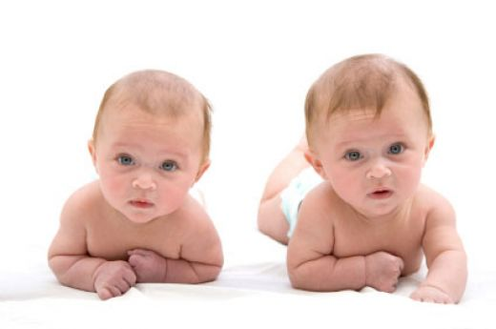
Week 2A
Personality
BUSI 2101
Summer 2017

Slide 2
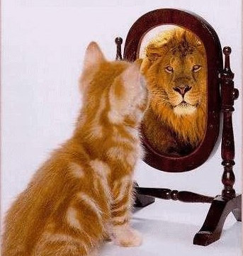
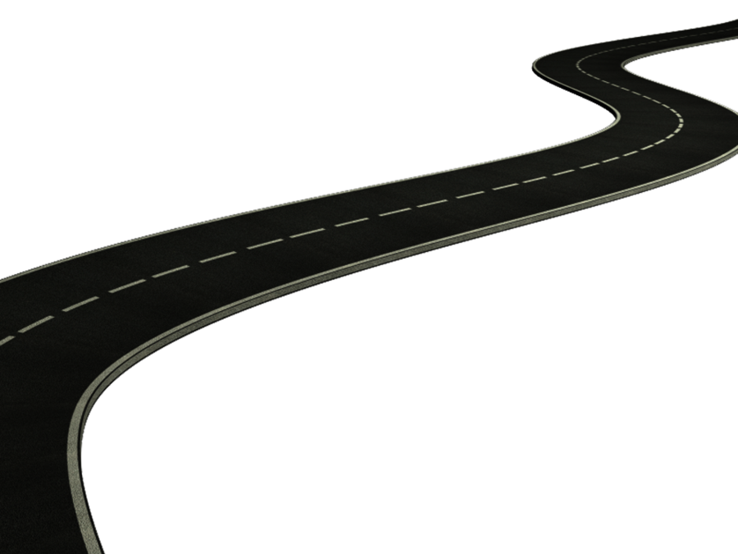
Road Map
Review Week 1
Learning
  Organizational Learning
  Interactive #1: Individual Learning
Personality
  Trait Approach
  Interactionist Approach

Slide 3
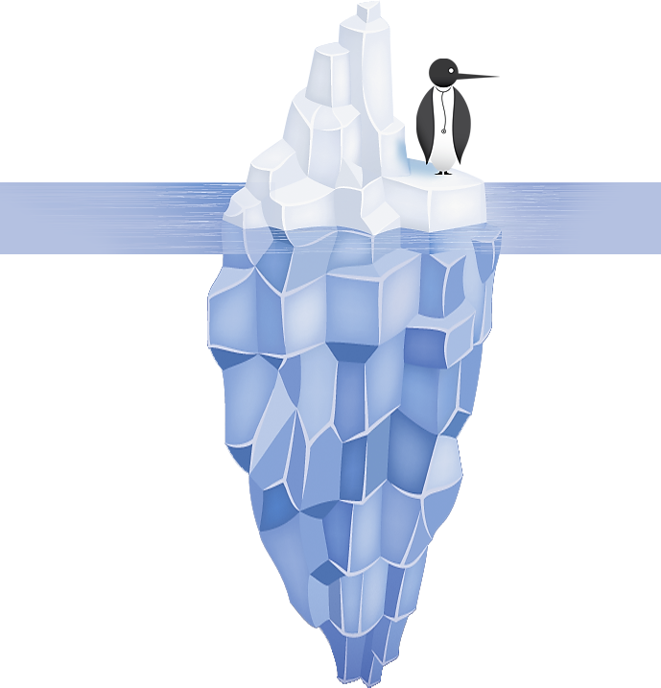
The Psychological Contract
Course Outline
CuLearn
Expectations

Slide 4


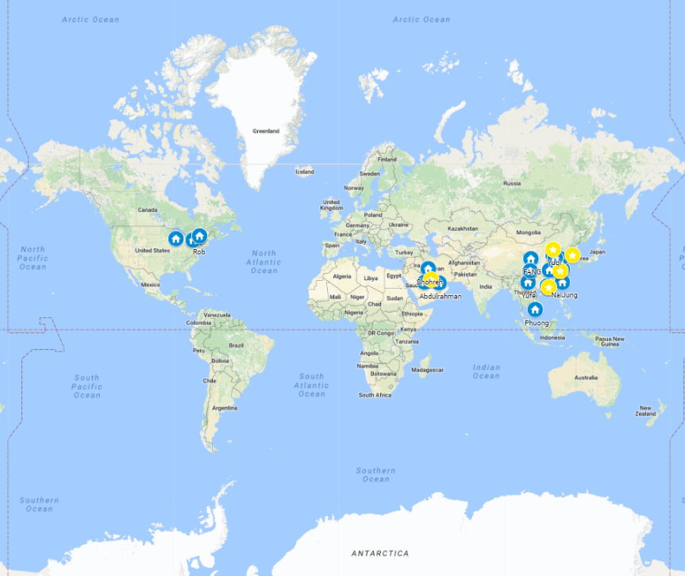



BUSI 2101: Around the world
Get into groups of four. Find one company from outside North America/Europe that Sprott students should know about but do not.
Go to our online form our online form

Slide 5
Quality Circles
The quality circle was first introduced by a number of large Japanese firms
  A systematic attempt to involve all their employees, at every level, in their organization's drive for quality
A quality circle is a small group of between three and 12 people who do the same or similar work. They
  voluntarily meet together regularly for about one hour per week in paid time
  usually under the leadership of their own supervisor
  trained to identify, analyse and solve some of the problems in their work
  presenting solutions to management and, where possible, implementing solutions themselves
There are two main tasks assigned to quality circles:
  the identification of problems;
  the suggestion of solutions.
A secondary aim is to boost the morale of the group through attendance at the meetings and the formal opportunity to discuss work-related issues

Slide 6
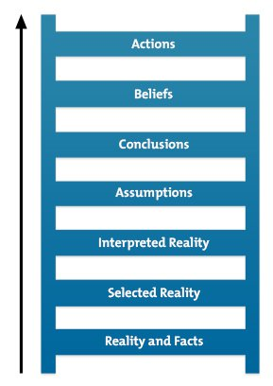
Group Learning
The Ladder of Inference
  When in dialogue, a group explores complex difficult issues from many different points of view. Individuals suspend their assumptions but they communicate their assumptions freely. The results is free exploration that brings to the surface the full depth of people’s experience and thought, and yet can move beyond their individual views (Senge,1990a, 241)
Social Learning
  Learning through the experience and observation of others
  We learn to anticipate consequences once we have observed them happening to others:
  Good consequences = good behaviour
  Bad consequences = bad behaviour
    Danger: consequences are in the eye of the beholder
Transactive Memory System
  The collection of knowledge possessed by each team member and a collective awareness of who knows what (Mathieu et al., 2008).
    Coordination gains
    Tacit knowledge
Team Mental Models

Slide 7
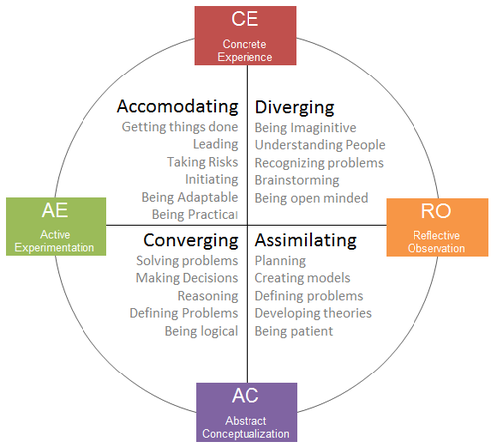
Week 1: Interactive Review

Slide 8

Week 2A
Personality
  Trait
    Big Five Inventroy
    MBTI
    Locus of control
    The dark triad
    Self Efficacy
    Interactionist approaches
    Emotions

Slide 9
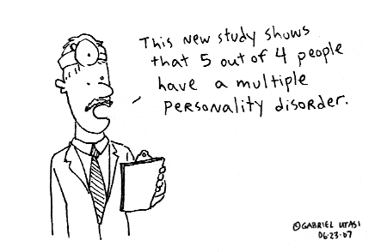
Personality
Managers must decode and understand employee behaviour so that they know what action to take.
Personality: stable patterns of behaviour and consistent internal states that determine interactions with others.
What determines your personality?
  Heredity
  The environment
  Situational factors

Slide 10
Trait Models of Personality
Personality Traits: enduring characteristics that describe an individual
  The Big Five
    Conscientiousness
    Extraversion
    Agreeableness
    Neuroticism
    Openness to Experience
Drawbacks of trait based personality tests:
  1. ___________________________________________________
  2. ___________________________________________________
  3. ___________________________________________________
Why should you care about personality tests?
1. Hiring decisions
2. Career development
  Myers Briggs
  1. Extraverted (E) or introverted (I)
  2. Sensing (S) or intuitive (I)
  3. Thinking (T) or feeling (F)
  4. Perceiving (P) or judging (J)
Self-Awareness

Slide 11
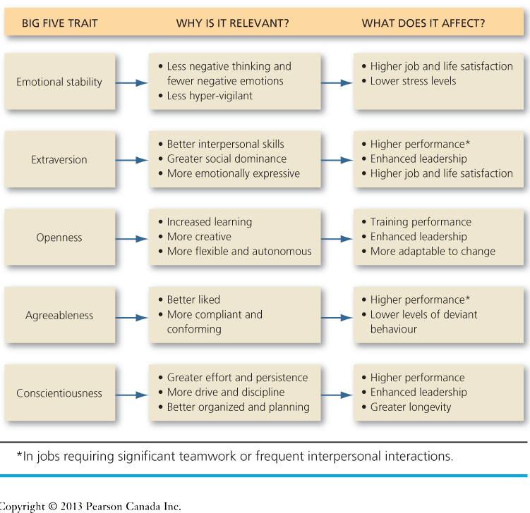
The Big Five (OCEAN)

Slide 12
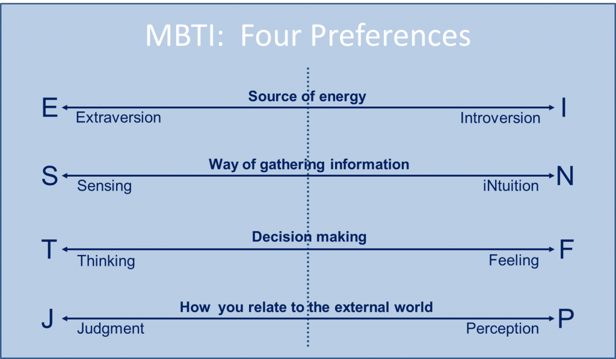
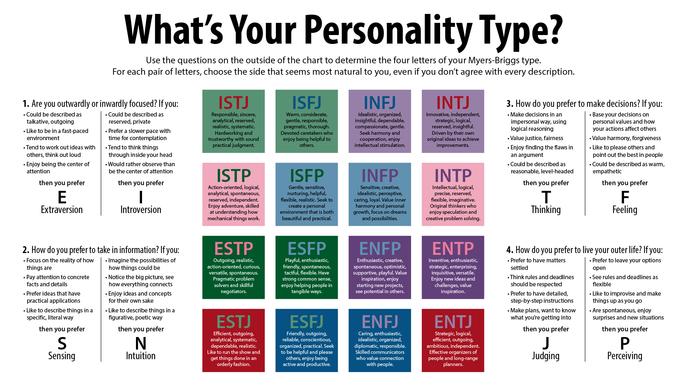
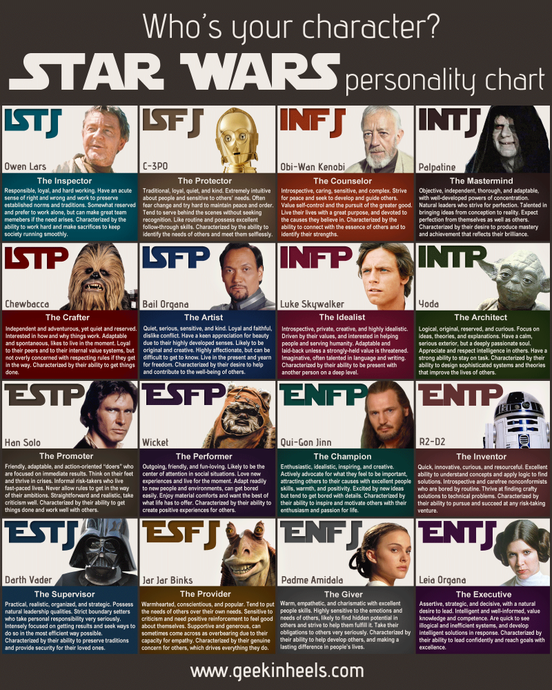

Jungian 16-Type Personality

Slide 13
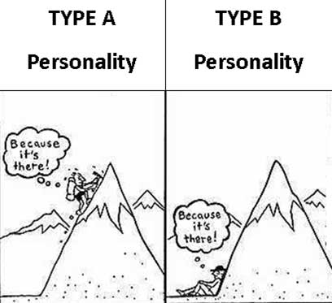
Type A Personality
Impatient, restless, competitive, aggressive, under time pressure, always attempting to accomplish several things at once
Competitiveness Scale
  Superiority Competitiveness
  Mastery Competitiveness

Slide 14

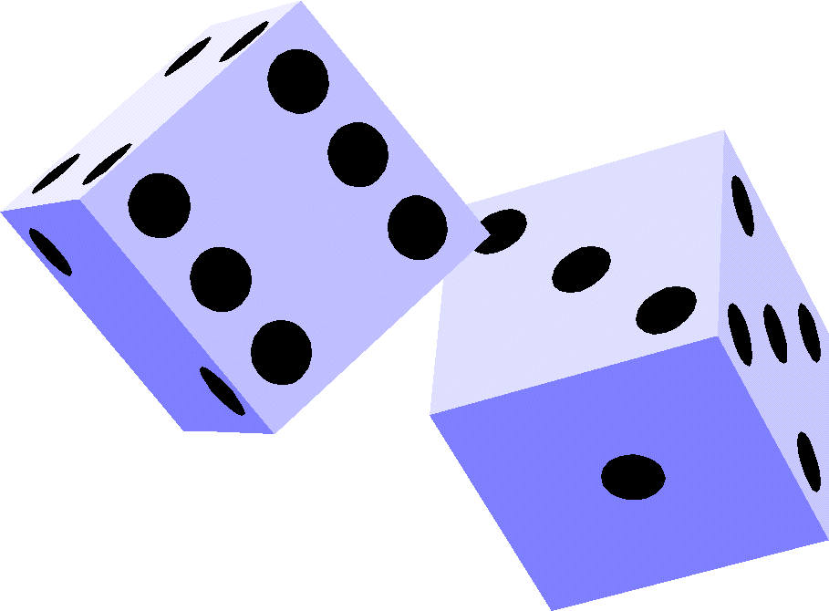
Locus of Control & Ambiguity
Locus of Control
Tolerance for Ambiguity
The extent to which you believe that forces beyond your control are responsible for what happens to you
Workplace interventions
The tendency to perceive ambiguous situations as desirable (Budner, 1962).

Slide 15
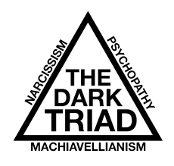

Narcissism & The Dark Triad
Machiavellianism: A pragmatic, emotionally distant power-player who believes that the ends justify the means
  Manipulative, deceptive, unethical, and persuade more than they are persuaded.
Narcissism: The tendency to be arrogant, have a grandiose sense of self-importance, require excessive admiration and have a sense of entitlement
Psychopathy: Prone to deviant behavior partly due to high levels of thrill-seeking, impulsivity, and selfishness. Tend to display a superficial charm, and lack of emotion and remorsefulness

Slide 16
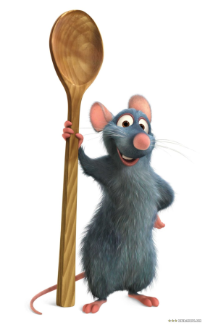
Self-Efficacy
Proactive Personality
Core self-evaluation
Identifies opportunities, shows initiative, takes action, and perseveres to completion
Creates positive change in the work environment
Fit with organization & supervisor is important
The degree to which an individual likes or dislikes himself, whether the person sees himself as capable and effective, and whether the person feels that he is in control of his environment or powerless

Slide 17

Dealing with Difficult People
Create a rich picture of the problem person.
Reframe your goals
Stage the encounter
Follow up

Slide 18
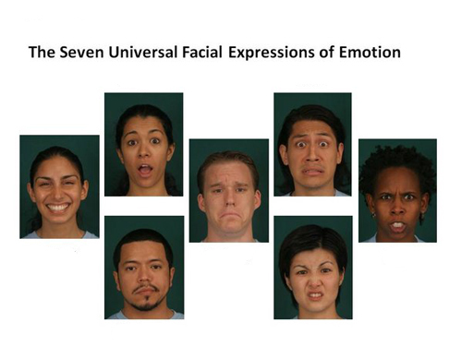
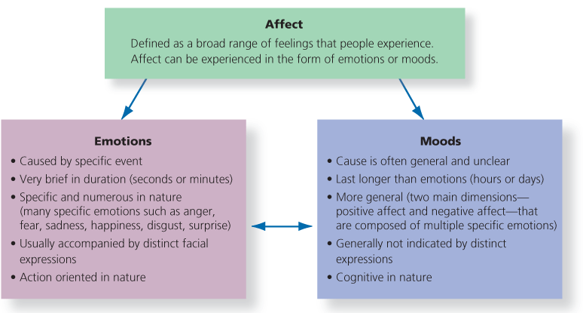
Emotions
Emotional Affect:
_________________
  Emotions:
  ___________________
  Moods:
  ___________________

Slide 19
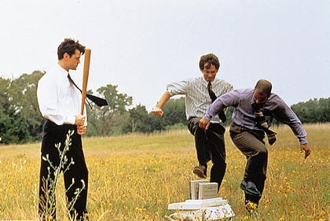
Emotions at Work
Emotional Labour:
__________________________________________
  Felt vs. displayed emotions
  Surface vs. deep acting
Gender and Emotions
  Women: more social? Higher EI? More positive emotions?
  Men: emotionally detached? Lower EI?
Affective Events Theory
  (see pg. 64 for link to performance & satisfaction)
____________________________________________________
  Emotional Contagion
Emotional Intelligence
  “the ability to monitor one’s own and others’ feelings and emotions, to discriminate among them, and to use this information to guide one’s thinking and action” (Salovey & Mayer, 1990: 189).
Negative Workplace Emotions
_____________________________________________________
Emotional Dissonance

Slide 20
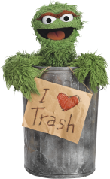
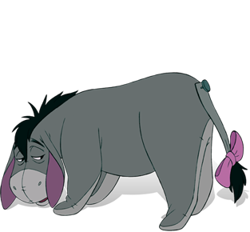
Interactionist Approach: CRA
How does the environment interact with your personality to determine behaviour?
Conditional Reasoning Approach
  Dispositional motivation – fear of failure vs. opportunity for learning.
    Exams
    Boss angry
    Competition

Slide 21
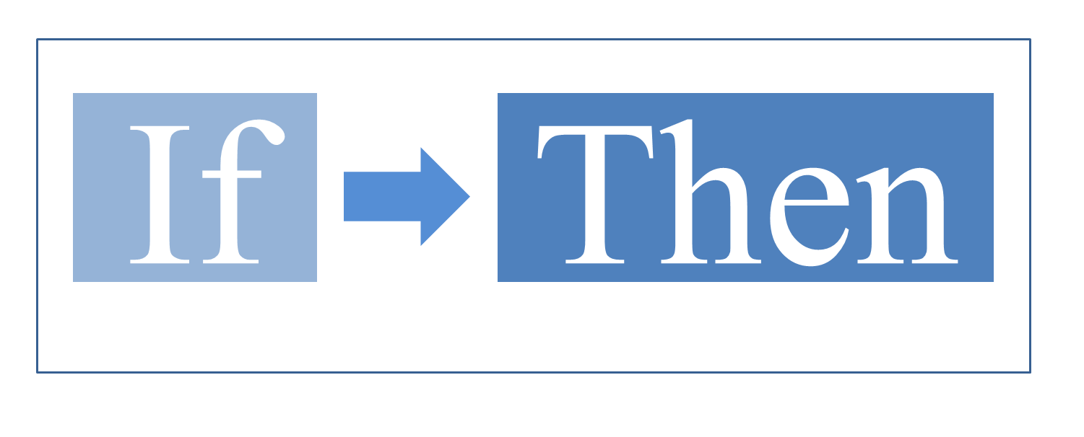
Interactionist Approach: CRA
Cognitive-Affective Processing Systems
  People search for dominant cues.
  Depending on a variety of factors (ie. emotion, culture, genetic, societal etc…) you activate mental if-then representations of the situation. This guides your action.
  Different cues activate different behaviours.

Slide 22


OB/OT Researchers in Canada
Steven Murphy
  Ted Rogers School of Business
  Ryesron University
  Dean
Research Interests
  Personality and emotions
  Organizational shunning
  Leadership development
  Ethics and meaning
  HR issues in Policing
  Employee well-being
  Murphy, S.A., M.J. Hine, N. Lupton and J. Zelenksi (2009), "Personality, Emotion and Judgement in Virtual Environments: A Theoretical Framework". Journal of Electronic Commerce in Organizations, 7(3), 21-43.

Slide 23
Next Class
  Week 2B: Motivation
  Week 3A: Motivation

Slide 24

Top Academic Journals related to this course
Academy of Management Review
Academy of Management Journal
Journal of Management
Research in Organizational Behaviour
Personnel Psychology
Administrative Science Quarterly
Organization Science
Journal of Management Studies
Organizational Behaviour and Human Decision Processes
Leadership Studies
Journal of Organizational Behaviour
Human Relations

