Slide 1

Week 1B
Individual and Organizational Learning
BUSI 2101
Summer 2017

Slide 2


Road Map
Review Week 1A
Learning
  Organizational Learning
    What is Knowledge?
  Types of learning
  Group Learning
  Individual Learning
  Interactive Groups

Slide 3
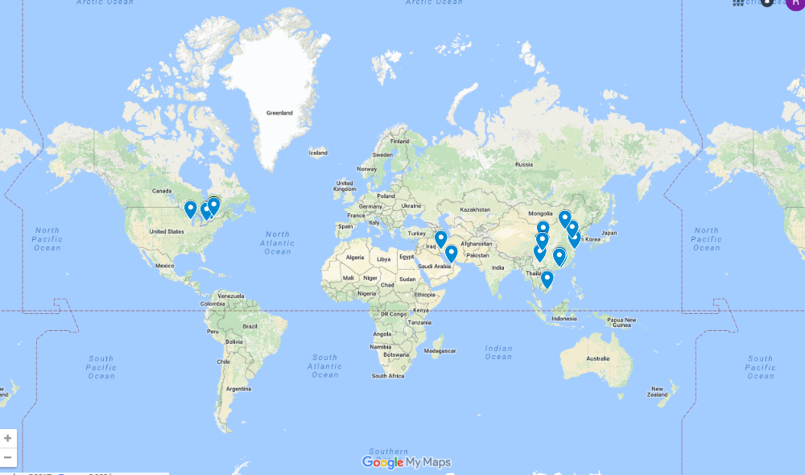
BUSI 2101A: Interesting Stuff
W1: Where are we from?
W2: How many languages do we speak?
    W2: Where are we from online poll

Slide 4
Companies from around the world
Get into groups of four.
Find one company from outside North America/Europe that Sprott students should know about but do not.
Go to https://docs.google.com/forms/d/e/1FAIpQLSfWy1JDmcUc2ItcxMDkWUcmP9b8U32Ba-1xfVn-f1H6ykdZAQ/viewform?usp=sf_link
And fill out the short questionnaire as a group.

Slide 5
Interactives
Group Interactive #1 (Montana)
  Neeharika Saha, Zhihui Deng, Jingyi Jiao, Nai-Jung Shao, Xinyang Liu, Anthony Bombardier-Touret, Yingfei Xu, Enayet Fareghi, Fang Chen, Tanya Chen, Yifei Xie, Kevin Li, Danielle McIntyre, Shanyao Xie, Mengqi Chen, Nadia Abbasi, Khaled Radaideh, Jason Macleod, Xin Wu, Khulud Alharbi, Donghe Zhang, Tong Lu, Hayden Cummings, Wei Zhan, Abdulrahman Abdullah (25 total)
Group Interactive #2 (Colin)
  Jiying Feng, Jovunjeet Brar, Yuchen Zhang, Bohan Jiang, Khadar Mousa, Dongjun Xie, Jianxue Rao, Fariz Setyobudi, Mingyu Zhou, Yi Zeng, Xinyi Gao, Wen Zhou, Shohreh Ali Akbar Pour, Zeyao Zhou, Yuqi Cheng, Ziyi Liao, Carrie Jiang, Yusha Xiao, Yufei Nie, Phuong Le, Ruming Zhang, Qingling Sun, Lixue Cheng, Xinyue Zhu (24 total)

Slide 6
Learning
A process (Kolb)
A relatively permanent change in:
  Knowledge, Behaviors, Skills, Values, Preferences, & Understanding
Types of Learning
Cognitive
  To learn to “know that” – to recall, analyze, synthesize, problem solve, etc.
Psychomotor
  - To learn “know how” – to learn a new skill, operate a machine, swim, drive a car, ride a bike, etc.
Affective
  - To learn to like, fear, etc.

Slide 7
Levels of Learning
  Individual – exploration and development
  Group – sharing of ideas and collaboration
  Organizational – developing and capturing knowledge across groups
  Inter-organizational – learning from competitors and other organizations & communities of practice
As a total system – realizing how all of these levels work together to generate knowledge

Slide 8
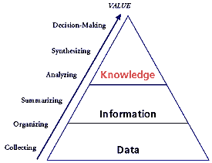
Knowledge
Includes facts, information and skills
Is acquired through experience, education, training, etc.
Is an organizational resource and capability
Is an outcome of learning
Managing knowledge is an important:
  Managerial and organizational function
  Competitive advantage

Slide 9
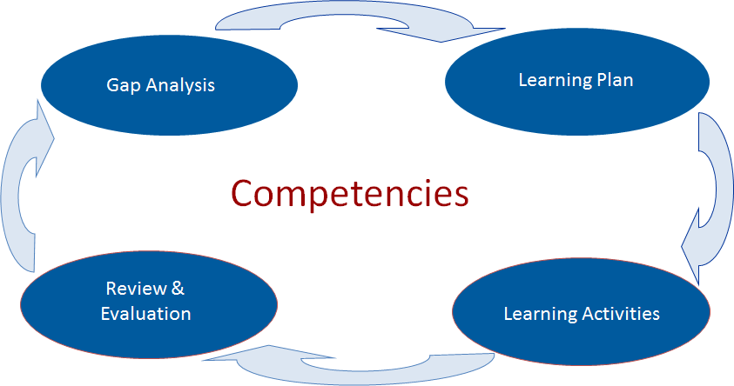
What is Organizational Learning?
The way management selects to create and enhance learning in the organization.
An organization’s capacity to acquire, process, exploit/apply and disseminate knowledge in order to ensure its success
It is a process.
Basically: the concept of individual learning applied to the organization as a whole as opposed to just individuals
  This approach is also one of the most criticized aspects of OL

Slide 10

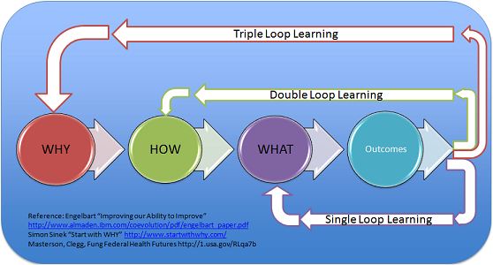


Organizational Learning Argyris and Schön (1978)
Single-loop learning: Adaptive Learning – coping
  Changing according to existing procedures & strategies.
  “Inside the box”
Double-loop learning: Generative Learning – creating
  Questioning and possibly altering the governing assumptions, policies, procedures, and strategies and developing a new ones
  “Outside the box”
Triple-loop or Deutero learning: learning to learn

Slide 11
Organizational Learning as an Advantage
All organizations change
Organizational learning is:
  A type of change
  An approach to embracing (positive) change
  A strategic approach to competitive advantage
Organizational learning has been identified as a strategic asset
Knowledge can be the most strategically significant resource of the firm
  Difficult to imitate and socially complex.
  Major determinants of sustained competitive advantage and superior corporate performance

Slide 12

Learning Organization
A company that facilitates the learning of its members and continuously transforms itself.
“Learning in organizations means the continuous testing of experiences and the transformation of that experiences into knowledge- accessible to the whole organization, and relevant to its core purpose” (Senge 1994, p.g 49).
In a learning organization, the individuals are connected to the organization by a shared vision and by a perspective of wholeness.(Senge, 1990).
All organizations learn only some are learning organizations.

Slide 13
Three key Characteristics of a Learning Organization
Learning organizations must have a commitment to knowledge
-selection of people very important
- People cannot be trained with all they will need to know
Learning organizations must have mechanism for renewal within itself
- bureaucratic rigidity does not allow learning.
Learning organization should possess a openness to the outside world
- So that it may be responsive
- Access to new developments
- How business environment is changing
(Mills and Friesen 1992)

Slide 14
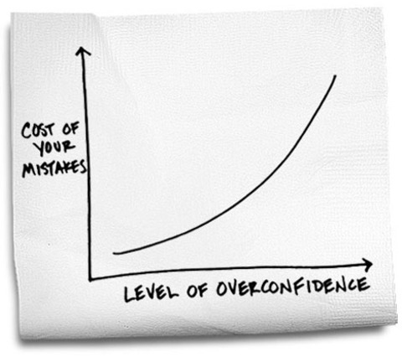
Success and Learning
  Positives:
  It provides a standard
  Leads to benefits for stakeholders
  Negatives:
  Maintains the status quo – follow the traditional way
  Can lead to complacency – play it safe
  Can limit additional ideas and searching
  Can limit awareness
  Leads to risk aversion – mistakes are embarrassing
Error Harvesting

Slide 15
Quality Circles
The quality circle was first introduced by a number of large Japanese firms
A systematic attempt to involve all their employees, at every level, in their organization's drive for quality
A quality circle is a small group of between three and 12 people who do the same or similar work. They
  voluntarily meet together regularly for about one hour per week in paid time
  usually under the leadership of their own supervisor
  trained to identify, analyse and solve some of the problems in their work
  presenting solutions to management and, where possible, implementing solutions themselves
There are two main tasks assigned to quality circles:
  the identification of problems;
  the suggestion of solutions.
A secondary aim is to boost the morale of the group through attendance at the meetings and the formal opportunity to discuss work-related issues

Slide 16
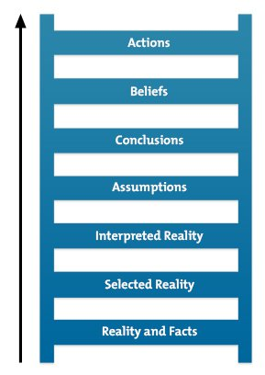
Group Learning
The Ladder of Inference
  When in dialogue, a group explores complex difficult issues from many different points of view. Individuals suspend their assumptions but they communicate their assumptions freely. The results is free exploration that brings to the surface the full depth of people’s experience and thought, and yet can move beyond their individual views (Senge,1990a, 241)
Social Learning
  Learning through the experience and observation of others
  We learn to anticipate consequences once we have observed them happening to others:
  Good consequences = good behaviour
  Bad consequences = bad behaviour
    Danger: consequences are in the eye of the beholder
Transactive Memory System
  The collection of knowledge possessed by each team member and a collective awareness of who knows what (Mathieu et al., 2008).
    Coordination gains
    Tacit knowledge
Team Mental Models

Slide 17
Interactive Groups Week 1
Activity: Kolb’s 4 step Learning process
Group Interactive #1 (Montana)
  Neeharika Saha, Zhihui Deng, Jingyi Jiao, Nai-Jung Shao, Xinyang Liu, Anthony Bombardier-Touret, Yingfei Xu, Enayet Fareghi, Fang Chen, Tanya Chen, Yifei Xie, Kevin Li, Danielle McIntyre, Shanyao Xie, Mengqi Chen, Nadia Abbasi, Khaled Radaideh, Jason Macleod, Xin Wu, Khulud Alharbi, Donghe Zhang, Tong Lu, Hayden Cummings, Wei Zhan, Abdulrahman Abdullah (25 total)
Group Interactive #2 (Colin)
  Jiying Feng, Jovunjeet Brar, Yuchen Zhang, Bohan Jiang, Khadar Mousa, Dongjun Xie, Jianxue Rao, Fariz Setyobudi, Mingyu Zhou, Yi Zeng, Xinyi Gao, Wen Zhou, Shohreh Ali Akbar Pour, Zeyao Zhou, Yuqi Cheng, Ziyi Liao, Carrie Jiang, Yusha Xiao, Yufei Nie, Phuong Le, Ruming Zhang, Qingling Sun, Lixue Cheng, Xinyue Zhu (24 total)

Slide 18
Kolb’s Individual Learning Styles
Everyone learns by going through a 4-step process
Individuals put greater emphasis on some of the stages (we have stronger and weaker stages or preferences)
There are individual differences in learning
There is no one best learning style. You must develop your ability to learn in different ways in order to learn complex skills.

Slide 19
Kolb’s Individual Learning Styles
Concrete Experience – activist – prefers doing and experiencing
Reflective Observation – reflector – observes and reflects
Abstract Conceptualization – theorist – wants to understand underlying reasons, concepts, relationships
Active Experimentation – pragmatist – likes to try things to see if they work

Slide 20

Top Academic Journals related to this course
Academy of Management Review
Academy of Management Journal
Journal of Management
Research in Organizational Behaviour
Personnel Psychology
Administrative Science Quarterly
Organization Science
Journal of Management Studies
Organizational Behaviour and Human Decision Processes
Leadership Studies
Journal of Organizational Behaviour
Human Relations
Notes:
l

