Slide 1
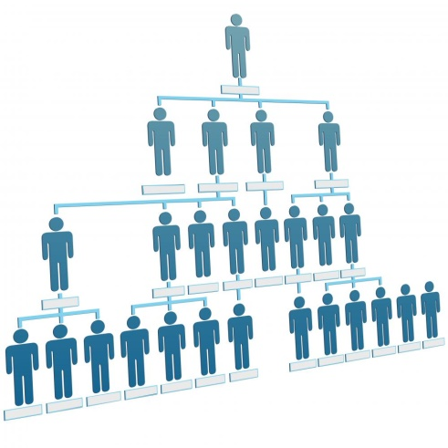
Week 1
Psychological Contract
BUSI 2101
Summer 2017

Slide 2

Road Map
Introduction to 2101
  Challenges! It will not be easy.
Goals for this class
  Understand the class format
  Engage, take control of your learning.
Success and the psychological contract
Violations and breaches
Employee responses

Slide 3






Managing Human Capital
Employee effectiveness
Behaviours
Motivation
Skills

Slide 4
BUSI 2101
SUMMER VS. FALL/WINTER
  Plenary lectures
  Interactives
  Exams
Why?
  Multiple faculty
  Interactive teachers
  Learning community

Slide 5

What is OB?
OB
  “a field of study that investigates the impact of individuals, groups and structure on behaviour within organizations.” -Langton, Robbins, & Judge (2012)
I/0 Psychology
  “the application or extension of psychological facts and principles to the problems concerning human beings operating within the context of business and industry"
  - Blum & Naylor (1968)
Human Resources
  “The division of a company that is focused on activities relating to employees. These activities normally include recruiting and hiring of new employees, orientation and training of current employees, employee benefits, and retention. Formerly called personnel.” – Businessdictionary.com
Human Capital
  “The skills, knowledge, and experience possessed by an individual or population, viewed in terms of their value or cost to an organization or country.”
  – Oxford Dictionary
Management
  "Management is the art of getting things done through people.“
  – Peter Drucker

Slide 6
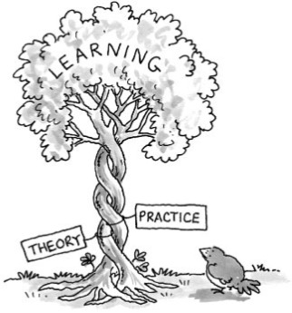
Challenges
This class will be difficult
  Multiplicity of theories
  Assumption Grounds
Assumption: beliefs about how the world works. Deeply held and rarely questioned.
  False consensus bias
  eg. What motivates students?

Slide 7
A Skilled Artisan of OB
A worker skilled in a trade – typically involving things made by hand.
The law of requisite variety
Conceptual toolbox

Slide 8
Course Outline
Key Points
  Course Objectives
  Textbook
  Grading
    Preparation
    Midterm
    Group Project
    Final
  Review the agenda
  Additional info

Slide 9

Psychological Contract and Success in the Business World
TRUST

Slide 10
Interactive: Psychological Contract
An individual’s beliefs, shaped by the organization, regarding the terms and conditions of a reciprocal exchange agreement between individuals and their organization.
Top Employers.
http://www.theglobeandmail.com/report-on-business/careers/top-employers/

Slide 11
Psychological Safety
Psychological Safety is defined as a shared belief that the team is safe for interpersonal risk taking.
  Makes tough feedback and difficult conversations possible.
  Helps combat groupthink.
  Image risks at work.
    Being labeled as ignorant
    Being labelled as incompetent
    Being seen as negative
    Being seen as disruptive.

Slide 12
The Benefits of Psychological Safety
Comfort Zone
Learning Zone
High
Encourages Speaking up
Enables clarity of thought
Mitigates failure
Promotes innovation
Removes obstacles
Increases accountability
Psychological Safety
Apathy Zone
Anxiety Zone
Low
Low
Accountability
High

Slide 13

Where in the world?
Link to Form for Map
Link to Map

Slide 14

BUSI 2101A Psyc Contract

Slide 15
Violations & Breaches
Breach: an employee’s cognition that he/she has received less than promised. When we perceive a breach we assess the ability and intent of the of the other party.
Violation: An emotional state that may result from the perception of the psychological contract breach
Contract makers
Systems
When are you most likely to perceive a contract violation?
Perception | Able | Unable
Willing | Inadvertent | Disruption
Unwilling | Breach | No Contract

Slide 16
Responses
Responses to Breach
Exit
Voice
Neglect
Silence
(loyalty)
Academy of Management Journal
  Rusbult et al. (1988)

Slide 17
Quiz – Week 1A & B: Preparation/Review

Slide 18

Top Academic Journals related to this course
Academy of Management Review
Academy of Management Journal
Journal of Management
Research in Organizational Behaviour
Personnel Psychology
Administrative Science Quarterly
Organization Science
Journal of Management Studies
Organizational Behaviour and Human Decision Processes
Leadership Studies
Journal of Organizational Behaviour
Human Relations

