Slide 1
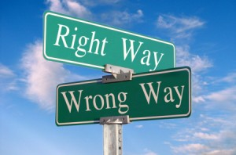
Week 6A
Ethics
Summer 2017

Slide 2
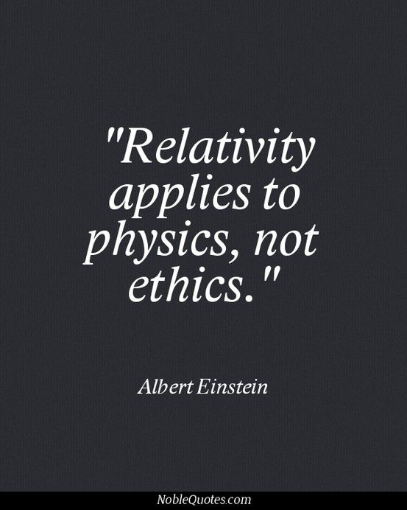

Road Map
Review Week 5
  Influence
  Power
  Politics
Values & Ethics
  Ethical Subjectivism
  Values
  Business ethics
  Making ethical Business decisions

Slide 3




BUSI 2101: Around the world
Get into groups of four. Find one company from outside North America/Europe that Sprott students should know about but do not.
Go to our online form our online form

Slide 4

Guest Speaker
Project-Based, Experiential Learning at Sprott.

Slide 5
Power And Politics
Week 5B

Slide 6
Cialdini’s 6 Influence Strategies
Reciprocity - Repay in kind. Includes gifts, favours and concessions people make to one another
Social proof - Follow the lead of similar others
Consistency - Align with clear public commitment
Scarcity - Want scarce items. e.g. “limited time offer”
Expertise and authority - Relevant expertise and experience persuades
Liking - People respond to those who are likable.
Notes:
See page 495

Slide 7
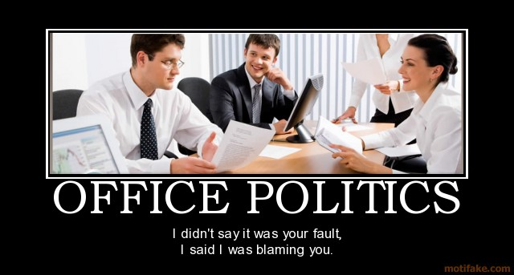
Politics: Power in Action
Political behaviour
  those activities that influence,
  or attempt to influence, the
  distribution of advantages and disadvantages within the organization.
  Legitimate: Normal, everyday behaviour.
  Illegitimate: Extreme political behaviours that violate the implied rules of the game.

Slide 8
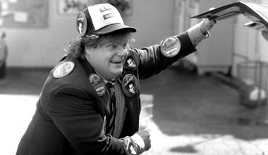
Types of Political Activity
Attacking or blaming others
Using information
Managing impressions – Link to behaviour
Building support for ideas
Praising others
Building coalitions
Associating with influential people
Creating obligations

Slide 9

Values & Ethics
Week 6A

Slide 10
What is ethics?
Ethics concerns principles of right and wrong
  Ethics sets standards of moral behaviour
    Defines things we should and shouldn’t do
    Reflects how we should treat one another
    Guides behavior in organizations in terms of what's acceptable
    Underlies our evaluations of the appropriateness of our own and others’ behaviour
  Ethical – Unethical – Non-Ethical
  *Non-ethical does not mean unethical.

Slide 11
Isn’t ethics subjective?
Since everybody has their own opinions of right and wrong, isn’t ethics subjective?
Ethical subjectivism
  implies that statements about what’s right and wrong are just a matter of opinion or tastes.
  and there’s no real way to say that one person’s opinion is better than any others.
  this suggests that everyone should just do whatever they themselves think is right.
Problems with Ethical Subjectivism.

Slide 12

Generational Value Differences
The Elders » over 70 years old
  Core values: Belief in order, authority, discipline, and the Golden Rule (do all to others that you expect to be done to you)
  Major Events: WW2, Great Depression
Baby Boomers » born mid-1940s to mid-1960s
  Core Values: Autonomy, career focus, disengaged Darwinists, Pragmatists who believe ends can justify the means, Achievement and material success are very important, Sense of accomplishment and social recognition rank high with them
  Major Events: Post War baby boom, competition for jobs, the 60s,
Generation X » born mid-1960s to early 1980s
  Core Values: Thrill-seeking materialists, aimless dependents, social hedonists, new Aquarians, autonomous, pessimistic, intellect, promotion, fun at work. Value flexibility, life options and achievement of job satisfaction. Less willing to make personal sacrifices for the sake of their employer than Boomers
  Major Events: Economic downturn
The Ne(x)t Generation (Millennials) » born 1977 to 1997
  Core Values: “Creators, not recipients”, Curious, contrarian, flexible, collaborative, high in self-esteem, change is ok, get bored easily
  Major Events: Economic prosperity, technological advance, globalization

Slide 13
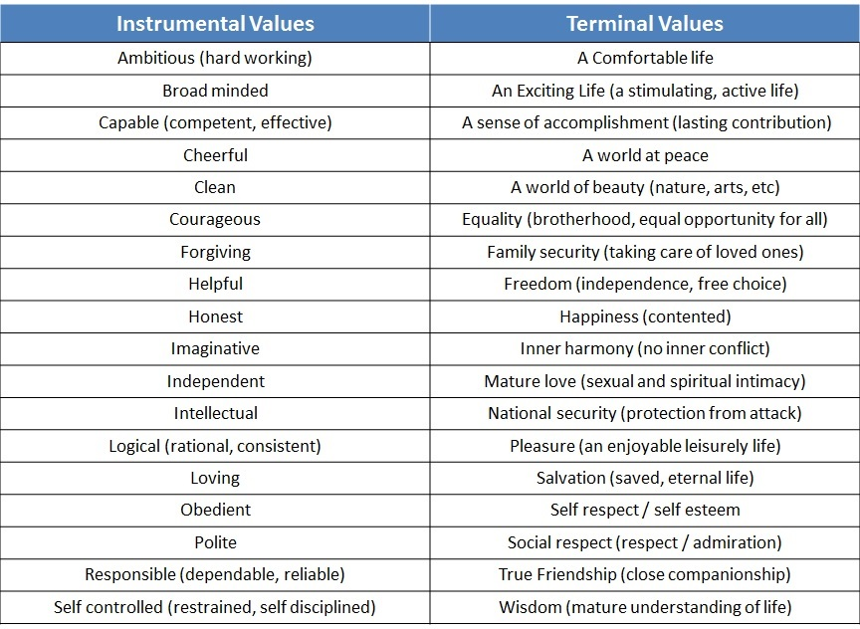

What are Values?
Terminal (the end value) vs. Instrumental Values (something you can act upon, in your everyday actions to see the end goal you want)
Alligator River Exercise

Slide 14
What is business ethics?
Business ethics (or “organizational ethics”)
  a form of “applied ethics” wherein principles of ethics are applied to business settings and issues.
Among other things, business ethics looks at:
  the ethical principles businesses and the people who work for them should adhere to in their activities
  how to promote ethical behaviour by and within businesses
  the impacts of ethical or unethical business behaviour on business performance

Slide 15
Ethical Climate
Ethical Climate: The shared perception of what I correct behaviour, and how ethical situations should be handled in and organization (Victor & Cullen, 1987, p.51).
Ethical leadership is defined as, ‘‘the demonstration of normatively appropriate conduct through personal actions and interpersonal relationships, and the promotion of such conduct to followers through two way communication, reinforcement, and decision making’’(Brown et al., 2005, p. 120).
Top movies about Business Ethics (www.businessethicsblog.com)
  The Coorporation (2003)
  Walmart: The high Cost of Low Price (2005)
  Glengarry Glenn Ross (1992)
  A Decent Factory (2004)
  Enron: The Smartest Guys in the Room (2005)
  Inside Job (2010)

Slide 16
Laws vs. Ethics
Laws should reflect ethical principles but they may not always be up to date or cover important areas for decision makers.
Obeying the law should be seen as a “bare minimum” of behaviour, or a “first step”.
  Consideration of ethics should be a fundamental part of every (business) decision.
  Ethics may require you to go well beyond the law in terms of how you treat your stakeholders.
  Stakeholder expectations > the law.

Slide 17

Why be ethical in business?
Long term profitability
Maintain trust and reputation with stakeholders
Attract new customers
Customer loyalty
Attract and keep employees
In order to be ethical, you will be faced with many issues
  Employee-Related Issues
  Customer-Related Issues
  International Issues
  Environmental Issues
  Governance Issues

Slide 18
Considerations for Business Decisions
There are a variety of ethical considerations that need to be taken into account in business decisions.
  Justice/Fairness
  Rights
  Utility (i.e., harms and benefits)
  Generalizability

Slide 19
Justice/Fairness
There are a variety of forms of justice that may need to be considered (depending on the situation).
  Distributive justice concerns fairness in the distribution of resources and/or the benefits and harms of our decisions among those affected.
  Procedural justice concerns the fairness of processes, and the application of them.
  Compensatory justice concerns compensating people fairly if they have been harmed.
  Retributive justice concerns fairness in punishing people for undesirable behaviour.

Slide 20
Rights
Rights are entitlements a person has to behave in a certain way, or be treated in a certain way.
A variety of rights may need to be considered (depending on the situation).
  Human/moral rights are rights that a person has just because (s)he is a human being.
  Legal rights are rights that a person has because the law says they do.
  Contractual rights are rights a person has because (s)he has signed a contract.

Slide 21
Utility
Utilitarian considerations relate to the consequences of our decisions.
  Utilitarianism argues that your goal should always be to maximize net utility across everyone affected by your decision.
  Utility is derived from the benefits (positive utility) and harms (negative utility) of our decisions.
    benefits and harms to be considered can be physical, psychological, financial, emotional, or of any other type.

Slide 22
Generalizability
Generalizability concerns the rationality of the principle underlying a proposed action.
  It is irrational to think that something is ethically permissible for you, but not ethically permissible for someone else the same situation.
  So, you must be willing to have everyone behave in the same ways that you do.
  And, you must be willing to be treated in the same ways that you treat other people.
  Kind of like the Golden Rule (but not exactly)

Slide 23
Steps for Making Ethical Decisions
Identify the ethical issue or problem.
List the facts that have the most bearing on the decision.
Identify anyone who might be affected by your decision and how.
Explain what each affected person would want you to do about the issue.
List three alternative actions and identify the best and worst case scenario for each alternative, anyone who would be harmed by this choice (and how), any values that would be compromised by selecting this alternative, and any automatic reasons why this alternative should not be selected (legal issues, rules, etc.).
Determine a course of action.

Slide 24
Case 1: Lorna
Identify the ethical issue
List the facts
Identify stakeholders
Explain what each affected person would want you to do about the issue.
List three alternative actions and identify the best and worst case scenario for each alternative,
Determine a course of action.
CASE 1: Lorna is an administrative assistant in the Human Resources Department. Her good friend, Bill, is applying for a job with the company and she has agreed to serve as a reference for him. Bill approaches her for advice on preparing for the interview. Lorna has the actual interview questions asked of all applicants and considers making him a copy of the list so he can adequately prepare.

Slide 25
Case 2: Emily
CASE 2: Emily works in Quality Control. Once a year, her supervisor gives away the refurbished computers to the local elementary school. No specific records are kept of this type of transaction and Emily really needs a computer for her son who is in college. Her supervisor asks her to deliver 12 computer systems to the school.
Identify the ethical issue
List the facts
Identify stakeholders
Explain what each affected person would want you to do about the issue.
List three alternative actions and identify the best and worst case scenario for each alternative,
Determine a course of action.

Slide 26
Case 3: Cathy
CASE 3: Richard and Conway are talking in the hallway about the employee benefits program. Conway, who has had some recent financial trouble, explains to Richard how the benefits program has a loophole that will allow him to receive some financial assistance that he really needs to help pay health care costs for his mother. Cathy, a fellow worker, overhears the conversation. Later, Cathy is approached by her supervisor who says he heard a rumor that some people were taking advantage of the company benefits program.
Identify the ethical issue
List the facts
Identify stakeholders
Explain what each affected person would want you to do about the issue.
List three alternative actions and identify the best and worst case scenario for each alternative,
Determine a course of action.

Slide 27
Testing the ethics of your decisions
Am I treating stakeholders fairly?
Does the decision maximize the net benefit across all affected stakeholders?
Does the decision violate anyone’s rights, or will it lead to the violation of their rights?
Am I willing to be treated this way by others?
Am I obeying the law?
How would I feel if everyone knew about my decision?

Slide 28
KOHLBERG’S MORAL REASONING FRAMEWORK
LEVEL 1: Self-Centred
Stage 1: Obedience and Punishment (act based on negative consequences)
Stage 2: Instrumental (what’s in it for me?)
LEVEL 2: Conformity
Stage 3: Conformity (be a good boy/girl)
Stage 4: Law & Order (do your duty)
LEVEL 3: Principled
Stage 5: Social Contract/Individual Rights (compromise for social harmony)
Stage 6: Universal Ethical Principles (act based on conscience, not laws)

Slide 29
Moral Disengagement
Who is likely to engage in unethical behaviour?
Propensity to Morally Disengage: an individual difference in the way that people cognitively process decisions and behavior with ethical import that allows those inclined to morally disengage to behave unethically without feeling distress (Bandura, 1990a, 1990b, 1999, 2002).
8 Interrelated Cognitive Mechanisms
Moral justification – its for the greater good.
Euphemistic labeling – be a team player
Advantageous comparison – other people expense vacations
Displacement of responsibility – my boss said it was ok.
Diffusion of responsibility – Challenger disaster
Distortion of consequences – the victimless crime
Dehumanization – they are not worth the same moral consideration
Attribution of blame – it is a crime to let a sucker keep his money

Slide 30
Next week
GUEST LECTURE
Decision Making
Christiane Fox
Assistant Secretary to the Cabinet - Communications at Privy Council Office, Government of Canada

Slide 31
Privy Council Office
The Privy Council Office (PCO) is the hub of non-partisan, public service support to the Prime Minister and Cabinet and its decision-making structures.
  Led by the Clerk of the Privy Council, PCO helps the Government implement its vision and respond effectively and quickly to issues facing the government and the country.
  In today's world of complex economic and social issues, much of this work involves consultation and coordination – both inside and beyond the federal government. The PCO secretariats play a key role in ensuring this collaboration.
  To this end, PCO works to achieve the highest professional and ethical standards in the federal Public Service.

Slide 32
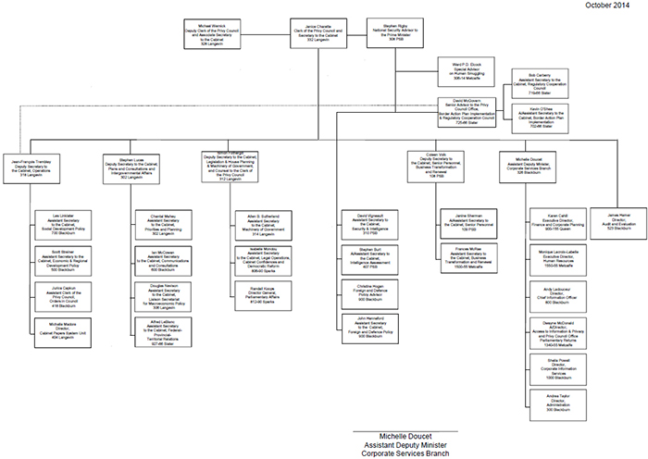
PCO - Organization

