Slide 1

Week 5B
Power
Summer 2017

Slide 2
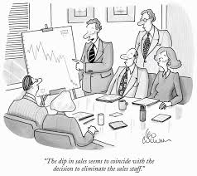
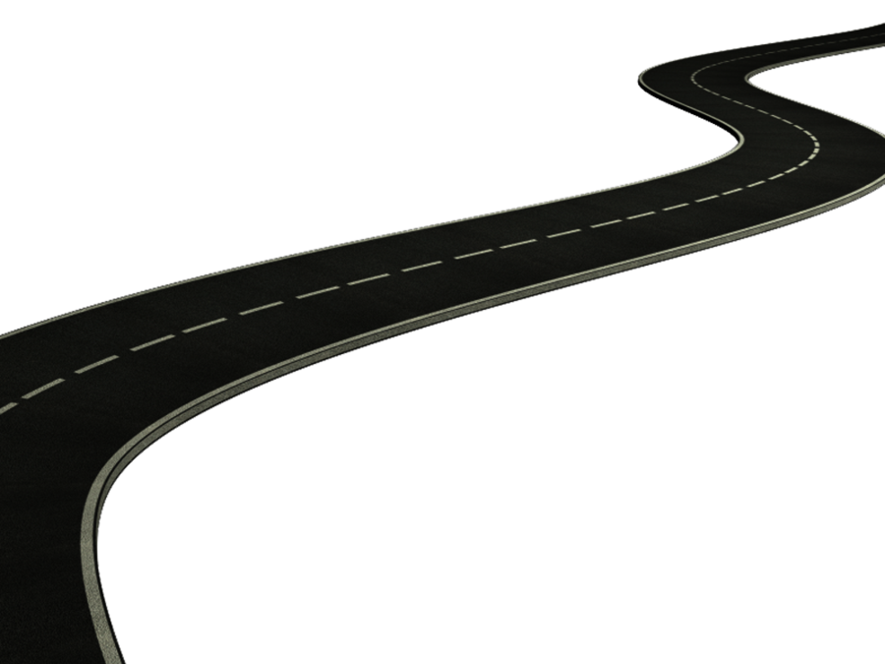
Road Map
Review Week 5A
  Organizational Culture
Week 5B Power
  Source s of Power
  Dependency
  Influence tactics
  Influence Styles
Next week
  Change up: Guest Lecture
  Christiane Fox
  Assistant Secretary to the Cabinet - Communications at Privy Council Office, Government of Canada

Slide 3


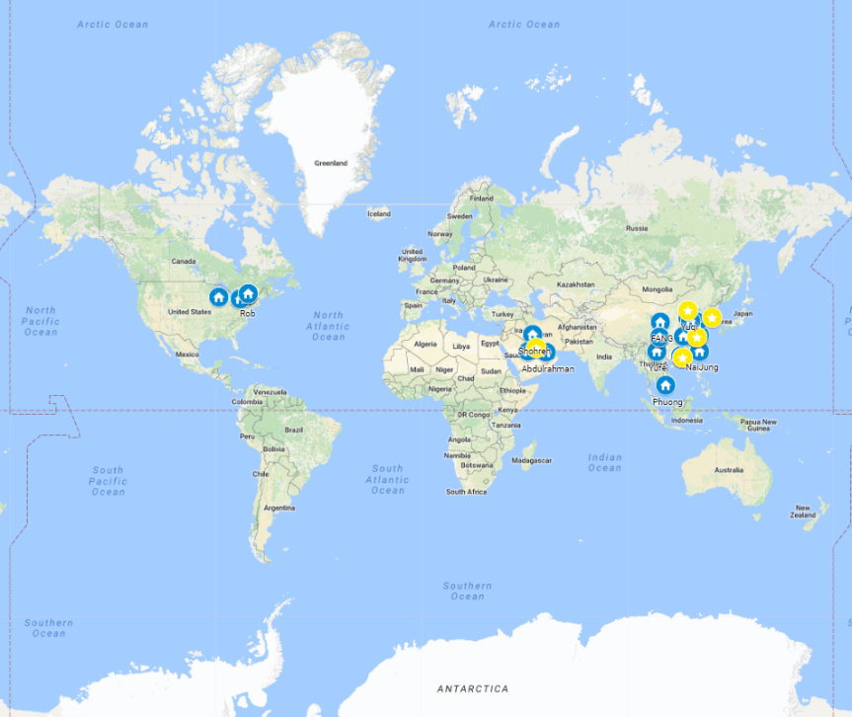



BUSI 2101: Around the world
Get into groups of four. Find one company from outside North America/Europe that Sprott students should know about but do not.
Go to our online form our online form

Slide 4

Dominant vs. Sub Cultures
There are primary values that are accepted throughout the organization.
  Dominant culture: manifests the values shared by a majority of the organizations members
  Subcultures : usually share the dominant cultures core values as well as other values that characterize their own unit.
  Countercultures: groups who’s values are in opposition to those of the dominant culture.

Slide 5
Transmitting Culture
Transmitting Culture
Socialization
Stories
Symbols
Jargon
Rituals
Statements of principle

Slide 6

Maintaining Culture
Creating and Maintaining Culture
Selection
  Identify and hire individuals who will fit in with the culture.
Top Management
  Senior executives establish and communicate the norms of the organization.
Socialization
  Organizations need to teach the culture to new employees.
Functions of a strong culture
  Social glue
  Boundary-defining.
  Sense of identity
  Commitment
  Behaviour guide

Slide 7
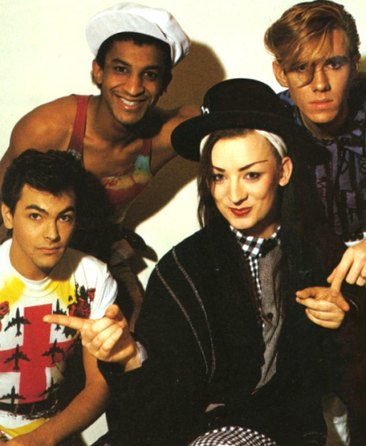
The Liabilities of Culture
Culture can have dysfunctional aspects in some instances.
  Major barriers to change
  Barriers to diversity
  Major barriers to mergers and acquisitions

Slide 8
Power And Politics
Week 5B

Slide 9

Power
Power
  The capacity that A has to influence the behaviour of B so that B acts in accordance with A’s wishes.
______________
  B’s relationship to A when A possesses something that B needs.
Influence –successfully persuading others to follow your advice or orders
Authority – power granted to an employee recognized as legitimate (legitimate power)

Slide 10

Dependency: Key to Power
General Dependency Postulate
The greater the dependency the greater the power
3 Factors
Importance
  The things you control must be important.
Scarcity
  A resource must be perceived as scarce.
Non-substitutability
  The resource cannot be substituted with something else.

Slide 11
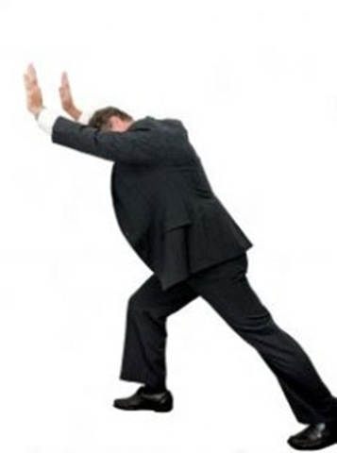
Bases of Power
Coercive Power:Emotional power, when someone threatens you in order to do something. ie.Do this or I beat you up __________________________________________
Reward Power :You get a reward for doing something ie. Getting paid for the job
Legitimate Power :____________________________
  ie. __________________________________________
Expert Power: Have an element of trust ie. Going to the doctor when youre sick
Referent Power: ie.dressing like a celebrity __________________________________________
Information Power :___________________________
  ie. People who know whats going on ie an office administrator
Source: Adapted from G. Yuki and C. M. Falbe, “Importance of Different Power Sources in Downward and Lateral Relations,” Journal of Applied Psychology, June 1991, p. 417. With permission.

Slide 12
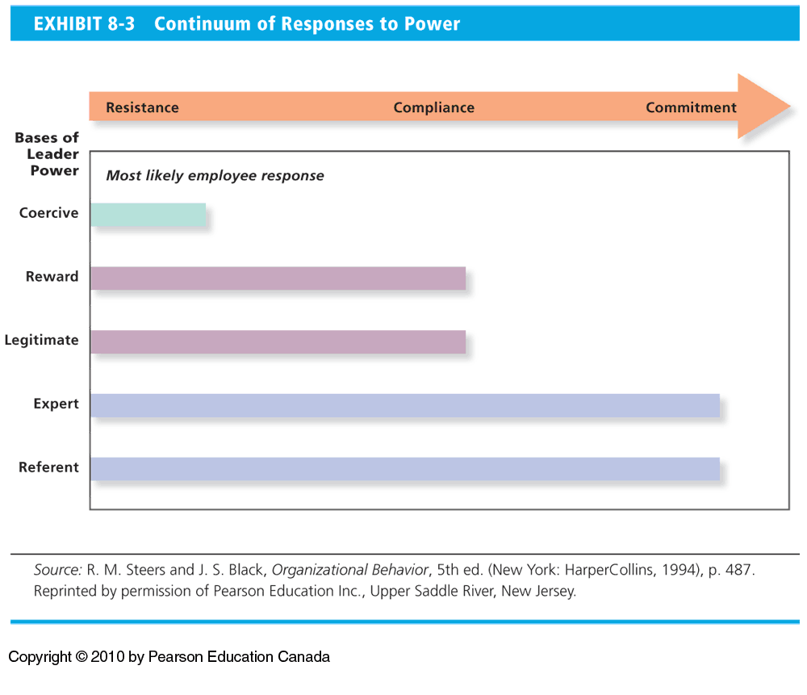
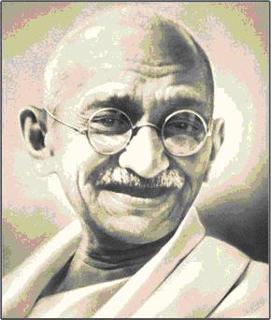
Leaders’ Use of Power
The least effective power bases are the ones most likely to be used by managers.
  Coercive, legitimate, and reward
  Easiest to implement
Effective leaders use referent and/or expert power.
3 responses to power
Commitment
Resistance
Compliance

Slide 13

Translating Power into Action
Influence Tactics
*covered in interactive
Rational persuasion
Inspirational appeals
Consultation
Ingratiation
Personal appeals
Exchange
Coalition tactics
Pressure
Legitimating tactics

Slide 14

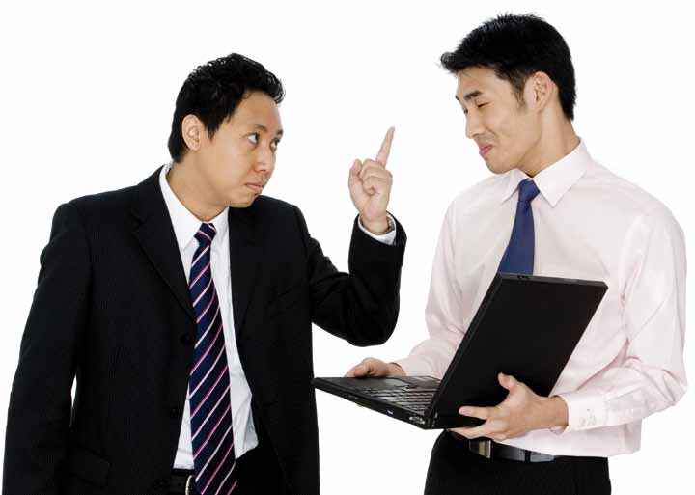
Understanding the Balance of Power
All parties have power!
Abuses of power
  Workplace Bullying
  Sexual Harassment
  Cultural differences.

Slide 15
Cialdini’s 6 Influence Strategies
Reciprocity - Repay in kind. Includes gifts, favours and concessions people make to one another
Social proof - Follow the lead of similar others
Consistency - Align with clear public commitment
Scarcity - Want scarce items. e.g. “limited time offer”
Expertise and authority - Relevant expertise and experience persuades
Liking - People respond to those who are likable.

Slide 16
Effective Persuasion
Conger (see page 298)
  Establish credibility
  Frame goals in a way that identifies common ground with those you intend to persuade.
  Reinforce your position using vivid language and compelling evidence.
  Connect emotionally with your audience.
Content vs. relationship objectives
See page 498

Slide 17
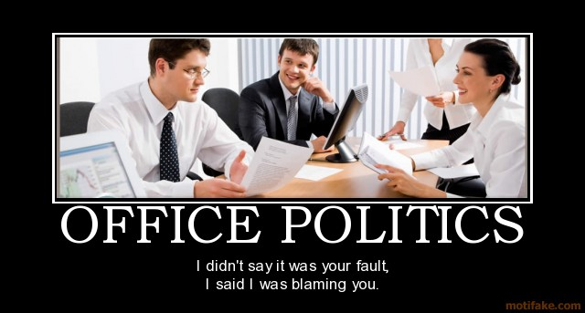
Politics: Power in Action
Political behaviour
  those activities that influence,
  or attempt to influence, the
  distribution of advantages and disadvantages within the organization.
  Legitimate: Normal, everyday behaviour.
  Illegitimate: Extreme political behaviours that violate the implied rules of the game.

Slide 18
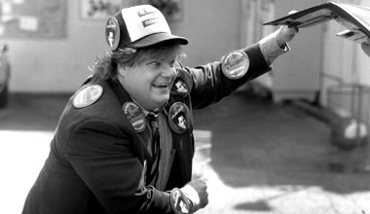
Types of Political Activity
Attacking or blaming others
Using information
Managing impressions
Building support for ideas
Praising others
Building coalitions
Associating with influential people
Creating obligations

Slide 19
Next week
GUEST LECTURE
Decision Making
Christiane Fox
Assistant Secretary to the Cabinet - Communications at Privy Council Office, Government of Canada

Slide 20
Privy Council Office
The Privy Council Office (PCO) is the hub of non-partisan, public service support to the Prime Minister and Cabinet and its decision-making structures.
  Led by the Clerk of the Privy Council, PCO helps the Government implement its vision and respond effectively and quickly to issues facing the government and the country.
  In today's world of complex economic and social issues, much of this work involves consultation and coordination – both inside and beyond the federal government. The PCO secretariats play a key role in ensuring this collaboration.
  To this end, PCO works to achieve the highest professional and ethical standards in the federal Public Service.

Slide 21
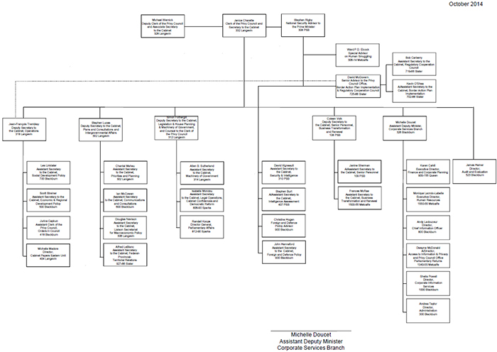
PCO - Organization

Slide 22
Interactive 5B
Power

Slide 23

Power and Politics
Power
  __________________________________________
______________
  B’s relationship to A when A possesses something that B needs.

Slide 24
General Influence Styles
Pushing Style
Assertive Persuasion
Reward and Punishment
Pulling Style
Participation and Trust
Common Vision
Notes:
Martin Luther king video – Common vision

Slide 25
Translating Power into Action
Influence Tactics
Rational persuasion
Inspirational appeals
Consultation
Ingratiation
Personal appeals
Exchange
Coalition tactics
Pressure
Legitimating tactics

Slide 26
Movie Analysis
Due in class and Online at 11:35am on Thursday June 8th at the start of class.
Do not summarize the movie.
Be sure to use quality sources and show you understand how to apply theory.

