Slide 1
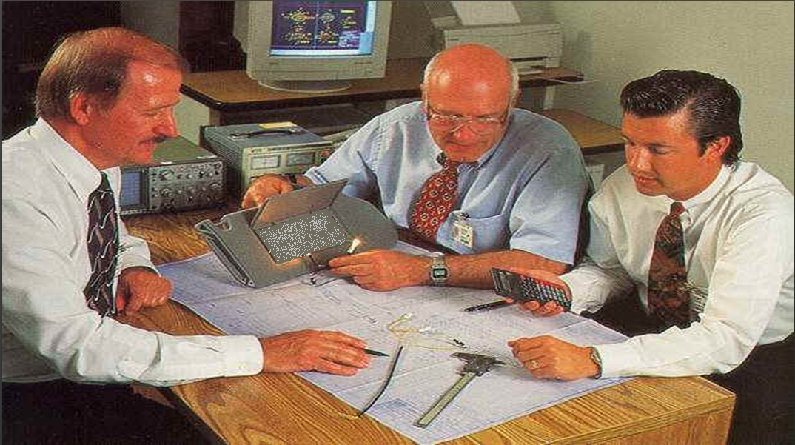
Project Management
Presented By: (Group G)

Slide 2
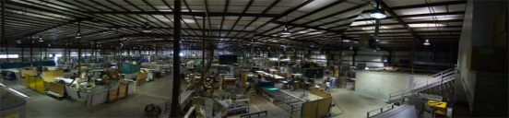
Statement of Work
Minimize production costs by reducing manual labour
Design a low cost robotic riveting cell for regional aircraft leading edges
Complete design by Mid April 2009

Slide 3
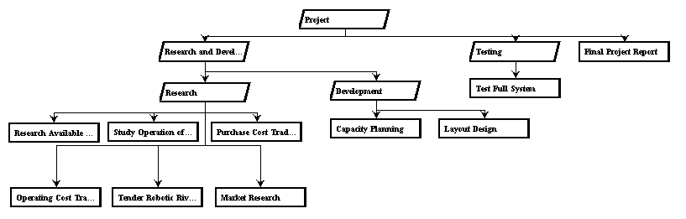
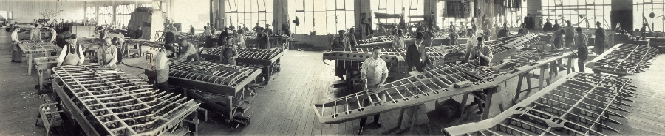
Work Breakdown Structure

Slide 4
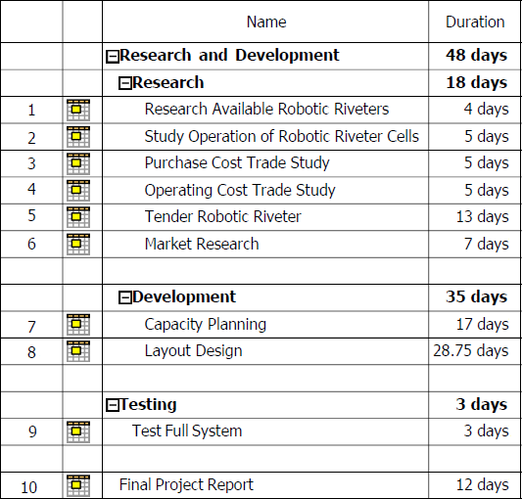
Project Tasks

Slide 5
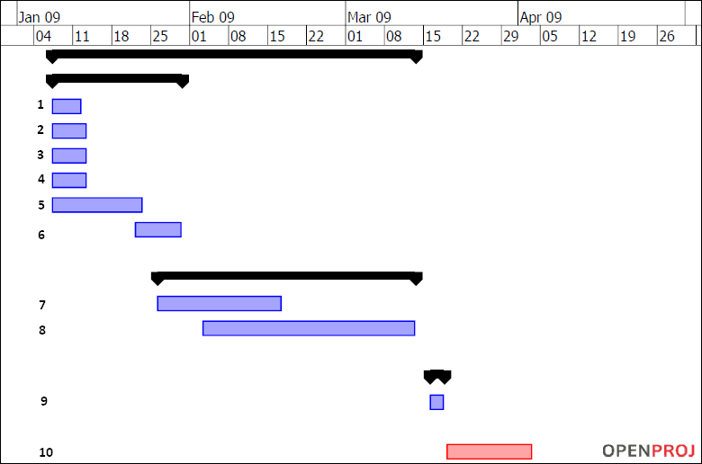
Project Schedule

Slide 6
Milestones
Milestone | Date
Tender Robotic Riveter | 23 January 2009
Capacity Plan | 17 February 2009
Layout Design | 13 March 2009
Full System Test Result | 18 March 2009
Final Project Report | 3 April 2009

Slide 7
Critical Path Method
2
3
5
1
7
8
9
10
4
Critical Path: 1-2-5-7-8-9-10
Expected Time: 83 days
Slack Time: 11 days on Task 6
6

Slide 8

Questions?

