Slide 1
Introductory Macroeconomics
Week 12
Monetary Policy
Policy Dilemmas
Final Review

Slide 2
Final Exam
Date/time: 2017 April 26 (Wednesday), 12:00 p.m., MAC ARENA
Seat Numbers: posted on D2L and venue, check before exam date
Time allowed: 120 minutes
Format: Multiple Choice questions (65)
Coverage: All lecture/ tutorial materials from week 1 to 12
  Textbook chapters 6 to 9, 10 to 15, and the following pages
    the PPF in chapter 1 (pages 14-15, 18-21), the circular flow diagram in chapter 2 (page 50-51), specialization and trade in chapter 17 (pages 458-466), exchange rates in chapter 18 (pages 495-499), and the long-run AD-AS model in chapter 16 (pages 428-437).
  Connect: all online graded assignments: 1 to 6
Please bring your photo I.D., calculator and pencil / eraser!

Slide 3
In-Class Assessment and Graded Assignments
In-Class Assessment
Each of the eight ICA (Quiz 1 to 8) will be of equal weight
The “lowest” score will be dropped
The “best” seven ICQ scores will count towards 10% of total
Graded Assignments (CONNECT)
Six graded assignments will have weighting based on the number of questions (points) in each assignment
Each assignment score will be based on “Best” attempt
All of the six graded assignments will be counted towards 20% of total

Slide 4
In-Class Question: Week 11 - Answers
11.1 What is the fiscal stance of the federal government’s recent budget? (5 points)
A. Neutral fiscal policy
B. Expansionary fiscal policy
C. Contractionary fiscal policy
Budget Deficit
⇒ Government spending > Total taxes
⇒ Government will inject more than it takes away from private sectors
⇒ Expansionary policy
Notes:
4
4
4

Slide 5
In-Class Question: Week 11 - Answers
11.2 If the desired reserve ratio of a banking system is 5%, what is the size of its money multiplier? (5 points)
A. 5
B. 8
C. 10
D. 20
Money multiplier
= 1 / desired reserve ratio
= 1/ 0.05
= 20
Notes:
5
5
5

Slide 6
In-Class Question: Week 11 - Answers
11.3 A $1,000 bond pays $50 annual interest. If the interest rate decreases to 4%, the price of bonds will… (5 points)
A. rise to $1,040
B. rise to $1,250
C. fall to $960
D. fall to $400
Initial interest yield on bond = $50 / $1000 = 5%
Interest rate ↓ to 4%, bonds became more attractive,
Buying of bonds will push up bond price until the yield falls to 4%
Price of bonds = $50 / 4% = $50 / 0.04 = $1,250
Notes:
6
6
6

Slide 7
In-Class Question: Week 11 - Answers
11.4 Given the money multiplier is 3, if Bank of Canada wants to decrease the money supply by $240 million via open market operation, it should …. (5 points)
A. Buy $240 million worth of bonds
B. Sell $240 million worth of bonds
C. Sell $80 million worth of bonds
D. Buy $80 million worth of bonds
Open market operations:
Bank of Canada wants to decrease money supply
⇒ Sell bonds
Money multiplier = 3
Amount of bonds to sell = $240 million / 3 = $80 million
Notes:
7
7
7

Slide 8
Recap
Money: a medium of exchange, an unit of account and an asset (most liquid store of value)
Money supply = currency + deposits
  Narrow definition (M1): Money as a medium of exchange
  Broad definition (M2): Money as both a medium of exchange and as an asset
Money Demand = transaction demand + asset demand
Money market equilibrium: MS = MD → i*

Slide 9
Recap
Monetary Policy (Bank of Canada):
Goal: keep inflation low, stable and predictable
→ full employment and growth
Instruments:
  Open market operations: buying and selling of government securities → ∆ money supply
    Buy securities: MS ↑
    Sell securities: MS ↓
  Key interest rate: target for the overnight rate
    Easing monetary policy: ↓ key interest rate
    Tightening monetary policy: ↑ key interest rate

Slide 10
Targeting the Overnight Lending Rate (Interbank Money Market)
Overnight Lending Rate
4.25
Demand curve for reserves is downward sloping
Operating band
4.0
3.75
D_{f}
Q_{f1}
Quantity of Reserves

Slide 11
Targeting the Overnight Lending Rate (Interbank Money Market)
Overnight Lending Rate
4.25
Demand curve for reserves is downward sloping
Bank of Canada targets 4% rate
Operating band
4.0
S_{f1}
Supply is horizontal at the target rate
3.75
D_{f}
Q_{f1}
Quantity of Reserves

Slide 12
Expansionary Monetary Policy
Overnight Lending Rate
Suppose that the economy faces recession and unemployment
Bank of Canada will
buy securities
reduce the key rate
4.0
S_{f1}
3.5
S_{f2}
Q_{f1}
Q_{f2}
Quantity of Reserves

Slide 13
Restrictive (Contractionary) Monetary Policy
Overnight Lending Rate
Suppose that the economy faces rising inflation
S_{f3}
Bank of Canada will
sell securities
increase the
key rate
4.5
4.0
S_{f1}
3.5
Q_{f3}
Q_{f1}
Quantity of Reserves

Slide 14
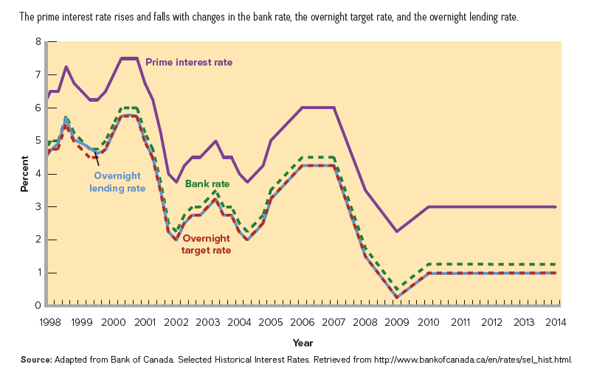
The Prime Interest Rate, the Bank Rate, the Overnight Target Rate, and the Overnight Lending Rate in Canada, 1998–2014
FIGURE 15-4
The various interest rates move in line with the overnight target rate.

Slide 15
Target the Real Interest Rate
Bank of Canada sets the nominal interest rate. It can also set the real interest rate if it can assess the inflation rate correctly
Real interest rate = Nominal interest rate – inflation rate
  Example:
Nominal interest rate | Inflation rate | Real interest rate
4 | 2 | 2
 | 3
 | 3
5
2
6
3

Slide 16
The Taylor Rule
The Taylor Rule assumes that the central bank is willing to tolerate a 2% target rate of inflation
When real GDP is equal to potential GDP (full employment) and inflation is equal to its target, the overnight rate should remain about 4%, implying a real interest rate of 2%.
  Under such a rule, the central bank will set a higher real interest rates whenever the inflation rates are higher

Slide 17
The Taylor Rule
  The output gap is also a measure of the inflationary tensions that exist in the economy.
  Question: If there is an inflationary output gap (real GDP > potential GDP) and actual inflation rate > target, how much should the nominal interest rate be raised?
Target overnight rate
= 2 percent + inflation rate
+ 0.5 × (inflation rate - inflation rate target)
+ 0.5 × (% output gap)

Slide 18
The Taylor Rule: Example
Target inflation rate = 2%
Inflation rate = 2%
Output gap = 0%
Question: What should be the target overnight rate?
The target nominal rate
= 2% + 2% + [(0.5 × 0%) + (0.5 × 0%)]
= 4%
Target real interest rate = 4% - 2% = 2%

Slide 19
The Taylor Rule: Example
Target inflation rate = 2%
Inflation rate = 3%
Output gap = 2%
Question: What should be the target overnight rate?
The target nominal rate
= 2% + 3% +[(0.5 × 1%) + (0.5 × 2%)]
= 6.5%
Target real interest rate = 6.5% - 3% = 3.5%
To raise the real interest rate to fight inflation, the target nominal rate has to be increased by a greater amount than the change in real interest rate

Slide 20
Tools of Monetary Policy: relative importance
Open-Market Operations:
  buying/selling of government securities
(Key) Interest Rate:
  the interest rate on loans to chartered banks
Of the two policy instruments, buying & selling securities in the open market is by far the most important
Key rate is a signalling device

Slide 21
Easy Money & Tight Money Policy
Recession & unemployment
easy money policy
  buy securities
  reduce the key rate
Inflation & overheated economy
tight money policy
  sell securities
  increase the key rate

Slide 22
Monetary Policy, Real GDP & the Price Level
The Transmission Mechanism:
Money supply impacts interest rates
Interest rates affect interest-sensitive spending, such as investment and consumption of durables
Investment and consumption are components of AD / AE
Equilibrium GDP and Price Level are changed
ΔMS → Δ i* → Δ I → Δ AD / AE → ΔY* / Δ P*

Slide 23
Monetary Policy and Equilibrium GDP
i%
S_{m1}
i%
S_{m0}
10
8
6
0
10
8
6
0
Investment
Demand
Real rate of interest, i
D_{m}
$125
$150
$billions
$15
$billions
potential
GDP
AS
If the money supply
increases to
stimulate the
economy....
Interest rates fall as people work off excess money by buying bonds
Price level
P₁
AD₀
GDP₀
Real GDP

Slide 24
Monetary Policy and Equilibrium GDP
i%
S_{m1}
i%
S_{m0}
10
8
6
0
10
8
6
0
Investment
Demand
Real rate of interest, i
D_{m}
$125
$150
$billions
$15
$20
$billions
potential
GDP
AS
Investment increases in response to lower interest costs
Price level
P₁
AD₀
GDP₀
Real GDP

Slide 25
Monetary Policy and Equilibrium GDP
i%
S_{m1}
i%
S_{m0}
10
8
6
0
10
8
6
0
Investment
Demand
Real rate of interest, i
D_{m}
$125
$150
$billions
$15
$20
$billions
potential
GDP
Investment increase
→ increase in AD
(multiplier effect)
AS
Price level
Increase in GDP and price level
P₂
P₁
AD₀
AD₁
GDP₀
GDP_{f}
Real GDP

Slide 26
Monetary Policy and Equilibrium GDP
i%
S_{m1}
S_{m3}
i%
S_{m0}
10
8
6
0
10
8
6
0
Investment
Demand
Real rate of interest, i
D_{m}
$125
$150
$175
$billions
$15
$20
$25
$billions
potential
GDP
AS
GDP doesn’t increase as much--multiplier effect weaker because of shape of AS
P₃
If the money supply increases again...
Price level
P₂
P₁
AD₀
AD₁
AD₂
GDP₀
GDP_{f}
GDP₁
Real GDP

Slide 27
Problem: Recessionary Gap
Bank of Canada buys bonds, or lowers the key rate
Reserves increase
Money supply rises
Interest rate falls
Investment spending increases
Aggregate demand increases
Real GDP rises by a multiple of the increase in investment

Slide 28
Problem: Inflationary Gap
Bank of Canada sells bonds, raises the key rate
Reserves decrease
Money supply falls
Interest rate rises
Investment spending decreases
Aggregate demand decreases
Inflation declines

Slide 29
Problems & Complications
monetary policy has certain limitations
  Lags (recognition, operational, not administrative)
    It might take up to two years for the money supply/interest rate effects to have full impacts on real GDP and employment
  changes in the spending habit
    Recession: people restrain from spending, any increase in money supply will have less effects on spending
  cyclical asymmetry
    Monetary policy is effective in slowing expansion and controlling inflation but less reliable in pushing the economy out of a severe recession

Slide 30
Sensitivity of money demand and investment demand to interest rate
Interest Elasticity of Money Demand
  The less elastic (less sensitivity) the demand for money to interest rate, the more elastic the investment demand to interest rate, the more effective the monetary policy
Interest Elasticity of Investment Demand
  The more elastic (less sensitivity) the demand for money to interest rate, the less elastic the investment demand to interest rate, the less effective the monetary policy
  ↑ MS → i* ↓ → I ↑

Slide 31
Sensitivity of money demand and investment demand to interest rate
i
MS₀
MS₁
Monetarist View: Monetary policy is very effective
i
i_{o}
i_{o}
i₁
i₁
I_{d}
Md
0
M_{o}
M₁
0
I_{o}
I₁
Quantity of money ($)
Investment ($)
i
i
MS₀
MS₁
Keynesian View:
Monetary policy is less effective
i_{o}
i_{o}
i₁
Md
i₁
I_{d}
0
M_{o}
M₁
0
I_{o}
I₁
Quantity of money ($)
Investment ($)

Slide 32
Impact of price level changes
An increase in the price level increases the demand for money. With the supply of money unchanged, the interest rate increases
P ↑ → Demand for money ↑ → i* ↑
The higher interest rate decreased planned investment:
i* ↑ → I ↓
Decreased planned investment reduces AD and AE and causes equilibrium output (income) to fall: I ↓ → AD/AE ↓ → Y* ↓
If the government conducts an expansionary monetary policy at the time, the increase in price level will counteract the effects of the change in money supply/ interest rate, thus reducing the effectiveness of the monetary policy

Slide 33
Impact of Price level changes
Easy Money Policy → Higher P
i
MS₀
MS₁
i
i₁
i₁
i_{o}
i_{o}
Higher P
MD₁
I_{d}
MD₀
0
M_{o}
0
I₁
I_{o}
Quantity of money ($)
Investment ($)
AE
P
AD_{o}
AE_{o}
AD₁
AS
AE₁
P_{o}
Fall in I
P₁
0
Y₁
Y_{o}
GDP
Y₁
Y_{o}
GDP
Output falls

Slide 34
Monetary Policy & the International Economy
Net exports effects reinforce monetary policy
  Expansionary policy: lower interest rate will cause capital outflows, depreciating the value of the C$, stimulate exports and AD, and increase equilibrium GDP
  i ↓ → capital outflows → e ↓→ Xn ↑ → AD/ AE ↑→ Y/P ↑
  Contractionary policy: higher interest rate will cause capital inflows, appreciating the value of the C$, decrease exports and AD, and decrease equilibrium GDP
  i ↑ → capital inflows → e ↑→ Xn ↓ → AD/ AE ↓ → Y/P ↓

Slide 35
Problem: recession, slow growth
Easy money policy
(lower interest rate)
Decreased foreign demand for dollars (capital outflows)
Dollar depreciates
Net exports increase
Aggregate demand increases
Monetary policy is reinforced

Slide 36
Problem: inflation
Tight money policy
(higher interest rate)
Increased foreign demand for dollars (capital inflows)
Dollar appreciates
Net exports decrease
Aggregate demand decreases
Monetary policy is reinforced

Slide 37
Macro Stability & the Trade Balance
The easy money policy that is appropriate for the alleviation of unemployment & sluggish growth is compatible with the goal of correcting a trade deficit
The tight money policy used to alleviate inflation conflicts with the goal of correcting a trade deficit

Slide 38
Monetary Policy in Action
Dominant component of Canadian national stabilization policy
Two key advantages over fiscal policy:
  speed & flexibility
  isolation from political pressure

Slide 39
Recent Monetary Policy
 | Major Events | Monetary Policy | Interest rate (target rate)
Early 1990s | Recession in 1991-92
After 1995 | Growth resumed
1997 | Financial crises in Asia/Russia/Latin America
1999-2000 | Stock Market Boom
2001-03 | 911 Terrorist attack, SARS, Mad Cow diseases

Slide 40
Recent Monetary Policy
 | Major Events | Monetary Policy | Interest rate (target rate)
Early 1990s | Recession in 1991-92 | Easing | ↓ from 9% to 3.5%
After 1995 | Growth resumed
1997 | Financial crises in Asia/Russia/Latin America
1999-2000 | Stock Market Boom
2001-03 | 911 Terrorist attack, SARS, Mad Cow diseases

Slide 41
Recent Monetary Policy
 | Major Events | Monetary Policy | Interest rate (target rate)
Early 1990s | Recession in 1991-92 | Easing | ↓ from 9% to 3.5%
After 1995 | Growth resumed | Tightening | ↑ from 4% to 6%
1997 | Financial crises in Asia/Russia/Latin America
1999-2000 | Stock Market Boom
2001-03 | 911 Terrorist attack, SARS, Mad Cow diseases

Slide 42
Recent Monetary Policy
 | Major Events | Monetary Policy | Interest rate (target rate)
Early 1990s | Recession in 1991-92 | Easing | ↓ from 9% to 3.5%
After 1995 | Growth resumed | Tightening | ↑ from 4% to 6%
1997 | Financial crises in Asia/Russia/Latin America | Easing | ↓ from 5% to 3.5%
1999-2000 | Stock Market Boom
2001-03 | 911 Terrorist attack, SARS, Mad Cow diseases

Slide 43
Recent Monetary Policy
 | Major Events | Monetary Policy | Interest rate (target rate)
Early 1990s | Recession in 1991-92 | Easing | ↓ from 9% to 3.5%
After 1995 | Growth resumed | Tightening | ↑ from 4% to 6%
1997 | Financial crises in Asia/Russia/Latin America | Easing | ↓ from 5% to 3.5%
1999-2000 | Stock Market Boom | Tightening | ↑ from 4% to 5.75%
2001-03 | 911 Terrorist attack, SARS, Mad Cow diseases

Slide 44
Recent Monetary Policy
 | Major Events | Monetary Policy | Interest rate (target rate)
Early 1990s | Recession in 1991-92 | Easing | ↓ from 9% to 3.5%
After 1995 | Growth resumed | Tightening | ↑ from 4% to 6%
1997 | Financial crises in Asia/Russia/Latin America | Easing | ↓ from 5% to 3.5%
1999-2000 | Stock Market Boom | Tightening | ↑ from 4% to 5.75%
2001-03 | 911 Terrorist attack, SARS, Mad Cow diseases | Easing | ↓ from 5.75% to 2%

Slide 45
Recent Monetary Policy
 | Major Events | Monetary Policy | Interest rate (target rate)
2004-2007 | Strong growth, Increase in U.S. interest rates
2008-2009 | Global financial crisis and recession
2010-2014 | Recovery (slow)
2015 | Sharp fall in oil prices

Slide 46
Recent Monetary Policy
 | Major Events | Monetary Policy | Interest rate (target rate)
2004-2007 | Strong growth, Increase in U.S. interest rates | Tightening | ↑ from 2% to 4.25%
2008-2009 | Global financial crisis and recession
2010-2014 | Recovery (slow)
2015 | Sharp fall in oil prices

Slide 47
Recent Monetary Policy
 | Major Events | Monetary Policy | Interest rate (target rate)
2004-2007 | Strong growth, Increase in U.S. interest rates | Tightening | ↑ from 2% to 4.25%
2008-2009 | Global financial crisis and recession | Easing | ↓ from 4.5% to 0.25%
2010-2014 | Recovery (slow)
2015 | Sharp fall in oil prices

Slide 48
Recent Monetary Policy
 | Major Events | Monetary Policy | Interest rate (target rate)
2004-2007 | Strong growth, Increase in U.S. interest rates | Tightening | ↑ from 2% to 4.25%
2008-2009 | Global financial crisis and recession | Easing | ↓ from 4.5% to 0.25%
2010-2014 | Recovery (slow) | Tightening | ↑ from 0.25% to 1%
2015 | Sharp fall in oil prices

Slide 49
Recent Monetary Policy
 | Major Events | Monetary Policy | Interest rate (target rate)
2004-2007 | Strong growth, Increase in U.S. interest rates | Tightening | ↑ from 2% to 4.25%
2008-2009 | Global financial crisis and recession | Easing | ↓ from 4.5% to 0.25%
2010-2014 | Recovery (slow) | Tightening | ↑ from 0.25% to 1%
2015-16 | Sharp fall in oil prices | Easing | ↓ from 1% to 0.5%

Slide 50
Transmission mechanisms
Output gap | Recessionary gap
Policy | Expansionary Fiscal policy | Easy Money policy
Instruments | G ↑ / T ↓ | MS ↑ / r ↓
First round effects
AD/AE | ↑ | ↑
Real GDP (Y) and employment | ↑ | ↑
Price Level | ↑ | ↑
Second round effects
Interest rate
Exchange rate
Investment
Net Exports
AD/AE
Y / P
Effects on policy

Slide 51
Transmission mechanisms
Output gap | Recessionary gap
Policy | Expansionary Fiscal policy | Easy Money policy
Instruments | G ↑ / T ↓ | MS ↑ / r ↓
First round effects
AD/AE | ↑ | ↑
Real GDP (Y) and employment | ↑ | ↑
Price Level (P) | ↑ | ↑
Second round effects
Interest rate | ↑
Exchange rate | ↑
Investment | ↓
Net Exports | ↓
AD/AE | ↓
Y / P | ↓
Effects on policy | counteracting

Slide 52
Transmission mechanisms
Output gap | Recessionary gap
Policy | Expansionary Fiscal policy | Easy Money policy
Instruments | G ↑ / T ↓ | MS ↑ / r ↓
First round effects
AD/AE | ↑ | ↑
Real GDP (Y) and employment | ↑ | ↑
Price Level (P) | ↑ | ↑
Second round effects
Interest rate | ↑ | ↓
Exchange rate | ↑ | ↓
Investment | ↓ | ↑
Net Exports | ↓ | ↑
AD/AE | ↓ | ↑
Y / P | ↓ | ↑
Effects on policy | counteracting | reinforcing

Slide 53
Transmission mechanisms
Output gap | Inflationary gap
Policy | Contractionary Fiscal policy | Tight Money policy
Instruments | G ↓ / T ↑ | MS ↓ / r ↑
First round effects
AD/AE | ↓ | ↓
Real GDP (Y) and employment | ↓ | ↓
Price Level | ↓ | ↓
Second round effects
Interest rate
Exchange rate
Investment
Net Exports
AD/AE
Y / P
Effects on policy

Slide 54
Transmission mechanisms
Output gap | Inflationary gap
Policy | Contractionary Fiscal policy | Tight Money policy
Instruments | G ↓ / T ↑ | MS ↓ / r ↑
First round effects
AD/AE | ↓ | ↓
Real GDP (Y) and employment | ↓ | ↓
Price Level | ↓ | ↓
Second round effects
Interest rate | ↓
Exchange rate | ↓
Investment | ↑
Net Exports | ↑
AD/AE | ↑
Y / P | ↑
Effects on policy | counteracting

Slide 55
Transmission mechanisms
Output gap | Inflationary gap
Policy | Contractionary Fiscal policy | Tight Money policy
Instruments | G ↓ / T ↑ | MS ↓ / r ↑
First round effects
AD/AE | ↓ | ↓
Real GDP (Y) and employment | ↓ | ↓
Price Level | ↓ | ↓
Second round effects
Interest rate | ↓ | ↑
Exchange rate | ↓ | ↑
Investment | ↑ | ↓
Net Exports | ↑ | ↓
AD/AE | ↑ | ↓
Y / P | ↑ | ↓
Effects on policy | counteracting | reinforcing

Slide 56
Effectiveness of policies
Factors | Fiscal policy | Monetary policy
Time lags | Recognition, administrative, operational | Recognition, administrative, operational
Political factors | More affected | Less affected
Size of multiplier
Change in Price level
Interest rate effect
Net export effect

Slide 57
Effectiveness of policies
Factors | Fiscal policy | Monetary policy
Time lags | Recognition, administrative, operational | Recognition, administrative, operational
Political factors | More affected | Less affected
Size of multiplier | Smaller multiplier → less effective policy | Smaller multiplier → less effective policy
Change in Price level
Interest rate effect
Net export effect

Slide 58
Effectiveness of policies
Factors | Fiscal policy | Monetary policy
Time lags | Recognition, administrative, operational | Recognition, administrative, operational
Political factors | More affected | Less affected
Size of multiplier | Smaller multiplier → less effective policy | Smaller multiplier → less effective policy
Change in Price level | More inelastic AS → larger price change → less effective policy | More inelastic AS → larger price change → less effective policy
Interest rate effect
Net export effect

Slide 59
Effectiveness of policies
Factors | Fiscal policy | Monetary policy
Time lags | Recognition, administrative, operational | Recognition, administrative, operational
Political factors | More affected | Less affected
Size of multiplier | Smaller multiplier → less effective policy | Smaller multiplier → less effective policy
Change in Price level | More inelastic AS → larger price change → less effective policy | More inelastic AS → larger price change → less effective policy
Interest rate effect | Crowding out → less effective policy | Reverse crowding out → more effective policy
Net export effect

Slide 60
Effectiveness of policies
Factors | Fiscal policy | Monetary policy
Time lags | Recognition, administrative, operational | Recognition, administrative, operational
Political factors | More affected | Less affected
Size of multiplier | Smaller multiplier → less effective policy | Smaller multiplier → less effective policy
Change in Price level | More inelastic AS → larger price change → less effective policy | More inelastic AS → larger price change → less effective policy
Interest rate effect | Crowding out → less effective policy | Reverse crowding out → more effective policy
Net export effect | Negative → less effective policy | Positive → more effective policy

Slide 61
Effectiveness of policies
Factors | Fiscal policy | Monetary policy
Cyclical symmetry | More effective in stimulating growth | More effective in controlling inflation
Specific Factors

Slide 62
Effectiveness of policies
Factors | Fiscal policy | Monetary policy
Cyclical symmetry | More effective in stimulating growth | More effective in controlling inflation
Specific Factors | Tax system affects the degree of built-in automatic stabilization Tax changes affect incentives to work, save and invest → Supply side effects reinforce policy | International financial crisis may affect capital inflows and outflows → uncertain effects

Slide 63
Policies and The Shape of the Aggregate Supply Curve
The slope of the AS curve has significant policy ramifications.
Flat AS curve ⇒ expansionary policy will be more effective in ↓ unemployment
Steep AS curve ⇒ restrictive policy will be more effective in ↓ inflation

Slide 64
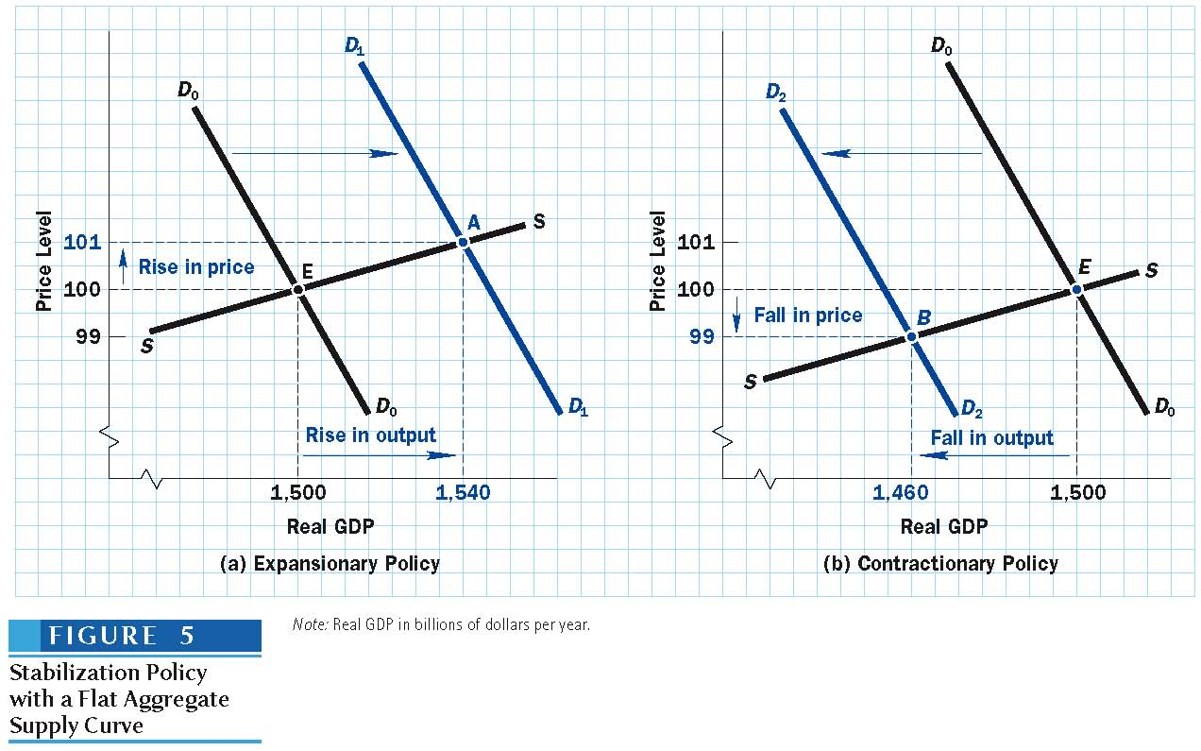
Stabilization Policy with a Flat Aggregate Supply Curve

Slide 65
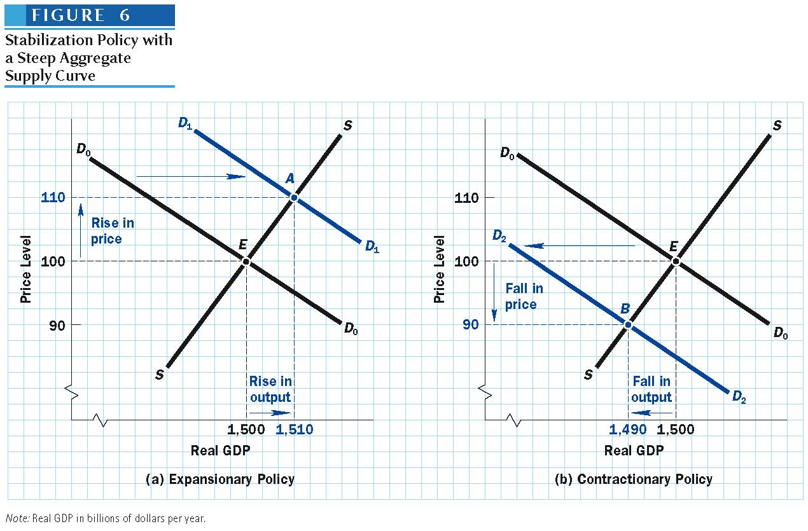
Stabilization Policy with a Steep Aggregate Supply Curve

Slide 66
Policies and The Shape of the Aggregate Supply Curve
The AS curve is fairly flat in the short run and fairly steep in the long run.
Effects of changes in AD
  More on output in the short run
  More on prices in the long run

Slide 67
SHOULD WE RELY ON FISCAL OR MONETARY POLICY?
Keynesian view: fiscal policy is more effective in affecting aggregate demand and lowering unemployment during recessions
Monetarist view: monetary policy is more effective in controlling inflation during booms
Fiscal policy: depends on annual budget cycle
Monetary policy: shorter policy lags
Notes:
67

Slide 68
The Trade-off between Inflation and Unemployment

Slide 69
Twin Evils: Inflation and Unemployment
Rising Inflation
  Demand-pull: AD↑→ P ↑→ GDP ↑→ U ↓
  Cost-push: AS ↓ → P ↑→ GDP ↓ → U ↑
Rising Unemployment
  Negative Demand Shock: AD ↓ → P ↓ → GDP ↓ → U ↑
  Negative Supply Shock: AS ↓ → P ↑→ GDP ↓ → U ↑

Slide 70
Policies to fight the twin evils
Rising inflation ⇒ Contractionary policy
AD ↓ → P ↓ → GDP ↓ → U ↑
Rising Unemployment ⇒ Expansionary policy
AD↑→ P ↑→ GDP ↑→ U ↓
Both fiscal and monetary policies act through the AD therefore inflation and unemployment will change in opposite direction
⇒ policy dilemmas
Lower inflation ⇒ higher unemployment
Lower unemployment ⇒ higher inflation

Slide 71
Policies to fight the twin evils
Long-run adjustments without policies require wages and AS to change
Inflationary gap → W ↑ → higher inflation
Recessionary gap → W ↓ → if W sticky → rising unemployment

Slide 72
Cost-Push Inflation and Policy Dilemma
Stagflation: inflation ↑ and unemployment ↑
If government attempts to maintain full employment, an inflationary spiral may occur
Expansionary policy → AD/AE ↑ → P ↑ (steep AS)
Otherwise, there will be a recession, with high unemployment and a loss of output
  Hands-off approach → recession → U ↑
  Contractionary policy →AD/AE ↓ → U ↑ (flat AS)

Slide 73
THE END

Slide 74
FINAL REVIEW

Slide 75
Study Questions
Chapters 12-16,
Chapters 13, 14, 15

