Slide 1
Fundamentals of International Business
The Foreign Exchange Environment; The Global Monetary System; Global Strategy

Slide 2
Definitions
Foreign Exchange
Exchange Rate
Foreign Exchange Risk

Slide 3
Functions of the Foreign Exchange
Market (1)
The foreign exchange market has two main functions:
  To convert the currency of one country into the currency of another.
  To provide some insurance against foreign exchange risk.

Slide 4
Functions of the Foreign Exchange
Market (2)
International businesses have four main uses of foreign exchange markets:
  The income a company receives for exports, investments, and licensing agreements abroad;
  Payments for products or services coming from abroad;
  Short/long-term investments in foreign markets;
  Currency speculation.

Slide 5
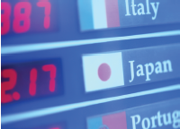
Insuring Against Foreign Exchange Risk
Spot exchange rates
Forward exchange rates
Currency swaps

Slide 6
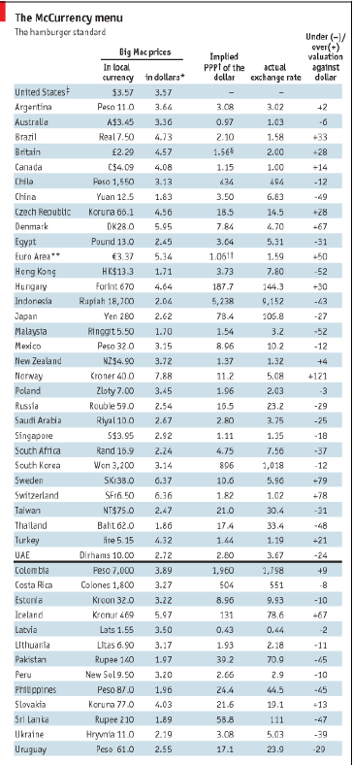
Prices and Exchange Rates
The Law of One Price
Purchasing Power Parity (PPP)
Money supply and price inflation

Slide 7
Exchange Rate Forecasting
The Efficient Market School
  Prices reflect all available public information
The Inefficient Market School
  Forward exchange rates will not be the best possible predictors of future spot exchange rates

Slide 8
Currency Convertibility
Free Convertible Currency
Nonconvertible Currency
Externally Convertible Currency

Slide 9
The Global Monetary System

Slide 10
The International Monetary System
The demand and supply of currencies is influenced by their respective countries’ relative inflation rates and interest rates.
When the foreign exchange market determines the relative value of a currency, we say that the country is adhering to a floating exchange rate regime.
  the exchange rate for converting one currency into another is continuously adjusted depending on the laws of supply and demand.

Slide 11
The International Monetary System
The world’s four major trading currencies:
  the U.S. dollar,
  the European Union’s euro,
  the Japanese yen,
  and the British pound,
are all free to float against each other.
Their exchange rates are determined by market forces and fluctuate against each other.

Slide 12
Definitions
Pegged Exchange Rate: the rate at which currency value is fixed relative to a reference currency.
Dirty Float System: a system in which a country’s currency is nominally allowed to float freely against other currencies, but the government will intervene, buying and selling currency, if it believes that the currency has deviated too far from its fair value.

Slide 13
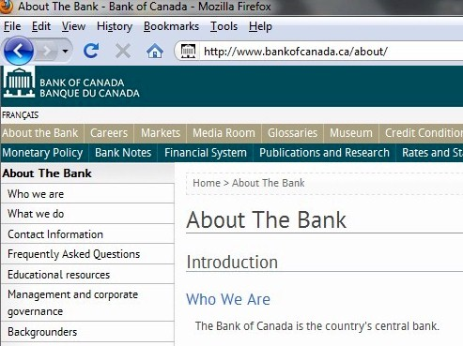
Central Banks
Click on the screen capture to the left to go to the website for the “Bank of Canada”, the central bank for Canada
http://www.bankofcanada.ca/about/

Slide 14
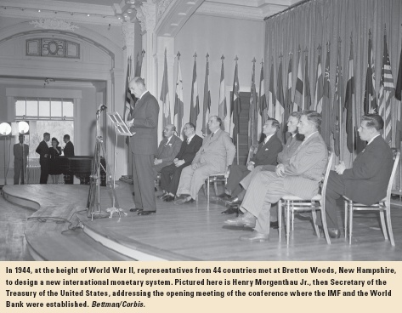
The Bretton Woods System
In 1944, representatives from 44 countries met at Bretton Woods, New Hampshire, to design a new international monetary system.
The agreement reached at Bretton Woods established two multinational institutions, the International Monetary Fund (IMF) and the World Bank

Slide 15
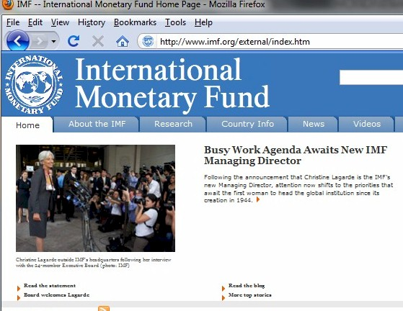
More about the IMF
www.imf.org
There is, however, a growing debate about the role of the IMF (and to a lesser extent the World Bank) and the appropriateness of their policies for many developing nations.

Slide 16

The Role of the World Bank
The World Bank www.worldbank.org is not one single entity but rather a group of five institutions. In their own words
"...the World Bank Group consists of five closely associated institutions:
IBRD - the International Bank for Reconstruction and Development
  The activity of most interest to people in int’l business
IDA -International Development Association
IFC - International Finance Corporation
MIGA - Multilateral Investment Guarantee Agency
ICSID - International Centre for Settlement of Investment Disputes ".

Slide 17
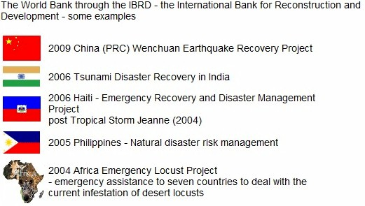
The Role of the World Bank
Things the World Bank has done

Slide 18

Fixed vs. Floating Exchange Rates
Fixed Exchange Rates
  Monetary discipline
  Speculation
  Uncertainty
  Trade balance adjustments
Floating Exchange Rates have two main elements:
  Monetary policy autonomy
  Automatic trade balance adjustments

Slide 19
Financial Crises in the Post-Bretton Woods Era
Currency Crisis
Banking Crisis
Foreign Debt Crisis

Slide 20
Global Strategy

Slide 21
Value Creation
Two basic conditions determine a firm’s profits
  the amount of value customers place on the firm’s goods or services (sometimes referred to as perceived value) and
  the firm’s costs of production.
In general, the more value customers place on a firm’s products, the higher the price the firm can charge for those products.

Slide 22
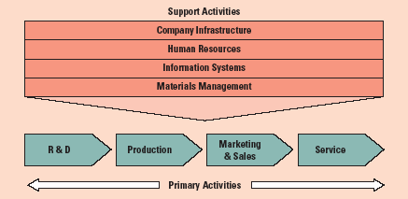
The Firm As a Value Chain

Slide 23

The Role of Strategy
Strategy is often concerned with identifying and taking actions that will lower the costs of value creation and/or will differentiate the firm’s product offering through superior design, quality, service, functionality, and so on.

Slide 24
Profiting from Global Expansion
Firms that operate internationally are
able to:
  Realize location economies,
  Realize greater cost economies,
  Earn a greater return from the firm’s distinctive skills or core competencies,
  Earn a greater return by leveraging any valuable skills developed in foreign operations.

Slide 25
The Experience Curve
  The strategic significance of the experience curve is clear.
  Moving down the experience curve allows a firm to reduce its cost of creating value
  The firm that moves down the experience curve most rapidly will have a cost advantage vis-à-vis its competitors

Slide 26
Pressures for Cost Reductions and Local Responsiveness
Firms that compete in the global marketplace typically face two types of competitive pressure.
They face pressures
  for cost reductions and
  to be locally responsive

Slide 27
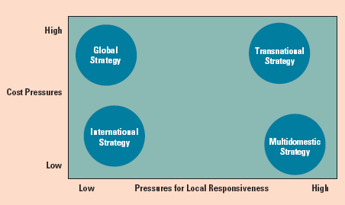
Four Basic Strategic Choices

Slide 28
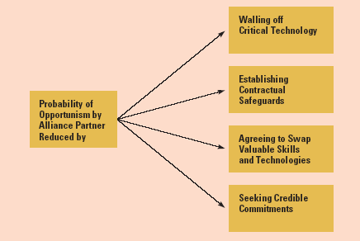
Alliance Structure
Structuring Alliances to Reduce Opportunism

Slide 29
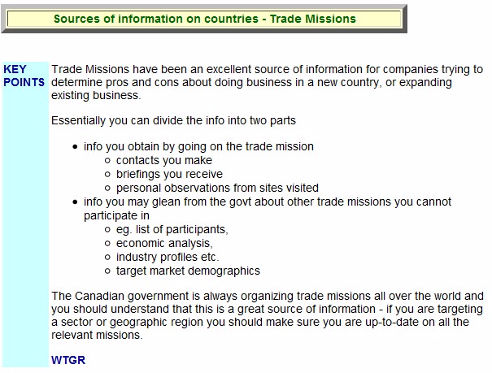
Trade Missions

Slide 30
Trade Missions
A webpage of Prof. Tim Richardson in which he specifically talks about trade missions and how participating in them can be advantageous
http://www.witiger.com/internationalbusiness/countryinfo.htm

